Slide 1
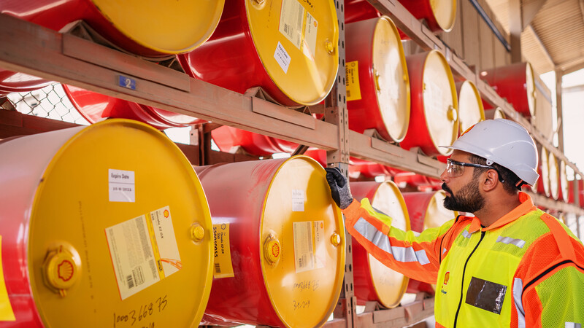
Outside-In Risks (OiR)
Hazards 33 Conference, UK
Pratik Toshniwal
Shell India Markets Pvt Ltd (Shell Projects & Technology)
Bangalore, India
Copyright of Shell India Markets Pvt Ltd
MOST CONFIDENTIAL

Slide 2
Definitions & cautionary note
The companies in which Shell plc directly and indirectly owns investments are separate legal entities. In this presentation “Shell”, “Shell Group” and “Group” are sometimes used for convenience where references are made to Shell plc and its subsidiaries in general. Likewise, the words “we”, “us” and “our” are also used to refer to Shell plc and its subsidiaries in general or to those who work for them. These terms are also used where no useful purpose is served by identifying the particular entity or entities. ‘‘Subsidiaries’’, “Shell subsidiaries” and “Shell companies” as used in this presentation refer to entities over which Shell plc either directly or indirectly has control. Entities and unincorporated arrangements over which Shell has joint control are generally referred to as “joint ventures” and “joint operations”, respectively. “Joint ventures” and “joint operations” are collectively referred to as “joint arrangements”. Entities over which Shell has significant influence but neither control nor joint control are referred to as “associates”. The term “Shell interest” is used for convenience to indicate the direct and/or indirect ownership interest held by Shell in an entity or unincorporated joint arrangement, after exclusion of all third-party interest.
Forward-Looking Statements
This presentation contains forward-looking statements (within the meaning of the U.S. Private Securities Litigation Reform Act of 1995) concerning the financial condition, results of operations and businesses of Shell. All statements other than statements of historical fact are, or may be deemed to be, forward-looking statements. Forward-looking statements are statements of future expectations that are based on management’s current expectations and assumptions and involve known and unknown risks and uncertainties that could cause actual results, performance or events to differ materially from those expressed or implied in these statements. Forward-looking statements include, among other things, statements concerning the potential exposure of Shell to market risks and statements expressing management’s expectations, beliefs, estimates, forecasts, projections and assumptions. These forward-looking statements are identified by their use of terms and phrases such as “aim”, “ambition”, ‘‘anticipate’’, ‘‘believe’’, ‘‘could’’, ‘‘estimate’’, ‘‘expect’’, ‘‘goals’’, ‘‘intend’’, ‘‘may’’, “milestones”, ‘‘objectives’’, ‘‘outlook’’, ‘‘plan’’, ‘‘probably’’, ‘‘project’’, ‘‘risks’’, “schedule”, ‘‘seek’’, ‘‘should’’, ‘‘target’’, ‘‘will’’ and similar terms and phrases. There are a number of factors that could affect the future operations of Shell and could cause those results to differ materially from those expressed in the forward-looking statements included in this presentation, including (without limitation): (a) price fluctuations in crude oil and natural gas; (b) changes in demand for Shell’s products; (c) currency fluctuations; (d) drilling and production results; (e) reserves estimates; (f) loss of market share and industry competition; (g) environmental and physical risks; (h) risks associated with the identification of suitable potential acquisition properties and targets, and successful negotiation and completion of such transactions; (i) the risk of doing business in developing countries and countries subject to international sanctions; (j) legislative, judicial, fiscal and regulatory developments including regulatory measures addressing climate change; (k) economic and financial market conditions in various countries and regions; (l) political risks, including the risks of expropriation and renegotiation of the terms of contracts with governmental entities, delays or advancements in the approval of projects and delays in the reimbursement for shared costs; (m) risks associated with the impact of pandemics, such as the COVID-19 (coronavirus) outbreak; and (n) changes in trading conditions. No assurance is provided that future dividend payments will match or exceed previous dividend payments. All forward-looking statements contained in this presentation are expressly qualified in their entirety by the cautionary statements contained or referred to in this section. Readers should not place undue reliance on forward-looking statements. Additional risk factors that may affect future results are contained in Shell plc’s Form 20-F for the year ended December 31, 2022 (available at www.shell.com/investor and www.sec.gov). These risk factors also expressly qualify all forward-looking statements contained in this presentation and should be considered by the reader. Each forward-looking statement speaks only as of the date of this presentation, [7th November 2023]. Neither Shell plc nor any of its subsidiaries undertake any obligation to publicly update or revise any forward-looking statement as a result of new information, future events or other information. In light of these risks, results could differ materially from those stated, implied or inferred from the forward-looking statements contained in this presentation.
Shell’s net carbon intensity
Also, in this presentation we may refer to Shell’s “Net Carbon Intensity”, which includes Shell’s carbon emissions from the production of our energy products, our suppliers’ carbon emissions in supplying energy for that production and our customers’ carbon emissions associated with their use of the energy products we sell. Shell only controls its own emissions. The use of the term Shell’s “Net Carbon Intensity” is for convenience only and not intended to suggest these emissions are those of Shell plc or its subsidiaries.
Shell’s net-Zero Emissions Target
Shell’s operating plan, outlook and budgets are forecasted for a ten-year period and are updated every year. They reflect the current economic environment and what we can reasonably expect to see over the next ten years. Accordingly, they reflect our Scope 1, Scope 2 and Net Carbon Intensity (NCI) targets over the next ten years. However, Shell’s operating plans cannot reflect our 2050 net-zero emissions target and 2035 NCI target, as these targets are currently outside our planning period. In the future, as society moves towards net-zero emissions, we expect Shell’s operating plans to reflect this movement. However, if society is not net zero in 2050, as of today, there would be significant risk that Shell may not meet this target.

Slide 3
PRESENTATION OUTLINE
Introduction - OiR
Catastrophic Consequence Level Scenario (CCLS) within OiR
OiR Workflow for Implementation (4 Step Process)
Conclusion

Slide 4
Sense of Purpose
Focus on “Residual Risk”
Thought Process (Black Swan vs Grey Rhinos)
CCLS Definition
1.0
Introduction - OiR

Slide 5
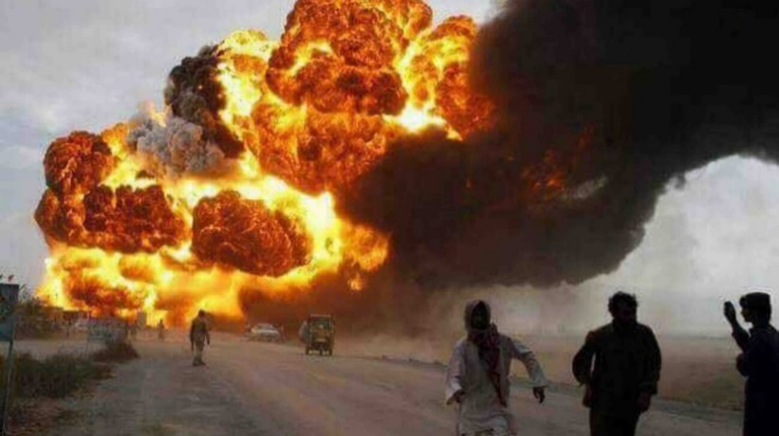
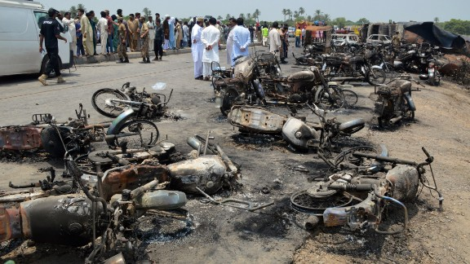
Reminder – Our sense of purpose
Pakistan Road Tanker Incident
(25th June 2017)
A road tanker operated by a Shell sub-contractor overturned, puncturing a tank and leaking gasoline. As local people gathered to collect the leaked fuel, the tanker exploded, killing 221 and seriously injuring many more.
This catastrophic consequence far exceeded our anticipated worst-case scenario
The vision of Outside-in Risks is to never again find ourselves surprised by, or unprepared for, plausible catastrophic Safety events

Slide 6
How many incidents associated with Shell operations have resulted in 10 or more fatalities (other than Pakistan)
Need to be more responsible…
Any other mass casualty incidents in Shell’s operating history (< 10)
2002 Clipper S76 Crash 11
1992 Cormorant A S92 Crash 11
1986 Brent Chinook Crash 45
1951 Roxana Il Refinery explosion 13
2009 Louisiana Helicopter Crash 8
2008 Nigeria Pipeline 6
1988 Shell Diamond Louisiana CCU 7
What is the highest number of community fatalities from a single event in the Industry?
Any recent incident within the Industry involving mass casualties?
2003 Sichuan China H2S from well blowout 200
1998 Jesse Nigeria pipeline sabotage 1000+
1989 Ufa Russia LPG pipeline 500+
1984 Mexico, PEMEX LPG Rupture 600+
2022 Cuba Tank Farm Fire/Explosion 14
2022 Jordan Toxic Gas Leak 13

Slide 7


Achieving the vision: three levers
Connect outside risks to Shell
Know about and respond to past & present events in industry to inform plausible, catastrophic scenarios
Broaden Thinking across Business promoting psychological safety enabling open discussions on potential outcomes
Vertical connect: Inclusivity
Emergency response preparedness
Establish emergency response plans to ensure preparedness for plausible, catastrophic scenarios

Slide 8
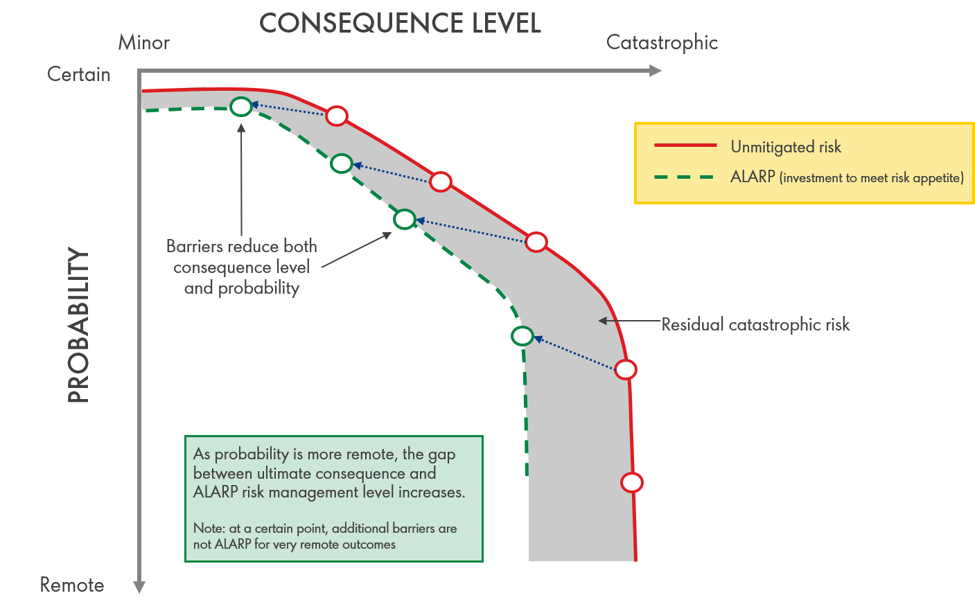
OiR: ALARP vs Residual risk
Residual risk: The gap between ultimate potential and invested capacity of mitigations (determined by ALARP).
This residual risk encompasses low probability/high consequence scenarios. These events have been termed as as Catastrophic Consequence Level Scenarios (CCLSs).

Slide 9

Definition: CCLS
A Catastrophic Consequence Level Scenario (CCLS) is an HSSE-originating scenario which could escalate to a level where harm to people may exceed 10 fatalities
A CCLS is:
a plausible HSSE incident
initiated by an acute HSSE event which (potentially) escalates and poses direct risk to life
an incident requiring emergency response action over which Shell has influence or accountability
All harm to people is equal, whether inside or outside the fence
Frequency and likelihood
is not considered

Slide 10

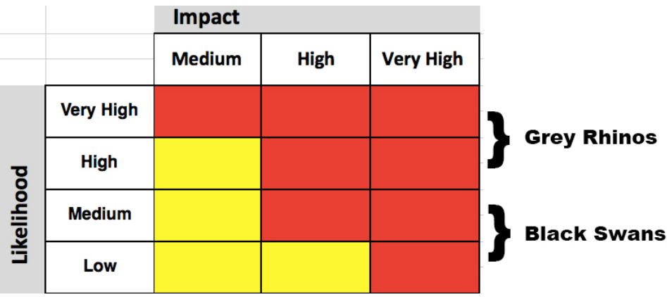

Thinking w.r.t OiR (black swans vs grey rhinos)
Extremely Rare Event
Very Severe Consequence
“Unpredictable”
(Beyond normal expectation)
Relatively More Probable Event
High Consequence Severity
An “emerging threat”
(Need to perceive full dimension)

Slide 11
Identify CCLS
Model CCLS
CCLS awareness and Communication
Prepare for CCLS (Emergency Response)
2.0
OiR Workflow for Implementation (4 Step Process)

Slide 12
Identify CCLS
Contextual Factors
  Proximity to communities
  Natural Hazards Triggering Technological Accidents (NaTech) susceptibility
  Adjacent high hazard facilities (operating in an industrial zone)
  Activities associated with Brownfield Modifications (construction or demolition/decommissioning)
Typical Hazards (with large escalation potential)
  Processing and storage with runway/reactive hazards (incl. mixing with O2)
  Bulk flammables storage or transport (road, rail, ship, pipe)
  Personnel Transport (e.g., bus ferrying Shell/contractor personnel)
  Where stability could be lost, such as in a floating facility (FPSO)
  Facilities close to borders or close to forested areas
Based on Operating Philosophy
  > 10 people expected or not expected to be present based on operation or location
  Any change w.r.t Operation (incl. supply chain) in the recent past

Slide 13
Case study 1: Mode of transportation
A business located on the coast requires ethylene (for production) which comes from a terminal 1400km away
Contracted Road Hauler; Regulated by Govt
Trucking Industrial Gases is routine in Industry
Contract HSE Plan in place for risk managed to tolerable/ALARP
Option 1
Road Transport
Option 2
Shipping
Although expensive; No of Service Providers available
Shipping HSE Plan in place for risk managed to tolerable/ALARP
Under standard risk management, both options have tolerable risk…
Option 1
1400km Road Journey (Dense urban areas, heavy traffic highway)
Limited access to rapid professional emergency response
History of significant heavy vehicle accidents (e.g. collision)
Loss of product scenario with 10+ fatalities plausible
Road Transport
Option 2
Shipping
No public exposure; unlikely to reach 10 fatality threshold
Shipping HSE Plan in place for risk managed to tolerable/ALARP
From OiR perspective, Shipping is better option!
Under OiR, there are added considerations that are to be included for risk management!

Slide 14

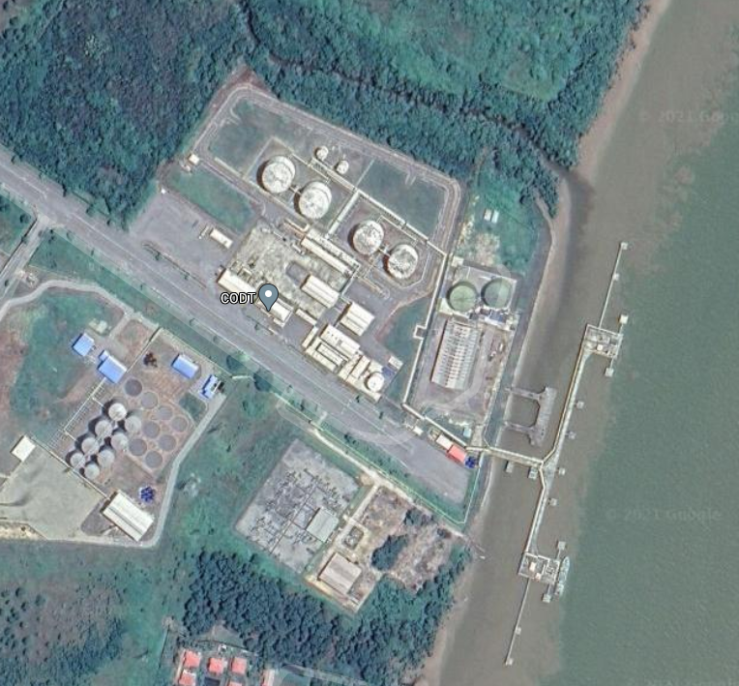
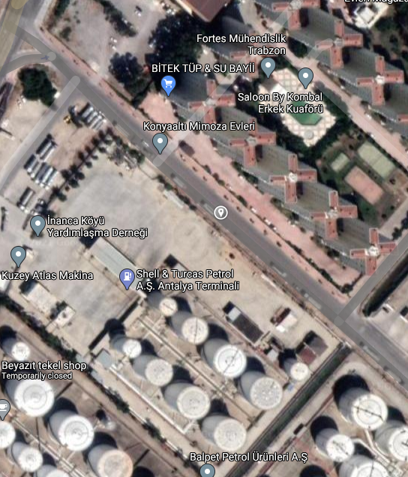
Case study 2: Geographical Presence
Gasoline is well known to have one of the highest risk level (considering severity and likelihood of release)
A LOPC from gasoline tank located far from the city and closer to shore is expected to have certain preparedness level
However, a LOPC from a gasoline tank in a tank farm within a built-up community would involve high escalation potential and may then be elevated to a CCLS event – thus changing the preparedness for the potential event.
Same product, same tankage, same risk profile but greatly different maximum foreseeable exposures from the outcome scenarios
1.5-hour drive from nearest city
1-2 shipments per month
Residential flats overlooking tank farm in hazard impact

Slide 15
Model CCLS
Focus on determining if there is a plausible path to realise worst potential outcomes
  NOTE: it may not be possible to determine the initiation chain in advance
Range of stakeholders is key to ensure depth, breadth and robustness of scenario modelling
Techniques will vary based on operation complexity; there is no prescribed method
  E.g., "What-If" analysis + threat/consequence lines in existing Bow Ties
  Existing Information sources (HAZID/HAZOP or Safety Case)
  Refer past events in Industry or across Relevant Industry
Understanding design basis for containment/escalation controls is also important!
For the Fukushima Daiichi nuclear power facility, original design for tsunami flood barriers was ~3 metres based on largest event in recent history (ca.100yr) equating to magnitude 7 quake.
However, records of twelve events since 1498 showed wave heights of >10 metres (out of which six with a height of >20 metres). The tsunami that led to the nuclear core event with wave height of ~10 metres (magnitude 9 quake)

Slide 16
Plausible Outcomes
Plausible: if by the judgement of the assessors, a “well reasoned argument” can be constructed for the validity of a catastrophic scenario.
They are foreseeable as informed by events in industry (“Outside → In”)
Evidenced by modelling where appropriate (e.g. toxic modelling → potential offsite impacts)
“What-if” approaches (using existing barriers / bow-ties) shows event progression
Upon examining hazards and context; there are logical escalation paths

Slide 17

CCLS awareness and communication
CCLS to be recorded in a clear and concise format
  Enabler for effective communication across organisation (leadership to front line)
CCLS information visible to Leaders when decisions regarding investment/budgeting done
  Business Leaders may decide that an operation to be ceased or significantly modified
  Alternatively, Business Leaders may prescribe additional preparedness measures
External Stakeholders should be engaged in an appropriate manner
  Certain consequences could originate from or impact 3rd parties
  Alternatively, 3rd parties could be of support during response to CCLS
In transportation of bulk flammable materials at areas of poor civil response, use of escort vehicles may be deemed appropriate to secure scene of an RTA and prevent having a CCLS.
The Business Leader could prescribe this measure and account for cost when determining viability of conducting business in this region.

Slide 18
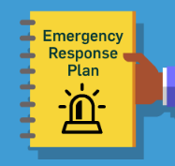
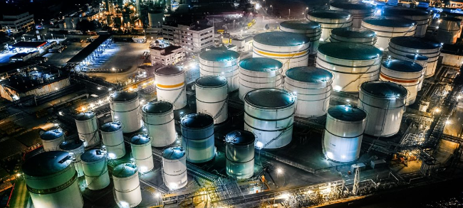
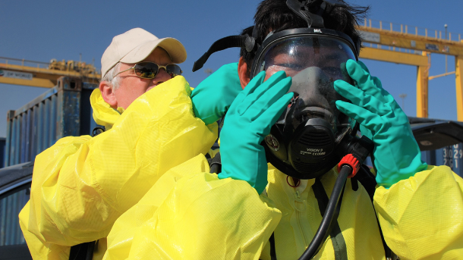
Prepare for CCLS (via emergency response)
Emergency response planning (ERP) for CCLS must be robust and resilient
  A specific ERP for the scenario (clearly defined; not buried under generic ERP)
  Includes scale of possible outcomes
  Includes likely incident timelines re. impact on vulnerable receivers
  Ensures alignment (based on realistic availability) between Company and
    2nd party (e.g., contractors) and 3rd party resources (e.g., civil responders)
  Assess hardware and personnel lead times re. incident timelines
    functionality of key emergency response hardware could be impaired
    there could be natural events coincident with the catastrophic event
    Limited access to respond (e.g., road tanker LOPC in a tunnel during traffic)

Slide 19
3.0
Conclusion

Slide 20


OiR: Overall Workflow
Input
Managed by updating existing systems/processes
External Event Data
Existing Safety Studies/Assessments
No
Is there potential for ≥10 fatalities?
Is this situation applicable to our industry?
Is this situation plausible¹ at given location?
Is potential worst-case outcome range uncertain³?
Does scenario have complex² risk mgmt?
Decisions
Yes
Yes
Yes
OR
CCLS
Yes
No
No
No
Out of scope
(not CCLS)
Update Company requirements
Input into pre-incident planning
Requires detailed discussion
and assessment
Result
¹ Plausible: assumes controls will fail
² Complex denotes multi-party/multi-organisation/multi-discipline
³ Uncertain: possible wide range of outcomes. Toxic gas release’s multiple variables (e.g., weather, community size) determines its consequence

Slide 21
Culture is critical to OIR success
Psychological Safety
The environment where everyone feels safe and responsible to speak up
Learner Mindset
The belief that we can always improve, everyone can grow their ability, learn from mistakes & successes
Human Performance
The way people, culture, work systems and processes all interact to optimize performance, reduce errors and minimize consequences as people execute tasks
Frontline workers are great at tactical risk assessment (e.g. JHA), but we should leave the major / strategic risks to the “experts”.
Do I ever diminish risks by thinking or saying it won't happen to us because…
  Shell has better systems than XYZ
  I am a good / better leader
  The risk assessment says its unlikely
  I’ve never seen that before!
  We’ve got the green light by the auditor or regulator
  We know exactly how this risk will materialize and we’ve prevented it
I would like to care more about this, but I’m only judged on my yearly operational performance, not on how I invest now for rare lifetime events.
Our ERPs are premised on everything going right, and within our capacity to respond, that’s what we drill.

Slide 22
Learning within Shell - Safeguard against psychological biases !
institutional and individual blindness (e.g., relying solely on narrow lived experience)
  being unaware of certain risks’ existence but still proceeding with operations
quality of risk assessment: ensuring right set of skills, experience and access to information
excessively wide focus so nothing is important: finite resources (SMEs/leader ‘bandwidth’)
understanding effectiveness of safeguards and being able to investigate areas of weakness
clarity on what is non-negotiable in relation to risk exposure for the entire organization

Slide 23
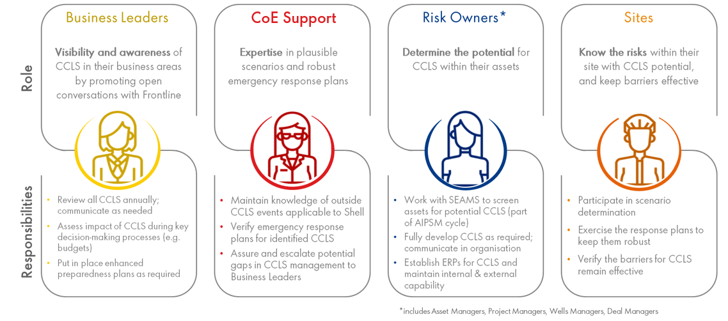
Roles & Responsibilities (when OiR brought into HSE-MS)

Slide 24
Open for Views/Comments/Clarifications/Questions
The End!

Slide 26
Some Recent CCLS Examples
Tank Farm Jaipur, India 2009
Harm to people: 12 fatalities, 150 injured. Asset losses: US $75m (today’s money)
Incident: Fire broke out in a giant tank holding 8,000 kilolitres of oil. Series of massive explosions could be heard up to 20 miles away as the fire escalated from one tank to another across the entire tank farm. Fire sustained for 11 days
Potential: This depot was part of an industrial complex close to Jaipur International Airport (5km)
Cyprus 2020
Harm to people: 100+ fatalities Asset losses: not reported
Incident: explosion and fire near a storage facility housing volatile chemicals (detonation of 2700 ton ammonium nitrate)
Potential: the storage facility was in proximity to the port but there was no information about ammonium nitrate being stored as it was an outcome of confiscation from a cargo ship 6 years ago (2014)
Aceh Indonesia 2018
Harm to people: 22 fatalities. Asset losses: not reported
Incident: newly drilled well exploded into flames when many people were trying to collect the gushing oil.
Potential: The well, was described to be “traditional,” likely meaning it had unclear ownership and was used by the local community. Aceh, at the northern tip of Sumatra, has significant commercially untapped natural gas reserves and dotted with illegal wells.
Fuel Depot Nagorno-Karabakh Region, Azerbaijan 2023
Harm to people: 125. Asset losses: TBC
Incident: explosion and fire occurred at fuel depot
Why: explosion took place as people lined up to fill their cars outside a fuel depot. Cause of the blast still under investigation but initial indication of negligence.

Slide 27
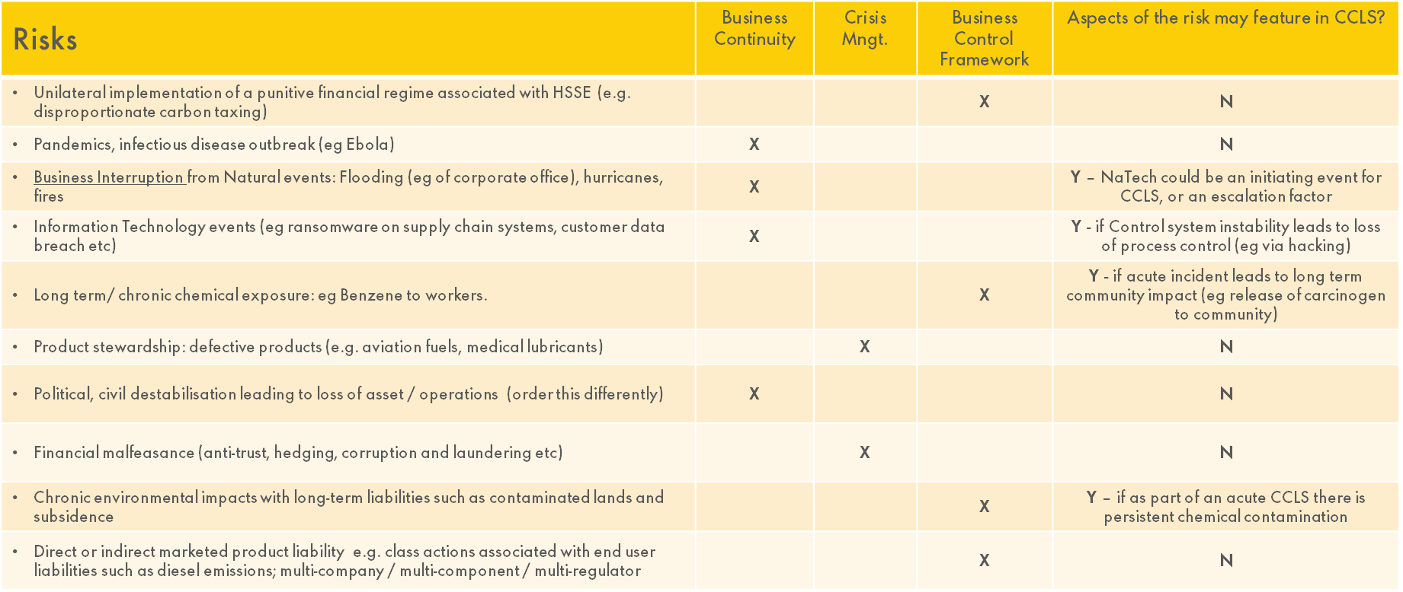
Comparative of risk management by CCLS (vis a vis other techniques)

Slide 28
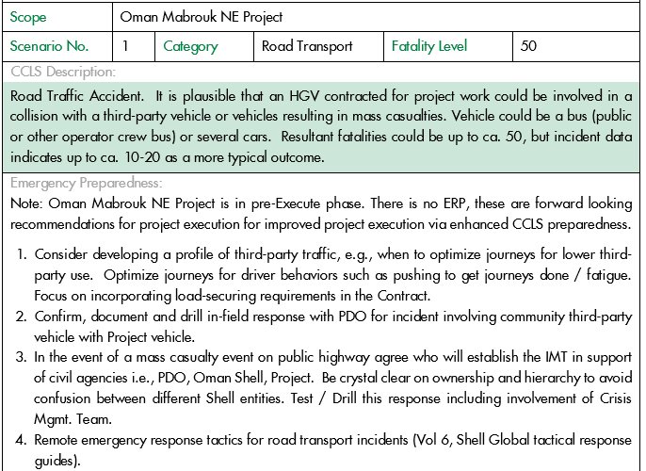
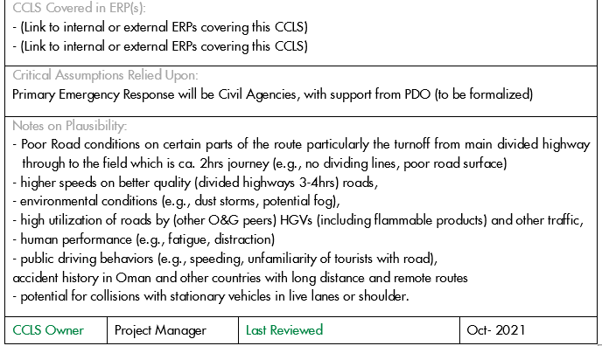
Sample template – record CCLS output
Go Back to Previous Slide

Slide 29
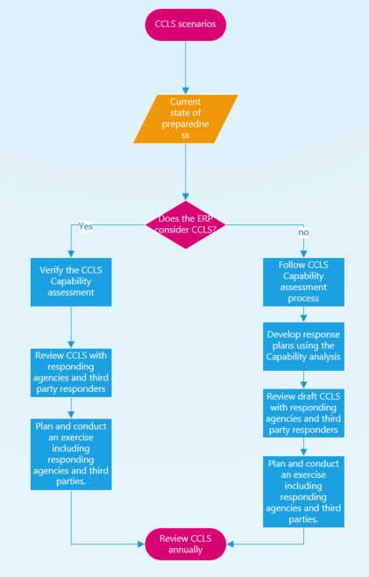
ER workflow (post CCLS identification & modelling)
OiR to be embedded with existing ER Planning
Dedicated Preparedness Check for each CCLS
Deliberate and Incorporate how ER could be weakened
Pre-Incident Plans to be Developed
Relevant External Agencies/Stakeholders to be kept informed
Mock Drills at intervals with identified 3rd party support

