Slide 1
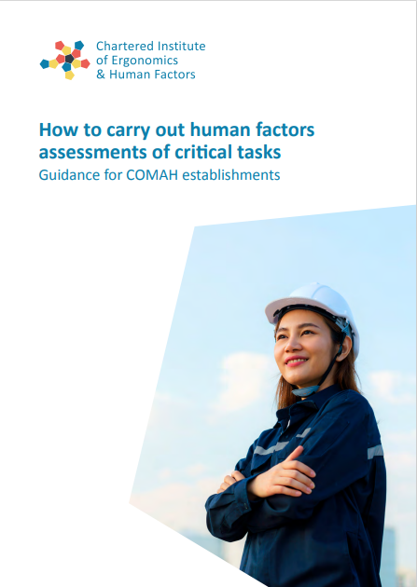
Human Factors assessment of critical tasks
Pippa Brockington
MSc, C.Erg.HF, FCIEHF
Lorraine Braben
C.ErgHF, C.Eng, MIChemE
Jamie Henderson

Slide 2
Lorraine Braben C.ErgHF, C.Eng, MIChemE
Human Factors Consultant
Auditing & assessment
Project delivery
Training and mentoring
Chartered Chemical Engineer
Qualified HR Professional
Chartered Human Factors Practitioner

Slide 3
Jamie Henderson, MSc, C.Erg.HF
Consultancy
Software
Training
www.humanreliability.com

Slide 4
What’s in this presentation
Why this guidance has been produced
The process
What’s new about the guidance

Slide 5
A note on terminology
Why “human factors assessment of critical tasks”?
Identify Critical Tasks
Hierarchical Task Analysis
Identify potential errors
Identify PIFs
Engineer out errors
Optimise PIFs
Prioritise the tasks
The purpose - to reduce the risk of human failure leading to a major accident.

Slide 6
Background – Regulatory Context
“Where reliance is placed on people as part of the necessary measures [to prevent major accidents and limit their consequences], human factor issues should be addressed with the same rigour as technical and engineering measures”. (HSE, 2015)

Slide 7
Background – Gaps and problems
Not identifying critical tasks
Identifying tasks that were not critical
Basing analysis solely on procedures
No real world understanding of the task
Bogged down, unable to resource a realistic programme of work
Problem not WHAT to do but HOW to do it

Slide 8
CIEHF involvement
HSE unable to resource the process of producing guidance
HSE approached CIEHF
CIEHF mandate to develop and produce guidance for Human Factors

Slide 9
Process – who was involved
Creative Team
Operations, Consultancy, Regulatory
Mark Benton – site HF Lead
Lorraine Braben - consultant
Andy Brazier – consultant
Pippa Brockington – consultant (ex HSE)
Jamie Henderson – consultant
Paddy Kitching – retired Site Manager
Mark Sujan - consultant
Michael Wright - consultant
Review Team
Regulatory, Consultancy, Operations
Julie Bell – consultant & ex HSE
Liz Butterworth – site HF specialist
Mary Marshall - HSE
Garry Moon - HSE
Caroline Morais - ANP
George Petrie - consultant
Elaine Skilling - HSE
Paul Traub - consultant

Slide 10
Process – How it developed
Series of Guidance Notes
Lack of Consistency
Existing guidance not provide direction
Range of opinions and practices
Application
Written for COMAH establishments
Suitable for all high hazard facilities / industries
Published by CIEHF in April 2023

Slide 11
Content - overview
GN1: Managing Human Factors Assessment Programmes
GN2: Competence Requirements
GN3: Identifying and Prioritising Critical Tasks
GN4: Gaining a Real World Understanding of the Task
GN5: Using Hierarchical Task Analysis to Represent Tasks
GN6: Identifying the Potential for Human Failure
GN7: Identifying Performance Influencing Factors
GN8: Identifying Improvements
GN9: Integrating Human Factors Assessment into Safety Management Systems

Slide 12
Organising
The COMAH Operator has developed, and is actively implementing, a programme of HRA that is suitably representative of the full range of MAH scenarios at the establishment (COMAH Competent Authority, 2015)
Maintaining momentum
Planning resources
Ownership
Monitoring progress
Notes:
Without prior experience of this type of work, it can be hard for sites to plan and organise. The guidance addresses this...
Momentum – Overcommit and fail to hit targets, or stall completely. May plan for analysis but not follow-up.
Resources – Need task expert time even with external support
Ownership – Without local ownership, no understanding of the issues, work performed by consultants, difficult to secure resource
Monitoring progress – Review progress. use Performance Indicators, adjust plans, look for similar issues and value

Slide 13
Roles & competencies
Outsourced (with core intelligent customer capability)
In-house analysis capability
Human Factors Champion
Human Factors Lead
Assessment Facilitator
Subject Matter Experts
Process Safety Engineer

Slide 14
Integrating HF assessments with process safety risk management
Notes:
Often the only interface is Task ID
Maximum value should relate the analysis to wider risk management (as shown)
Where do we rely on people?
Will safeguards work as we hope?
Input to the demonstration that the risk as ALARP
Also: gives guidance on the purpose and limitations of human factors assessments

Slide 15
Summary
https://ergonomics.org.uk/resource/comah-guidance.html
Practical guidance to supplement existing technical guidance
What to do and how to go about it

