Slide 1
Human Factors GATEWAY approach
Using outputs from Safety Critical Task Analyses (SCTA) to support rapid identification of Human Factors (HF) issues in related tasks
Notes:
Hello,
Today we are going to talk to you about what we are calling the Human Factors GATEWAY approach. This stands for: Generic Audit Tool Exercise for Widening and Accelerating Yield.
Essentially this is about Using outputs from Safety Critical Task Analyses (SCTA) to support rapid identification of Human Factors (HF) issues in related tasks.
This work was undertaken as a collaboration effort between Johnson Matthey and Human Reliability ,and demonstrates how operators and consultants can work together to develop new tools and techniques.

Slide 2
Human Factors GATEWAY approach
AGENDA:
01 - Introductions
02 - An Operator's Perspective
03 - The ‘HF GATEWAY’ approach
04 - Testing the tool and lessons learned
05 - Conclusions and Next steps
Notes:
The agenda for today’s presentation is as follows:
We will start with a brief introduction to the presenters and key contributors to our paper, followed by providing some context for why we completed this work.
My colleague Dominic will then be giving an overview of the process and approach undertaken.
Following this we will discuss some of the lessons learned through testing of the ‘GATEWAY’ tool .
and then we will move on to our conclusions and the next steps for both JM and Human Reliability in terms of the further development and use of the tool.

Slide 3
Introductions
Dominic Furniss, PhD.
Senior Human Factors Consultant – Human Reliability Associates LTD.
15+ years working in Human Factors, with 5+ years' experience of teaching and consulting in Human Factors SCTA
Jamie Henderson
Senior Human Factors Consultant –
Human Reliability Associates LTD.
20+ years working in Human Factors applied to Process Safety, co-authored industry guidance on SCTA
Karam Bhinder
Process Safety Specialist & Assurance Lead – PGMS Global – Johnson Matthey.
9+ years of working on Upper Tier COMAH sites, with 7 years working specifically in Process Safety
Notes:
Hi, My name is Karam Bhinder, I am the Process Safety Specialist and Assurance Lead for Johnson Matthey’s PGMS business.
I have worked for JM for over 7 years now dedicated to Process Safety across two of our largest sites in the UK.
JM has been a client of Human Reliability for a number of years, and I have worked alongside Dominic and Jamie on several Safety critical task assessments for our sites.
The concept for the work we are going to discuss today was based on an idea that we had as part of the discussions during the completion of previous SCTA’s.
Hi, I'm Dominic. I've been working in Human Factors for about 15 years, and supporting SCTA work through consultancy and training for about 5 years. Both myself and Jamie work for Human Reliability – we specialise in SCTA and human factors risk management. Both Jamie and I have been key contributors to this work.

Slide 4
An Operator’s Perspective: Johnson Matthey
Safety is our top priority
Challenge with balancing the resources required to drive new initiatives and day to day running of our business.
Our Process Safety journey is one area where this balancing act has been required.
Process Safety initiatives can take time (days/weeks/months)
Accepting extended timelines is challenging:
1) For competitive advantage
2) For delaying key risk reduction activities.
Notes:
-At Johnson Matthey, Safety is our top priority and an essential part of how we conduct business. In recent years, our sites have all embarked-on Process Safety improvement journeys, focussed on further enhancing the organisations understanding of the risks and managing them effectively.
-One of the challenges we face as an innovative and science led company is balancing the resources required to drive new initiatives related to business opportunities with the essential day to day running of our business.
-Our Process Safety journey is one area where this balancing act has been required.
-As many of you will be aware, the assessments and essential activities required for Process Safety (such as PHA’S, PHR’s, LOPA’s and DSEAR assessments) can take significant amounts of time (days/weeks/months) and require resources to complete, but the challenge is that these resources are also the same people required for other key activities across the business.
-Accepting extended timelines is a challenge for any business not only from a competitive advantage point of view but especially when confronted with the possibility that key risk reduction activities could be delayed.

Slide 5
HF GATEWAY: Methodology Development
JM embarked on our Human Factors (HF) improvement program, but our progress was slower than desired.
We wanted to explore more expedient approaches to accelerate our HF improvement initiative.
In conjunction with Human Reliability Associates we developed the:
HF GATEWAY methodology: A Generic Audit Tool for Widening and Accelerating Yield.
Essentially, this takes Human Factors issues and lessons from an SCTA study and helps spread the learning wider and faster to other similar tasks.
NOTE: This is not intended to replace full SCTA studies but raise the bar of similar tasks by identifying the ‘low hanging fruit’ without the need to employ expensive resource.
Notes:
As JM embarked on our Human Factors (HF) improvement program and conducted several in-depth studies, it became evident that our progress was slower than desired.
This realisation prompted Johnson Matthey's dual-site Process Safety team to explore more expedient approaches to pinpoint improvement actions and accelerate our HF initiative
Developed in conjunction with Human Reliability associates, the Human Factors GATEWAY methodology focusses on maximising the value from completed studies, by capturing repeat learnings from tasks of a similar nature and in turn allowing the site team to review their processes alongside these already captured findings and make the necessary improvements that we may typically wait for a Human Factors resource to identify.
Typically, these issues are related to:
1. Underlying ways of working/cultural issues,
2. procedural improvements
3. generic Performance Influencing Factors (PIF) improvements.
This approach also offered a broader scope of coverage and cost savings, as it minimised the reliance on external consultants to identify what we would consider ‘low-hanging fruit’. The idea is that this tool could be used by the Operations team to highlight improvement actions that are typically within their control.
An overarching objective is to elevate the standards of related tasks pre-emptively. By leveraging insights gained from one study, we can avoid redundant SCTA sessions for similar tasks and bypassing redundant discussions.
Our presentation and paper discusses the trial application of this approach at one of Johnson Matthey’s COMAH sites. It includes a description of the approach, arguments for and against adopting it, and an example of its application in the context of the manual charging of chemicals to a batch process, a task-type of which Johnson Matthey has multiple examples.

Slide 6
What we did to develop the tool
1. Identify a good candidate task for the HF GATEWAY approach
2. Conduct an exemplar SCTA
3. Conduct a literature review
4. Draft a generic audit tool
5. Add a table of generic Performance Influencing Factors (PIFs)
6. Draft a guidance document to introduce the topic and the tool
Notes:
We wanted to go through what we did in a bit of detail so you can see the process, see a bit of the tool we produced, and so you can follow this if it interests you.
One of the first steps we did was to identify a candidate task. This should be part of a representative set, so a task that represents many similar tasks that are done on site. This could be something like removing a Pressure Relief Valve for testing and calibration, or offloading a road tanker. In JM's case we looked at correctly identifying and charging material to a reactor – being a small batch processing facility they do lots of this at their site.
When we selected the task we perform an SCTA on it.
In parallel we did a literature review to see whether there is any relevant guidance or best practice related to the task we're studying, e.g. in our case we found a document by the European Process Safety Centre on the misidentification of chemicals to be very useful.
We wanted to use the results of the SCTA and the literature review to create a generic audit tool. In our case we listed the main stages of the process we were looking at (from the suppliers, to the presentation of the chemical material, to storage, movement, charging and post charging) and then listed the Human Factors risks and issues that people should attend to, with some suggestions on how they might be addressed.
In addition to the main audit tool we included a table of the HSE's generic PIFs with example questions on how these might apply to this particularly task.
Finally, we wanted to draft a Guidance Document to front end the tool and table. People might be coming to this with little knowledge of the topic area and Human Factors. We need to introduce them to the importance of the topic and the Human Factors systems perspective, and how to use the tool, its scope and limitations.

Slide 7
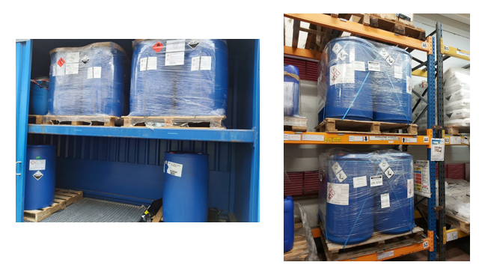
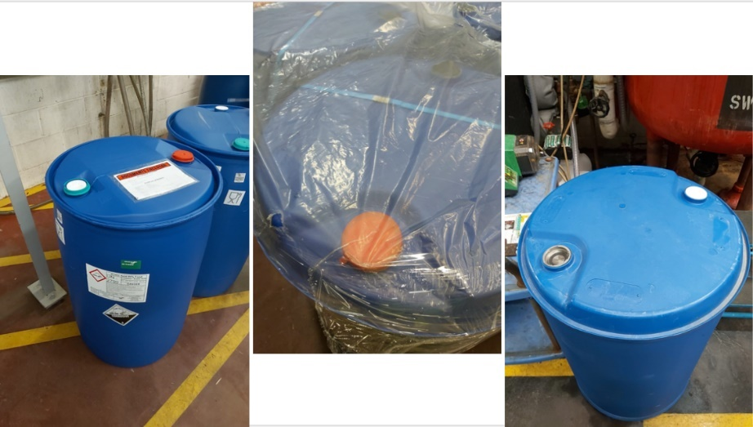
SCTA Case Study: Inadvertent mixing of Acetic Acid and Hydrazine
Notes:
This is the SCTA case study that formed the basis for the tool.
The concern was inadvertently charging Hydrazine instead of Acetic acid. Mixing the two together wasn't a problem itself, it was only when other things were added later in the batch when a potential MAH could occur.
Following a regulatory visit it was recommended that JM should conduct a SCTA on this potential failure.
You can see that they're both in similar looking 200L blue drums.
They were both used within the same department, by the same operators working across different processes.
From JM's perspective the current control mechanisms were primarily procedural.
They involved separate storage areas, they had different coupling points and the chemicals were used in separate rooms.
JM wanted some Human Factors scrutiny to check that the risks had been reduced to ALARP.
We included a summary of this case study in the Guidance Document to demonstrate the sorts of issues we were concerned about and the approach we had taken.

Slide 8
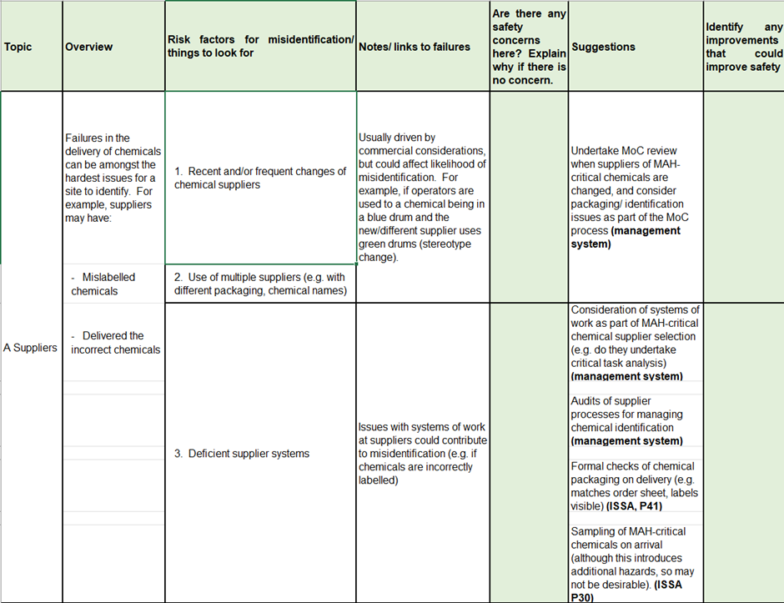
Generic Audit Tool
Notes:
This is an extract from the Generic Audit Tool we created.
You can see the structure, which we created in Excel.
This top section considers issues related to the supplier, e.g. if the right material has been delivered and whether it has been correctly labelled.
We then list areas of potential concern and elaborate on them a little.
There's a column to enter observations and concerns highlighted in green.
There's a column with suggestions, with a references where appropriate.
There's another column at the end where people can enter potential improvements.
So, this table continues down to the other stages in the process, e.g. to the presentation of the chemical material, to storage, movement, charging and post charging
Some of these sections have more advice and details than others.

Slide 9
Generic (PIFs)
Notes:
This is the Generic PIF table we created and shows how we've tried to make the PIFs directly relevant to the task at hand,
e.g. signs might be more to do with the quality of the labelling on different storage areas,
and equipment interface might include whether the materials have unique coupling points or not.

Slide 10
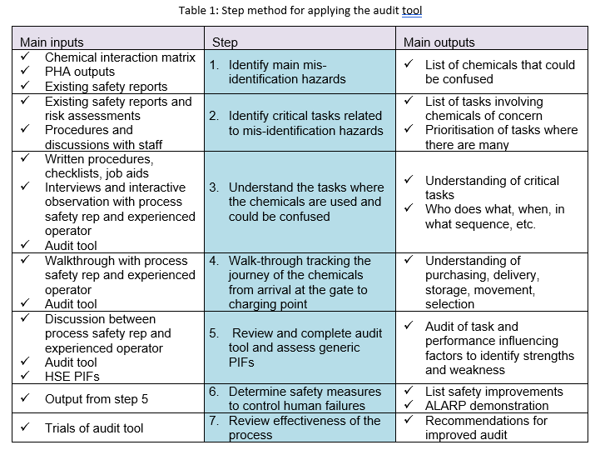
Guidance document
Notes:
Part of the scope and intention of this work was to produce detailed guidance on how to use the tool for a non-Human Factors expert.
As we've already said the Guidance Document will introduce the reader to the topic area, the Human Factors systems perspective, the SCTA Case Study summary and details on how to use the tool.
We also included this table that takes people through the steps of using the audit tool, inspired by a similar looking table in the EI SCTA Guidance document that summarises the SCTA process.
In our case this moves from identifying the main hazards and creating a chemical interaction matrix, to becoming more familiar with the task (using procedures, interviews and walkthroughs), to applying the tool to attend to Human Factors issues of concern.
So this front-end Guidance Document acts a little like a User Manual for the Generic Audit Tool Exercise.

Slide 11
Testing the Audit Tool
A second Full SCTA study was conducted in a different but related area.
This moved from the inadvertent mixing of drummed material to the inadvertent mixing of bagged material.
The audit tool was then validated against the output.
Notes:
Following completion of the initial study and creation of the audit tool
An opportunity presented itself to trial the audit tool on another similar task.
The original GATEWAY approach was based on a task focused on the inadvertent mixing of drummed material, but this new SCTA study was focused on confusing 25kg bags of white powder, namely Sodium Chlorate and Ammonium Chloride. The SCTA study was done first, and then the audit tool was used to complement the analysis.
A striking difference between the two tasks was that, for this second SCTA study, bags of different types were stored in the same area. This increased the likelihood of the incorrect bag being selected for charging.. Essentially there were four different white bags of powder stored on palettes next to four reactors, each material had a different reactor to be charged to, and the worst combination was confusing Sodium Chlorate and Ammonium Chloride. This would not cause problems at the reactor itself, but later on in the process.

Slide 12
Lessons learnt from the HF GATEWAY approach:
POSITIVES:
USES: The tool can be used for different types of manual charging tasks.
Preparation: Using the tool prior to a study could help identify what information may be required for the detailed SCTA.
Re-Assurance – The tool offers re-assurance that a detailed SCTA hasn’t missed anything (when comparing the two outputs)
Improvement Opportunities:
Inherent Safety: Further prompts could be provided to stimulate thinking around inherent safety – change the form of the material to promote differentiation
Limitations:
The tool is may fail to capture nuances of specific tasks, hence the need to still complete a further detailed SCTA for the most critical tasks.
Notes:
So, what did we learn from testing
Some of the positives were:
In terms of Uses - The tool can be used for different types of manual charging tasks/Inadvertent mixing scenarios and not just drummed material. We had some initial concerns that the tool may have been too focussed on drums but once we tested these concerns were put to bed
In terms of Preparation -The tool can be used to help prepare sites/departments for a full SCTA, the information contained within the audit tool can serves as a checklist of items to bring along to the study
In terms of Audit & Assurance - The tool can also be utilised post SCTA to provide assurance that all typical findings have been identified and suitable actions have been proposed.
We also identified a potential Improvement opportunity which was that
the tool talks about containers having similar appearance and where they are similar having unique coupling points if possible. This leads one to think about the appearance of bags and if they could be differentiated and how the bags are used. However, it doesn’t readily get the assessor to think about using different forms of the material (e.g. prediluted Ammonium Chloride) so it is already in liquid form rather than using bags. This is differentiation on a much higher level.
And In terms of Limitations:
As previously stated the tool isn’t a substitute for a detailed SCTA, although the tool helped identify the low hanging fruit during the testing on another task, there was specific more detailed items which the tool alone would maybe not have picked up.

Slide 13
Conclusions – Next steps
The Human Factors GATEWAY (Generic Audit Tool Exercise to Widen and Accelerate Yield) has been proposed to maximise the value of SCTA studies for organisations that have similar sets of tasks and issues.
The Human Factors GATEWAY approach is not proposed as a replacement for SCTA studies, but to support the spread of knowledge to representative task sets.
This raises the standards of representative task sets faster and allows limited HF SCTA resource to be deployed to more fruitful areas – both strategies that should improve the yield of safety insight from HF work.
To some degree we are trading off thoroughness for efficiency, as an audit is not the same as doing a full SCTA study so nuances and issues may be missed (but, as we previously argued, it could take years to deploy a full SCTA study for these tasks).
Notes:
KARAM:
In conclusion - The Human Factors GATEWAY has been proposed to maximise the value of SCTA studies for organisations that have similar sets of tasks and issues.
Operators of upper and lower tier COMAH sites need to meet the requirements set out in the HSE Delivery Guide for Human Factors (2016), which includes a requirement for the use of structured Human Reliability Analysis (HRA) for COMAH-critical tasks.
However, with programmes of SCTA work stretching on for many years resource needs to be used efficiently and effectively.
Using SCTA resource to repeatedly attend to similar tasks, with little cross pollination, does not seem like the most effective use of resource.
DOMINIC:
The Human Factors GATEWAY approach is not proposed as a replacement for full SCTA studies, but to support the spread of knowledge to representative task sets – this raises the standards of representative task sets faster, and allows limited HF SCTA resource to be deployed to more fruitful areas – both strategies that should improve the yield of safety insight from HF work.
To some degree we are trading off thoroughness for efficiency, as an audit is not the same as doing a full SCTA study so nuances and issues may be missed (but, as we previously argued, it could take years to deploy a full SCTA study for these tasks). The GATEWAY approach aims to spread learning faster, using non-Human Factors experts to benefit safety.
Following development and testing we believe can be the tool can be used in the following ways:
As a gap analysis to help ensure that best practice is to applied to other MAH-critical tasks of this task a quickly as possible (i.e. until a more detailed SCTA is possible).
As a simplified PIF analysis for lower criticality tasks which involve chemical identification.
We have tested the audit tool on a similar task, again at Johnson Matthey, and the results look promising for providing reassurance and insight.
Further testing is planned for this area, importantly involving people from outside of the core development team on tasks that have not yet had HF SCTA attention. This will be a more robust test than has been conducted to date.
Other potential areas of application include representative sets of tasks such as road tanker offloading and the testing of high-level trips; and generic task elements (GTEs) such as operation of valves and isolation proving and purging. It is also possible to apply HF GATEWAY approach to smaller units of work where HF issues will apply, e.g. effective second checks and visual checks and inspections. Essentially, any module of human work that can be subject to HF assessment could also create a generic audit tool from the results, complemented by a relevant literature review, to create an audit tool for non-HF specialists to use for their own assessments.

Slide 14
Karam.Bhinder@matthey.com
dominic.furniss@humanreliability.com
henderson@humanreliability.com

