Slide 1
Integrating Safety Critical Task Analysis (SCTA) with Wider Engineering Risk Assessments
Jamie Henderson
Dominic Furniss

Slide 2
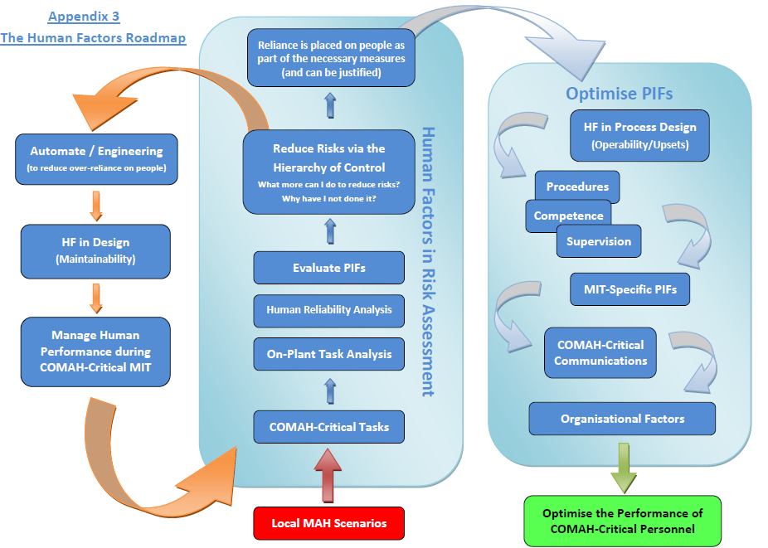
HSE HF Roadmap
http://www.hse.gov.uk/comah/guidance/hf-delivery-guide.pdf
Notes:
As a company, we have undertaken hundreds of these analyses on behalf of UK clients over the past 15 to 20 years. Our observation has been that SCTAs are often treated independently of Major Accident Hazard Risk Assessments (MAHRAs) (e.g. HAZOPS, PHRs, LOPAs), with SCTA programmes of work taking place largely in parallel to these wider risk assessment activities.
Our belief is that improved guidance on the integration of SCTA with MAHRA could result in efficiency gains and better overall risk management.

Slide 3
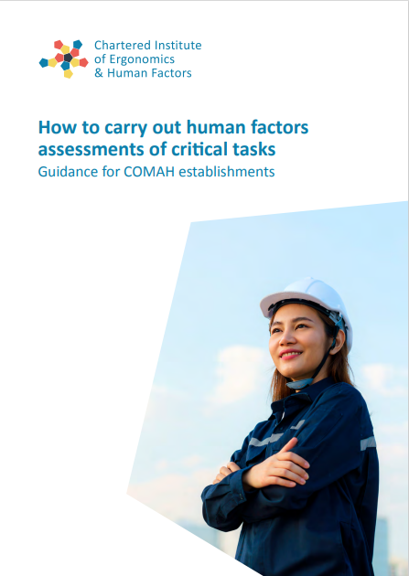
Existing guidance
Until recently, limited guidance on the relationship between SCTA and Major Accident Hazard Risk Assessments (MAHRA)
Guidance on Human Factors Safety Critical Task Analysis (Energy Institute, 2020). Technical focus.
How to Carry Out Human Factors Assessments of Critical Tasks (CIEHF, 2023). Includes some relevant sections:
Guidance Note 8 ‘Identifying Improvements’
Guidance Note 9 ‘Integrating Human Factors Assessment into Safety Management Systems’
Notes:
The key points arising, and their implications for SCTA practice, are summarised in the following sections.

Slide 4
CIEHF SCTA guidance – Key points related to MAHRAs
SCTAs should be developed in relation to a MAHRA
Key goals of SCTA:
Confirm that safeguards work as intended
Identify where there is reliance on people
Address potential human failures and PIFs
Qualitative analysis is sufficient
SCTA is required even where risk has been assessed as Broadly Acceptable
Notes:
The guidance also sets out that, even where an existing MAHRA has established that the risk is Broadly Acceptable, MAH-related tasks should still be subject to SCTA to determine PIFs that require optimisation (and ensure that Recognised Good Practice is being met) (GN8, P35). Irrespective of the assessed risk level, Human Factors Recognised Good Practice (RGP) should be met for all MAH critical tasks.

Slide 5
CIEHF SCTA guidance – Relationship between SCTA and MAHRA (GN8, Page 35)
Systems without engineered safeguards likely to be in intolerable band
HF improvements alone (e.g. procedures, training) unlikely to be sufficient
HF improvements may be used to reduce risk to lower end of TIF-ALARP or to Broadly Acceptable
HF solutions alone may be sufficient
https://www.hse.gov.uk/foi/internalops/hid_circs/permissioning/spc_perm_37/
Notes:
There is a legal requirement to reduce risk to ALARP. The HSE categorises risk as “Intolerable”, “Tolerable if ALARP” risk or “Broadly Acceptable” (SPC47). The key implications include:
⭓ Action must be taken for Intolerable risks
⭓ Reasonably practicable risk reduction should be taken for Tolerable risk
⭓ If the risk is in the Broadly Acceptable Region, then ALARP is achieved by meeting RGP.
The HSE provides detailed guidance on ALARP demonstration in the context of COMAH (summarised in SPC 37, HSE, Undated). SPC 37 explains how Regulation 4 of the COMAH Regulations requires Operators to take all measures necessary (AMN) to prevent major accidents. In practice, this is interpreted as being the equivalent of reducing risks to ALARP.
HSE guidance starts with the expectation ‘that suitable controls must be in place to address all significant hazards and that those controls, as a minimum, must implement authoritative good practice irrespective of situation based risk estimates’ (HSE, Undated). In other words, good practice must be in place regardless of assessed risk.
It then goes on to state, that once the existing measures represent good practice, the residual risk will be in one of three bands:
Intolerable – ALARP not achieved. Action must be taken to reduce the risk almost irrespective of cost.
Tolerable if ALARP (TIF ALARP) - Case specific ALARP demonstration required (What more can I do? Why have I not done it?). The extent of the demonstration should be proportionate to the level of risk.
Broadly Acceptable - ALARP demonstration by meeting recognised good practice.
Therefore, it is important that SCTAs can be used to support demonstration that risk is ALARP. However, there is little existing guidance on how to do this. This gap, and the degree to which it is addressed in the new CIEHF guidance, is discussed in the following sections.

Slide 6
CIEHF SCTA Guidance – Other relevant information
Tasks should not include steps with single point failures (i.e. task steps where a human failure could result in a MAH scenario without engineered preventative or mitigation safeguards). (GN8, P33)
Where human performance has been already been identified as a risk reduction measure…the purpose of the assessment is to demonstrate that the company is justified in making this claim. Unless additional engineering controls are implemented, no extra claim for risk reduction can be made as result of the assessment. (GN9, P39)
Notes:
However, when the human failure is the initiating event for a scenario, carrying out and acting upon the assessment can be used to demonstrate that the initiating event is less likely
There should be no tasks, sub-tasks or task steps where a human failure could result in a MAH scenario without engineered preventative or mitigation safeguards. This is the equivalent of a “single point failure” in engineering terms. This might be considered “a serious deficiency” by the regulator (which could lead to the process being prohibited). I

Slide 7
Before an SCTA use an MAHRA to…
Establish MAHs that have already been identified in relation to the task (e.g. overfill, over-pressurisation).
Identify existing safeguards for which credit is being taken (e.g. high-level trip, operators’ response to alarm)
Establish the existing assessed risk associated with the task.
If Broadly Acceptable – Optimise PIFs/ meet RGP
If Tolerable – Identify opportunities for Hierarchy of Control improvements + Optimise PIFs/ meet RGP
If Intolerable – Discuss suitability of SCTA

Slide 8
Before an SCTA use an MAHRA to…
Establish how much credit is being taken for human performance (may not be apparent from the MAHRA)
 | Likelihood |  | Consequences | Risk
Human Failures and Safeguards together | Very low |  | Major | TIF ALARP
 | e.g. 0.0001
Human Failures and Safeguards separated | Very low | C – Low | Major | TIF ALARP
 | Failure 0.1 | Control Measures 0.001
But what if?
Human Failures and Safeguards separated (2) | Very low |  | Major | TIF ALARP
 | Failure 0.01 | Control M 0.01
Notes:
This is also important for establishing the scope and purpose of the analysis. If extensive credit is being taken for human performance, then the rationale for this should be discussed in advance with the site, and it might affect subsequent steps (see Practical Tips column, right).
This may not be apparent from the MAHRA. For example, often risk matrices will have consequence and likelihood dimensions. As a result it can be unclear how much of the assessed likelihood comes from engineering safeguards and how much from human performance.

Slide 9
Use the SCTA to…
Illustrate where there is reliance on human performance
Report to the site any degraded safeguards.
Demonstrate that any risk reduction claimed for human performance in the MAHRA is justified.
Report any additional MAHs identified during the course of the analysis.

Slide 10
Conclusion
SCTAs are often treated as parallel activities to MAHRAs, with little dialogue between the two processes.
Greater integration between these two types of assessment should ensure better risk management.
Additional benefits for SCTA practice:
clearer definition of SCTA purpose
identification of the most important MAHs.
May also improve SCTA focus, analysis effort directed at the tasks (or parts of tasks) related to the most significant hazards.
Notes:
However, when the human failure is the initiating event for a scenario, carrying out and acting upon the assessment can be used to demonstrate that the initiating event is less likely

