Slide 1
To enclose or not to enclose?
Karina Almeida Leñero, Michael Bristow, Chris Gold & Matthew Jenkins
An investigation on the influence of ventilation arrangements on hydrogen explosion hazards in compressor enclosures

Slide 2

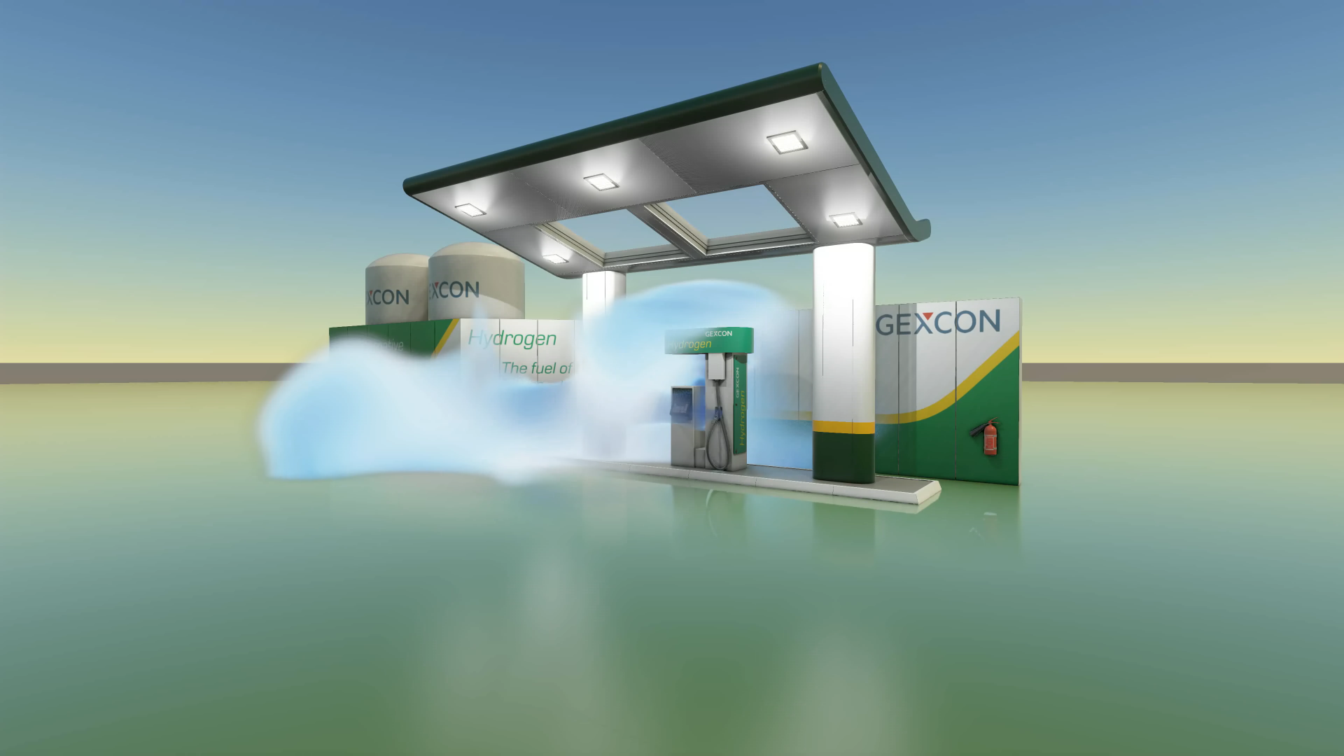
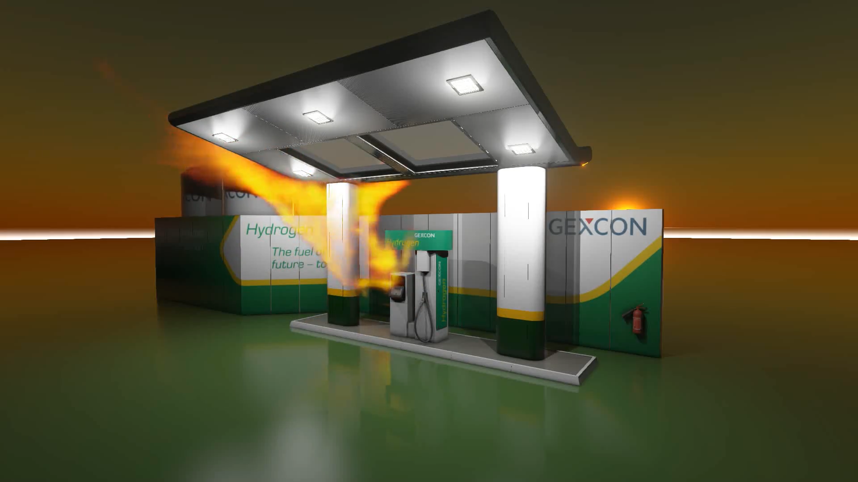
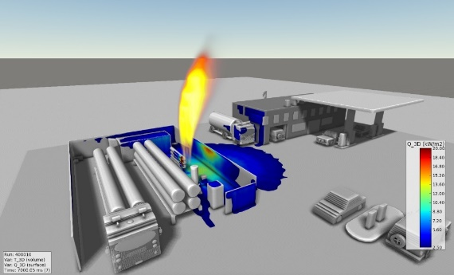
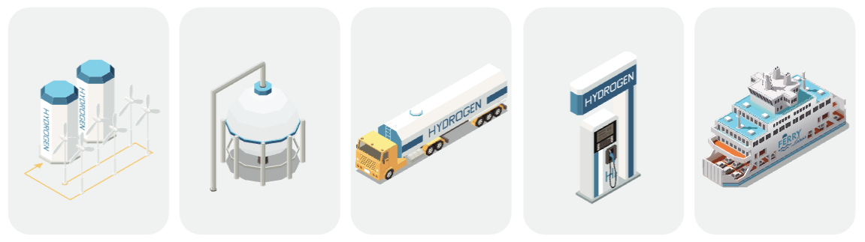
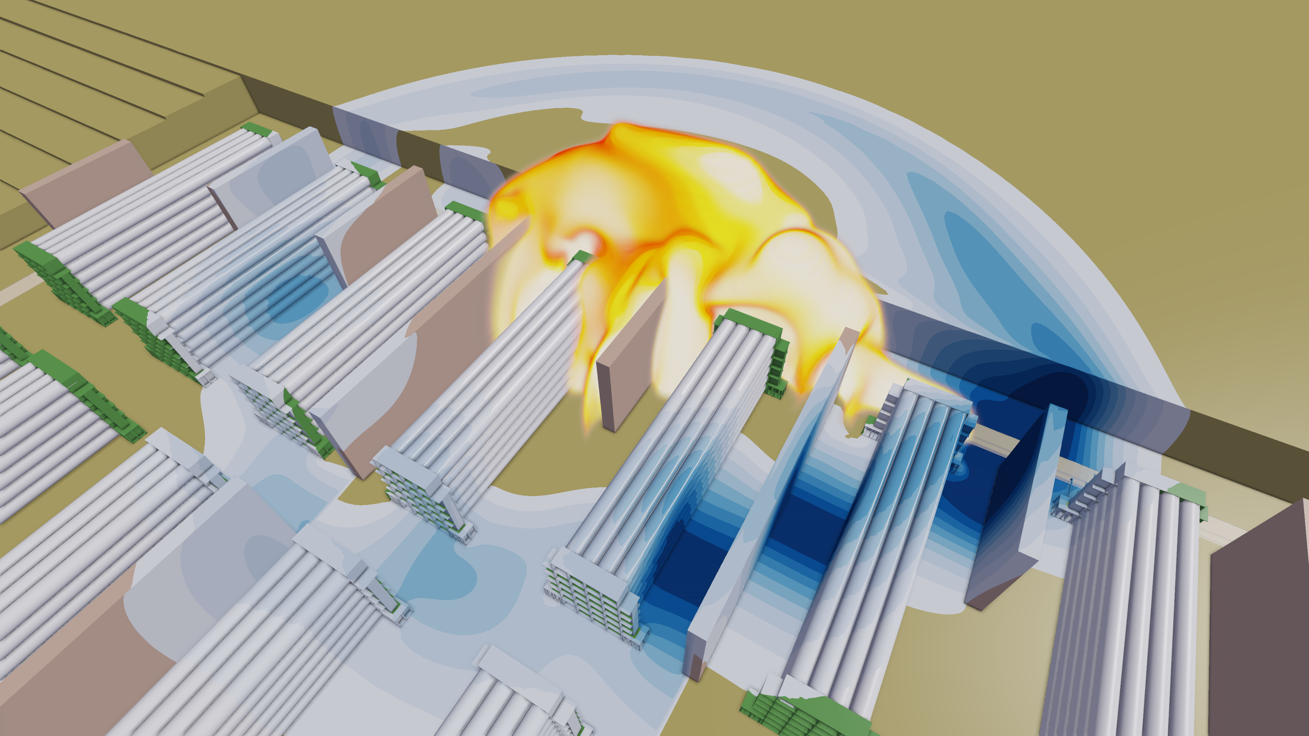
Gexcon Expertise in Hydrogen Safety
Wealth of experience on various H₂ related projects
Process safety and safety reviews
Assistance for conceptual phase : safety distances, arrangement/ layout optimization
Regulation and ATEX compliance
Optimization of ventilation and gas detection
Modeling of accidental events : dispersion, explosion and fire
Prevention and Mitigation measures
Design of structures and equipment to withstand accidental events
PRODUCTION
STORAGE
TRANSPORT
DISTRIBUTION
MOBILITY

Slide 3
Background
The use of high-pressure hydrogen (500-900 barg) is growing dramatically in a variety of applications, like transport, mobility and in heavy duty vehicles.
  At these pressures even a small hydrogen leak can lead to the formation of a large flammable gas cloud which, if ignited, could result in a severe explosion.
Many vendors and process designers prefer to enclose compressors for maintenance reasons and to comply with maximum allowable noise levels.
From the process safety perspective, an open design would allow natural ventilation to disperse the H₂ and prevent the accumulation of large, reactive flammable gas clouds.
At Hazards 32 we showed that background ventilation alone cannot dilute a high-pressure H₂ leak below LFL.

Slide 4
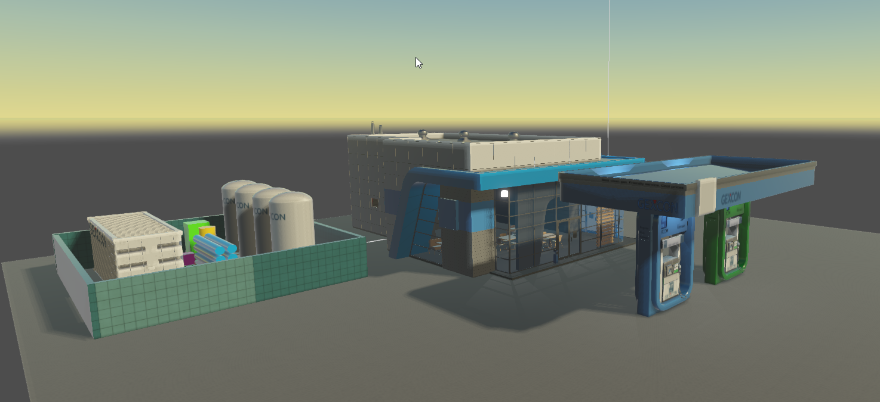
Where did we leave it last year?
Often ventilation is used as a basis of safety, assuming that it will disperse a flammable cloud below LFL, thus a severe explosion is not credible.
A previous study combined, ventilation dispersion and explosion assessment:
  Assess if ventilation can dilute a hydrogen leak below flammable limits
  Understand the concentration of H₂ across the cloud.
    In case of ignition, how does ventilation affect the explosion severity?
Container with
Compressor unit
Notes:
Transition: We started thinking about

Slide 5
Hazardous Area Classification & Ventilation
The objective of Hazardous Area Classification is the control of ignition sources.
  It normally only considers very small release sizes
    Fugitive leaks (from flanges, valves, instrument connections, etc)
    Planned releases (e.g. venting)
Typical hole sizes considered in BS EN 60079-10-1:
  0.025 to 2.5 mm² (∅ =0.2 to 1.8 mm).
This usually results in zone extents of just a few meters

Slide 6
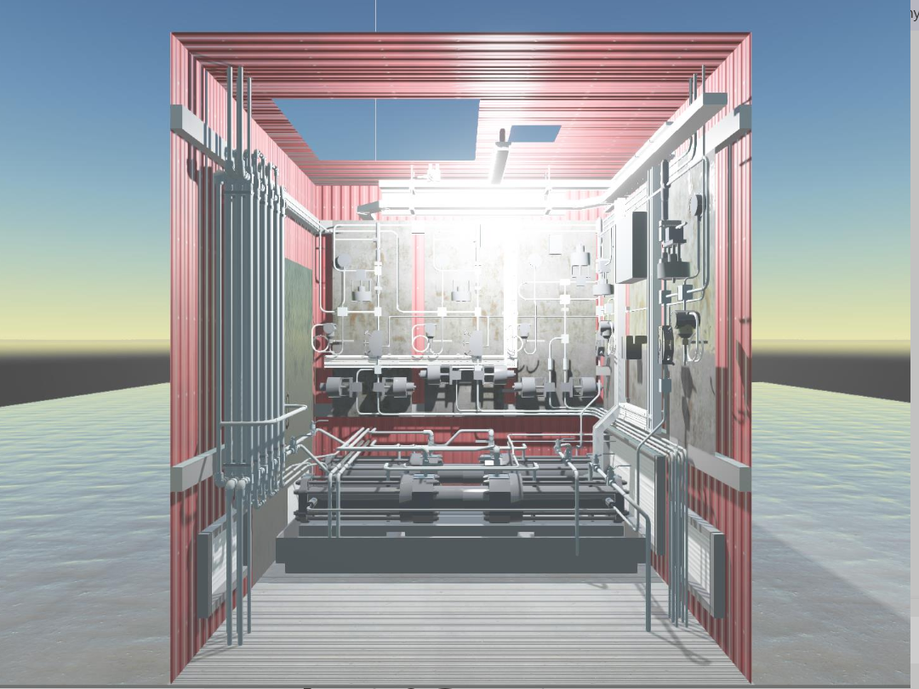
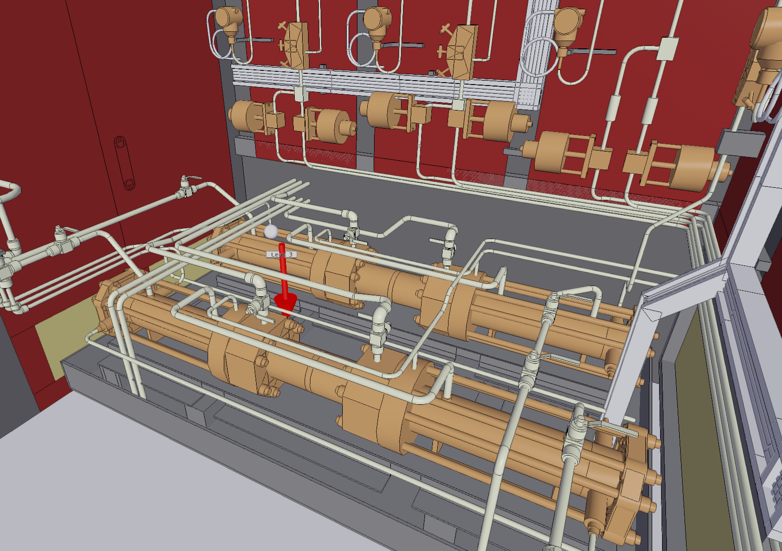
Modelling Set-up: Geometry
Notes:
In the compressor module, most leaks are expected to occur in joints and instrument connections associated with the compressor. Figure shows the location of the leak studied, on the discharge size of the compressor. The leak pointing vertically downwards is likely to represent a worst-case scenario, as the high momentum will be partially destroyed when impacting on the ground, causing the leak to spread and only then start rising towards the extraction point.

Slide 7
Modelling Set-up: Hydrogen Leak
Pressure & temperature: 950 bar & 30 °C
Leak Sizes:
    A = 0.1 mm² (diameter = 0.4 mm)
    A = 0.5 mm² (diameter = 0.8 mm)
Leak direction: Downward
Leak duration: 30s
Notes:
In the compressor module, most leaks are expected to occur in joints and instrument connections associated with the compressor. Figure shows the location of the leak studied, on the discharge size of the compressor. The leak pointing vertically downwards is likely to represent a worst-case scenario, as the high momentum will be partially destroyed when impacting on the ground, causing the leak to spread and only then start rising towards the extraction point.

Slide 8
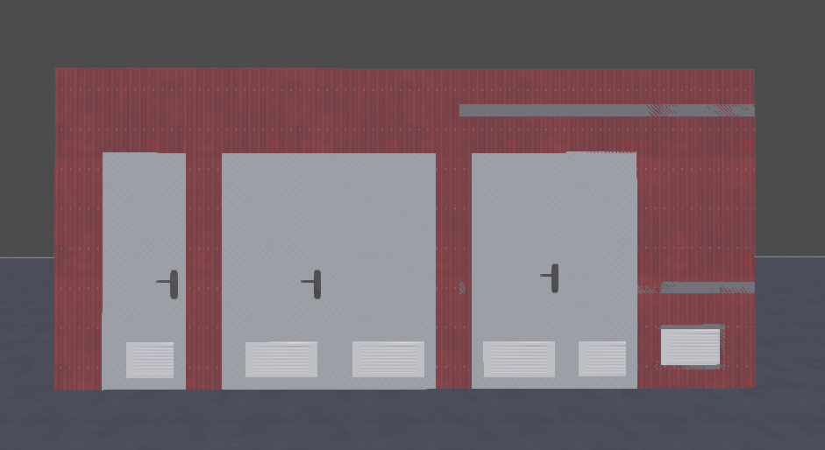
Modeling Set-up: Ventilation
Air intakes through grilles in doors
Air Intakes in doors
Extraction through roof
Flow rates :
  1000 m³/h → 10,000 m³/h

Slide 9
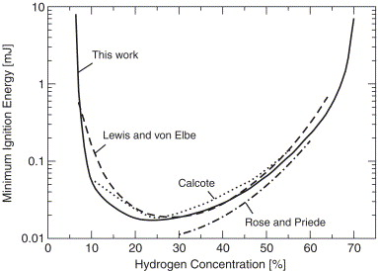
Why is Hydrogen Concentration Important?
Minimum Ignition Energy
Laminar Burning Velocity

Slide 10
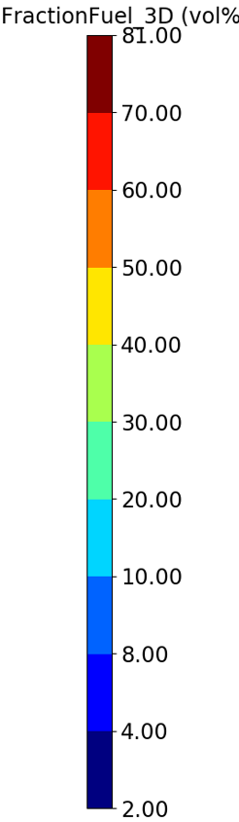
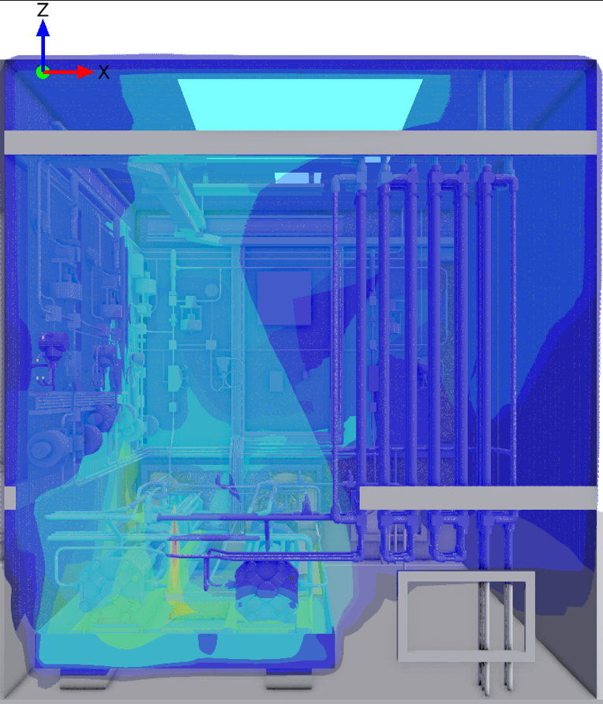
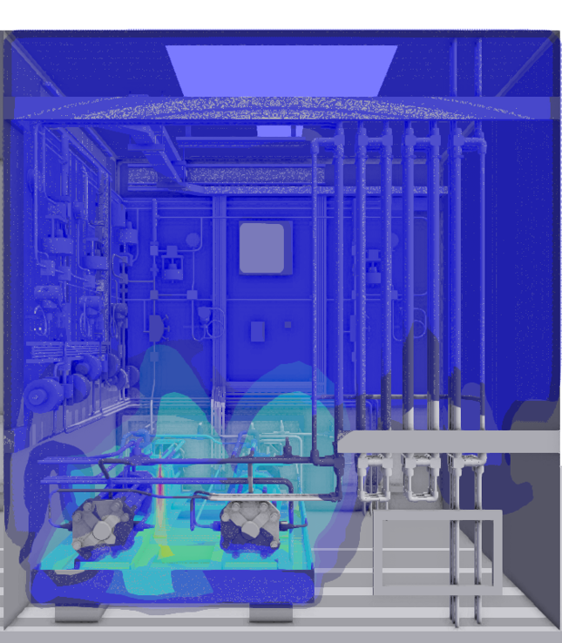
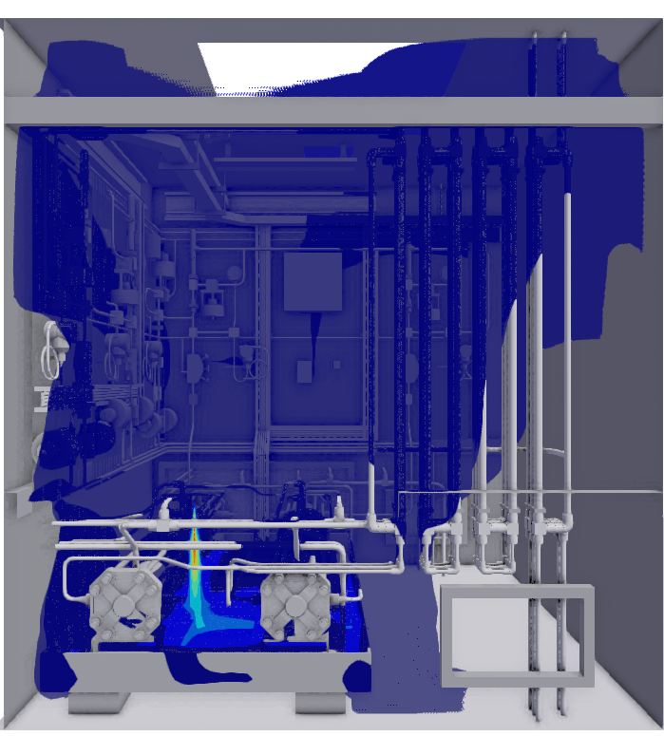
Is Ventilation Working as Intended?
Original ventilation rate: 1000 m³/h
5x ventilation rate
10x ventilation rate

Slide 11
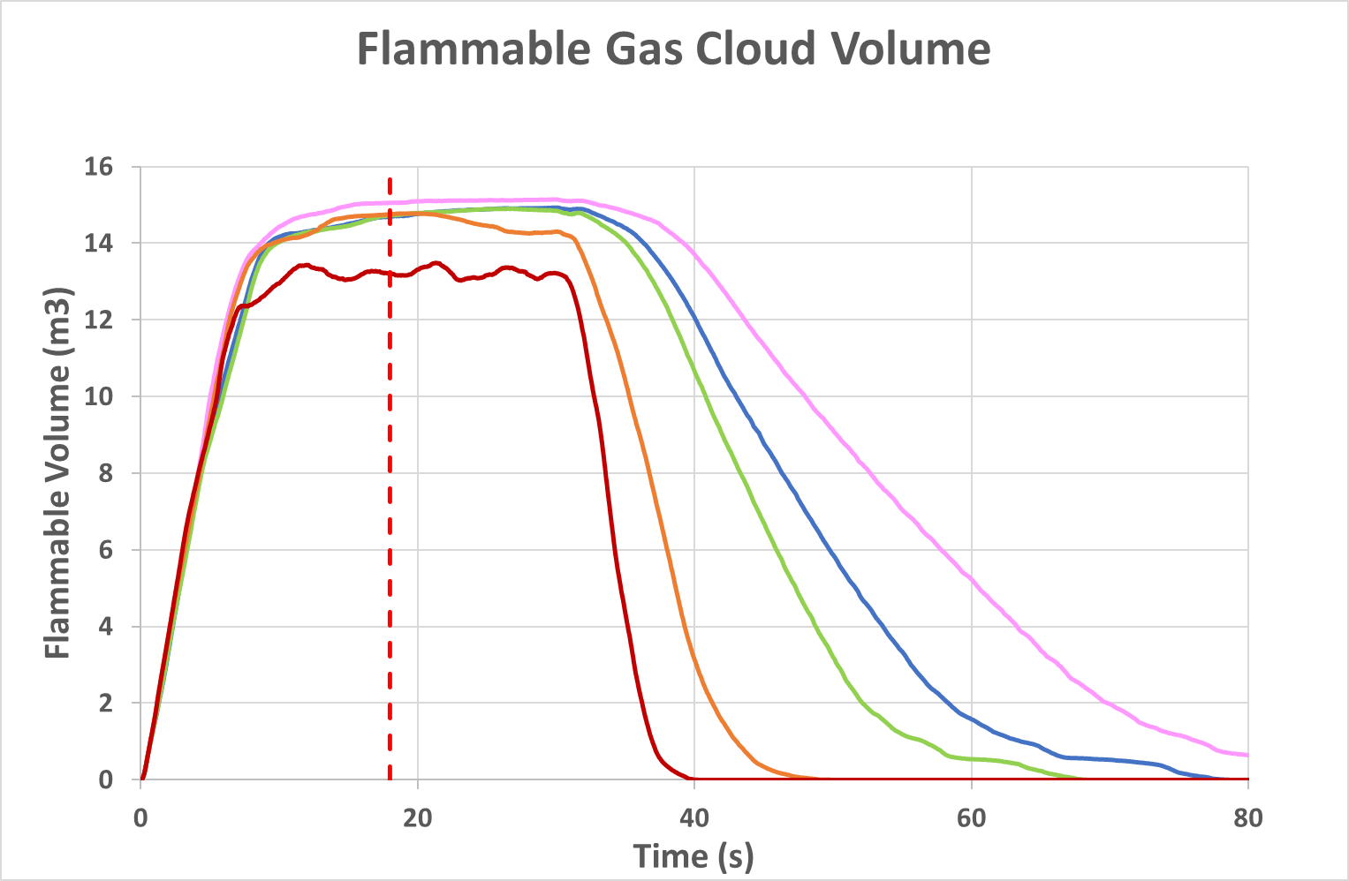
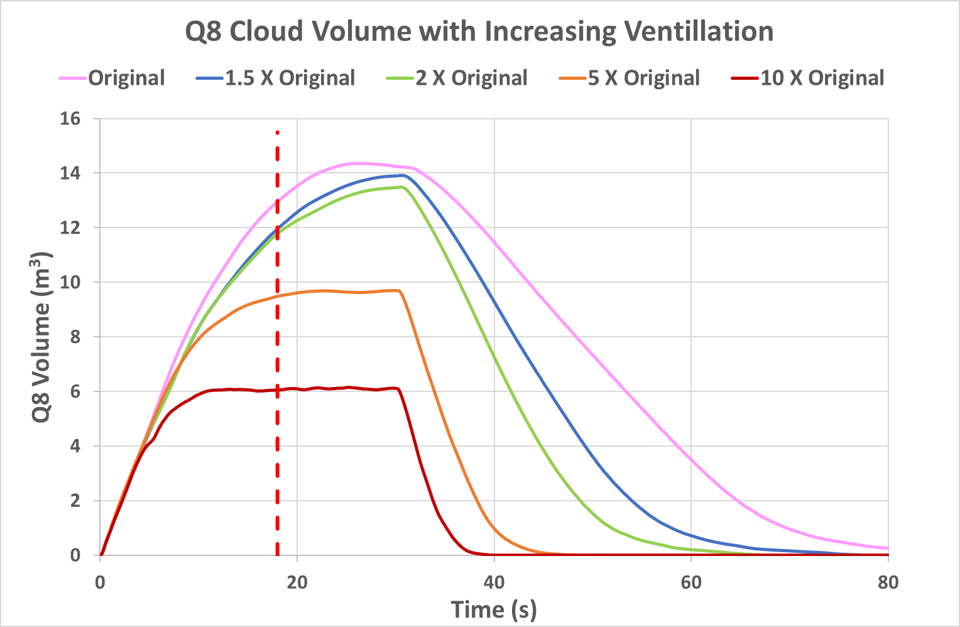
Effect of Ventilation on Cloud Size & Reactivity
Leak size: 0.5 mm²
1,000 m³/h
1,500 m³/h
2,000 m³/h
5,000 m³/h
10,000 m³/h

Slide 12
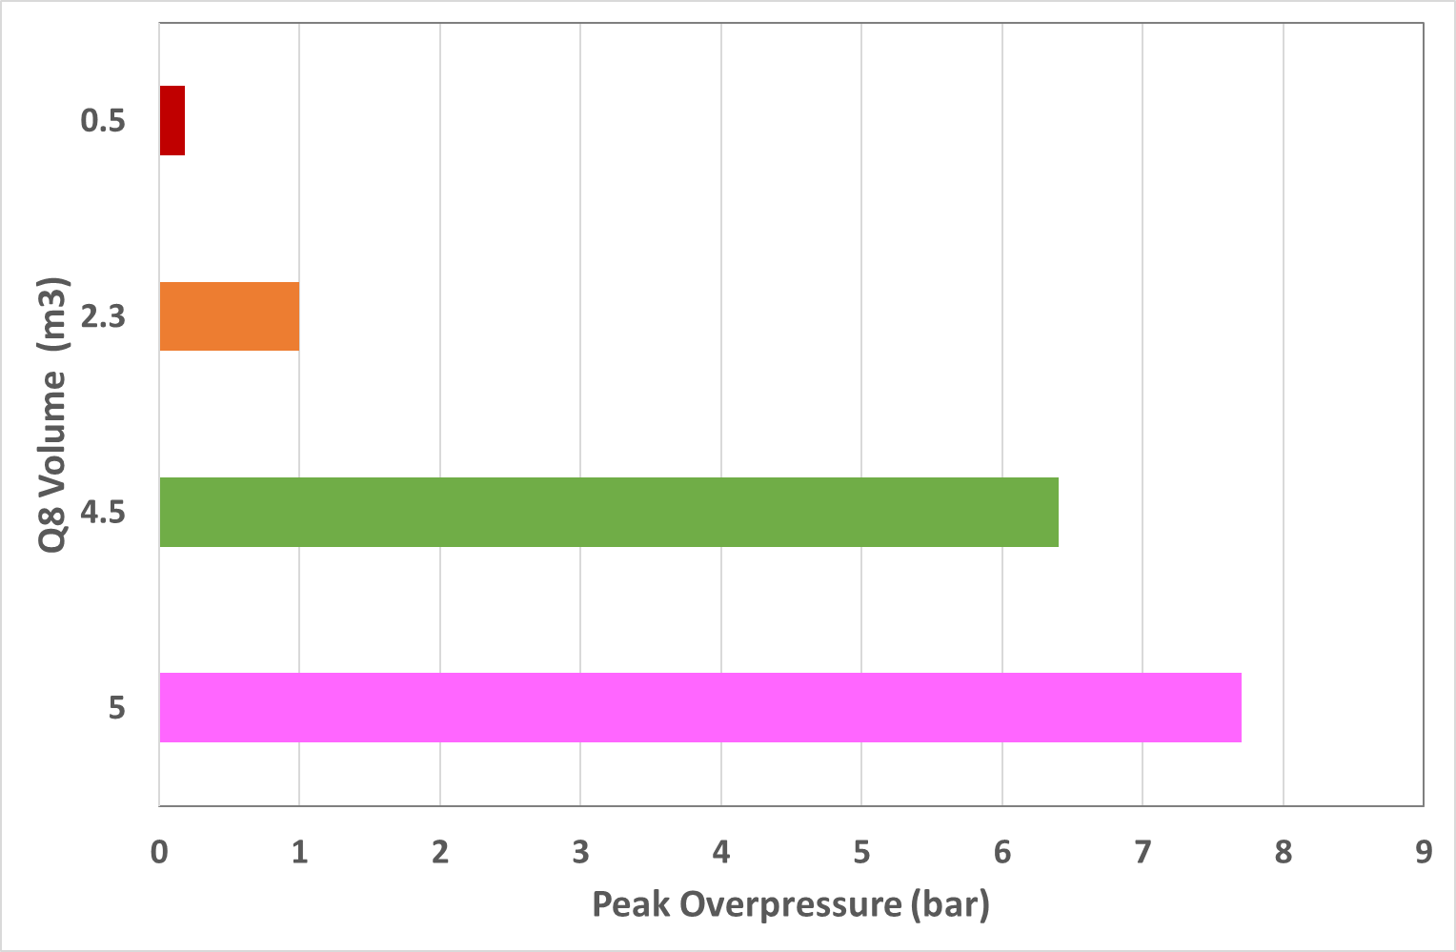
Effect of Cloud Volume on Explosion Overpressure
Notes:
Note that only with the smaller cloud (0.5m3)

Slide 13
Conclusions from previous study
For high pressure applications, even a relatively small H₂ leak in an enclosed compartment cannot be effectively diluted with mechanical ventilation.
  Even very high ventilation rates (in the order of 10,000 m³/h) are not sufficient to dilute a high-pressure leak below LFL.
Rapid detection & shut-down are essential to control the size and reactivity of the flammable cloud.
Notes:
Note that only with the smaller cloud (0.5m3)

Slide 14
Present Study

Slide 15
What do we want to know?
What is the effect of placing the compressor in an open shelter?
What are the differences between the configurations?
If an enclosure is required: is there a ventilation set-up that would provide ‘sufficient’ air flow to dilute a hydrogen leak below the flammable limits?
Can a hazardous zone of negligible extent (Zone 2 NE) be achieved within a hydrogen compressor enclosure?

Slide 16
Objective
Comparison between 3 potential alternative ventilation configurations
Assess the ability of the ventilation set-up to dilute a leak of hydrogen
  and is there and optimal configuration?
To facilitate comparison with the previous work, the same leak parameters will be assessed
  P = 950 barg pressure,
  T= 30°C
  Release sizes: 0.1mm² and 0.5mm²

Slide 17
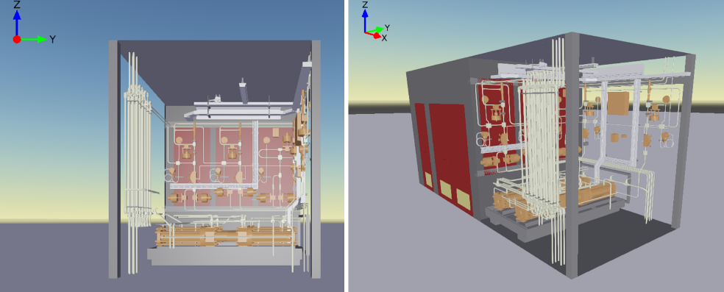
Case 1: Open Shelter
Notes:
Figure shows a CAD drawing of the compressor shelter in the open configuration used for “Case 1”. It should be noted that this is simplified representation as not all and piping supports are included; this is more likely to be a unit in a skid with some structure around it to support the piping. It is intended however to be an approximate representation of a compressor shelter with a roof to provide limited weather protection with piping and instrumentation affixed to a back wall. If a unit installed on a skid (i.e. without a wall) was used it is expected that ventilation would be more effective.

Slide 18
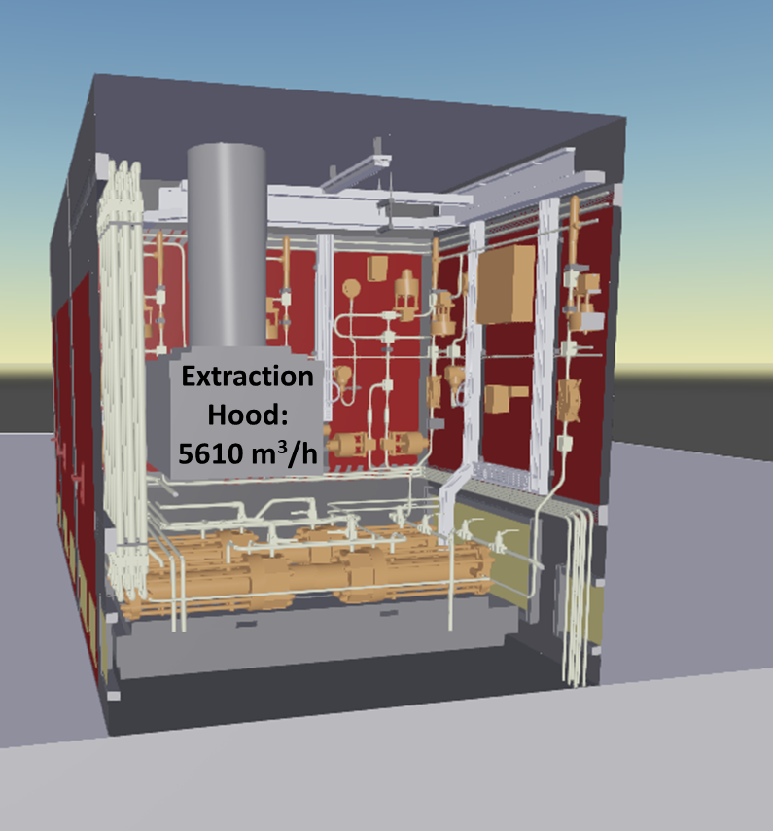
Cases 2 & 3: Enclosed
Extraction Fan: 1,000 m³/h
Notes:
For the enclosed configurations (cases 2 & 3), the same geometry as in the previous paper was used, with the addition of an extraction hood over the compressor discharge, where the higher-pressure leaks are expected (Figure 3). In case 2, only the extraction hood was used, using an extraction rate of 5,610 m³/h. In this case, the size of the hood opening was adjusted to obtain a ventilation speed of 3.2 m/s. In case 3, both the extraction hood and a fan at the ceiling were used. The extraction rate for the fan was set to 1000 m³/h, which was the base-case ventilation in our previous paper (vide supra). In all cases the ventilation was started at the same time as the leak, thus not considering a delay time for gas detection after the leak starts; because this is a booster compressor (designed to top-up a high-pressure booster tank on demand) it was considered reasonable to have the ventilation available all the time the compressor is in operation. This should in principle mitigate the accumulation of a flammable hydrogen cloud inside the compressor enclosure.

Slide 19
Scenarios Considered
Case / Configuration | Leak Size (mm²) | Leak Flow Rate (g/s) | Leak Direction | Ventilation Type | Wind Conditions | Ventilation Rate
Base case (previous paper) | 0.5 | 22.3 | Vertical downwards | Fan only | N/A | 1,000 m3/h
Case 1- Open | 0.1 | 5.6 | Vertical downwards | Natural | 2F, wind across shelter | N/A
Case 1- Open | 0.5 | 22.3 | Vertical downwards | Natural | 2F, wind across shelter | N/A
Case 1- Open | 0.5 | 22.3 | Horizontal, towards back wall | Natural | 2F, wind towards back wall | N/A
Case 2-Enclosed | 0.5 | 22.3 | Vertical downwards | Hood | N/A | 5,610 m^{3/}h
Case 2-Enclosed | 0.5 | 22.3 | Horizontal, towards back wall | Hood | N/A | 5,610 m^{3/}h
Case 3-Enclosed | 0.5 | 22.3 | Vertical downwards | Hood + Fan | N/A | 5,610 m^{3/}h (hood), 1,000 m^{3/}h (fan)

Slide 20
Results for Open Shelter

Slide 21
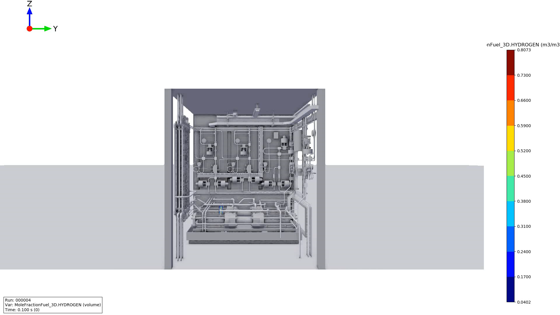
Case 1 – Dispersion Results

Slide 22
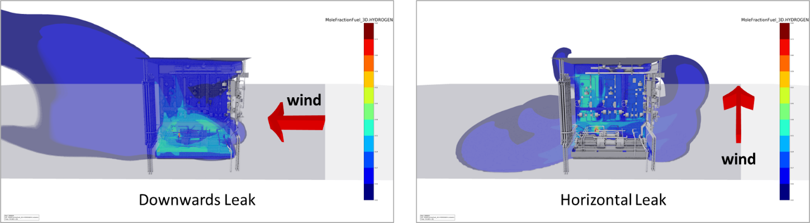
Case 1 – Dispersion Results
30 seconds after leak initiation
Notes:
The figure shows the dispersion contours (between 0.5 LFL and UFL) for the downwards and horizontal leak in the open shelter, just before the leak is stopped (30 seconds). For the vertical leak, a flammable cloud at concentrations between 20-40% fills the bottom third of the shelter, where most of the congestion is located. This is likely to result in high flame acceleration, and thus severe explosion overpressures, if the leak was ignited. The flammable cloud is also carried by the wind outside the container at the lower concentrations (below 20%). For the horizontal leak, high concentrations of hydrogen accumulate at the back wall.

Slide 23
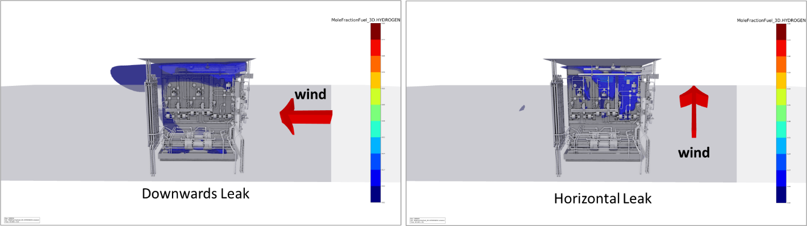
Case 1 – Dispersion Results
40 seconds after leak initiation (10 seconds after leak is stopped)
Notes:
Nevertheless, 10s after the leak is stopped (40s after the start of the leak), the flammable cloud inside the shelter has been diluted below 0.5 LFL and only small pockets of hydrogen remain below the ceiling and close to the back wall (Figure 5).

Slide 24
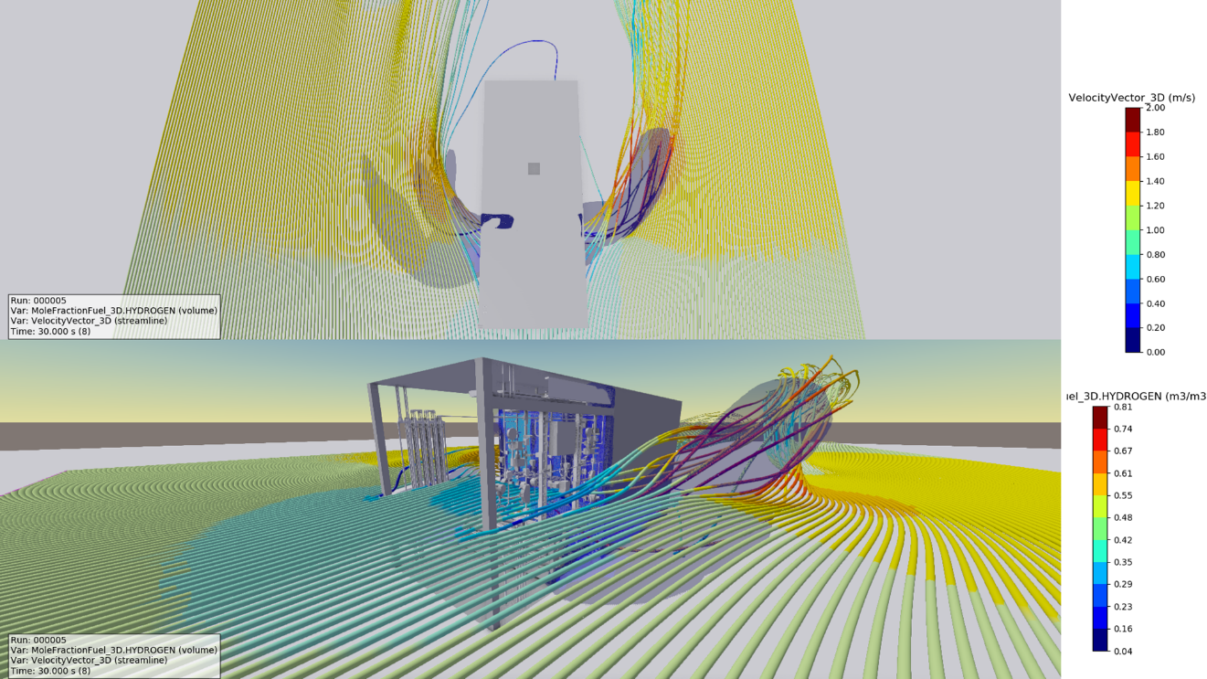
Case 1 – Effect of wind
Notes:
Figure shows how, outside the compressor shelter, the flammable cloud follows the wind; this is contrary to the common belief that hydrogen will just “disperse upwards” due to buoyancy effects. In reality, for concentrations close to LFL, the density of the flammable cloud is very similar to that of ambient air and thus will move along with the wind.

Slide 25
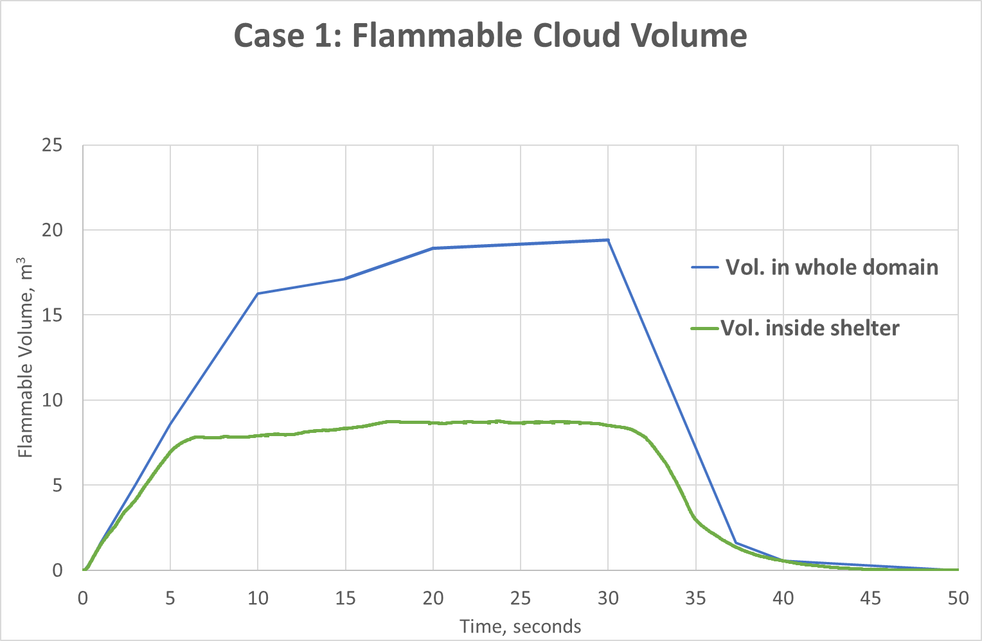
Open Shelter – Flammable Cloud Volume
Notes:
Max volume in domain = 19.4 m3, which is actualy higher than in enclosed cases, as not limited by volume of container.
Max volume in shelter= 8.8 m3, might not seem a big improvement, but let’s look at reactrivity

Slide 26
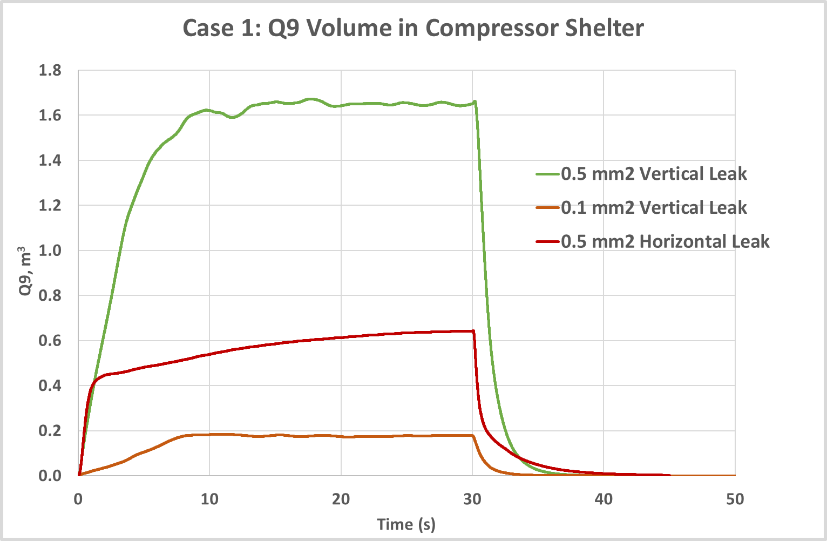
Open Shelter – Cloud Reactivity
Q9: Equivalent cloud at concentration for maximum expansion.
This variable indicates the reactivity level of the cloud.
Notes:
The figure shows the calculated Q9 volume for the open-sided shelter (case 1). For releases from a 0.5mm2 hole, the leak pointing downwards results in an equivalent stoichiometric cloud almost three times larger than the horizontal release. This supports the typically stated assumption that vertically downwards releases close to the ground tend to represent worst-case scenarios as the momentum is rapidly destroyed and the cloud spreads close to the ground before dispersing with the wind.

Slide 27
Results for Compressor in Enclosure

Slide 28
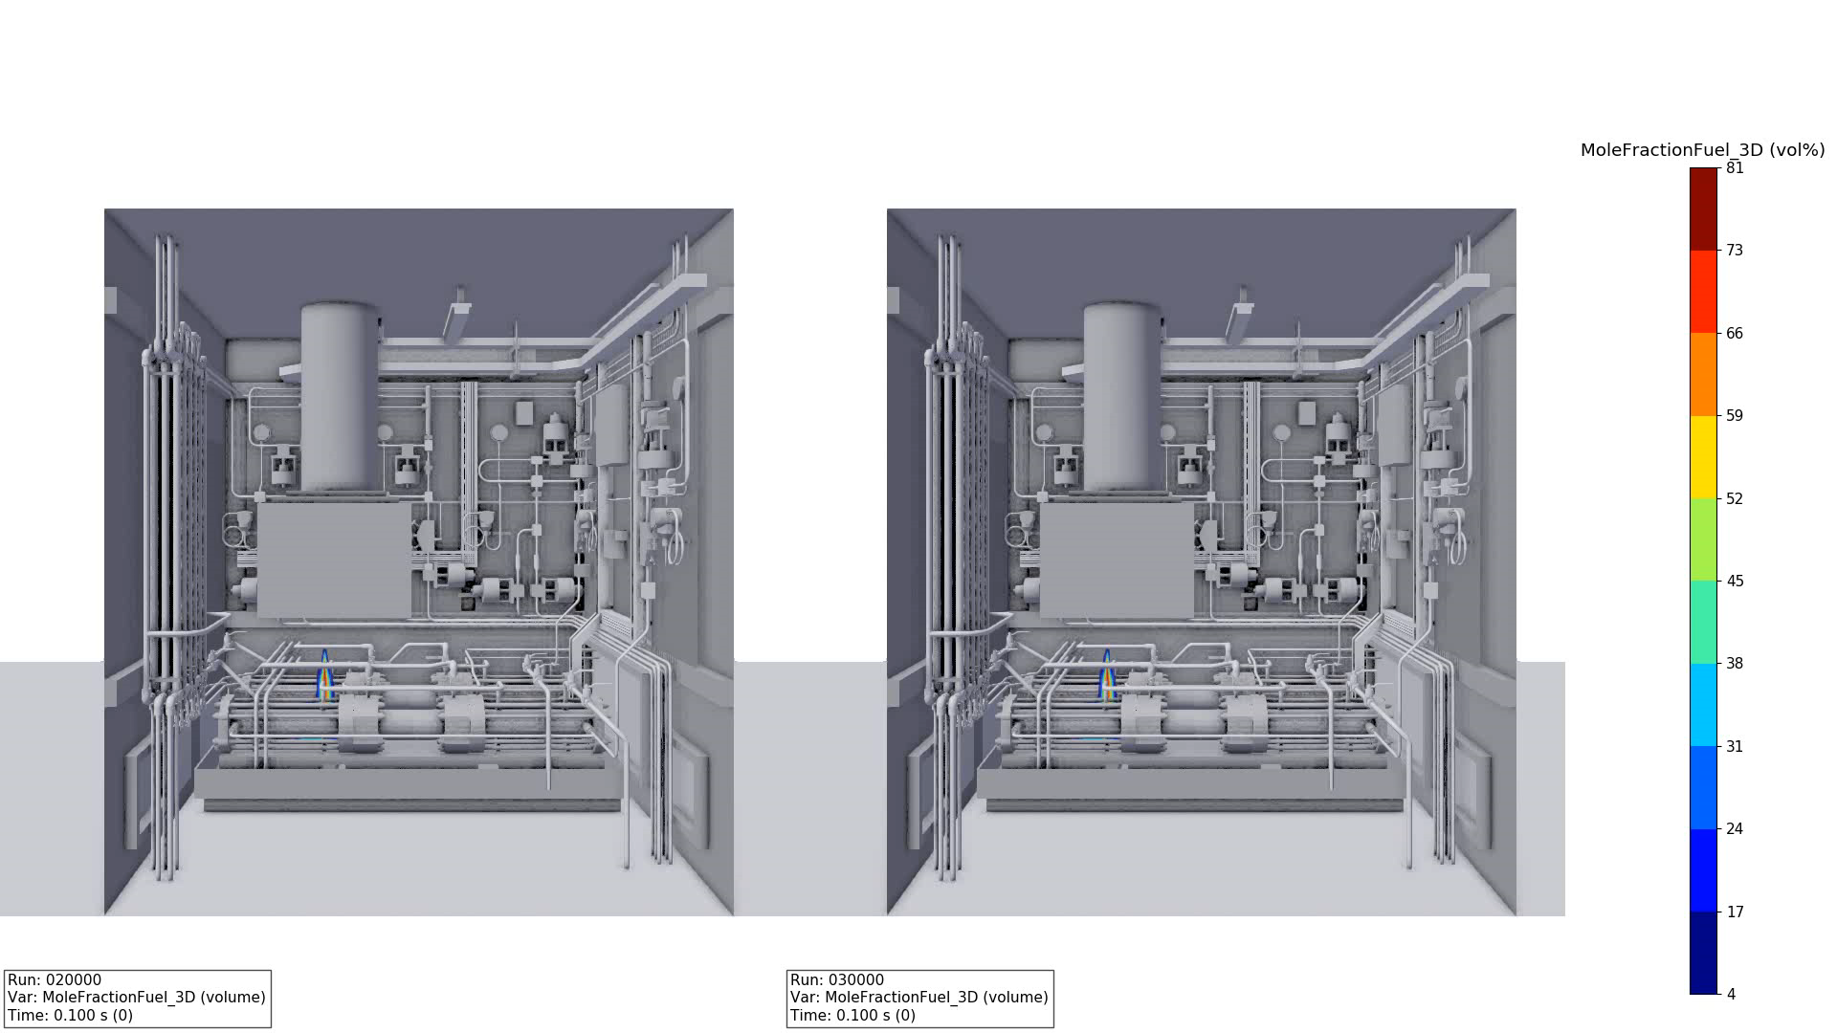
Case 2 & 3 – Dispersion Results Comparison
Vertical Leak
Hood Only
Hood + Fan

Slide 29
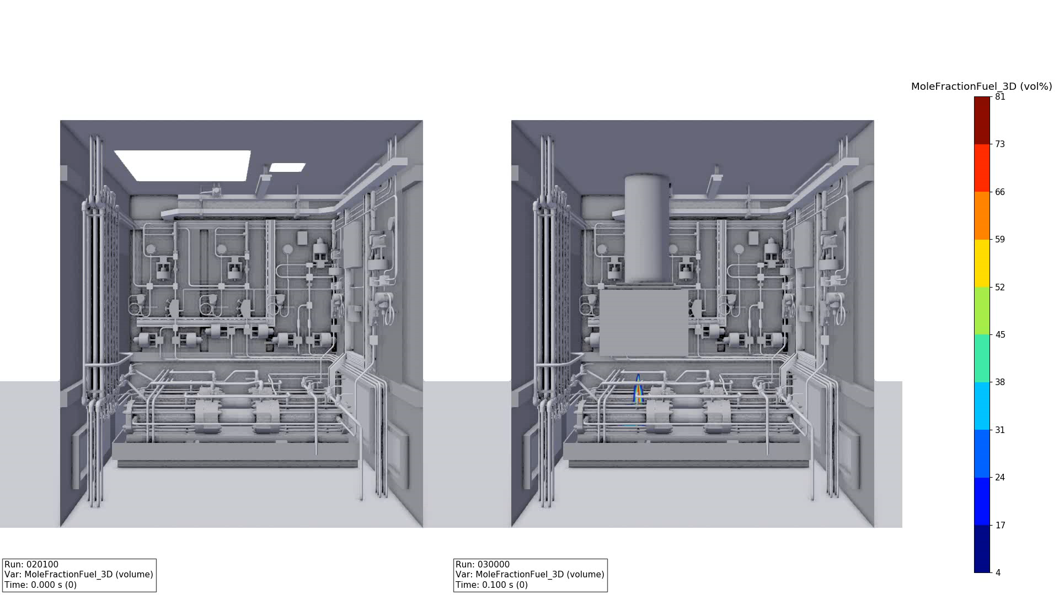
Comparison: Base Case vs Case 3
Base Case: Fan Only
Case 3: Hood + Fan
Notes:
Nevertheless, 10s after the leak is stopped (40s after the start of the leak), the flammable cloud inside the shelter has been diluted below 0.5 LFL and only small pockets of hydrogen remain below the ceiling and close to the back wall (Figure 5).

Slide 30
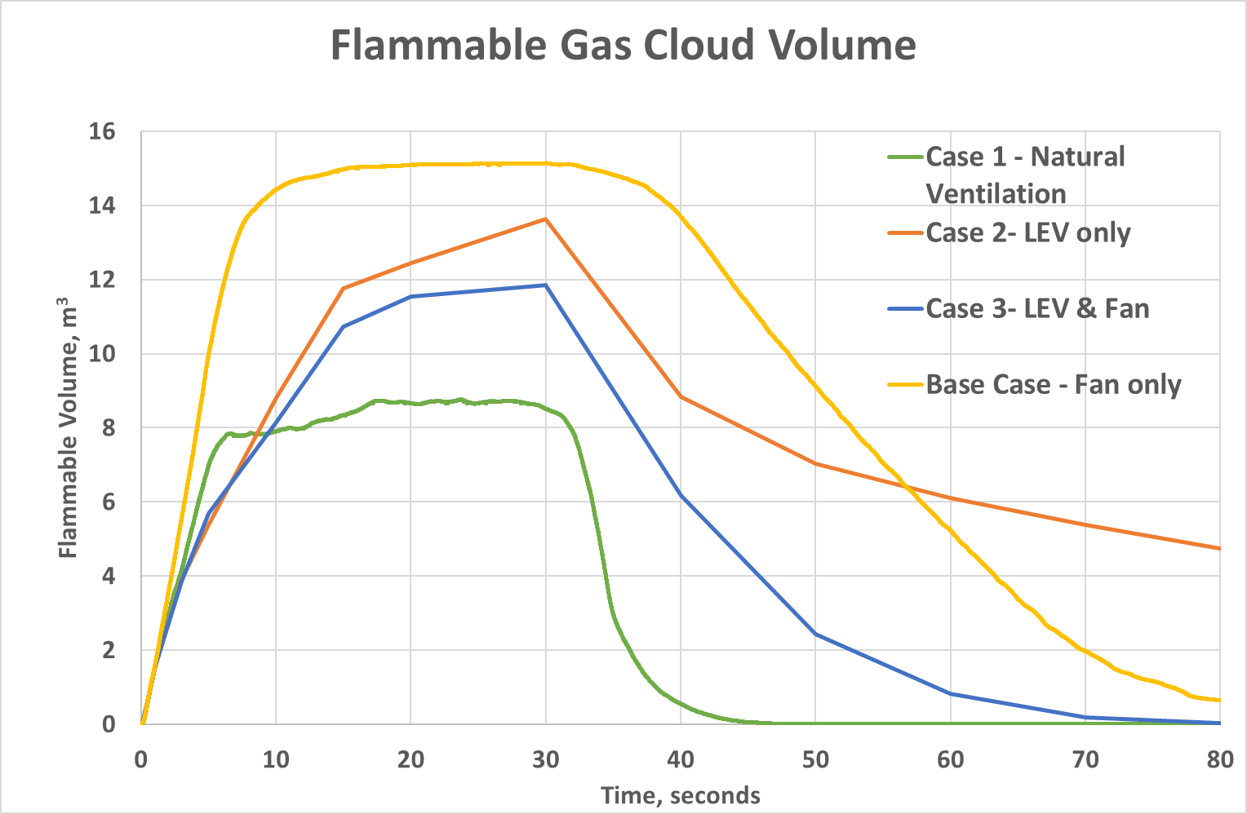
Flammable Gas Cloud Comparison

Slide 31
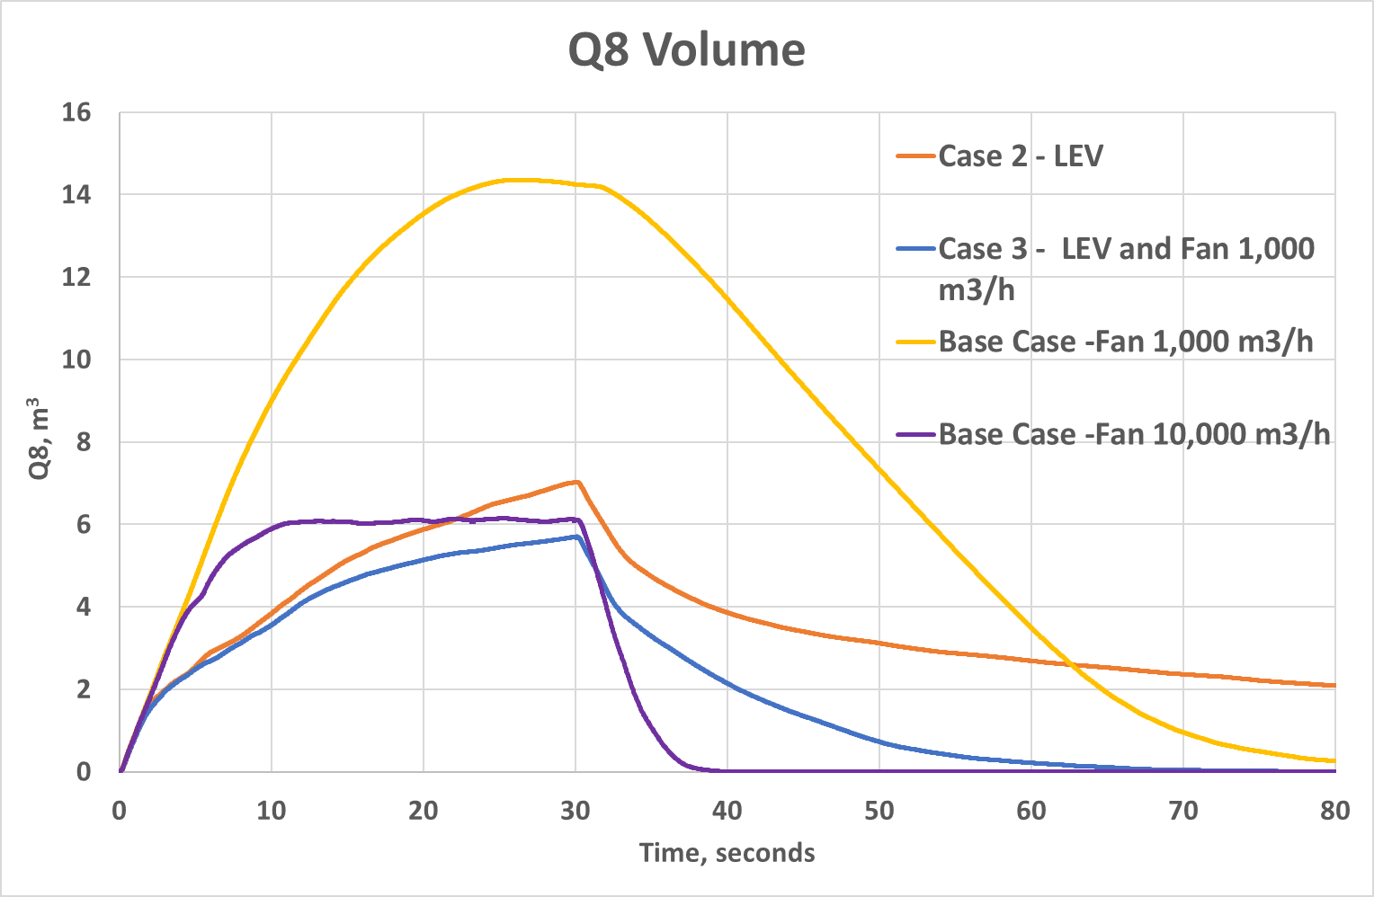
Reactivity Comparison - Stoichiometric Cloud (Q8) Volume
Q8: closed volume equivalent cloud at concentration for maximum expansion.
This variable indicates the reactivity level of the cloud.
Notes:
As before, another factor to consider is the residence time of the cloud. Chart 3 shows that although the combination of LEV and background ventilation is the most efficient at decreasing the reactivity of the cloud, it still takes over 30s after the leak is stopped to completely dilute the Q8 cloud. In this case, the very high extraction rate (10,000 m³/h) studied previously (Connor, J.; et al, 2022) is able to dilute the flammable cloud much quicker than LEV combined with a fan extracting at the lower rate of 1,000 m³/h. The main effect of the extraction hood without background ventilation (case 2) is to limit the reactivity of the cloud, but it is not very effective at diluting the flammable cloud once the leak has stopped.

Slide 32
Conclusions & Recommendations

Slide 33
Conclusions
Natural ventilation in a (semi)-open shelter provides the best means to rapidly disperse a hydrogen gas cloud
In an enclosed container, the best ventilation regime is a combination of LEV above the leak location combined with background ventilation (case 3);
The main effect of the extraction hood is to reduce the reactivity of the flammable cloud.
Rapid detection and shutdown are essential to mitigate the severity of a potential explosion and reduce the time at risk.
  It is not possible to dilute the gas cloud while the leak is ongoing, dilution only starts once the leak is stopped.
It is very difficult to achieve a zone 2 of negligeable extent (Zone 2 NE) and a careful analysis of the effectiveness of ventilation should be performed if this is to be used as a basis of safety.
Notes:
A Detailed Consequence Analysis by means of FLACS-CFD can help assessing the impact of ventilation, dispersion and gas detection on the explosion risks, in order to help review mitigation barriers and allow a built environment design to be strengthened with respect to them. This also assists with demonstrating compliance with DSEAR.
Significant technical safety assessment can be used to determine a suitable level of safety for the installation and support demonstrating that risks have been reduced to a level which can be considered As Low As Reasonably Practicable (ALARP), in line with UK law

Slide 34
Recommendations
Consider placing high pressure hydrogen compressors in the open where possible.
Limited weather protection can be provided by using a roof and a wall to support piping, but sufficient natural ventilation should be available to rapidly dilute a potential leak.
If an open design is not possible (e.g. due to noise constraints) consider the combination of LEV and background ventilation. However, the design of the ventilation system should be optimised in a case-by-case basis.
Rapid detection and shutdown are essential to mitigate the severity of a potential explosion. The location of gas detectors should be assessed to maximise the likelihood of isolating leaks before a hydrogen-air cloud can accumulate.
Notes:
A Detailed Consequence Analysis by means of FLACS-CFD can help assessing the impact of ventilation, dispersion and gas detection on the explosion risks, in order to help review mitigation barriers and allow a built environment design to be strengthened with respect to them. This also assists with demonstrating compliance with DSEAR.
Significant technical safety assessment can be used to determine a suitable level of safety for the installation and support demonstrating that risks have been reduced to a level which can be considered As Low As Reasonably Practicable (ALARP), in line with UK law

Slide 35
Thank you for your attention!!
Karina Almeida Leñero
Hydrogen Safety Technical Lead UK
Karina.Almeida@gexcon.com
Notes:
Potentially take some of Case Study 2 to slim down.

Slide 36
Back-Up Slides

Slide 37
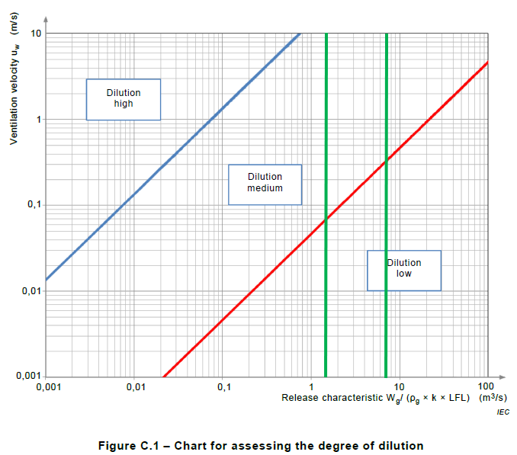
Ventilation Requirements - BS EN 60079-10-1
Pressure: 950 bar & Temperature : 30 °C
Hole size: 0.1 mm²
  Release characteristic : 1.4
Hole size: 0.5 mm²
  Release characteristic : 6.7
Graphs shouldn’t be extrapolated!!

Slide 38
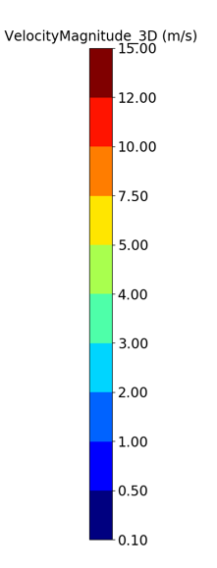
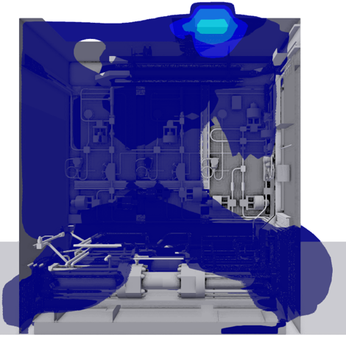
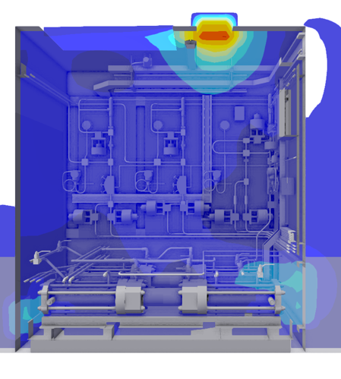
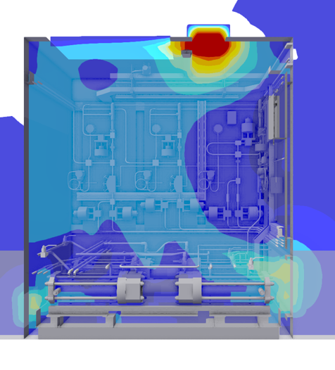
Ventilation Comparison
Original ventilation rate: 1000 m³/h
5x ventilation rate
10x ventilation rate

Slide 39
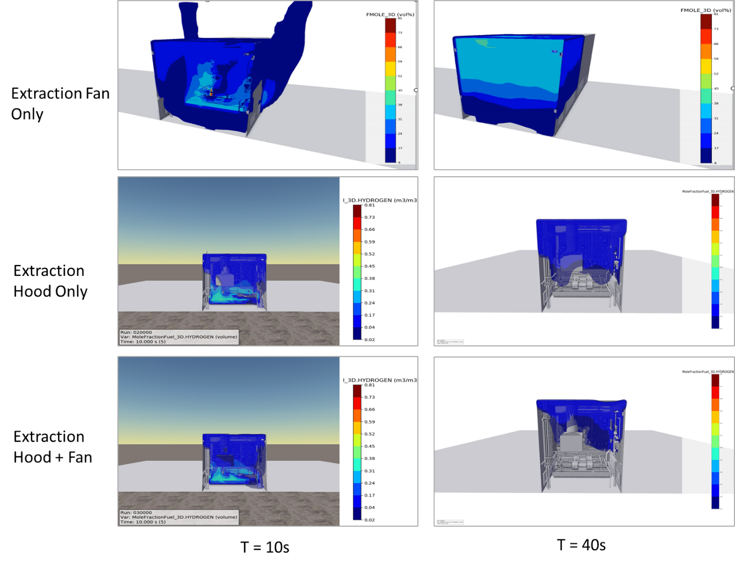
Ventilation Regime Comparison
Notes:
The figure shows the dispersion contours for the three cases studied where the compressor is in an enclosed compressor with mechanical ventilation. It is clear that for all variations studied, the flammable cloud almost completely fills the container only 10 seconds after the start of the leak. As for case 1, concentrations of hydrogen between 20% and 40% are observed around the compressors and associated piping. However, at 40 seconds (10s after the leak stops), the different ventilation regimes show important difference in their ability to dilute the flammable cloud: while with only an extraction fan in the ceiling (base case, 1,000 m³/h) the flammable cloud still fills the container and high concentration of hydrogen are observed in top half of the container, when the same fan is combined with the extraction hood above the leak (case 3), a smaller flammable cloud at concentration below 20% is present in the top third of the container. The extraction hood only (case 2) is able to dilute the cloud below 20% hydrogen, although it still fills most the volume in the container. The ventilation provided by thew combination of extraction hood and fan allows the flammable cloud to be diluted below 50%

Slide 40
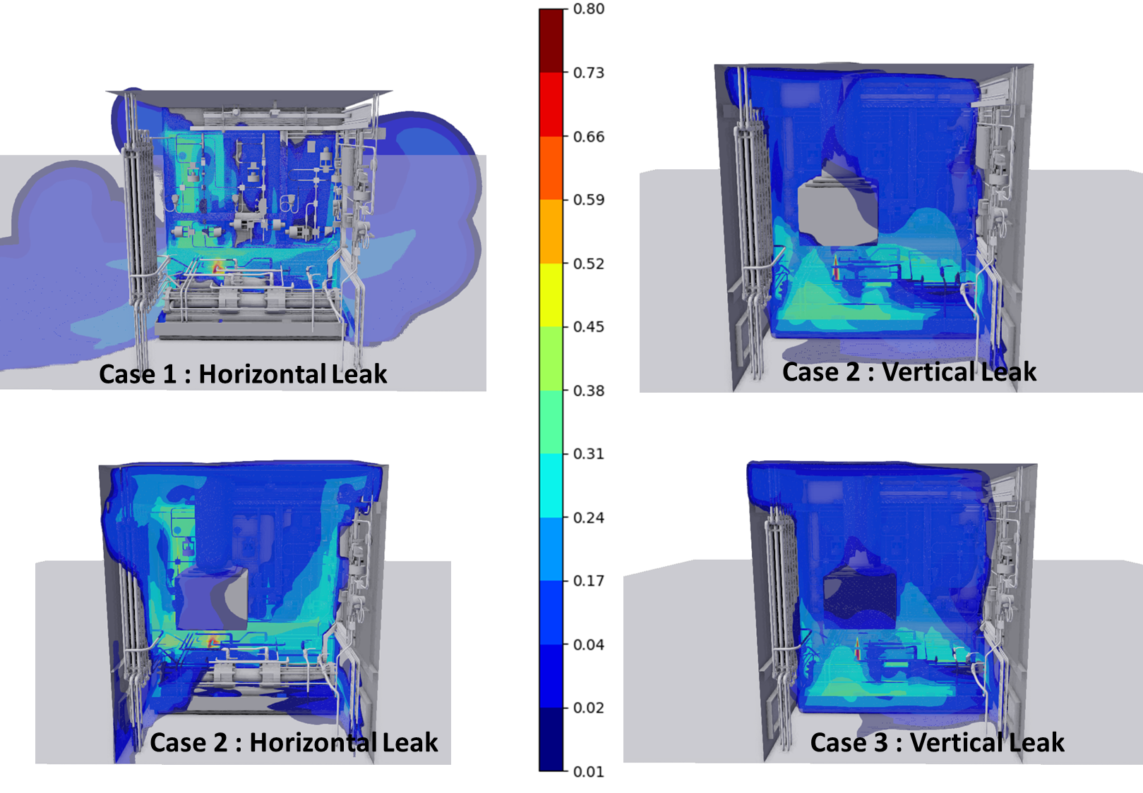
Implications for Leak Detection in Enclosures
Notes:
It is a common practice to set hydrogen detectors at 10% LFL for alarm and 25% LFL for automatic isolation. In principle, thus should allow for isolation of the system before a flammable cloud builds up. One issue is that the gas needs to reach the detectors before any action can be taken, plus the reaction time of the detector varies between a couple to tens of seconds, depending on detection technology. This means that there is a time lag of several seconds between the onset of the leak and detection, on top of the time required for isolation and depressurisation, giving enough time for the formation of potentially hazardous flammable clouds. Figure 8 shows the concentration of hydrogen, between 0.25 LFL and UFL) 5 seconds after the start of the leak for the cases studied. In particular the for the horizontal leaks, flammable cloud containing 1% hydrogen (0.25 LFL) have not reached large areas of the enclosure, while in other areas high concentration of H₂ (20%) are already accumulating. This illustrates the difficulty in placing point gas detectors to ensure rapid leak detection.

