Slide 1
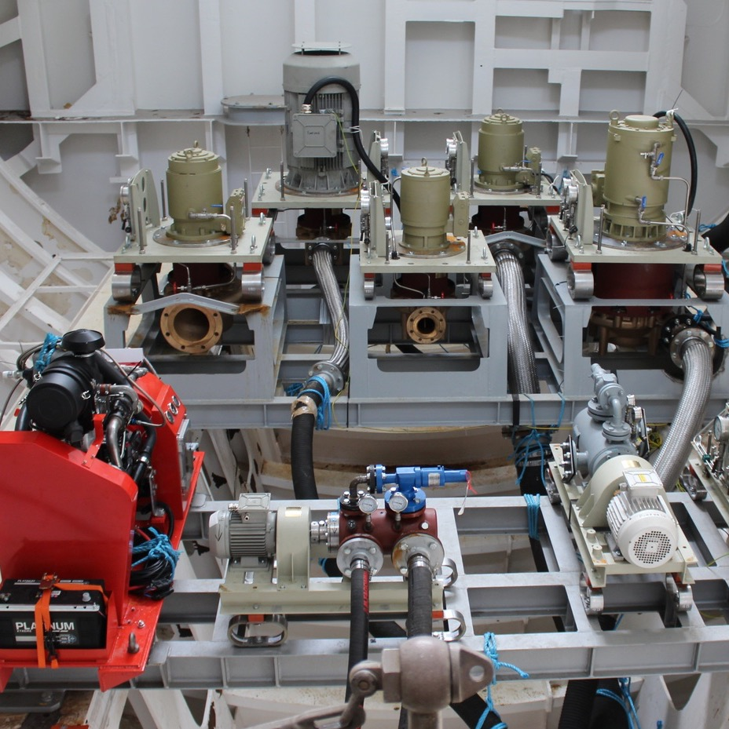
Hazard Assessment of Energy Storage Systems with a Focus on Hydrogen and Hydrogen Derivatives
8 November 2023
John Evans
Hazards 33, Birmingham, UK

Slide 2
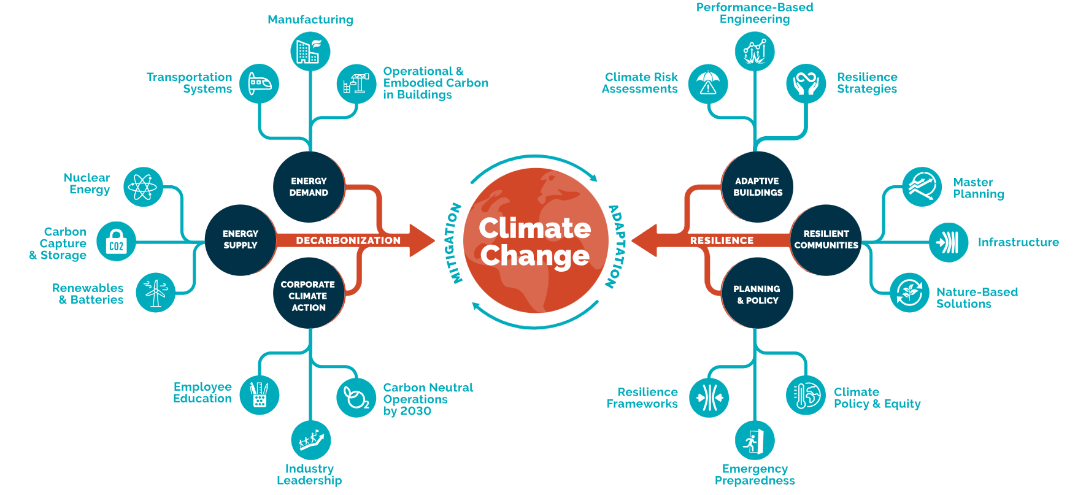
Climate Action
Notes:
Thornton Tomasetti are heavily involved in the Net Zero Agenda and have developed this schematic which shows the different strands of the business that support the climate change agenda.
The diagram looks similar to a bow-tie diagram with the left had side focussing on the issues and control mechanisms, so energy demand and supply and the drive to decarbonisation. On the right had side is resiliance or the response to the changing climate.

Slide 3
Climate Action

Slide 4
introduction
Decarbonisation = “to stop or reduce carbon gases, especially carbon dioxide, being released into the atmosphere as the result of a process, for example the burning of fossil fuels”
Renewable Energy
  Wind
  Solar
  Hydro
Intermittent
∴ Energy Storage Required
Notes:
Definition from Cambridge Dictionary 2023
Moving away from fossil fuels requires renewable energy which can be intermittent - therefore need an energy storage system

Slide 5
Energy storage
Superconducting magnets
Supercapacitors
Electrical storage systems
Mechanical storage systems
Electrochemical storage systems
Thermal storage systems
Low carbon fuels
Pumped hydroelectric
Compressed air
Buoyancy energy
Gravitational energy
Flywheels
Battery storage
Flow battery storage
Sand batteries
Molten salt batteries
Pumped thermal storage
Liquid air storage
Hydrogen
Hydrogen derivatives
Notes:
We have not included nuclear power as it generates energy rather than just stores it, and it is highly regulated

Slide 6
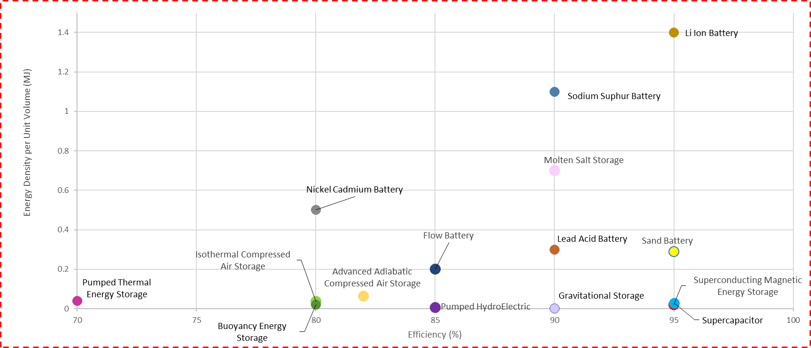
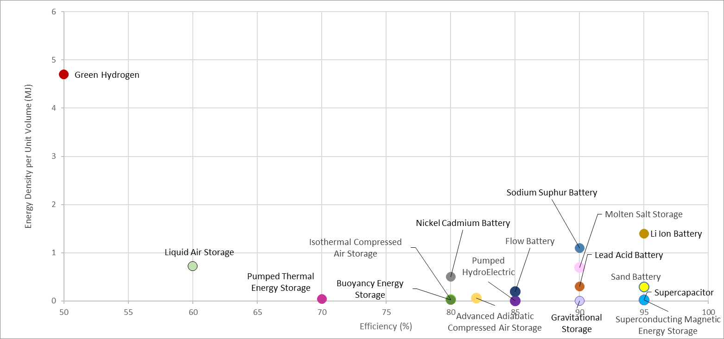
Energy Storage
Notes:
Efficiency of conversion vs energy per unit density

Slide 7
Energy Storage
Major Accident Hazard = “a potential source of danger which, in the event of an incident could cause severe harm to a large number of people”
Notes:
From HSE Guidance document: Large-scale temporary outdoor events near to major accident hazards
Oil & Gas industry use five for more persons

Slide 8
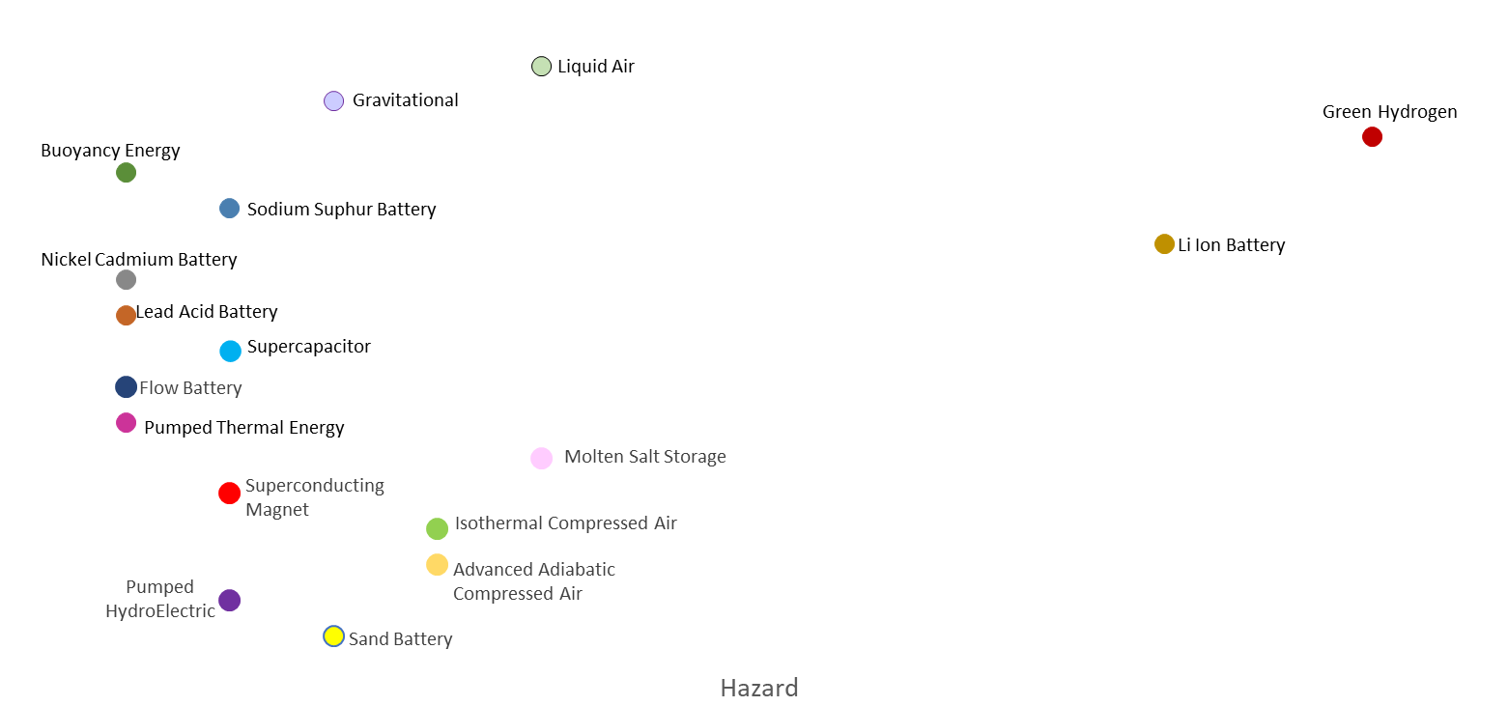
Energy Storage
Major Accident Hazard = “a potential source of danger which, in the event of an incident could cause severe harm to a large number of people”

Slide 9
Energy Storage
Major Accident Hazard = “a potential source of danger which, in the event of an incident could cause severe harm to a large number of people”
Notes:
The only energy storage system considered that can be used to transport energy from place to place is hydrogen.

Slide 10
Hydrogen
 | Production Means
Green Hydrogen | Production by renewable energy sources to electrolyse water | Acidic (PEM)
Blue |  | Alkali (AEL)
 |  | Solid Oxide (SOEC)
Blue Hydrogen | Production from fossil fuel using steam methane reformers with carbon capture and storage
Grey Hydrogen | Produced from natural gas using steam methane reformers without carbon capture
Black or Brown Hydrogen | Produced from coal using steam methane reformers without carbon capture
Turquiose Hydrogen | Production by the thermal splitting of methane; methane pyrolysis
Purple Hydrogen | Production by nuclear power and heat through combined chemo thermal electrolysis splitting of water
Pink Hydrogen | Production by nuclear energy to electrolyse water
Red hydrogen | Produced from nuclear power via high temperature catalytic splitting of water
Yellow hydrogen | Production by solar power to electrolyse water
White hydrogen | Naturally occurring

Slide 11
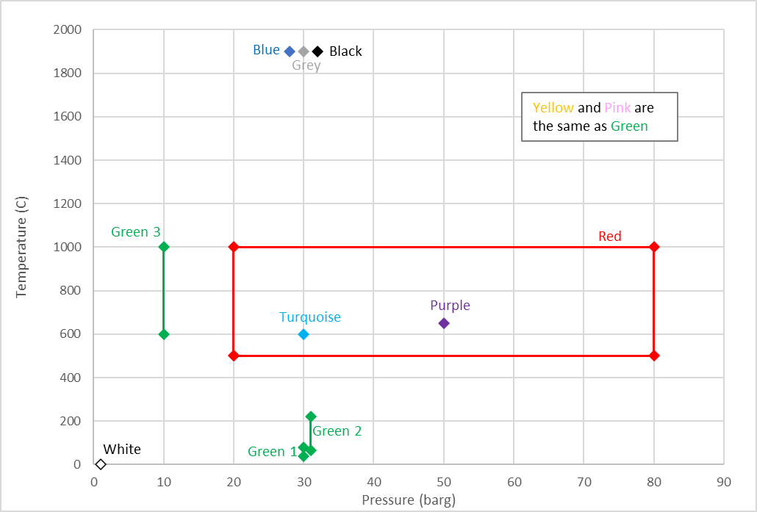
Hydrogen
Notes:
Green – electrolysis of water
Yellow – solar power to electrolyse water
Pink – nuclear energy to electrolyse water
Red - nuclear power via high temperature catalytic splitting of water

Slide 12
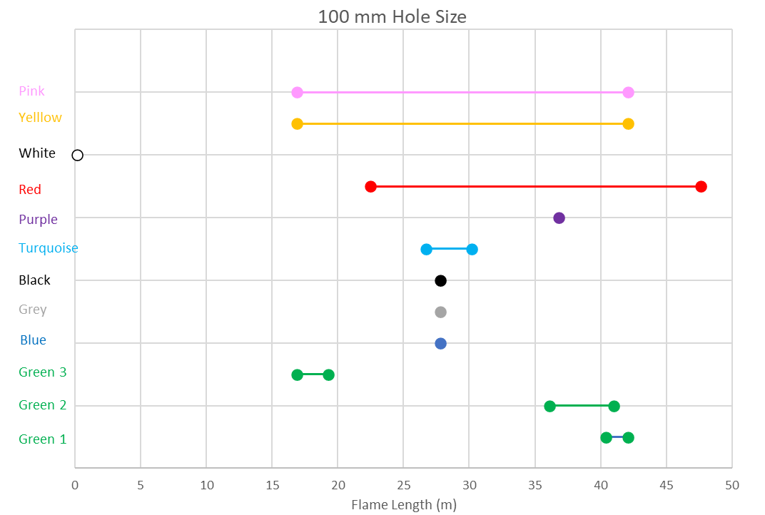
Hydrogen Production
Notes:
Modelled for 100mm steady state release
Durations likely to be small as small inventories

Slide 13
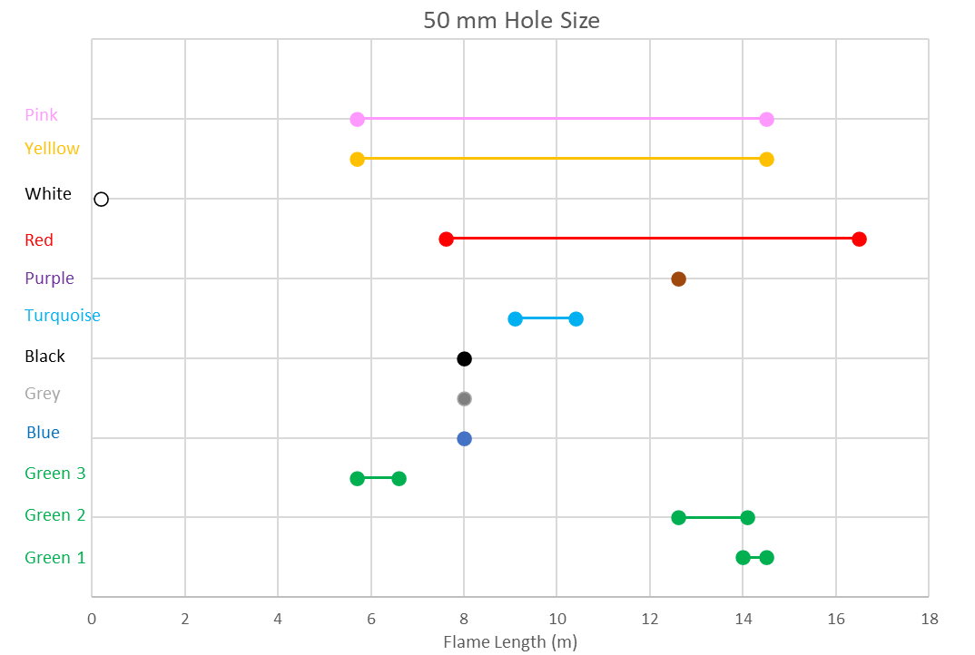
Hydrogen Production

Slide 14
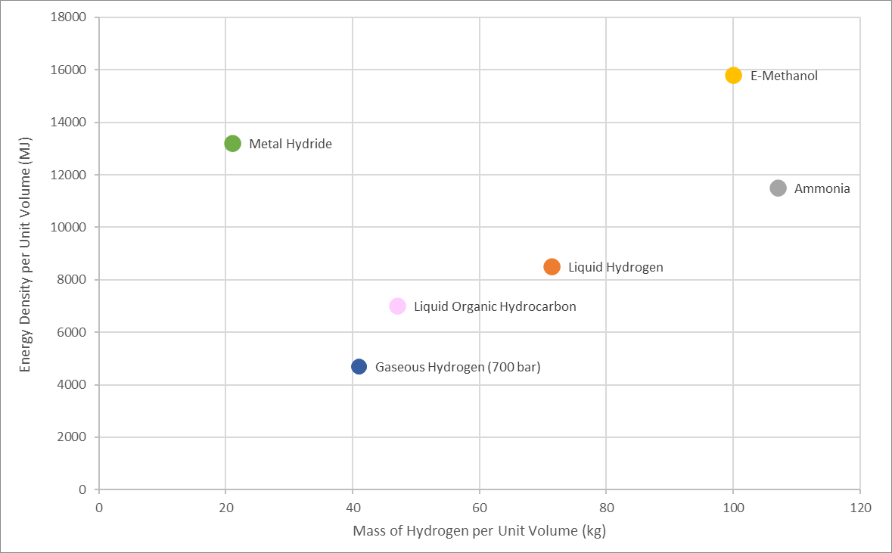
Hydrogen Storage and Transport Options

Slide 15
Hydrogen Transport Options
Storage System |  | Road | Rail | Pipeline | Ship (bulk storage)
Gaseous Hydrogen | Gas | Y | Y | Y | N
Liquid Hydrogen | Liquid | Y | Y | N | Y
Ammonia | Liquid | Y | Y | Y | Y
Methanol | Liquid | Y | Y | Y | Y
Liquid Organic Hydrocarbon | Liquid carrier | Y | Y | N | Y
Metal Hydride | Solid carrier | Y | Y | N | N

Slide 16
Hydrogen Derivative Production
Ammonia via the Haber-Bosch process: hydrogen at 500 C and 200 barg
Methanol via synthesis with CO2: hydrogen at 250 C and 100 barg
LOHC via hydrogenation: hydrogen at 200 C and 50 barg
Notes:
Ammonia made by synthesis – N2 and energy, cracking to convert to H2 needs ‘cleaning’
Methonal made by synthesis – CO2, energy and catalyst, methanol reformer to convert needs steam
LOHC – hydrogenation plant, dehydrogenation needs catalyst and system to ‘clean’ H2

Slide 17
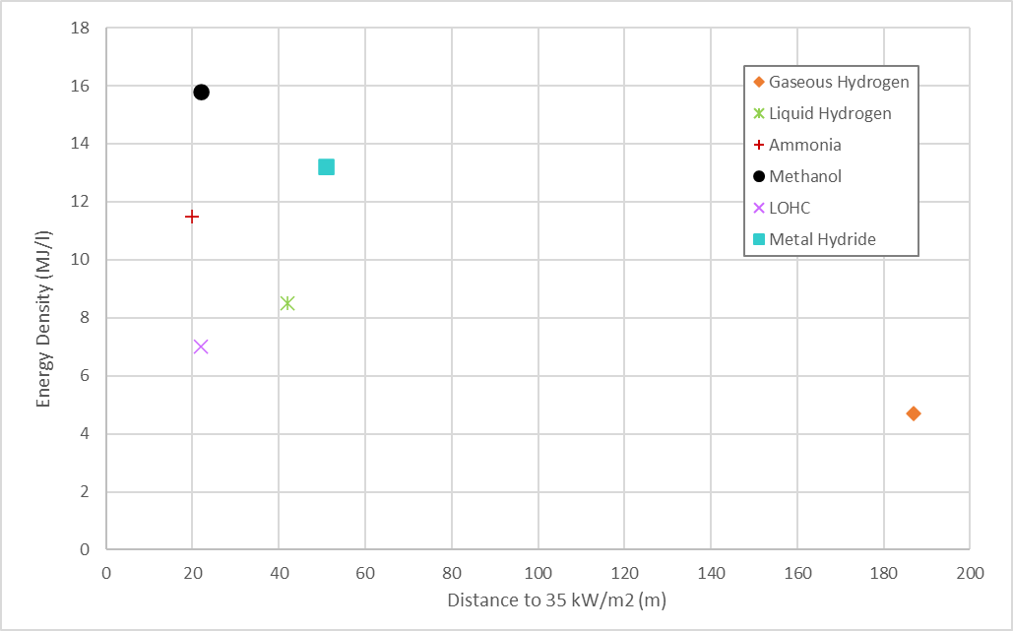
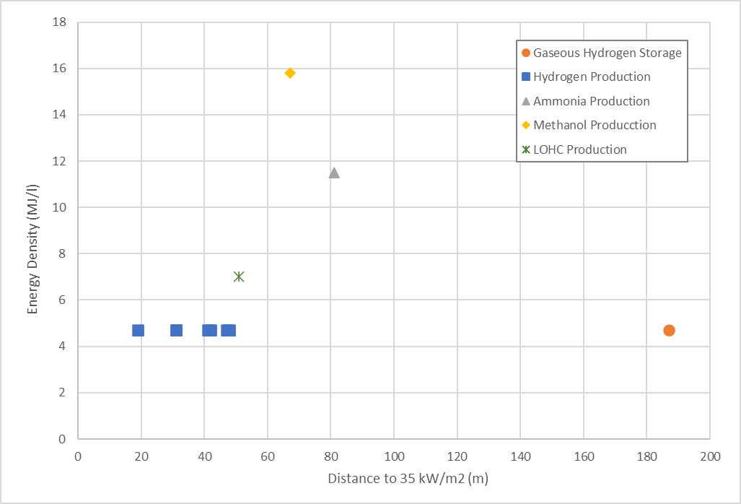
Hydrogen production and storage

Slide 18
Hydrogen Production and Storage

Slide 19
Site Selection
Energy Requirements
Production
Storage
Export
Destination
Energy Requirements
Infrastructure
Infrastructure
Requirement for Energy Generation
Accessibility
Infrastructure
Feedstock
Infrastructure
Mass Stored
Hazard Assessment

Slide 20
Summary
Energy Storage Requirement
Transport
Energy Production Requirement
Notes:
Holistic view required when considering what to use excess energy to produce including storage requirement, transport requirement and point of use.

Slide 21
Thank you
ThorntonTomasetti.com

