Slide 1
Lessons Learned from Hydrogen System Integration
Graham Morrison and Karina Almeida Leñero

Slide 2
Thanks
Thanks to Gexcon for supporting me to write this paper and present at Hazards
Thanks to Karina as co-author
Also particular thanks to Derek Cross from the Gexcon Perth (Australia) office for his valuable comments and feedback

Slide 3
Agenda
Expertise in H2
About Gexcon
“The issue at hand”
Main Issues
Key Learnings and Takeaways
All images from Google Image Search – nothing confidential here…
Care has been taken not to identify individual projects or clients

Slide 4


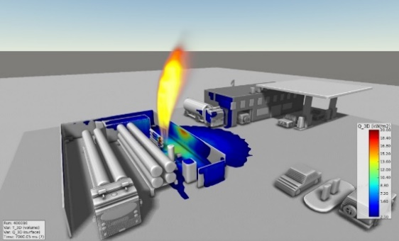

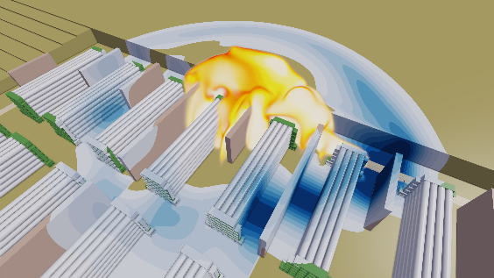
Expertise in Hydrogen Safety
Gexcon has a wealth of experience on various H₂ related projects
Process safety and safety reviews
Assistance for conceptual phase : safety distances, arrangement/ layout optimization
Regulation and ATEX compliance
Optimization of ventilation and gas detection
Modeling of accidental events : dispersion, explosion and fire
Prevention and Mitigation measures, design of structures
Incident Investigation
PRODUCTION
STORAGE
TRANSPORT
DISTRIBUTION
MOBILITY

Slide 5





Our Products & Services
CONSULTING
SOFTWARE
ACADEMY
FIRE & EXPLOSION TESTING
INCIDENT INVESTIGATION
Process hazard analysis
Safety and risk management
Consequence modelling
Regulatory compliance
Reliability and availability
Structural response
Expert training
FLACS-CFD
EFFECTS
RISKCURVES
Shell-FRED
Shell-Shepherd
Shell-PIPA
FLACS-CFD Training
FLACS-EFFECTS & FLACS-RISKCURVES Training
Shell FRED & Shell Shepherd Training
Process Safety Management Course
Explosion Hazards Course
Gas Explosion Properties Testing
Dust Explosion Properties Testing
Jet-Fire Testing
PFP Testing
Blast Testing
R&D Testing
ATEX/ DSEAR/ Equipment Testing
Coordinating the investigation
Conducting root cause analysis
Providing recommendations
Implementing strategies to prevent further incidents occurring
Acting as expert witnesses in on-going investigations
Notes:
Loads of experience in Biomass and Battery Storage

Slide 6
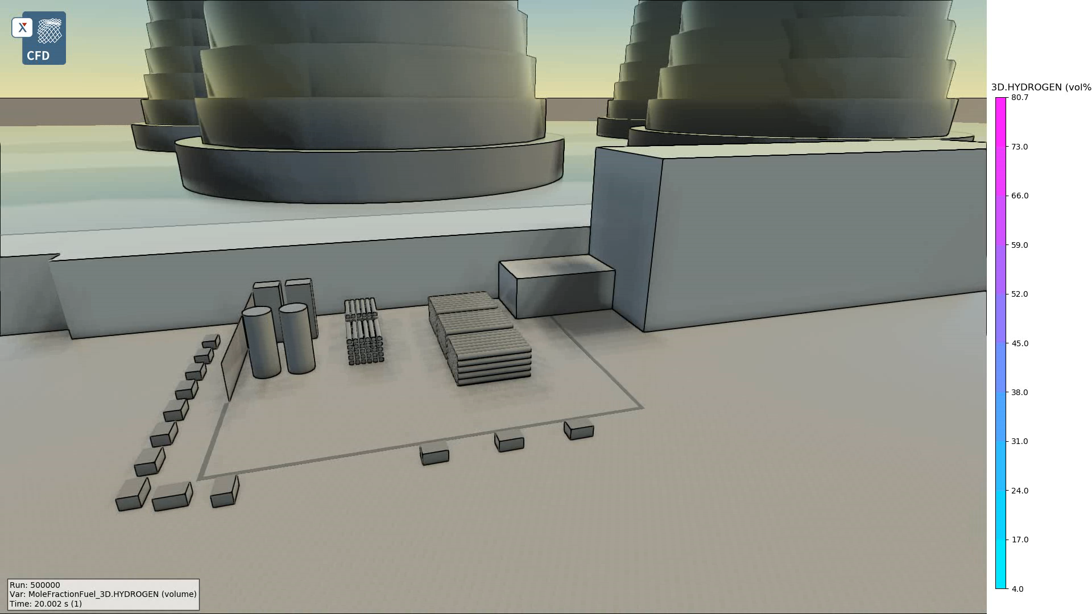
Example H₂ Release modelling
Notes:
Video shows areas of higher conc (pink colour) close to storage banks
As it loses momentum, cloud disperses and is diluted, leading to lower conc (blue colour)
Ran steady state condition
For this case, inventory available was quite high with one release location. Reviewed the release rate with time and release duration. Simulations indicated that steady state conditions were reached quite quickly with fairly significant release duration. Therefore in this case, modelled one release rate (steady state rate), not pressure decay. But this would be feasible if relevant

Slide 7
Distributed Hydrogen Systems
What lessons have we learnt?
Gexcon has been working on distributed hydrogen systems for a number of years
  With more every month!
We come across the same observations time and time again:
  Nature of businesses
  Scale of developments
  Business models for delivery
Hopefully we can relate some key learnings for process safety professionals!
Gexcon’s history and values – Knowledge sharing!

Slide 8
What are we actually doing?
Hydrogen System Development
Increasingly conducting safety studies for new hydrogen facilities around the world:
  Concept siting studies
  Quantitative risk assessments
  CFD modelling (key strength!)
Primarily: a large volume of PHA (Process Hazard Assessments)
  HAZID
  HAZOP
  LOPA etc.
A range of common issues have been identified:
  Often the first proper process safety engagement in the project.
  Frequently the first time that a third-party (i.e., safety consultant) is involved in the project

Slide 9
Who are we doing it for?
Companies who already operate major hazards facilities
  Large integrated developments
  Embedded Process Safety culture
Entrants from other renewable sectors (e.g., wind, solar) who are intending to use excess renewable energy generated on their sites (particularly remote sites) to generate hydrogen
  Differences between Process and Occupational Safety
  Understanding of hydrogen hazards
  However: take safety seriously
New entrants, without any experience of the major hazards industry who do not have experience in process safety.
  Small distributed facilities
  Aggressive timelines
  “Interesting” business models/funding mechanisms
  Lack of embedded Process Safety expertise

Slide 10
Typical Distributed Hydrogen Systems
What do they look like?
O₂ and water
H₂ compression
H₂ storage
H₂ and water - purification & drying
Electrolyser
Transport to end user:
Pipeline
Tube trailer
Liquefaction
HRS
Water and Power Supply

Slide 11
Process Safety in Projects
Smaller entrants are typically designing facilities that are below the Control of Major Accident Hazards Regulations, COMAH (Health and Safety Executive, 2015) threshold for hydrogen (5 te)
  Requirement for process safety consideration is driven by other regulation or by planning considerations,
  Does not always give a clear requirement for PHA studies
  e.g., DSEAR/ATEX (or Health and Safety at Work Act) does not specify or mandate any specific process study
  No clear requirement to consider facility siting either (also below 2 te Hazardous Substances Consent)
Process safety input can come very late in the development process

Slide 12
What is a PHA?
Assume Hazards attendees will know!!
Structured workshop approach to hazard identification/process safety assessments
As is well known to most process safety practitioners:
  PHA process has its roots in a methodology developed by ICI in the 1970s, and published in the book “A guide to Hazard and Operability Studies” (ICI 1977) and various others such as ICI’s Process HSE Guides (ICI Technology, 1997).
  Studies termed HS1 (Hazard Study 1 – concept HAZID), HS2 (Hazard Study 2) and so on. Hazard Study 3 being the HAZOP.
In the Oil & Gas/Petrochemical industries, HS1 etc terminology is less common
  Studies referred to descriptively (Concept HAZID, HAZOP etc)
  Similar intent
However for all of these studies, various industry-specific guides are available, along with reference documents from different companies, and consultant’s internal guidance.

Slide 13
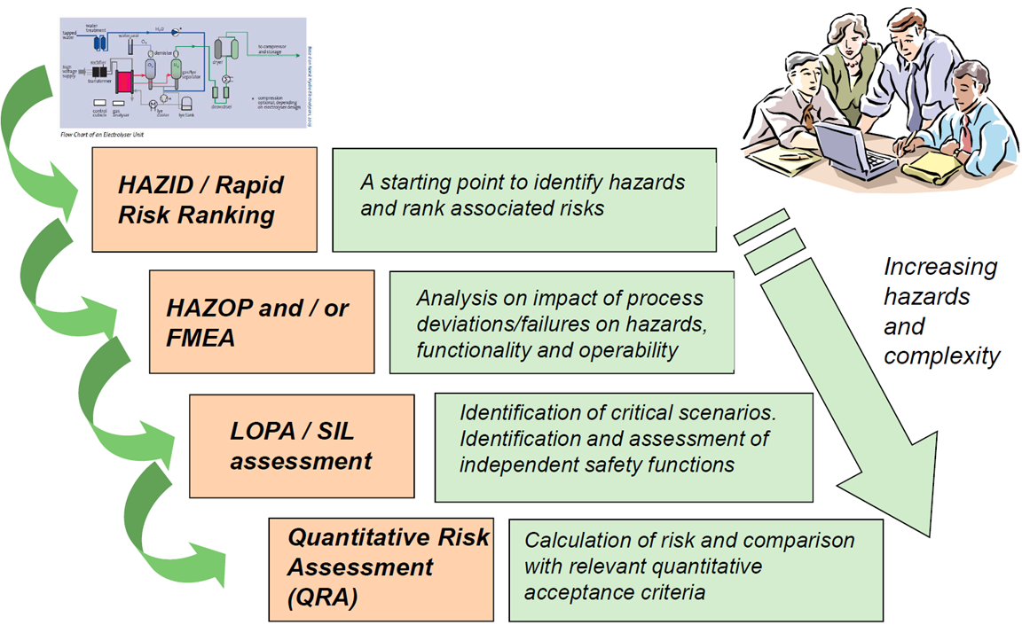
Design processes
Typical engineering stage-gate for process/major projects
  Concept, pre-FEED, FEED, Detailed Design etc.
  Usually means Process Safety is considered
Architectural design e.g., RIBA Plan of Work (UK) – 8 stages
  Quite common for distributed H₂ applications where it will be co-sited (w/ eg warehouse, factory)
  Process Safety is not explicitly included (although general H&S is)
  See later slides…

Slide 14
Funding and Timescales
A dichotomy…
Government or grant funded
“lumpy” funding – not aligned with typical engineering design processes
Uncertain
Competitive application process
Private equity funded
Resource-light organisations
Delivery-focussed
Highly aggressive timescales

Slide 15
Key Issues

Slide 16
Awareness and Competence
Typical process safety design principles:
  Resource light organisations – in house competence?
  Experience with hazardous materials?
Integration requirements
  Awareness – off-the-shelf equipment needs to be integrated!
High speed of development and non-typical design processes
  Reference previous discussion on funding

Slide 17
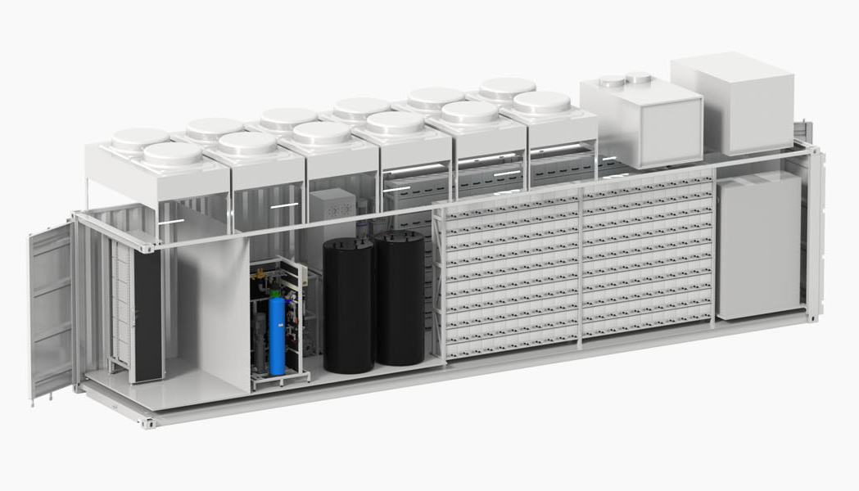
Series-Produced Equipment
Different philosophies:
  Control philosophy
  Trips and isolations
  Emergency depressurisation - location and timing
Variations in P&IDs between systems
  Hard to workshop/assess – easy to miss things
Can be an “integration nightmare”
  Especially if the procuring company is trying to integrate and doesn’t have the expertise…

Slide 18
Information Sharing
High levels of secrecy and NDAs
  Difficult to share learnings from project to project – even within a project
  Even when near misses or failures have occurred…
Lack of engagement
  Suppliers’ workshop attendance…
  No time!
  No point!
  Not in the contract!
Obviously this is very negative – most suppliers are happy to be involved
Notes:
e.g., membrane failures

Slide 19
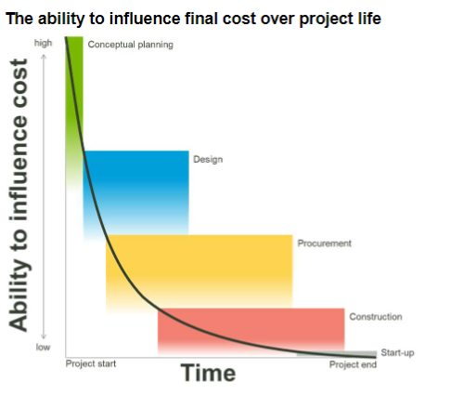
Conclusions
Best case – costly redesign and project delays
Worst case – ???
However – most engineers want to do the right thing
  Process Safety Education and Competence
  Awareness
  Engagement
Wideman, 2001 cost-influence curve
Notes:
They just need to know what the right thing is…

Slide 20
What can we take away?

Slide 21
Key Learnings
For Projects…
All parties in a project need to be aware of:
  Particular challenges associated with handling hydrogen
  Expectations of safety engineering design with respect to hydrogen
  Timelines
  Lifecycle
Operational and safety integration of the packages needs to be considered EARLY
  Requires an open dialogue among vendors regarding system functionality and the client requirements.
One specific action:
  A “process design review” involving all vendors and the final operator should be performed early: ahead of the HAZID or HAZOP.
  This is often entirely missed in small scale hydrogen projects!

Slide 22
Key Learnings
…and what can we do?
Do not assume that all parties in a new development are familiar
  With process safety design principles
  With Hydrogen
When working in traditional hazardous industries we often assume most parties understand “why we do what we do” – but this may not always be the case.
Advise
  Be prepared to share knowledge
  Tender/contract specifications on their suppliers
  Conduct an early stage process design review. If the HAZOP is the first time they are being raised, that is too late.
Be flexible. Process safety professionals can be quite exacting…
  Better to proceed with imperfect information than not to proceed at all!
  This can give the impression that process safety is difficult, expensive, or inconvenient

Slide 23
Thanks for your attention
Graham Morrison
Graham.Morrison@Gexcon.com

