Slide 1
Artificial Intelligence in Safety
The Future or a Recipe for Disaster?

Slide 2
What does AI think?
Artificial intelligence (AI) in process safety has the potential to be both the future and a recipe for disaster.
If implemented correctly, with thorough validation, continuous monitoring, and clear boundaries, AI can significantly improve process safety by predicting and preventing incidents.
However, if deployed without proper safeguards, it can introduce unforeseen vulnerabilities and risks.
The outcome depends on the approach to integration, understanding, and management of the technology.

Slide 3
Introduction
Craig Paterson MSc BEng AMIChemE
Process Safety Engineer at Salus Technical

Slide 4
Salus Technical – What we do
Engineering
Process Safety engineering support, workshop facilitation and general UK Offshore Safety Regulations support
Training
Bespoke Process Safety training courses and videos
Software
Suite of cloud-based Process Safety software products related to bowtie diagrams and human factors

Slide 5
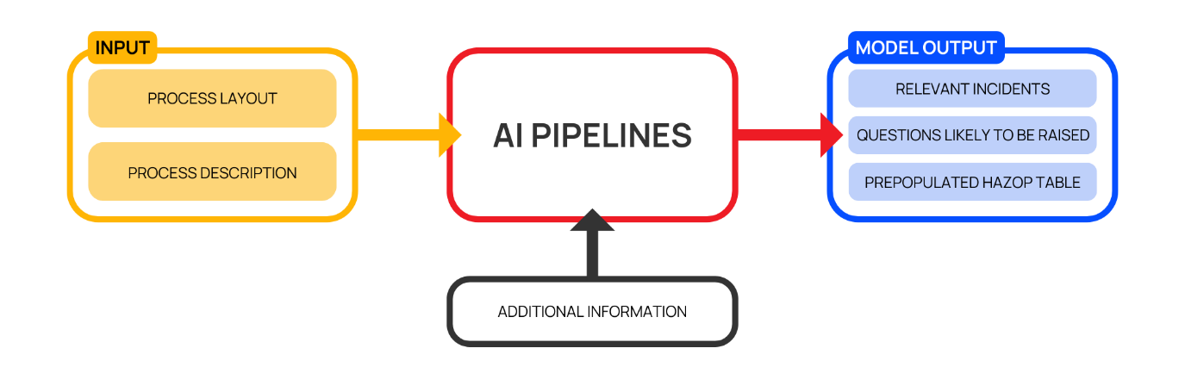
An AI HAZOP copilot demo

Slide 6
Agenda
Motivation behind the work
A discussion on Large Language Models
Case study on HAZOP.AI
Conclusions

Slide 7
A Case Study on GitHub Copilot
Assists developers in writing computer code
In a study users completed their task 55% faster using GitHub copilot.
What if we could unlock similar improvements?

Slide 8
Hazard & Operability Studies
The HAZOP process
The challenges of HAZOP
Automated HAZOP?
What does the future look like?

Slide 9
HAZOP Challenges
Time
Resourcing
Preparation & follow-up
Participants

Slide 10
Integrating AI into HAZOPs
Could solve some of these challenges
But it may exacerbate others
Or even introduce new challenges
Enhancement over replacement

Slide 11
Large Language Models
What are Large Language Models (LLMs)?
LLMs are rapidly developing
The limitations and known issues of LLMs
Applying LLMs to the real world

Slide 12
Overcoming the limitations of LLMs
Prompt engineering methods
Writing clear and concise instructions
Giving the model ‘Time-to-think’
Utilising a methodology for improvement

Slide 13
Giving the model time to think

Slide 14
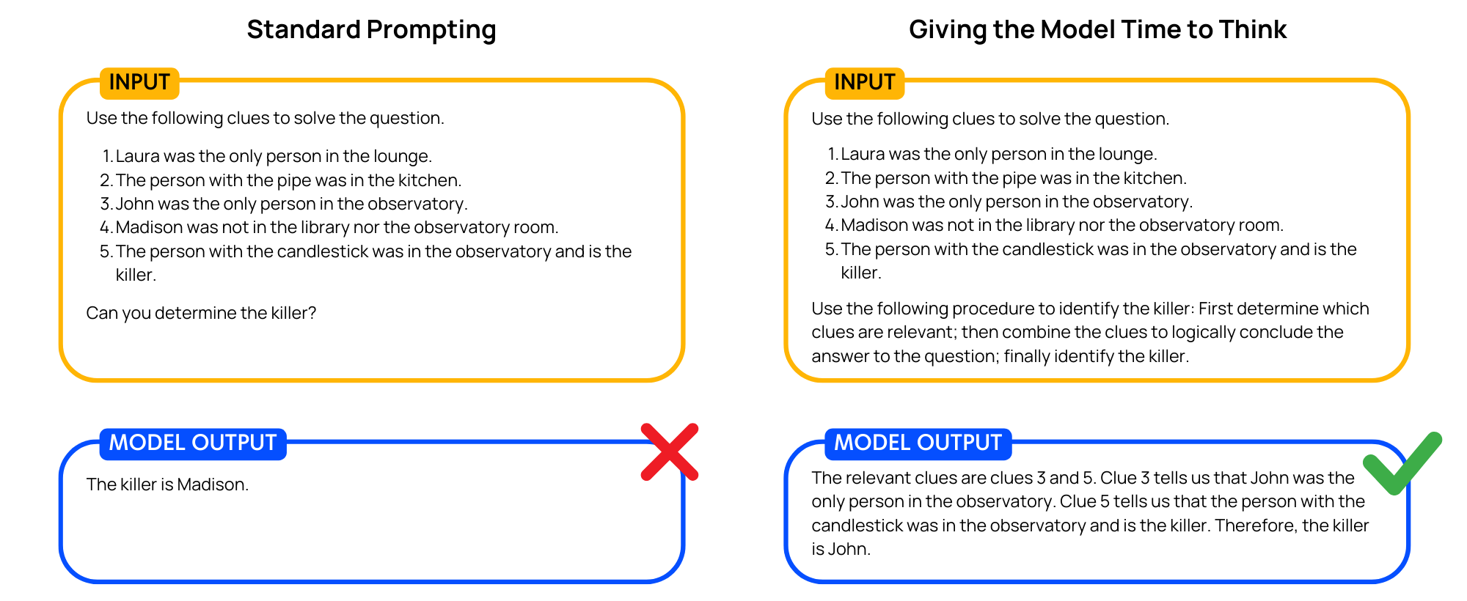
Giving the model time to think

Slide 15
Prompt engineering
Further techniques
Defining a methodology for improvement
And many more
Combining methods for powerful prompting
Disadvantages of prompt engineering
Recent improvements in LLMs

Slide 16
AI in Process Safety
Please write a haiku about HAZOPs.
Risks in processes, HAZOP seeks, understands, Safety in design.
Goal: Augmentation of risk assessments over automation
LLMs on their own cannot fully automate the process

Slide 17
HAZOP.AI Case Study

Slide 18
HAZOP.AI initial testing
Issues in testing:
Causes that were not credible e.g., debris and ice
Failure to understand components
Hallucinated additional equipment that wasn’t there

Slide 19
Methodology
Prompt engineering methods:
Writing clear and concise instructions
Giving the model ‘time to think’
Defining a methodology to for improvement
We encountered hallucinations about components
Component information database

Slide 20
Relevant incidents
Reliance on participant memory.
Database of incidents.
This pipeline described a related incident and then gave two questions to consider.
A database does not forget.

Slide 21
Questions likely to be raised
Questions and context
The questions assist with preparation
Stimulate discussion & build momentum

Slide 22
HAZOP table pre-population
This was by far the most complex pipeline that we built and involved multiple aspects.
Meaningful understanding of the inputs.
Deviation first approach?
Following a cause to its ultimate consequence.

Slide 23
Limitations and issues
P&ID input
Quality of inputs
Database limitations
Node size

Slide 24
Conclusions
So, is AI in Process Safety the future or a recipe for disaster?
The future of HAZOP.AI
Consider the extent AI is used
Our goal should not be to replace the human element but to augment it

Slide 25
Thanks for listening
Contact: info@salus-technical.com

