Slide 1
Development of a Safety Culture Model and Measure for Great Britain’s Nuclear Industry
Office for Nuclear Regulation
Nick Shaw, Principal Nuclear Safety Inspector
Alliance Manchester Business School
Professor Sharon Clarke, Professor David Holman,
Dr David Hughes, and Dr Lina Siegl

Slide 2
Challenges for Great Britain’s Nuclear Industry
Existing safety culture models and measures
Low validity of nuclear specific measures based on IAEA model (de Castro et al., 2013; Martinez-Corcoles, 2023)
Generalisability across life cycle, sites and facilities
Applicability of general measures of safety culture
Implications
Confidence in decision making
Notes:
A review of the existing measures of safety culture for the nuclear industry revealed a lack of strong validity, meaning that they may not accurately measure what they say they measure and may not predict important safety outcomes well.
It was also not clear whether they are generalisable across the diverse lifecycles, sites and facilities which make up Great Britain’s (GB’s) nuclear industry.
Cannot make effective decisions if the measurement of safety culture is not accurate: flawed measures lead to flawed policy
Given the overriding priority of safety within the nuclear industry and the importance of regular safety culture assessments, it is important to address this issue.
ONR addressed this challenge by commissioning a team from Alliance Manchester Business School comprising of Professor Sharon Clarke, Professor David Holman, Dr David Hughes and Lina Siegl, to undertake this research, working collaboratively with the industry, to develop a model and measure of safety culture.

Slide 3
Comparison to Existing Measures
There is insufficient systematic development practices and validity testing in:
General scale development (Hughes, 2018) and social science papers (Falke et al., 2020)
The nuclear safety culture field (Diaz –Carbera & Isla-Diaz, 2009; Marrow et al., 2014; de Castro et al., 2017; Goncalves Filho & Waterson, 2018; Fleming et al., 2018)
The IAEA’s safety culture model (de Castro et al., 2013; Martinez-Corcoles, 2023)
The AA Model of Scale Evaluation (Hughes, 2018)
Accuracy | %
Content representation | 55%
Response process | 0%
Factor structure | 90%
Invariance | 35%
Convergent | 75%
Appropriateness
Prediction | 10% - 60%
Incremental prediction | 20%
Known groups | 10%
Fairness | 0%
Feasibility | 0%
Notes:
The data analysis confirmed that NISCI exceeded all accepted criteria
We followed best practice when it comes measure development, and that most measures are not developed so systematically

Slide 4
Model and Measure Development
Nuclear Industry Safety Culture Inventory (NISCI) model
Literature review
Ten interviews with academics and industry experts
Development of an initial six-dimensional model
Item development
15 item development interviews
14 ‘Think Aloud Protocols’ interviews
Data collection
Initial survey: 8 nuclear organisations (n=952)
Second survey: 15 nuclear licensees (of GB’s 17) (n=3480)
Data analysis
Validity of the structure of NISCI
Predictive validity of NISCI

Slide 5
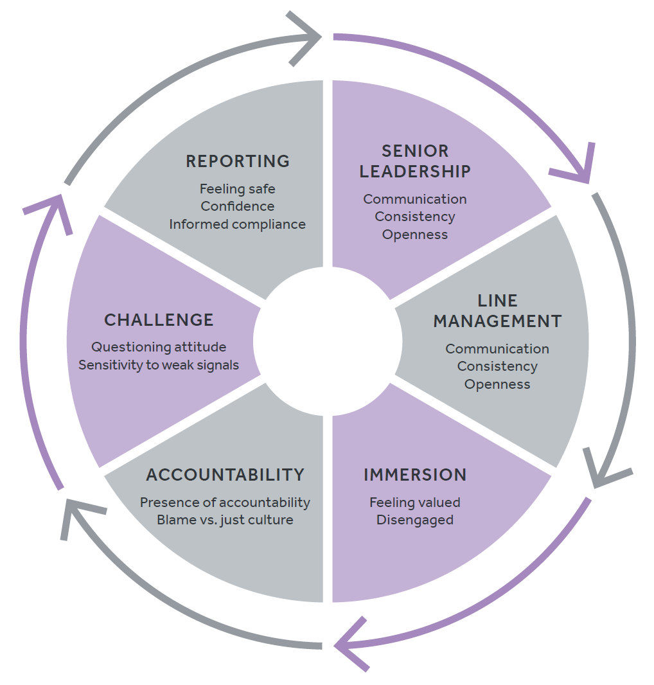
Safety Culture Model
Versions:
60 item scale (4 items per subdimension)
30 item scale (2 items per subdimension)
15 item scale (1 item per subdimension)
Each dimension can also be measured individually, so there are an additional six survey tools available.

Slide 6
Dimension 1: Senior Leadership
Senior leader communication | The extent to which individuals perceive that senior leaders communicate the importance of safety in a clear, consistent, frequent manner.
Senior leader consistency | The extent to which individuals perceive the behaviour of senior leaders as consistent with their messaging.
Senior leader openness | The extent to which individuals perceive that senior leaders are open to workers’ feedback and ideas regarding safety.
Notes:
Strong safety leadership is of the upmost importance to an organisation’s safety culture. Senior leadership consists of three dimensions, which describe the main leadership attributes that shape safety culture in nuclear organisations. These are communication, consistency and openness.
Senior leader communication: This dimension not only considers whether communication takes place but also how it takes place (e.g., are leaders visible and do they talk to workers in a way that upholds safety standards).
Senior leader consistency: This is also referred to as ‘walking the talk’ and ‘practicing what they preach’ when it comes to safety.
Senior leader openness: This includes elements that foster opportunities to provide feedback (e.g., encouragement) and the reaction to such feedback/ideas (e.g., actions taken).

Slide 7
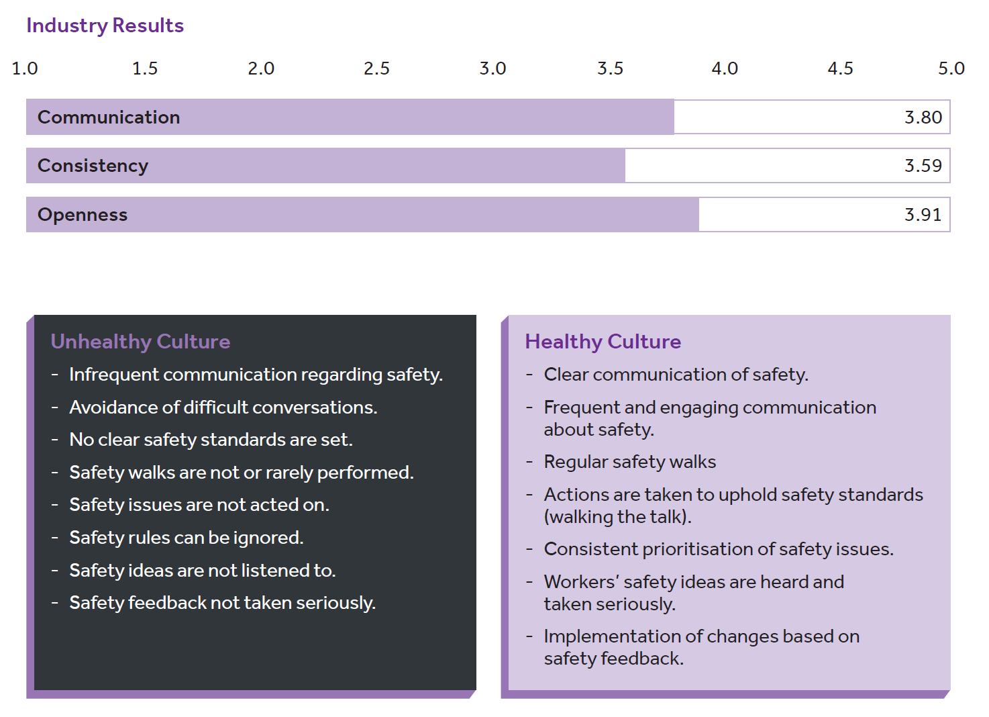

Slide 8
Dimension 2: Line Management
Line manager communication | The extent to which individuals perceive their line manager to communicate the importance of safety in a frequent, clear, and engaging manner.
Line manager consistency | The extent to which individuals perceive the behaviour of line managers as consistent with their messaging and whether line managers uphold the safety standards discussed by senior leaders.
Line manager openness | The extent to which individuals perceive that line managers are open to, create opportunities for, and take seriously, workers’ safety ideas and feedback.
Notes:
Line managers play an important role in workers’ daily experiences. The main attributes that shape safety culture from a line management perspective are the same as those for senior leaders, communication, consistency, and openness. However, they are manifest through different actions. Workers often perceive senior and line managers very differently and it is important to differentiate between managerial levels.
Line manager communication: This dimension not only considers whether communication takes place but also how it takes place (e.g., engaging in difficult conversations to uphold safety standards, proactively check-in with workers to regarding safety).
Line manager consistency:
Line manager openness:

Slide 9
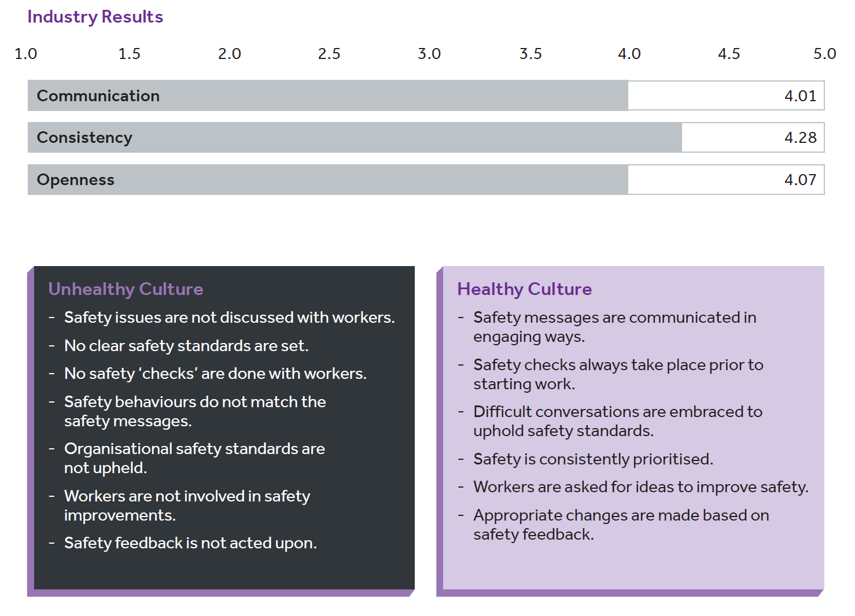

Slide 10
Dimension 3: Immersion
Valued feeling | The extent to which individuals feel respected, trusted, and valued within the organisation. This includes whether the organisation recognises and rewards individual efforts and good safety behaviours.
Disengaged | The extent to which individuals feel detached and withdrawn from the safety culture.
Notes:
Immersion is an emotional component of safety culture that comprises of two sub dimensions: ‘feeling valued’ and ‘disengaged’, with regard to safety and general performance. The degree to which employees feel immersed within the organisation is a crucial component that influences safety culture in the nuclear sector.
Valued: This includes whether the organisation recognises and rewards individual efforts and good safety behaviours.
Disengaged: This comprises whether workers are switched-off and see safety like a tick-box exercise rather than an overarching priority that they actively contribute to.

Slide 11
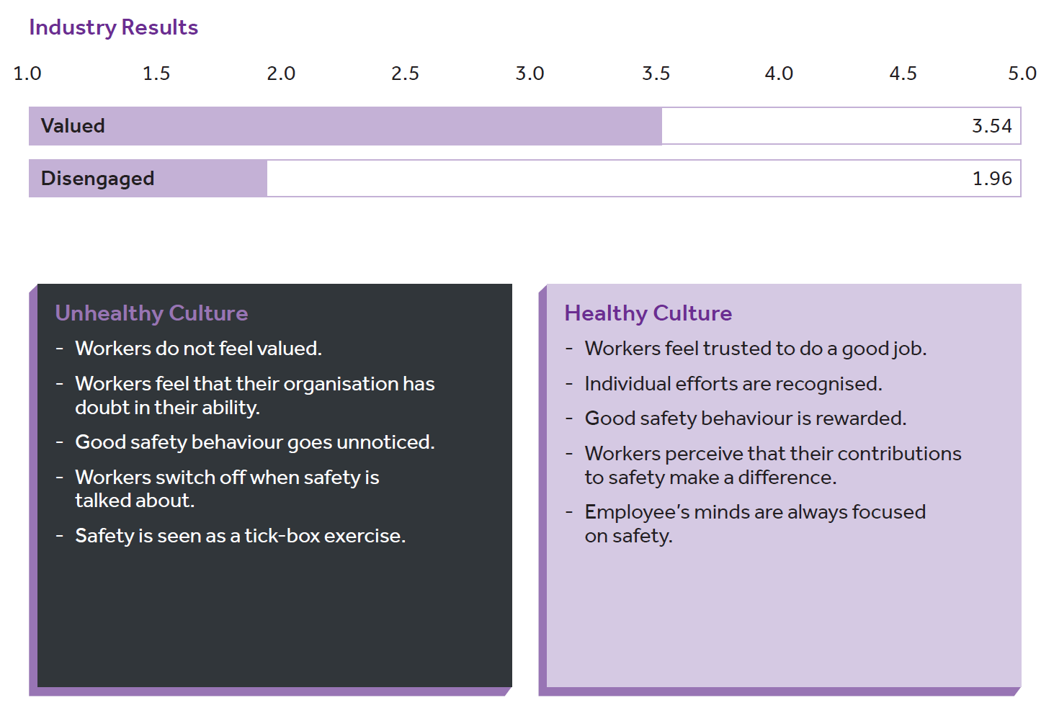

Slide 12
Dimension 4: Accountability
Presence of accountability | The extent to which individuals are held accountable for their actions regarding safety.
Blame v’s just culture | The extent to which individuals are held to account in a fair way, without undue blame, adopting a learning approach to accountability.
Notes:
In the nuclear sector, it is of upmost important that individuals are accountable for their safety behaviours. Accountability has two sub-domains that describe common forms of accountability: ‘presence of accountability’ and there is a ‘blame vs. just’ culture.
Presence of accountability: This requires appropriate action when poor safety behaviours are displayed and is applicable to people at all levels of the organisation.

Slide 13
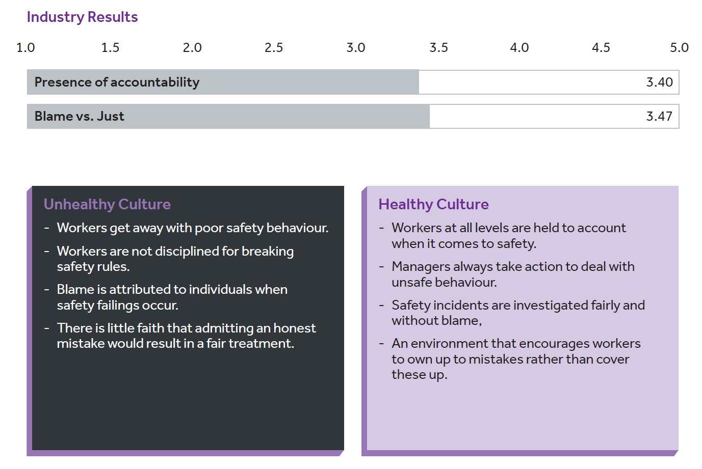

Slide 14
Dimension 5: Challenge
Questioning attitude | The extent to which individuals are comfortable challenging safety policies, procedures, behaviours and norms, even if the challenge impacts productivity or questions senior leader actions.
Sensitivity to weak signals | The extent to which individuals remain vigilant for minor issues that may be warning signs or precursors of something more significant.
Notes:
A crucial component of safety culture in the nuclear industry is to recognise and challenge behaviours and assumptions that could adversely impact safety immediately or in the future. Due to the high standards of safety within this sector, accidents or disasters occur rarely. However, remaining vigilant to spot and communicate warning signs early remains essential. Challenge culture includes two sub-dimensions: “questioning attitude” and a “sensitivity to weak signals”

Slide 15
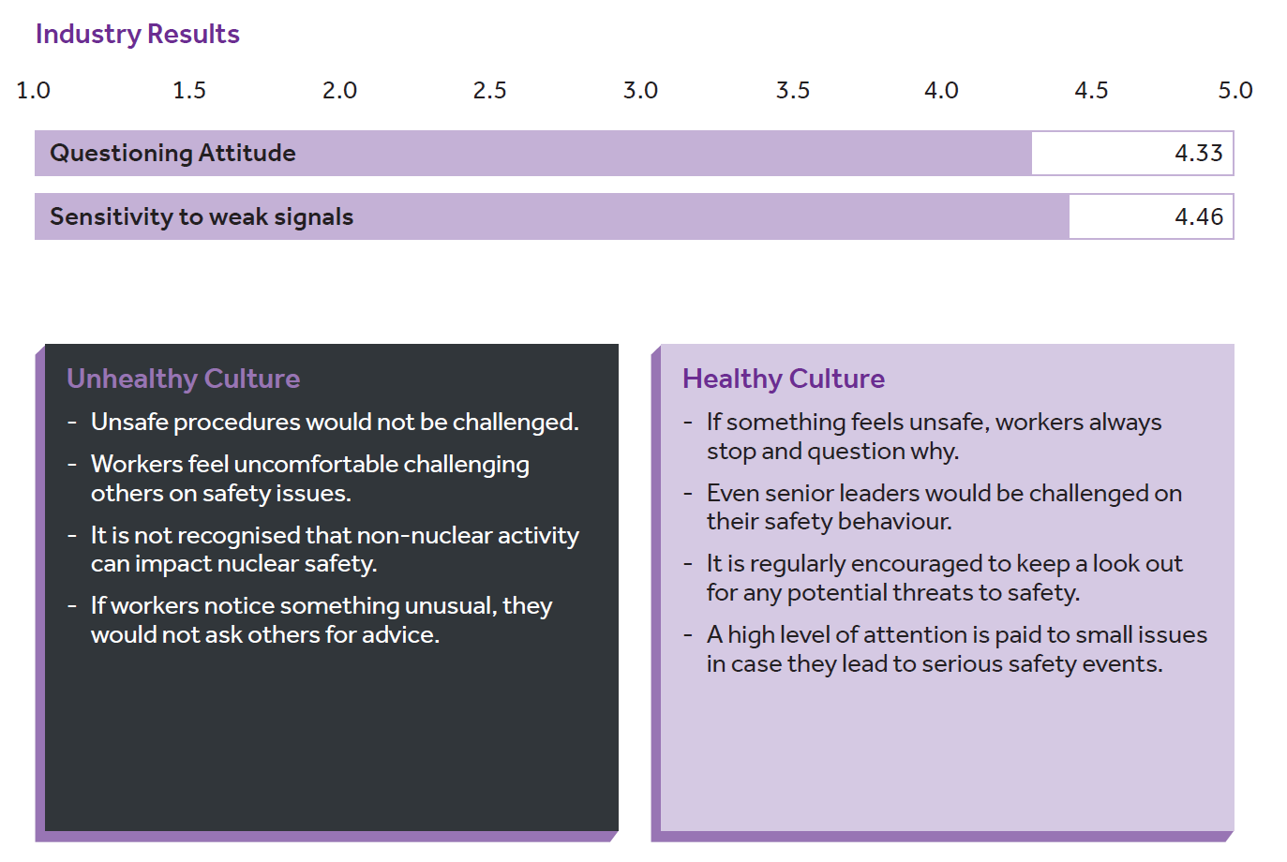

Slide 16
Dimension 6: Reporting
Feeling safe | The extent to which individuals feel safe to raise safety concerns without fear of personal consequence.
Confidence | The extent to which individuals are confident that any safety concerns raised will be acted upon.
Informed Compliance | The extent to which individuals understand the significance of and comply with safety rules and procedures.
Notes:
Reporting closes the safety culture circle and is built upon all previous dimensions. It plays an inevitable part in the sustainability of an organisation’s safety culture as it not only contributes to the identification, tracking, and management of safety events but also to the level of compliance workers’ exhibit. This dimension comprises of three essential components: ‘feeling safe’, ‘confidence’ and ‘compliance’
Feeling safe: This includes whether individuals who raise safety concerns are rewarded or seen as troublemakers.
Confidence: Here, the speed with which concerns are acted upon, even if they challenge other important organisational goals (i.e., productivity), and the effectiveness of the reporting system are important.
Compliance: This requires individuals to be fully informed of the safety risks and requirements relevant to their job rather than blindly carrying out safety procedures that are poorly understood.

Slide 17
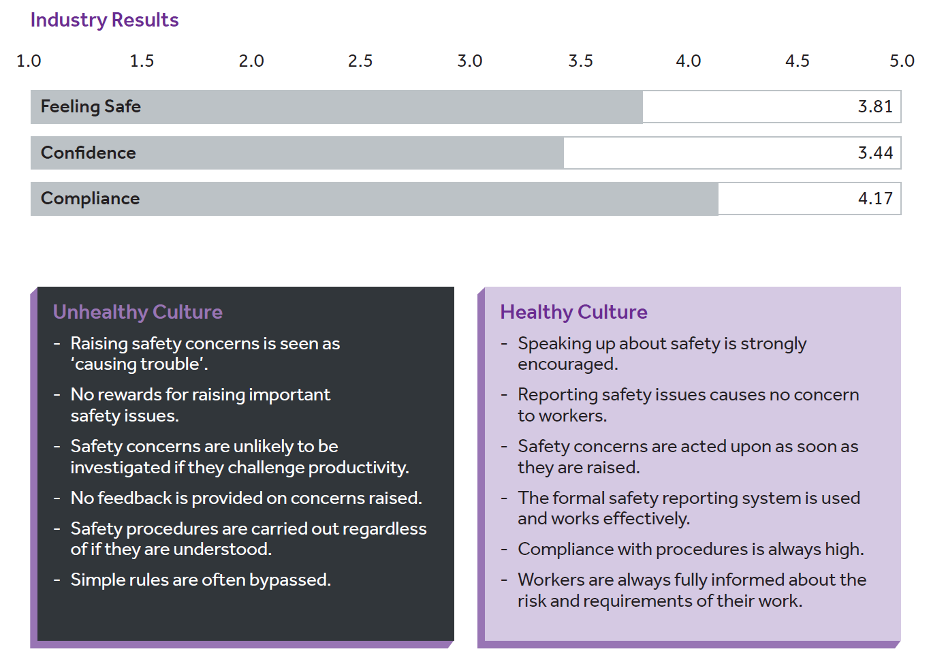

Slide 18
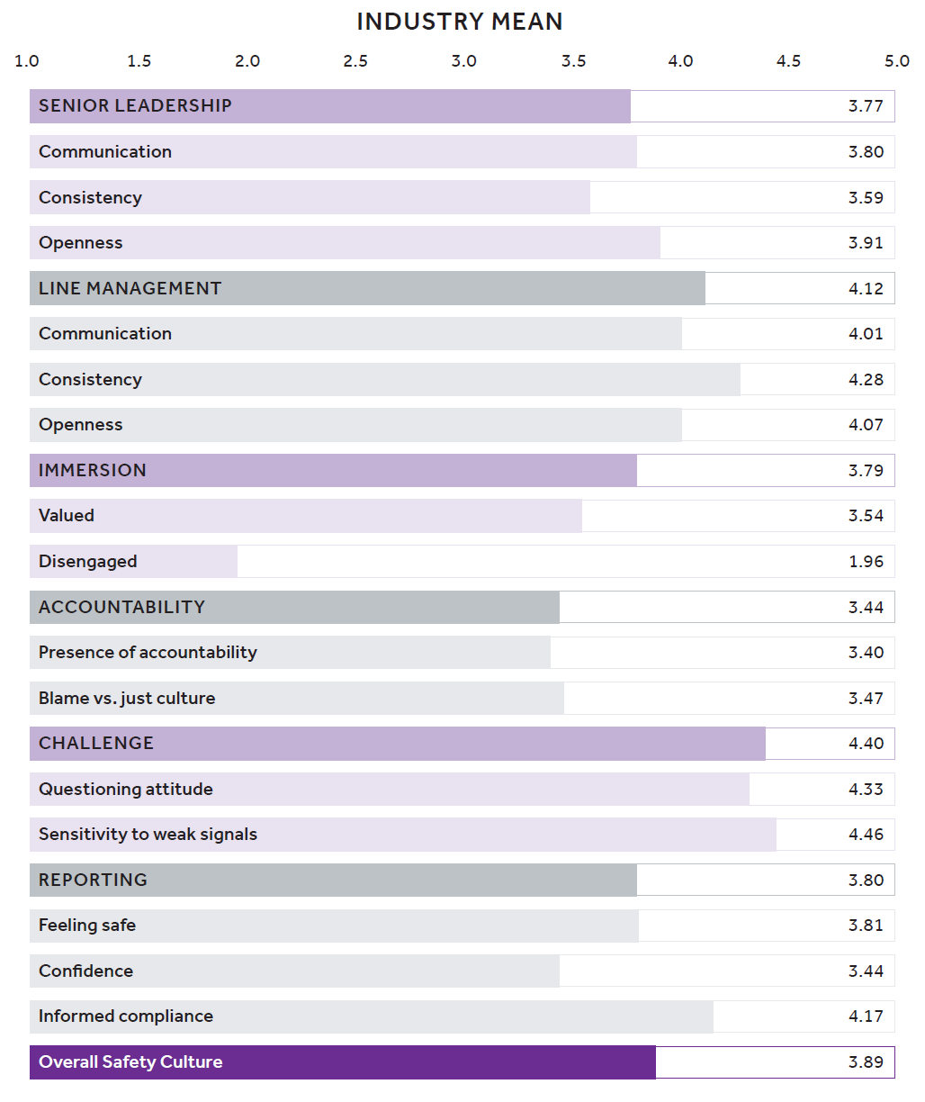

Slide 19
Relationship with safety performance
The NISCI positively predicts:
Organisational-level safety performance ratings
Individual safety performance ratings
It also reflects differences in ONR inspector-ratings of organisational safety performance:
Each dimension is sensitive to differences between organisations rated as having high and low safety performance, and between organisations rated as having low and medium safety performance

Slide 20
Next Steps
ONR is working collaboratively with GB’s nuclear industry to encourage the use of NISCI. The vision includes:
Full industry adoption
Industry benchmarking
Industry learning
Improved safety outcomes
Adoption by other industries and nations
Development of a software platform

Slide 21
Thank-you
Office for Nuclear Regulation
Nick Shaw: nick.shaw@onr.gov.uk
Alliance Manchester Business School
Professor Sharon Clarke: s.g.clarke@manchester.ac.uk
Dr Lina Siegl: lina.siegl@manchester.ac.uk

