Slide 1
Good Practices on Effectively Managing Process Safety Issues When Replicating a Modular Mid-Scale LNG Design
  Veronica Luna, HSE Director (Process Safety)

Slide 2
Introduction and Objectives
  Modular Mid-Scale Liquefied Natural Gas (LNG) Solutions
  One of the emerging potential solutions to meet the needs of the evolving LNG market and global demand for clean energy
  Benefits
  Decrease time to market
  Lower total installed cost (TIC)
  Faster and cheaper LNG liquefactions plants
  Staged investment while generating revenue
  Flexibility to be installed in different configurations
  Modules can be installed in different location and type of facility

Slide 3


Introduction and Objectives
Modify to meet Client-specific needs
Replicate to increase total plant capacity
Reference design as a starting point
minimal efforts in design and procurement
compressed schedule

Slide 4
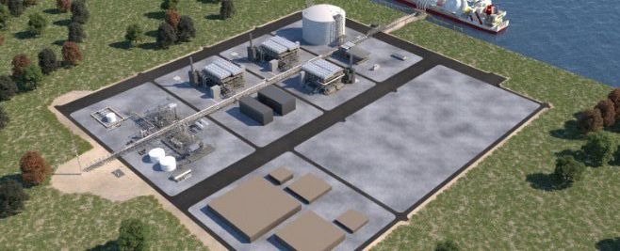
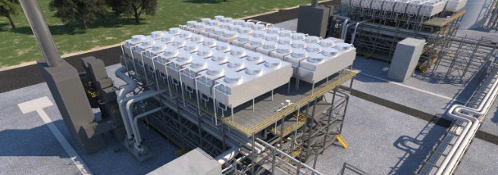
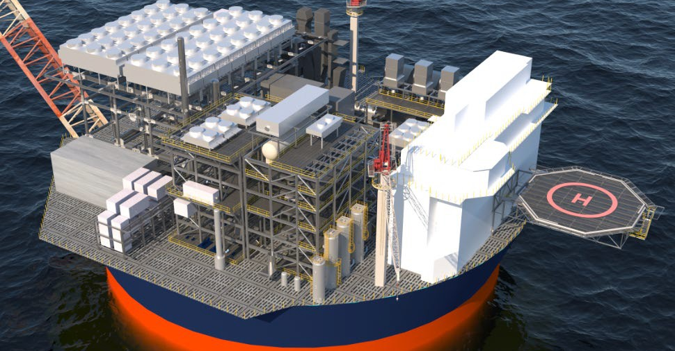

Overview of Modular Mid-Scale LNG Solutions
  Mid-scale LNG facilities produce trains in
  0.7-3.0 MTPA range
  Utilizes one of the liquefaction technologies available
  Reference design
  Typical conceptual and front-end engineering
  design (FEED) deliverables
  Considered minimal intial overall facility needs
  Layouts maximized modular content
  Land-based but adaptable to marine facilities
  Based on a readily available and understood feedstock ang climatic conditions

Slide 5
Process Safety Features Incorporated in
Reference Design
  Hazard identification initiated
  Safety features integral to the process design incorporated
  ISD concepts incorporation maximized
  Preventive and mitigative measures in process design incorporated
  Other risk reduction measures
  Need to be site specific
NATURAL GAS
LIQUEFIED NATURAL GAS
Flammable vapor
Fire, VCE
Flammable liquid/vapor
Cryogenic temperature
Asphyxiant
Fire, VCE, BLEVE
Asset impact
Personnel impact
REFRIGERANT
HEAVY HC
Flammable liquid/vapor
Low temperature
Asphyxiant
Fire, VCE, BLEVE
Personnel impact
Flammable liquid
Harmful to environment
Fire
Environmental impact
HYDROGEN SULFIDE
AMINE
Acute toxic gas
Personnel exposure to toxic gas
Corrosive to skin
Toxic to environment
Personnel impact
Environmental Impact

Slide 6

Considerations During the Replication Process
To copy?
or
Not to copy?

Slide 7
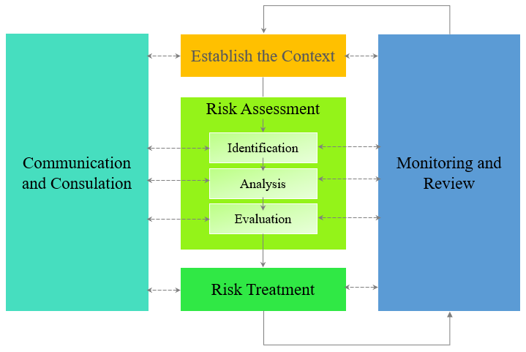
Risk Management during the Base Design Development and Replication Process
Minimum Expectations
Critical Input Data
Reference: Risk Management Process (IOGP, 2018)

Slide 8
Considerations During the Replication Process
Minimum Process Safety Requirements
Local regulations
Applicable codes and standards
Risk Tolerability Criteria
Local regulations
Client tolerability criteria
Risk Profile
Facility type
Site environmental and meteorological conditions
Client-specific requirements
Process technologies and conditions
Plot layout and arrangement

Slide 9
Considerations during the Replication Process
 | Minimum Process Safety Requirements | Client-specific Requirements | Environmental/ Meteorological Conditions | Process Technology/ Conditions | Plot layout / arrangement | Facility Type
F&G detection provisions
Ignition control
Passive fire and explosion protection
Cryogenic protection
Active fire protection system
Emergency Shutdown system
Relief Depressurization, and Flare system
Drainage arrangement
EER arrangement
Lifesaving/ Safety equipment
Environmental protection
✓
✓
✓
✓
✓
✓
✓
✓
✓
✓
✓
✓
✓
✓
✓
✓
✓
✓
✓
✓
✓
✓
✓
✓
✓
✓
✓
✓
✓
✓
✓
✓
✓
✓
✓
✓
✓
✓
✓
✓
✓
✓
✓
✓
✓
✓
✓
✓
✓
✓
✓
✓
✓
✓
✓
✓
✓
✓

Slide 10
Case Studies
  Case Study 1 (Base Design): Modular Mid-Scale LNG on
  Jack-Up Rigs
  Case Study 2: Modular Mid-Scale LNG on Fixed
  Jacketed Platforms
  Case Study 3: Modular Mid-Scale LNG on Sevan Unit
  Case Study 4: Modular Mid-Scale LNG Onshore

Slide 11

Case Study 1: Modular Mid-Scale LNG on Jack-Up Rigs
  Utilized reference project for onshore
  To be installed in three offshore
  jack-up rigs
  Two process rigs; one utilities rig
Location is in Gulf of Mexico
Minimum safety requirements based on local regulations and class society requirements and applicable codes
and standards
Safety critical elements mostly protected by location

Slide 12
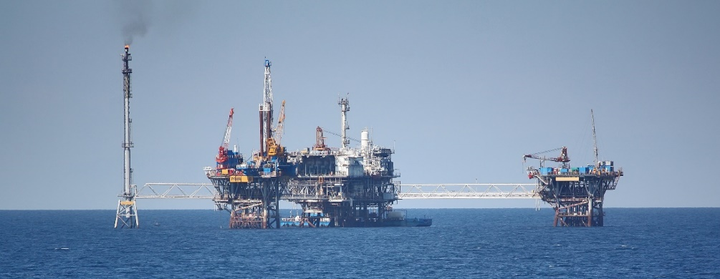
Case Study 2: Modular Mid-Scale LNG on Fixed
Jacketed Platforms
  Case 1 replicated for installation on three fixed jacketed platforms
  Two process rigs; one utilities rig
  Location is in US Gulf Coast

Slide 13
Case Study 2: Modular Mid-Scale LNG on Fixed Jacketed Platforms
PROCESS SAFETY DRIVERS
SOURCE OF CHANGES
ANY CHANGES?
IMPACTED PS ACTIVITIES
Minimium process safety requirements
Local regulations
Appllicable codes and standards
Client-specific requirements
Classification and certifying
body requirements
Local regulations
Client tolerability criteria
Facility type
Site environmental and meteorological conditions
Plot layout and arrangement
Y
N
N
Y
N
N
Y
Y
Y
HSE philosophies
Engineered risk reduction measures design and their performance requirements
Engineered risk reduction measures design and their performance requirements
Risk tolerability criteria
Risk profile
HSE philosophies
HAZID/ENVID results
HSE studies results
Engineered risk reduction measures design and their performance requirements
Process technologies
and conditions
Y
HSE studies results

Slide 14
Case Study 2: Modular Mid-Scale LNG on Fixed Jacketed Platforms
 | Minimum Process Safety Requirements | Client-specific Requirements | Environmental/ Meteorological Conditions | Process Technology/ Conditions | Plot layout / arrangement | Facility Type
F&G detection provisions
Ignition control
Passive fire and explosion protection
Cryogenic protection
Active fire protection system
Emergency Shutdown system
Relief Depressurization, and Flare system
Drainage arrangement
EER arrangement
Lifesaving/ Safety equipment
Environmental protection
✓
✓
✓
✓
✓
✓
✓
✓
✓
✓
✓
✓
✓
✓
✓
✓
✓
© 2023 Fluor. All Rights Reserved. Fluor is a registered service mark of Fluor Corporation.
✓

Slide 15
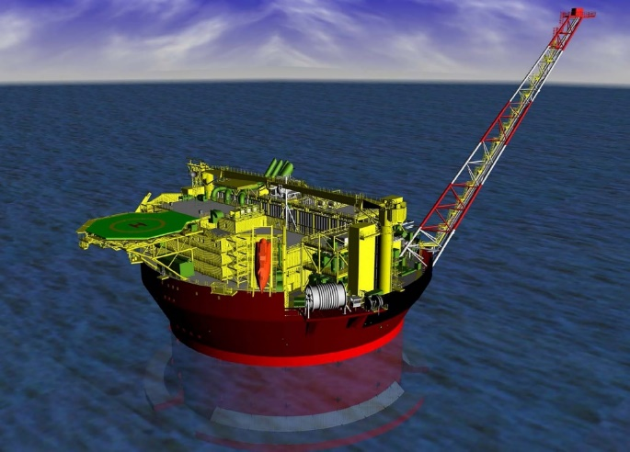
Case Study 3: Modular Mid-Scale LNG on Cylindrical Floating Unit
  Case 1 replicated for installation on a cylindrical floater
  Location is in Gulf of Mexico

Slide 16
Case Study 3: Modular Mid-Scale LNG on Sevan Unit
PROCESS SAFETY DRIVERS
SOURCE OF CHANGES
ANY CHANGES?
IMPACTED PS ACTIVITIES
Minimium process safety requirements
Local regulations
Appllicable codes and standards
Client-specific requirements
Classification and certifying
body requirements
Local regulations
Client tolerability criteria
N
N
N
N
N
Y
N
Y
Y
Risk tolerability criteria
HSE studies results
Engineered risk reduction measures design and their performance requirements
Risk profile
Site environmental and meteorological conditions
Facility type
Plot layout and arrangement
HAZID/ENVID results
HSE studies results
Engineered risk reduction measures design and their performance requirements
Process technologies and conditions
N
HSE studies results

Slide 17
Case Study 3: Modular Mid-Scale LNG on Sevan Unit
 | Minimum Process Safety Requirements | Client-specific Requirements | Environmental/ Meteorological Conditions | Process Technology/ Conditions | Plot layout / arrangement | Facility Type
F&G detection provisions
Ignition control
Passive fire and explosion protection
Cryogenic protection
Active fire protection system
Emergency Shutdown system
Relief Depressurization, and Flare system
Drainage arrangement
EER arrangement
Lifesaving/ Safety equipment
Environmental protection
✓
✓
✓
✓
✓
✓
✓
✓
✓
✓
✓
✓
✓
✓
✓
✓
✓
© 2023 Fluor. All Rights Reserved. Fluor is a registered service mark of Fluor Corporation.

Slide 18
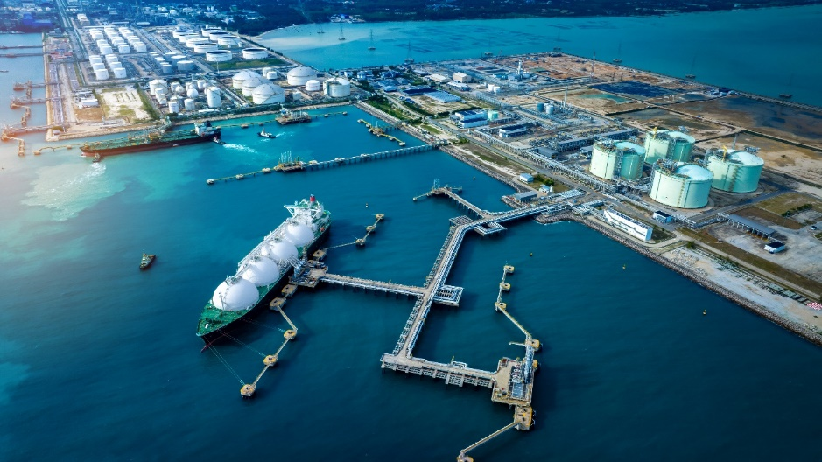
Case Study 4: Modular Mid-Scale LNG Onshore
  Case 1 replicated for installation on an onshore facility
  Different client
  Location is in British Columbia, Canada
  Two trains to be installed in
  phased manner

Slide 19
Case Study 4: Modular Mid-Scale LNG Onshore
PROCESS SAFETY DRIVERS
SOURCE OF CHANGES
ANY CHANGES?
IMPACTED PS ACTIVITIES
Minimium process safety requirements
Local regulations
Appllicable codes and standards
Client-specific requirements
Classification and certifying
body requirements
Local regulations
Client tolerability criteria
Facility type
Site environmental and meteorological conditions
Plot layout and arrangement
Process technologies and conditions
Y
Y
Y
Y
Y
Y
Y
Y
Y
Y
HSE philosophies
HAZID/ENVID results
HSE studies results
Engineered risk reduction measures design and their performance requirements
Risk tolerability criteria
Risk profile

Slide 20
Case Study 4: Modular Mid-Scale LNG Onshore
 | Minimum Process Safety Requirements | Client-specific Requirements | Environmental/ Meteorological Conditions | Process Technology/ Conditions | Plot layout / arrangement | Facility Type
F&G detection provisions
Ignition control
Passive fire and explosion protection
Cryogenic protection
Active fire protection system
Emergency Shutdown system
Relief Depressurization, and Flare system
Drainage arrangement
EER arrangement
Lifesaving/ Safety equipment
Environmental protection
✓
✓
✓
✓
✓
✓
✓
✓
✓
✓
✓
✓
✓
✓
✓
✓
✓
✓
✓
✓
✓
✓
✓
✓
✓
✓
✓
✓
✓
✓
✓
✓
✓
✓
© 2023 Fluor. All Rights Reserved. Fluor is a registered service mark of Fluor Corporation.
✓
✓

Slide 21
Recap and Summary
  Modular mid-scale LNG solutions translates to faster and cheaper LNG liquefaction plants
  Reference design is available and can be modified to meet project
  specific requirements
  Customized base design can be replicated to meet capacity expansion requirements or can be installed in different facility and location
  Process safety features in reference design is limited, hence risk reduction measures are to be made project specific

Slide 22
Recap and Summary(Cont.)
  During replication process, gap analysis shall be undertaken at the onset focusing on the three main drivers.
  Minimum process safety requirements
  Applicable risk tolerability criteria
  Facility risk profile
  Results of gap analysis shall be used to determine which risk reduction measures can be carried over from base design
  Risk management framework + gap analysis = compliant and safe design

Slide 23

Any Questions?
  Send me an email at
  veronica.christine.balangue-luna@fluor.com
  Connect with me via Linked In by scanning the
  QR code
© 2023 Fluor. All Rights Reserved. Fluor is a registered service mark of Fluor Corporation.

