Slide 1

Explosion safety in anaerobic digestion sites; where it can go wrong and guidance to avoid that happening
Sarah Bergin
Major Hazards Unit, HSE Science and Research Centre
Disclaimer: This publication and the work it describes was funded by the Health and Safety Executive (HSE). Its contents, including any opinions and/or conclusions expressed, are those of the authors alone and don’t necessarily reflect HSE policy.

Slide 2
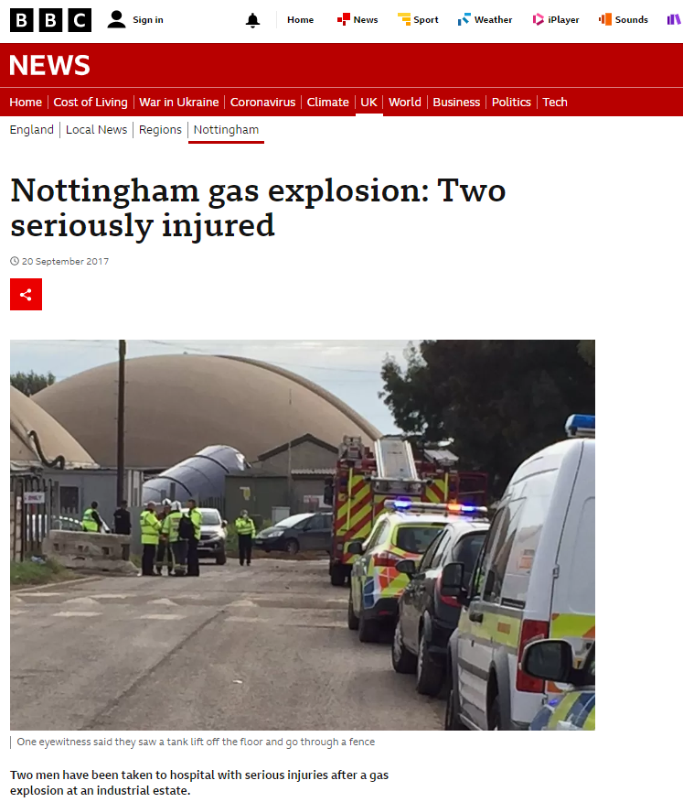
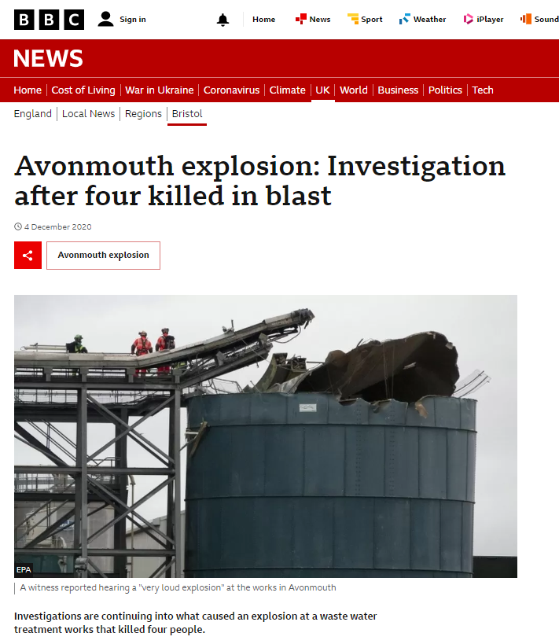
What explosions?
Notes:
Mention that it these high profile incidents that have caused HSE to wonder are there potential knowledge gaps/recurring unsafe trends in the industry that could be highlighted and thus prevent future incidents like these occurring. So the HSE commissioned an internal project, looking at the industry from a number of angles to see if these trends could be identified. The intention was also to hopefully give the inspectors some particular pointers to look at when visiting sites (there are many features at an AD site and so its very unlikely that all aspects can be inspected in a single site visit). The outcomes from this project form the basis of this presentation.

Slide 3
Presentation overview
Part 1: DSEAR and Hazardous Area Classification (HAC)
Part 2: Overview of anaerobic digestion (AD)
Part 3: Overview of UK incident reports
Part 4: Findings from HSE inspection programme
Part 5: Standards and guidance
Part 6: Ventilation system design for storage tanks (pre and post digester)
Conclusions
Notes:
The content has been split into four parts, that represent the different approaches that were taken. Quick introduction to AD and the regulations relating to the explosion safety side (namely DSEAR). Part 1 relates to anaerobic digester site incidents, the majority of which were recorded by either the Health and Safety Executive or the Environment Agency between 2010 and 2020. Underreported and at the mercy of search terms. Part 2 relates to the findings that were made during 2021-2023, anecdotal information, and outcomes from these inspections (Note: these were routine inspections and not as a result of an occurrence). Part 3: Standards and guidance – AD sector in other countries more developed so wanted to understand what official guidance was out there both nationally and internationally. Part 4: This was one of the very obviously recurring trends during site visits and identified in paperwork. Wanted to give a high level insight into potential approach that could be applied when sizing/checking that your ventilation system is adequate. But also considerations for biogas tanks specifically e.g. density variation.

Slide 4
Overview of DSEAR and Hazardous Area Classification

Slide 5
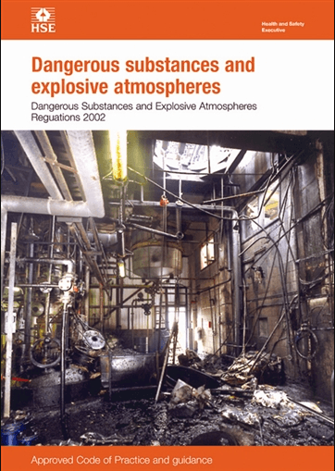
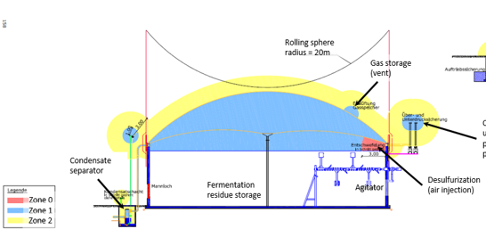
DSEAR – Explosive Atmospheres Regulation
Legal requirements for managing the risk of fire, explosion arising from dangerous substances at the workplace
Risk assess (areas and activities), aiming to remove/reduce the potential for explosive atmosphere as far as possible
If risk cannot be completely eliminated, zone and classify the hazardous area (HAC)
DSEAR Approved code of Practice and guidance L138 (hse.gov.uk)
Desulfurisation
(air injection)
Notes:
Dangerous Substances and Explosive Atmospheres Regulations 2002 - the United Kingdom's implementation of the European Union-wide ATEX directive.
Zone 2NE because a sufficiently small volume of explosive atmosphere would have insignificant over-pressure or thermal effects if it ignited.

Slide 6
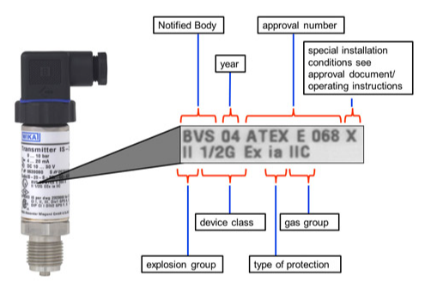

Hazardous Area Classification (Zoning)
Zone 0 – present continuously, or for long periods or frequently.
Zone 1 – occur occasionally in normal operation.
Zone 2 – does not normally occur, but if it does, does so rarely and only for a short time.
Zone 2^{NE} – sufficiently small volume that it would have insignificant over-pressure or thermal effects if it ignited. ATEX equipment is not required for Zone 2^{NE} areas
Desulfurisation
(air injection)
blog.wika.com
Notes:
Should also consider the non-normal activities and maintenance task e.g. emptying a digester.

Slide 7
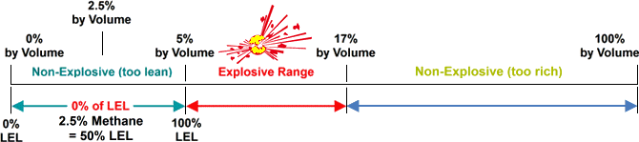
Biogas – Explosive range
Methane explosive range (5-15/17 %vol)
Biogas explosive range (6-12/14 %vol)
Methane concentration constantly varying e.g. tank emptying, hot spots
Typical biogas composition
Compound | Formula | %
Methane | CH₄ | 50–75
Carbon dioxide | CO₂ | 25–50
Nitrogen | N₂ | 0–10
Hydrogen | H₂ | 0–1
Hydrogen sulphide | H₂S | 0–3
Oxygen | O₂ | 0–1
Ammonia | NH₃ | 0-1

Slide 8
Overview of Anaerobic Digestion (AD)

Slide 9
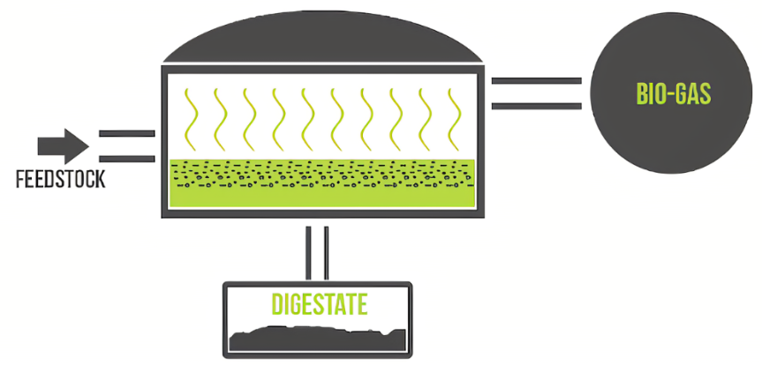
Anaerobic digestion – the process
Input organic feedstock, e.g. manure
In the absence of oxygen, various bacteria/ microorganisms digest and break down the feedstock
Biogas generated in the process; used for heat, electricity, or upgraded to biomethane
Digestate as by-product, can be
used as fertiliser
Notes:
AD overview – saying essentially what is on the slide, mention how it differs from Aerobic digestion (wastewater treatment as an example) and what the advantages are e.g. capture of gas for use, Energy produced from waste to run the plant, Reduced volume of sludge,Potential to process energy-rich food waste. 1 tonne of CO2 = 1 unit GWP. Time is important Over 100 years 1 tonne of methane = 27-30 GWP. Over 20 years 1 tonne of methane = 81-83 GWP
In an aerobic system, such as composting, the microorganisms access free, gaseous oxygen directly from the surrounding atmosphere. The end products of an aerobic process are primarily carbon dioxide and water which are the stable, oxidised forms of carbon and hydrogen. If the biodegradable starting material contains nitrogen, phosphorus and sulfur, then the end products may also include their oxidised forms- nitrate, phosphate and sulfate.^{[1]} In an aerobic system the majority of the energy in the starting material is released as heat by their oxidisation into carbon dioxide and water.

Slide 10







Anaerobic digestion – explosive atmospheres
CHP
Mixing/buffer tanks
Pasteuriser
Condensate trap
Pasteuriser
Digestate tanks

Slide 11
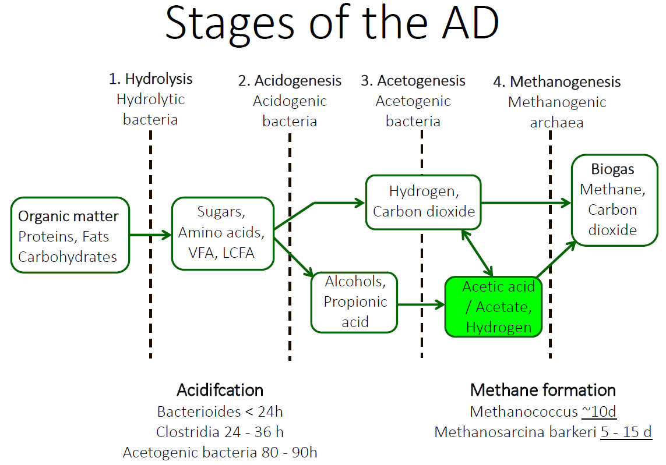
Anaerobic digestion – biology
4 stages – all happening at the same time
Stage 1 and 2 – faster, heat generating steps
Stage 3 and 4 – need energy/heat to complete steps
Regular monitoring to ensure bacterial communities are happy
Consider effects of feedstock e.g. NH₃ effects, solids content
Notes:
Stage 1 and 2 - hydrolytic and acidifying bacteria – fermentation
provide acetic acid which is what the methanogens use to generate methane. A key part of the process is generation of partial pressure hydrogen in stage 3. These MUST be used up in stage 4 or will pack up system. Will see a change in pH if the hydrogen ion is not being used up.
Things like NH3 (from feedstock) can inhibit methanogen process.

Slide 12
Part 1: Overview of UK incident reports

Slide 13
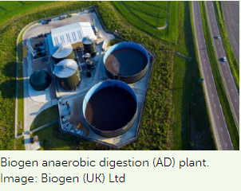
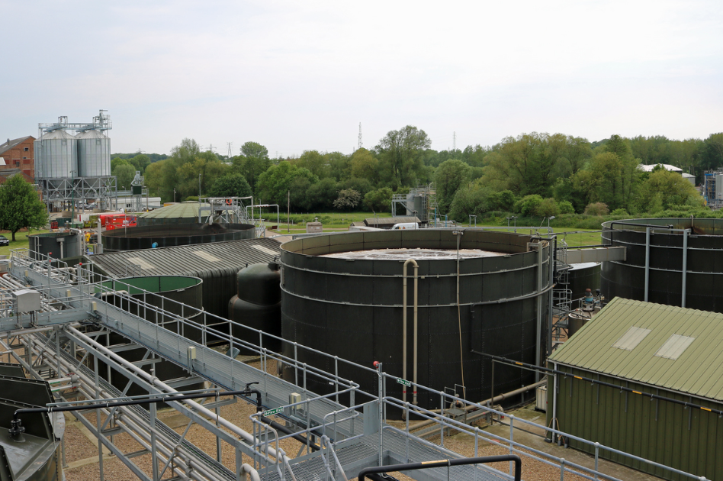
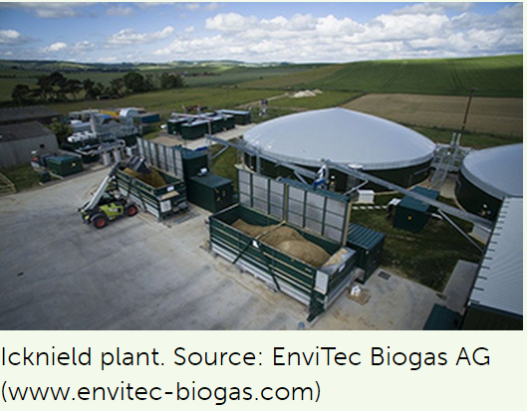
Anaerobic digestion in the UK 2022
As of April 2022, 660 Anaerobic digesters in the UK (NNFCC)
>80% AD sites process gas on site e.g. CHP
13 new biomethane to grid (BtG) since 2021
“AD sector attractive due to the high proportion of inflation-linked revenues backed by government subsidy regimes”
Muntons reaches energy milestone with anaerobic digester
Notes:
Introduction – mention current numbers of ADs in the UK, what incentivised the growth of AD e.g. RHI, GGGS, where the direction is potentially going e.g. war in Ukraine meant countries wanted to reduce reliance on Russia for gas, Net zero – looking at biomethane in the transport sector (Sweden good example)

Slide 14
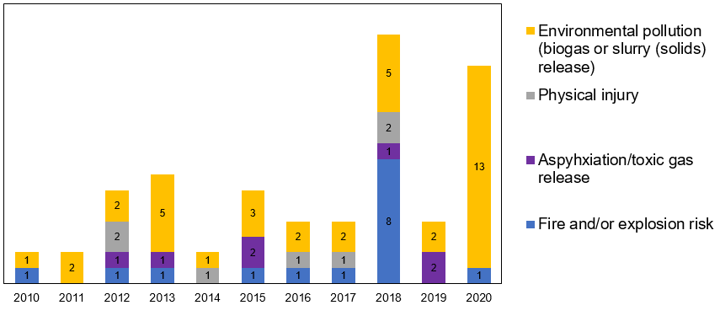
Part 1: Overview of UK incident reports
68 incidents between 2010-2020 (underreporting?)
Most related to environmental pollution
Fire and explosion risk
- deviation from
normal operation
- maintenance
activities
Notes:
Data has been extracted from HSE and EA reports, and summarised under topics including, year/industry type, nature/category of incident and plant involved. 40 logged as industrial sites, 9 agricultural, 19 unknown.
Environmental permitting of most AD sites tends to be routinely inspected against the environmental criteria of the license rather than health and safety regulations
Physical injuries e.g. equipment failure (aging), incorrect tools/PPE used, no safe systems of work. Asphyxiation/toxic gas e.g. dangerous maintenance activity

Slide 15
Causes in fire/explosion incidents
Crust/floating layer formation due to power cut ceasing agitation
Excessive foaming blocking valves
Catalytic iron filters going on fire during maintenance
Dangerous electrical management e.g. exposed connections
Lack of safety features e.g. flare, vacuum or pressure relief, lack of ventilation in storage tanks
Unsafe system of work e.g. hot works on gas containing tanks
Notes:
Here is just a summary of some of the causes, it’s interesting to note where on the site they happened. See paper

Slide 16
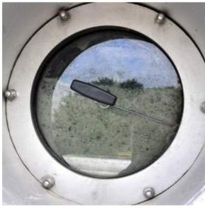
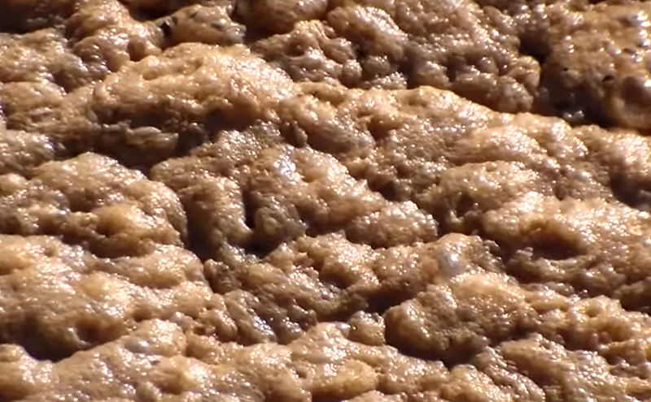
Unhappy bacteria - excessive foaming
Gas bubbles form and collapse as part of process (methane and carbon dioxide)
If unable to collapse, foaming occurs, bubbles has oil/surfactant skin
Consequences – valve blockage, loss of containment, digester membrane rupture
Corrective action – foams sensors in tank, regular visual monitoring, anti-foaming agent (enzymes)
Excessive foam visible through a viewing port (FM BioEnergy)
Example of foam in AD (envirotecmagazine.com)
Notes:
Darker thick foam – slow formation, due to undigested dry matter, high dry solids, poor mixing, mousse-like yellow “champagne” foam

Slide 17
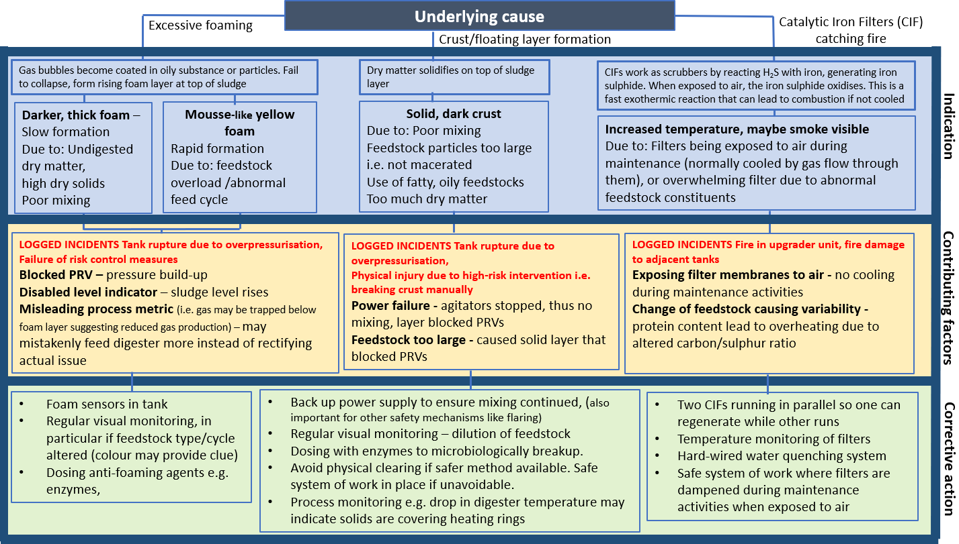
More common recurring incidents

Slide 18
Part 2: Finding from HSE inspection programme

Slide 19
Summary of inspection campaign
22 site visits to larger industrial sites e.g., sewage, food waste (Material breaches found in 50% of visits)
49 site visits to agricultural sites (Material breaches found in 40% of visits)
Recurring trends:
- Lack of understanding around hazardous area classification, - Poor quality or missing risk assessments/ safe systems of work
- Limited knowledge of density variation in biogas.
Notes:
difficulty in demonstrating competency amongst duty holders due to the lack of industry specific competency benchmarks. That being said, the campaign overall produced positive outcomes; for example, one operator applied the advice given by the HSE process safety specialist around hazardous area zoning at one of their managed sites to all of their operated sites.
Limited understanding of density variation in biogas (covered in part 4)

Slide 20
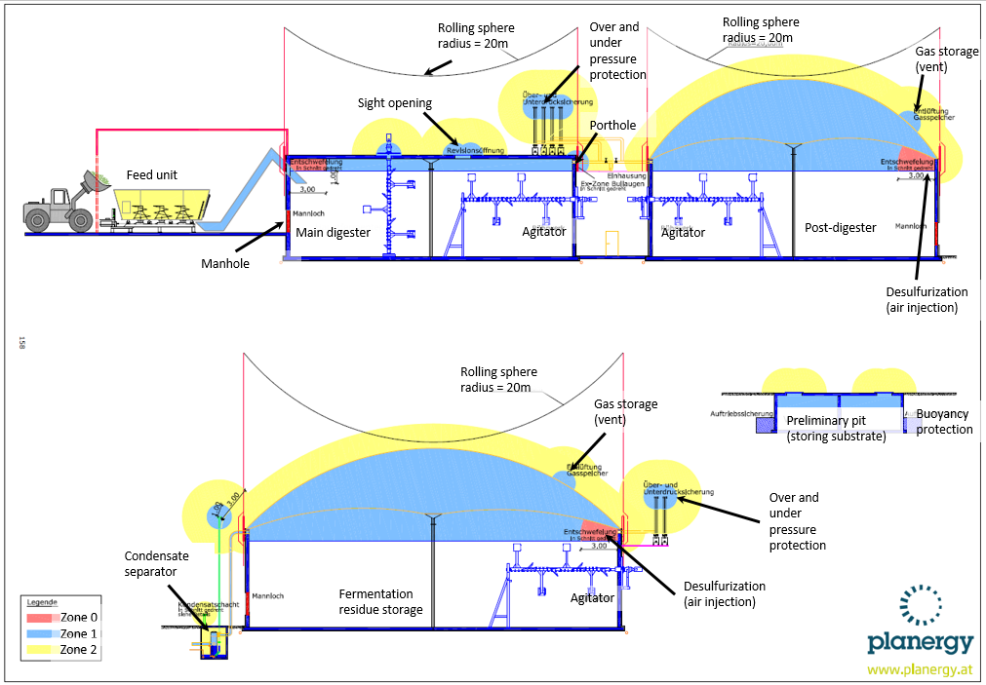

Hazardous Area Classification (DSEAR)
Biogas (50-75% CH4)
Explosive atmosphere expected in digester - but also the reception area, the digestate, the bits in between
Consider all aspects of operation
Notes:
Being generic, often with large chunks copied from UK or European regulations or standards without analysis of site specific conditions.
ii. Including significant content from consultants that did not correspond to actual practice on site. For example, citing start-up procedures based on nitrogen inerting when this was never actually done.
iii. Missing specific assessment of explosion risks during maintenance operation – this was extremely common. In some cases there were separate written procedures to cover maintenance, in some cases there were not.
iv. Faulty or incomplete assessments especially in relation to Hazardous Area Classification. Some specific issues are discussed below.
In several cases the HSE visits led to rewriting of DSEAR reports both in the site visited and other sites operated by the companies involved.

Slide 21
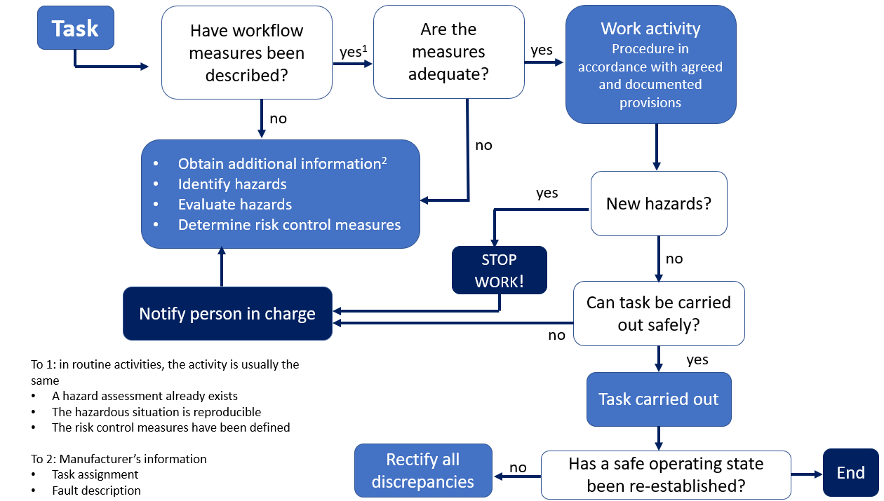
Inadequate RAs/safe systems of work
Understanding of the process and hazards areas
Monitoring important e.g., of both gas and process indicators
Regular maintenance
Notes:
Understanding – AD is an live process, can’t switch off, indicators such as pH, Gas concs can tell if digester is souring
Monitoring – Pressure, foam indicators, H2S concs
For example, a reduction in system pressure could be an indicator of a gas release, which could be occurring due to failure of a components e.g., tear in gas membrane, faulty seal. Staff should consider their own safety when responding to an abnormal reading e.g., having appropriate PPE, personal gas monitoring, knowledge of the hazards in the area they may be entering and process safety components that allow them to make an area safe before entering.
A risk assessment specific to the maintenance tasks being undertaken. For example, what hazards are there when opening the digester hatch to replace the agitator and can additional temporary risk control measures be put in place during that activity.
ii. Written work instructions (and a permit to work if carrying out hot works) that considers the specific hazards of that part of the plant, such as pressurised pipes, location of potentially explosive atmospheres, checklist to confirm that additional risk control measures have been put in place (active ventilation, clearance measurement with gas detector).

Slide 22
Part 3: Standards and guidance

Slide 23
Regulation of AD – UK vs. others
Construction/operation of AD plants managed (mostly) via environmental permitting (UK)
In Germany, adherence to all areas of law examined as part of the licensing approval for biogas plants e.g., CDM, DSEAR
In Austria, guidance documents reference relevant regulations in single guidance document
Zoning still tends to be described for normal operation only
Notes:
Smaller plants may require Local Authority permission only e.g. no waste leaving site, non-waste feedstock
EA SR guidance documents are prescriptive only in terms of environmental aspects and minimisation of pollution/impact on sensitive receptors. It is stated in the SR documents that appropriate safety documentation should be present e.g., risk assessment, DSEAR but there is no guidance for the applicant to assist with the preparation of this documentation.
It is expected that an element of this responsibility for safety documentation will lie with the plant installer/designer and be shared with the operator as part of the handover and acceptance procedures. However it is not known if this is the case in practice.

Slide 24
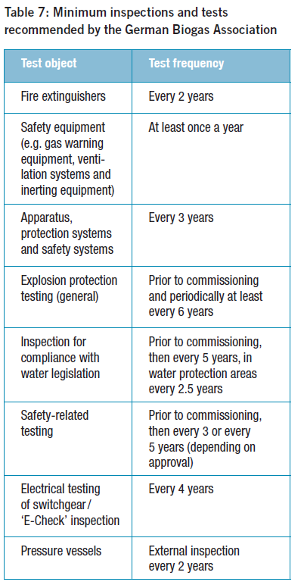
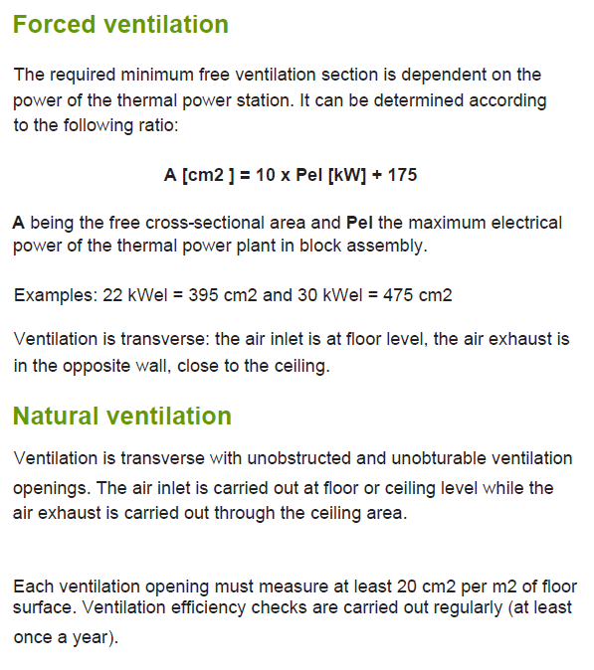
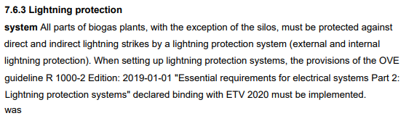
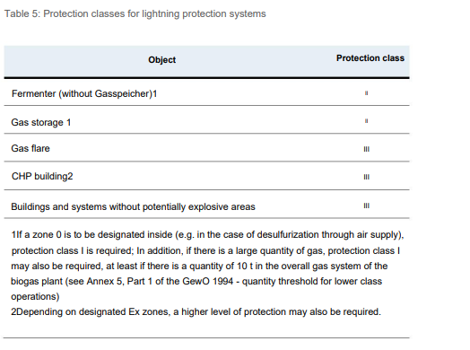
Useful aspects from guidance
Federal Ministry of Education, Science
and Research, Austria
Ministry of Agriculture and Fisheries France
German Biogas Association

Slide 25
Part 4: Ventilation system design for storage tanks

Slide 26
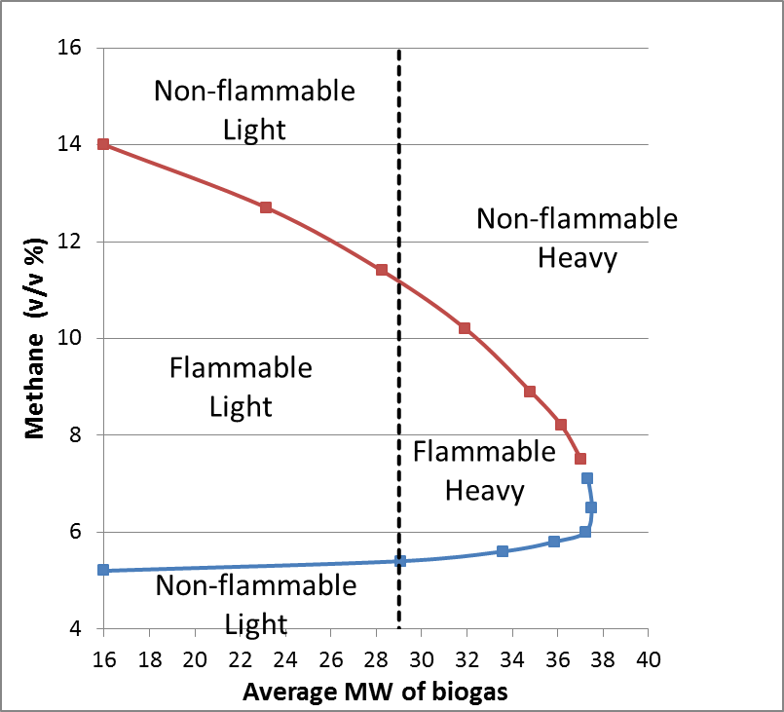
Density and flammability of biogas mixtures
Though usually buoyant, explosible biogas can be lighter or heavier than air
Average molecular weight of CO₂/methane mixtures exceeds that of air (29 gmol-1) for concentrations of CO₂ over about 50%
Monitor placement important – high and low
Density of flammable mixtures relative to air at the same temperature
Notes:
During normal anaerobic production of biogas in a digester the CO₂ fraction should be less than about 45% but during process deviations such as emptying of the digester the CO₂ fraction may rise. Biogas with higher levels of CO₂ are also likely in the ullage of input/output buffer, mixing or storage tanks.
The average molecular weight of CO2/methane mixtures exceeds that of air (29 gmol⁻¹) for concentrations of CO₂ over about 50%. The flammable region is plotted against molecular weight in Figure. This figure also shows the regions in which flammable gases are lighter or heavier than air (at the same temperature).
In the digester biogas may be significantly warmer than ambient. Figure shows that the region where mixtures at ambient plus 30°C are both flammable and heavier than ambient air. The range of such mixture is narrowed but is still significant.
The fact that biogas can be lighter or heavier than ambient air means that it can accumulate at high or low level in an enclosure with limited ventilation

Slide 27

Density effects in biogas accumulation
Lighter than air – air jets progress to liquid surface, resulting in good mixing (constant gas concentration)
Heavier than air – air jets may not reach surface of liquid if not sized properly (undiluted or partially diluted biogas in lower part of tank)
Inlet air
Extraction (e.g. to odour control)
Biogas lighter than inlet air
Ullage well mixed
Waste
Inlet air
Extraction (e.g. to odour control)
Inlet air lighter than biogas
Biogas accumulation
Waste
Notes:
Constant gas concentration means monitoring can be accurately made at outlet of tank

Slide 28
Effective ventilation strategies
The efficiency of extraction (for a given ventilation volume flow) is maximised by:
  A single inlet vent (rather than several distributed over the tank top)
  Vents in horizontal or near horizontal surfaces (i.e. in the roof rather than at the top of the walls)
  Round or square vents (rather than slots with an equivalent area)
  Smaller vents with higher speed inflow.
Inlet air
Extraction (e.g. to odour control)
Inlet air lighter than biogas
Biogas accumulation
Waste
Notes:
The ventilation required falls off when the tank is nearly full as the inflow of air can easily reach the liquid surface and when the tank is nearly empty when the gas production rate falls away because there is much less liquid. The worst case is around 30-40% liquid fill level.

Slide 29
Conclusions
Understanding - Greater understanding of explosive atmospheres needed when risk assessing, e.g. sizing of ventilation systems
Training - Staff training important so that operators can spot the signs of issues occurring and react appropriately and safely
Risks – Many of the safety risks in AD are common to other industries and so safe systems of work to mitigate these should be easy to implement
Guidance about process safety in AD is useful
Notes:
Incidents relating to fire and explosion tended to occur during times when deviation from normal operation occurred, such as an unnoticed change in the microbial activity, leading to scenarios such as crust formation or excessive foaming. Greater understanding of the process indicators is needed so that deviations from normal operation can be rectified before they become a process safety issue. e.g. awareness of the potential for foaming events or crust formation and how to take appropriate action to mitigate for them.
A good understanding of where and why flammable atmospheres can be generated is required amongst operators, and appropriate engineering and procedural steps should be taken to mitigate these flammable risks. This consideration process should be reflected in a detailed DSEAR assessment and zoning plan, and fire/explosion risks communicated to relevant staff. This may lead to the inclusion of other potentially hazardous areas that often appear to be overlooked in current practice, such as storage tanks. The DSEAR risk assessment should also consider those activities outside normal operation i.e. maintenance activities, foreseeable deviations; this should be accompanied by production of documentation and safe systems of work that mitigate for the (possibly different from normal operation) hazards.
Equipment, including ventilation systems, should be sized and adequate for the particular process for that specific AD site, appreciating the variations in pressure, gas production, gas density as a result of varying microbiological activity. The size of the tank needs to be considered in order to ensure adequate ventilation rates are achieved.

