Slide 1


Historical Analysis of Wind Turbine Fire Incidents
IChemE HAZARDS 33
VAHID FOROUGHI (BSc MSc PhD CFSP)
Dr. ADRIANA PALACIOS (BSc MSc PhD)
Dr. ERIKA PALACIOS (BSc MSc phd)

Slide 2
Agenda
Introductions
Background
Data Collection
Data Analysis
Results and Conclusion

Slide 3
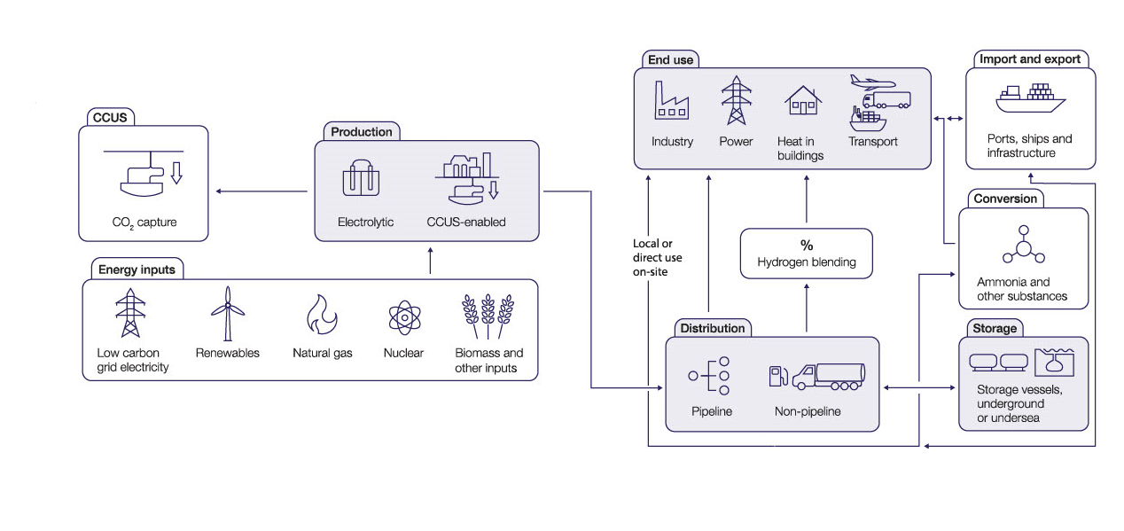
Background
Source: UK Hydrogen Strategy, BEIS, 2021

Slide 4



SCOPE
&
GOALS
Overview
Scope: Historical Analysis of Wind Turbine Fire Incidents
Uncovering reported and unreported wind turbine fire incidents
Objective 1
Investigating the Roots of Wind Turbine Fires
Objective 2
Uncovering Hidden Risks for Advancing Safety in Wind Energy
Objective 3
Quantifying Wind Turbine Fires
Objective 4
IChemE Hazards 33
Notes:
The main goal of this research is defined as Investigations the geometrical features and thermal impact of subsonic and sonic propane jet fires
In order to achieve this goal the following steps were followed:
Building a special experimental setup to make these flames, studying their shapes and sizes, so we can be safer.
Watching these flames closely to understand how they behave -.
Seeing what happens when these fiery flames hit something, like a pipe, to understand the danger they pose.
Also, checking if computer programs can help us predict and understand these flames.

Slide 5
Review existing data and reports from various sources
Background Research
IAFSS
Renewable UK
Wind Power Eng. Magazine
Media
Data Collection
414 wind turbine fire accidents were recorded globally between 1993 to 2021.
Focus Areas of Data Analysis
Data Analysis
Time Analysis
Location Analysis
Wind Characteristics Analysis
Turbine Brand Analysis

Slide 6
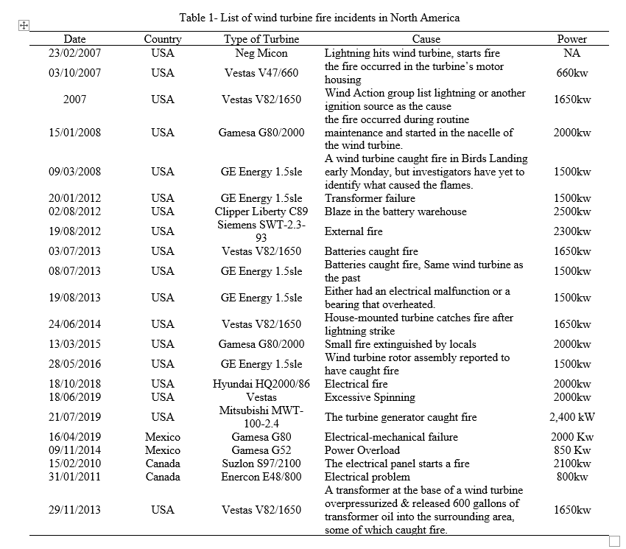
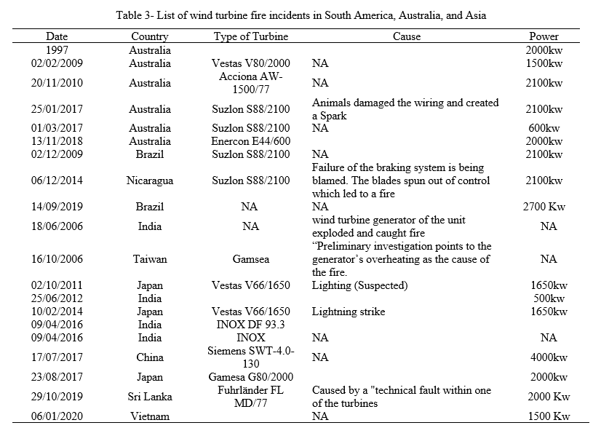
Data collection

Slide 7
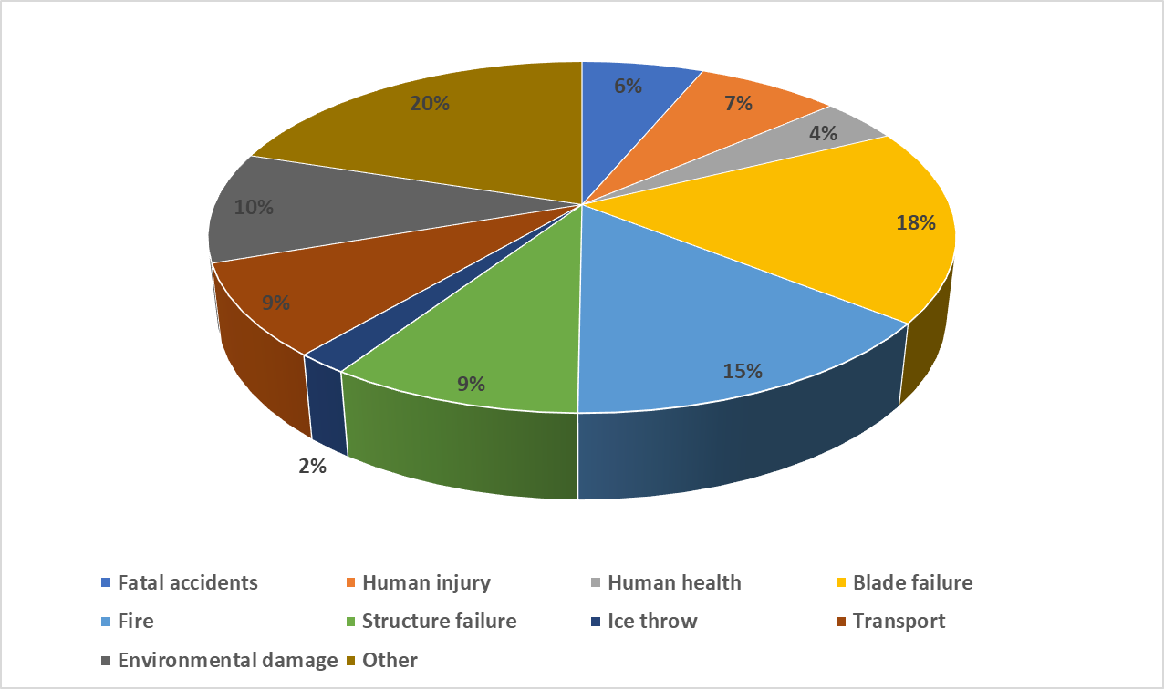
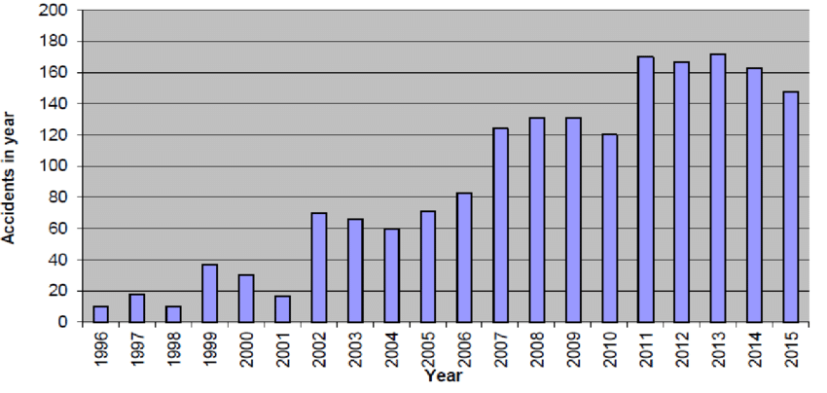
Figure. 1 Evolution of Wind Turbine Fire Incidents Over Time
- Evolution of Wind Turbine Fire Incidents Over Time
17.9% of Incidents: Blade Failures
14.5% of Incidents: Wind Turbine Fires
9.2% of Incidents: Structural Failures
(Tower Collapse and Turbine Damage)
- Most Common Incident Types: Blade Failures, Fires, Structural Failures
- 126 Fatal Incidents Highlight the Importance of Safety

Slide 8
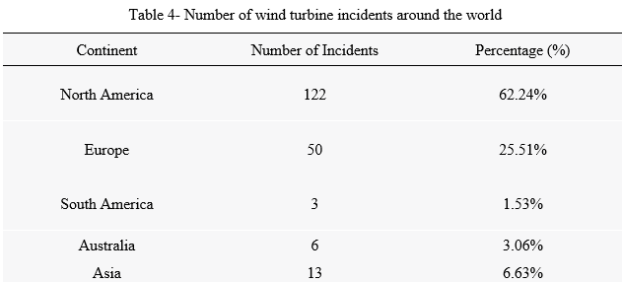
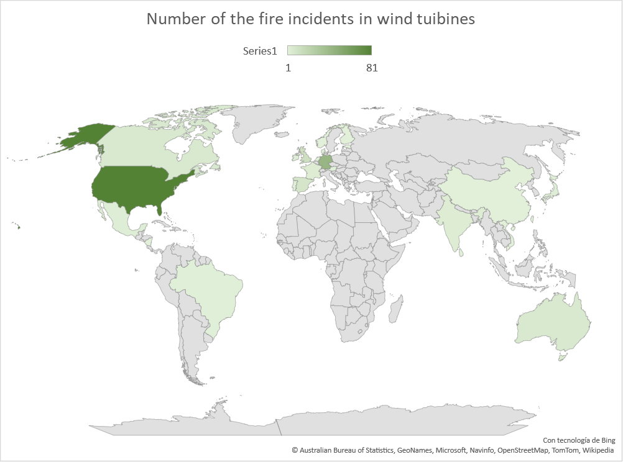
Data Analysis: Geographical Distribution
United States: Leading in Reported Incidents
Germany: A Significant European Contributor
Asia's Growing Presence
Oceania, South America
Figure 2- Distribution of wind turbine incidents around the world

Slide 9
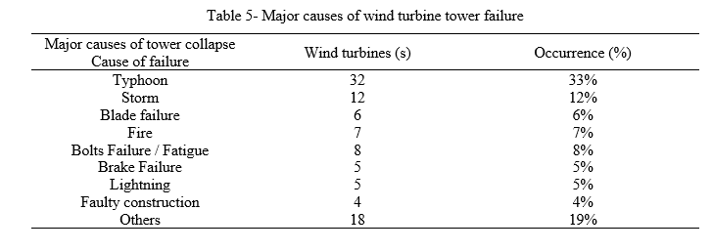
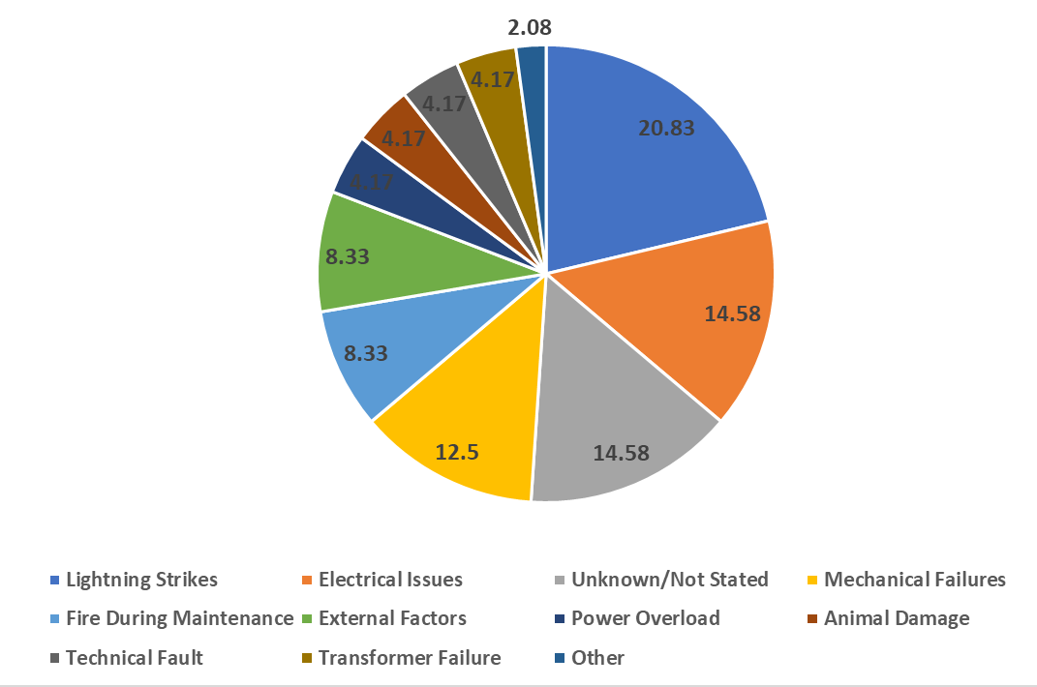
Data Analysis: Root Causes
Leading Cause: Lightning Strikes (20.83%):
Electrical Problems (14.58%)
Unknown/Not Stated" Category (14.58%)
Figure 3- Categorization of the causes of wind turbine incidents

Slide 10
Data Analysis: Root Causes
Lightning Strikes (20.83%)
Vulnerability to Natural Electrical Discharges
Electrical Problems (14.58%)
Maintenance and Inspection
Unknown/Not Stated" Category (14.58%)
Robust Reporting Systems
Mechanical Failures (12.50%)
Robust Design and Maintenance
Incidents During Maintenance (8.33%)
Prioritizing Safety Procedures
External Factors (8.33%)
Fulfil Risk Mitigation Requirements
Less Common Causes (2.08% to 4.17%): Power Overload, Animal Damage, Technical Faults, and Transformer Failures
Fulfil Risk Mitigation Requirements for less predicted scenarios

Slide 11
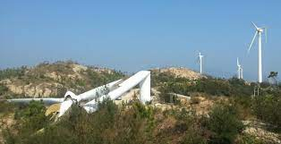
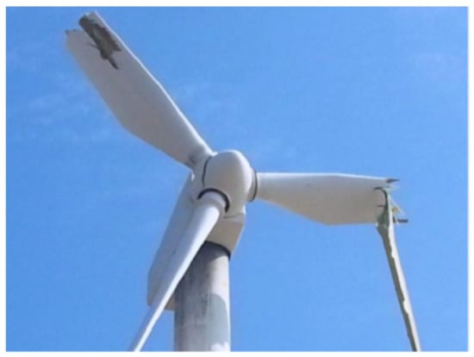
Data Analysis: Brands and Manufacturers
Primary cause: Extreme Wind Conditions (55%)
Secondary Causes (6% to 8% each): Blade Failure, Fire, Bolt Failure, Fatigue
Third Most Prevalent Causes (5% each): Brake Failure, Lightning, Faulty Construction
Figure 4- Photograph showing blade damage due to Typhoon Usagi

Slide 12
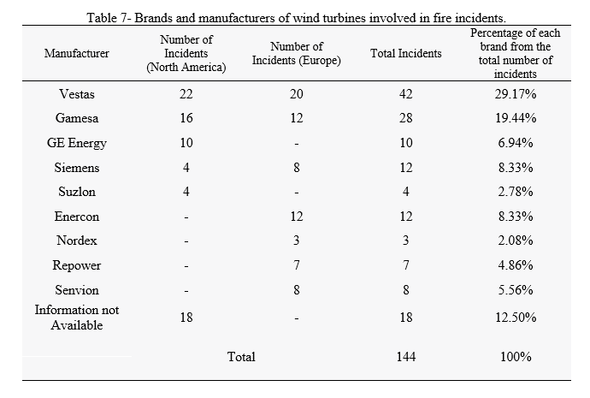
Data Analysis: Brands and Manufacturers
Leading Wind Turbine Manufacturers in North America: Vestas, Gamesa, and GE Energy
Leading Manufacturers in European Wind Energy: Vestas, Enercon, and Gamesa
Diverse Manufacturer Dataset in Europe
Collective Impact of Incidents in Europe
The Need for In-Depth Analysis and Enhanced Safety in Europe
Importance of Comprehensive Data Collection and Investigations
Standardized Reporting Practices to Minimize Risks

Slide 13
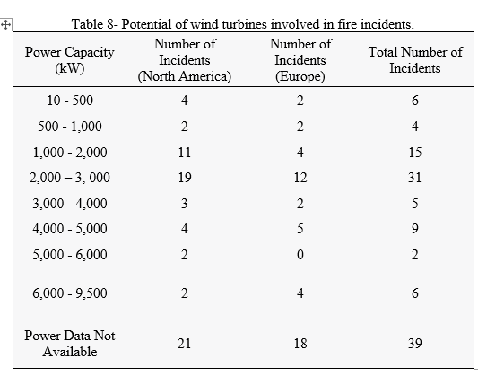
Data Analysis: Wind Potential Analysis
Correlation Between Wind Potential and Fire Incidents
Identifying the 2,000 kW Category as Having the Highest Incidents
Prevalent Capacities in North America: 1500 kW and 1650 kW
Frequent Capacities in Europe: 1500 kW and 1800 kW
Acknowledging Reporting Variations in European Countries
Need for Detailed Examination by Incident Type and Location
Higher-Capacity Turbines May Have Different Risk Factors and Safety Protocols

Slide 14
Conclusions
Geographical Distribution and Manufacturer Analysis
Wind turbine incidents are a global concern, affecting regions across North America, Europe, Asia, South America, Australia, and more..
Notably, the United States leads in the number of reported incidents, emphasizing the need for rigorous safety measures in North America, given its prominent position in the wind energy sector.
Germany and other European countries also play significant roles, highlighting the importance of region-specific safety measures

Slide 15
Conclusions
Brands and Manufacturers
Manufacturer analysis provided valuable insights into the safety records of various wind turbine manufacturers.
In North America, Vestas, Gamesa, and GE Energy are associated with incidents, while in Europe, Vestas, Enercon, and Gamesa emerge as prominent manufacturers.
The presence of incidents categorized as "Information Not Available" in both regions underscores the need for standardized reporting practices.

Slide 16
Conclusions
Wind Potential Analysis
The evaluation of wind potential and its correlation with fire accidents in analyzed countries emphasized the importance of standardized data collection practices.
Power capacity analyses in North America and Europe revealed variations in incident counts across different power capacity categories.
The presence of the "Power Data Not Available" category highlights data limitations, indicating the need for better data collection practices.

Slide 17
Conclusions
Trends and Insights
Different regions exhibit varying power capacity preferences, likely influenced by factors such as wind resources and energy demand.
Identifying common power capacity ranges within each region can assist manufacturers in tailoring their offerings.
Investigating the impact of power capacity on incident rates is crucial, as it can inform safety measures and practices.
The safety records of various manufacturers highlight areas for improvement in design and safety protocols.

