Slide 1
Human Factors issues and solutions when undertaking major projects on operational sites
Andy Brazier – AB Risk Limited
Nick Wise – SSE Thermal
Neil Ford – Atkins.
Notes:
Hello. In this paper we want to share some learning about human factors in major projects taking place alongside an operational site

Slide 2
Author Collaboration
Nick Wise – Client
Neil Ford – Project Engineering Consultant
Andy Brazier – Human Factors Consultant
Notes:
I worked with my 2 co-authors on a couple of projects. Nick represents the client. Neil was with the project engineering team and I provided human factors support.

Slide 3
Salt Cavern Gas storage
Wellhead
National Grid
Gas Plant
SSSV (Sub-Surface Safety Valve)
Casing
String
Cavern
Notes:
A very overview of the business. Salt Caverns were created by leaching. Natural gas is bought when the price is low and put into storage. It is withdrawn when the price is high. We have some fairly convention process equipment at the gas plant. The subsurface element introduces us new equipment and terminology, but it is really a set of pipes and valves.

Slide 4
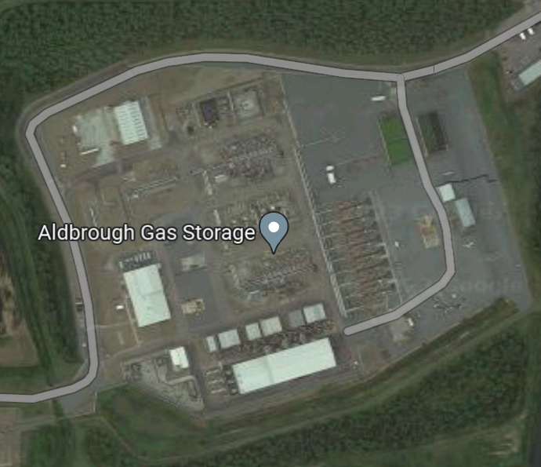
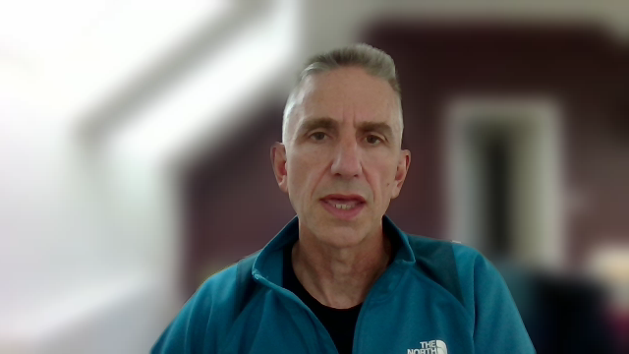
Projects
Project Site
Notes:
The contents of the paper are based on learning from two particular projects. One involved changing the wellhead equipment and the other rewatering a cavern to displace the gas it contains. This involved creating a fairly significant project site in very close proximity to the permanent gas plant, which remained in operation throughout.

Slide 5
Simultaneous Operations
High hazard operation
High hazard projects
Combined hazards
Minimal HF guidance for SIMOPS
Temporary
Project
Permanent Operation
Notes:
The jargon used to describe this situation is SIMOPS. A term that is very widely used in offshore oil and gas, but maybe less so onshore. In this case we had a high hazard permanent operation. Also, a high hazard temporary projects. One of the challenges was understanding the combined hazard. This is the focus of SIMOPS, but we found that very little has been said about human factors in this.

Slide 6
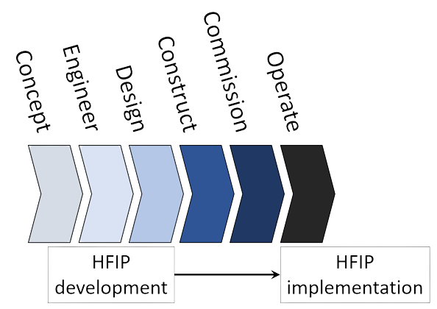
Human Factors Integration Plans
Capital projects
Typical
Focus on operate phase
Misses construction and commissioning
Notes:
A part of project planning it was decided that a human factors integration plan may be useful. When we looked at this we found that these plans are almost exclusively developed for new plants or for significant modifications during engineering and design phases. But the focus is on the human factors requirements for the operate phase. Very little consideration is given to the construction and commissioning phases. It was recognised that our projects would involve fairly significant operations during construction and commissioning, but would never enter a permanent operate phase. We realised we were entering some uncharted water but the client was keen that it happened.

Slide 7
Project - initial screening
Projects performing temporary operations
Temporary teams have significantly different experience, procedures and expectations
Critical HF topics clearly relevant
Tasks identified from project plan / schedule
Criticality ranked (HSE report OTO 1999/092)
Operating company ultimately responsible
Notes:
To develop the HF integration plan an initial screening exercise was carried out. This identified the temporary operations and highlighted a potentially significant difference between the teams working on the operations site vs. the project site.
From the plans being developed it was possible to identify some high criticality tasks, but arguably one of the key realisations was that the operating company is ultimately responsible for actions performed by others on their behalf.

Slide 8
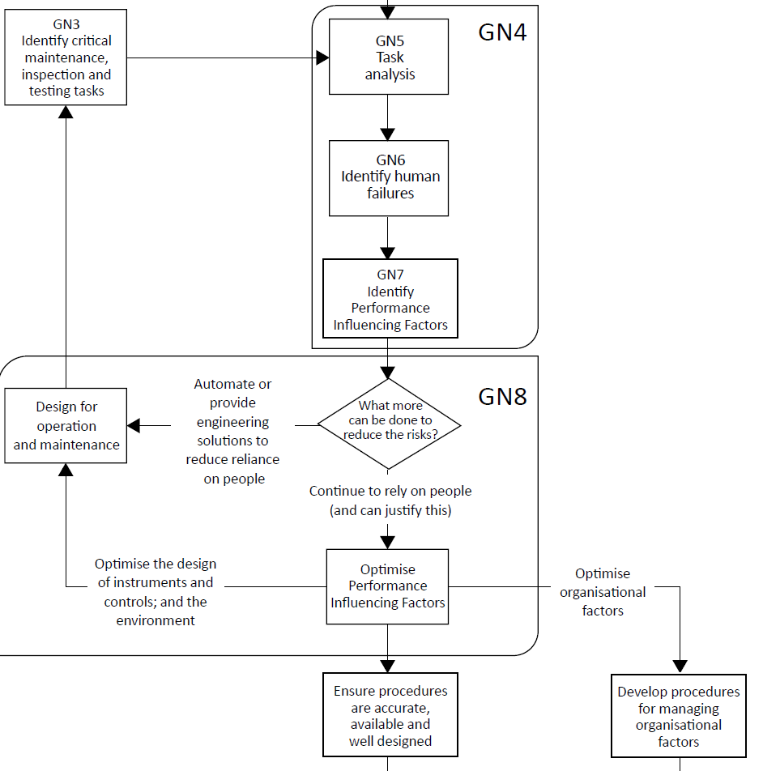
Critical tasks and procedures
Task analysis carried out
Engagement with contractors (first time for them)
Mostly standard activities
Procedures for most critical tasks
Terminology vs understanding
When is the plant “shutdown”?
Is it OK to “Gag in” a pressure transmitter to avoid a trip?
Guidance from Chartered Institute of Ergonomics and Human Factors
Notes:
We followed the standard approach to safety critical task analysis. One of the key elements was engagement with the contractors who would be performing the work during the project. Despite them working in a high hazard industry it was clear that this was the first time they had ever been involved in anything like this.
What we found was most of the work they were going to was fairly standard for them. But some of it was not.
We found they had procedures for most of their tasks. But not all of them, including for some of the most critical.
And we found that terminology sometimes affected our understanding of what was going to happen. For example, when is the plant actually shutdown and is it OK to gag in a pressure transmitter?

Slide 9
Control of work
Workload created for operating team
Contractors assuming they can get a permit whenever they like
Off-site vehicle holding area
Avoiding confined space entries
Notes:
Due to the proximity of the project site the operational site’s permit to work system would be used. The workload created by this was highlighted as a potential issue. A key message was that contractors should make requests in advance, including when wanting to bring vehicles on to site.
Some good work was done to arrange things on site to avoid the need for routine entry to pits, that are considered to be confined spaces.

Slide 10
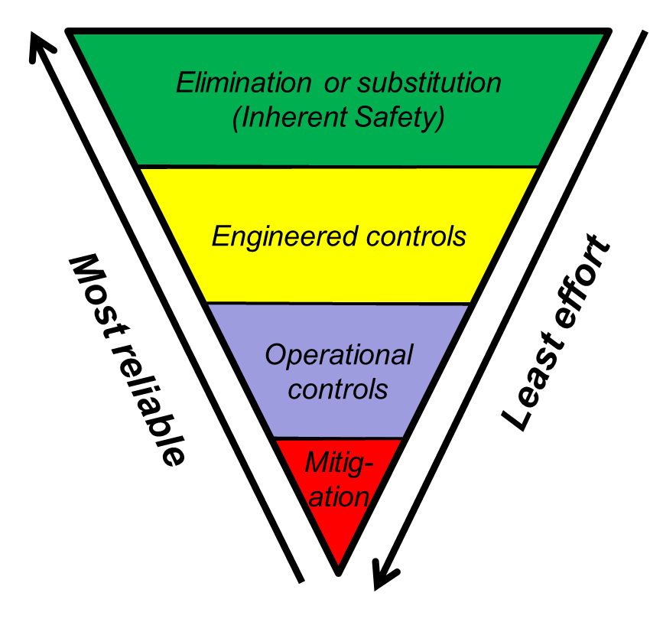
Safety critical equipment
Fewer Safety Instrumented Systems (SIS)
Higher reliance on human actions
Identifying the discrepancy increased awareness and scrutiny
Testing critical equipment
Bench testing before installation
In-situ testing introduced as a result of HF plan
Notes:
One key learning was how project equipment has far fewer engineered controls compared to permanent plant equipment, and so there is much higher reliance on human actions. Whilst would like to have changed that it was not practical. However, being able to identify this did lead to more scrutiny of how risks would be managed.
One thing that came out was that contractors were generally happy that equipment was tested before shipping to site. We were able to get procedures in place for in-situ testing.

Slide 11
Alarm management
Alarms pre-installed on rented equipment
No overall alarm philosophy
Contractors familiar with the alarms
Don’t change them for one project
Types of alarm
Fixed / absolute
Locally set-up based on observations at commissioning
Adjustable
Deactivated at times
Notes:
We know alarms are an issue for permanent operational sites but a new set of issues emerged for temporary project equipment. Because equipment is rented it is difficult to apply any for of overall philosophy and making changes for a single project would be problematic. One thing we found was that alarm management is quite dynamic. Some alarms are fixed but other are adjusted on site and may be deactivated by operators for certain activities. Again, we would rather have got away from this but we were at least able to ask for some recording and assessment of changes that are made.

Slide 12
Critical communications
Site telecoms improved
Daily meetings to share plans
Terminology
Clearing a trip by pressurising pipework or using an override?
Notes:
Communications was identified as critical. Site telecoms had been improved, which was good. The importance of daily meetings to share plans for both the operational and project sites were formalised.
Terminology was again highlighted. For example, when starting some equipment there was a note in a procedure that a low pressure trip would have to be made healthy. We may assume that that would involve pressuring the pipework to above the trip point. In discussion we found that the more likely method would be to override it by one of several methods.

Slide 13
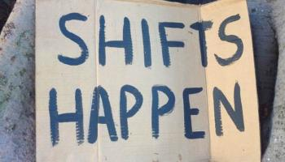
Fatigue management
Contractors and operators working 12 hour shifts
Contractors happy to work three weeks or more without a break
What about activities before mobilisation and travel time to site?
No formal system for evaluating hours actually worked (over time)
Notes:
The operations and project teams both work 12 hour shifts. The big difference is that contractors are happy to work 3 weeks or more without a break. And we would not know what they had been doing in the weeks proceeding mobilisation to site or how long they may have travelled.
Everyone was going to get paid for their hours worked but no one was looking at the figures to look for any fatigue risks.

Slide 14
Emergency response
Interfaces between project and operators
Different assumptions on both sides
Terminology again
Some well control “emergencies” are not an immediate threat
Others can escalate rapidly and require immediate evacuation
Routine emergency exercises
Off-site personnel
“Silver command”
Duty Manager
Notes:
Given that both the operational and project activities were high hazard, it was clear that emergency response had to be a critical consideration. We found both had good procedures in place for themselves, but made some assumptions about what others would be doing. Again terminology was a potential issue. Some events may be described as well control emergencies but with little threat. Others may have less dramatic titles but require a wider ranging response.
Routine exercises were included in the project plan. Also, people working off site who may have role in an emergency had to be considered

Slide 15
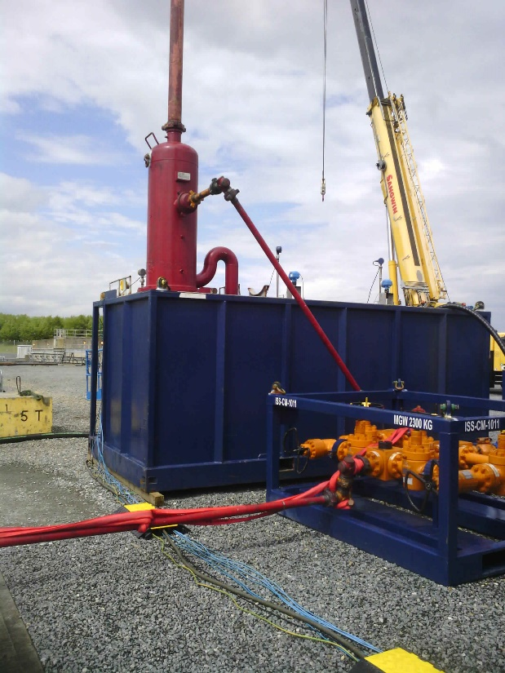
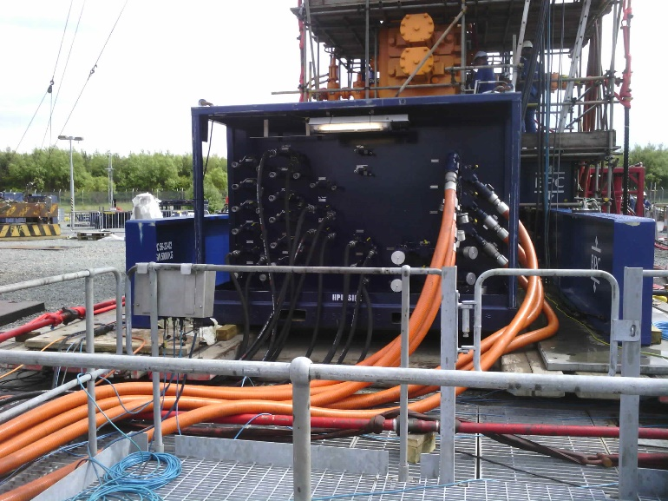
Site visit
Snap-shot of Performance Influencing Factors (PIF)
Neat and tidy site
Contractor single team
Observations
PSV selector valve – not locked
Open ends on pipework
Mobile pump safe but not consistent with site rules
Tank filling by dangling a hose over the edge
Tank contents not displayed
Notes:
One activity for us as part of the human factors plan was a site visit. This proved to be a useful way of evaluating performance influencing factors, but west will in the world it could only be a snap shot.
In general we were very impressed. There was a lot of equipment but it was neat and tidy. And the different contractors were working together as a single team.
We did notice some things that would not be tolerated on the permanent operational site. There was a safety valve selector valve that was not locked, open ends on pipework and a plan to fill a tank by dangling a hose over the edge.

Slide 16
Key contents for HFIP
Issues known to contribute to major accidents
Constraints on ability to optimise HF integration
Dependencies with other development activities
Plan for HF studies at key stages of the project
User involvement (contractors)
Progress monitoring vs plan
Creating a forum to optimise between the ideal and practicable solutions to problems.
Notes:
The human factors integration plan developed for these projects was based on some in-house guidance. We found these items most useful.
Focussing on major accidents but being mindful of constraints and other activities that have to be considered.
Developing a clear plan for human factors studies and making sure the right people attend. Actions inevitably arise, and there has to be a realistic understanding of how and when they will be dealt with.
Overall, the main benefit of the plan is that it can create a constructive forum for identifying and resolving potential issues.

Slide 17
Conclusions
Legal and moral obligation to manage risks to ALARP
Delegating responsibility to contractors does not reduce risk exposure
Temporary projects rely on human action far more than permanent operations
A human factors approach created a collaborative approach and shared understanding
Emphasised the need to scrutinise project plans – early!
Notes:
This work reminded us that an operating company has the ultimate legal and morale duty to manage risks and that human factors is a key part of that. Delegating responsibility for work does not reduce exposure to risk.
Temporary projects rely far more on human actions that would be accepted for permanent operational sites. Taking a strategic approach using a human factors integration to focus efforts was very effective at achieving collaboration and shred understanding.
Despite employing highly competent and experienced contractors we found quite a number of potentially significant issues that needed scrutiny. By doing this at the planning stage we had a chance to develop an effective solution. Without this we would have been relying on a more dynamic approach, developing solutions on the hoof.

