Slide 1

Reflekt
Situation Awareness as a factor in Accidents and Incidents
IChemE Hazards33, Birmingham 9th November 2023
Graeme Dick, B.Sc. Hons. FIChemE, Senior Safety Advisor,
Mike Pollard B.Sc. Hons, Senior Safety Advisor,
Reflekt AS
©Reflekt AS

Slide 2
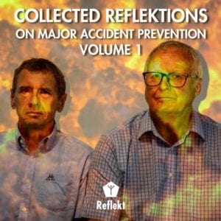


Reflekt – www.reflekt.as
Started in October 2017
Learning from Major Accidents
Reflekt
Investigation of incidents, series of incidents, successes
Assessment of vulnerability to Major Accident
Facilitation of risk workshops and post-activity wash-ups/lessons learned
Seminars
Weekly Reflektions (newsletter), available in book form
Fuelbox for Major Accident prevention
©Reflekt AS

Slide 3
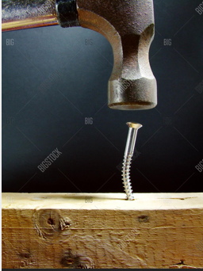
Situation Awareness
Reflekt
Buzzword for causes to accidents
Misuse of the term for example
‘The pilot did not have adequate situation awareness therefore was negligent’.
Situation awareness is more than ‘just paying attention or not’.
©Reflekt AS

Slide 4
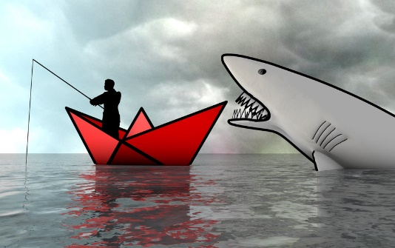
Situation Awareness
Reflekt
Information gathering – know the typical sources of information available.
Understanding information – be able to interpret the information gathered.
Anticipation – be able to anticipate how a situation will develop and change.
©Reflekt AS

Slide 5
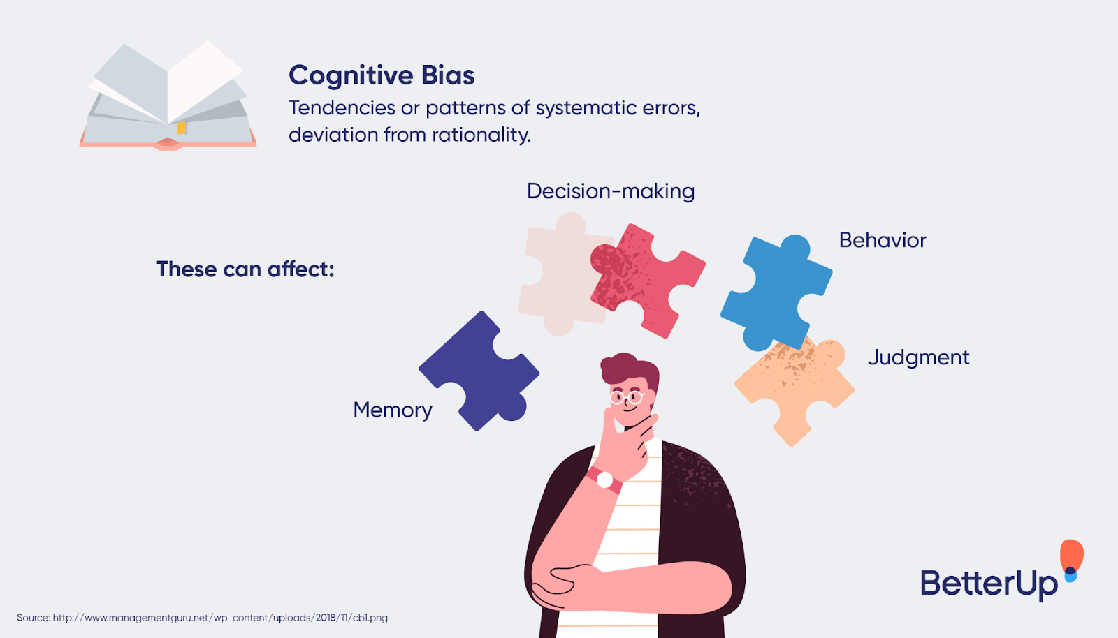
Cognitive biases
Gathering – understanding- anticipation
Reflekt
Human beings have been programmed with cognitive biases as part of evolution. These biases have a significant influence on our situation awareness.
We are not trying to re-program people we are trying to work around the disadvantages.
©Reflekt AS

Slide 6
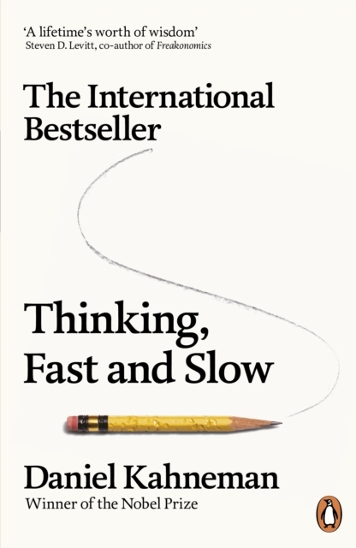
Reflekt
Cognitive Bias and
Situation Awareness
Outcome bias
Confirmation bias
Hindsight bias
Optimism bias
Negativity bias
Anchoring
Cognitive miser theory
Zeigarnik effect
©Reflekt AS

Slide 7
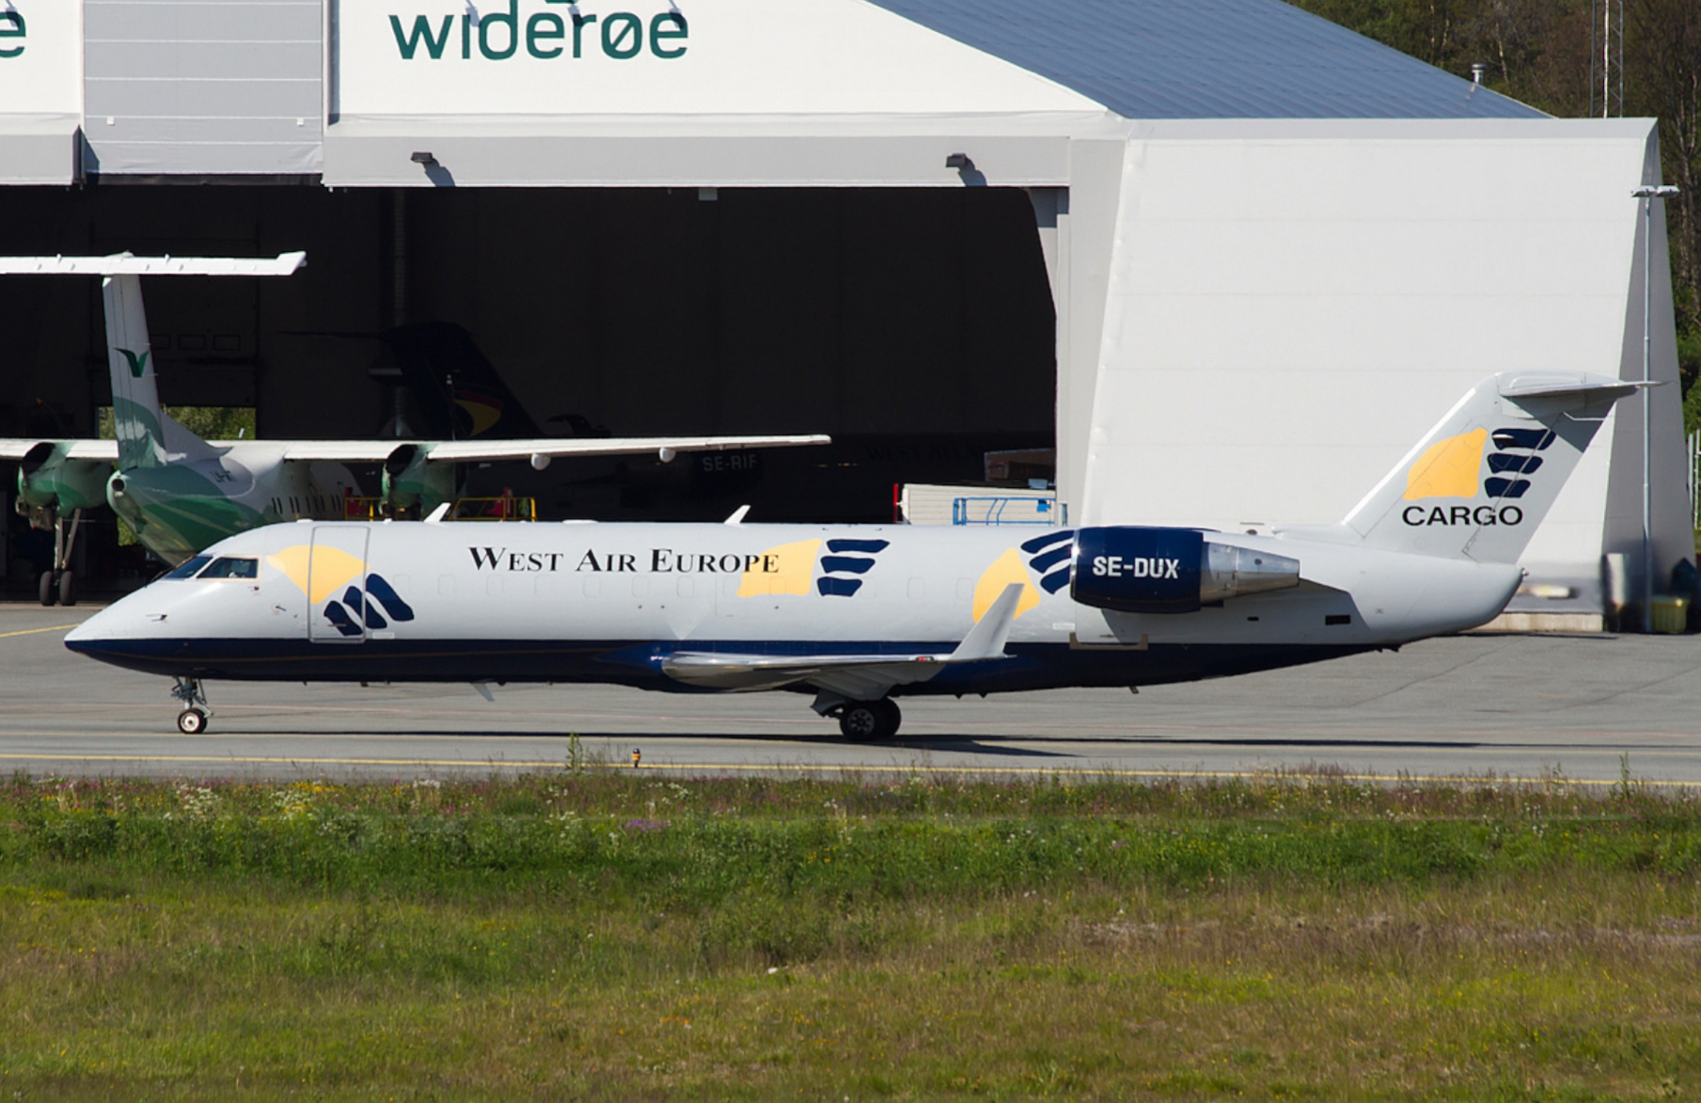
West Air Sweden Flight 294
Reflekt
Cargo flight with captain and first officer on board.
On the night of 8th January 2016, the aircraft fell 6485 meters in 60 seconds and hit the ground at 1000 km/hr.
©Reflekt AS

Slide 8
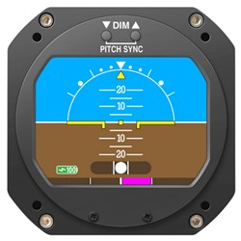
West Air Sweden Flight 294
Reflekt
Cabin lights switched on for pre-landing checklist
During the check list captain says ‘what’.
He pushes the controls forward and puts plane into a dive
First officer reacts saying ‘what’ and tries to pull out of the dive
Crash (60 seconds later)
Attitude indicator (AI)
©Reflekt AS

Slide 9
West Air Sweden Flight 294
Lights on in cabin and crew lose the outside horizon
During the check captain notices the AI indicates aircraft climbing (incorrect reading). Alarm on control panel indicates AI discrepancy
Captain reacts to reading and puts aircraft into a dive. Actions disengage autopilot.
Dive situation causes flight control system to adopt non-clutter mode – discrepancy alarm disappears
First officer tries to pull out of dive, working against captains’ actions
G-forces caused spatial disorientation.
No clarification of situation, two different awarenesses
Reflekt
Attitude indicator (AI)
©Reflekt AS

Slide 10
West Air Sweden Flight 294
Reflekt
Alternative dialog
‘My instrument is reading pitch up what does your instrument indicate?’
‘My instrument is reading level flight, must be a problem with yours’
‘Ok, switching to back-up instrument, make a note to report the fault’.
Attitude indicator (AI)
©Reflekt AS

Slide 11
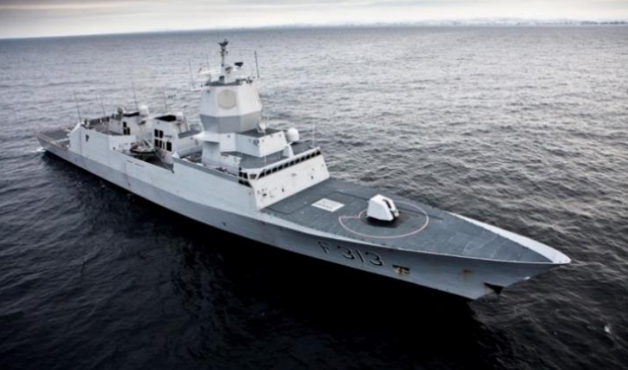
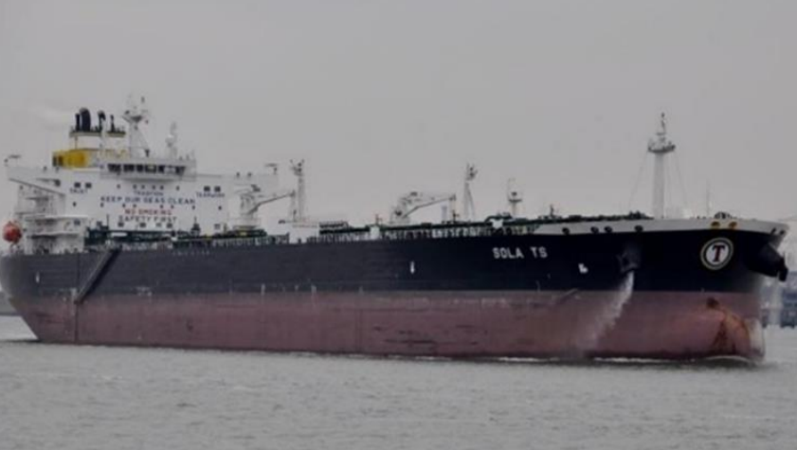
Helge Ingstad collision with Sola TS
Reflekt
Sola TS - Oil tanker
Length 250 m, breadth of 44 m
112939 tons
Helge Ingstad - Norwegian navy frigate
Length 133.25 m and breadth of 16.8 m
5370 tons
https://www.youtube.com/watch?v=U0aOfNnmU8s
©Reflekt AS

Slide 12
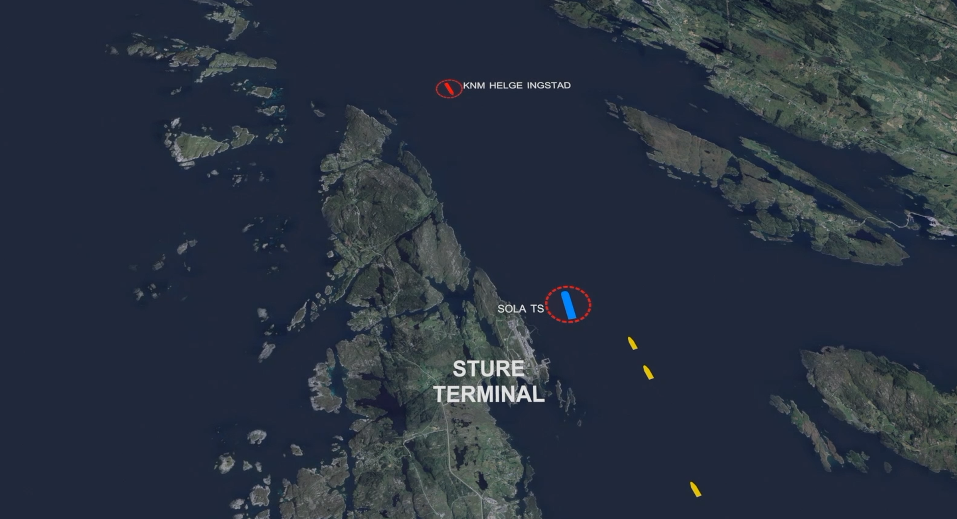
Overview
Reflekt
©Reflekt AS
Notes:
.

Slide 13
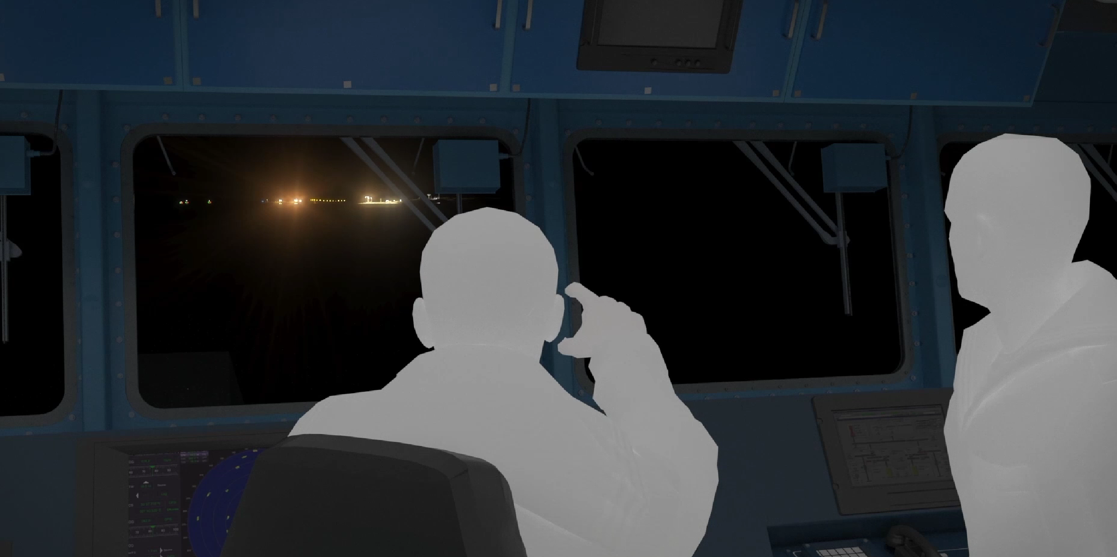
Anchoring and confirmation bias
Reflekt
©Reflekt AS

Slide 14
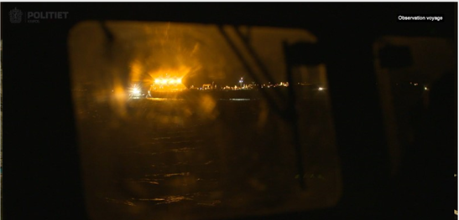
Anchoring and Confirmation Bias
Reflekt
©Reflekt AS

Slide 15
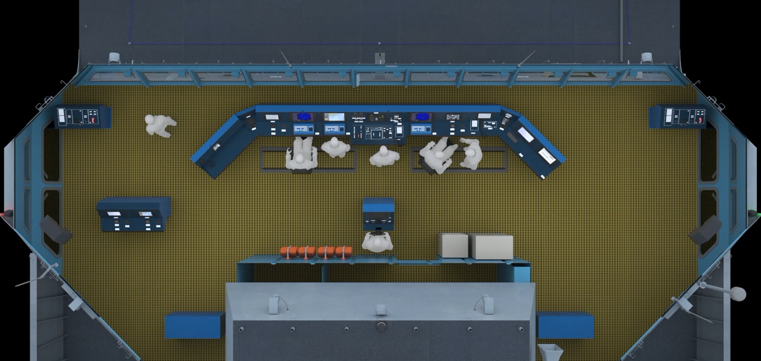
Distractions
Reflekt
©Reflekt AS

Slide 16
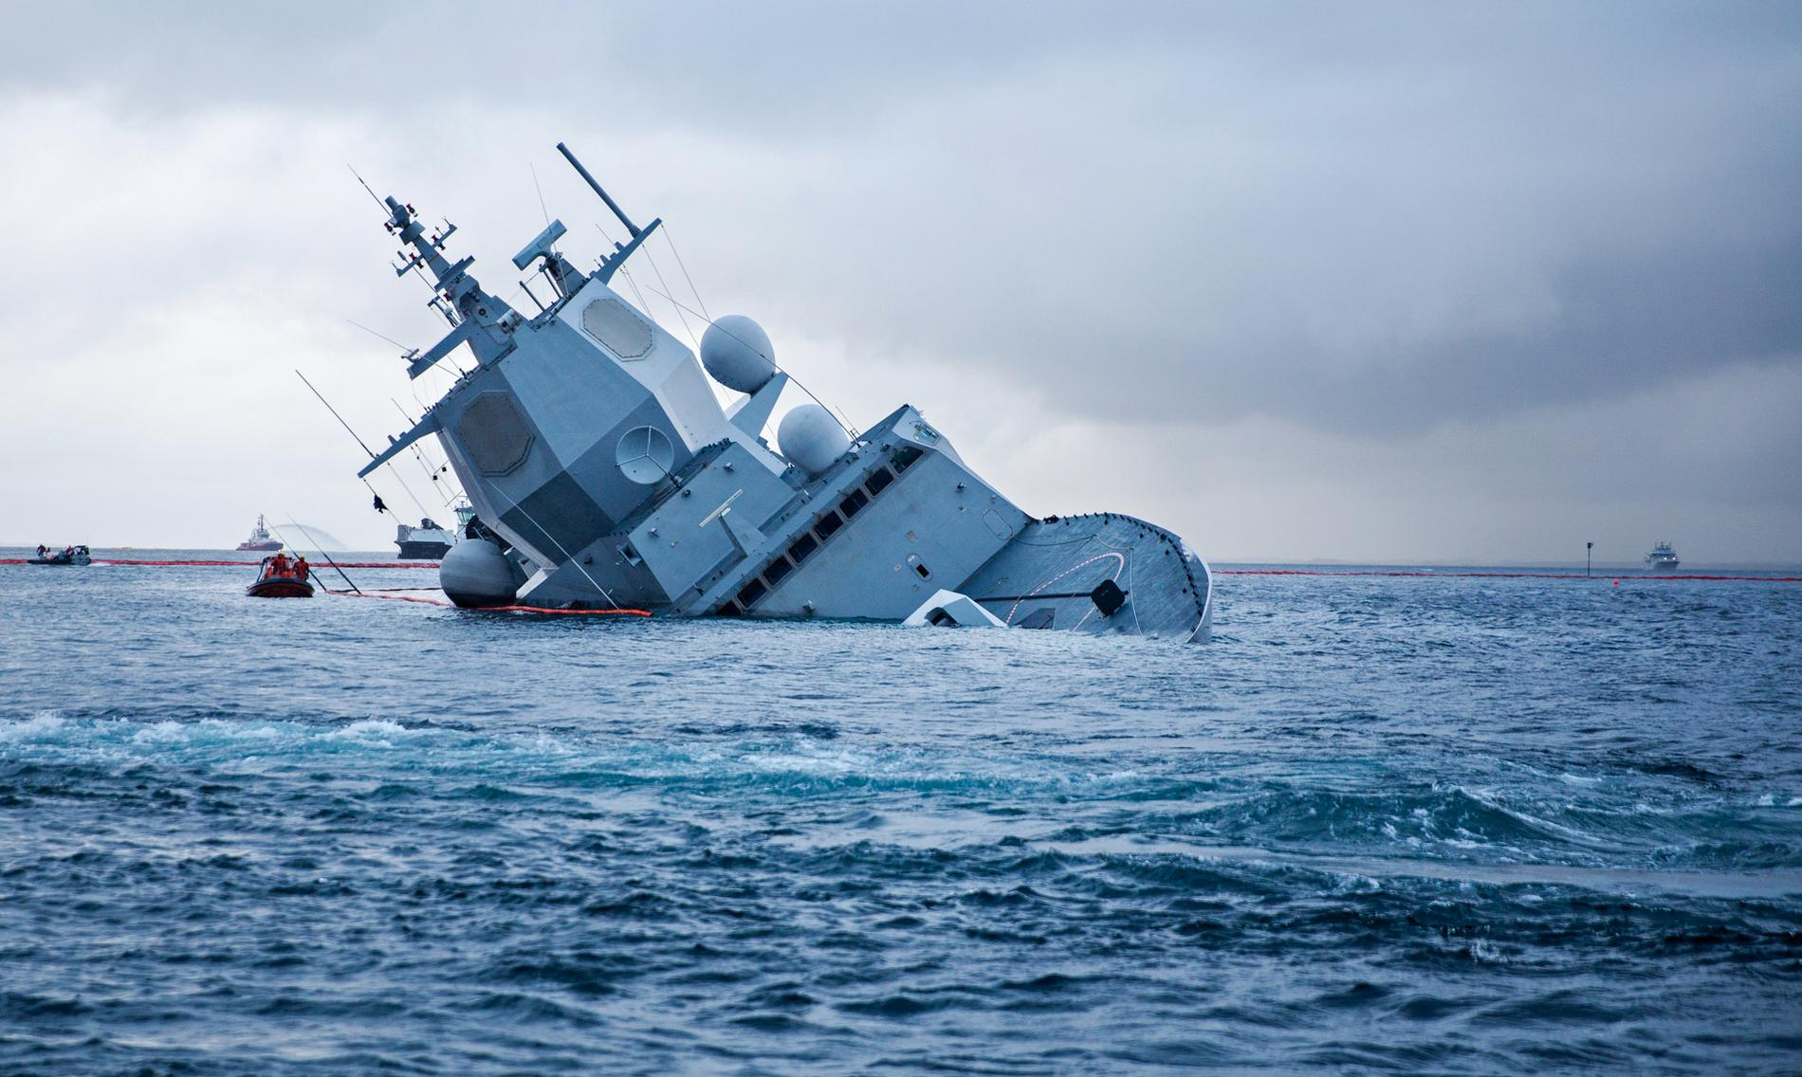
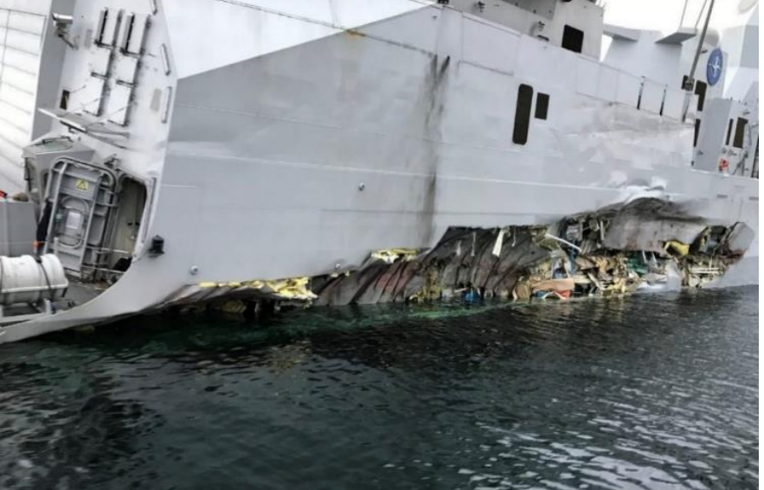
Damage to Helge Ingstad
Reflekt
©Reflekt AS

Slide 17
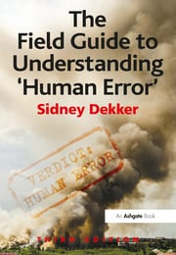
Understanding Human Error
People in general do not set out to cause an accident or a hazardous situation.
People normally want to do a good job and certainly want the job done without hurting anyone including themselves.
We need to find out why people did what they did
We need to understand why it made sense for them to do what they did.
Sidney Dekker calls this the ‘New View’
Reflekt
©Reflekt AS

Slide 18

Improving situation awareness
Reducing the effect of cognitive bias
Reflekt
Stories and films on incidents and accidents (emotional investments)
©Reflekt AS

Slide 19
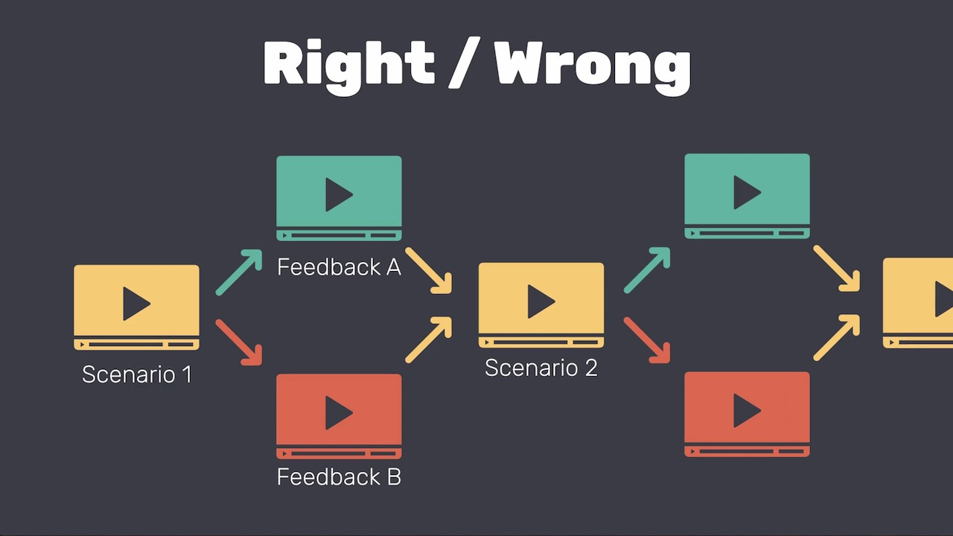
Improving situation awareness
Reducing the effect of cognitive bias
Reflekt
Tabletops
Exercises
Scenario training
Role playing
©Reflekt AS

Slide 20
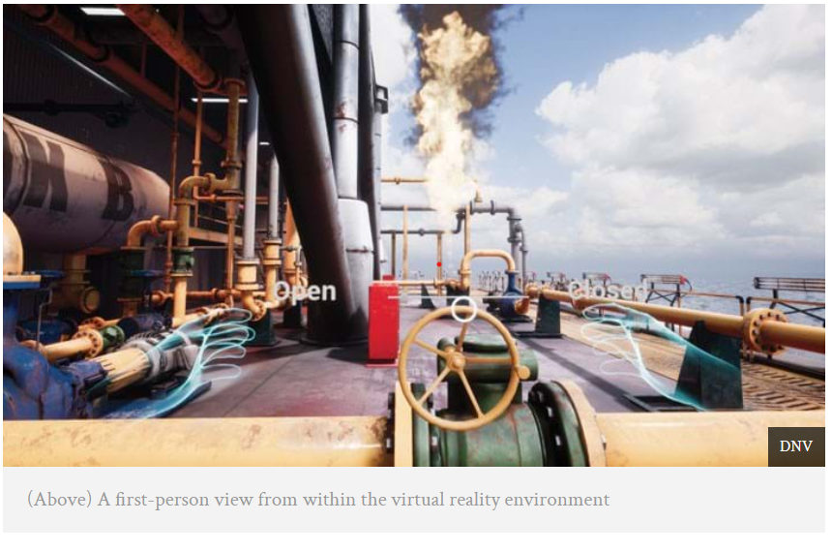
Improving situation awareness
Reducing the effect of cognitive bias
Reflekt
Animations
Simulators
Virtual reality
©Reflekt AS

Slide 21

Reflektions
Reflekt
We need to look for situation awareness and the factors that influence situation awareness in our incident investigations.
We need to set up training, experience transfer and learning that considers how to improve situation awareness.
In any incident, i we can’t understand why people did what they did and why it would have been rational for them to do it, then we really don’t know what happened and are in a poor position to judge.
©Reflekt AS

