Slide 1
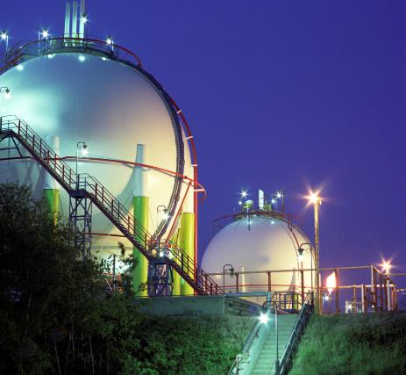
EI15 5th edition
^{Improvements and Changes}
Steve Sherwen &
Tim Jones (RPS)
9th November 2023

Slide 2
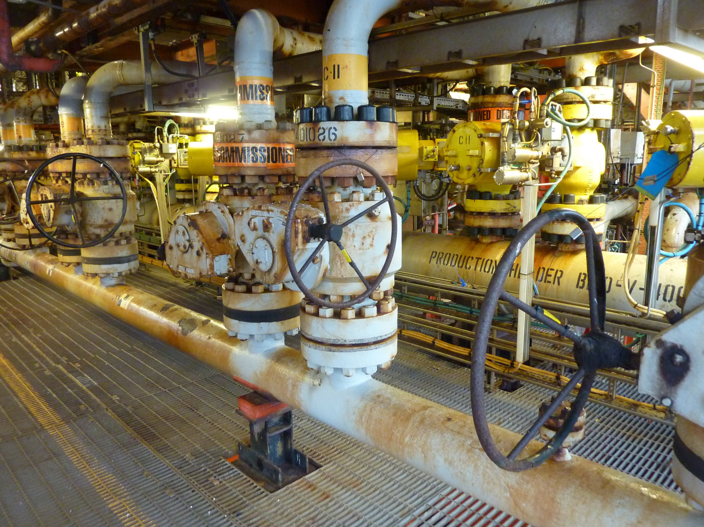
EI 15 5th Edition
Structure
  Acknowledgements
  Overview and Introduction
  Legislation and Definitions
  Modelling
  Significant Changes
  Summary
The statements and data in this paper are for information only. Until the 5th Edition is formally issued by the EI in 2024, this information is subject to change and so should not be used to justify any technical decisions.

Slide 3
RPS Risk Services
Explosive Atmospheres
(ATEX / DSEAR)
Hazard Identification & Analysis
Risk Analysis, Assessment and Management
Quantitative Risk
Assessment (QRA)
Fire Safety
Functional Safety
Safety Case /
Safety Reports
Environmental
Assessment
Safety Critical Elements (SCEs)
CFD
Bowtie Software, Analysis & Training
Human Factors
Fire & Explosion Modelling
Fire & Gas Detector Mapping
HAZOP
Accident & Incident Investigation
Training
LOPA/SIL
Machinery Safety
HAC

Slide 4


















RPS Risk Clients

Slide 5
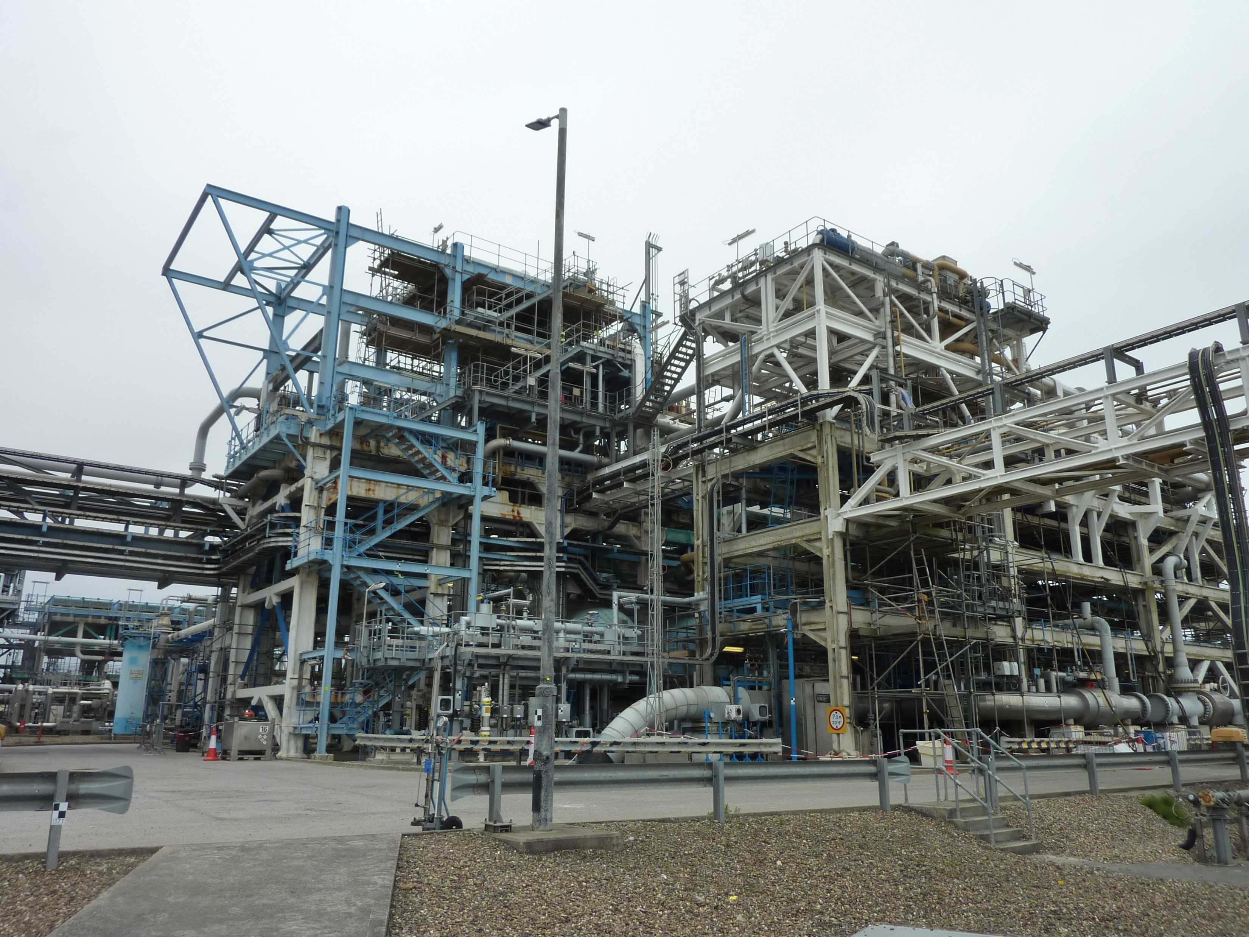
Acknowledgements
Thanks to:-
  Energy Institute (EI) for allowing RPS to present this paper.
  EI15 Working Group.
  Special thanks to Kieran Glynn (Working Group Chair) and to Laszlo Komaromi who organised the revision, the Working Group and drafted the document for publication.

Slide 6
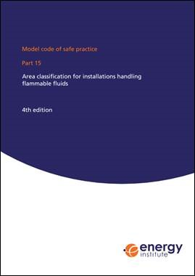
Energy Institute EI15
Widely recognised and accepted code of practice.
Written for petroleum installations by end users.
Methodology transferable to other chemical installations.
Referred to in BS EN IEC 60079-10-1:2021 as industry guidance.

Slide 7
DSEAR
Classification of areas containing explosive atmospheres
Regulation 7 requires areas where explosive atmospheres may occur to be classified into hazardous and non-hazardous workplaces. Any hazardous workplaces should also be classified into zones. Such workplaces and zones should be identified as part of an employer's assessment of risk under Regulation 5.
Additional guidance on hazardous area classification and controlling ignition sources is contained in the following publications:
  (a) Model Code of Safe Practice Part 15 Area Classification Code for Installations Handling Flammable Fluids

Slide 8
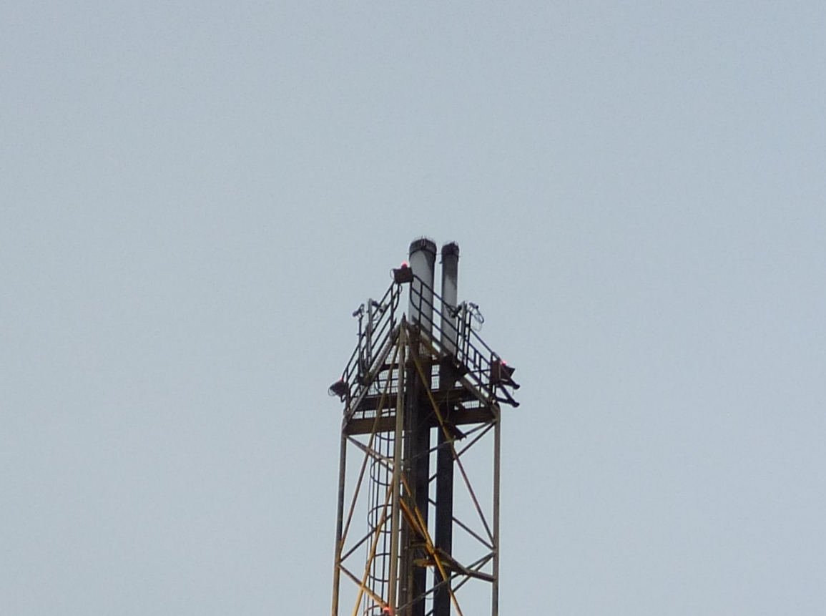
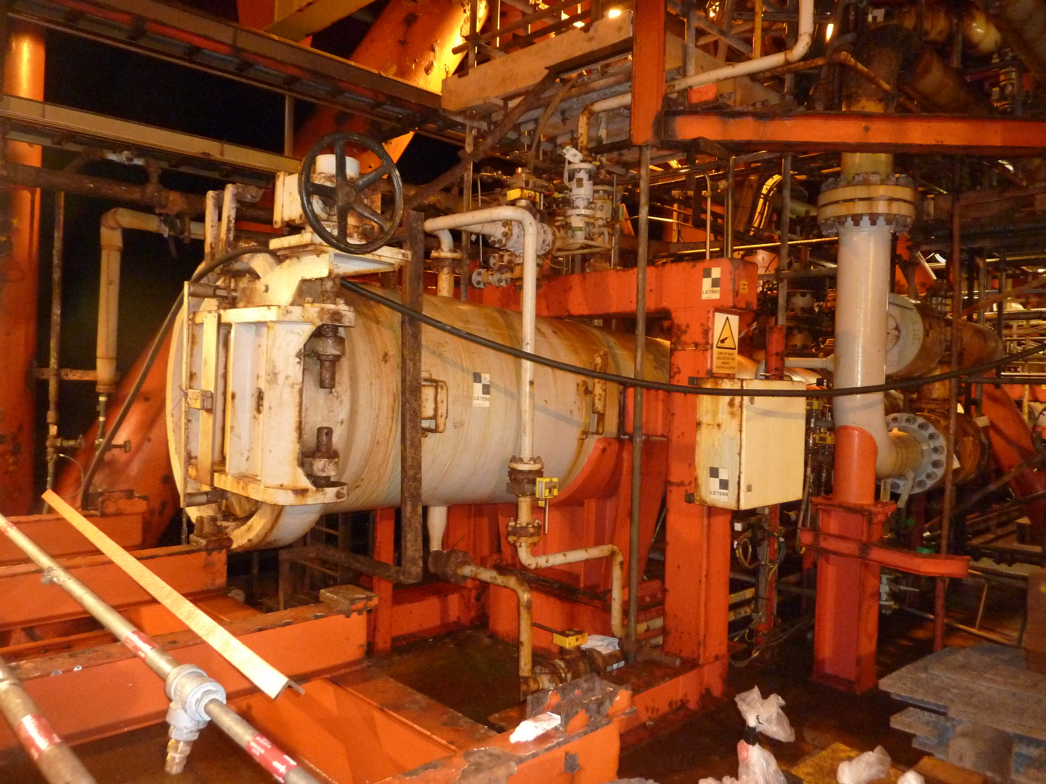
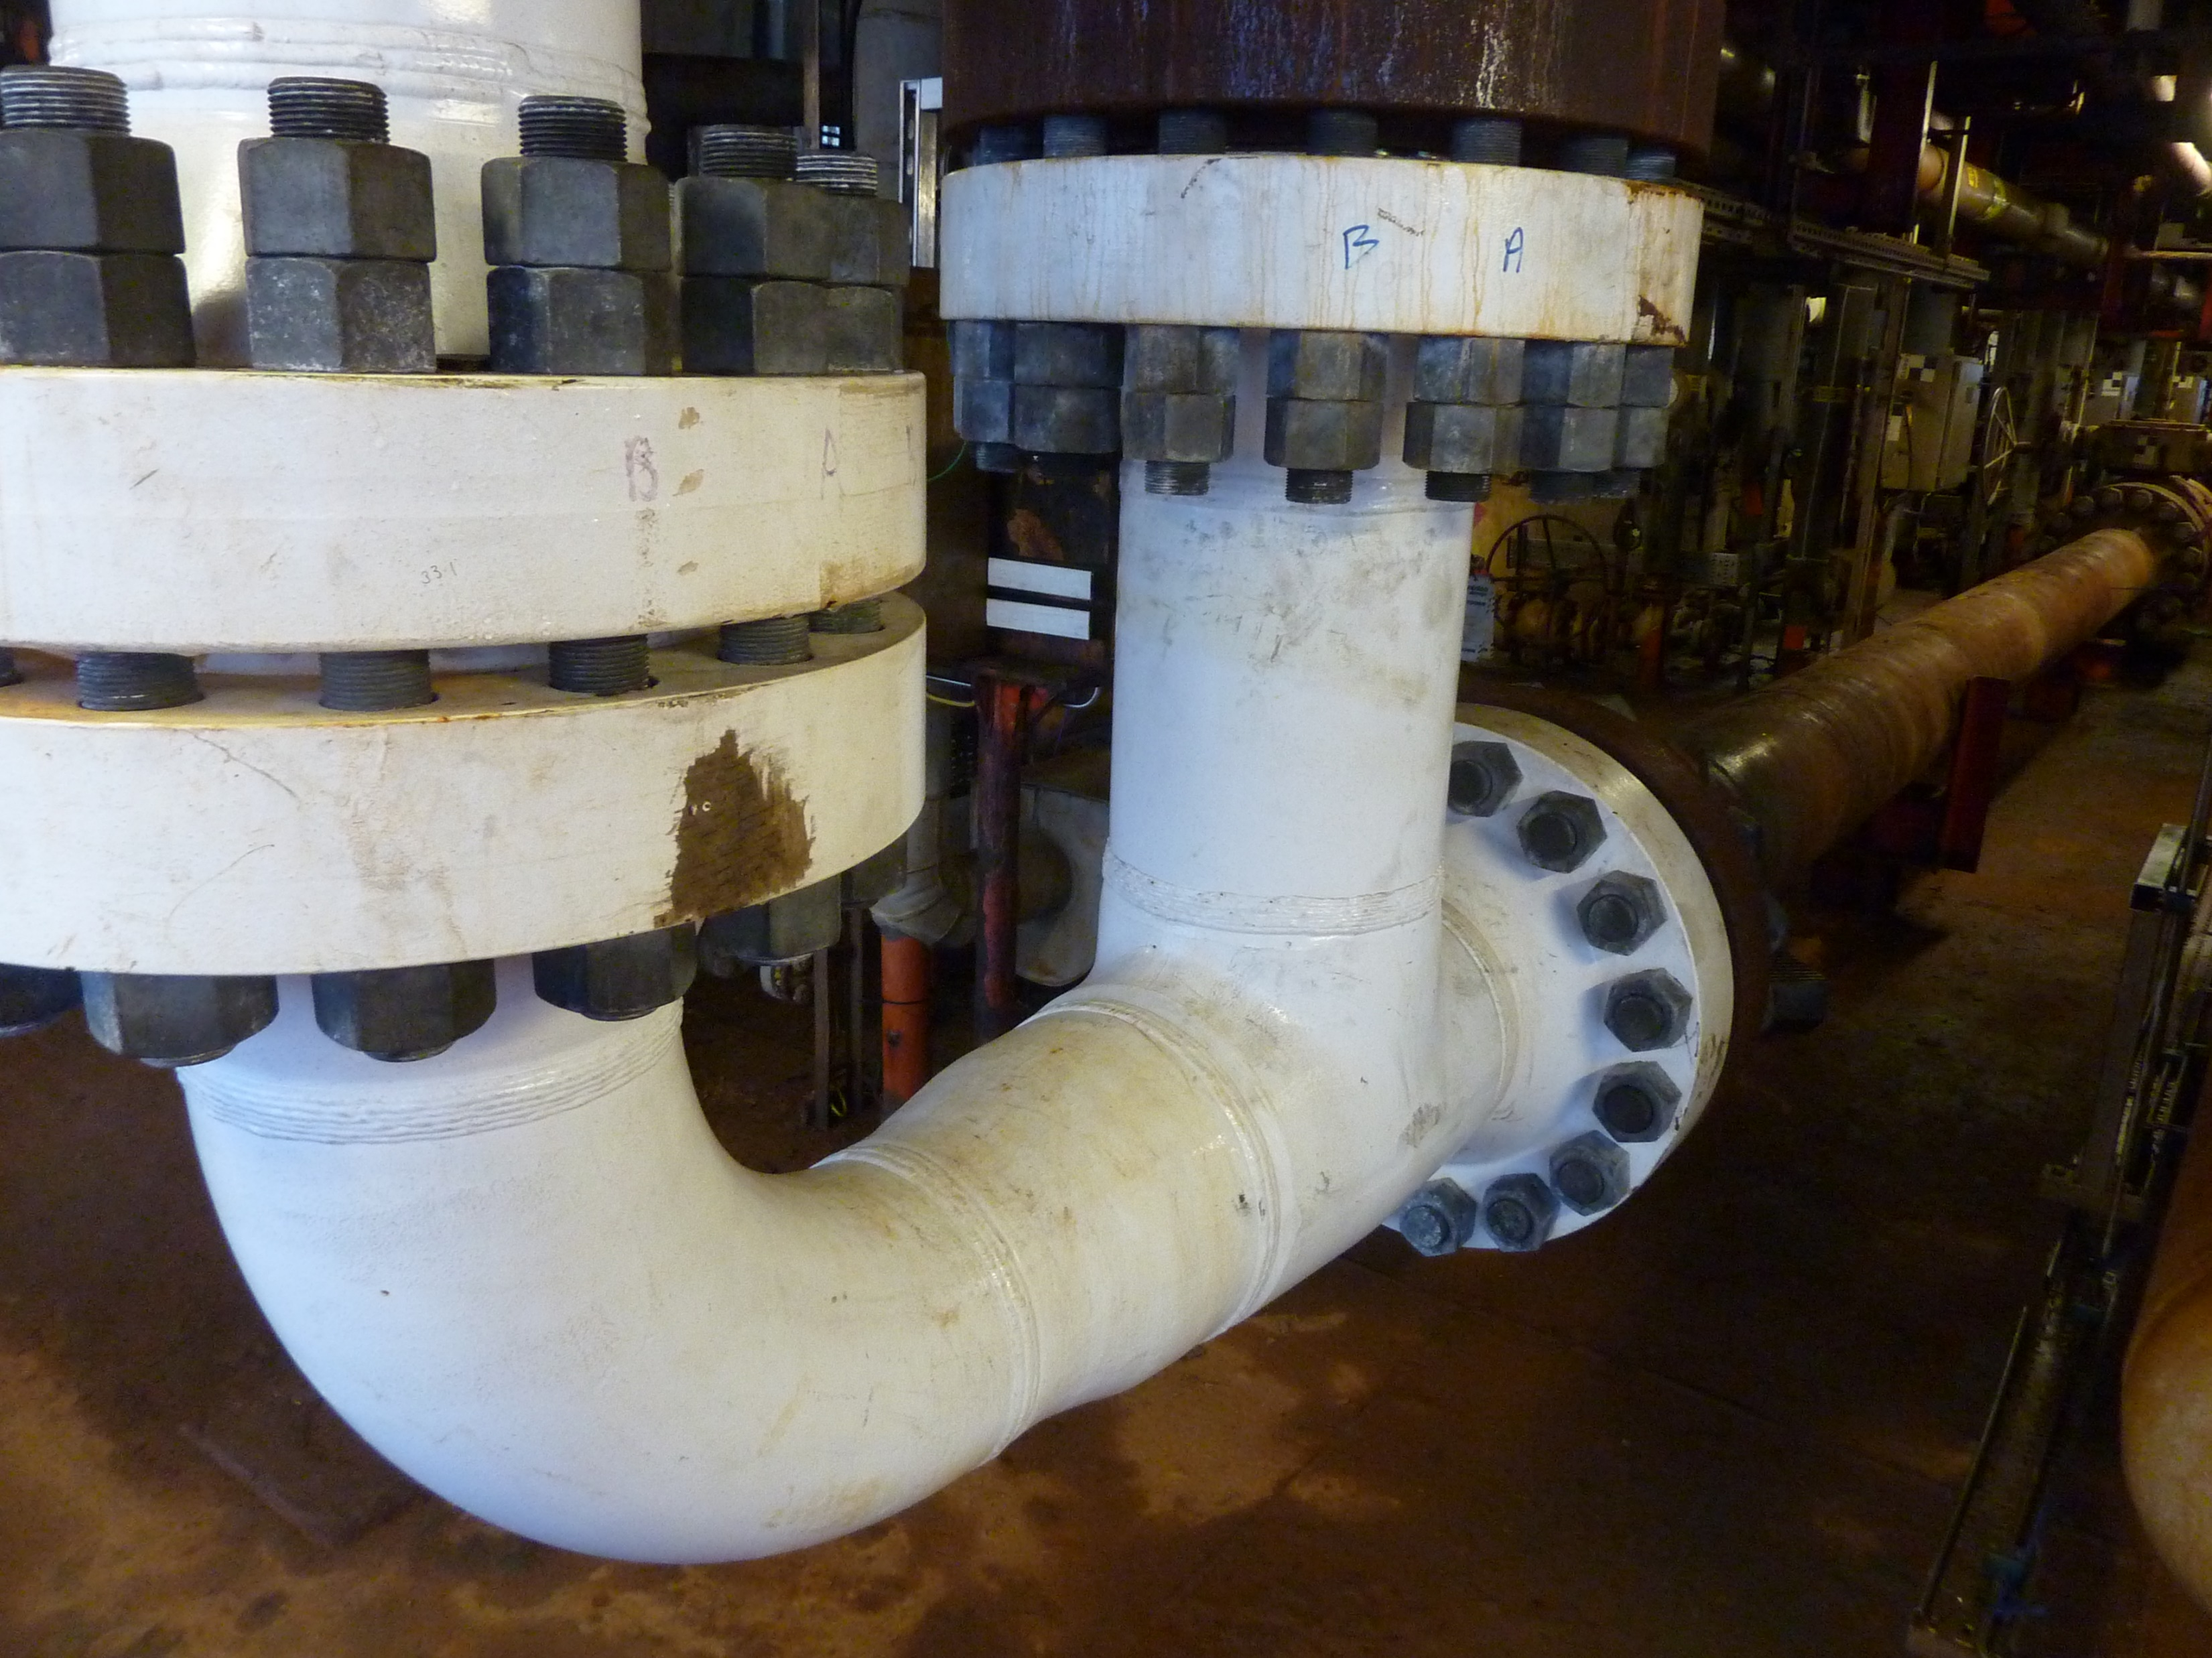
Zone Definitions
Combination of frequency/ size or release and the ability of the ventilation to dilute/ disperse.
  Zone 0 – a flammable atmosphere present all the time – ignition sources must be excluded.
  Zone 1 – a flammable atmosphere present during normal operation – ignition sources must be tightly controlled.
  Zone 2 – a flammable atmosphere is there infrequently (foreseeable failure) – ignition sources must be controlled.

Slide 9
Modelling Validation - Objectives
  Revalidate zone extents in 4th edition of EI15.
  Addition of gaseous and liquid hydrogen.
  Conduct sensitivity analysis.
There will be a research report that accompanies the 5th Edition of EI15. This presentation gives an overview of some of the key findings but there is additional detail in the research report (over 450 pages of tables and figures!).

Slide 10
Modelling Validation - Introduction
Existing Zone Extents
  Pressurised releases (Table C4).

Slide 11
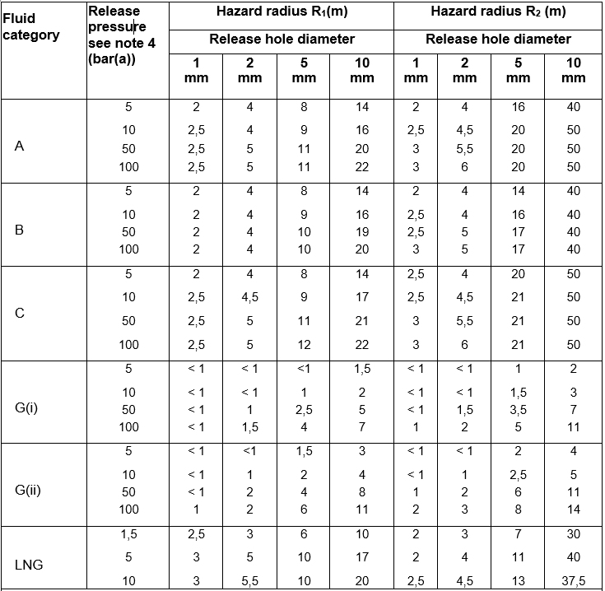
Modelling Validation – Table C4

Slide 12
Modelling Validation - Introduction
Existing Zone Extents
  Pressurised releases (Table C4).
  Atmospheric and process vents (Table 3.1 and 3.2).

Slide 13
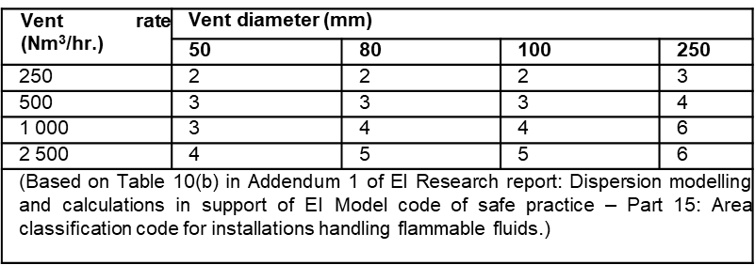
Modelling Validation – Table 3.1

Slide 14
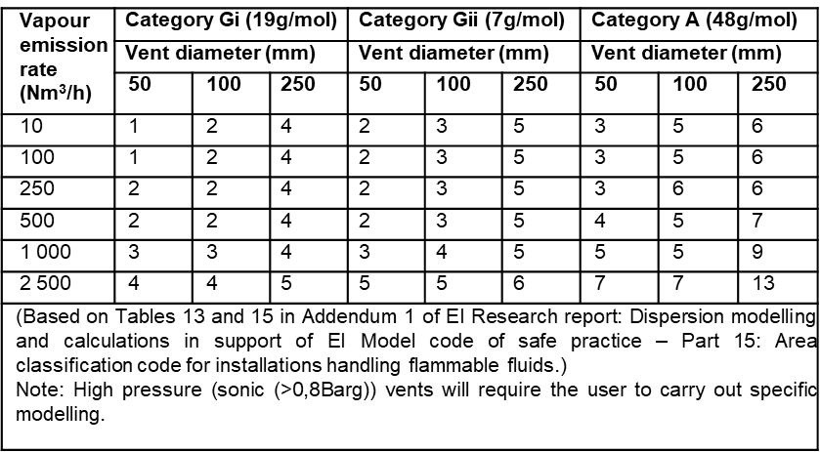
Modelling Validation – Table 3.2

Slide 15
Modelling Validation - Introduction
Existing Zone Extents
  Pressurised releases (Table C4).
  Atmospheric and process vents (Table 3.1 and 3.2).
  Liquid pools (Table C6)

Slide 16
Modelling Validation – Table C6

Slide 17
Modelling Validation – Findings
Notes:
Previous modelling used PHAST v6.51.
Pseudo-component modelling – essentially averages properties and composition does not change between storage conditions and release conditions.
Multi-component modelling – is able to handle mixture properties more rigorously. Captures how composition of different phases changes between storage and release conditions. Is not able to capture rain-out though which is key for some fluid categories.

Slide 18
Modelling Validation – Pseudo vs Multi-Component
Use of multi-component modelling. For the various fluid categories the most appropriate method was chosen.
Material | Method | Reasoning
A | PC | Potential for liquid rain out.
B | PC
C | PC
G(i) | MC | Mixtures with limited potential for rainout.
G(ii) | MC
LNG | PC | Modelled as single component therefore no requirement to use MC model.
H₂ | PC | Single component.
Notes:
Previous modelling used PHAST v6.51.
Pseudo-component modelling – essentially averages properties and composition does not change between storage conditions and release conditions.
Multi-component modelling – is able to handle mixture properties more rigorously. Captures how composition of different phases changes between storage and release conditions. Is not able to capture rain-out though which is key for some fluid categories.

Slide 19
Modelling Validation - Hydrogen
4th Edition included Fluid Category G(ii) which was representative of ‘refinery grade’ hydrogen – 80% mol.
5th Edition includes 100% gaseous and liquid hydrogen.
State | Pressures (bara)
Gaseous | 5, 10, 50, 100, 200, 400, 1000
Liquid | 2.5, 5, 7.5, 10, 13.3
Notes:
Hydrogen is seen as key in the energy transition and the drive for decarbonisation and achieving net zero. It has wide ranging potential uses as a fuel or energy carrier in road freight, industrial manufacturing, aviation and shipping.

Slide 20
Modelling Validation - Hydrogen
Table shows the R1 distance to LFL for G(ii) and hydrogen and the difference.
Hydrogen > G(ii)
Highlights importance of including hydrogen. Use of G(ii) would be non-conservative.
G(ii) vs H₂ | Hole Size (mm)
 | 1 |  |  | 2 |  |  | 5 |  |  | 10
Pressure (bara) | G(ii) (m) | H₂ (m) | Δ (m) | G(ii) (m) | H₂ (m) | Δ (m) | G(ii) (m) | H₂ (m) | Δ (m) | G(ii) (m) | H₂ (m) | Δ (m)
5 | 0.3 | 0.6 | 0.3 | 0.7 | 1.3 | 0.6 | 1.6 | 2.9 | 1.3 | 3.2 | 5.7 | 2.4
10 | 0.5 | 1.0 | 0.5 | 0.9 | 1.7 | 0.8 | 2.2 | 3.9 | 1.7 | 4.4 | 7.7 | 3.3
50 | 1.0 | 1.8 | 0.8 | 1.9 | 3.5 | 1.5 | 4.8 | 8.3 | 3.5 | 9.4 | 16.0 | 6.6
100 | 1.4 | 2.5 | 1.1 | 2.7 | 4.7 | 2.0 | 6.6 | 11.5 | 4.8 | 13.0 | 22.0 | 8.9
Notes:
Hydrogen is seen as key in the energy transition and the drive for decarbonisation and achieving net zero. It has wide ranging potential uses as a fuel or energy carrier in road freight, industrial manufacturing, aviation and shipping.

Slide 21
Modelling Validation – Fluid Category C Composition Study
Fluid category C is defined as:
  a flammable liquid handled above its flash point or
  if pressurised, a material handled below its flashpoint but has the potential to form a flammable atmosphere if released as an aerosol.
  This represents a wide range of materials with differing volatilities.
  Sensitivity conducted for different compositions that represent fluid category C.
Notes:
Methanol, acetone, hexane

Slide 22
Modelling Validation – Fluid Category C Composition Study
Hexane chosen as it is the most volatile alkane that is liquid at ambient temperature.
Stream Component (mol %) | C | Hexane
Propane | 1 | 0
Butane | 1 | 0
Pentane | 2 | 0
Hexane | 3 | 1
Heptane | 3 | 0
Octane | 27 | 0
Nonane | 25 | 0
Decane | 38 | 0
Molecular Weight (g/mol) | 125.03 | 86.18
LFL (vol %) PHAST v8.4 | 0.86 | 1.2

Slide 23
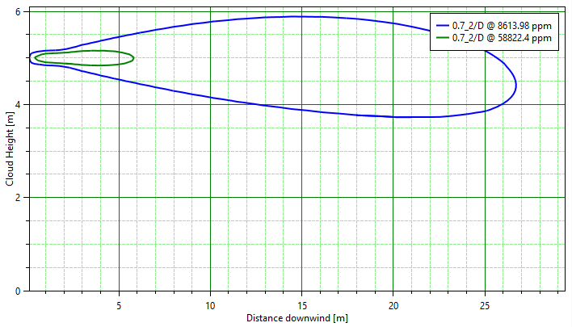
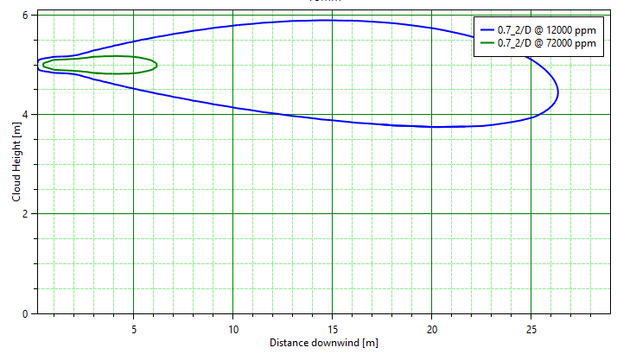
Modelling Validation – Fluid Category C, R1
Although hexane is more volatile, the distances to LFL are governed by the aerosol portion of the release.
Even for the highest pressures and hole sizes, no pool forms.
The distances to LFL are larger for Fluid Category C because the mass flow rates are larger and the LFL is lower (0.86% v/v compared to 1.2% v/v).
Fluid Category C and Hexane: Pressurised Release: Maximum R1 distance to LFL (m) for 150 bara and 10 mm
Fluid Category C
Hexane

Slide 24
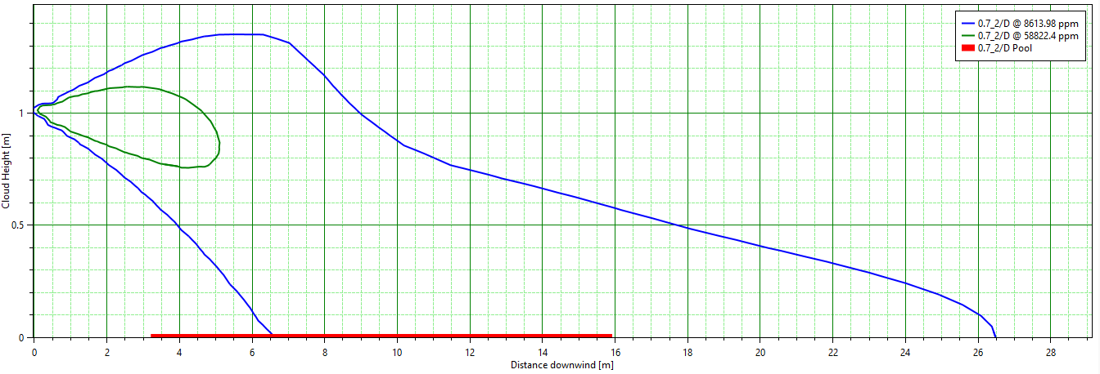
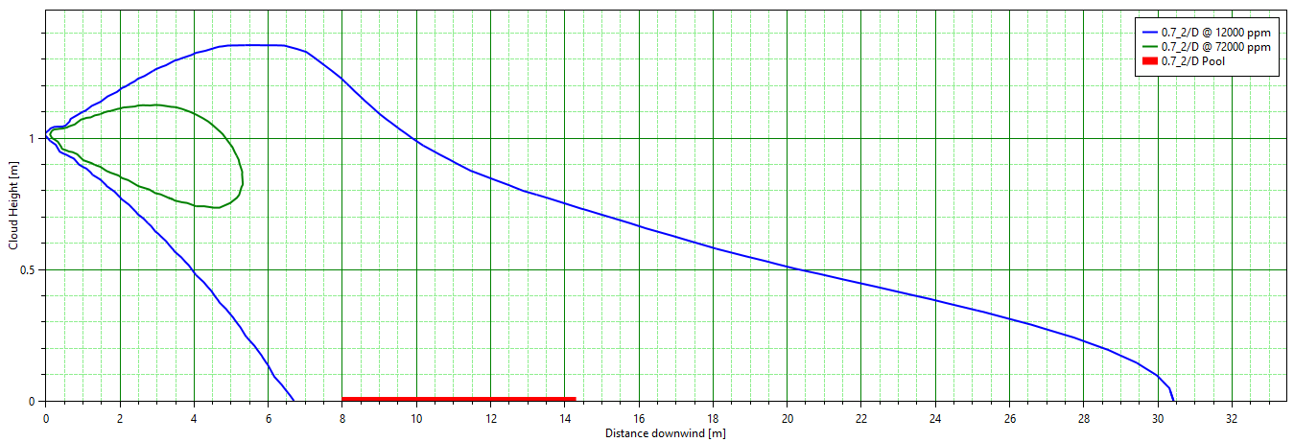
Modelling Validation – Fluid Category C, R2
A similar trend is observed for R2 although there are some instances where the distances to LFL increase.
For 5 bara, 10 mm case the increase for hexane is 2.6 m.
This case results in a pool being formed on the ground and the behaviour differs between the two compositions.
This comparative study highlighted the need to be cautious if using a fluid composition that varies significantly from that used in EI15 but for the hole sizes typically used in HAC (1 mm and 2 mm), the maximum difference was only 0.1 m.
Fluid Category C and Hexane: Pressurised Release: Maximum R2 distance to LFL (m) for 5 bara and 10 mm
Fluid Category C
Hexane

Slide 25
Modelling Validation - Fluid Category C
Table shows the R2 distance to LFL for the 4th and 5th Edition for fluid category C.
There is little difference in smaller hole sizes but more pronounced for 5 mm and 10 mm. Thought to be due to rounding in 4th edition.
4th Ed. Vs 5th Ed. | Hole Size (mm)
 | 1 |  |  | 2 |  |  | 5 |  |  | 10
Pressure (bara) | 4th Ed. (m) | 5th Ed. (m) | Δ (m) | 4th Ed. (m) | 5th Ed. (m) | Δ (m) | 4th Ed. (m) | 5th Ed. (m) | Δ (m) | 4th Ed. (m) | 5th Ed. (m) | Δ (m)
5 | 2.5 | 2.0 | -0.5 | 4 | 4 | 0 | 20 | 9 | -11 | 50 | 29 | -21
10 | 2.5 | 2.0 | -0.5 | 4.5 | 4 | -0.5 | 21 | 11 | -10 | 50 | 31 | -19
50 | 3 | 3 | 0 | 5.5 | 5.0 | -0.5 | 21 | 13 | -8 | 50 | 31 | -19
100 | 3 | 3 | 0 | 6 | 5 | -1 | 21 | 14 | -7 | 50 | 32 | -18
Notes:
Hydrogen is seen as key in the energy transition and the drive for decarbonisation and achieving net zero. It has wide ranging potential uses as a fuel or energy carrier in road freight, industrial manufacturing, aviation and shipping.

Slide 26
Modelling Validation – Liquid/Pool Releases
The 4th edition of EI15 considered fluid category A, B and C liquid pools.
Fluid category A.
  Fluid Category A is a vapour at ambient temperature and pressure. In the 4th Edition of EI15 Fluid Category A was modelled at -40°C.
  Fluid Category A is representative of Liquid Petroleum Gas (LPG). Based on discussions with representatives from Liquid Gas UK, it is understood that the vast majority of installations in the UK store LPG as a pressurised liquid (covered in Table C4) rather than as a refrigerated liquid at lower pressure. Fluid category A has therefore been removed from the 5th edition of EI15.
  Single pool depth of 0.1 m has been modelled in 5th edition of EI15.
    Difficult to estimate pool depth as it will vary with time.
    0.1 m chosen as larger pool depths gave greater distances to LFL.

Slide 27
Modelling Validation – Liquid/Pool Releases, Cat. B
  The distances to LFL have reduced in the 5th Edition of EI15.
  Main reason for the decrease is the evaporation rate calculation changing in newer version of PHAST.
  Evaporation rate 3 x lower in some instances.
B: Liquid Pool: 4th Edition vs 5th Edition EI15 Table C6: Distances to LFL from the edge of the pool
EI15 4th Edition vs 5th Edition (PHAST v8.4) | Depth (m)
 | 0.1
Pool Diameter (m) | Distance to LFL (m) |  | Δ (m)
 | 4th Edition EI15 | 5th Edition EI15
1 | 3 | 2.9 | -0.1
3 | 15 | 6.1 | -8.9
10 | 28 | 20 | -8.0

Slide 28
Modelling Validation – Liquid/Pool Releases, Cat. C
  The distances to LFL have again reduced for similar reasons.
B: Liquid Pool: 4th Edition vs 5th Edition EI15 Table C6: Distances to LFL from the edge of the pool
EI15 4th Edition vs 5th Edition (PHAST v8.4) | Depth (m)
 | 0.1
Pool Diameter (m) | Distance to LFL (m) |  | Δ (m)
 | 4th Edition EI15 | 5th Edition EI15
1 | 2.6 | 1.8 | -0.8
3 | 7.5 | 3.7 | -3.8
10 | 24 | 12.9 | -11.1

Slide 29
Modelling Validation – Sensitivity Study

Slide 30
Modelling Validation – Sensitivity Studies
The values in EI15 are based on a base case set of parameters.
Sensitivity study conducted varying the following parameters.
  Ambient temperature
  Relative humidity
  Weather category (speed and stability)
  Surface roughness
  Release angle and impingement
Over 100,000 cases run in total – labour of love!

Slide 31
Modelling Validation – Sensitivity Studies
Detailed results for each fluid category included in research report.
  Of all the parameters considered, the release angle and impingement had the greatest effect on the distance to LFL. The following were considered,
    -60°
    Horizontal impinged
    Downward impinged
Notes:
This is because higher surface roughness values result in increased turbulence levels causing greater mixing with air and therefore dilution of flammable material.
The work conducted in support of the 4th Edition of EI15 [7] considered releases angles of -30°, -45° and -60° from the horizontal. -60° gave the greatest distance hence this was used.
If a release impinges on the ground this reduces the momentum and reduces the dilution by shear driven entrainment. This is when air is drawn into the plume due to the differential between the velocity of the release and the surrounding air i.e. the bigger the differential the greater rate at which air is entrained.

Slide 32
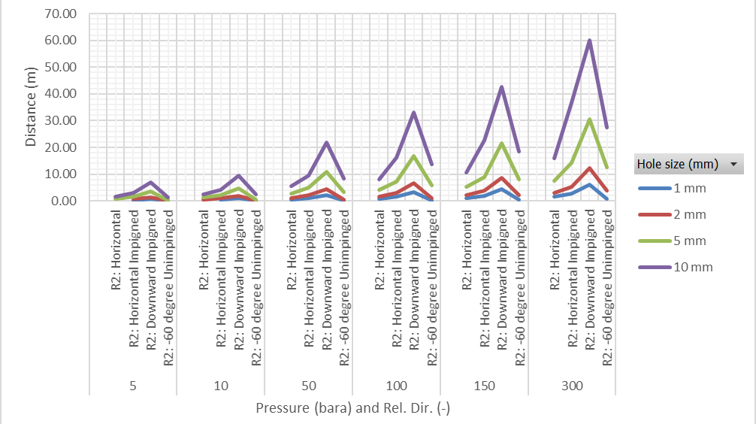
Modelling Validation – Sensitivity Studies, Rel. Angle
R1 fluid category G(i)

Slide 33
Modelling Validation – Sensitivity Studies
Detailed results for each fluid category included in research report.
  Of all the parameters considered, the release angle and impingement had the greatest effect on the distance to LFL. The following were considered,
    -60°
    Horizontal impinged
    Downward impinged
Notes:
This is because higher surface roughness values result in increased turbulence levels causing greater mixing with air and therefore dilution of flammable material.
The work conducted in support of the 4th Edition of EI15 [7] considered releases angles of -30°, -45° and -60° from the horizontal. -60° gave the greatest distance hence this was used.
If a release impinges on the ground this reduces the momentum and reduces the dilution by shear driven entrainment. This is when air is drawn into the plume due to the differential between the velocity of the release and the surrounding air i.e. the bigger the differential the greater rate at which air is entrained.
It is implemented by applying a velocity modification factor (user input with a default value of 0.25) or a final velocity limit (user input) to the release. Downwards impingement is modelled as a horizontal release at ground level (0 m above the ground) and applying a velocity modification factor (user input with a default value of 0.25) or a final velocity limit (user input) to the release.

Slide 34
Modelling Validation – Sensitivity Studies
Detailed results for each fluid category included in research report.
  Of all the parameters considered, the release angle and impingement had the greatest effect on the distance to LFL. The following were considered,
    -60°
    Horizontal impinged
    Downward impinged
  Impinged releases tended to give the largest hazard ranges. Despite this, the hazard ranges calculated using the impinged models treat impingement simplistically via a velocity modification factor but there is limited guidance on the value to employ.
  Due to the lack of validation of the impinged models in PHAST the R2 distances are calculated as the maximum of the following values.
    Horizontal release at 5 m.
    Horizontal release at 1 m.
    Release angles at -60° from the horizontal at 1 m.
Notes:
This is because higher surface roughness values result in increased turbulence levels causing greater mixing with air and therefore dilution of flammable material.
The work conducted in support of the 4th Edition of EI15 [7] considered releases angles of -30°, -45° and -60° from the horizontal. -60° gave the greatest distance hence this was used.
If a release impinges on the ground this reduces the momentum and reduces the dilution by shear driven entrainment. This is when air is drawn into the plume due to the differential between the velocity of the release and the surrounding air i.e. the bigger the differential the greater rate at which air is entrained.
It is implemented by applying a velocity modification factor (user input with a default value of 0.25) or a final velocity limit (user input) to the release. Downwards impingement is modelled as a horizontal release at ground level (0 m above the ground) and applying a velocity modification factor (user input with a default value of 0.25) or a final velocity limit (user input) to the release.

Slide 35
General Updates

Slide 36
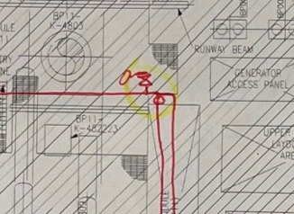
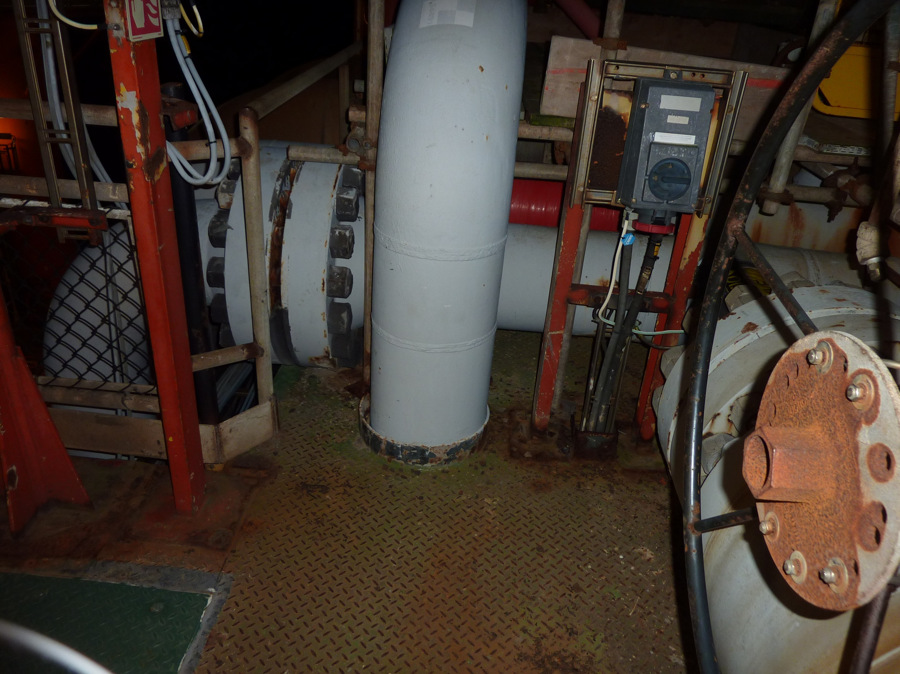
Review Period
How often should a HAC be reviewed?
  As often as needed.
  DSEAR states that the RA should be reviewed if significant changes have taken place.
  Every 5 years if no changes have required a review.
    In line with COMAH and OSCR submissions.

Slide 37
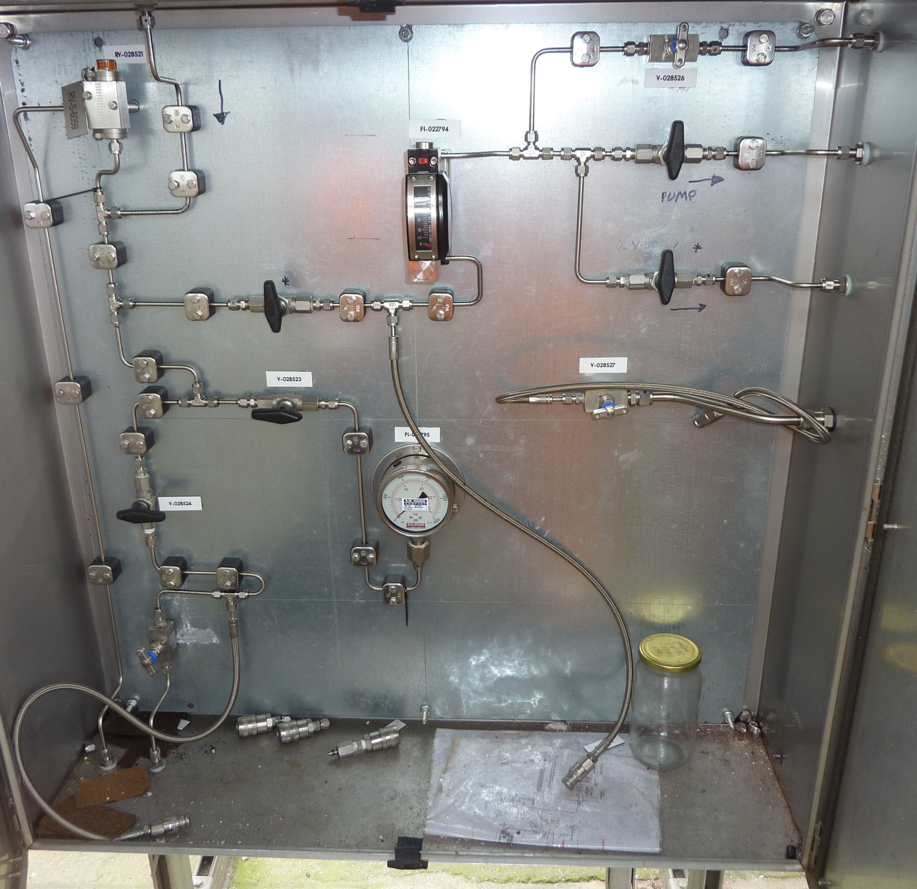
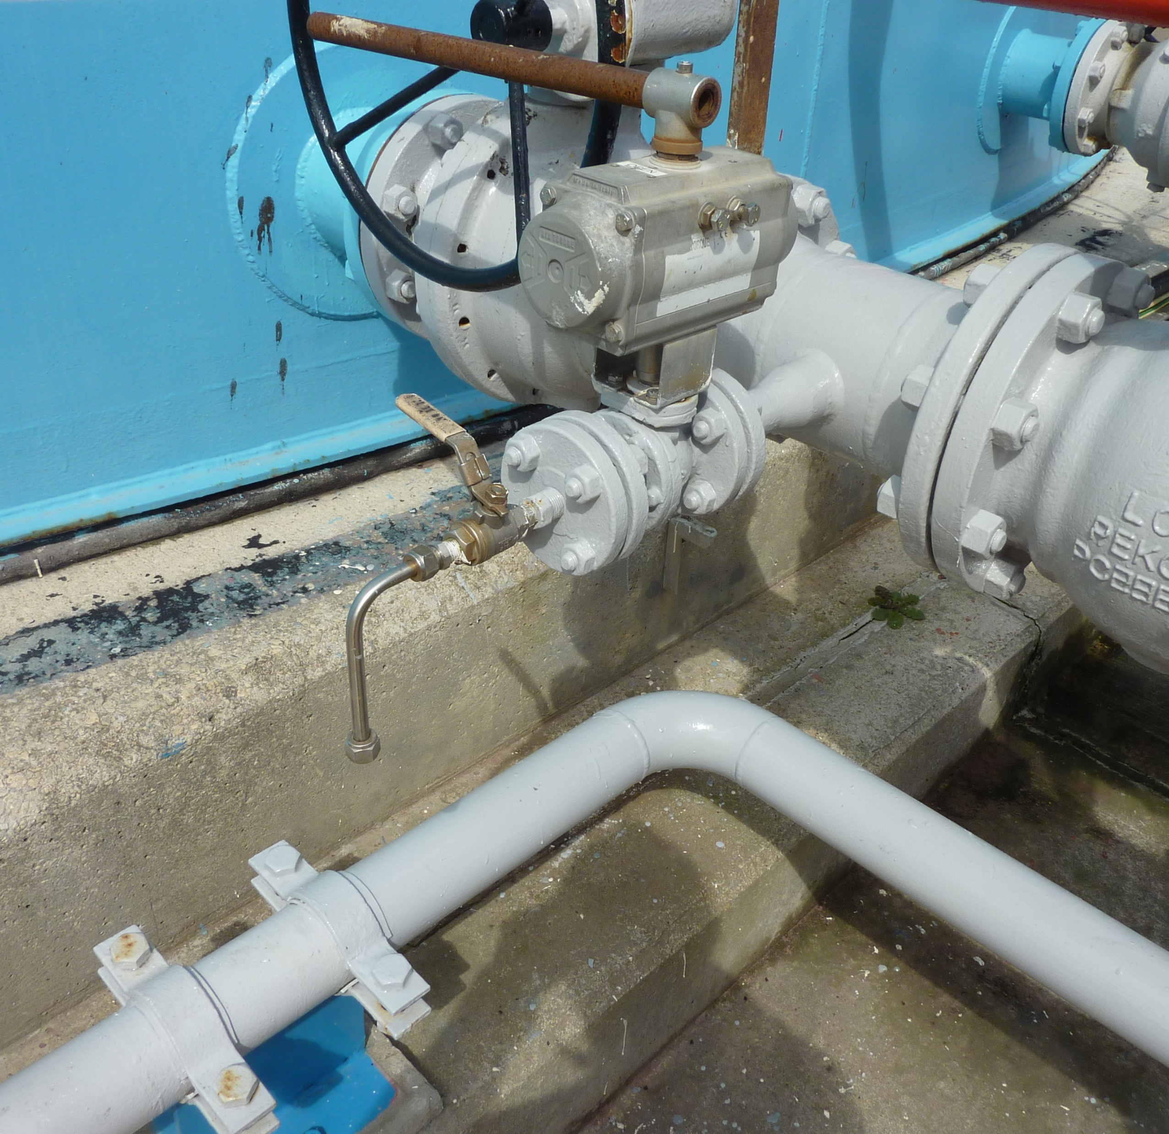
Point Sources – Sample Points
Simplifies the guidance to pragmatic options.
If frequently used – 1 m radius Zone 1.
Larger secondary release Zone 2 but limit through technical measures.

Slide 38
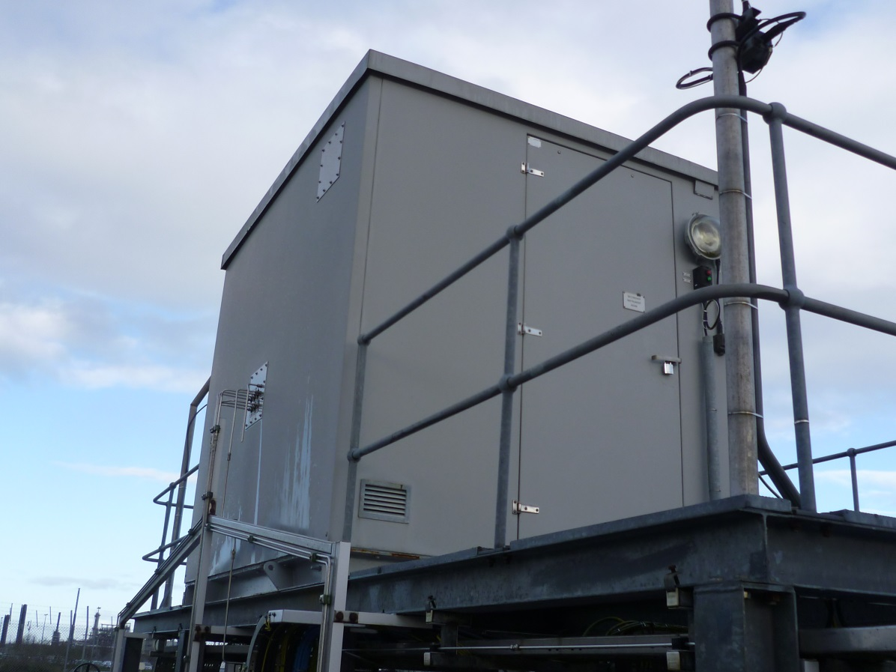
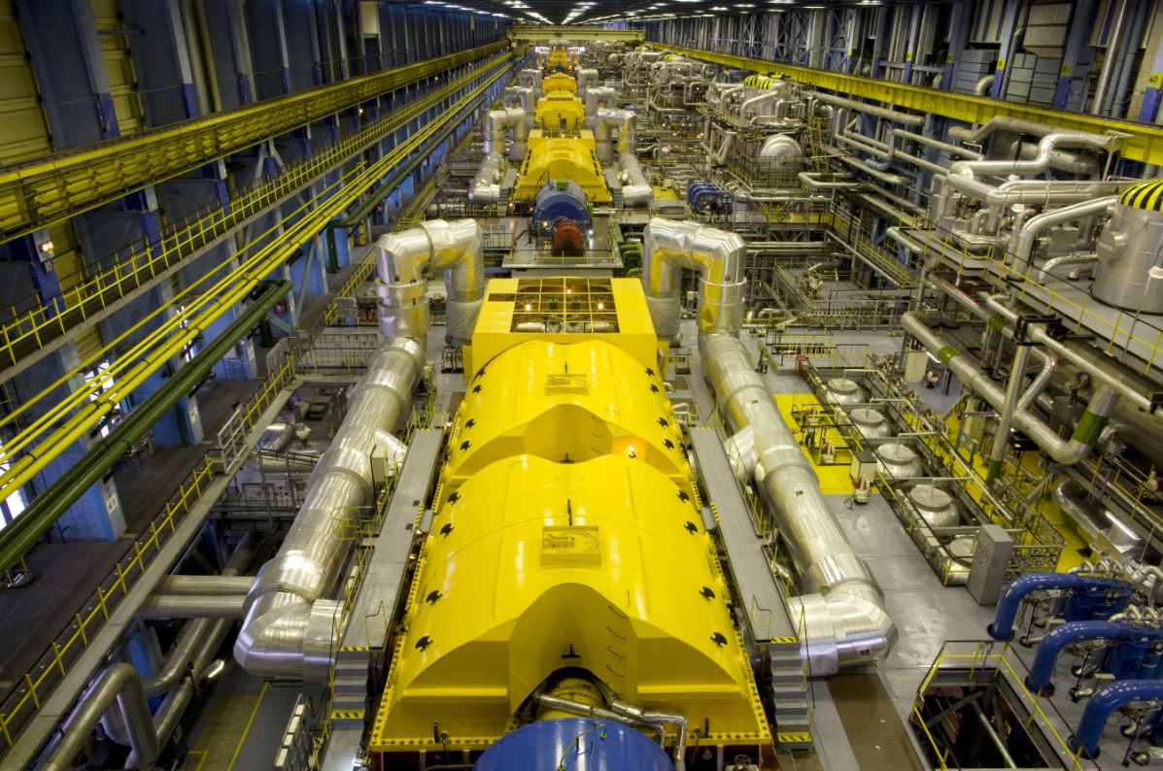
Ventilation
Little change since fundamental review in 2015.
Addition of guidance for pressurised rooms on loss of pressurisation.

Slide 39
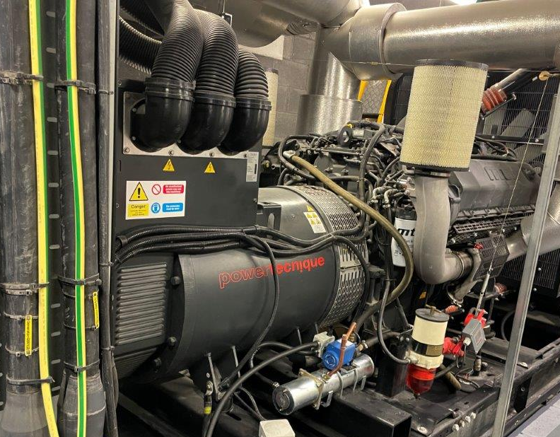
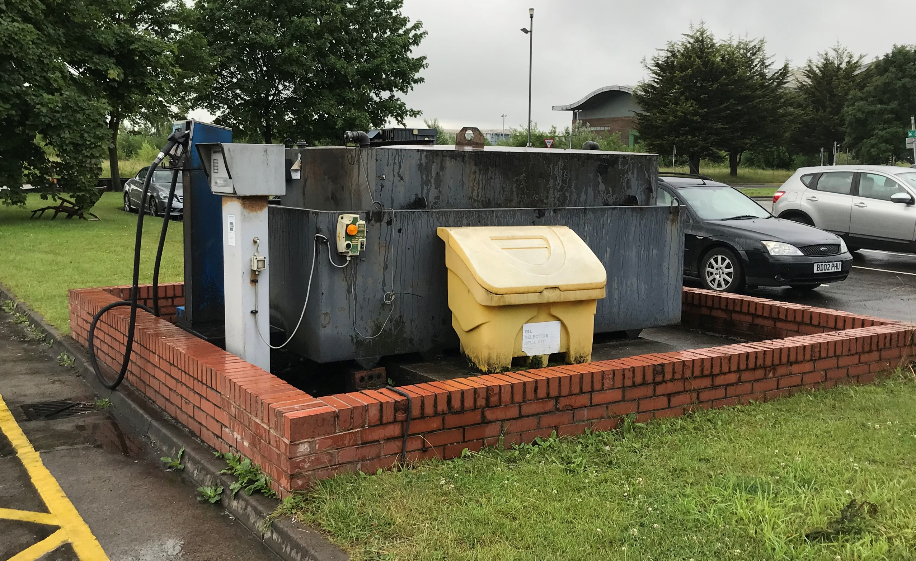
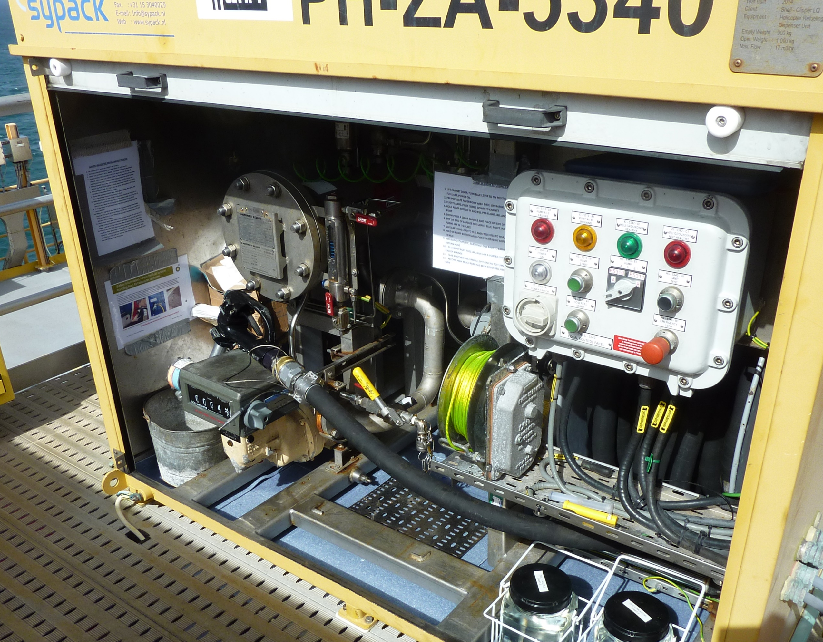
Misted Releases
Incorporation of HSL research and industry input.
Simple diesel system (domestic and commercial) carry out a DSEAR RA but often, zoning will not be required.
More complex systems may need zones to be identified and ignition sources controlled – however equipment is only certified for gases or dusts – not mists.

Slide 40
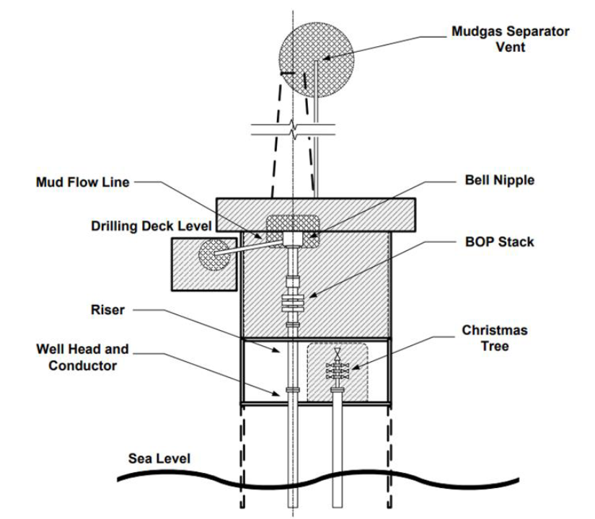
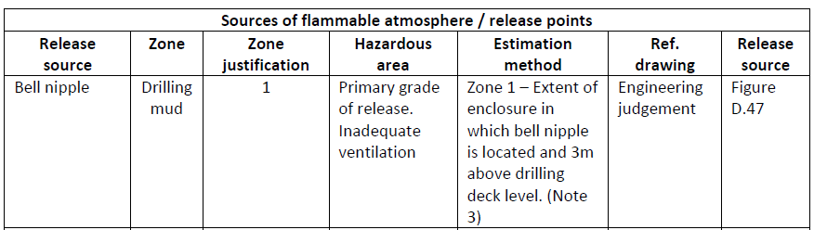
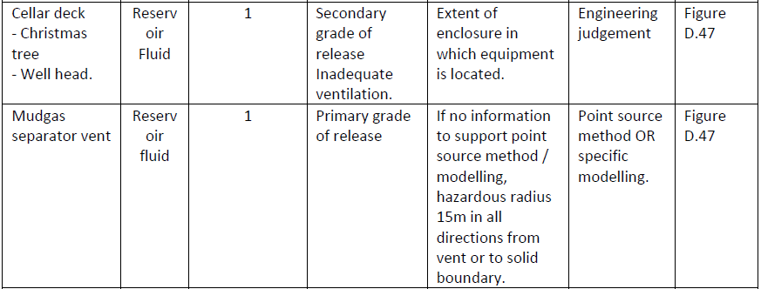
Direct Examples – Oil and Gas Production
Better alignment with Point Source zone extents.
Easier to align diagrams with notes.
Reviewed by industry experts –
  Tank Storage Association
  HSE
  BP
  Flogas

Slide 41
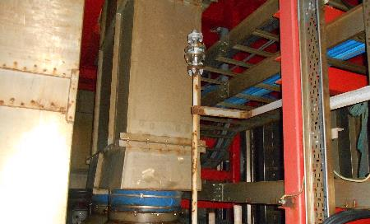
Requirement to Reclassify?
On balance, the resulting zones from 5th Edition are more accurate.
  Up to date modelling.
  Industry expert input.
Good practice to routinely review classifications.
  Changes to process conditions.
  Changes to equipment.

Slide 42

Summary
Having an up to date HAC is a legal requirement.
EI15 5th Edition provides an evolution from the 4th edition.
The modelling has been thoroughly reviewed using the most up to date version of PHAST and replaces the variety of information sources used previously.
These revisions allow the guide to be used more effectively by all industry sectors for more pragmatic determination of hazardous areas.

Slide 43
Any Questions?
Steve.Sherwen@rpsgroup.com 07483 939200
Tim.Jones@rpsgroup.com 07775 704324

Slide 44
Modelling Validation – Sensitivity Studies
Detailed results for each fluid category included in research report.
Key conclusions,
  For hole sizes typically used in HAC (1 mm and 2 mm) results are not too sensitive to wind speed and stability. Variance typically less than 1 m.

Slide 45
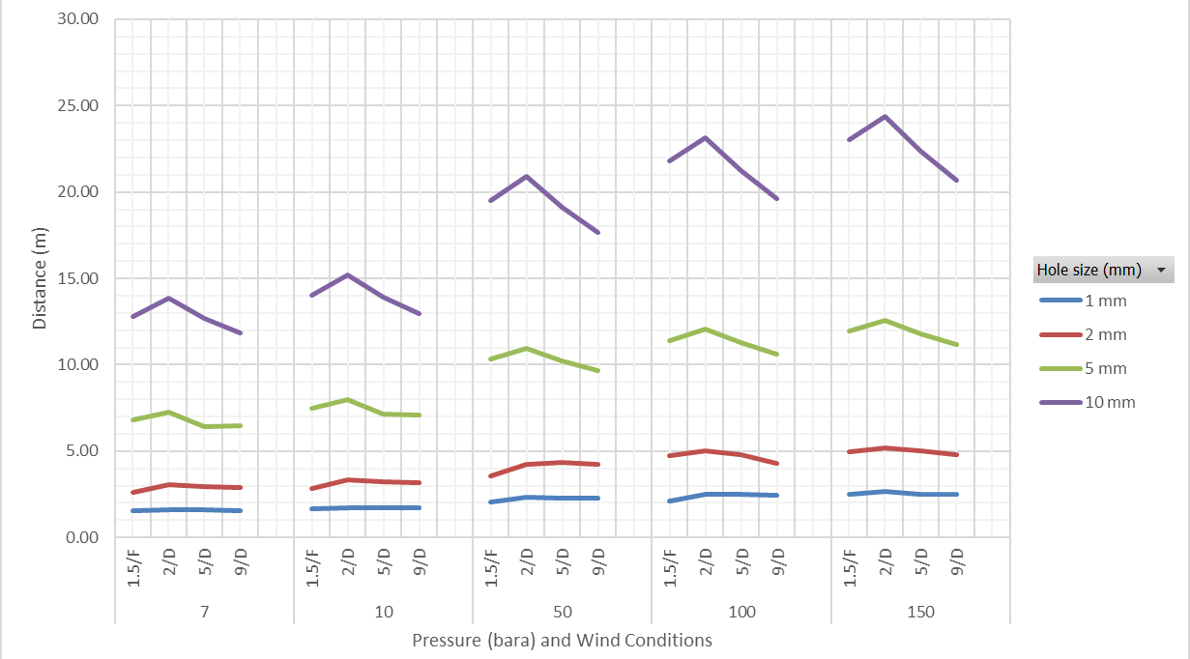
Modelling Validation – Sensitivity Studies, Wind Category
R1 fluid category A

Slide 46
Modelling Validation – Sensitivity Studies
Detailed results for each fluid category included in research report.
Key conclusions,
  Relative humidity has the smallest effect on distances to LFL except for liquid hydrogen. Typically, across all pressures and hole sizes, variance is less than 0.5 m.

Slide 47
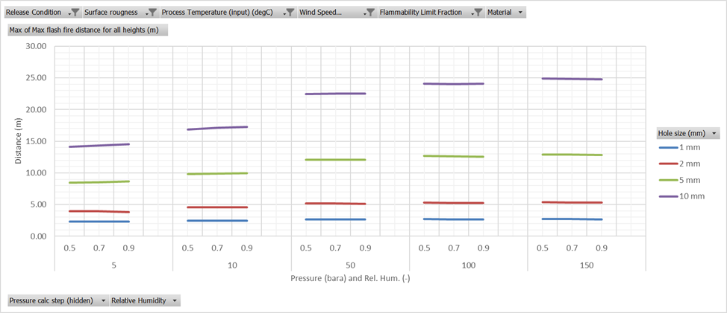
Modelling Validation – Sensitivity Studies, Rel. Humidity
R1 fluid category B

Slide 48
Modelling Validation – Sensitivity Studies
Detailed results for each fluid category included in research report.
Key conclusions,
  The base case value of surface roughness of 0.03 m tends to give the largest distance to LFL.
Notes:
This is because higher surface roughness values result in increased turbulence levels causing greater mixing with air and therefore dilution of flammable material.

Slide 49
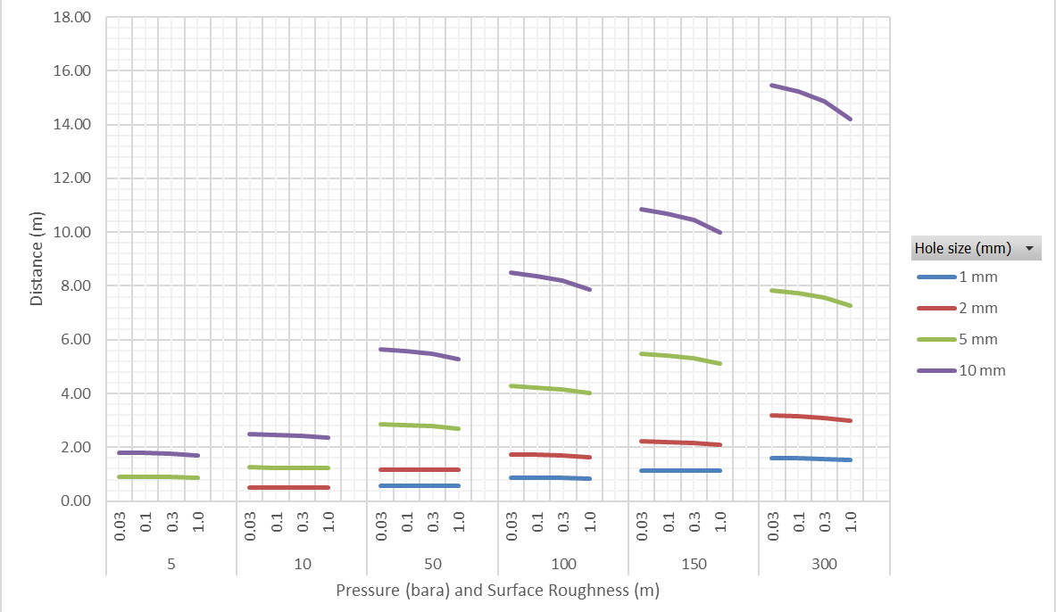
Modelling Validation – Sensitivity Studies, Surf. Roughness
R1 fluid category G(i)

