Slide 1
Adapting Hazard Studies to Reflect Climate Change
Mike McKay, Principal Process Safety Consultant
George Watson, University of Manchester

Slide 2
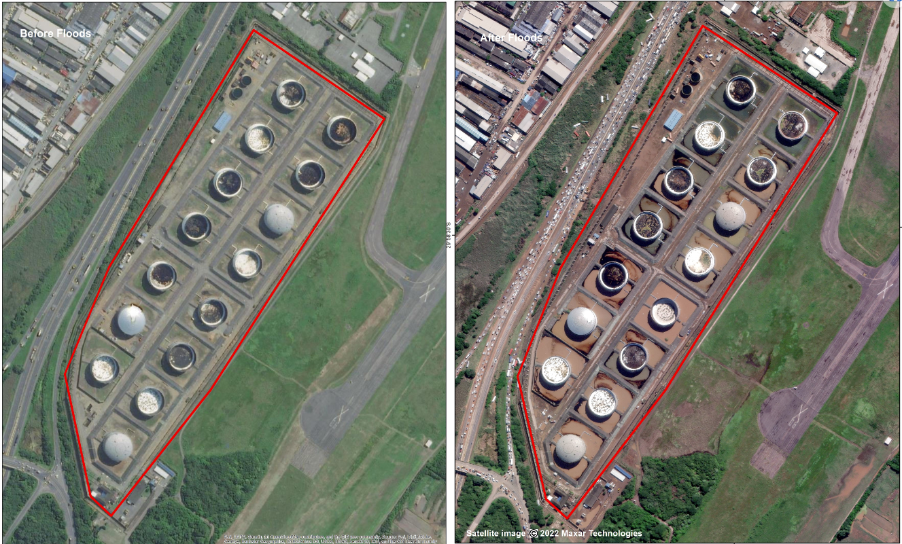
Adapting Hazard Studies to Reflect Climate Change

Slide 3
Adapting Hazard Studies to Reflect Climate Change
A Few Incidents Attributable to Extreme Weather Conditions
Melting permafrost at a Nickel mine in Norilsk, Siberia
Hurricane Harvey impacting Valero Energy Refinery, Houston, Texas and Arkema facility, Crosby Texas
Heavy flooding at Ensenada refinery, Argentina
Bushfires at AECI, near Cape Town, South Africa

Slide 4
Adapting Hazard Studies to Reflect Climate Change
Hazard Study 2 – Hazard Identification
Hazard study 2 is an obvious place to assess the threats posed by extreme weather effects:
Extreme Temperature
External Fire
Excess Loading
Puncture or Burst
Extreme Level
Hazard study 2 also assesses safeguards for possible weakness:
Wind
Extremes of temperatures
Storm damage
Flooding

Slide 5
Adapting Hazard Studies to Reflect Climate Change
Hazard Study 3 – Hazard and Operability Study (HAZOP)
HAZOP is a deviation analysis of the process design.
New guideword of ‘Extreme Weather’

Slide 6
Adapting Hazard Studies to Reflect Climate Change
Hazard Study 7 – PHR / Delta HAZOP
A retrospective study has the greatest potential opportunity to identify weakness from climate change but limited opportunities to prevent their effects. Typically, a retrospective hazard study will include:
Review of incidents and near misses
Plant tours
Review of the original hazard studies
Reviewing experiences of operating and maintenance teams

Slide 7
Adapting Hazard Studies to Reflect Climate Change
Summary
This presentation and paper have discussed where and how hazard studies can be adapted to reflect the extreme weather conditions experienced because of climate change.
Hopefully, it has raised the profile of the impact of climate change and extreme weather on the process industries and how this can be addressed.
TÜV Rheinland, with the acquisition of ABB, have inherited the original ICI Hazard Study methodology and are updating this to help identify and assess the effects of extreme weather. Operating companies and process safety professionals should decide whether to modify their hazard study methods to reflect climate change. Equally, how this is implemented needs to match their experiences.
The changes suggested are only examples of how and when / where these issues can be addressed within hazard studies. The examples are just that – examples.
However, the key to ensuring consideration of climate change and extreme weather is:
through the quality of the hazard study procedure,
the adherence by study teams to the procedure
the competence of the hazard study leader in prompting an open discussion, which is a key aspect of all good hazard studies

Slide 8

Adapting Hazard Studies to Reflect Climate Change
Any Questions?

