Slide 1
PFAS Remediation: Navigating Challenges, Exploring Technologies, and Envisioning the Future.
Adam Farahani
March 2024

Slide 2
SciDev A leading provider of water treatment solutions and chemical services
What we do
Develop and deliver tailored permanent, temporary & mobile water treatment systems
Reduce waste, OPEX costs and minimise environmental risk
How we do it
Innovative water treatment technology
Industry-leading toolkit of PFAS treatment technology.
Build Own Operate and Design & Construct commercial models
Leading PFAS treatment technology-FluorofIX™
Advanced Ion Exchange systems capable of treated water for the sum of PFAS to <0.2ng/L
Capable of removing both Short and Long chain PFAS
RegenIX™ SciDev’s regenerable Ion-Exchange (IX) resin technology to reduce OPEX costs
Markets
Water Treatment
PFAS Treatment
Infrastructure and Construction
Mining and Mineral Processing
Oil and Gas

Slide 3
SciDev and PFAS
> 7 billion litres
treated to date
35 PFAS impacted sites remediated
First company to treat below the detectable limit of 0.2ng/L
First PFAS mobile treatment licence granted in NSW
First company in WA to treat and release in a drinking water catchment area
First company in VIC to continuously discharge to the environment
SciDev’s Technology
Treats both short and long-chain analytes
Commercialised PFAS technology treating to the lowest reportable level available
Modular and adaptable to changing site conditions
3

Slide 4
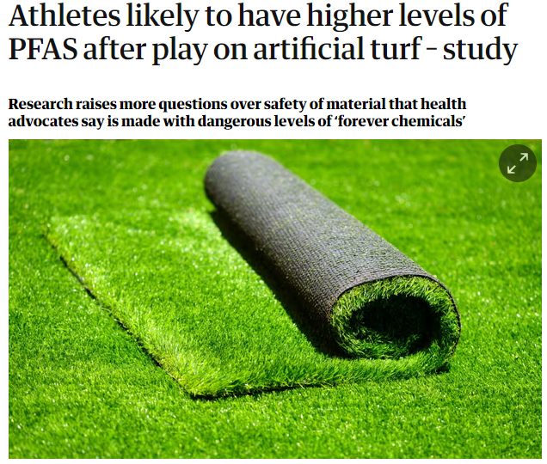
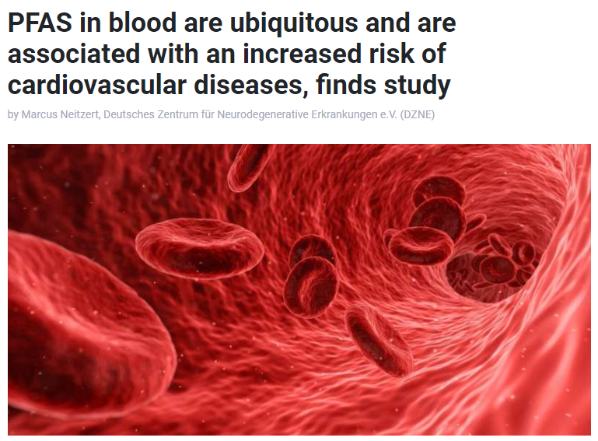
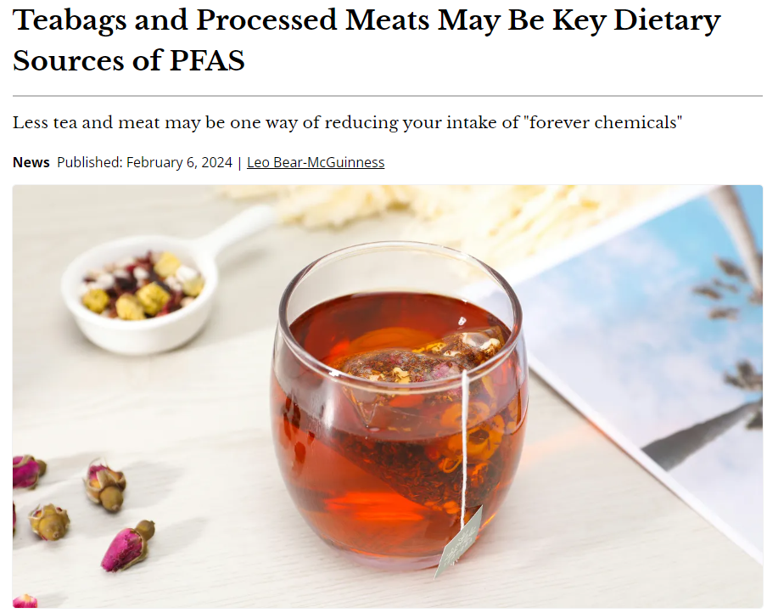
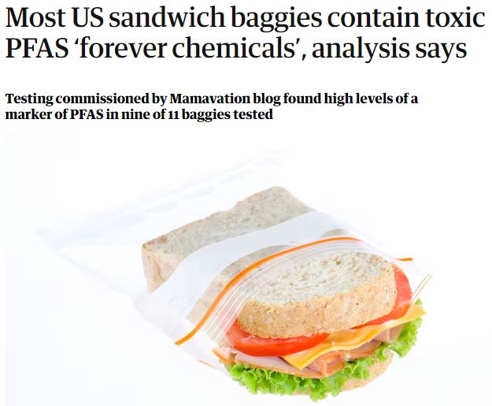
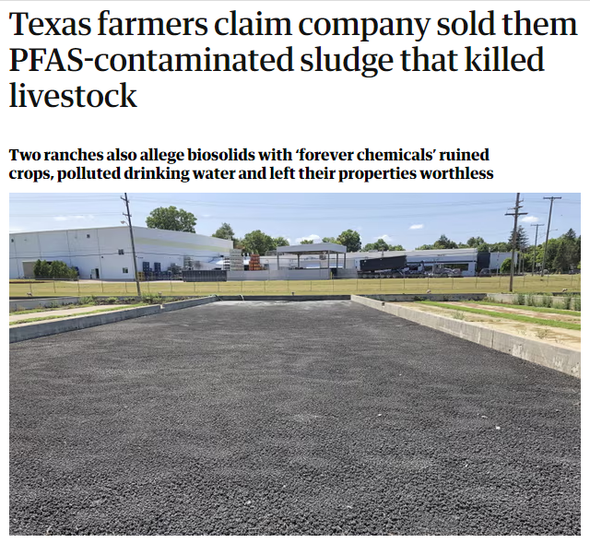
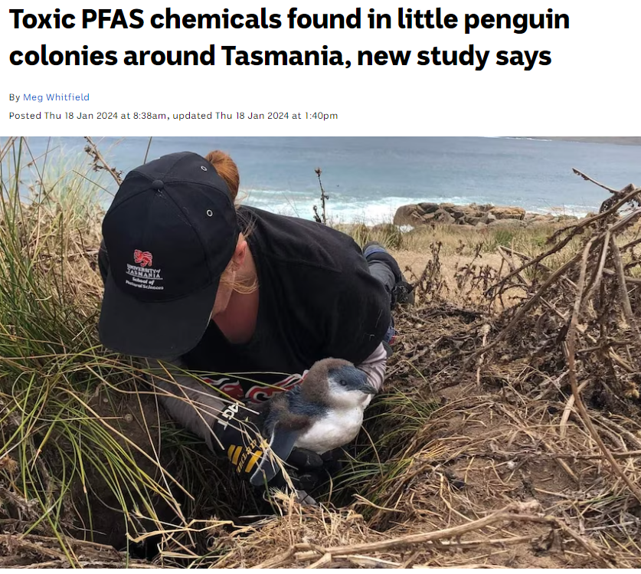
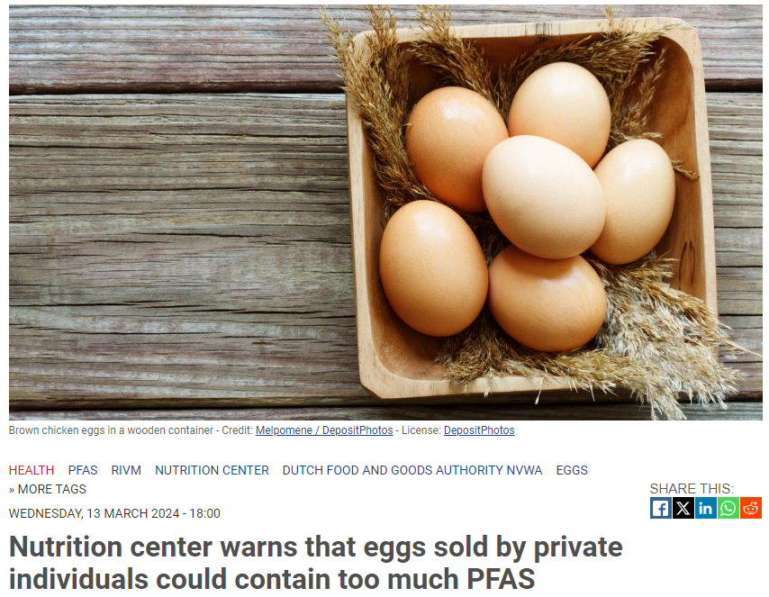
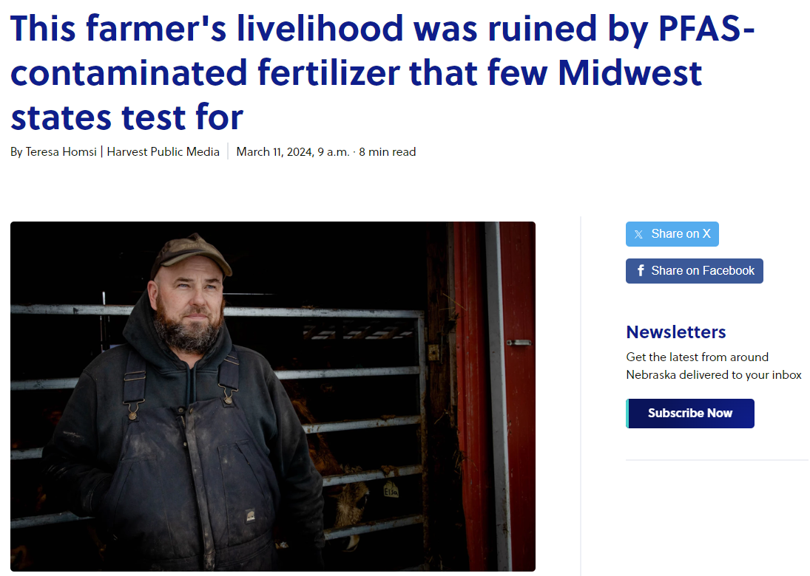
Some NEWS from the last few days….

Slide 5
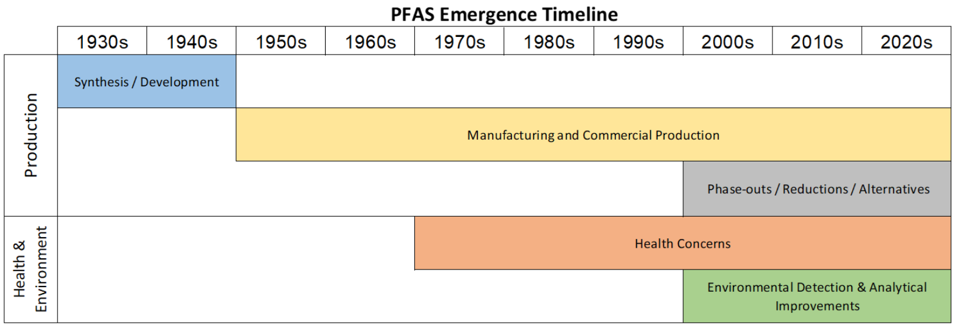
Per- and Polyfluoroalkyl Substances (PFAS)
A class of man-made (synthetic) chemicals
Widely used in industrial processes and consumer products
Studies on PFAS have found links between higher exposures and impacts on human health.
PFAS do not break down in the environment, thus earning the name “forever chemicals.”
Became popular because they repel oil and water, are temperature resistant, and reduce friction

Slide 6
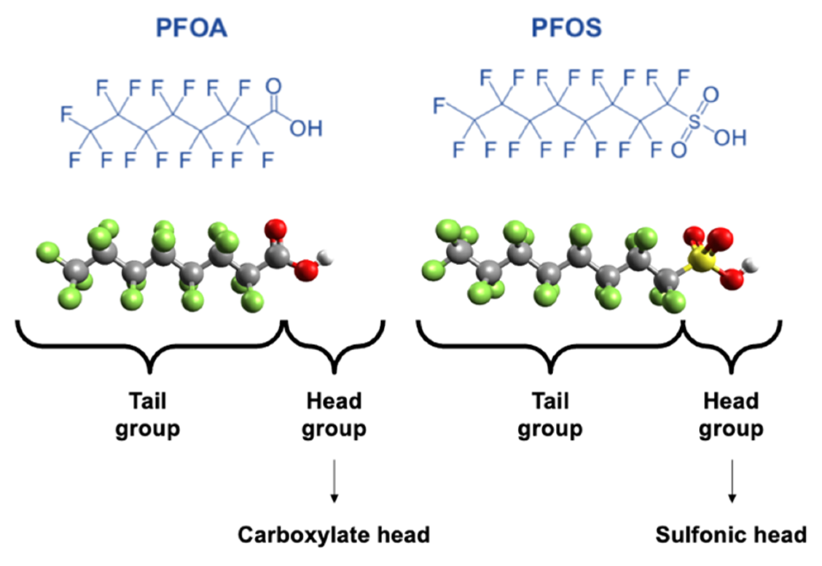
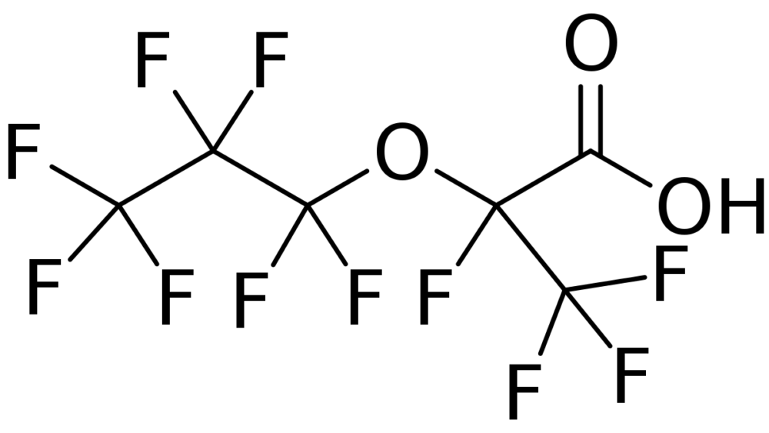
Most Common PFAS
Other examples of PFAS
PerFluoroOctanoic Acid (PFOA)
PerFluoroOctaneSulfonic Acid (PFOS)
PolyTetraFluoroEthylene (PTFE)
6:2 Fluorotelomer alcohol (6:2 FTOH)
6:2 Fluorotelomersulfonic acid (6:2 FTS)
2,3,3,3-tetrafluoro-2-(heptafluoropropoxy)
-propanoate (GenX)

Slide 7
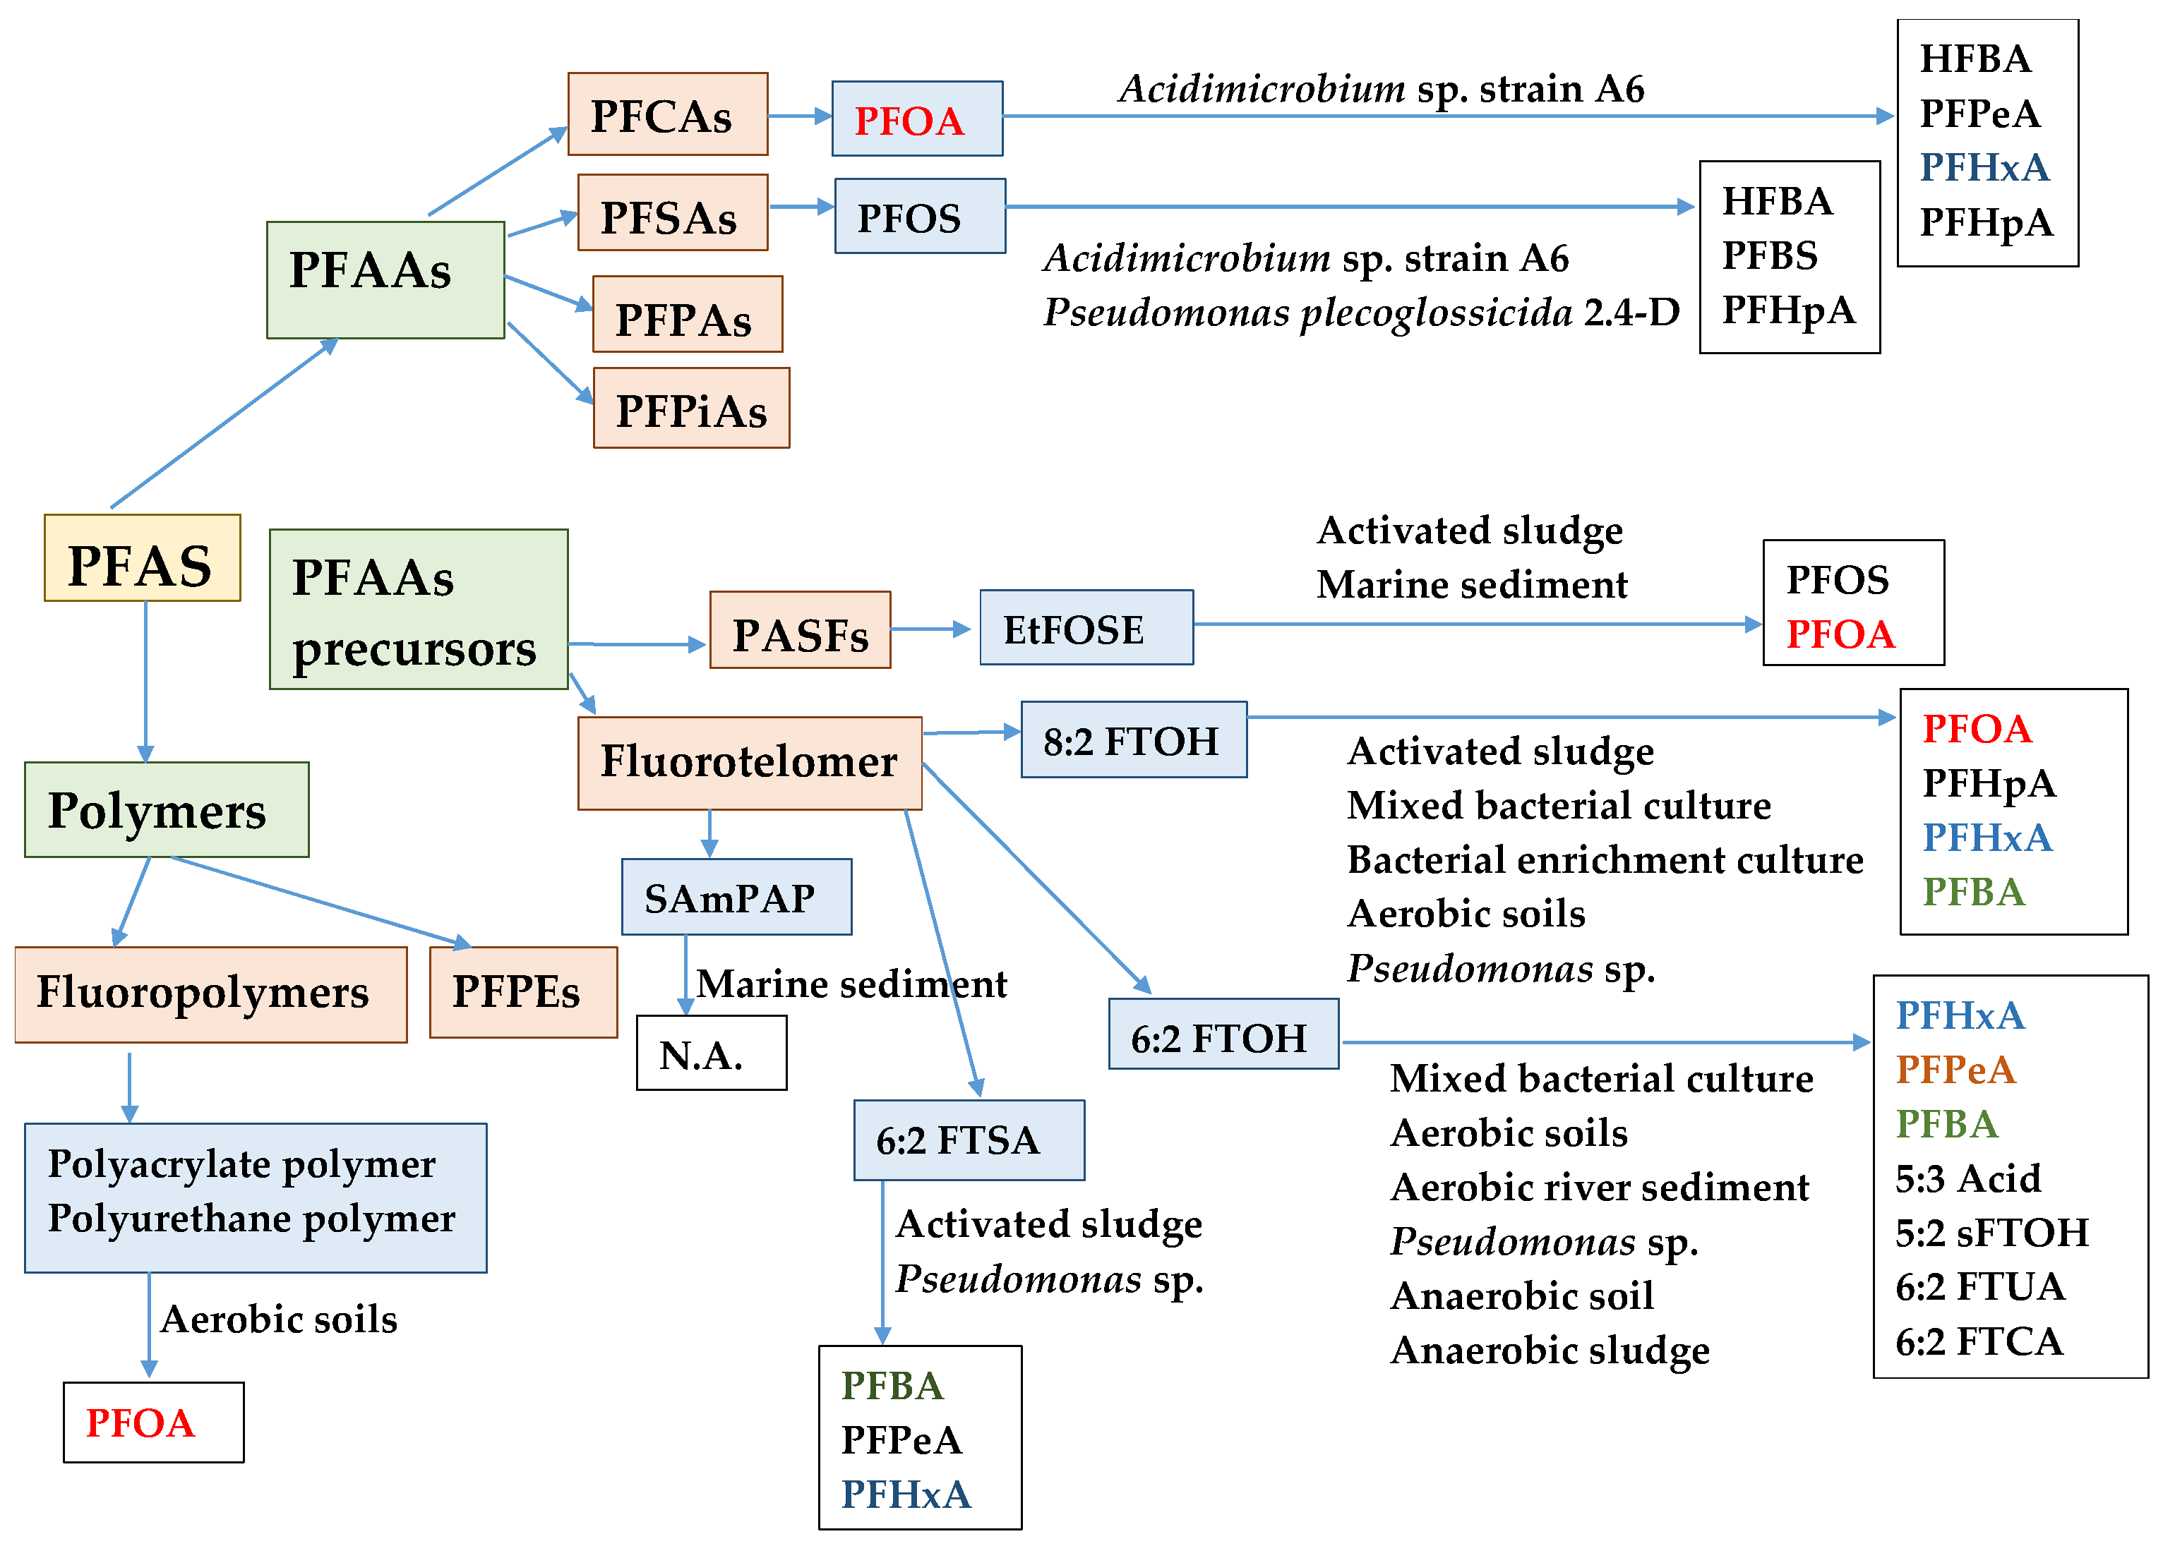
Thousands of Chemicals
More Than Just PFOA and PFOS

Slide 8
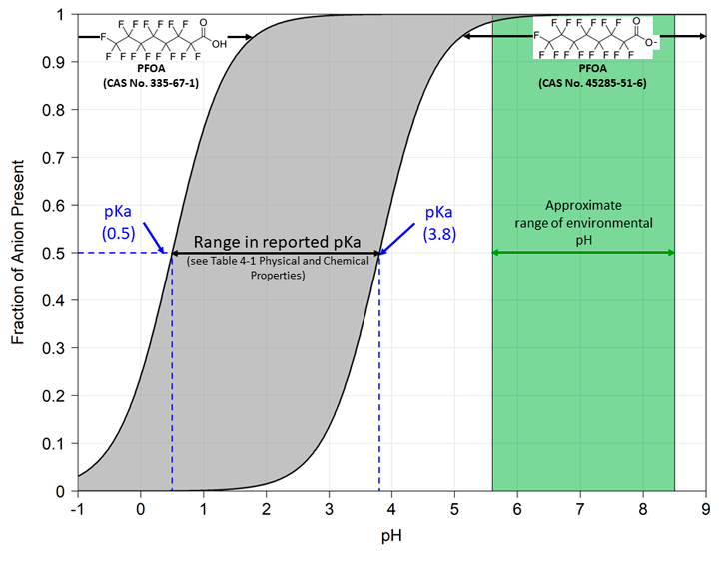
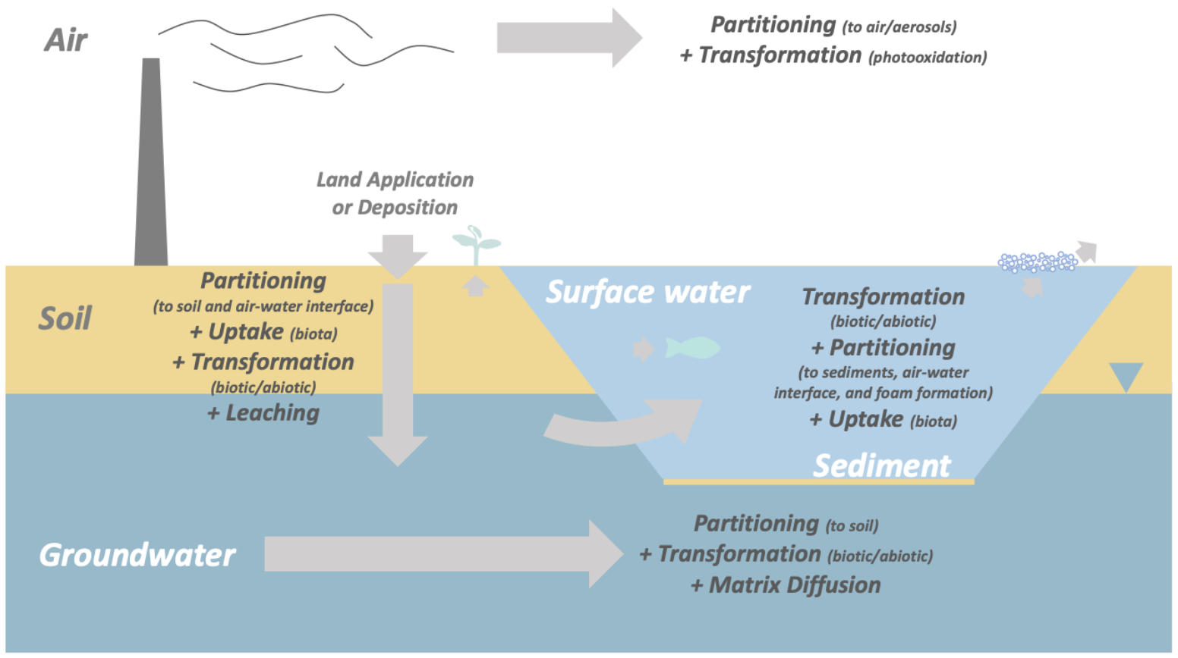
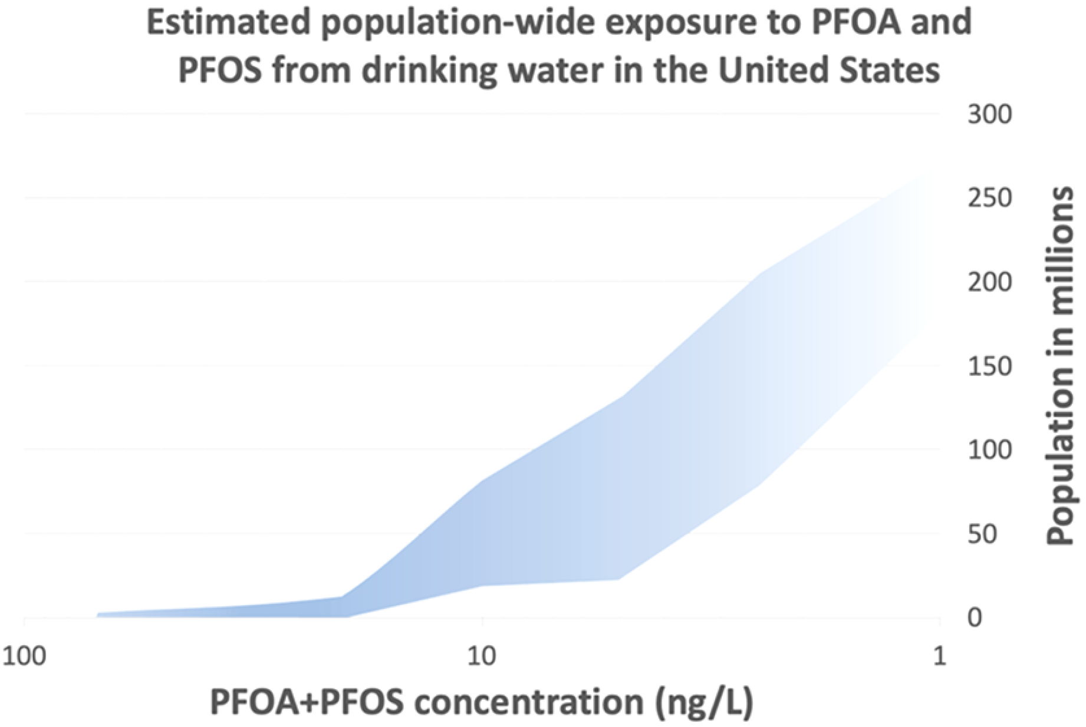
Challenges

Slide 9
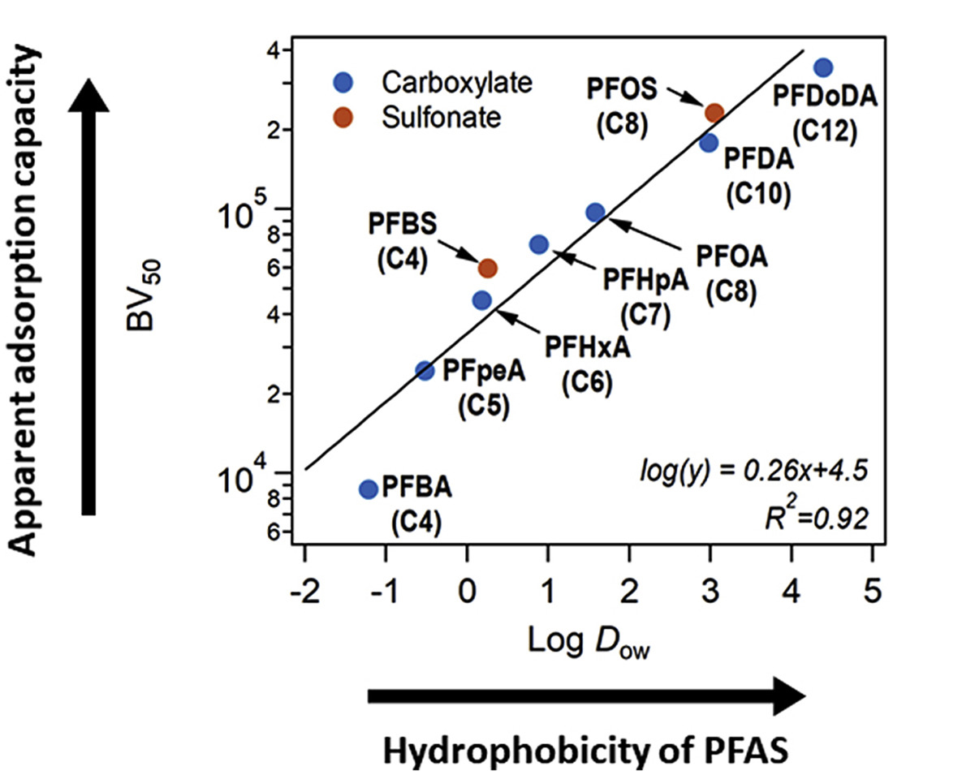
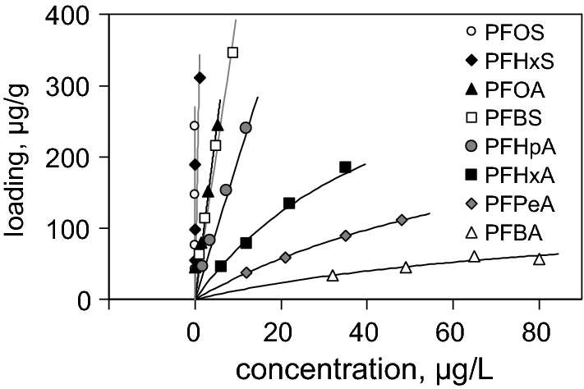
Short-chain PFAS
Isotherms of the sorption of different PFAS

Slide 10
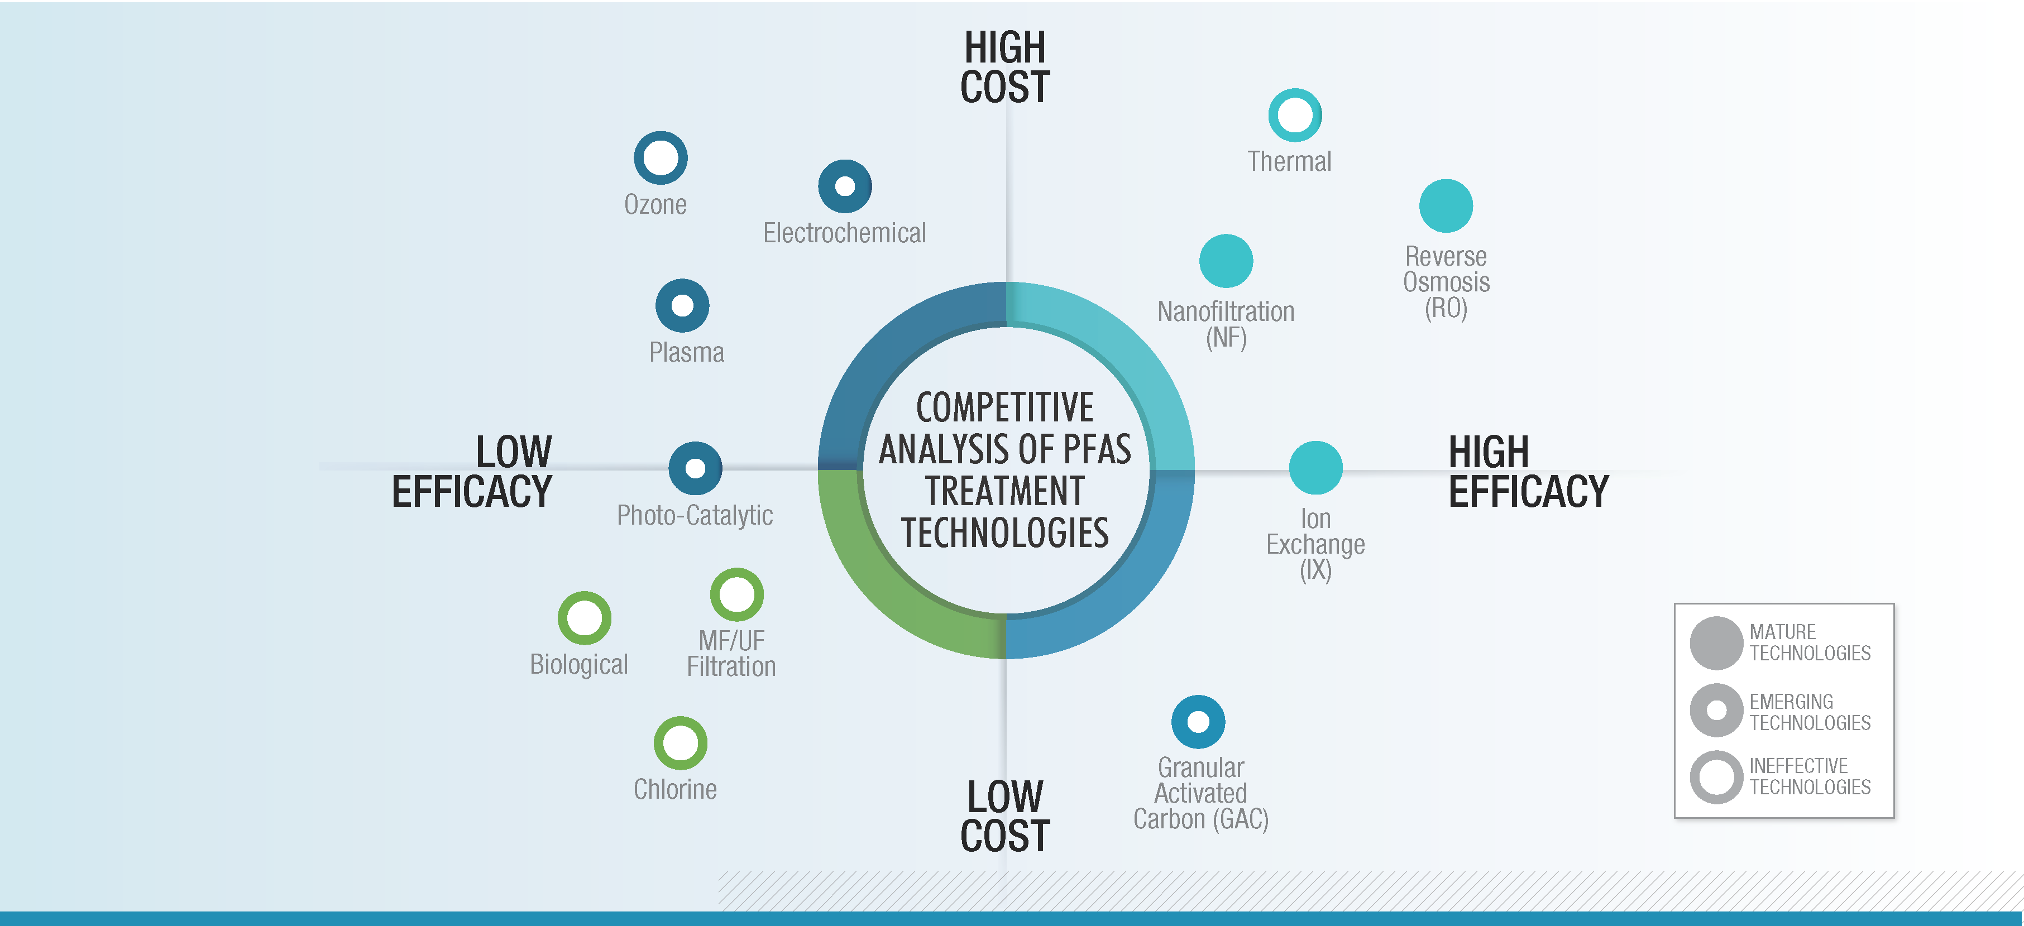
Treatment & Degradation Technologies SWOT Analysis

Slide 11
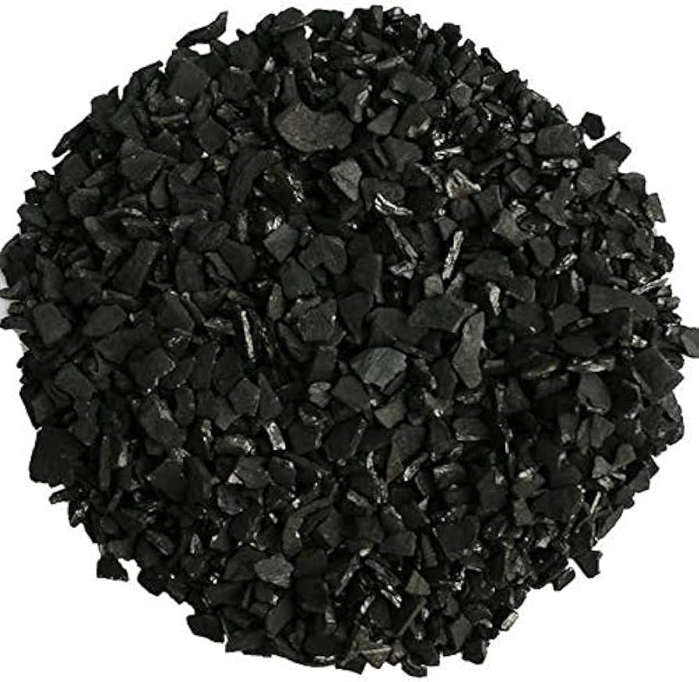
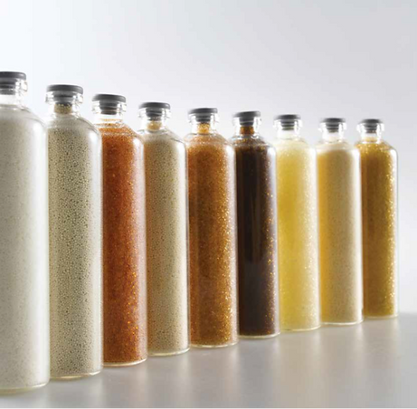
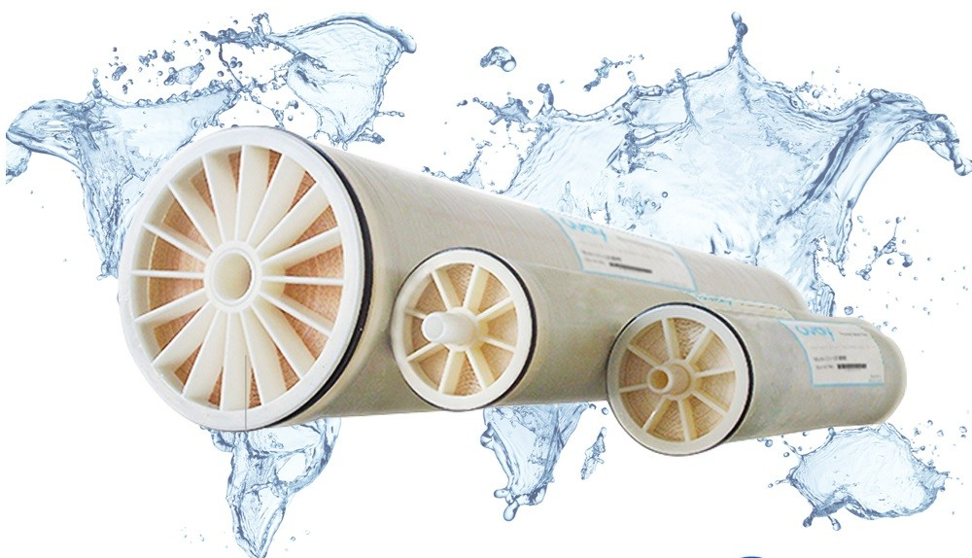
Effective PFAS Removal Techniques from Wastewater

Slide 12
FluorofIX™
FluorofIX™ is a high-performance ion exchange resin treatment system that removes both long-chain and short-chain PFAS compounds from contaminated water.
Mobile & modular solution which can treat total PFAS down to non-detect levels, whilst generating minimal waste streams.
Utilising a series of weak and strong base IX resins which are selected and activated using a proprietary process enabling an extremely high holding capacity for PFAS.
Dynamic piping and valving designs to allow real-time adjustments to flow and vessel/media priority to ensure complete capacity utilisation & adapt to chemistry variability
Built-in RegenIX™ compatibility

Slide 13
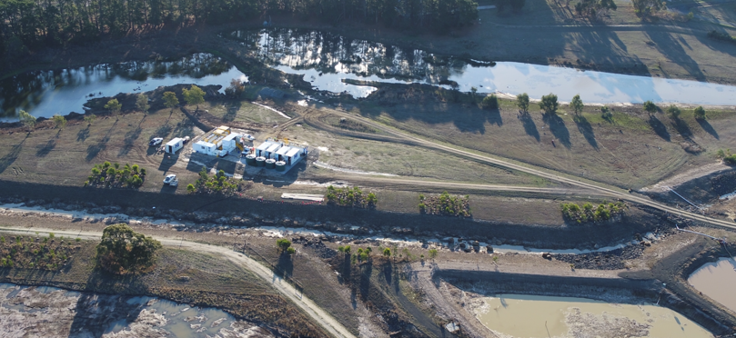
Raw Water Characteristics
PFAS distribution in-line with historical AFFF contamination
Major regulated compounds (PFOA, PFOS, PFHxS) make up 50% of contamination levels
Discharge criteria of 0.002µg/L (2ng/L) for sum of PFAS
Case Study: Site Photography
90.58% of sulfonic acids present were long chain molecules
91.26% of Carboxylic acids present were short chain molecules
PFAS Group Distribution Averages for Raw Water

Slide 14
Breakthrough Curves of Regulated Compounds in AU
PFOA was completely removed below 0.002µg/L after the second filter bank.
PFOS + PFHxS wasn’t completely removed, but values were below the drinking water guidelines and 95% species regulation after the second filter bank.
Notes:
This slide only pertains to regulated compounds in Australia. I am not sure if there is any value in it for you in the US.
The drinking water guidelines (DWG) indicate that you only need the sum of PFOA under 0.56 ug/L and the sum of PFOS + PFHxS under 0.07 ug/L.
Based on the above-mentioned targets, filter bank 2 (FB2) was good enough for PFOA up to 900 BVs. However, it was not good enough for PFOS + PFHxS, and a third filter bank completed the job in this case.

Slide 15
Short Chain Removal Performance: Filter Bank 2
Short Chain (PFCA’s) responsible for accelerated breakthrough
PFHpA ~ 7700 BVs
PFHxA ~ 4000 BVs
PFPeA ~ 2400 BVs
PFBA ~ 800 BVs
The shorter the chain, the faster the breakthrough.
Filter Bank 3 is designed to tackle short-chain PFAS loading
Concentrations of PFBA vs Bed Volumes for filter bank 2
Concentrations of PFHxA vs Bed Volumes for filter bank 2
Concentrations of PFPeA vs Bed Volumes for filter bank 2
Concentrations of PFHpA vs Bed Volumes for filter bank 2
Notes:
This slide is all about the short-chain PFASs, which are mostly carboxylic-based in this fee.
The C4 compound (PFBA) starts leaking sooner than others at around 800 BVs, and dumping occurs at around 3000 BVs.
The C5 compound (PFPeA) is next and starts leaching around 3000 BVs, and dumping occurs around 6500 BDs.
You can follow the lead for the C6 (PFHxA) and C7 (PFHxA) PFASs.

Slide 16
Short Chain Removal Performance: Filter Bank 2
FB3 continues to remove “carry over” PFSAs to Non-Detect Levels with intermittent spiking
Additional FB4 ”polish” treatment step remove carryover compounds
Designed to ensure Non-Detect discharge during media change out.
PFCA breakthrough at ~9000 BVs triggering a media changeout
Case Study One: Concentrations of the sum of PFSAs vs Bed Volumes for filter bank 3
Case Study One: Concentrations of the sum of PFSAs vs Bed Volumes for filter bank 3
Concentrations of the sum of PFAS vs Bed Volumes for filter bank 3
16
Notes:
This slide is all about the short-chain PFASs, which are mostly carboxylic-based in this fee.
The C4 compound (PFBA) starts leaking sooner than others at around 800 BVs, and dumping occurs at around 3000 BVs.
The C5 compound (PFPeA) is next and starts leaching around 3000 BVs, and dumping occurs around 6500 BDs.
You can follow the lead for the C6 (PFHxA) and C7 (PFHxA) PFASs.

Slide 17
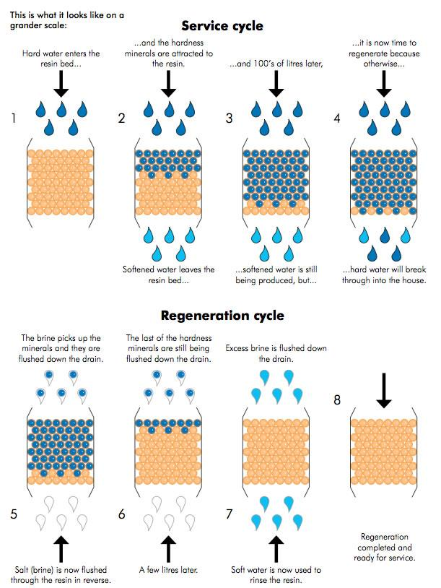
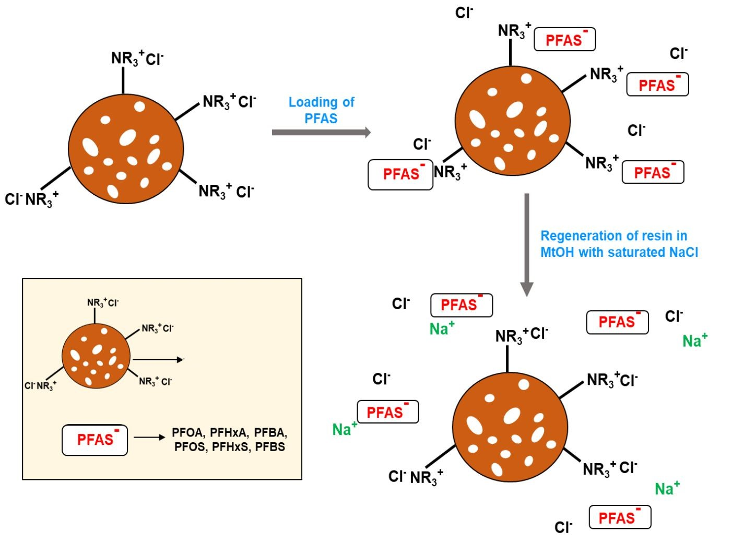
Regeneration
resin

Slide 18
RegenIX™
RegenIX™ is SciDev’s IX resin solvent-free regeneration technology, which is integrated into all SciDev’s treatment system designs without significant additional CAPEX costs.
This approach allows our FluorofIX™ high holding capacity resins to deliver extraordinary PFAS removal performance while optimising RegenIX’s™ ability to restore the resin’s holding capacity and minimising costly IX resin replacement.
Regenerable ion exchange (IX) resins can have a significantly positive impact on reducing treatment system OPEX and the associated waste generation by minimising the IX resin replacement frequency
Resin regeneration in PFAS treatment offers an environmental advantage by minimising waste generation, reducing the need for raw materials, and ultimately lessening the carbon footprint associated with disposal

Slide 19
Degredations | Destruction Technologies
Thermal Destruction (Incineration)
Bioremediation
Chemical Oxidation/Reduction
Advanced Oxidation/Reduction Process
Mechanochemical degradation
Electrochemical degradation
Sonolysis
Gamma ray (γ-ray)
Beams of electrons(eBeam)
Plasma
Photolytic degradation

Slide 20
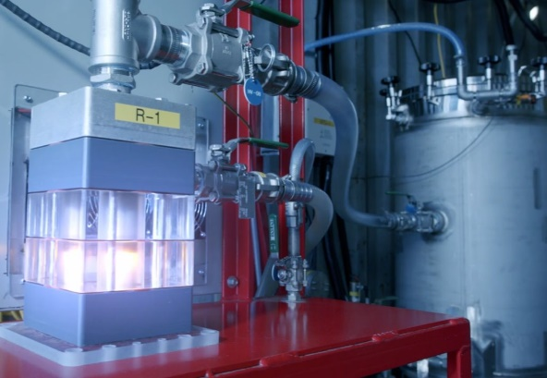
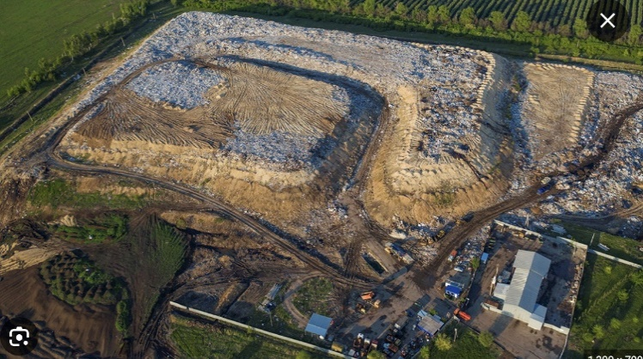
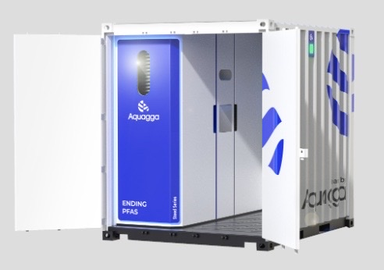
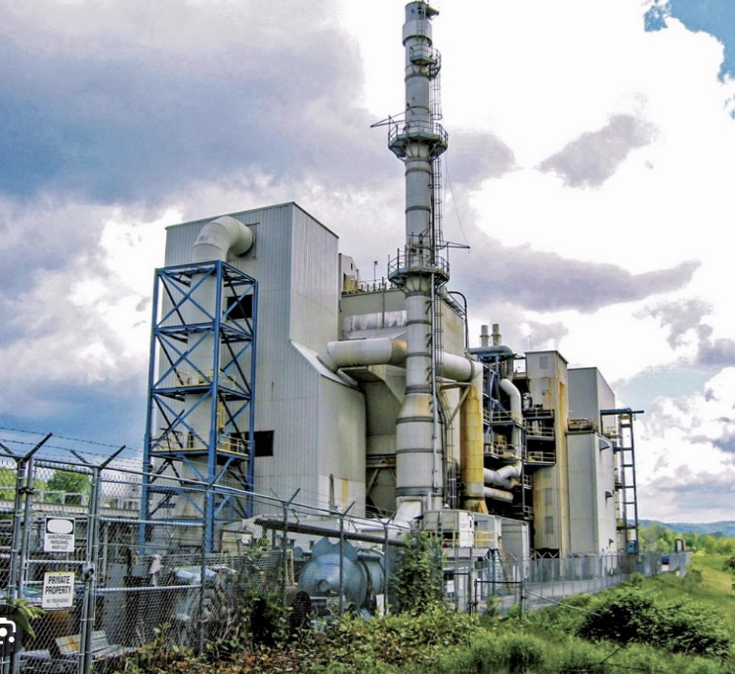
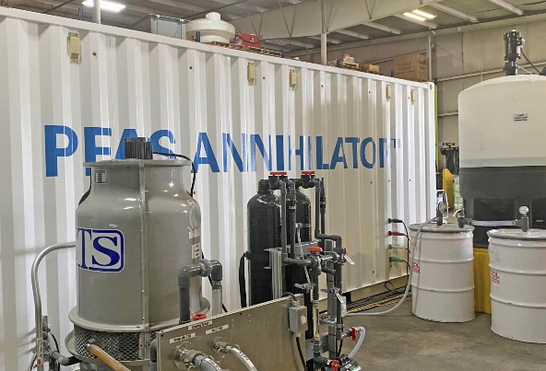
RegenIX™ Waste Regenerant – Disposal Options
Title C Landfill
Deep Well Injection
Destruction
Plasma
Incineration
Halt
SCWO

Slide 21
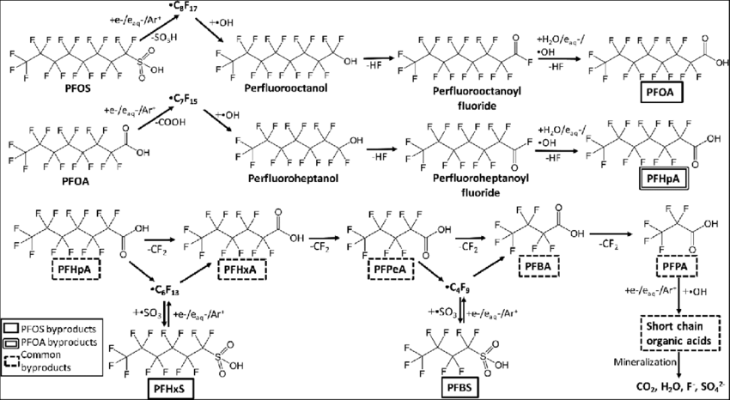
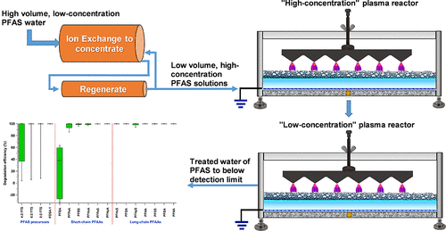
Plasma

Slide 22
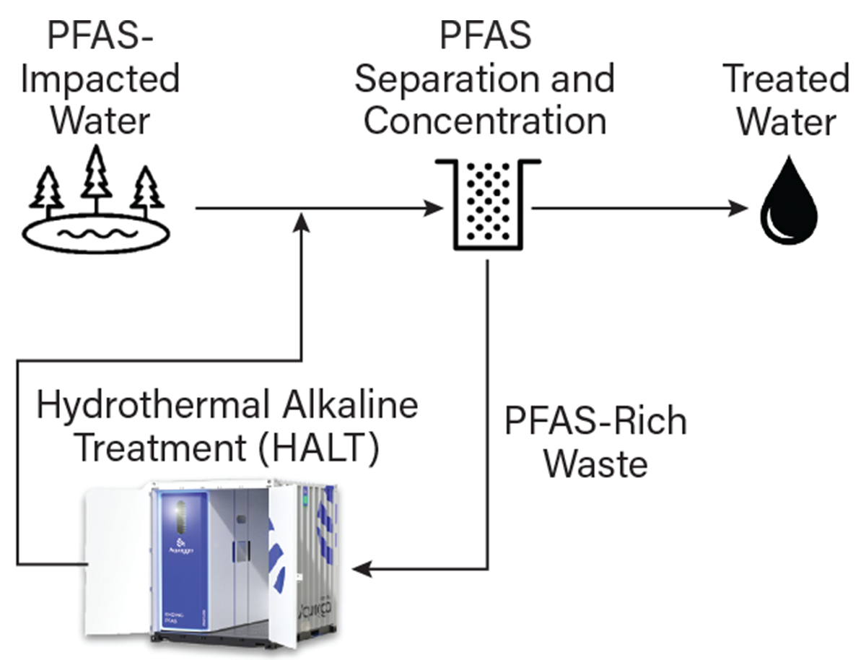
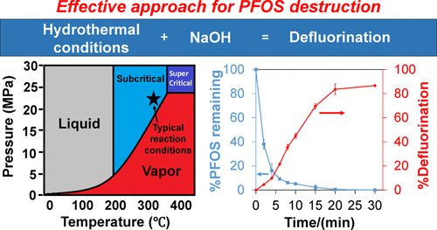
Hydrothermal Alkaline Treatment (HALT)

Slide 23
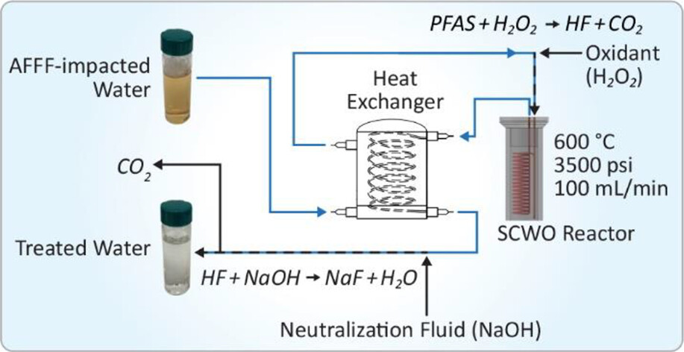
Supercritical Water Oxidation (SCWO)

Slide 24
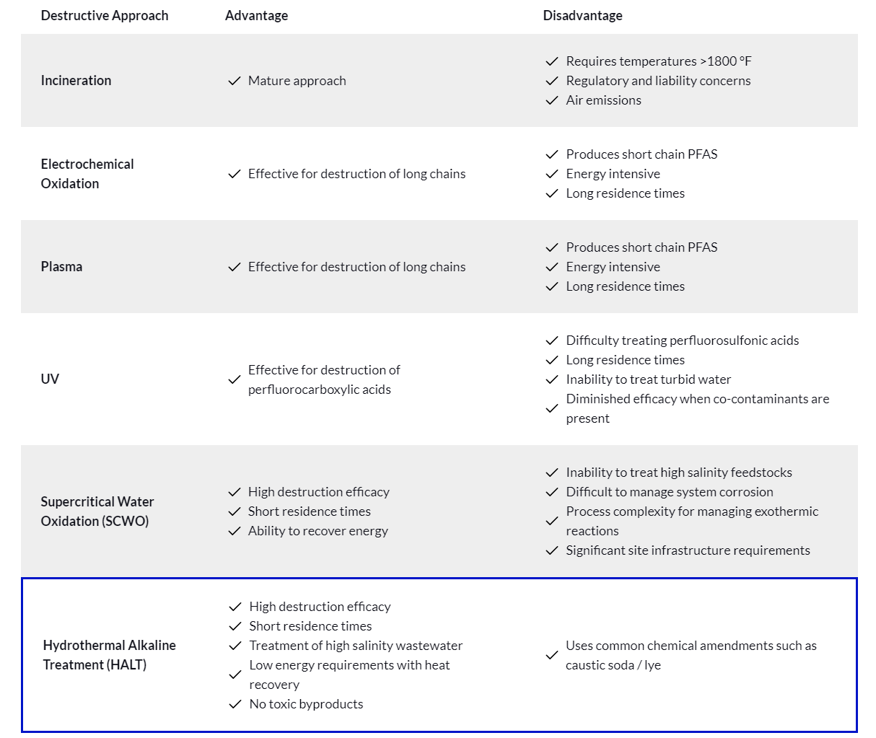
SWOT Analysis of Destruction Methods

Slide 25
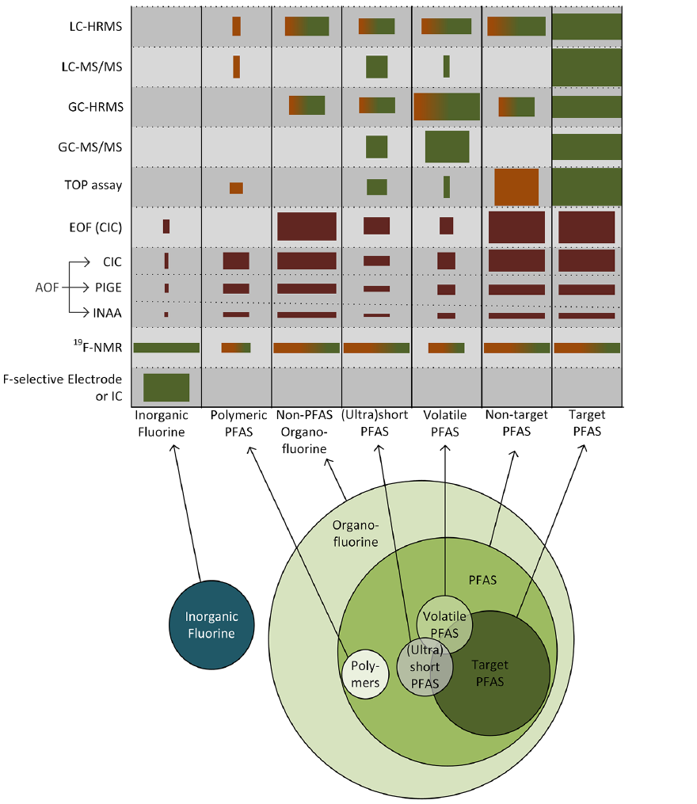
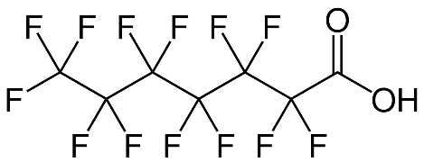
Mass Balance
To illustrate this distinction, if all perfluorooctanoic acid (PFOA, C8) in a matrix is degraded to perfluoro-heptanoic acid (PFHpA, C7), the technology will have a PFOA degradation efficiency of 100%, a defluorination efficiency of 13% (provided the C−F bonds in the lost CF2 moiety are broken), and a mineralisation efficiency of 0%.
-CF2
PFOA
PFHpA

Slide 26
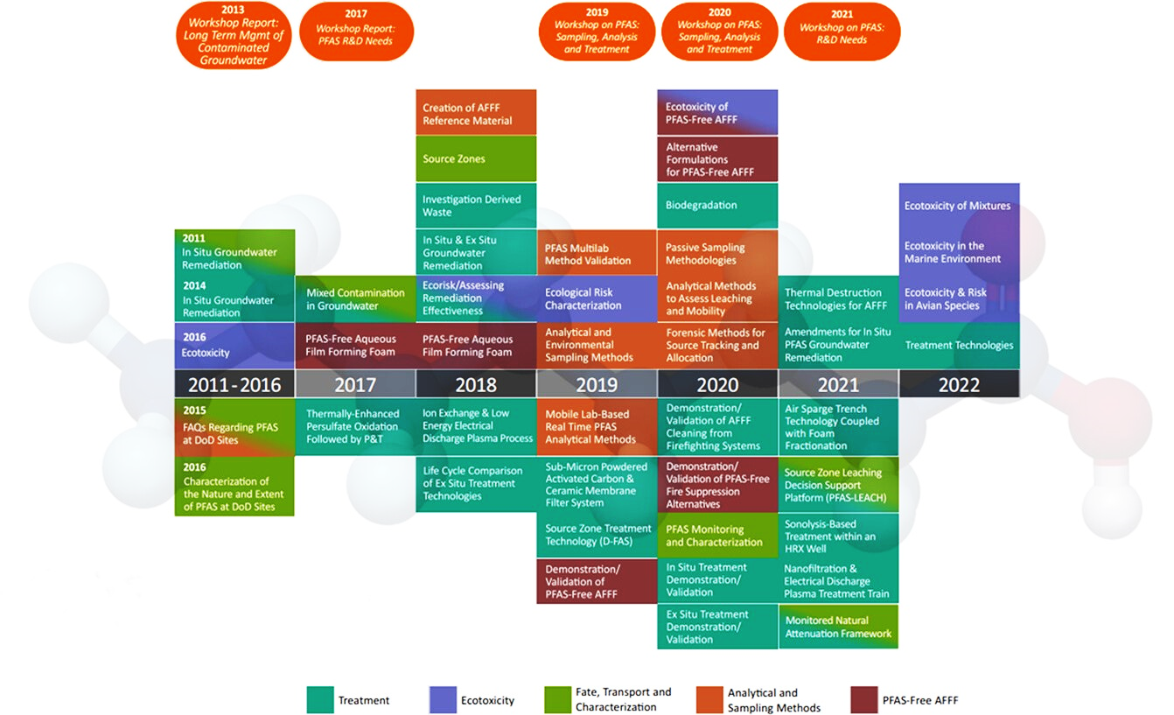
Progress

Slide 27
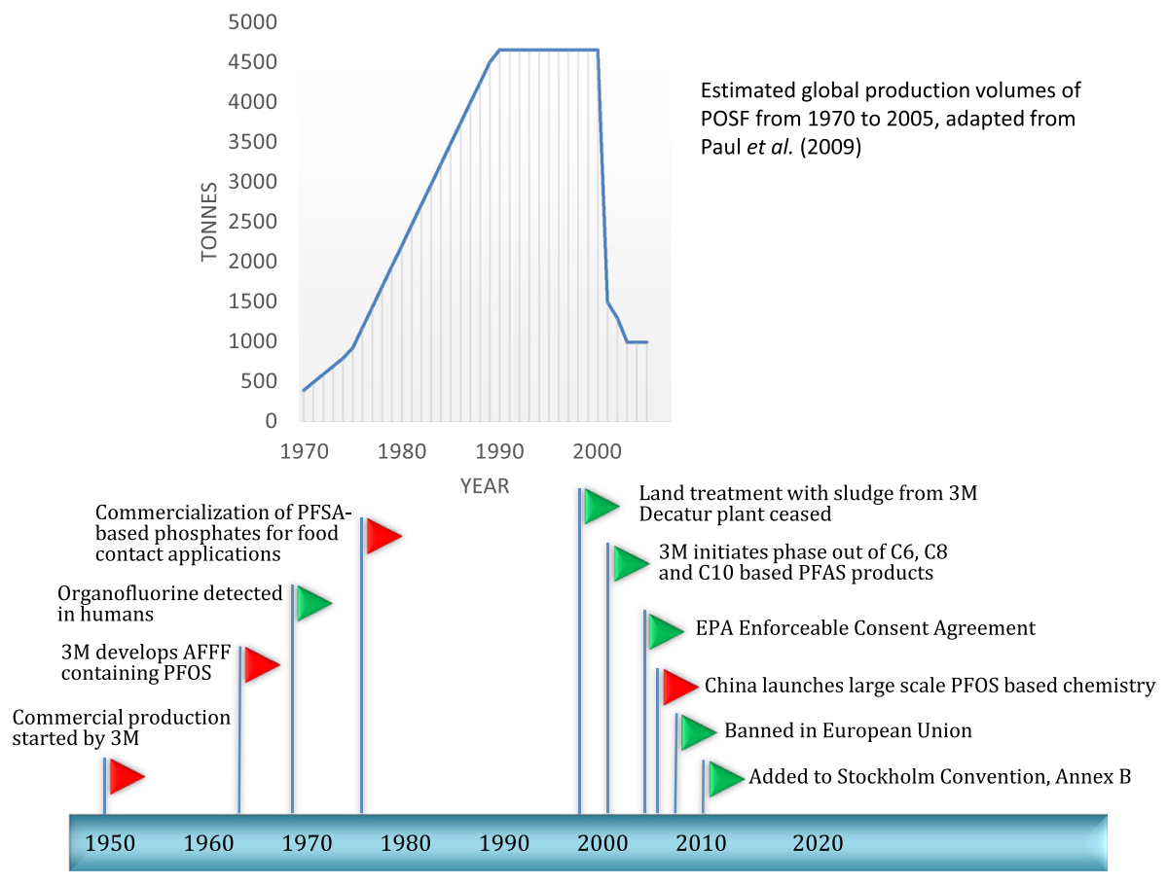
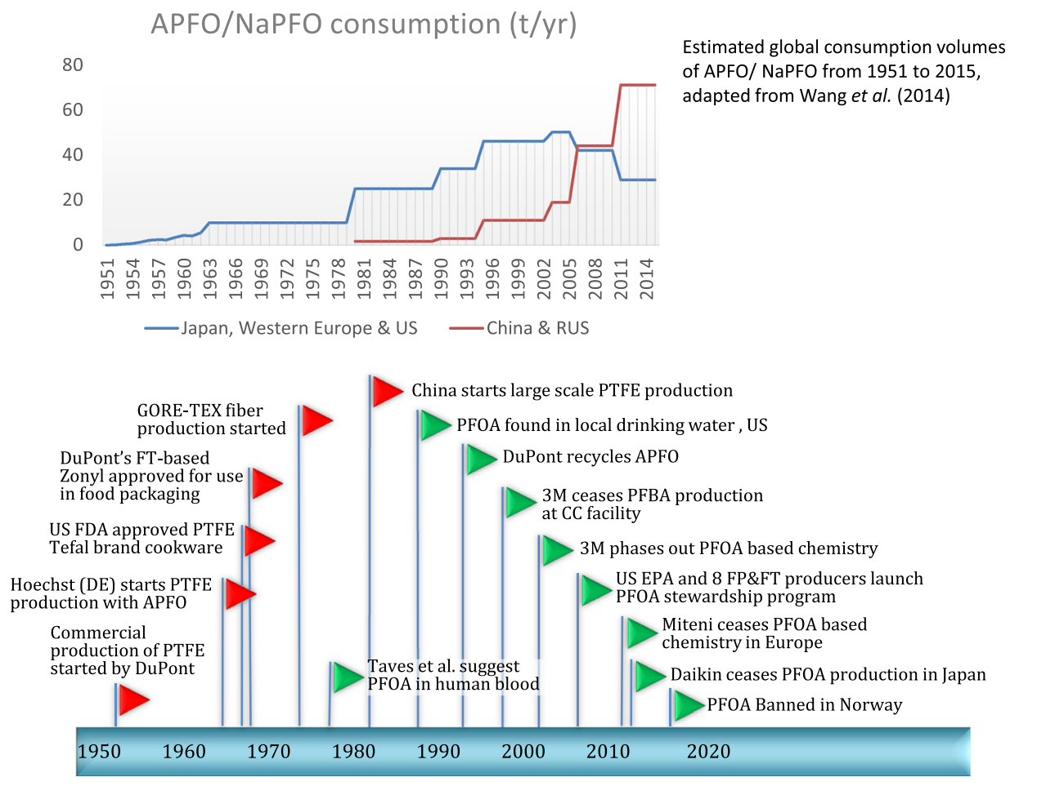
Production of PFOA and PFOS

Slide 28
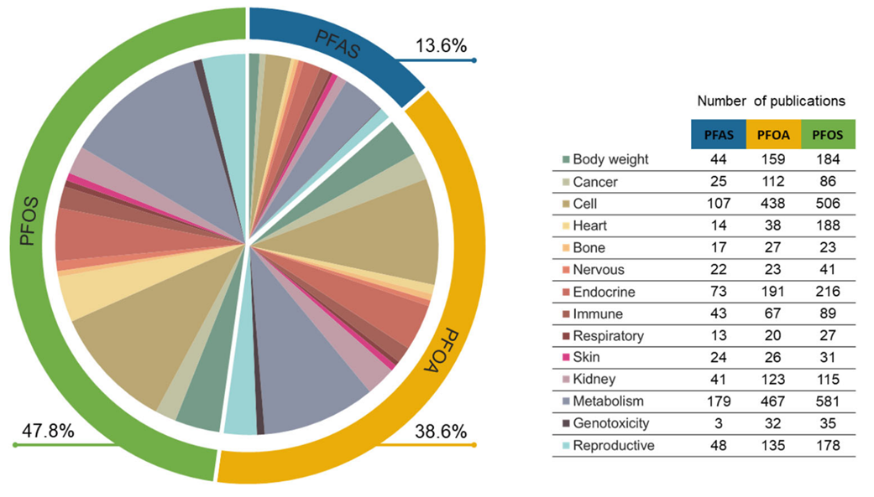
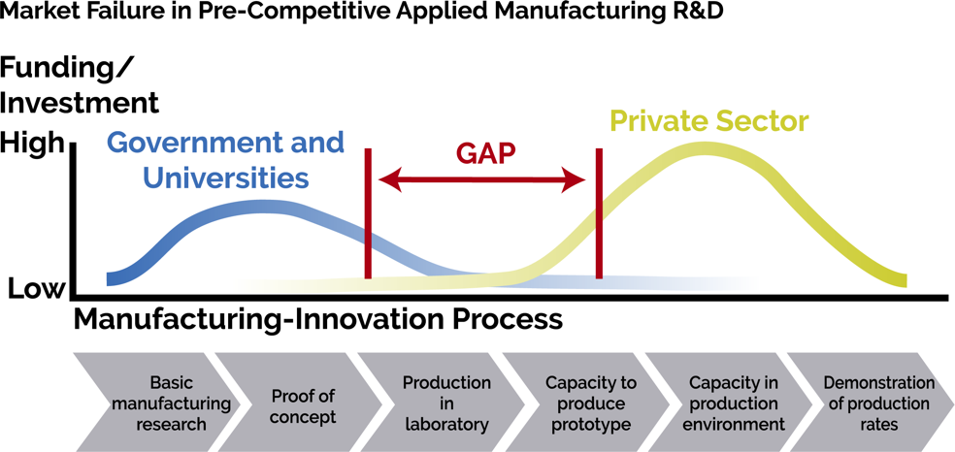
Future…
PFAS remediation spending is forecasted to triple by 2030
For substitution, there are two proposals put forward:
A universal ban
A universal ban with use-specific exemptions where there is no known substitute to transition to

Slide 29
Thank you!
John Wilson Vice-President Water Technologies, Europe john.wilson@scidevltd.com
QUINN SMITH Vice-President Water Technologies, Americas quinn.smith@scidevltd.com
ADAM FARAHANI Technical Manager, Australia adam.farahani@scidevltd.com

