Slide 1
The Process Industry Neurology Initiative
Rewiring the Brain of the Process Industries
Advances 2025
Chris Hamlin, HancockHamlin Ltd

Slide 2


















Who Are We?
MSc
Sustainable Development
Office of Science & Technology
Penny Hamlin
Visiting Professor
Fellow
Fellow
MBA &
Visiting
Fellow
Chris Hamlin FREng

Slide 3
Origin Story

Slide 4


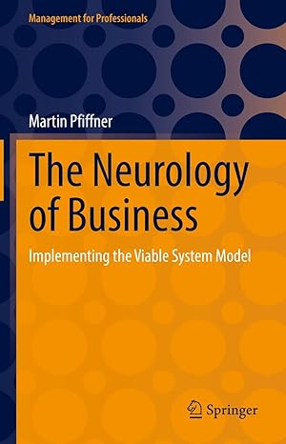
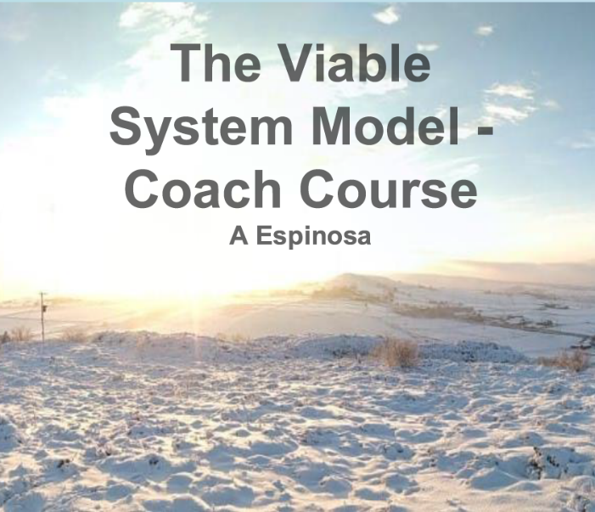
Influences & Inspiration
The Neurology of Business
VSM Coach Training

Slide 5

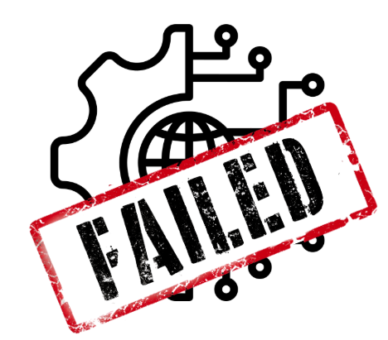

Why hasn’t the Process Industry transformed?
Billions spent on digitalisation but…
…70% of digital transformations FAIL¹
Why? Because the focus is wrong.
We’re trying to change complex evolving systems using linear engineering logic.
1. Dr Corrie Block, Forbes Coaches Council, 2022 “12 Reasons Your Digital Transformation Will Fail”
Notes:
Despite decades of effort and billions spent on digitalisation, advanced analytics, and AI, the process industries remain largely unchanged. Process industries operate much as they did 50 years ago—even as the pace and potential of technology have exploded. It’s not for lack of tools; it’s a systemic issue.
Multiple reports over the last 10 years show most transformations fall short of their objectives.
The reason you only have a 16% chance of success is that you’re paying attention to the wrong things. DX is 80% soft skills, 20% technology.

Slide 6
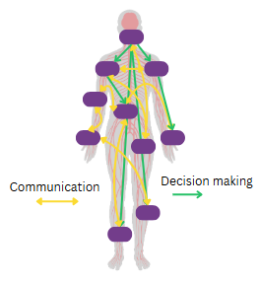


The Neurology Analogy
Organisational Structure
- Anatomy
Decision & Feedback Flows
- Neurology
Business Processes
- Physiology
Notes:
In organisations, we’ve long studied anatomy (organisational design) and physiology (business processes). But we’ve neglected neurology - the system that integrates sensing, cognition, feedback, and decision-making. We centralise data in repositories, assume visibility equals understanding, and wonder why transformation stalls. It’s the organisational equivalent of operating with a brain but no spinal cord or nervous system.
Imagine if we ran our bodies like we run our businesses: no real-time awareness, no adaptive response, no functional nervous system.
It’s time to change that.

Slide 7




Purpose of today - Exploration with you all
Ideas
Commentary
Insight
Interest

Slide 8
Exploring the VSM Connection

Slide 9
Introducing the Viable System Model (VSM)

Slide 10
Introducing the Viable System Model (VSM)

Slide 11
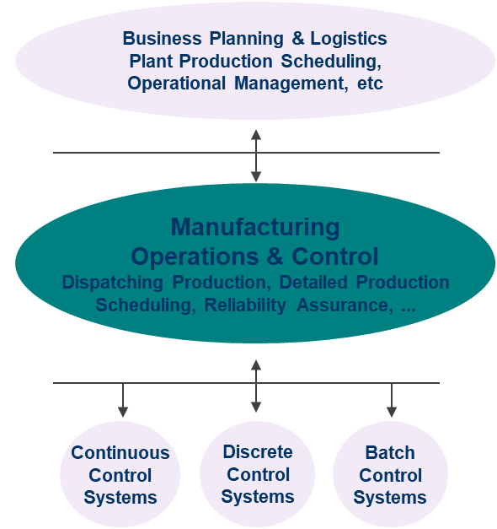
“Business Control Hierarchy”™
Risk Management
Coping with an uncertain World
Prices & markets; Supply and demand uncertainty; Plant availability & reliability
Agility Management
Responding to fluctuations and deviations
37
Alternate production and supply routes; Spot opportunities; Responsiveness & flexibility
Performance Management
Knowing what’s happening and what’s possible
7
Identifying deviations (in production performance, supply/demand patterns etc); Validation of planning models and assumptions; Driving continuous improvement
Conformance Management
Doing what’s wanted or expected
7
Staying on spec (quality control); Minimising costs (constraint control); Pushing appropriate limits (real-time optimisation)
Conservation Management
Keeping the process running
Basic regulatory control (closed-loop); Conservation of mass and energy

Slide 12
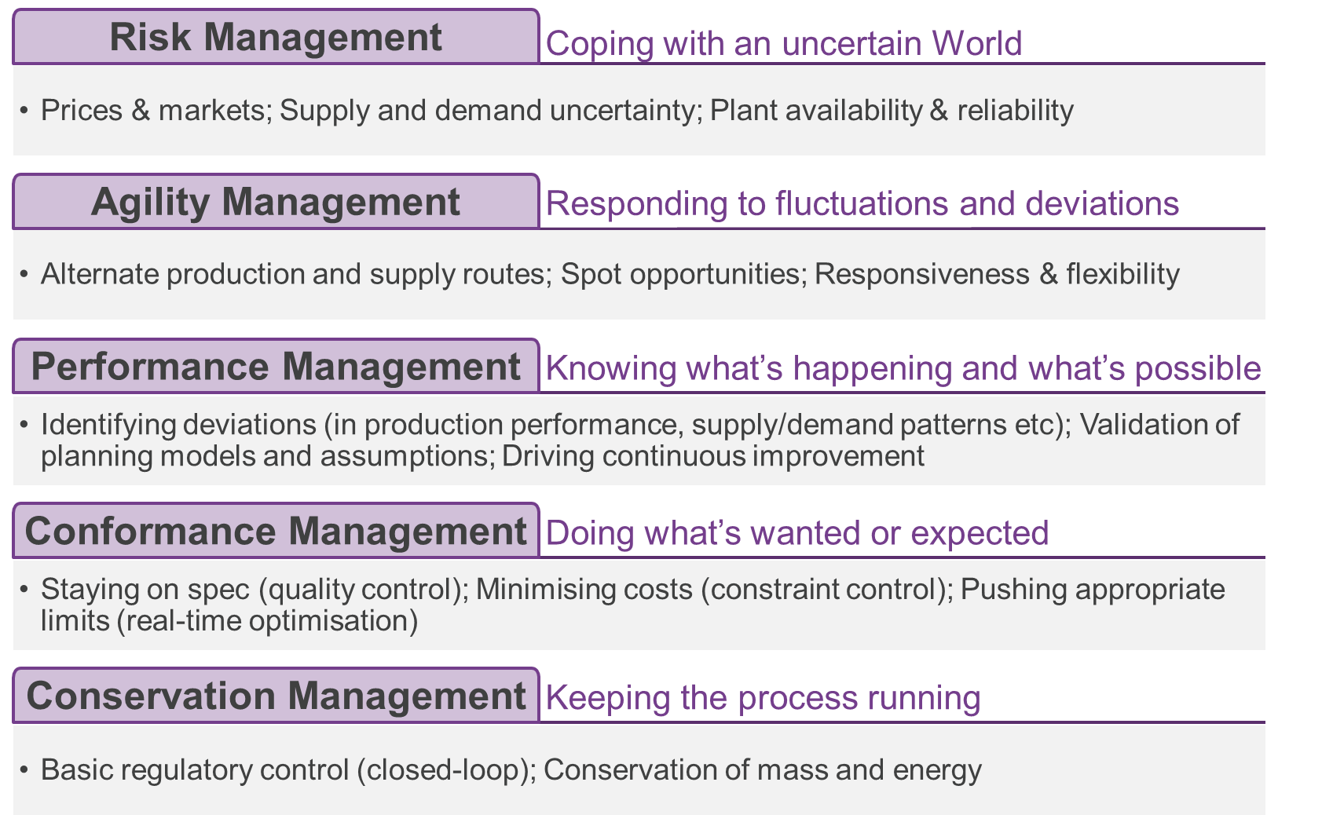
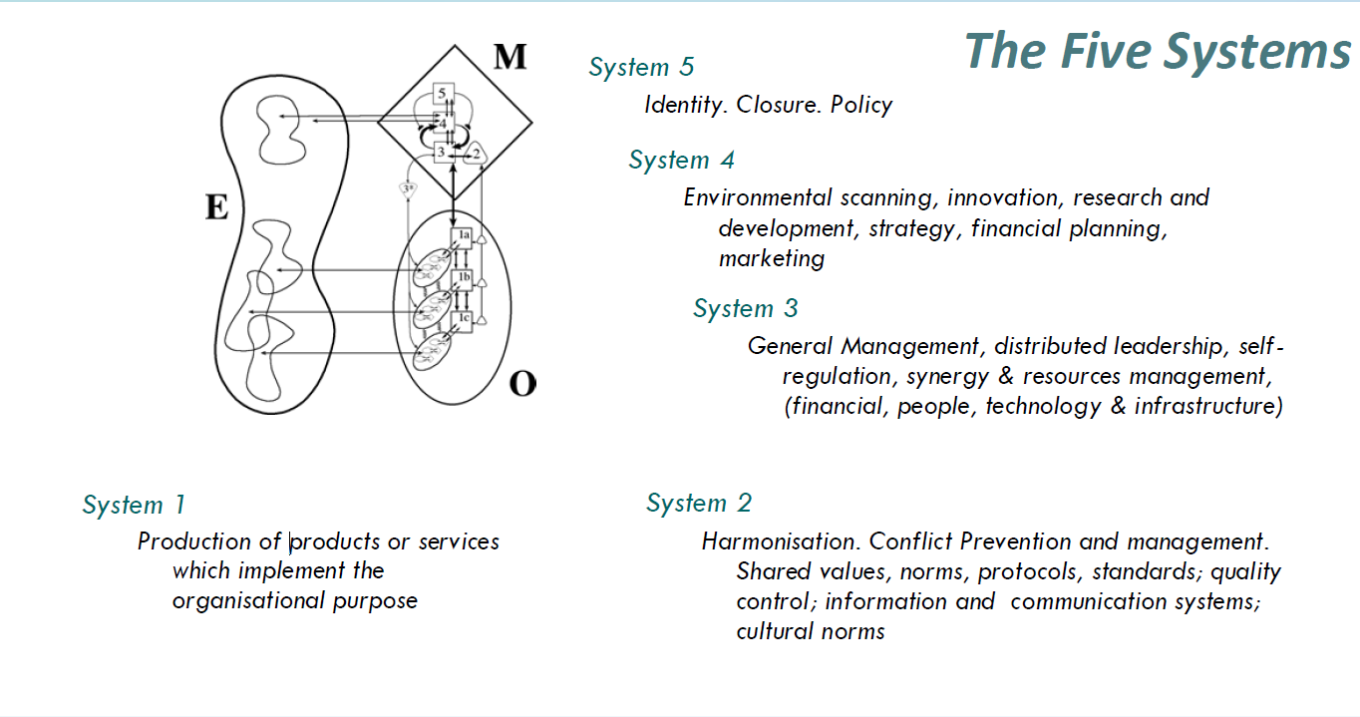
Recursion – Business Control Hierarchy™ in Practice

Slide 13
The Person Responsible™ for…. Is this a possible S1 & recursion model?
Business Performance
Operating Margin
Commercial Operations
Planning & Scheduling
Investments
Projects & Capital
Perception & Compliance
EHS
Production Cost
Acquisitions
Safety Performance
Feedstock Purchasing
Product Sales
Logistics Operations
Production
Asset Availability
Process Improvement
Turnarounds
Project Procurement
Operational Productivity
Process Efficiency
Energy and Utilities
Instruments & Systems
Electrical
Mechanical
Rotating Machines
Procurement
Maintenance Productivity
Project Management
Financial Accounting
Production Accounting
Fiscal Reporting
Activity Planning
Working Capital
Regulatory Compliance
Environmental Compliance
Reliability
Quality
Support Services
Cyber Security
IT Cost and Performance
Human Capital
Data Analytics

Slide 14

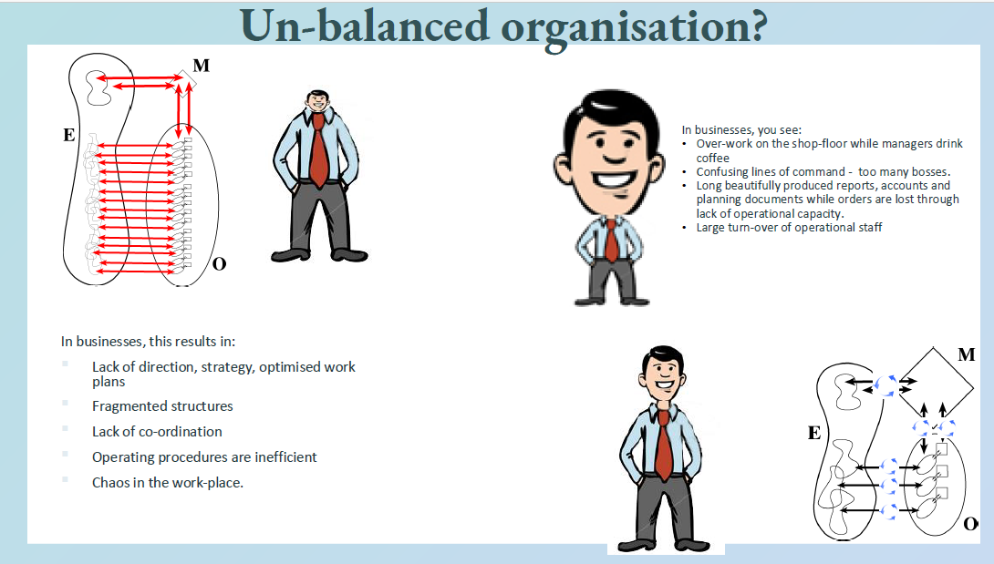


Meta-system not understood in any way
Images from Angela Espinosa’s VSM Coach Course

Slide 15
Systems 1-5 not all fully present
S1 is clear, and in some aspects has been digitised for decades at the shop floor
S2 has historically been manually implemented through successive levels of scheduling and planning
S3 is “Operations Management” and rarely appropriately autonomous at any level – consequential anarchy on shop floor
S4 is only present at business level – predicting market demand
S5 is confused with S3, and digitalisation has amplified the tendency for micromanagement in lieu of appropriate responsibility assignment
Process industries – different archetypes are likely to have different emphasis and requirement of systems.
e.g. Compliance based will likely have stronger System 3* than some others
System 1
Production of products or services which implement the organisational purpose
System 2
Harmonisation. Conflict Prevention and management. Shared values, norms, protocols, standards, quality control; information and communication systems.
System 3
General Management, distributed leadership, self-regulation, synergy and resources management
System 4
Environmental scanning, innovation, R&D, strategy, financial planning, marketing
System 5
Identity. Closure. Policy

Slide 16
Motivation & Opportunity

Slide 17
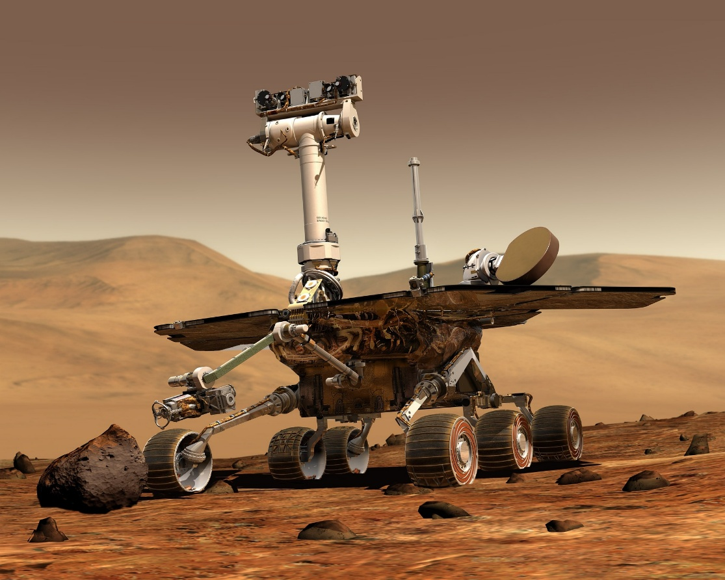

Why it matters
Process Industry’s Current Approach
What it could be…
Image by WikiImages from Pixabay
Gorodenkoff/Shutterstock.com
Careful, Deliberate, Slow
Dynamic, Responsive, Immediate
Notes:
managing a process manufacturing business today is more like operating the Perseverance Mars rover - careful, deliberate, slow - when it could be more like driving a car in real-time. We need systems that:
Enable dynamic, in-flight decision-making, not post mortem reports.
Use decentralised, adaptive feedback rather than centralised command.
Focus run-time validated information at the right place for the right level of decision making at the right time
Work with run-time facility-specific data, not industry long-run averages.
We manage facilities like NASA operates Perseverance, relying on a structured process: collecting data, validating it, defining objectives, and deploying plans with no direct oversight. For Perseverance, this method is necessary due to interplanetary communication delays and bandwidth limitations – it can take between three and 22 minutes for a signal to reach the rover. However, on Earth, this approach is increasingly outdated. Despite advances in digital capabilities, businesses and governments still rely on standards-based metrics, retrospective reporting, and aggregated KPIs. These traditional methods fail in complex systems, where simple definitions and measurements are inadequate.
This isn't just an academic exercise. The potential of contemporary advances in data, analytics, digitalisation, and AI to drive systemic change is still largely untapped in the process industries.

Slide 18

Ancient Greece – Two Understandings of Time
Chronos
Kairos
Kairos
Regular, linear progression - seconds, minutes, hours, days, weeks, months, years
Quantifiable
Measured
Systematic
Predictable
Rhythmic action
Not bound by clock or calendar - focuses on the significance and quality of any particular moment
Conditional
Experienced
Qualitative
Opportune
Responsive action
Image generated by DALL-E on ChatGPT Jan 2025

Slide 19
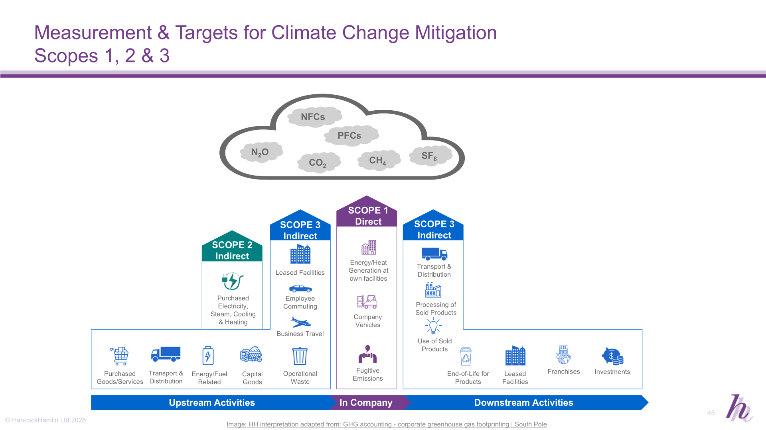
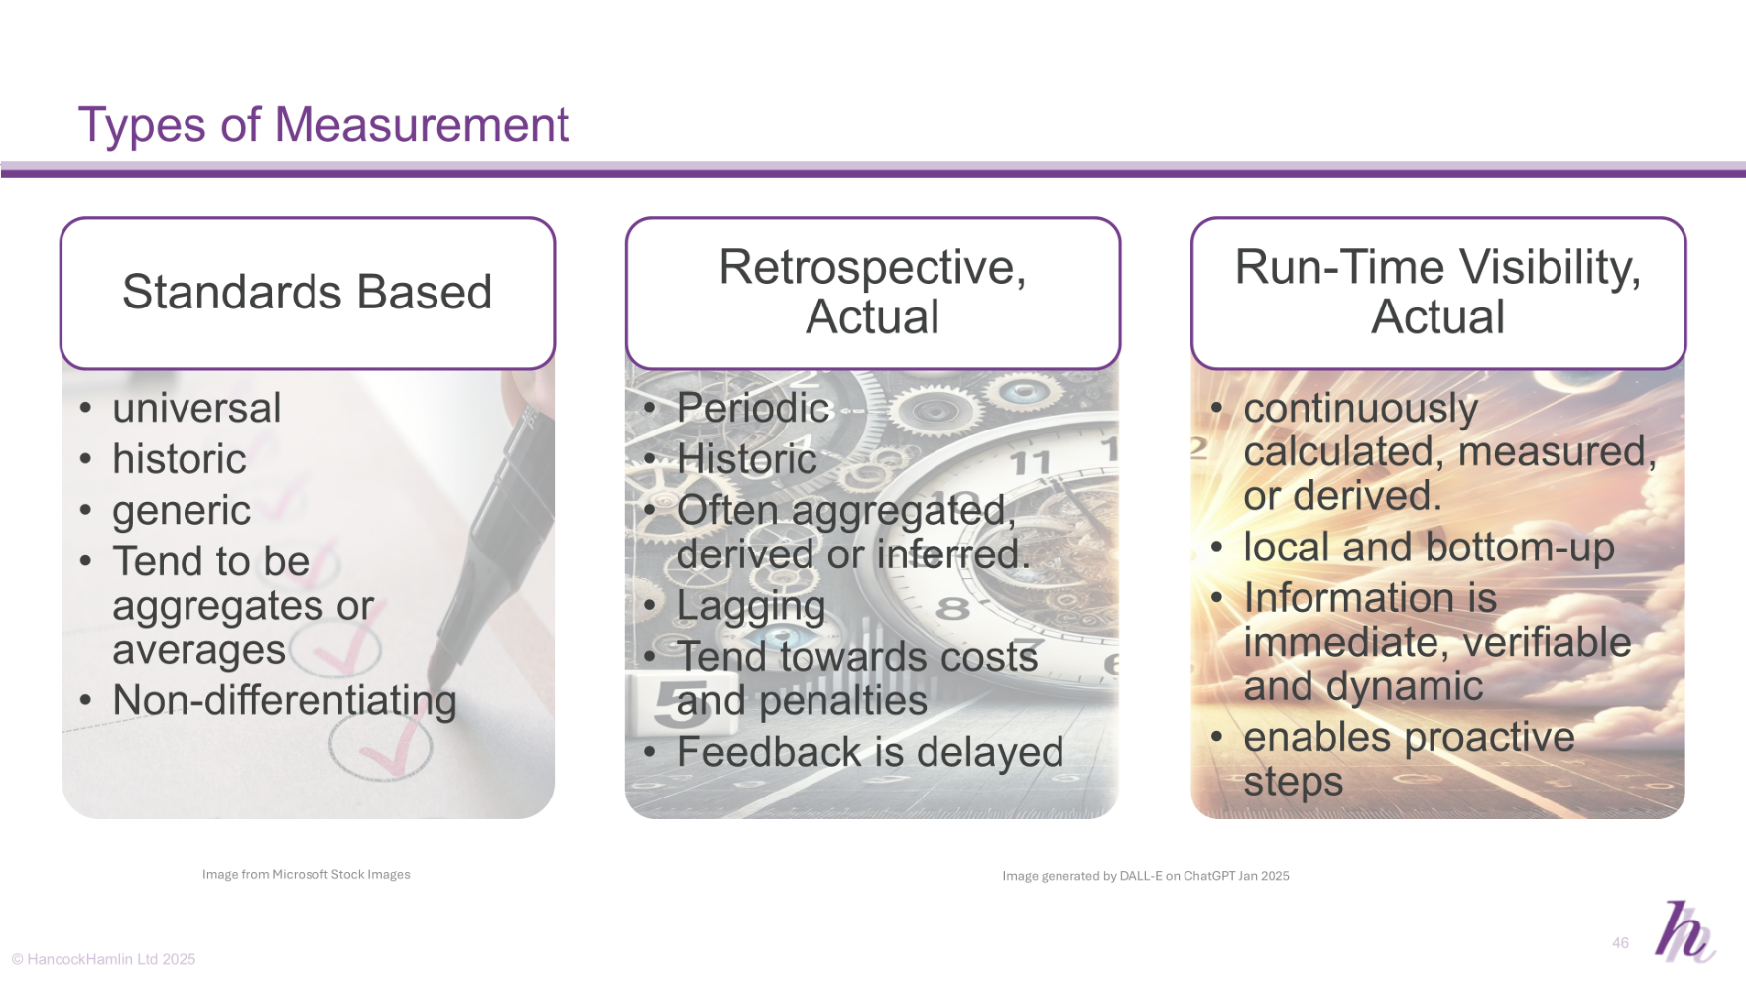
One Example - Measurement of GHG Impact in Upstream Industry

Slide 20
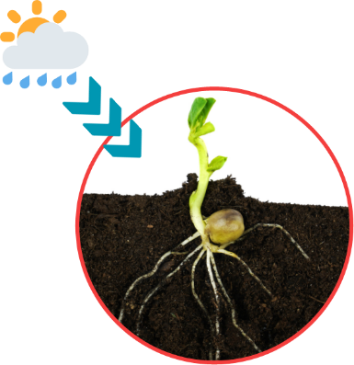

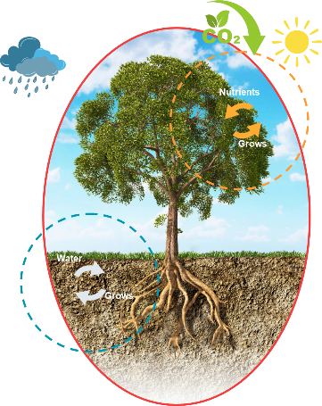
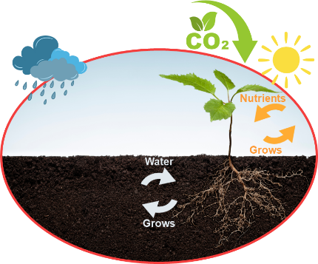
Illustrative, imaginary industry transformation pathway - creating attractors and positive feedback loops
Shift 1
Scope 1 (then 2) reporting moves to a run-time basis
Shift 2
Scope 3 transitions from standards-based to retrospective actual reporting
Shift 3
Scope 3 upstream shifts to run-time reporting
Shift 4
Run-time visibility of entire value chain sows seeds of next cycle of innovation
Image by Mabel Amber, from Pixabay
Notes:
Acorns ON THE TREE – seeds of the next generation ready to fall

Slide 21






The Full Journey
Starting Position
Step 1
Step 2
Step 3
Step 4
SCOPE 1
Retrospective Actual
Run-Time, Actual
SCOPE 2
Retrospective Actual
Run-Time, Actual
SCOPE 3
Upstream
Standards Based
Retrospective Actual
Run-Time, Actual
SCOPE 3
Downstream
Standards Based
Retrospective Actual
Retrospective Actual
Run-Time, Actual
Image by Marek from Pixabay
Image by Nico Wall from Pixabay
Photo by Андрей: https://www.pexels.com/photo/green-plant-near-tall-trees-10981093/
Image by Kevan Craft from Pixabay
Image by Marek from Pixabay

Slide 22
Implications of Kairos-based Operations (Run-Time Enterprise) Analagous to Maximisation of Autonomy at Lowest Possible Recursion Level
Run-time visibility of deviation
Potential to intervene and mitigate/correct
Validation and verification
Certification and Quantification at facility/batch level
Creation of economic premium for responsible production
Transparency, quantification and awareness of acceptable standards
Highlighting of laggards

Slide 23
Process Neurology Initiative

Slide 24
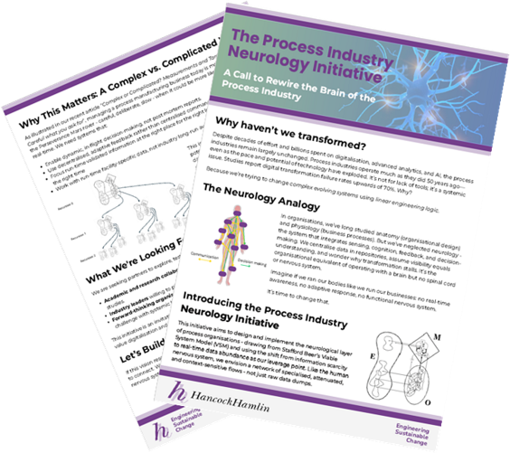
The Process Industry Neurology Initiative
Using VSM and the shift from information scarcity to real-time data abundance as our leverage point to re-imagine the process industry and map generic transition pathways.
Formalisation of concepts including:
Attenuation
Amplification
Homeostats

Slide 25

What we’re looking for
Help Needed!
join us to pioneer the thinking and practice that might finally unlock the value digitalisation and AI have long promised but rarely delivered.
Academic and research collaborators - to help develop the frameworks and run comparative studies.
Industry leaders – to pilot new approaches within a live facility or business unit.
Forward-thinking organisations – to form a consortium to advance this as a shared challenge with systemic benefits.

