Slide 1
Digitalize Design Review &
HAZOP Action Closeout Process
Presenter: Malak Al Azzani
Process Engineer in petroleum development Oman

Slide 2
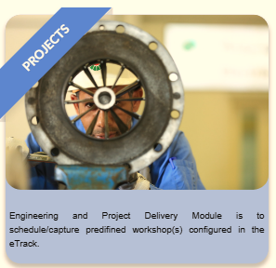
Introduction
Petroleum Development Oman (PDO) is the leading exploration and production company in the Sultanate of Oman, responsible for over 70% of the country's crude oil production and a significant portion of its natural gas supply. PDO executes around approximately 100 projects annually.
In Project Engineering Phase Two critical assurance review owned by process engineering discipline
1. Design Review
2. HAZOP

Slide 3
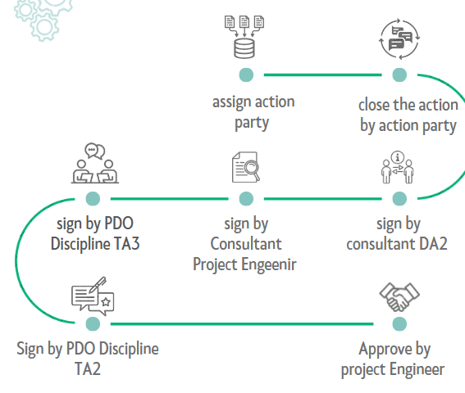
Old Methodology
Slower processing times
Extensive manual effort required for monitoring and tracking
Lack of a centralized platform for storing actions
Prolonged communication delays between consultants and PDO

Slide 4
New Digitalize Approach
Develop New System
Upload Actions
Add Action Resolution

Slide 5
Cont.’
Approve the Action
Generate Action closeout

Slide 6

Benefits
E-Track application enable the following:
Track the progress of actions closeout and continually improve the closeout process.
Simplify and improve Engineering workshop actions closeout.
Streamline the review and approval of review actions and ultimately enhance the delivery of PDO Projects and FIPs.
Producing Action closeout sheet from the E-track tool with the approved responsible engineer rather than the manual signature.
Enhancing the digitalization of the EPSF-6
Tracking and monitoring the progress of actions closeout
Preventing any bypass of the approval cycle.
Provides an easy access to the data base of a project’s assurance, and reviews actions for any company auditing and references.

Slide 7


Challenges
Introduced the tool to all relevant Engineering, Operations, and Project teams within PDO.
Presented the tool to more than seven consultant engineering companies.
Created separate user accounts for all engineering disciplines for external users
Resolved format and numerical error issues.
Develop and digitalize the process flow

Slide 8

End
Digitalize the DR/HAZOP actions closeout is a major improvement in project management in PDO. It enhances PDO’s digital transformation journey

