Slide 1
Digitalisation practice applied to tablet packing
Digitalisation in the Pharmaceutical Industry
Presented by Dr Tony Margetts, Factorytalk UK (tma@factory-talk.com)
Acknowledgement : Andy Birch, MTC, (andy.birch@the-mtc.org)

Slide 2
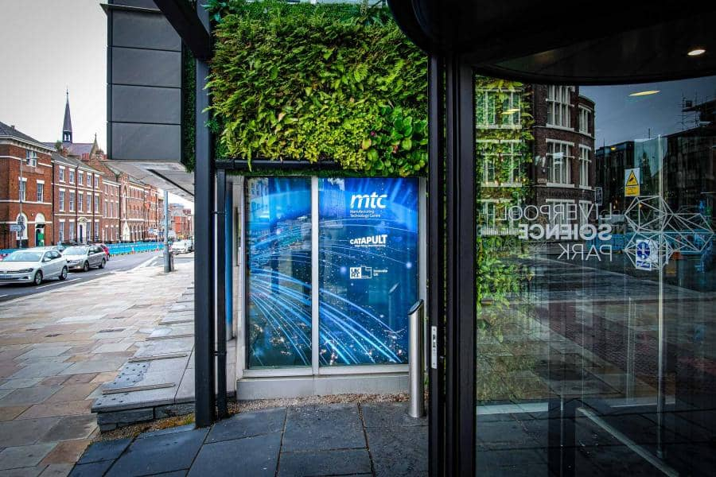

The Manufacturing Technology Centre
The Manfacturing Technology Centre (MTC), is part of the High Value Manufacturing Catapult
Supported by Innovate UK and established to prove innovative manufacturing processes and technologies in an agile environment in partnership with industry, academia and other institutions.
Through the Digital Manufacturing Accelerator project, designed and built the automatic tablet packing line as a demonstration of new technology
The line uses digitalisation to ensure right first-time operation including continuous monitoring of all critical parameters

Slide 3



DIGITAL MANUFACTURING ACCELERATOR​
The DMA assets allow manufacturers to experience the advantages of industry 4.0, IoT, smart manufacturing, robotics, and automation in a risk-free environment with accurate financial and operational projections to enable the deployment and rapid scale-up of technological capabilities.
£15m Investment in the assets
LCRA Funding
MTC’s Technical Specialists
MTC
Digital Factory Environment
DMA
Rapidly-Reconfigurable Factory Environment
DFE provides a catalogue of digital infrastructure to:
Enable the rapid testing, down-selection of architectures, processes, and technologies
In a secure, risk-free environment.
DFE
RRFE
4.0 technologies physical test-bed facility
Located in Liverpool
This demonstrates the advantages of modular manufacturing
DFE

Slide 4
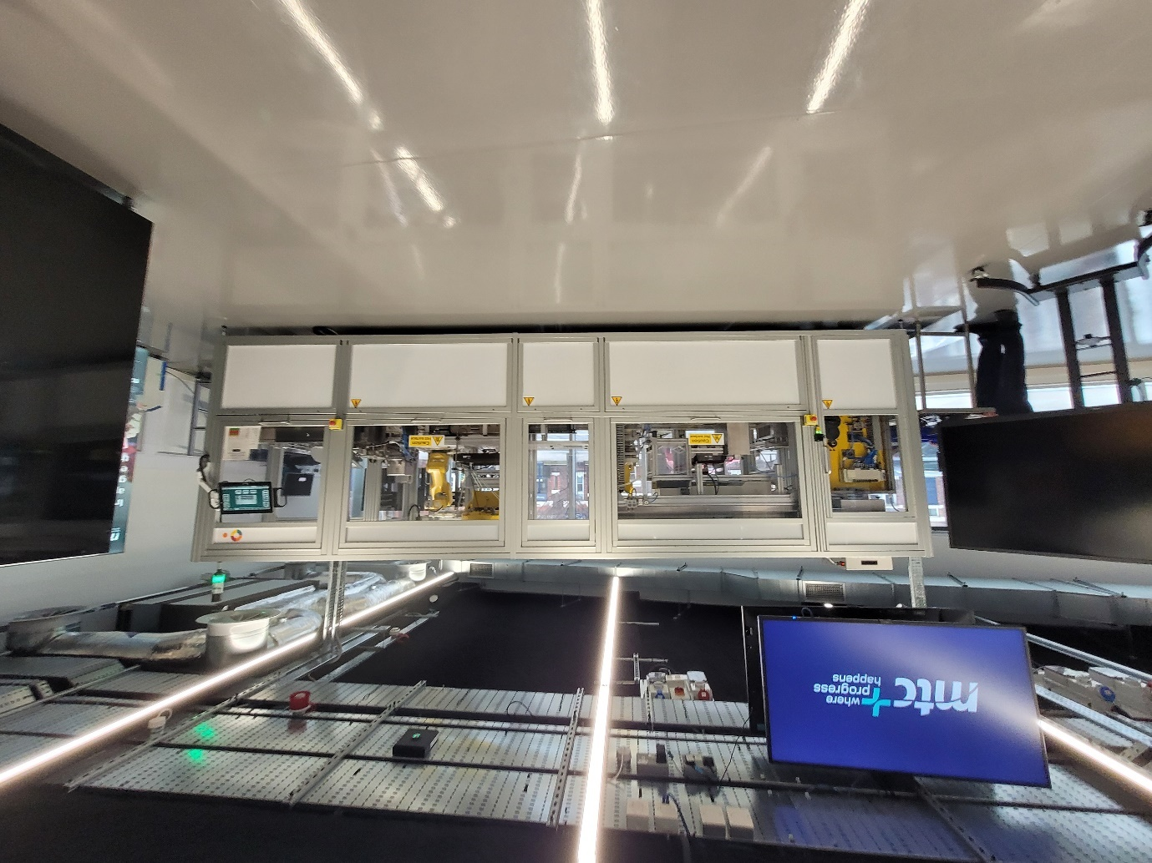
The Packing Line

Slide 5
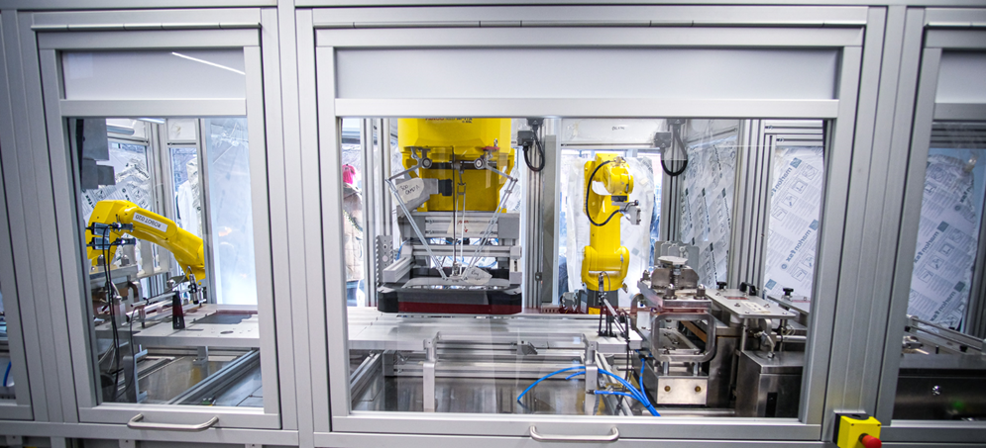
The Challange
“Digitalisation enabling customised products“
Production solution to meet the market need for customised (multi-drug blister) medication and productive small batch production.
Design by Validation 4.0
Special Purpose Machines
Process Digital Twin
Enhanced Product Traceability
Enhanced Quality Assurance
Adaptive Scheduling
Virtual Engineering
Digital Work Instructions
Challenges:
Existing packaging technologies lack adaptability with low OEE.
Production changeover is labour and time intensive and prone to human error.
Lack of control of product requires manual inspection.
Basic equipment monitoring, lack of connectivity & industry 4.0 adoption.
Paper-based traceability with labour intense manual batch sign off.
New production introduction is expensive, time consuming with long downtime.

Slide 6
Project Objectives
Able to pack patient specific pack formats ( eg possible different tablets in the same blister)
Complete automation of line operation and quality checks of all Critical Process Parameters especially the heat seal and the printing
Complete recording and display of all data
Systemised data management across recipe and master data and across the Manufacturing App (MES) Platform, the Process Control System, and the Electronic Batch Record (EBR), from manufacturing orders to finished packs
High efficiency in- line setup and clearance that can handle the complexity of the possible packing formats to enable rapid and flexible changing of the pack make-up for a defined range of tablet types and dimensions
Reduce any risks of cross contamination
Innovation using Validation 4.0 principles in the equipment qualification and process validation

Slide 7
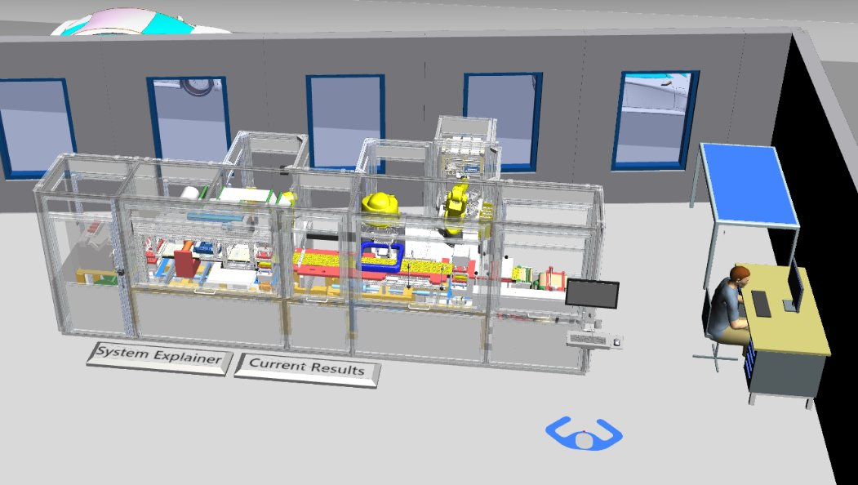
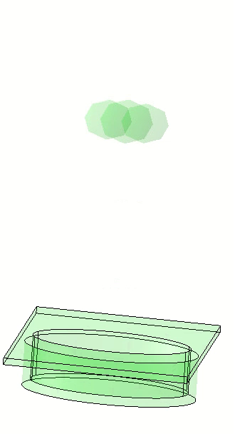
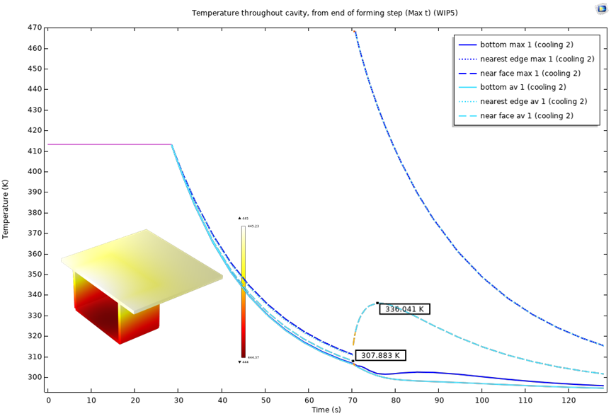
Virtual Engineering
Starting from Virtual Engineering
Multi-disciplinary use of integrated simulations as virtual prototypes to design, analyse, and optimise production systems, before physical prototypes are built​
Test, assess, debug, commission, demonstrate digital manufacturing solutions in a virtual environment
Benefits​
Reduce prototyping​
Cost and lead-time benefits​
Rapid adaptive packaging production​
Facility layout for reconfigurability​
Assess need for cooling around thermal processes​
Validate material handling processes quality​
Quantify impact of pick-and-place capacity on productivity​
Production simulation
Tablet placing model
Thermal model

Slide 8
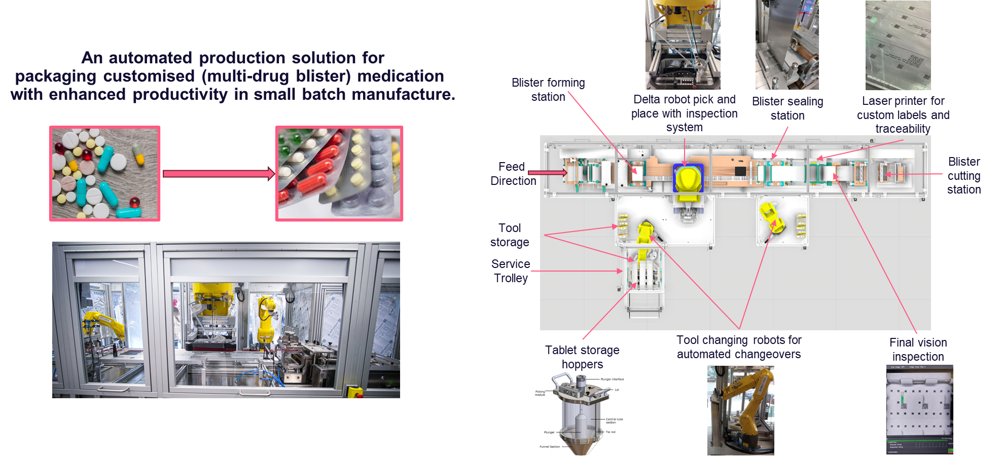
The Packing Line

Slide 9
Line Operation
The line is completely automated and embodies state of the art camera checks to ensure correct operation. The line is managed with a light no code management system (MES) with the process control system running below this. There is a lean batch record system to collect the packing batch record.
A production order is created in the MES and started. Two robots select the changeover parts to match the order depending on the size of tablets. It places them in the forming and heat seal stations.
The line forms pockets in PVC film and a robot fills each pocket with a tablet.
a foil sheet is fed on to the top of the filled pockets and a heat sealer seals the packs
A laser printer prints the variable data on each pocket including the seal temperature
A cutter chops out the individual packs which are collected at the end of the line.

Slide 10
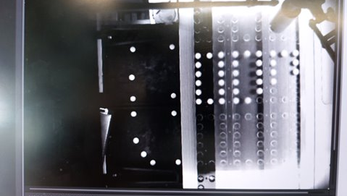
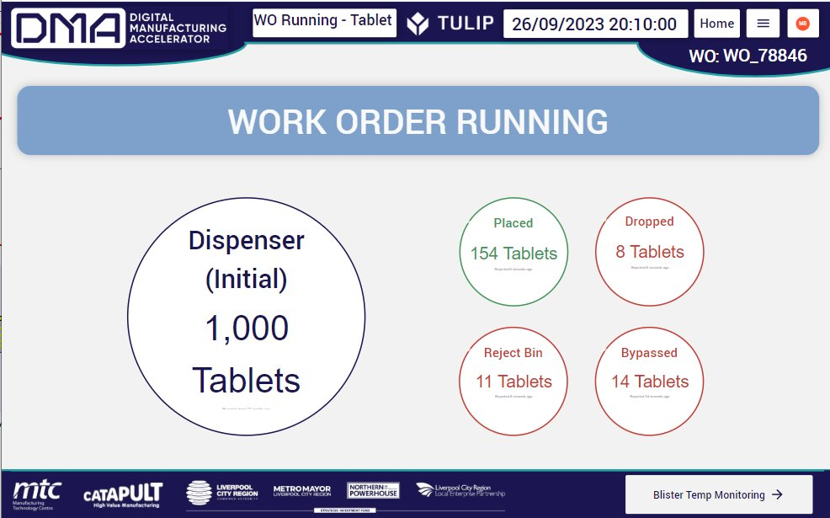
Line Monitoring
Everything is continually monitored and any faults rejected. The monitor functions include detection of :
malformed PVC pockets
chipped or damaged tablets
pockets with no tablets
heat seal defects
print problem
These potential problems are monitored with high definition cameras which are able to pick up any problems and correct them as they occur. Any faulty strips are rejected after cutting.

Slide 11
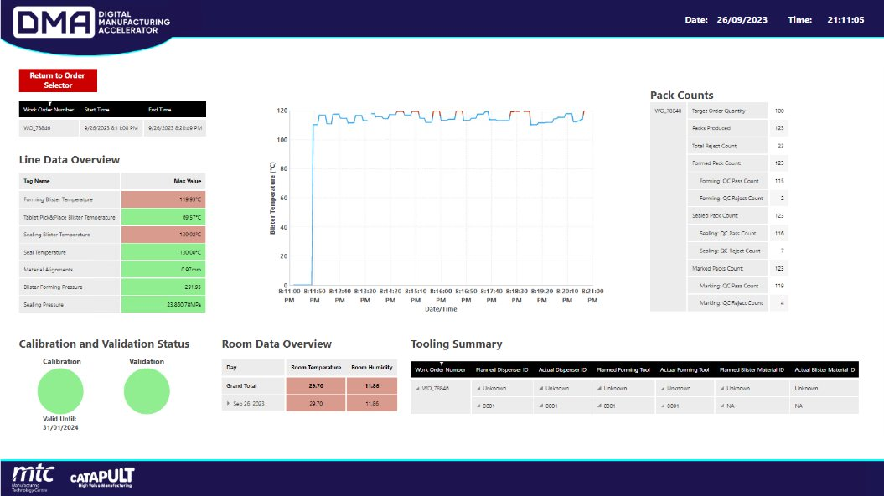
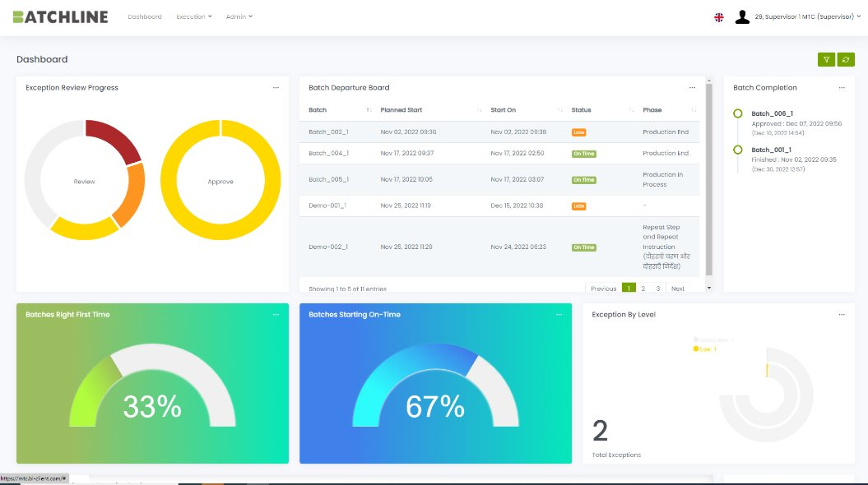
Details of Line Monitoring
Malformed pockets are not filled
Damaged tablets are not picked by the robot
If a pocket has no tablet the robot will return to fill it
The heat seal setting is determined by validation testing and the set temperature is printed on the strip and monitored . Any deviation of the heat seal temperature is monitored and alarmed
The print definition is continually monitored and wrong or poor printing is rejected
Key parameters are recorded and continuously displayed during the run
The line makes an auto reconciliation at the end of the run.
The MES provides guidance to the operator, collection of all data and simplified validation. For example
the heat seal temperature which is a critical parameter is printed on each patient strip.

Slide 12
Digitalisation supports the continuous checking and right first time operation, in particular:-
Packing of patient specific pack formats ( eg possible different tablets in the same blister)
Complete automation of line operation and quality checks of all Critical Process Parameters especially the heat seal and the printing
Complete recording and display of all data
Systemised data management across recipe and master data and across the Manufacturing App (MES) Platform, the Process Control System, and the Electronic Batch Record (EBR), from manufacturing orders to finished packs
High efficiency in- line setup and clearance that can handle the complexity of the possible packing formats to enable rapid and flexible changing of the pack make-up for a defined range of tablet types and dimensions
Reduce any risks of cross contamination
Innovation using Validation 4.0 principles in the equipment qualification and process validation

Slide 13


Electronic Systems
Out of the box solution configured using composable apps to :-
Manage the whole operation from manufacturing order to finished packs
Provide operator guidance with human centric interfaces
Store all the data
Display critical parameters
Affordable
BatchLine is a compact and robust cloud-based digital Batch Record system built on modern web technology. Off the shelf configured solution with the advantages :-
Automatic Generation of Final Batch Report
Review By Exception, less time spent on the QA process
Automatic data completeness check
Data entry checked against specification on input
Cycle time reduction
Siemens PLC
Machine control

Slide 14
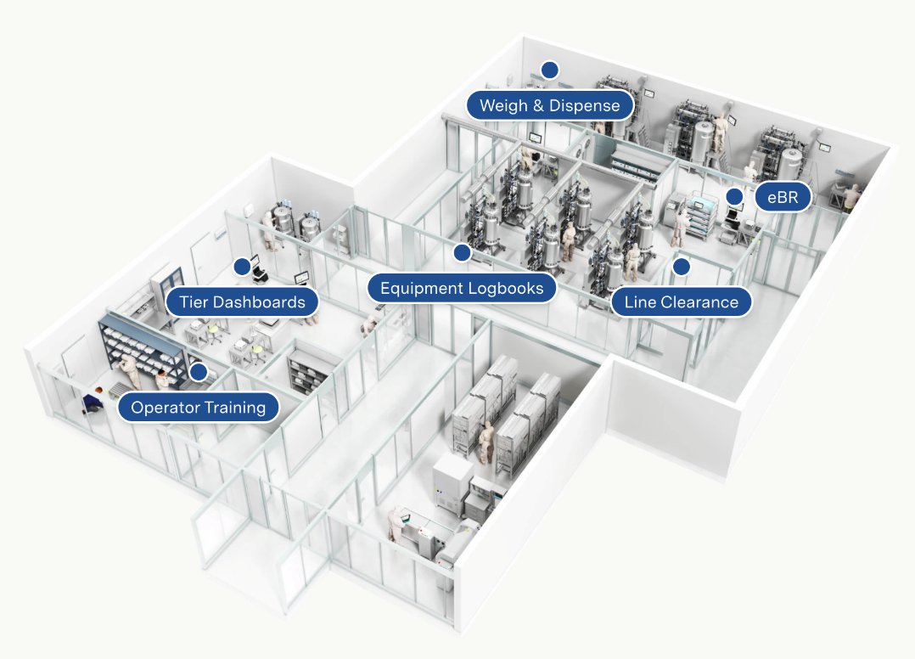
What is Tulip?
A platform for Developing No-Code Software Apps for Manufacturing
Supports Composable Digtitalisation – Compose Apps to match operations
Drag and drop, easy to use.
Customers can develop their own Apps and/or use Factorytalk
Many interfaces to the process
Validateable – built for GxP use
Cloud native, highly scalable.

Slide 15
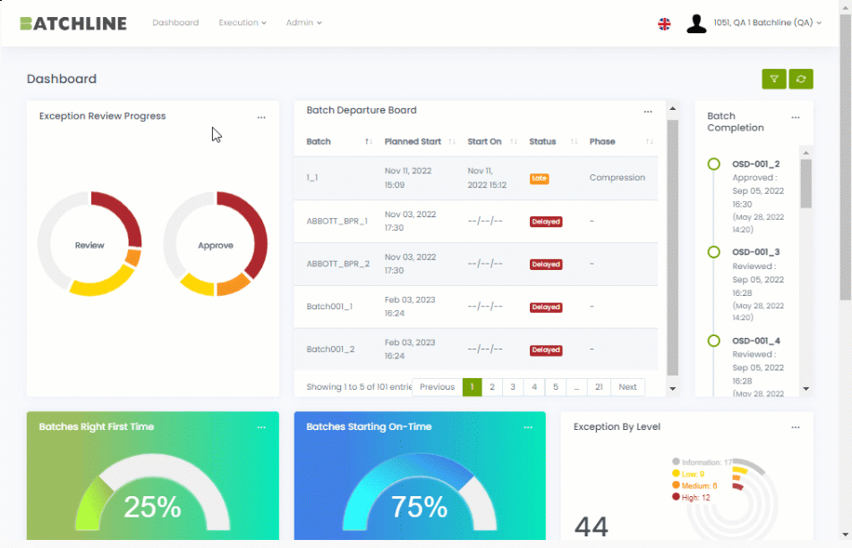
What is BatchLine Lite MES?
BatchLine offers a Lite MES with Electronic Batch Record (EBR), purpose built for Pharma and other GxP regulated companies to digitize production and quality for more efficient manufacturing operations.
With advanced technology and Pharma expertise we provide unparalleled benefits in an affordable product. Our experienced teams facilitate fast and simple onboarding, enabling EBR accessibility for all companies.
Smart, efficient, digital GxP manufacturing. Made simple, compliant and affordable.

Slide 16
MTC Machine Qualification & Validation Plan
Innovation using Validation 4.0 principles in the equipment qualification and process validation
The following validation documents were produced
Validation Plan
URS
Risk Assessment
Design Review
Acceptance testing
Validation Report
Risk Assessment

Slide 17
Tablet Packing Process & Critical Instruments
PVC feed
Tablets
Lidding feed
Forming the cavities
Cavity QC check
Dispense tablets to feeder
Check tablet QC check
Tablet filling
Foil lid heat seal
Heat seal QC check
Mark on each pocket
Check Marking QC
Profile cut
QC check tablet in every cavity
Laser
Optical
Optical vision check
Reconciliation count
Optical
Optical
Reconciliation count
QC check Reject packs with faults
Need to record failures for quality tracking / quality event
Print captured
for batch record
(Sample)
Need to record failures for quality tracking / quality event
Optical
Reconciliation count
Reconciliation count
The qualification checks ensure that the QC checks are working and that any faults are rejected at the reject station . The batch record does not need to know about these faults
GMP record includes :-
Issue of batch number & expiry date
Raw material identification and status
Change parts identification & status
Line clearance
Set up tests which check the QC checks and line speed
Reconciliation, number started, rejects, number completed
Printed information
Any major failures eg heat seal or printing recorded as quality events
Final approval by QA
Efficiency / predictive maintenance does need to know about these faults
QC checks are quality events and do need to be recorded in the batch record

Slide 18
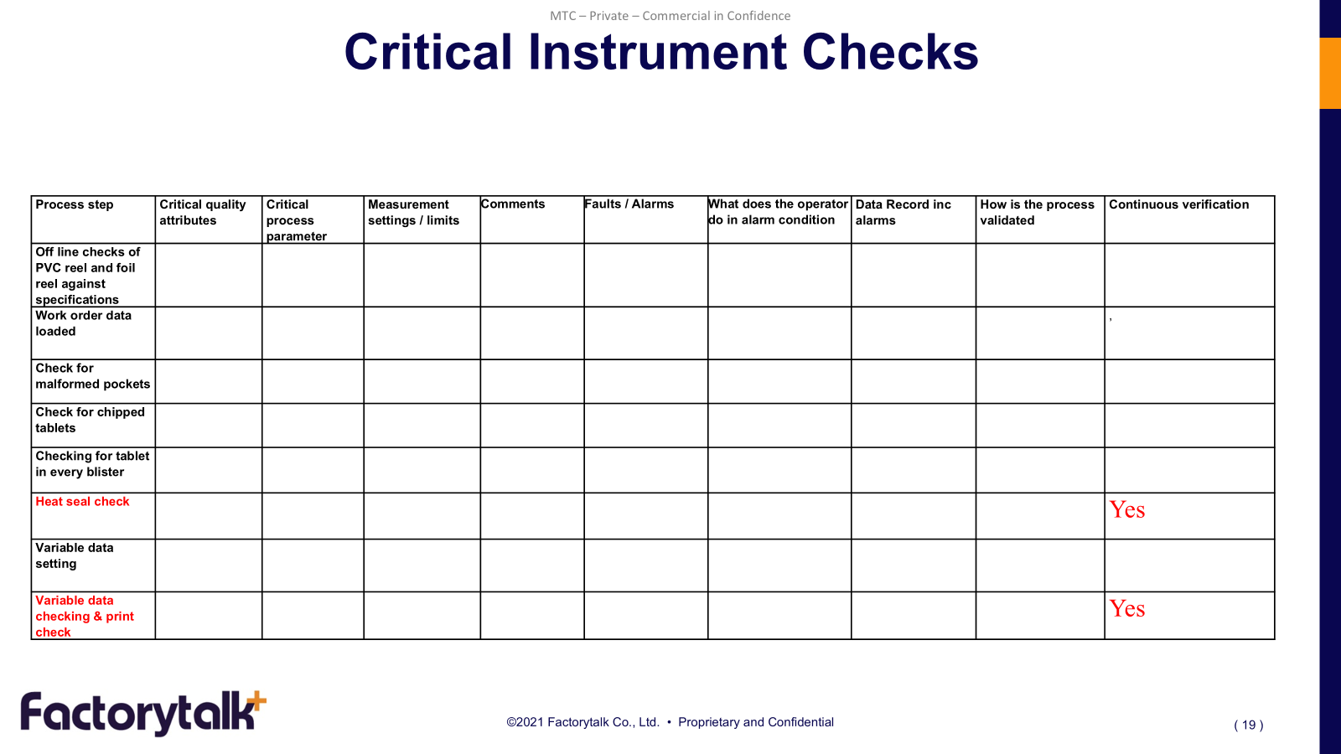
Critical Instrument Review (Design Review)
The critical instruments directly affect the product or product data
Line speed as part of line set up
Check on chipped tablets
Check on tablet in every cavity
Check for deformed cavity
Heat seal temperature and dwell time
Heat seal QC check (batch record)
Marking QC check (batch record)

Slide 19
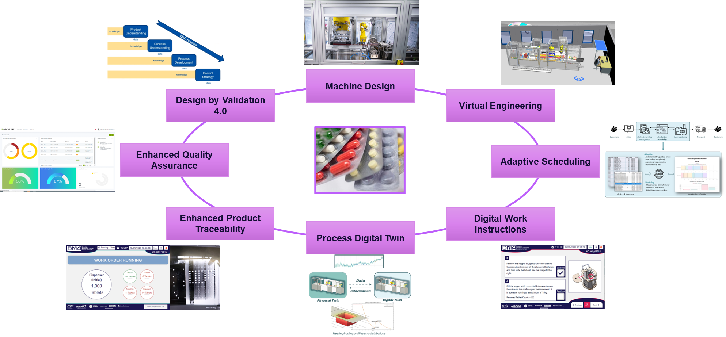
The Packing Line Summay

Slide 20
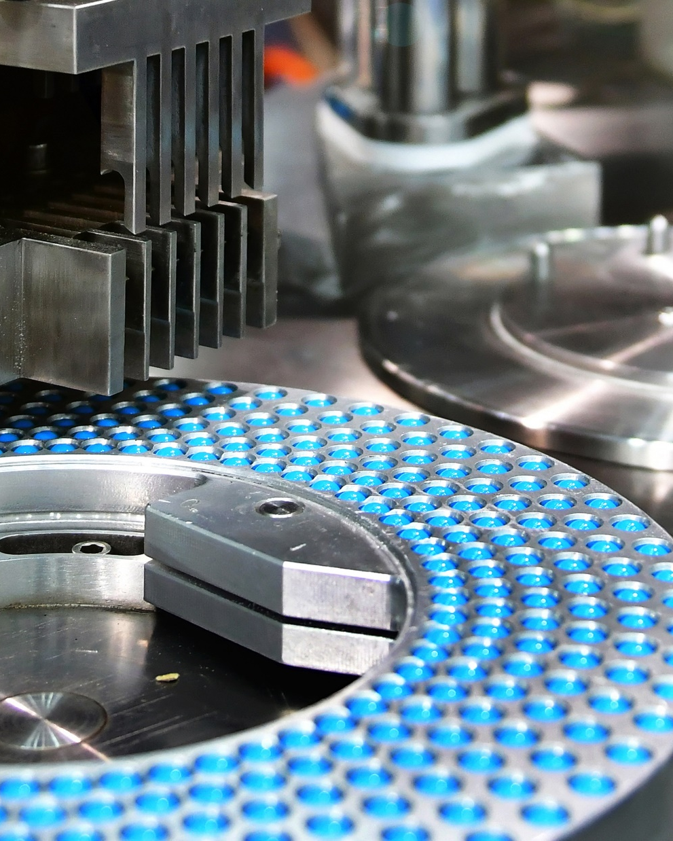






https://factory-talk.com
About Factorytalk ..
Specialist Consulting and Software Solutions for Life Sciences Manufacturers
Found in 2004
in Bangkok, Thailand
Teams in UK, Thailand, Indonesia, Brazil.
20+ years experience in MES, EBR, eDHR, eQMS, and CSV for GxP Regulated companies
Operate in Asia, Europe, and USA
75 staff + extensive freelance/ partner network
ISO 9001:2015 certified
Volunteer for ISPE since 2004

Slide 21
Visit to The Manufacturing Technology Centre
The registration is available here :
https://www.icheme.org/Visit-to-MTC
Next week
The Manufacturing Technology Centre, 131 Mount Pleasant, Liverpool L3 5TF
Free
09.30 to 15.30
Morning talks about the design
Afternoon visit to the line
The registration is available here :
https://www.icheme.org/Visit-to-MTC

Slide 22
Conclusions - Advantages of Digitalisation
Automatic checking of :-
Good heat seal (off line testing not required)
Heat seal temperature continually monitored
Print quality continually monitored
Every blister has a tablet
Tablet damage checks
Auto reconciliation at the end of the run
Continuous validation – correct operation is continually monitored
Questions ?

