Slide 1
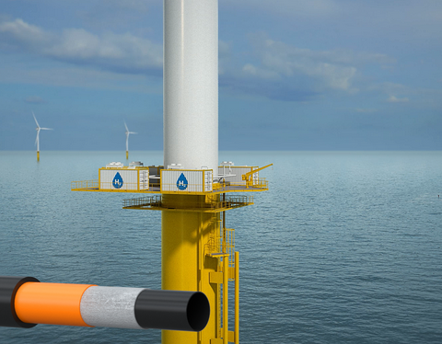


Monitoring and Evaluation of In-situ Consolidation of Thermoplastic Composite Pipe Layers
Presented by
Obinna Okolie, Prof Nadimul Haque Faisal and Prof James Njuguna
At the Advances in digitalisation of process industries conference, ICHEME, 16-17 October 2025

Slide 2
      Outline
Introduction
Research aims & objectives
Methodology Overview
Discussion of results & other analyses
Conclusion
Acknowledgement

Slide 3
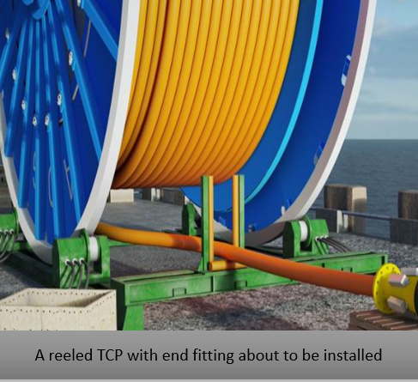
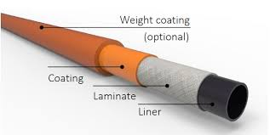
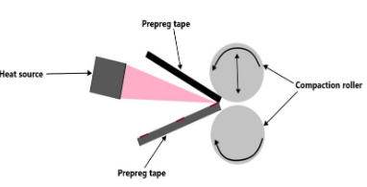
Introduction
TCP benefits include being lightweight, no corrosion and modular.
Thermoplastic composite pipes (TCP) manufacturing challenges.
Need for smart, adaptive manufacturing.
Real-time sensor integration during consolidation of polyethene (PE)/ glass fibre (GF) laminates.
TCP layer composition

Slide 4
Research aims & objectives
Aims: To demonstrate the potential and the influence of embedded sensors in accurately monitoring thermal and pressure distributions in real time to optimize the parameters to improve inter-laminar bond strength (ILBS).
Objectives:
Monitor temperature and pressure in real-time
Evaluation of effects of consolidation parameters
Improve inter-laminar bond strength (ILBS)

Slide 5
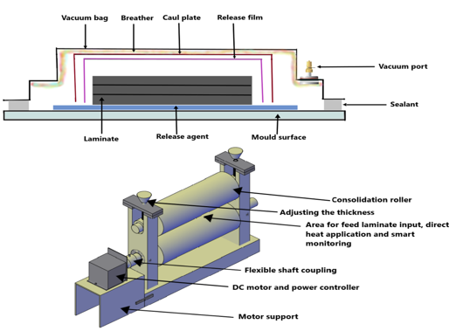
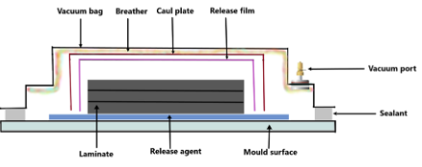
Methodology Overview
• Sensors: K-type thermocouples & 350 Ohm strain gauges
• Consolidation techniques: Dual roller, vacuum bag, post-heating.
• Dual roller and vacuum bag methods used.
• Post-treatment heating to reduce voids and improve strength.
• Parameters: Temperature (150°C, 200°C, 250°C), pressure, and time
• Data analysis: BBD model, PSO optimization, ANOVA
Vacuum bag consolidation
Dual roller consolidation

Slide 6
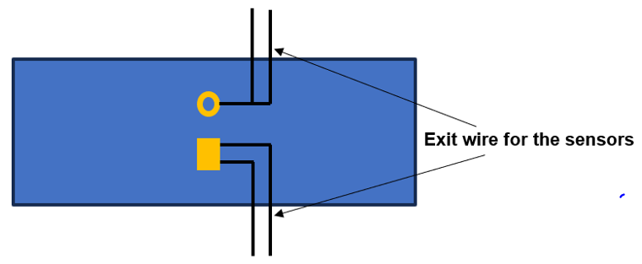
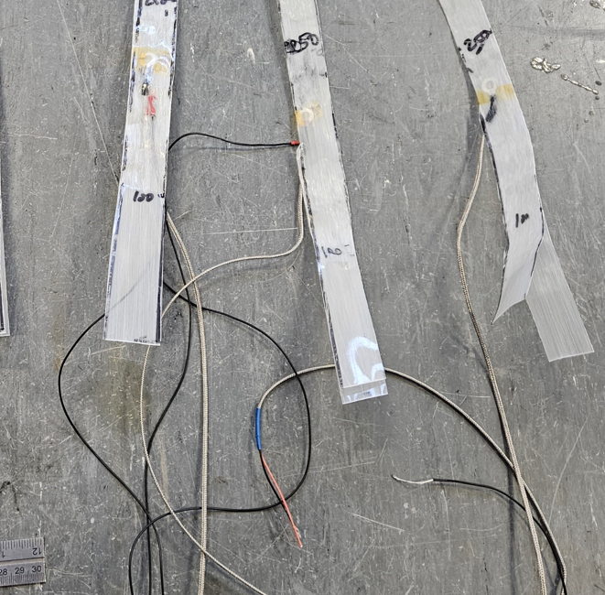
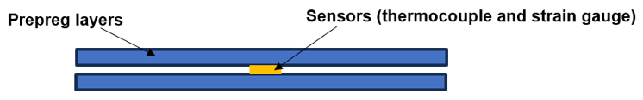
Sensor Embedment & Monitoring
Thermocouples & strain gauges embedded in centre of laminate interface
Kapton tape for thermal insulation
Sensors monitored real-time pressure and temperature
Influences on ILBS evaluated
Sample stack
Embedded sample
Sensor within the prepreg sample

Slide 7
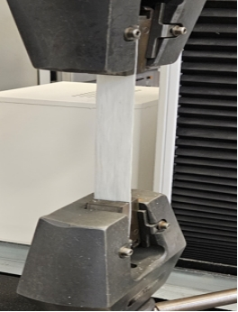
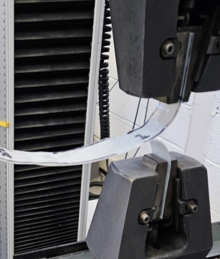
Mechanical testing
Tensile Test (ISO 527-4): Measured strength, ductility, modulus
T-Peel Test (ASTM 1876-01): Measured inter-laminar bond strength
Instron 3382 with 100kN load cell
18 tensile and 36 peel test samples
Analysed with SEM and ImageJ software
Tensile test
T-peel test

Slide 8
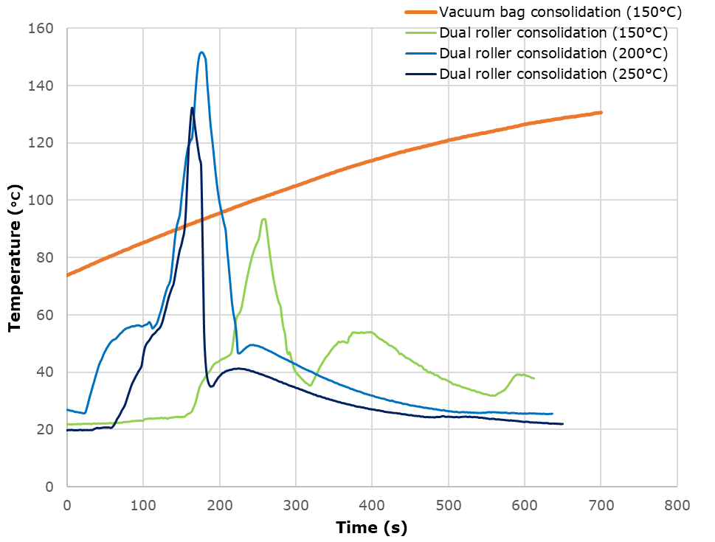
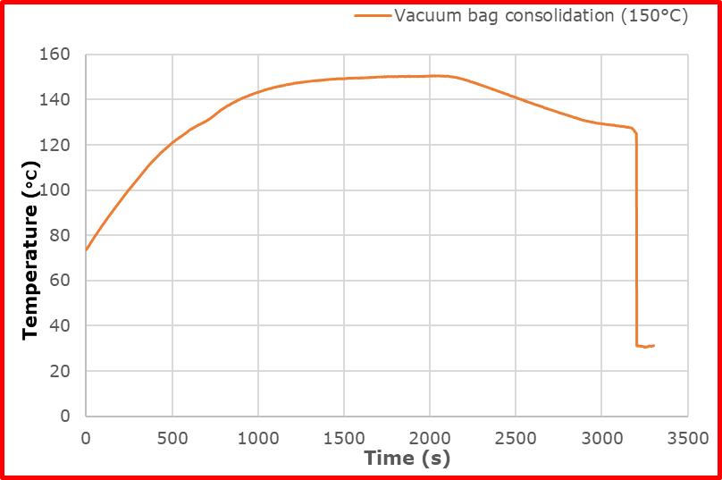
Discussion - Consolidation findings
Sensor data captured thermal and pressure profiles.
Best consolidation at 200°C: Optimal melt flow and bond for balance between bonding and degradation.
150°C: Poor bonding, voids
250°C: Matrix degradation observed
Post-treatment improved tensile strength by 9.52% and ILBS by up to 74.27%
Temperature distribution for both methods

Slide 9
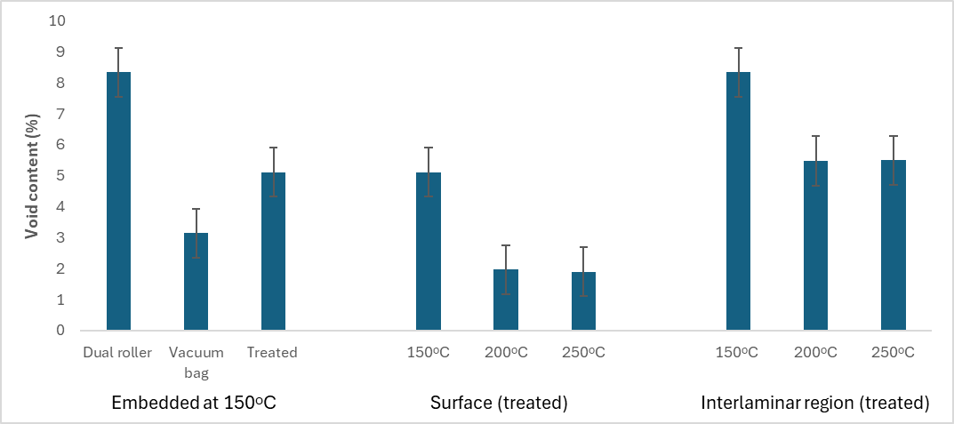
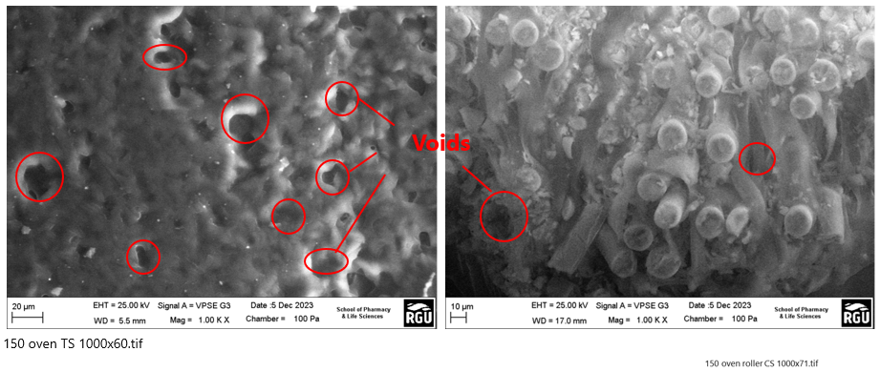
Void Analysis
SEM and Image J used for void quantification
Void content for 200°C consolidation reduced by 60% with post-heating
Dual roller at 150°C had highest voids
250°C risk of matrix degradation
Void analysis through SEM Void content for the consolidated samples

Slide 10
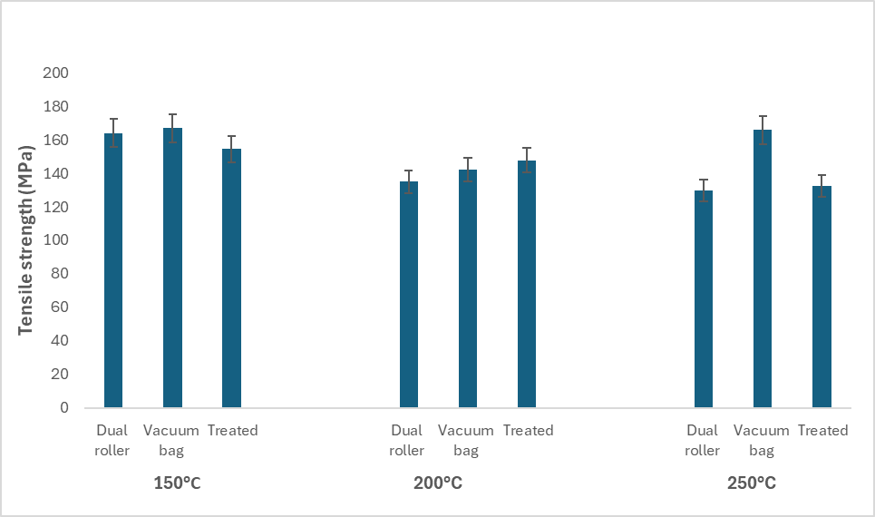
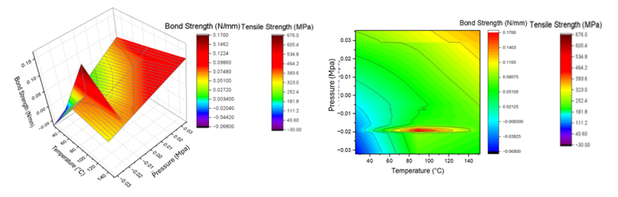
Effect of consolidation parameters on performance
High pressure needed at 150°C due to high viscosity.
At 200°C, balance of melt and strength.
250°C: Matrix degradation risk, uniformity of properties.
Proper tuning needed to avoid defects.
BS = 0.4517 - 0.0142A - 0.0373B + 0.0015AB + 0.0001A² - 0.0027B²
The effect of the processing parameters on the performance Tensile properties

Slide 11
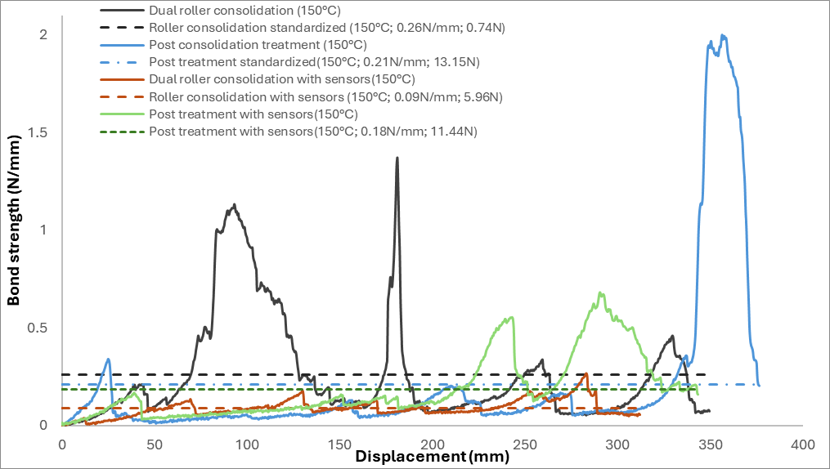
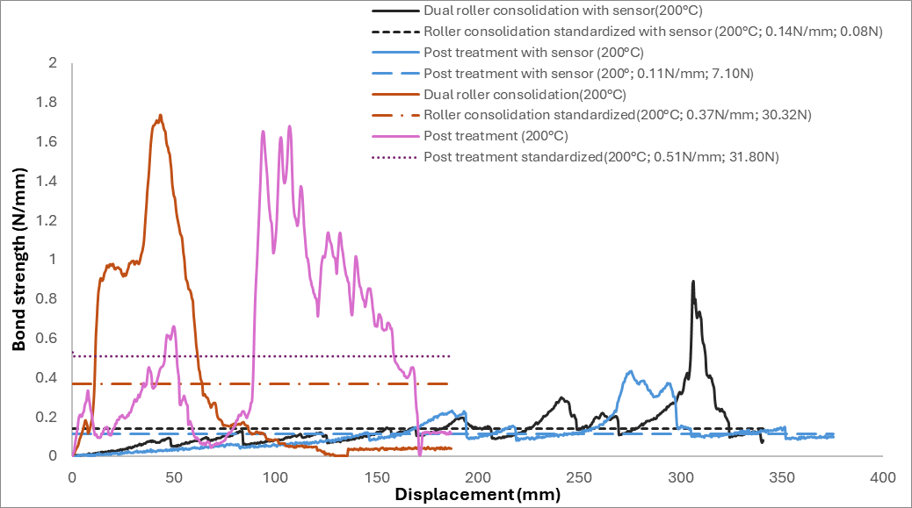
Influence of sensor integration
Reduced bond strength due to embedded sensors
Mid-layer is optimal position for sensors – advocate for more locations
Post-heating mitigates strength loss from sensor embedment
Calibration of sensor and data acquisition needed to avoid inaccuracies
150°C
200°C
Normalized bond strength plot

Slide 12
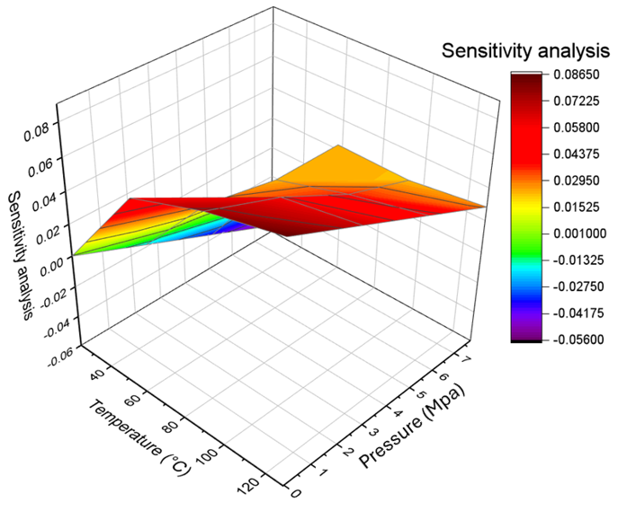
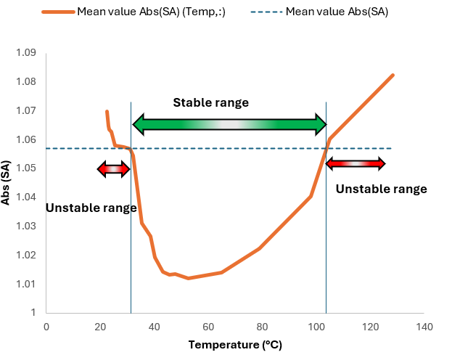
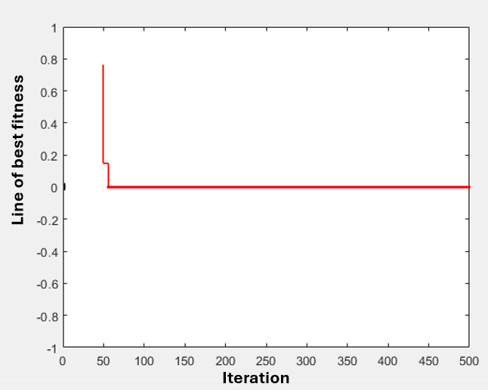
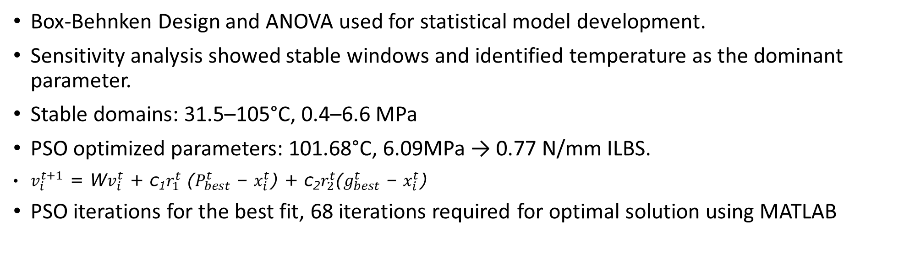
Sensitivity and optimization analysis
Box-Behnken Design and ANOVA used for statistical model development.
Sensitivity analysis showed stable windows and identified temperature as the dominant parameter.
Stable domains: 31.5–105°C, 0.4–6.6 MPa
PSO optimized parameters: 101.68°C, 6.09MPa → 0.77 N/mm ILBS.
$v_{i}^{t+1}$ = W$v_{i}^{t}$ + c₁$r_{1}^{t}$ ($P_{best}^{t}$ – $x_{i}^{t}$) + c₂$r_{2}^{t}$($g_{best}^{t}$ – $x_{i}^{t}$)
PSO iterations for the best fit, 68 iterations required for optimal solution using MATLAB
Sensitivity of the temperature distribution
Stability range for temperature distribution
Iteration of best fit

Slide 13
Conclusion
200°C is identified as the optimal consolidation temperature
Post-treatment is essential for void and strength optimization.
Post-treatment and optimized parameters enhance ILBS
PSO and sensitivity analysis validated 0.77 N/mm ILBS
Embedded sensors enable adaptive manufacturing process control.
Foundation for smart TCP manufacturing.

Slide 14






Acknowledgement
Prof James Njuguna; Prof Nadimul Faisal; Harvey Jamieson – Subsea7; Arindam Mukherji – SP Advanced Materials Ltd
Allan McPherson; Alan McLean; David Smith; Patrick Kane; David Howie – SOCET RGU
Emily Hunter; Slawek Rybczynski; Tracey Willox – PALS RGU
Agnieszka Leszczyńska and Konstantinos Raftopoulos – Cracow University of Technology
Julia Benhsen; Tristan Lowe - NXCT
Scottish Research Partnership in Engineering
SP-Advanced Engineering Materials Pvt. Ltd.
Henry Moseley X-ray Imaging Facility
Point of contact: o.okolie@rgu.ac.uk.

Slide 15
THANK YOU !!!
Comments, Suggestions and Questions

