Slide 1



Enhancing Process Safety with Graph-RAG Based Decision Support AI chatbot
A Digital Companion for Safety-Critical Environments
Ian Baker
AI R&D and developer
Joel Chacon
Safety AI bot Concept
October 20205

Slide 2

Why This Matters
High-hazard industries rely on effective safety barriers (technical, procedural, organisational)
Process safety decisions often require fragmented data collation
Temporary measures
Work orders
Failure mode analysis
Safety observations
Manual Data integration = slow, error-prone, risk of oversight

Slide 3
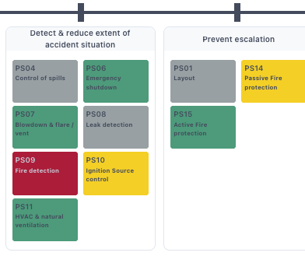
The Challenge
Engineers must answer:
Which barriers are degraded?
Which work orders matter most for safety?
What actions mitigate current failures?
Current pain points: information overload, inconsistent prioritisation, delayed insights

Slide 4
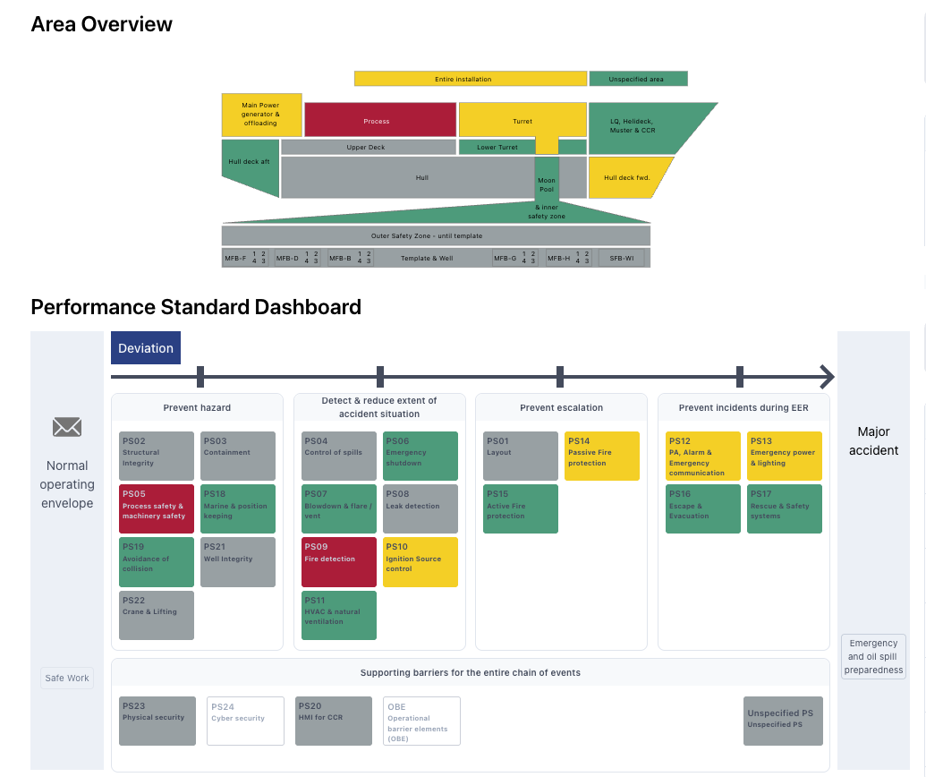
Existing capabilities
Barrier Status Panel (BSP)
A monitoring and visualisation tool that provides a consolidated overview of the availability and integrity of safety-critical barriers in industrial operations.
Failure Modes, Effects, and Criticality Analysis (FMECA)
A systematic, structured approach to identifying and evaluating potential failures within a system, their causes, and their consequences

Slide 5
Research Question
How can AI help address these challenges by consolidating safety-critical information and making it more accessible?

Slide 6
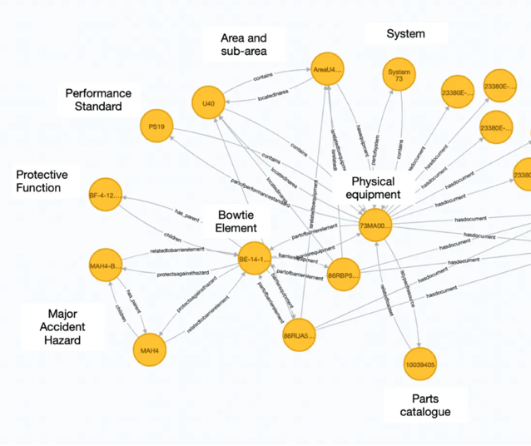
Our Solution – A Graph-RAG Based AI Chatbot
Concepts
Graph model
RAG = Retrieval Augmented Generation
Objective: To assist process safety engineers in assessing the safety position of industrial plants.
How it Helps: Provides a simple, one-stop solution for quick and accurate information.
Key Capabilities:
Querying safety status.
Work order prioritisation to maximise plant safety measures.
Recommended actions based on failure analyses.
Graph model around a single item of Safety and Environmentally Critical Equipment (SECE)

Slide 7

How the Chatbot Works
Retrieval Augmented Generation: Combines data from multiple, heterogeneous sources:
Real time work-order status databases
Graph model for BSP
Graph model for FMECA
Contextualised Responses: Provides engineers with contextualised, accurate responses to complex operational questions by linking structured knowledge with real-time data.
Memory: The chatbot retains context, allowing for follow-up questions that refer to previous queries and answers.

Slide 8
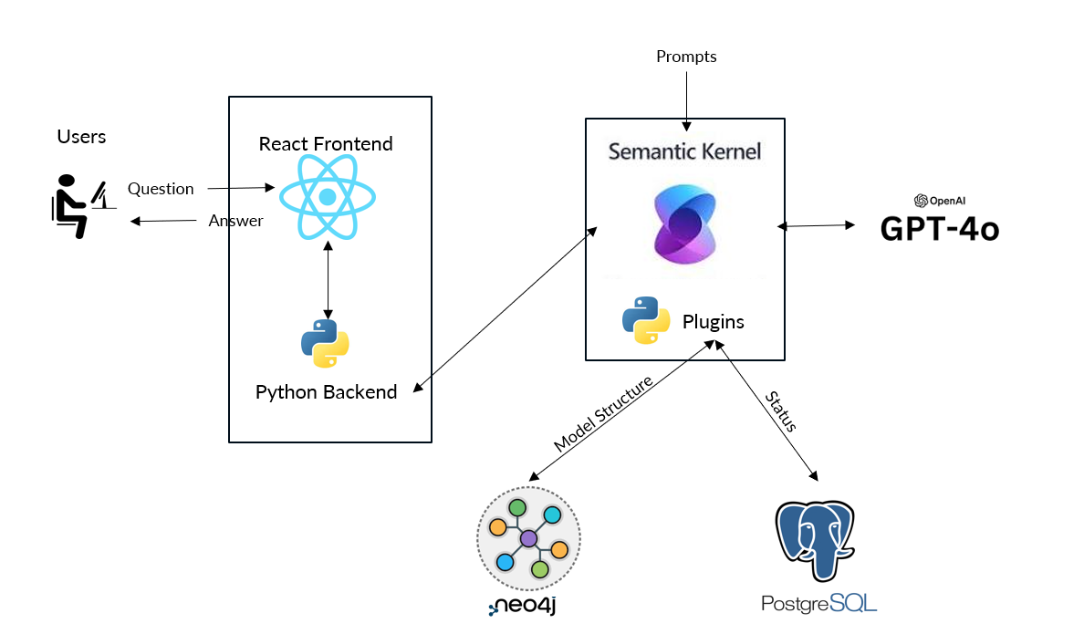
Chatbot Architecture
BSP + FMECA
Graph model
Workorder
statuses

Slide 9
Results

Slide 10
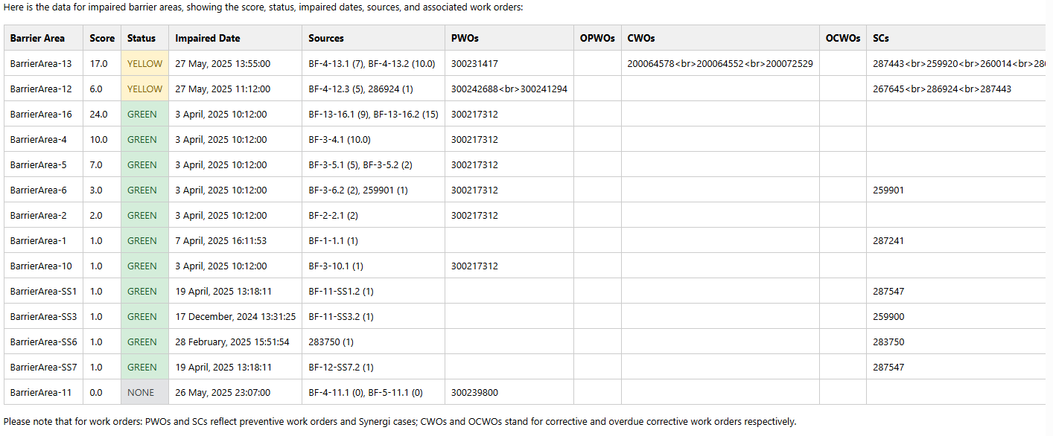
What worked well
“List the areas with score, status, impaired dates, sources and work orders”

Slide 11
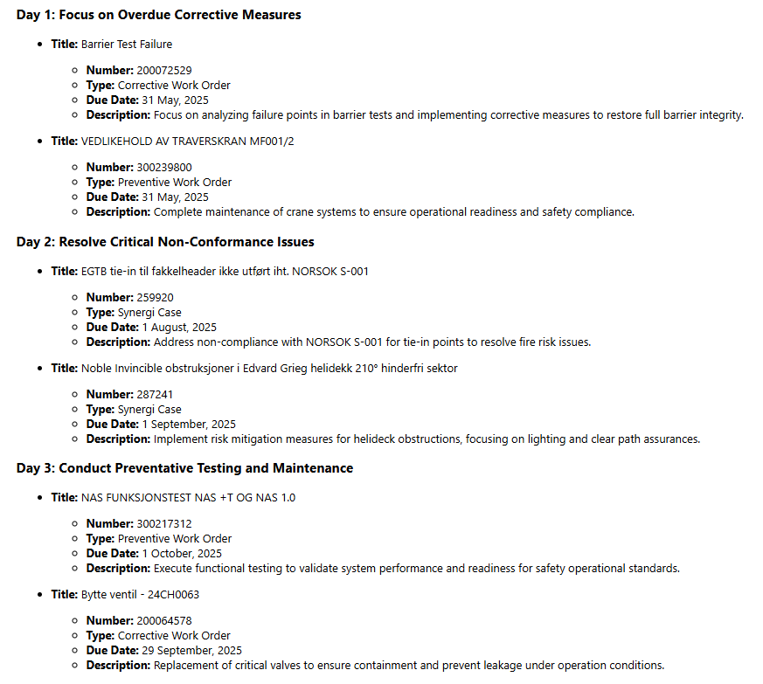
What worked well
“Give me a work plan for the next three days to make the plant as safe as possible ”
This response correctly identifies the most important work orders to complete to reduce the overall risk profile of the plant.
This information is not immediately obvious just looking at the list of pending work orders.
The Chatbot has correctly analysed the data to determine which work orders have the most impact on the plant.

Slide 12
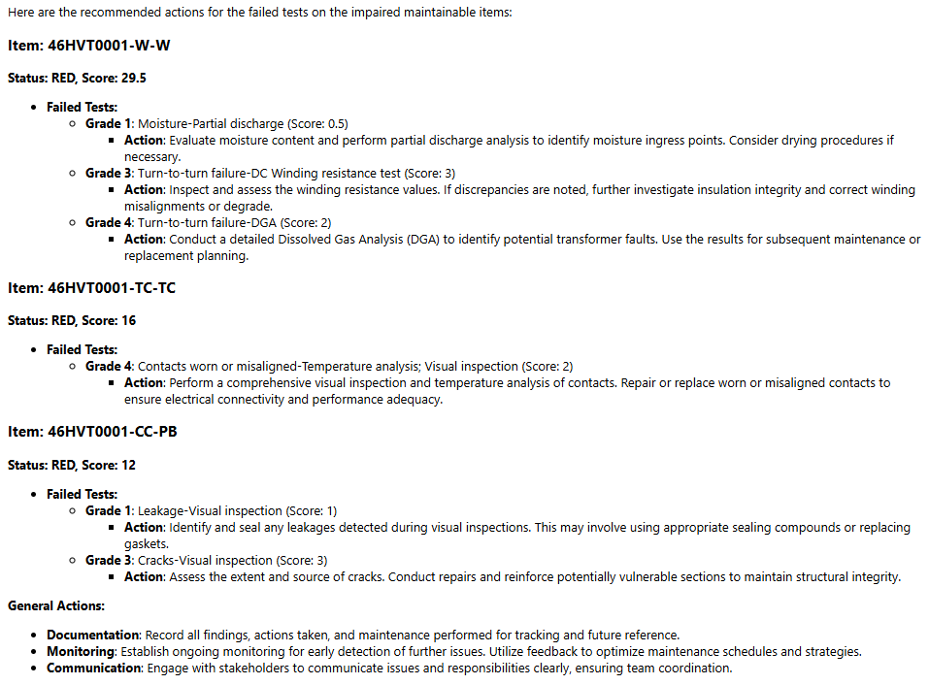
What worked well
“What are the recommended actions for the failed tests for the maintainable items”
Unsolicited general advice

Slide 13
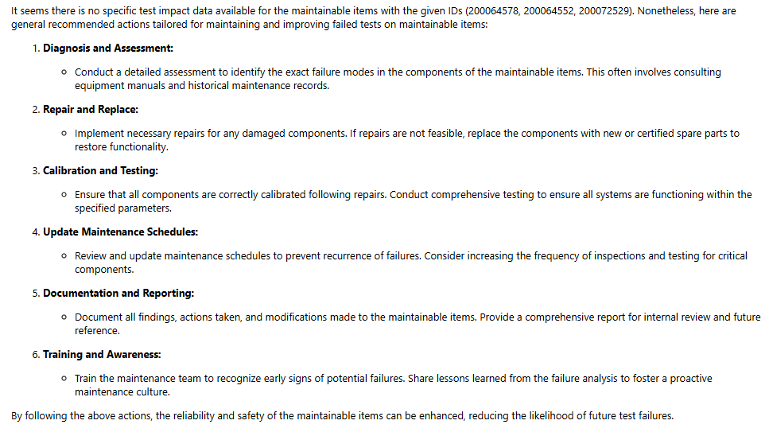
Failure examples
“What are the recommended actions for the failed tests for the maintainable items”

Slide 14
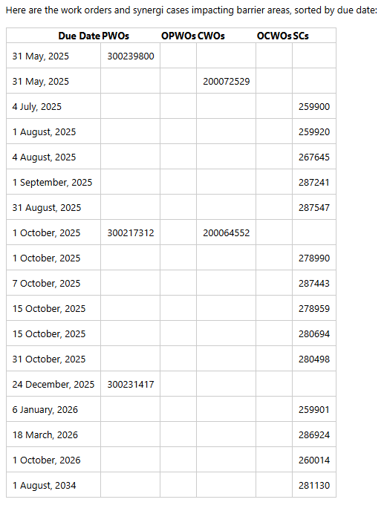
Discussion
The AI component was unaware of data structures: Only received the result of the RAG queries
A generic approach: Does not depend on Data Schemas: The AI component can remain data structure-agnostic
The Chatbot found it difficult to sort numerical data, so data was pre-sorted by the backend RAG queries
Hallucinations: When the answer is not available in the given data, AI makes up an answer!
Inconsistent results. Same request → Multiple responses, sometimes cosmetic, but some not!

Slide 15
Conclusion
This project demonstrates the potential of Graph-RAG AI technology to support decision-making in complex, safety-critical environments.
The system is able to answer operationally relevant questions that would otherwise require considerable manual effort.
The chatbot is capable of combining heterogeneous datasets, reasoning across them, and presenting useful insights, particularly in relation to barrier status and work order prioritisation.
However, some limitations remain subject to further research.

Slide 16


So, what are the use cases?
Hands-free speech queries to support operations in the field.
Industrial Maintenance Planer Agent.

Slide 17
Thank you!
For any further queries, email us at info@eigen.co

