Slide 1

Toward Transparent Decision Support: Building Fully Integrated Digital Twin for Refinery Operations
Balázs Palotai ^{a,b*}, Gábor Kis ª, László Grad-Gyenge ^{c}, Zoltán Máthé ^{d}, Tibor Chován ^{b}, Ágnes Bárkányi ^{b}
a - Group Downstream Production and Technology, MOL Group Plc, Hungary
b - Department of Process Engineering, University of Pannonia, Hungary
c - Creo Group, Hungary
d - Emerson, Hungary
16–17 October 2025 - Manchester UK – Advances 2025

Slide 2
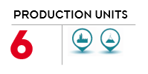

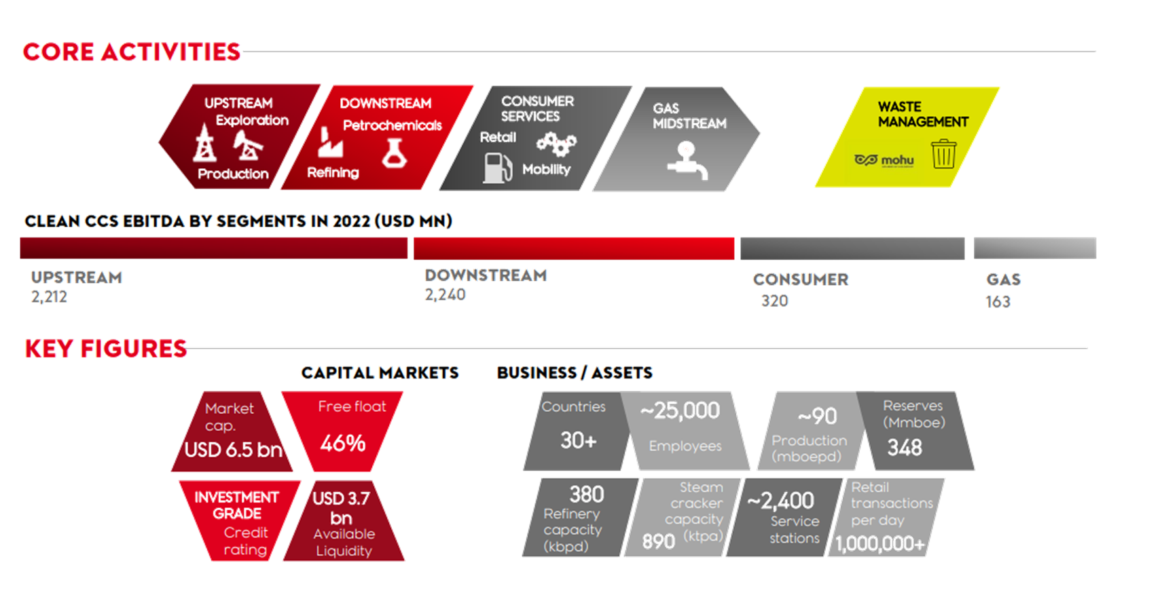
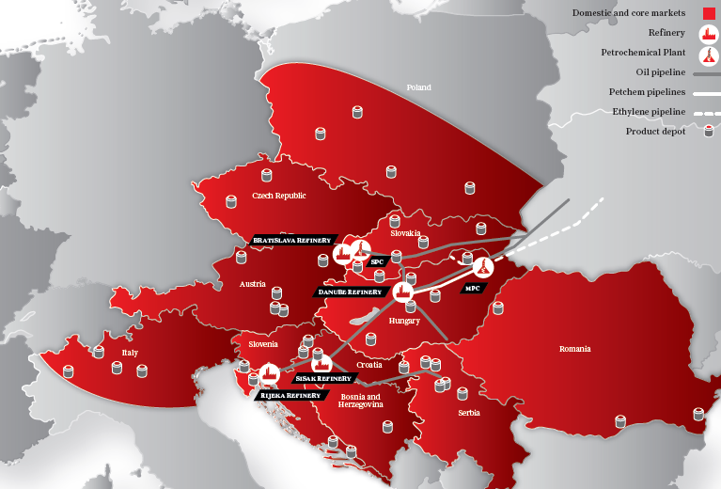
MOL Group in Brief
Integrated Downstream in CEE
20.9 mtpa refining and
2.2 mtpa petrochemicals
capacity
Service stations
~1.900
in 10 countries

Slide 3
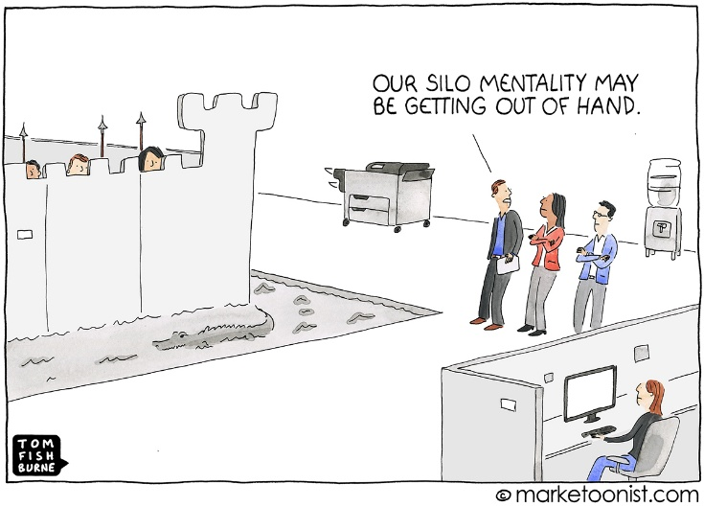
Why - Digital Twin (DT)
A Digital Twin:
cyber-physical integration by which data can be collected, analyzed, and visualized
to make more informed decisions
to optimize operations
Separate models with different scope
Simulation models,
Energy prediction, monitoring,
Quality prediction,
Crude selection,
Anomaly detection, etc..
Model generation ad-hoc, problem driven
Models not integrated into one eco-system
Models' health are not monitored -> missing continues maintenance, version control
Simulation models are available only for a narrow group
Physical object
Digtial object
Digital model
Not automated (Silo)
Physical object
Digtial object
A faster and continuous response to business needs could increase profitability by transitioning from siloed digital models to an integrated Digital Twin
Digital Twin
Fully integrated

Slide 4
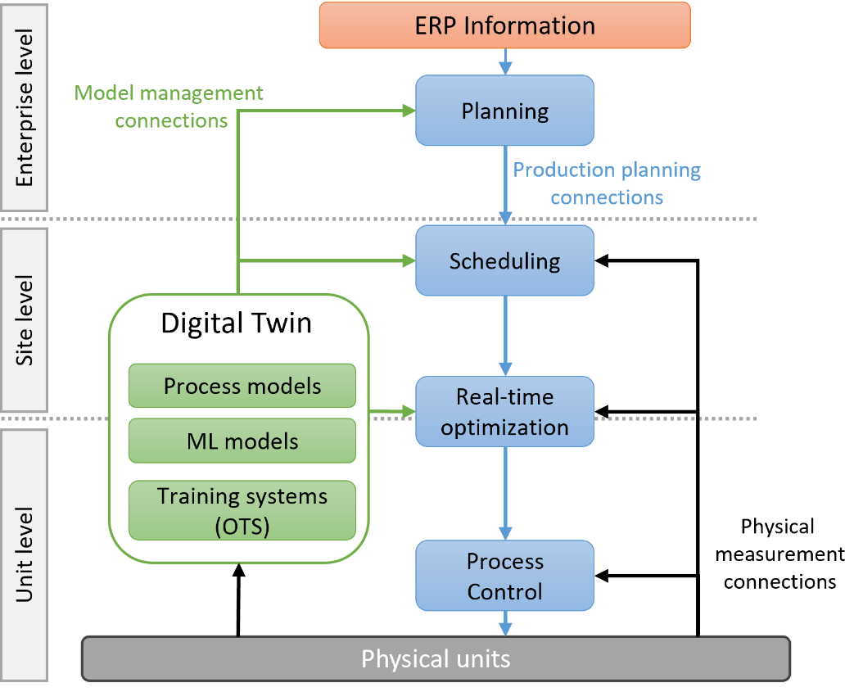
RTO or Digital Twin? What’s the difference?
RTO
Dynamic process control – Continuously adjusts operational parameters to optimize the performance
Aim: move the system towards optimum, given current boundary conditions
Digital Twin
High-fidelity virtual model of a physical process
Integrates available process information („White Box”)
Can simulate various scenarios to analyze the impact of changes, such as variations in catalyst activity or feedstock quality.
Objective:
RTO: Focuses on continuously optimizing the current process in real-time to achieve the best performance under existing conditions.
Digital Twin: Aims to provide a virtual environment for testing and analysis, allowing for the exploration of various scenarios and their impacts without disturbing the actual process.

Slide 5
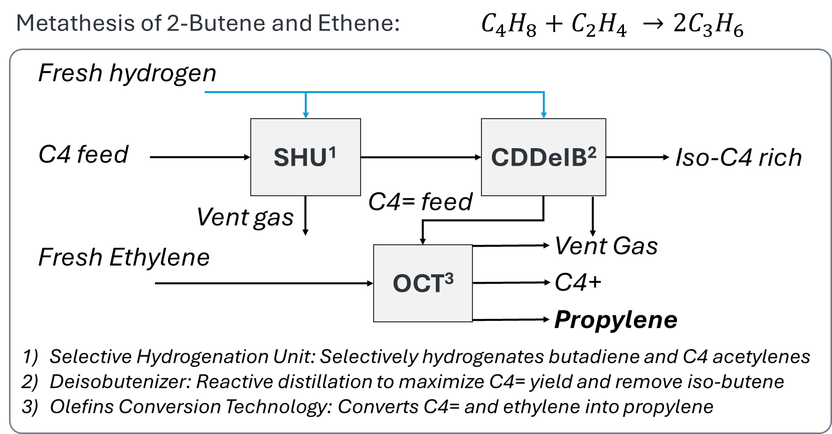
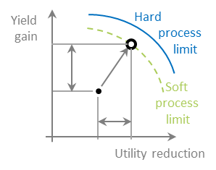
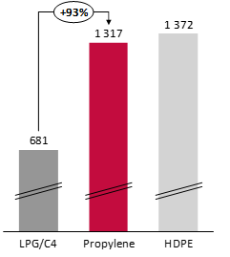
Use-Case Olefin Conversion Unit (OCU)

Slide 6
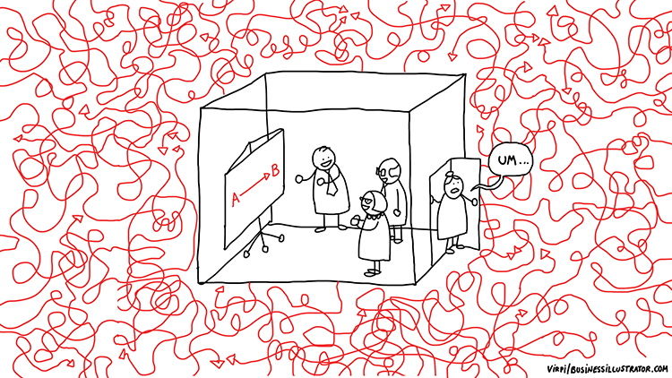
Moving Towards Digital Twin Seems to be Simple…
Physical object
Physical object
Physical object
Digtial object
Digtial object
Digtial object
Challenges
Real-time automated connection adds excessive system complexity.
Multi-model integration (first-principles + ML).
Model management – monitoring, continuous calibration, and version control.
Poor data quality → poor model output.
Siloed models instead of multi-purpose use.
Weak/missing validation.
Low trust – caused by complex and hard-to-interpret solutions.
Digital model
Digital representation
Not automated
Digital shadow
Automated one-way dataflow
Digital twin
Fully integrated

Slide 7
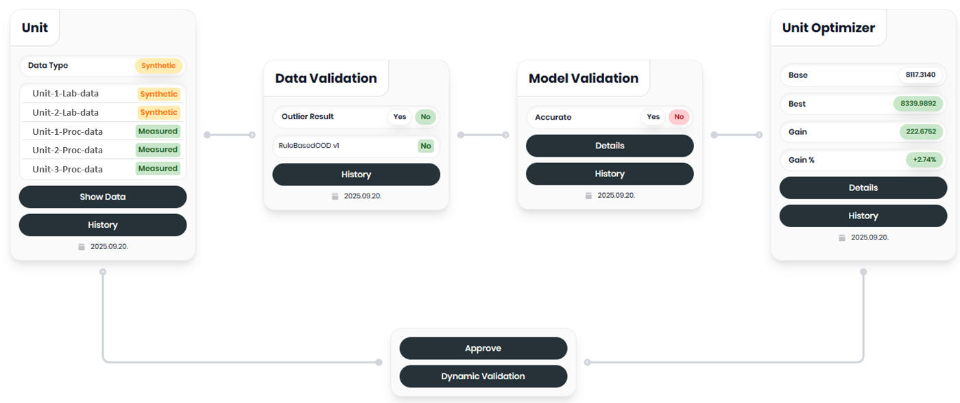
Key Elements of Developed Fully Integrated Digital Twin Framework

Slide 8
Data Validation & Integration
Reliable decisions require trusted data:
Filter by operating range – apply models only where they are valid.
Validate data – remove outliers, correct errors, ensure consistency.
Integrate sources – merge sensor, system, and database inputs.
Harmonize – align units, formats, and timestamps for clarity.
Explain with visuals – clearly show what was changed, removed, or corrected, and why.
Poor quality or out-of-range data can lead to inaccurate results, limiting the model's effectiveness and compromising decision-making.

Slide 9
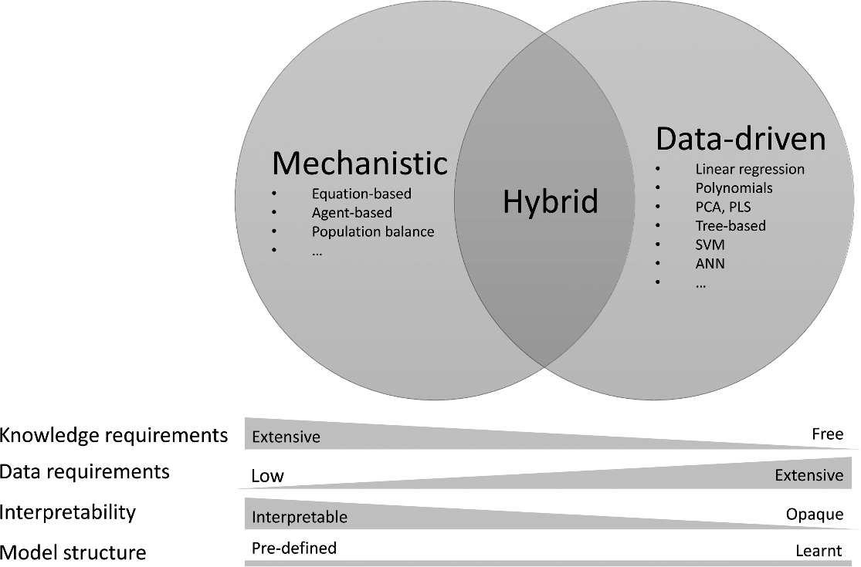
The Heart of a Digital Twin: Models
Within Digital Twin the model(s) can vary in type, level of detail, and granularity. These models:
Simulate physical system behavior
Coherent multi-layered view of the system (interconnectedness).
How can we seamlessly integrate diverse models in a digital twin?
Flowsheet model
ML
Ext
LP
Wrapping models and standardizing
Inputs
Model
1
Model
2
Model
3
Model 4
Outputs
Validation
Metadata
*Schneider, Mariane Yvonne, et al. "Hybrid modelling of water resource recovery facilities: status and opportunities." Water Science and Technology 85.9 (2022): 2503-2524.

Slide 10
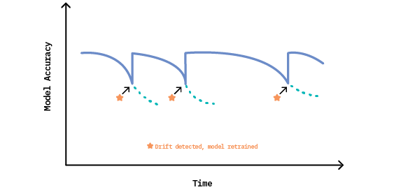
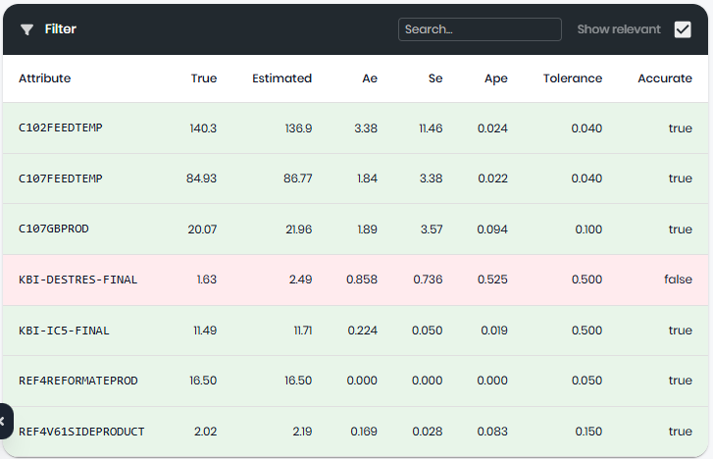
Model Integration & Validation
Maintaining flowsheet model performance is critical as real-world degradation occurs. Online connectivity demands continuous monitoring and timely intervention when drift is detected.
Clear ownership – model changes are handled by subject-matter experts.
Performance monitoring – detect concept drift and degradation
Online calibration – use automated/semi-automated tuning to maintain accuracy.
Transparent validation – track and explain model performance before and during application.
Model calibration:
Balázs Palotai, Gábor Kis, János Abonyi, Ágnes Bárkányi, Surrogate-based flowsheet model maintenance for Digital Twins. Digital Chemical Engineering, 15, 100228. Elsevier, 2025
Balázs Palotai, Gábor Kis, Tibor Chován, Ágnes Bárkányi, Online learning supported surrogate-based flowsheet model maintenance. Digital Chemical Engineering – Under review

Slide 11
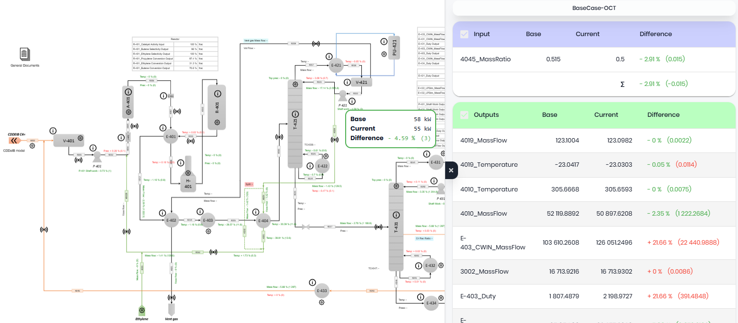
Application & Playground

Slide 12
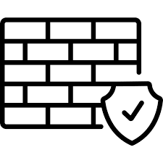


Importance of Dynamic Validation in Digital Twin
ERP Data
Internal Network
External Network
Models in External environment
Process data
~90 parameter
90 model input
Paramount importance of Emerson Dynamic Check (EDC) is to avoid tripping the physical system and/or not losing money and credibility
Digital Twin Core – MOL Environment
SHU
Data management
CDDeIB
498 model output
OCT
Model management
User interface
25 Setpoint
+ parameters
Physical system
Model applications
Dynamic Model Testing: optimal operating state testing in a dynamic model system.
Setpoint Change Analysis: setpoint change analytics and understanding.
Optimal Strategy Development: strategy development for setpoint adjustment.
Noise and Trip Prevention: noise and trip avoidance in the real system.
*EDC: practically OTS and include offline DeltaV and dynamic AspenTech Hysys model
90 input data/iter
3000+ output data/iter
Emerson Dynamic Check (EDC)*
Confidence Assessment

Slide 13
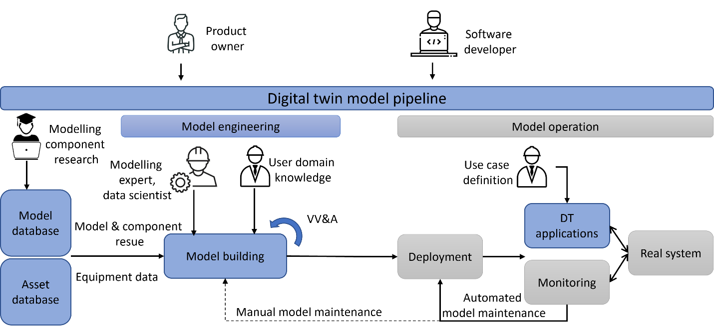
Summary
Clarity and explainability make digital twins trusted tools in refinery operations:
Clear blocks – show how each part works and connects.
Explained decisions – why data/models are valid, why optimizers choose a point.
Robust validation – ensure safety and operational feasibility.
Flexible use – optimization, ad-hoc analysis, advanced insights.
User trust – built through clarity, visualization, and realistic testing.

Slide 14


Thank You

