Slide 1

AI, Ethics and Workforce Transformation: Preparing Engineers for Digital Manufacturing Challenges
Professor Mo Zandi
Chemical, Materials and Biological Engineering
University of Sheffield
17 October 2025

Slide 2
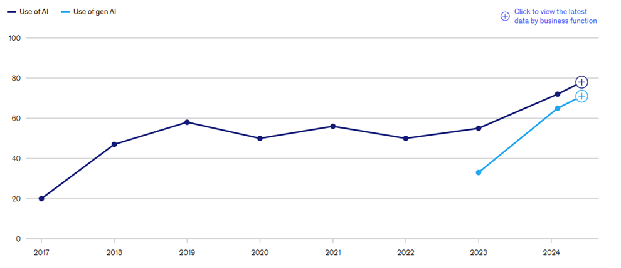
AI Positive World
Source: McKinsey Global Surveys on the state of AI

Slide 3
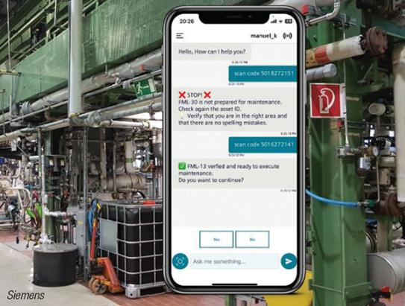
AI in Manufacturing
Siemens CoPilot:
“GenAI enhances human decision-making by providing context-aware support and making complex information accessible”
Source: Generative and Agentic AI: Intelligent Manufacturing Evolves, June 2025

Slide 4
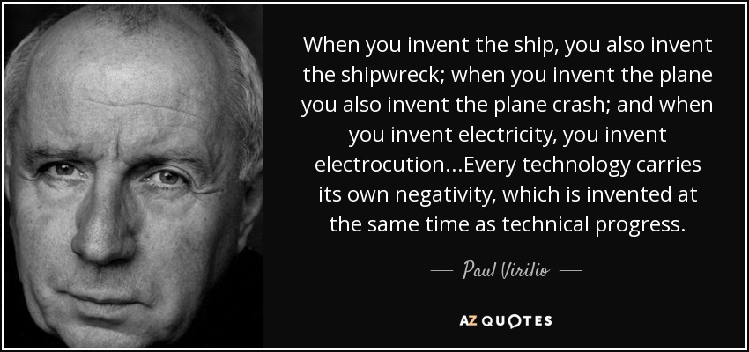

Slide 5
Knowns and Unknowns of AI
KNOWN
UNKNOWN
Known knowns
Misinformation and hallucination
Skills and reskilling
Unknown knowns
Effects of misinformation on us
Scaling bias
Fusion of AI into everything
KNOWN
Known unknowns
Redesigning education system
Environmental costs of AI systems
Deskilling decision-making to AI and losing agency – who is responsible?
Unknown unknowns
Superintelligent AI systems
Extreme catastrophic failures
UNKNOWN
Good read: 5 strategies to activate your agency and stay relevant in the age of AI https://www.weforum.org/stories/2024/07/5-strategies-agency-relevant-age-of-ai/
Notes:
Unknown knowns: Things we think we know, but we find that we don’t understand them when they manifest.
Known unknowns: These are obvious, highly likely events, but few acknowledge them. The current AI debate neglects the critical need to reimagine education. AI threatens not by its existence, but by our education systems failing to adapt.
Unknown unknowns: Things that we don’t know that we don’t know. For these unpredictable outliers

Slide 6
Is AI neutral?
How we answer it can help us to determine the responsibilities of anyone involved in creating or using AI technology?
And can help us to maximise its benefits and minimise its harms.

Slide 7

AI is neutral…
Paul Daugherty, Chief Technology and Innovation Office at Accenture:
“So, I’d ask you to think a bout a simple question: Is technology and AI, good or bad?
The answer is Neither. Technology is neutral, AI is neutral. The way ‘we’ as humans, apply and use the technology is what defines if the impact is good or bad.”

Slide 8

AI is neutral…
Demis Hassibis, the co-founder of DeepMind:
“I think AI is no different to any other powerful technology that was invented in the past. I think the technology itself is neutral. The question is how the society decided to deploy it.”

Slide 9

AI isn’t neutral…
Sir Tim Berners-Lee, WWW creator:
“As we’re designing the system, we’re designing society. Ethical rules that we choose to put into that design [impact society]....Nothing is self-evident. Everything has to be put out there as something that we think will be a good idea as a component of our society.”

Slide 10

A Double-Edged Sword: The Unseen Dangers of AI Enhancement
Geoffrey Hinton:
"I am scared that if you make the technology work better, you help the NSA misuse it more. I'd be more worried about that than about autonomous killer robots."

Slide 11
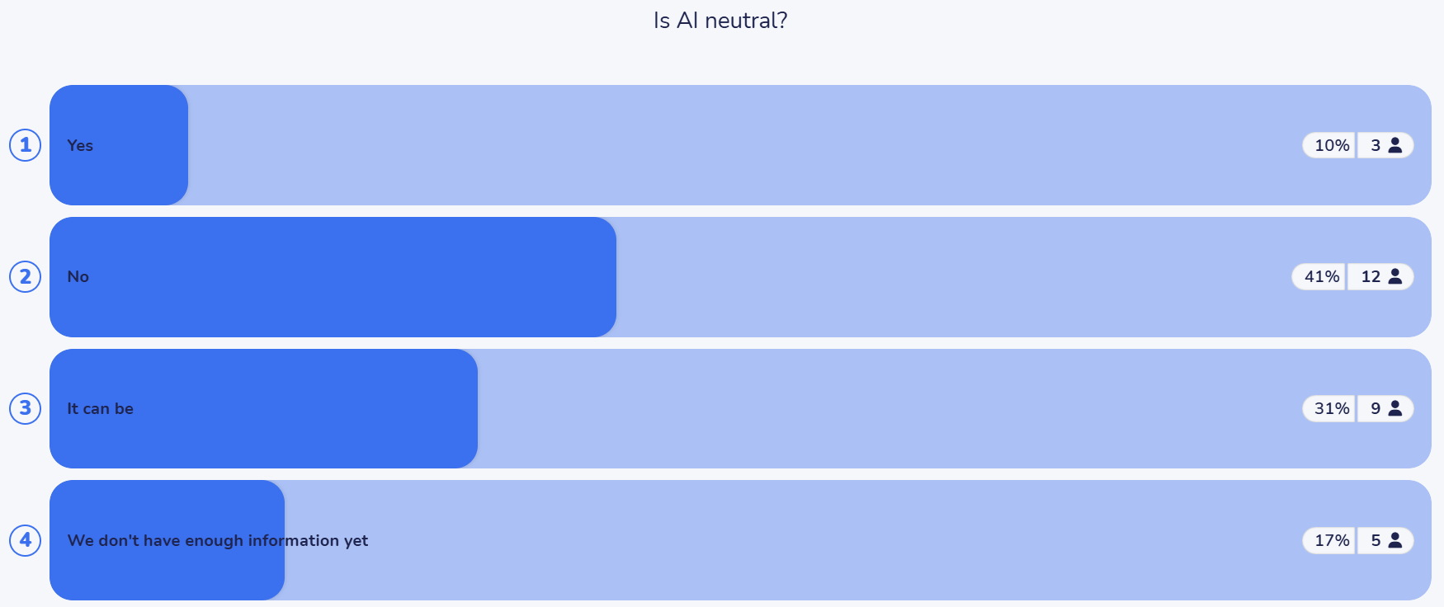
ChemEngDay UK – April 2025

Slide 12

Ethics of AI - UNESCO
In no other field is the ethical compass more relevant than in artificial intelligence. These general-purpose technologies are re-shaping the way we work, interact, and live. The world is set to change at a pace not seen since the deployment of the printing press six centuries ago.
AI technology brings major benefits in many areas, but without the ethical guardrails, it risks reproducing real world biases and discrimination, fueling divisions and threatening fundamental human rights and freedoms.
Gabriela Ramos
Assistant Director-General for Social and Human Sciences of UNESCO
https://www.unesco.org/en/artificial-intelligence/recommendation-ethics

Slide 13
Do we have an established universal framework to fully and ethically embrace and leverage AI in manufacturing today?

Slide 14
Worldwide AI Ethics
Number of times an aggregated principle was cited.
https://nkluge-correa.github.io/worldwide_AI-ethics/
Nicholas Kluge Correa et.al.

Slide 15
AI Ethics in Manufacturing
"AI" OR "Artificial Intelligence" OR "machine learning"
1.6 million papers
AND
"ethical concern*" OR "job displacement" OR "bias*" OR "discriminat*" OR "ethic*"
72k papers
For all time…
AND
Human OR "occupat*" OR "workforce*" OR "workplace*" OR "labour*" OR "labor*" OR "worker*" OR "operator*"
31k papers
AND
402 papers
manufactur*
AND
328* papers
Excluding healthcare/banking
* Search updated in June 2025.
Notes:
Could add more: (if there is time)
Studies from when? Country distribution?

Slide 16
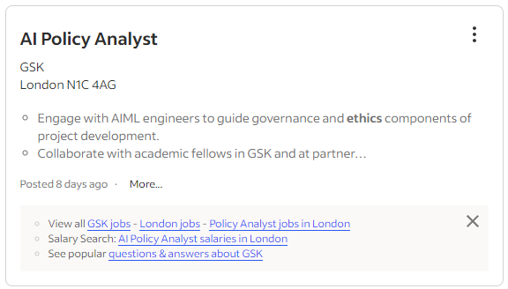


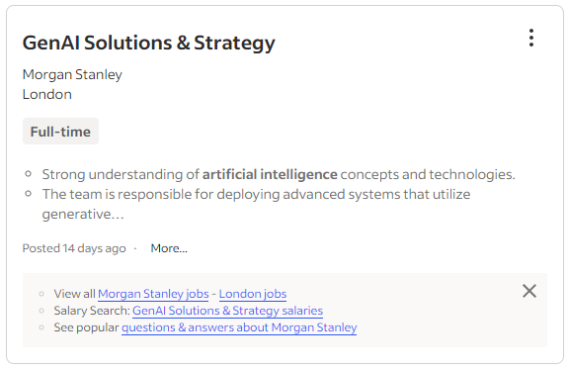


Slide 17

Empowering the Manufacturing Workforce for the Future: Democratisation of Digitalisation and Ethical Integration of AI

Slide 18
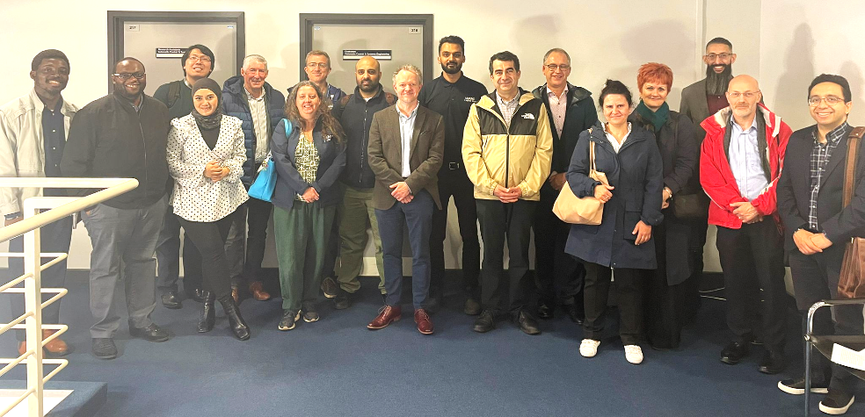
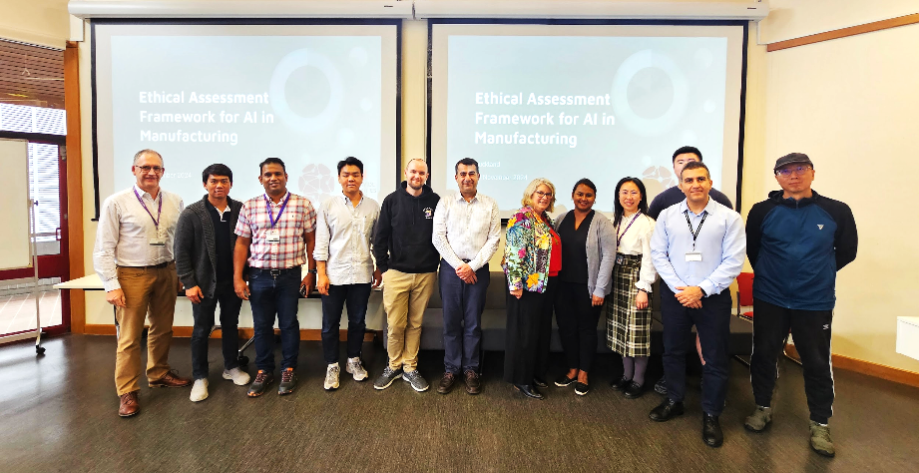
Workshops
13 June 2024
University of Sheffield, UK
13 November 2024
University of Auckland, New Zealand

Slide 19
Grand Challenge
Feature | Traditional system | AI-powered system
Functionality | Rigid, predefined | Dynamic, adaptive
Learning ability | Basic or None | Machine learning
Flexibility | Low | High
Data handling | Limited to structured data | Unlimited to structured and unstructured data
Decision-making | Based on predefined rules and logic | Based on data insights and patterns - no explicit rules
Complexity | Copmplicated, deterministic | Complex, non-deterministic
Human intervention | High | Low to very low
Behaviour | Predictable | Unpredictable

Slide 20
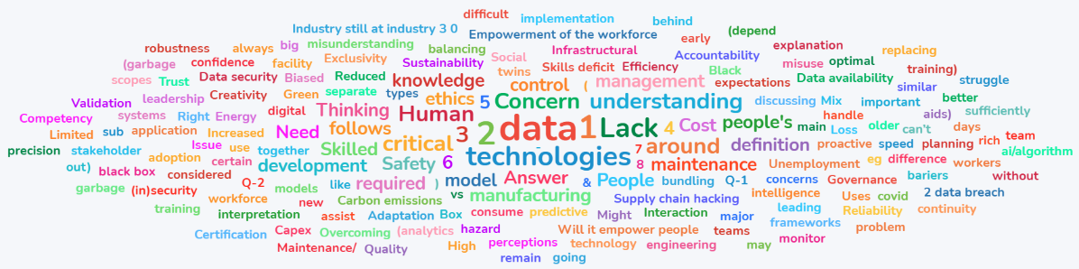
Workshops takeaways
Concerns:
Data in manufacturing is not always big data and sufficiently rich for model development: Industry still at industry 3.0.
Lack of and difference in understanding by workforce and business on what AI is, what it can and can’t do, and how it can assist.
Human with AI replacing human without AI.
Job displacement and replacement: Moving manufacturing (jobs) offshore.
Upskilling workforce requires skilled workforce.

Slide 21
Five steps for adopting AI
Know your problem: Do you need AI to solve your problem? Clearly define the specific problem you're trying to solve to avoid unintended consequences including its environmental cost.
Know your data: Understand the origin, diversity, and limitations of your data, biased data produces biased outcomes! Treat data as an assest and not by-product.
Perform ethical & safety assessments: Evaluate your AI system for potential ethical dilemmas and safety risks, ensuring transparency and accountability in their use. Who is responsible?
Trial in low-risk environments: Deploy your AI solutions in controlled, lower-stakes scenarios to identify and mitigate potential problems before broader implementation.
Treat AI like an intern: Supervise your AI closely, provide continuous feedback, and never rely entirely on AI decisions without human oversight.

Slide 22

Using GenAI is easier than asking my supervisor for support!
52% of PhD stduents had used GenAI within their doctoral research and/or writing.
“This is a tool, the same as Word, Excel, Google, WhatsApp, YouTube and others.”
Do we prepare engineering students to think ethically?
How often do we encourage students to reflect on and discuss the societal trade-offs associated with technology?
A rather stupid but always available brainstorming partner’: Use and understanding of Generative AI by UK postgraduate researchers https://doi.org/10.1080/14703297.2024.2446236
Notes:
Need to change the way we teach

Slide 23

“In medicine, you learn about ethics from day one. In mathematics [Engineering], it’s a bolt-on at best. It has to be there from day one and at the forefront of your mind in every step you take.”
Hannah Fry,
Hello World: How to be human in the age of AI.
Good read: Technology is not neutral, a short guide to technology ethics, Stephanie Hare, 2022.

Slide 24
Useful Resource
ISO/IEC TS 12791:2024 - Information technology — Artificial intelligence — Treatment of unwanted bias in classification and regression machine learning tasks
ISO/IEC 42001:2023 - Information technology — Artificial intelligence — Management system
UNESCO Ethical impact assessment: a tool of the Recommendation on the Ethics of Artificial Intelligence
Rolls Royce Aletheia Framework- Toolkit for ethics and trustworthiness in artificial intelligence
IChemE - Ethical Decision Making for Chemical Engineers - Basic knowledge to understand and make ethical decisions.

Slide 25










Acknowledgement
Mahnaz Arvaneh
Payam Soulatiantork
Hamed Ahmadi
Brent Young
Gihan Kuruppu
Zeyu Song
Collins Ogbodo
Siti Nurlisa B Ahmad

Slide 26
Get in touch: m.zandi@sheffield.ac.uk
www.sheffield.ac.uk/cmbe
https://www.linkedin.com/in/mzandi/

Slide 27
AI Systems Definition
AI system:
Engineered system that generates outputs such as content, forecasts, recommendations or decisions for a given set of human-defined objectives.
Information technology — Artificial intelligence — Artificial intelligence concepts and terminology ISO/IEC 22989

