Slide 1

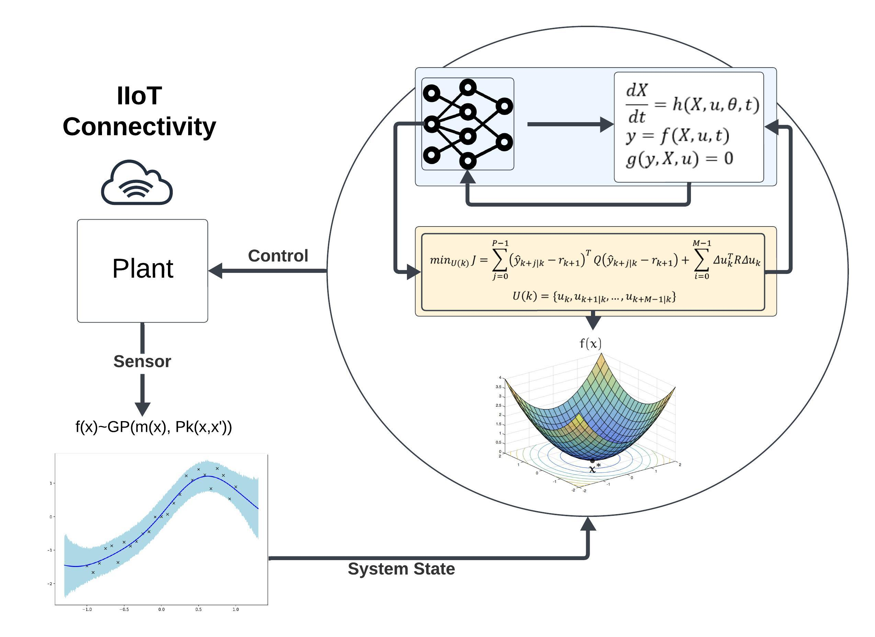
Bioprocessing 4.0: Minimising Cost of mRNA Vaccine Manufacturing
Kesler Isoko ^{a,b}, Mahdi Ahmed ^{b}, Joseph Middleton ^{b}, Joan L. Cordiner ^{b}, Zoltan Kis ^{b,c*}, Peyman Z. Moghadam ^{a*}
a Department of Chemical Engineering, University College London, Torrington Place, London WC1E 7JE, United Kingdom
b School of Chemical, Materials and Biological Engineering, University of Sheffield, Mappin Street, Sheffield S1 3JD, UK
c Department of Chemical Engineering, Imperial College London, South Kensington Campus, London SW7 2AZ, UK
uceckis@ucl.ac.uk

Slide 2
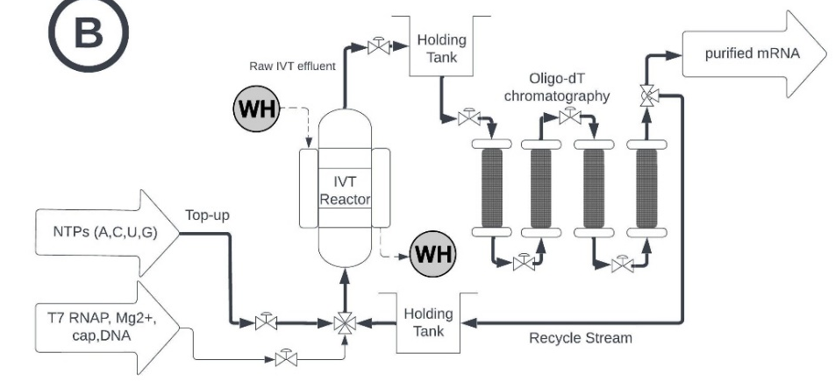
The Goal: Recycling Expensive Raw Materials
Opportunity
Recycling expensive reagents could significantly reduce the cost of mRNA (2-5x)
Problem
However, this process is still very manual, and the high dead-times, low observability make it challenging to control
(Nair et.al., 2025 ~ draft; patent - PCTGB2024/052819) ~ filed

Slide 3
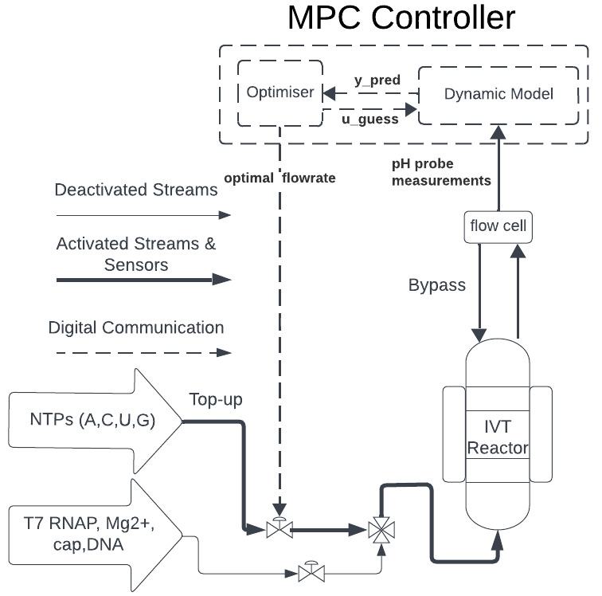
Control Setup in mRNA Recycling
Variable Names | Notation | Example
Prediction Horizon | P | Number of steps the model predicts
Control Horizon | M | Number of control actions evaluated
Control Outputs | Y | RNA yield
Reference Trajectory | r | Desired Yield Response
State Variables | x | Other Components i.e. DNA Template
Control Inputs | U | NTPs Valve Position
Measurements
pH can be used to monitor the reaction
Objective
Our goal is to feed NTP such that we maximise yield with minimum side-effects such as pyrophosphate ions production

Slide 4
Control Setup: Dynamic Model
Variable Names | Notation | Example
Prediction Horizon | P | Number of steps the model predicts
Control Horizon | M | Number of control actions evaluated
Control Outputs | Y | RNA yield
Reference Trajectory | r | Desired Yield Response
State Variables | x | Other Components i.e. DNA Template
Control Inputs | U | NTPs Valve Position
Measurements
pH can be used to monitor the reaction
Objective
Our goal is to feed NTP such that we maximise yield with minimum side-effects such as pyrophosphate ions production

Slide 5
Dynamic model development: Data Driven
Purely data-driven (System identification)
AutoRegressive with eXogenous inputs (ARX)
Nonlinear AutoRegressive with eXogenous inputs (NARX)
Neural Networks (RNN, LSTMs, etc…)
Purely Mechanistic (with state estimation)
Extended Kalman Filters (EKF), Unscented Kalman Filters (UKF), Kalman Filters (KF)
Process Analytical Technologies (PAT)
Soft sensors
Hybrid semi-parametric modelling
Serial
Parallel
Pros of data-driven
No first principal knowledge required
Linear models generates a quadratic optimisation programme (convex) that can be solved reliably online
Cons of data-driven
ARX Might not capture nonlinear dynamics leading to instability
Requires enough step response data or access to plant to calibrate dead-time, rise-time and steady states parameters

Slide 6
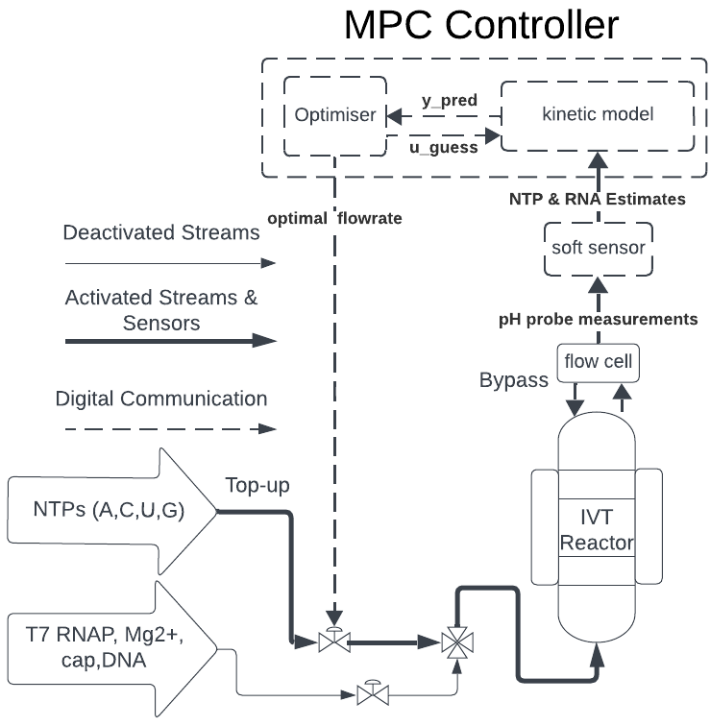
Control Setup: Dynamic Model
Variable Names | Notation | Example
Prediction Horizon | P | Number of steps the model predicts
Control Horizon | M | Number of control actions evaluated
Control Outputs | Y | RNA yield
Reference Trajectory | r | Desired Yield Response
State Variables | x | Other Components i.e. DNA Template
Control Inputs | U | NTPs Valve Position
Measurements
pH can be used to monitor the reaction
Objective
Our goal is to feed NTP such that we maximise yield with minimum side-effects such as pyrophosphate ions production

Slide 7
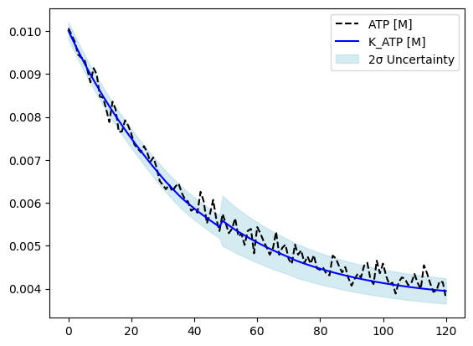
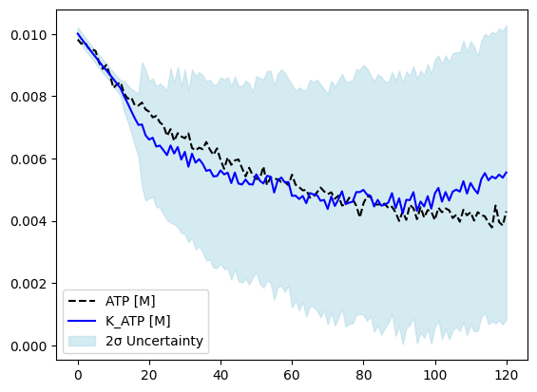
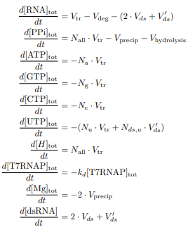
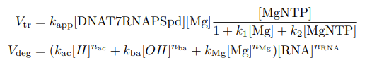

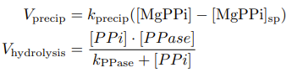
Dynamic model development: Mechanistic
Purely mechanistic
Moving Horizon Estimation
PAT
Soft sensor for key variables
Methodology
Linearisation techniques lead to poor performance (EKF)
UKF is accurate however requires proper calibration and is too slow to be integrated in optimisation loop

Slide 8
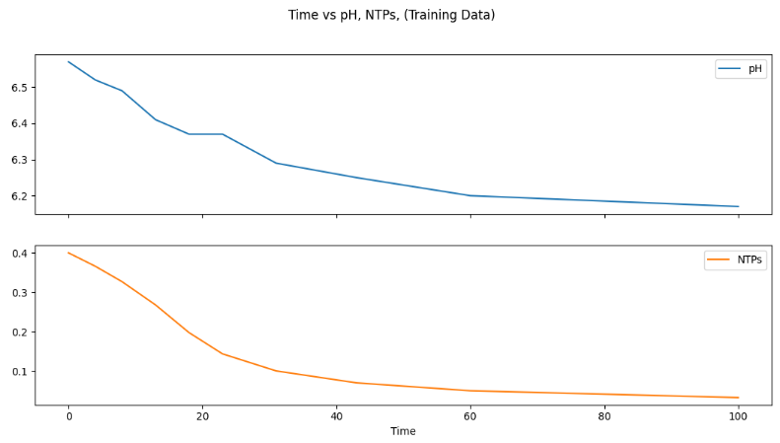

Developing a PAT sensor
Pros
Provides accurate estimates of NTP & RNA
Cons
Numerical instability of the log in python due to floating point errors
Sensitive to noisy measurements
$$\begin{aligned}pH=pK_{a}+\log\left(\frac{\left[A^{−}\right]}{\left[HA\right]}\right) \#\end{aligned}$$

Slide 9
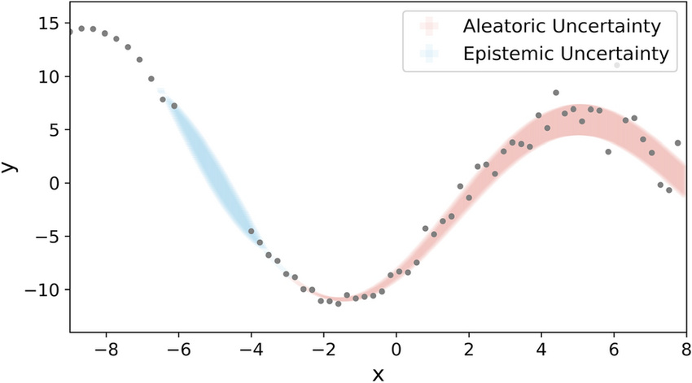
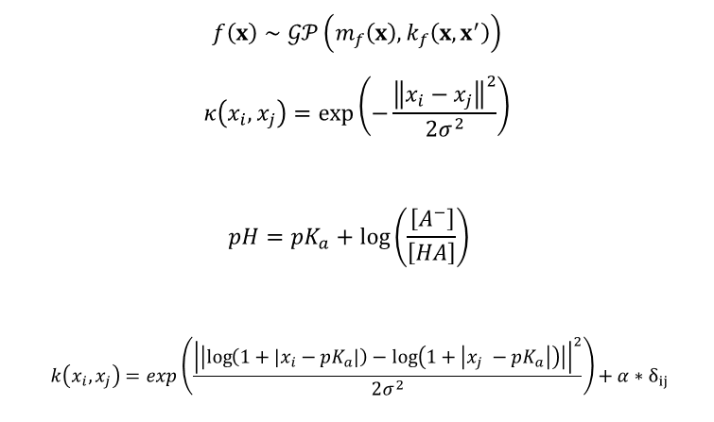
Soft sensor development: Physics-informed Gaussian Process Regression
$$f\left(x\right)∼𝒢𝒫\left(m_{f}\left(x\right),k_{f}\left(x,x^{′}\right)\right)$$
$$κ\left(x_{i},x_{j}\right)=\exp\left(−\frac{{\left\|x_{i}−x_{j}\right\|}^{2}}{2σ^{2}}\right)$$
$$\begin{aligned}pH=pK_{a}+\log\left(\frac{\left[A^{−}\right]}{\left[HA\right]}\right) \#\end{aligned}$$
$$\begin{aligned} k\left(x_{i},x_{j}\right)=\exp\left(\frac{{\left|\left|\log\left(1+\left|x_{i}−pK_{a}\right|\right)−\log\left(1+\left|x_{j} −pK_{a}\right|\right)\right|\right|}^{2}}{2σ^{2}}\right)+α∗δ_{ij}\#\end{aligned}$$
Requirements
Keep the physics
Sampling efficient
Robust to noisy measurements
Gaussian Processes
Follow a Bayesian formulation
Require little data
Uncertainty Quantification

Slide 10
Soft sensor development: Physics-informed Gaussian Process Regression
Two models deployment (complicated setup)
Error can carry over leading to unnecessary instability
Kinetic model performance was unsatisfactory

Slide 11
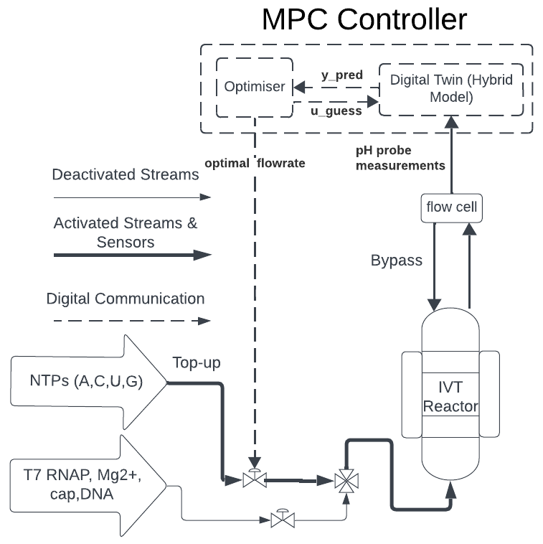
Control Setup: Hybrid Model
Variable Names | Notation | Example
Prediction Horizon | P | Number of steps the model predicts
Control Horizon | M | Number of control actions evaluated
Control Outputs | Y | RNA yield
Reference Trajectory | r | Desired Yield Response
State Variables | x | Other Components i.e. DNA Template
Control Inputs | U | NTPs Valve Position
Measurements
pH can be used to monitor the reaction
Objective
Our goal is to feed NTP such that we maximise yield with minimum side-effects such as pyrophosphate ions production

Slide 12
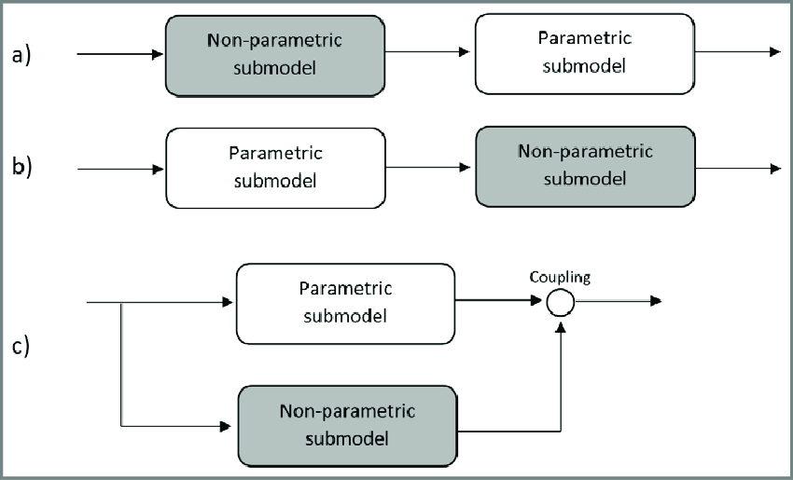
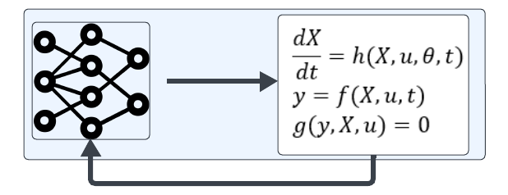
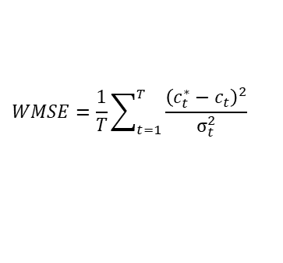

Dynamic model development: Hybrid Model
Hybrid semi-parametric model
Serial structure (ensemble)
Parallel structure (discrepancy, hierarchical)
Methodology
$$f\left(x\right)∼𝒢𝒫\left(m_{f}\left(x\right),k_{f}\left(x,x^{′}\right)\right)$$
$$κ\left(x_{i},x_{j}\right)=\exp\left(−\frac{{\left\|x_{i}−x_{j}\right\|}^{2}}{2σ^{2}}\right)$$
Evaluated ALL the relevant ML techniques
Support Vector Regression
Bayesian Regression
Gaussian Processes
Xgboost, Random Forest, LightGBM
Linear Regression, ElasticNet
Partial Least Squares
$$WMSE=\frac{1}{T}\sum_{t=1}^{T}{\frac{{\left(c_{t}^{∗}−c_{t}\right)}^{2}}{σ_{t}^{2}}}$$
Levenberg-Marquardt (LMM) algorithm

Slide 13
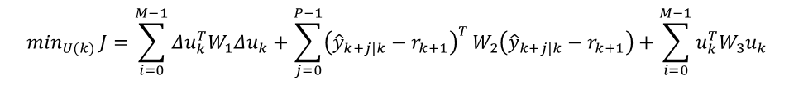
Control Setup: Optimiser
Variable Names | Notation | Example
Prediction Horizon | P | Number of steps the model predicts
Control Horizon | M | Number of control actions evaluated
Control Outputs | Y | RNA yield
Reference Trajectory | r | Desired Yield Response
State Variables | x | Other Components i.e. DNA Template
Control Inputs | U | NTPs Valve Position
Measurements
pH can be used to monitor the reaction
Objective
Our goal is to feed NTP such that we maximise yield with minimum side-effects such as pyrophosphate ions production
$$\min_{U(k) }J=\sum_{i=0}^{M−1}{Δu_{k}^{T}W_{1}Δu_{k}}+\sum_{j=0}^{P−1}{{\left({\hat{y}}_{k+j|k}−r_{k+1}\right)}^{T}}W_{2}\left({\hat{y}}_{k+j|k}−r_{k+1}\right)+\sum_{i=0}^{M−1}{u_{k}^{T}W_{3}u_{k}}$$

Slide 14
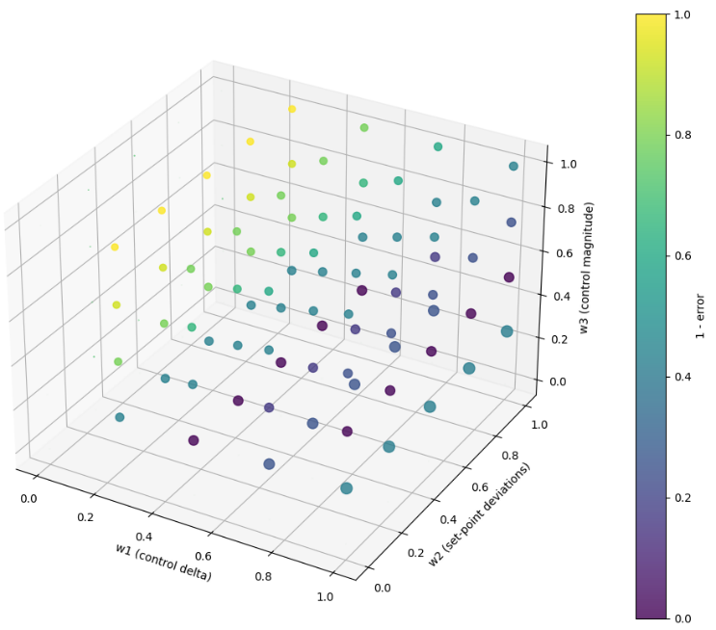
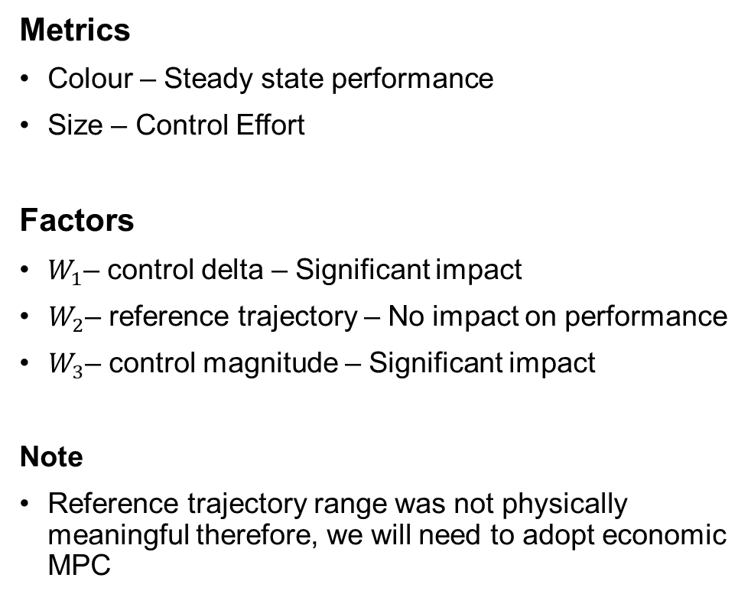
MPC Controller Design: Tuning Parameters
Metrics
Colour – Steady state performance
Size – Control Effort
Factors
$W_{1}$– control delta – Significant impact
$W_{2}$– reference trajectory – No impact on performance
$W_{3}$– control magnitude – Significant impact
Note
Reference trajectory range was not physically meaningful therefore, we will need to adopt economic MPC

Slide 15
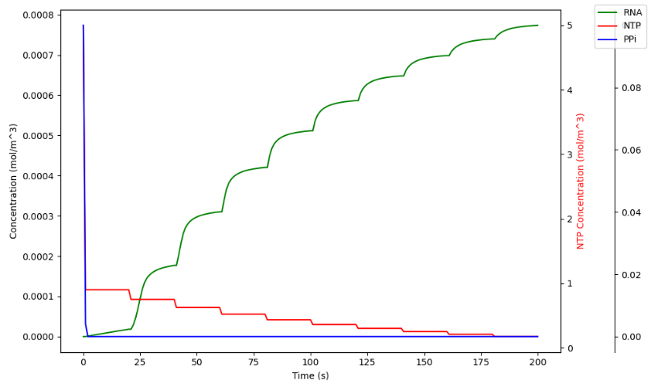
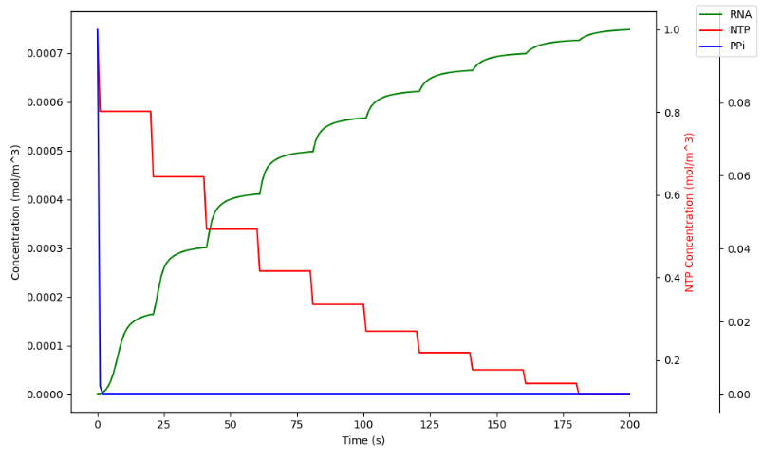
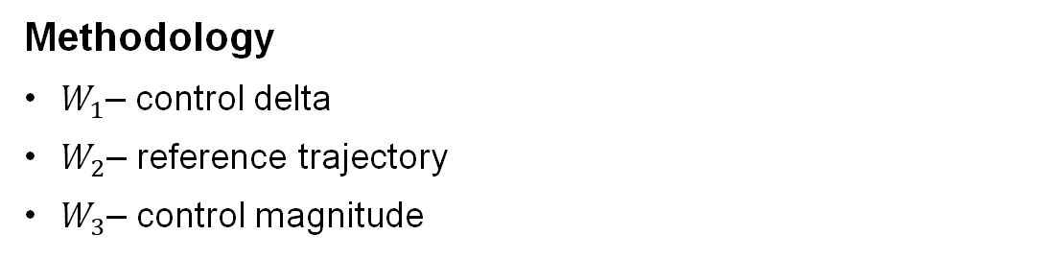
MPC Controller Design: Control Effort
Methodology
$W_{1}$– control delta
$W_{2}$– reference trajectory
$W_{3}$– control magnitude
$$\min_{U(k) }J=\sum_{i=0}^{M−1}{Δu_{k}^{T}W_{1}Δu_{k}}+\sum_{j=0}^{P−1}{{\left({\hat{y}}_{k+j|k}−r_{k+1}\right)}^{T}}W_{2}\left({\hat{y}}_{k+j|k}−r_{k+1}\right)+\sum_{i=0}^{M−1}{u_{k}^{T}W_{3}u_{k}}$$

Slide 16
Control Setup: Connectivity
Variable Names | Notation | Example
Prediction Horizon | P | Number of steps the model predicts
Control Horizon | M | Number of control actions evaluated
Control Outputs | Y | RNA yield
Reference Trajectory | r | Desired Yield Response
State Variables | x | Other Components i.e. DNA Template
Control Inputs | U | NTPs Valve Position
Measurements
pH can be used to monitor the reaction
Objective
Our goal is to feed NTP such that we maximise yield with minimum side-effects such as pyrophosphate ions production

Slide 17
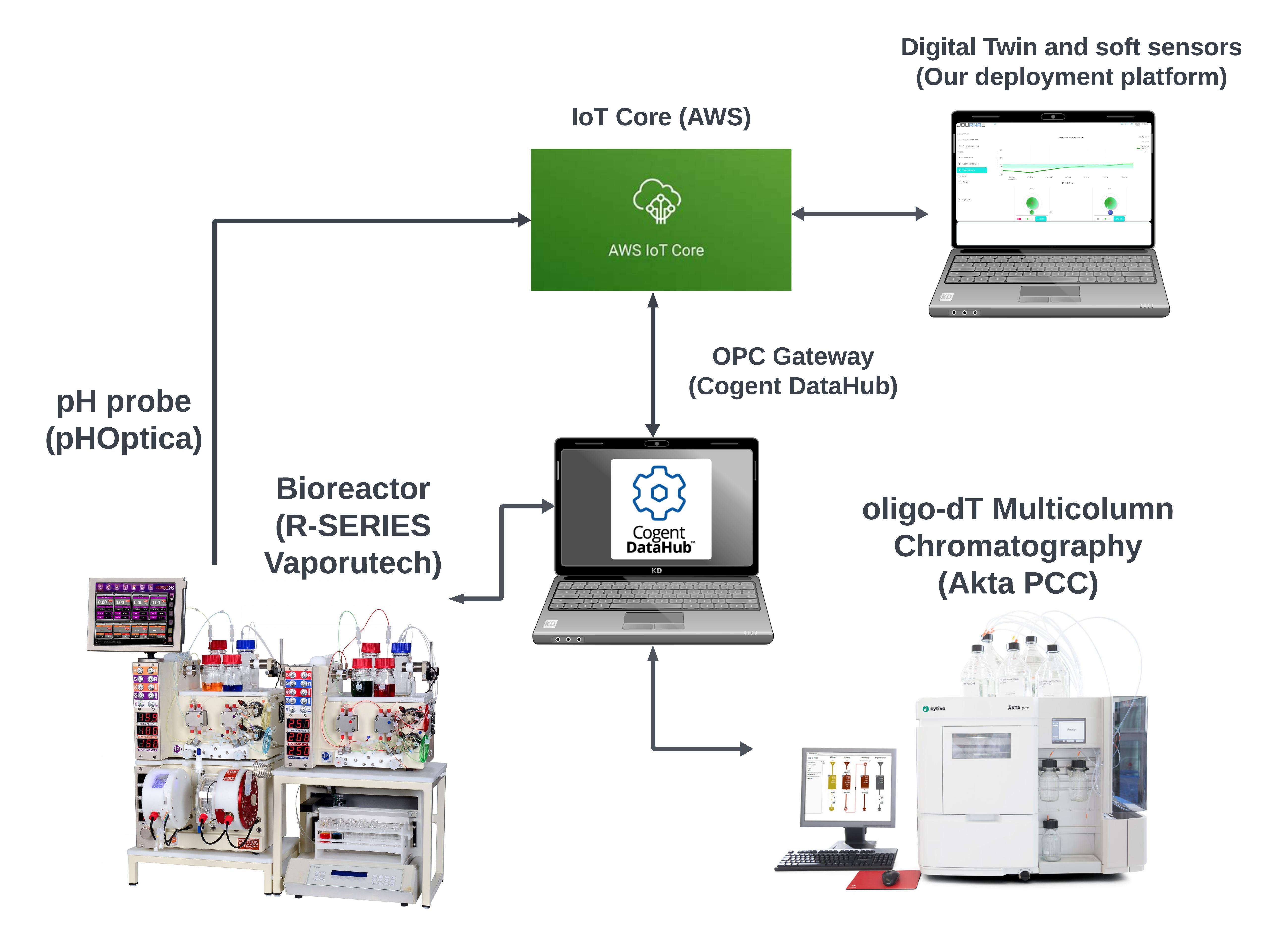
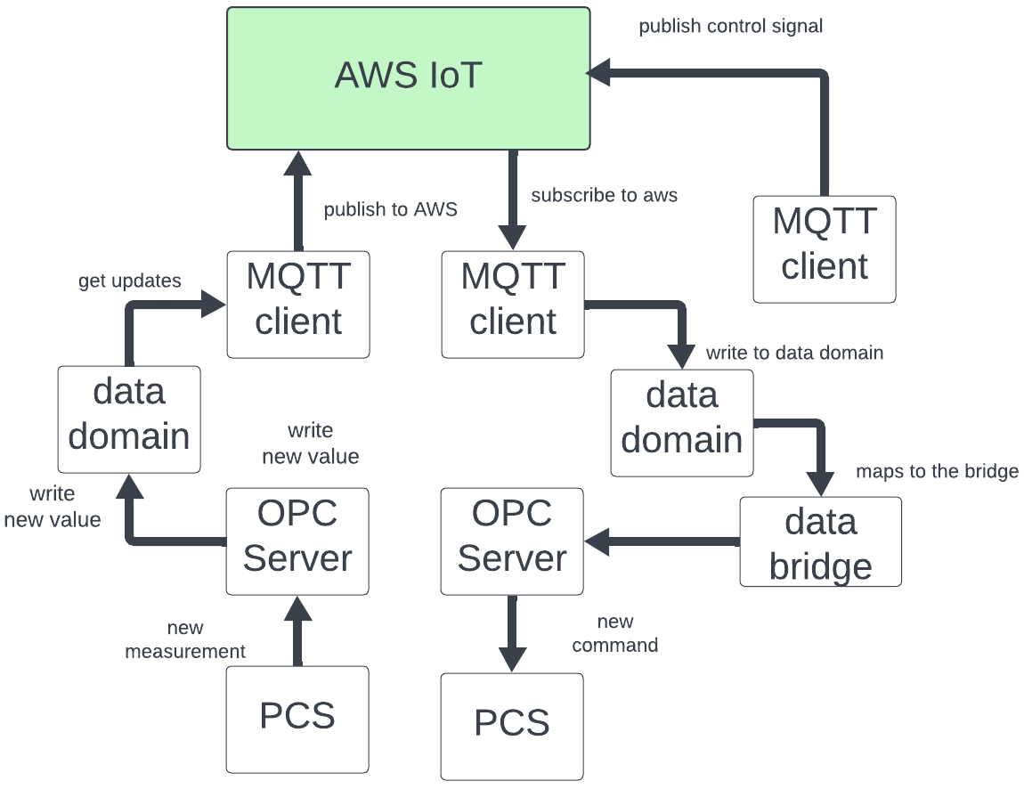
Industrial IoT Platform: Model Deployment and Connectivity
Methodology
OPC – for interoperability
MQTT – for lightweight robust communication

Slide 18
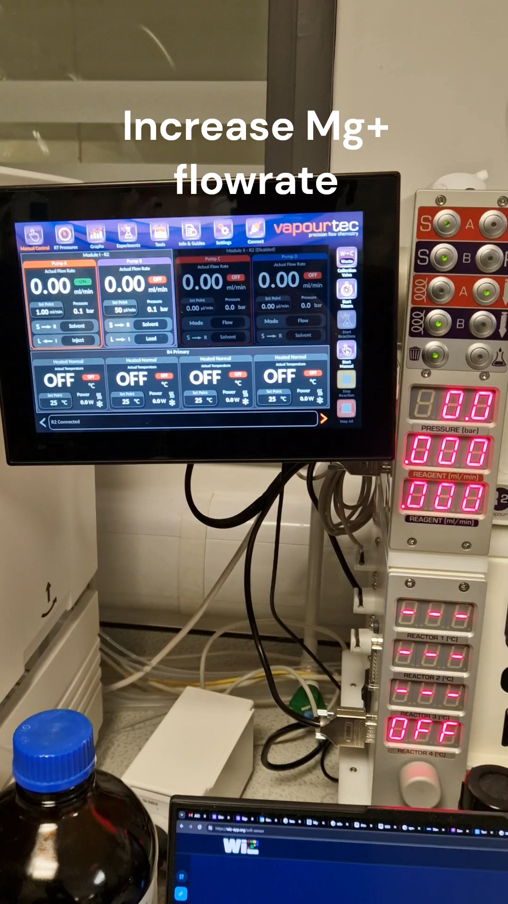
IIoT Platform Test Feedback
Test Type I errors (False Positives)
Step 1: Increase Mg2+ flowrate to 1.25 L/min. (SAFE)
Step 2: Check new RNA yield prediction (≈7 g/L) within acceptance ranges so reaction continues.
Test Type II errors (False Negative)
Step 3: Increase Mg2+ flowrate to 2.00 L/min. (PRECIPITATION)
Step 4: Check new RNA yield prediction (≈5 g/L) outside acceptance ranges.
Step 5: The model shuts down the reaction (Set minimum flowrate to 50 𝜇L/min to prevent bad batch)

Slide 19
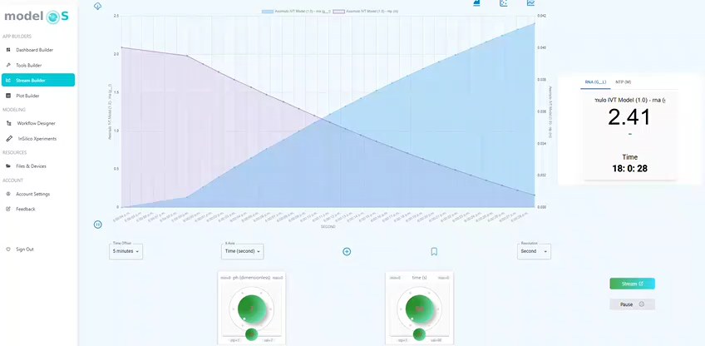
IIoT Platform Soft Sensor Deployment

Slide 20
Results
Hybrid model
accuracy: 85% in forecasting RNA yield
Soft sensor
accuracy: 90% in estimating current NTPs & RNA concentrations
IIoT Platform Features:
model deployment
two-way data connectivity
real-time visualisation
MPC Controller
Reduce Costs by 31% vs recycling w PID (85% vs Traditional)

Slide 21
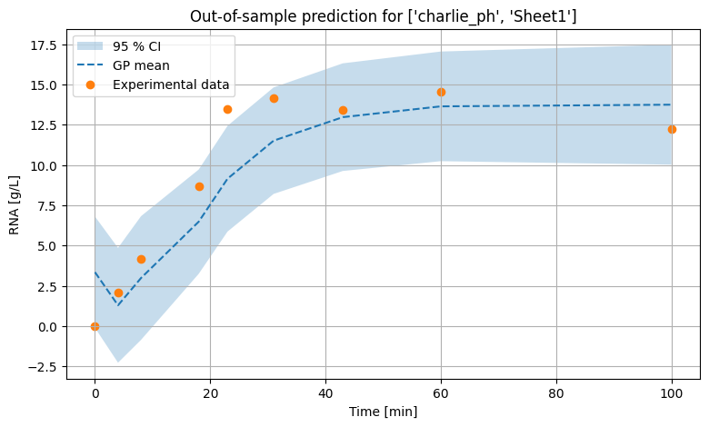
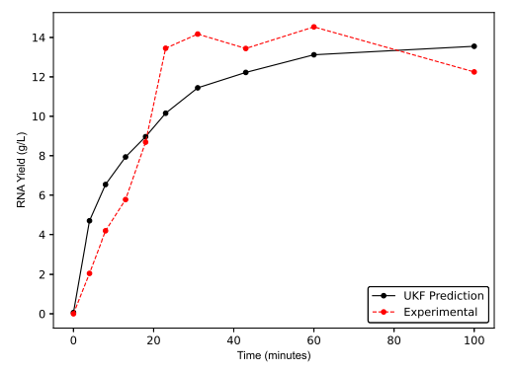
Results Hybrid Model vs Mechanistic Model
Hybrid model predictions on unseen data
Mechanistic model predictions on unseen data

Slide 22
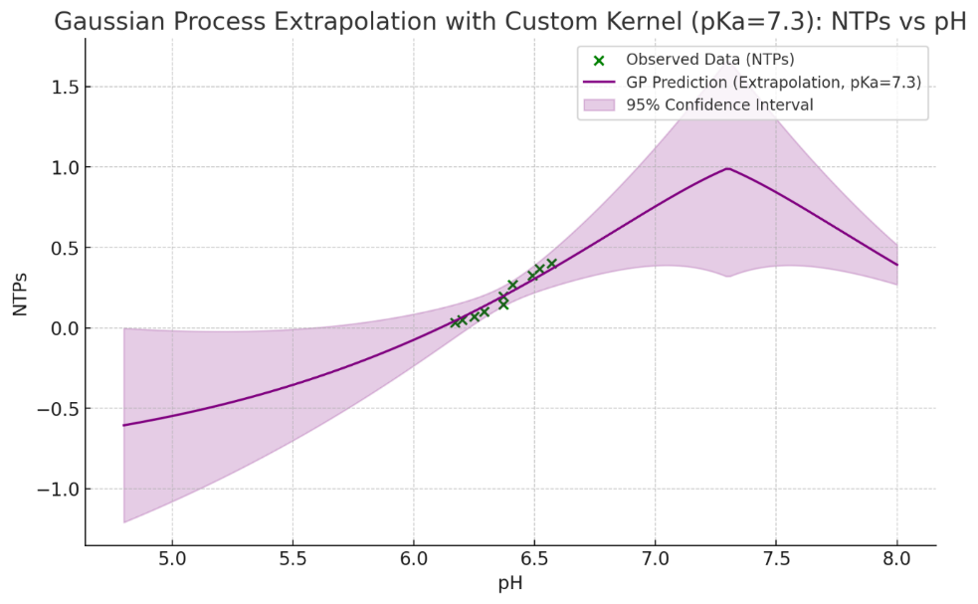
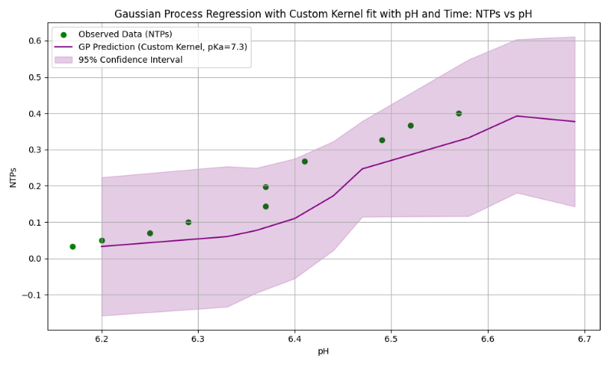
Results: soft sensor
Non-linear relationship between pH and NTPs
Ceiling constrained successfully!

Slide 23
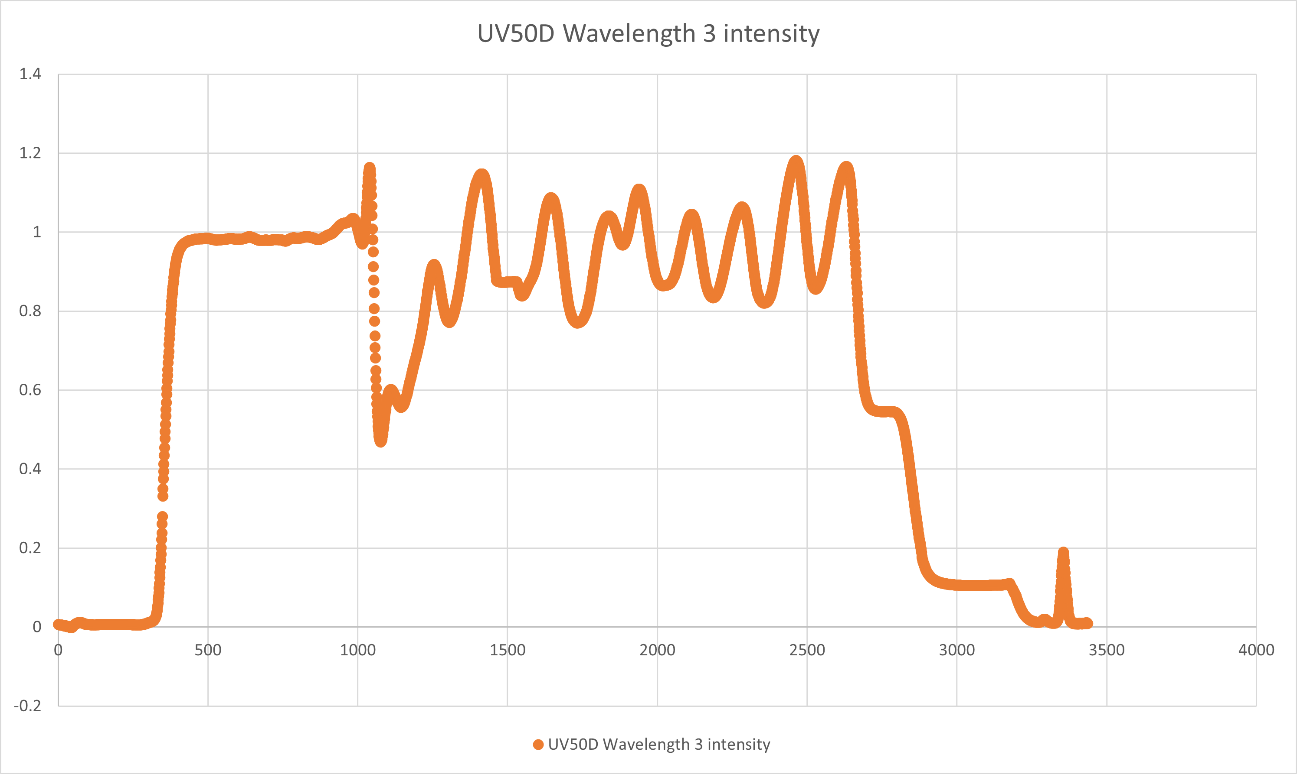
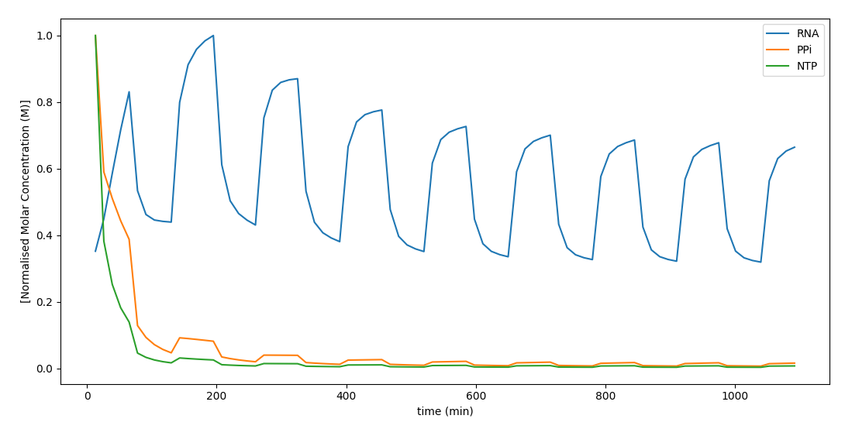
Results: Plant Simulator
MPC Response Profile
Regular Top-up Response Profile
Plant simulation captures oscillatory dynamics in experimental data
Quantitative evaluation of the plant required

Slide 24
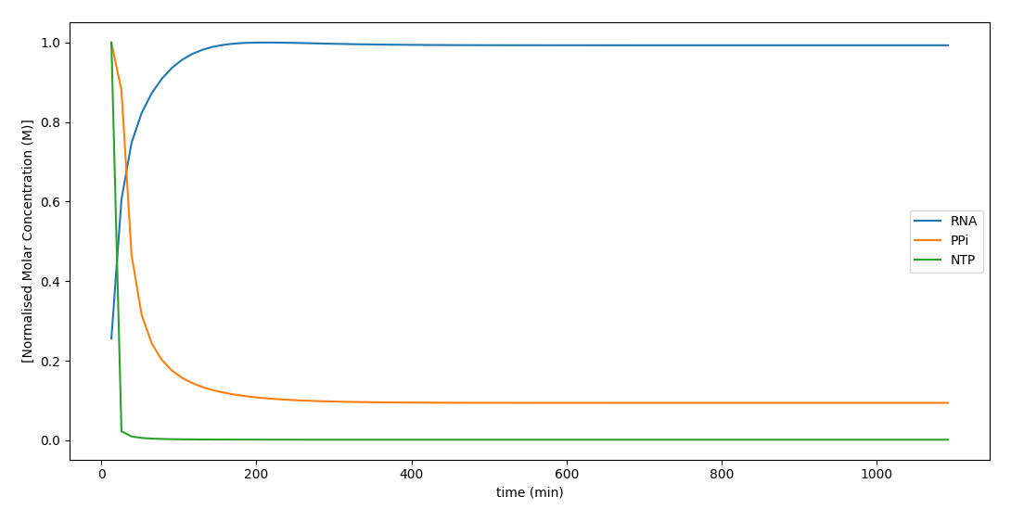
Results: Multi-objective optimisation
MPC Response Profile
Regular Top-up Response Profile
Model Predictive Controller minimises impurity (PPi)
MPC controller also maximises yield and maintains optimal operations
MPC controller achieves better stability and faster steady-state

Slide 25
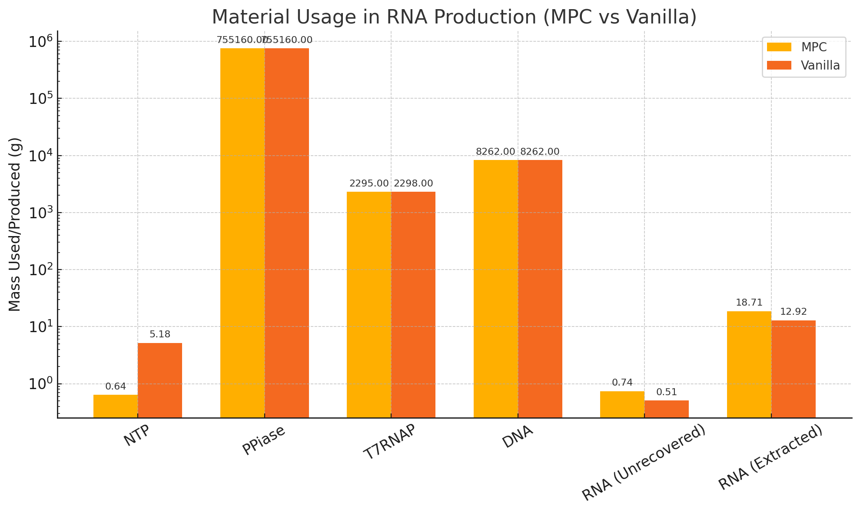
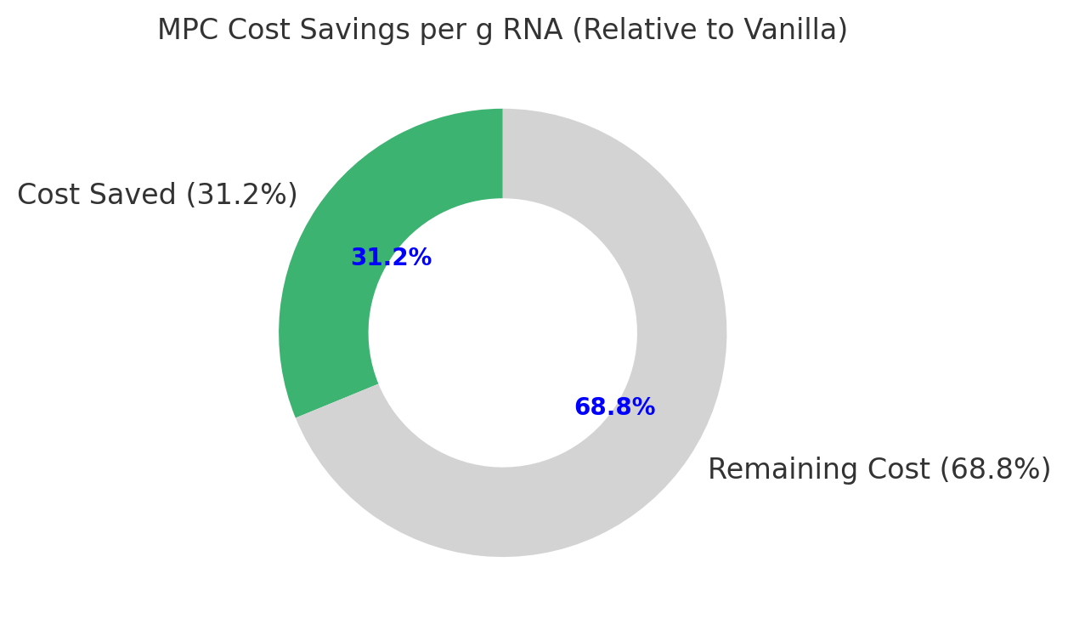
Results: Multi-objective optimisation
$0.69
MPC costs $0.69 on the dollar compared to standard recycling
Compared to traditional (no recycling) is < 15% of the cost
MPC makes use of manipulated variables (NTPs) much more effectively
This leads to higher yields of RNA using less reagent

Slide 26
Summary & Future Work
Summary
Developed dynamic hybrid model and soft sensors for real-time predictions
Achieved multi-objective optimisation
Tested the control strategy in simulation demonstrating cost savings
Deployed dynamic model in predictive mode via a custom IIoT Platform
Future Work
Implement Economic MPC with GP-ARX model in the close-loop
Use Bayesian Optimisation to tune controller parameters
Deploy full-controller

Slide 27

Acknowledgments Thanks for listening Any Questions?
Funding: Wellcome Leap R3 Programme, CEPI, H. Walter Stern Scholarship
Collaborators: Kesler Isoko, Mahdi Ahmed, Joseph Middleton, Joan L. Cordiner, Zoltan Kis, Peyman Z. Moghadam

