Slide 1
Showcase of Advanced Regulatory Control in the Sugar Industry
James Caws MEng CEng MIChemE
Senior Automation & Control Engineer, British Sugar
Notes:
Hi, my name is James Caws, Senior Automation and Analytics Engineer at British Sugar.
I am delighted to share my presentation for Advances 2025 with you, showcasing some examples of using advanced regulatory control in the sugar industry.
In the current age of developing AI, machine learning, digital twins and the like, I hope this presentation reminds us the importance of getting the most out of our control systems and that there is still very much a place for well established control techniques that serve as a solid foundation for some of the more modern technologies.

Slide 2
Agenda
Control Challenges
Simple Soft Sensors
Smith Predictor Dynamic Compensation
Dynamic Mass Balance
Dynamic Feedforward
Notes:
I will aim to discuss some of the common control challenges we face, before giving a few examples of where we have used advanced regulatory control techniques to overcome these challenges.
I hope to give a good range of examples from very basic through to more advanced techniques.
For those that may not be familiar, advanced regulatory control is general defined as control more advanced than standard PID control, but not going as far as say multivariable predictive control, so this often means making use of some of the more advanced but still standard function blocks available within most DCS systems.

Slide 3

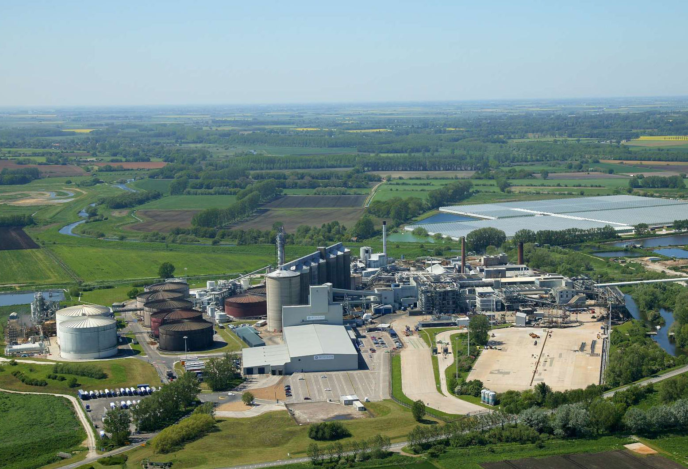
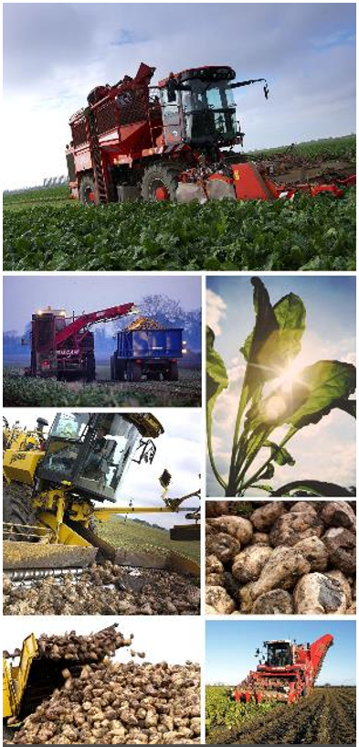

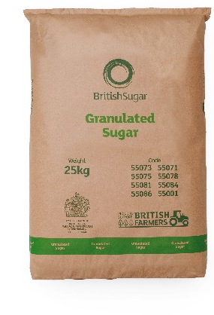
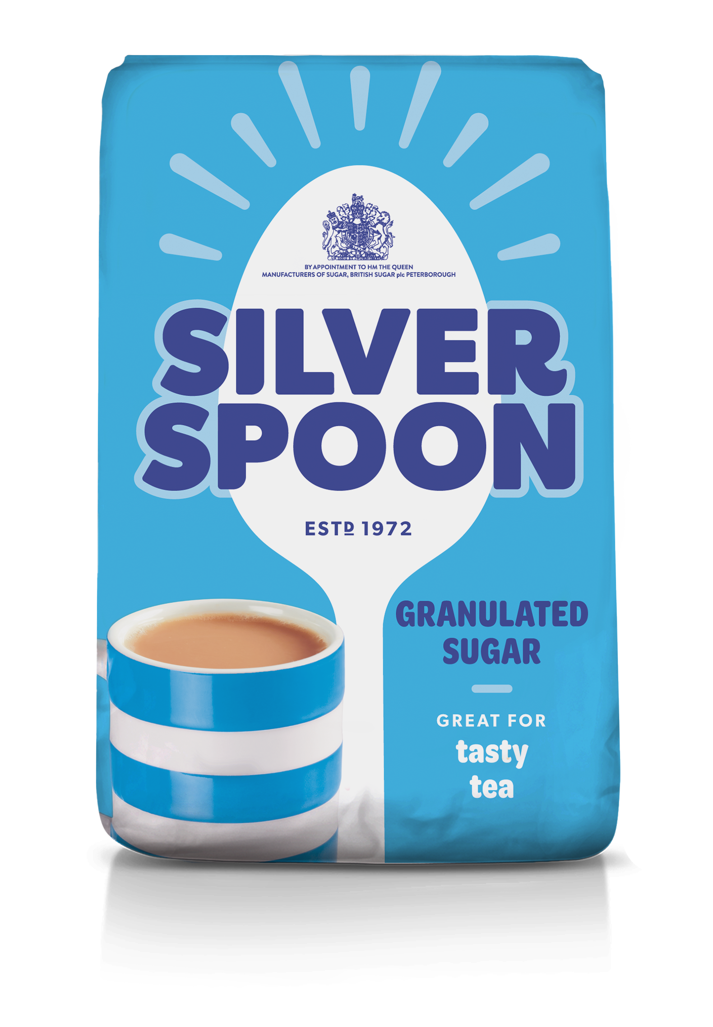

Introduction to British Sugar
co-products
8 million tonnes
1.2 million tonnes
Notes:
Just to give a brief introduction to British Sugar, we are the sole processor of UK grown sugar beet.
So, we take about 8 millions tonnes of sugar beet and extract and refine that into about 1.2 million tonnes of white sugar, plus a variety of co-products including animal feed, bioethanol and electricity.

Slide 4
Control Challenges
Unmeasured disturbances – variable raw material
Long process dynamics
Mix of continuous and batch unit operations
Harsh environment for instrumentation – scaling/abrasion
Lack of operator familiarity with more complex control strategies
Advanced Regulatory Control (ARC) we have found, in general, a good compromise between and the simplicity of base control (such as PID) and the complexity and cost of Multivariable Predictive Control
Notes:
Why I’ve found the sugar industry to be a fascinating place to work, particularly when it comes to control engineering, is that there are a number of challenges, although many will be shared with other industries.

Slide 5
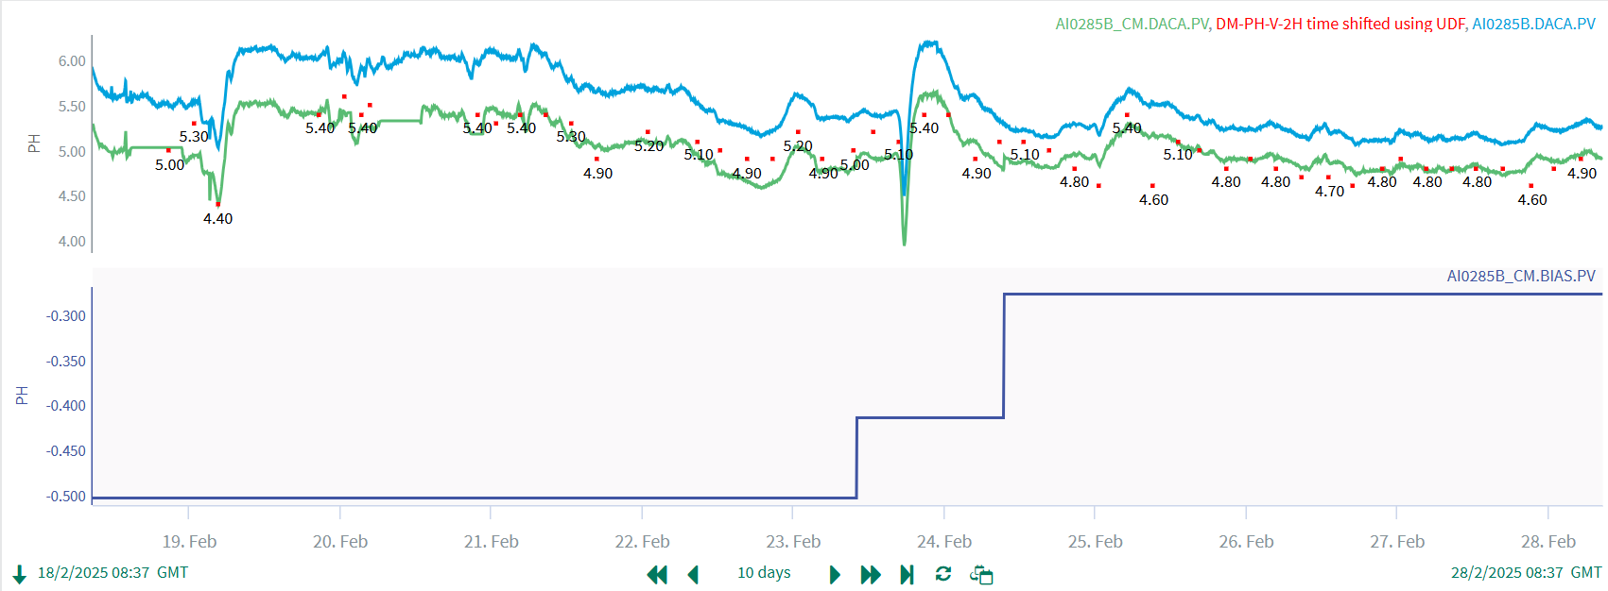
Soft Sensors
Raw
Lab
Infer.
Control of pH on a rotating drum
pH probe drifts over time
Operators would have to adjust pH setpoint based on lab results
Inferential aligns the raw probe reading with lab
Opportunity for reduced lab sampling frequency
Bias
Notes:
I wanted to start with a very simple example of using a soft sensor or inferential.
In the diffusion part of our process, we have large rotary drum style diffusers and for optimal diffusion conditions, are interested in controlling the pH in the middle of this rotating drum, which is a challenge.
On similar harsh duties, we would opt for an auto-cleaning, auto calibrating pH probe but that is not possible in this case.
So we have a simple pH probe installed, with some signal conditioning so it only reads raw values when the meter is fully submerged in liquid. Because of the less than ideal conditions for this pH probe, we do find the reading drifts over time but does still give a good trend of what is going on. We are also able to take lab samples, but perhaps only every 4-8hours.
So we have used a very simple soft sensor use the laboratory results to automatically adjust the bias of the online pH meter, to keep the online reading in-line with the lab results.
This allows us to react more quickly to process disturbances and rely less on the lab sampling.

Slide 6
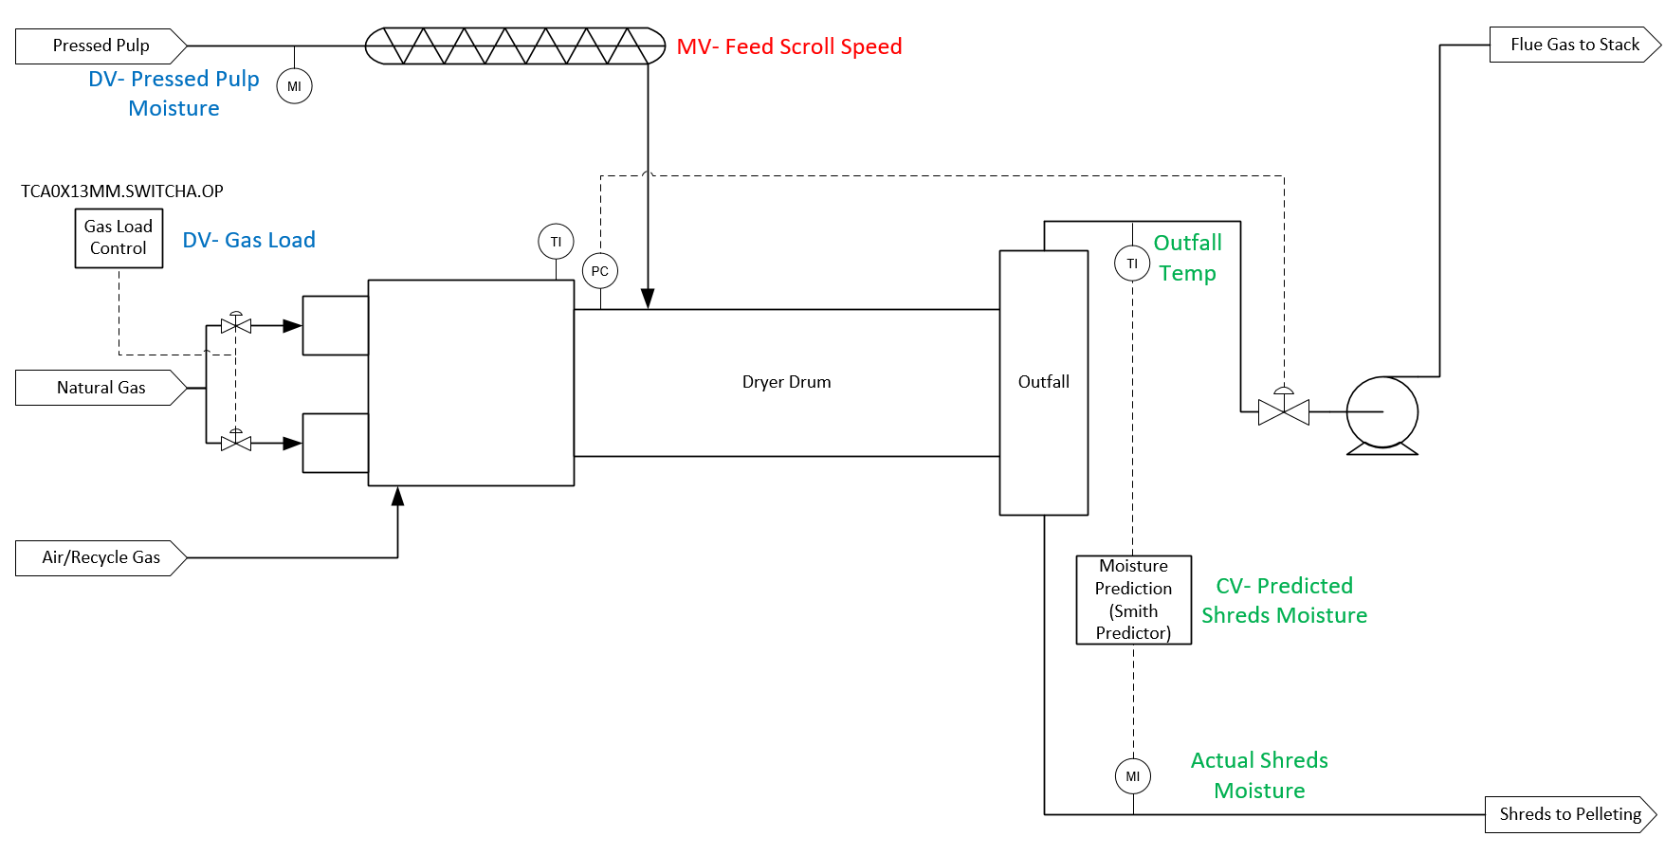
Smith Predictor - Dynamic Compensation
Although we have online product moisture, this lags about 10mins behind the temperature of the flue gas
Notes:
Moving onto an example from the animal feed part of operations, our animal feed dryers have always been a challenge to control due to large disturbances and long process dynamics.
These are rotary dryers, with exhausted sugar beet pulp being fed into the front of dryer drum, with a gas burner to generate hot gases to dry the pulp. The pulp passes through the drum with an internal structure lifting and distributing the pulp in the drum to give good contact area.
The pulp takes about 20mins to travel through the drum, leaving along with the flue gases and you have the challenge of adjusting the pulp feed rate in order to control the product moisture, with at times very large variation in feed moisture.
In recent years, online moisture measurement of the product has become more reliable, however this measurement lags behind the temperature of the flue gas by about 10mins, which adds significantly extra dynamics to make the control harder – basic PID control is going to struggle with process dynamics this large.
This is one reason why the flue gas temperature has been used as the controlled process variable in the past. However, it is really moisture we need to control.

Slide 7
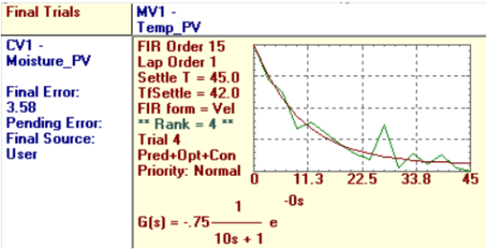
Smith Predictor - Dynamic Compensation
Use temperature to predict moisture and control to the predicted moisture.
Actual moisture is used to correct the prediction bias.
Notes:
The good news is that there is a strong dynamic model between flue gas temperature and product moisture – represented very nicely with a first order model with a 10min lag.
So, working with Howard Boder from NewLand control, we decided to implement a smith predictor, a basic type of predictive control good for compensating for long dynamics, whereby we use the flue gas temperature to predict product moisture and control to the predicted temperature instead.
The online moisture is used to correct the prediction bias in real time – that is to say, we can compare the moisture now to what we predicted it to be about 10mins ago and this tells us how much we need to adjust our prediction by.

Slide 8
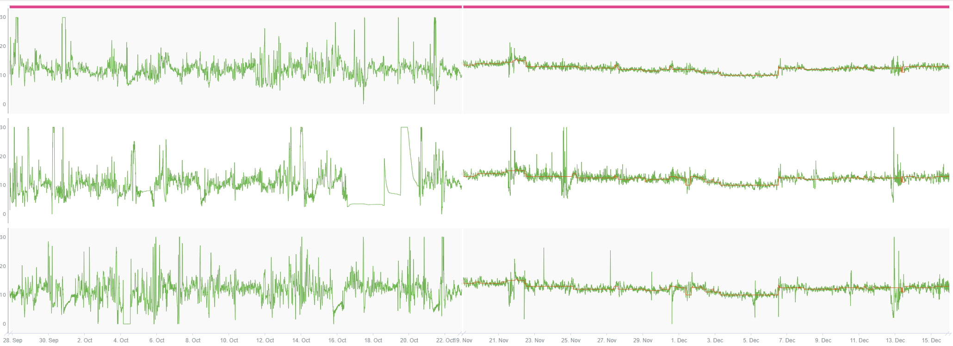
Smith Predictor - Dynamic Compensation
Before ARC
After ARC
Before ARC
Notes:
As you can see, some great benefits in control have been achieved with this approach, across all 3 dryers at one of our factories, as unreliable older methods of control often resulted in the dryers being controlled manually, or at least requiring a lot of setpoint adjustments
In this case, a reduction in standard deviation of 60%.
So we benefit from a more consistent product quality and increased product revenue because we can control closer to the specification limit. Also, other soft benefit was that the reduction in operator actions needed to control the process freed up our operators’ time to focus on other tasks, which was actually a big driver for our automation program at this time.
So it is definitely worth exploring smith predictors for processes with a small number of variables, but with long process dynamics.

Slide 9
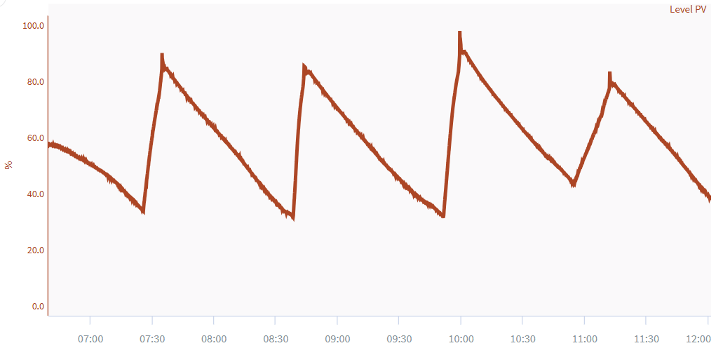
Mix of Continuous & Batch – Dynamic Mass Balance
How to determine the setpoint for raw cents to keep as smooth as possible?
Vapour
White Centrifuges (Batch Centrifugation)
High Green Syrup Tanks
Raw Pans (Semi-batch Crystallisation)
Receivers
Raw Centrifuges (Continuous Centrifugation)
5 hour batch cycle time (discharge every 60-90mins)
Low-grade sugar recycled
Notes:
My third example relates to dealing with the mix of batch and continuous processes. In the refining part of our process, after we have crystallised our final white sugar product, we separate those crystals in batch centrifuges and are left with a syrup that we want to further extract sugar from. We do this in some semi batch crystallisers where the syrup is boiled under vacuum to grow sugar crystals – each batch takes about 5 hours, and the batches are discharged into a receiver vessel every 60-90mins or so, resulting in the receiver trend looking much like this saw tooth profile.
Much like in the white centrifuges, we then need to separate the raw sugar which is done in a number of continuous centrifuges we call raw cents.
The challenge we have here is, how can we set the throughput of the raw centrifuges, such that we keep the throughput as smooth as possible – the low grade sugar coming from these machines is being recycled to be recovered earlier in the process, so minimising disturbances is really important.
Because of the long time delays, operators controlling the raw cent throughput manually would inevitably end up being quite reactive to the receiver level, which especially during unsteady periods of plant operation, gave a significant variation in the amount of recycled low grade sugar. Much like with the dryer control, there was also a desire to free up operator time managing this station to allow focus on more important tasks.

Slide 10
Mix of Continuous & Batch – Dynamic Mass Balance
Use receiver capacity to calc emptying rate SP
Cascade to Power Control Setpoints
Filter + Delay
Mass Balance
Overrides/
adjustments
Emptying Rate PID
Vapour
LI
ROC
LI
FI
White Centrifuges (Batch Centrifugation)
High Green Syrup Tanks
Raw Pans (Semi-batch Crystallisation)
Receivers
Raw Centrifuges (Continuous Centrifugation)
Low-grade sugar recycled
Notes:
What we developed in this case was a dynamic mass balance approach.
If we know the flow of syrup coming from the white cents, by mass balance over the area shaded in blue, we can work out the flow we expect to see leaving the receivers. However, we have to apply a deadtime and lag to account for the process dynamics in the raw pan station, which is simply achieved using a deadtime function block and a first order lag or simply a filter block. We don’t have a flow meter to control the flow out of the receiver, but we can use the rate of change of the receiver level to infer this flow instead. So we use the capacity of the receiver to calculate a rate of change SP and have a PID controller which outputs to the setpoint of the raw cent controllers to control to this emptying rate.
One thing we realised is that the mass balance calc is not going to be exact, due to making some assumptions, and also our dynamics are not going to be spot on. So we therefore needed some sort of level override to trim our calculation and keep the receiver level within a band. But the nature of the batch process means having a standard level override control wouldn’t work because of the saw tooth trend of all the vessels as material is transferred between each stage of the process. We also want this level override to be very smooth as we don’t want to be reacting to a one-off larger peak or trough in the receiver level. Instead, we realised that if we treated all the vessels within the shaded blue region as one big tank, and aimed to keep this total level within a range, that would be a much smoother level override. So we implemented this to trim the calculated SP. There were also a number of more standard overrides to protect downstream processes in abnormal situations.

Slide 11
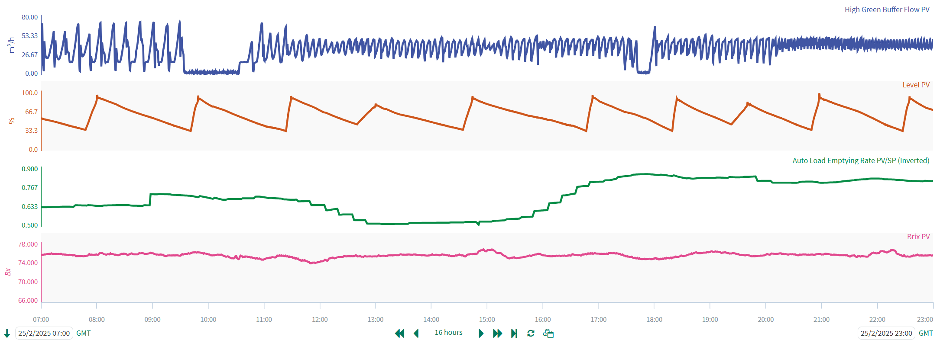
Mix of Continuous & Batch – Dynamic Mass Balance
Downtime in upstream process
About 2 hours after stop, control starts to reduce throughput of centrifuge station
Tank level stays in control and impact on downstream density is minimised
Notes:
If we look at a trend of the control in action, we have the measured upstream flow in blue, then the receiver level in brown, then the calculated emptying rate in green and finally the concentration of the syrup into which our raw sugar is recycled, which is really what we are aiming to keep as steady as possible.
In the time period chosen here, we can see we have had some downtime in the upstream process.
So I think this is a really interesting example of applying a dynamic mass balance calculation, but also dealing with the batch and continuous nature of the process by treating certain areas as one big tank for the purposes of level overrides.

Slide 12
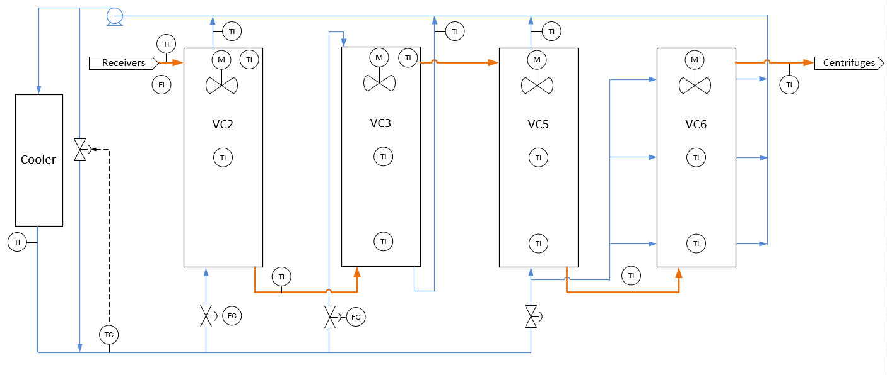
Long Dynamics – Dynamic Feedforward
Cooling Crystallisation Process
Notes:
We’ve already seen some examples of quite long dynamics, but what if we look at the very back end of the sugar refining process where higher concentrations of impurities make it increasingly harder to recover sugar – here we have some cooling crystallisers where we have very long residence times in an attempt to extract as much sugar as is economically possible. Our main process stream flows through a series of tanks, containing cooling coils and our aim is to control the temperature of the material leaving and going to centrifuges for separation.

Slide 13
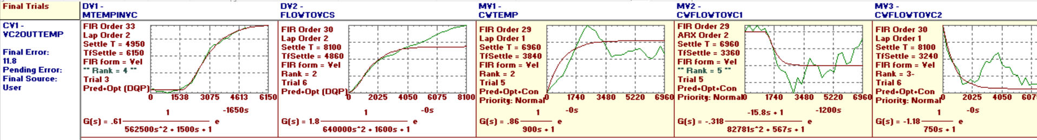
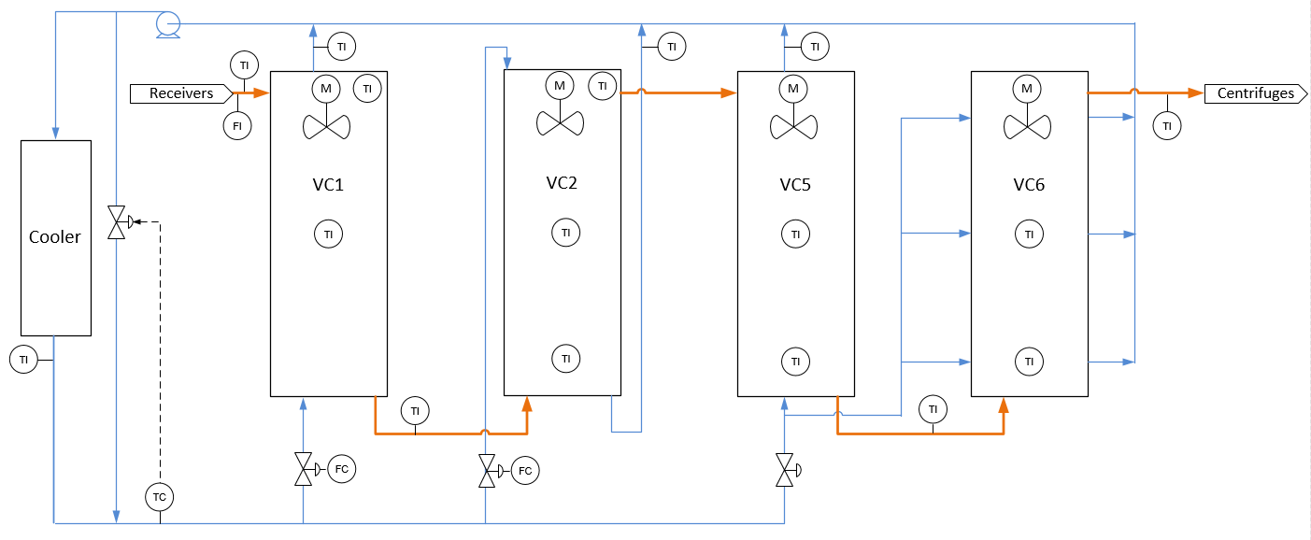
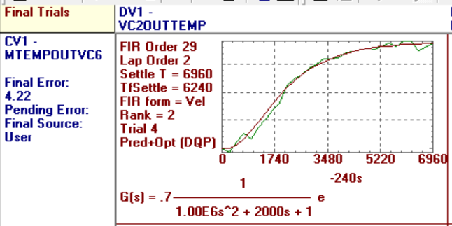
Long Dynamics – Dynamic Feedforward
Long Dynamics – Vertical Crystalliser Cooling
TI
TI
FI
TI
TC
FC
FC
Notes:
If we study the process dynamics, here using Honeywell profit design studio software, we see extremely long dynamics, with deadtimes of close to 24 hours, and lags of perhaps 12hours if you were to treat them as first order lags. These relationships represent the response of the temperature midway through the process if there were to be a step change in either the incoming flow, incoming temperature, or a change to the cooling water flows or cooling water temperature. Very tricky to deal with as a control problem.

Slide 14



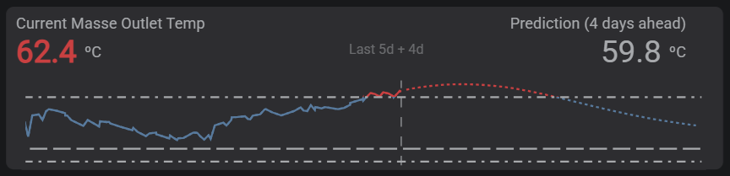
Long Dynamics – Dynamic Feedforward
Long Dynamics – Vertical Crystalliser Cooling
TI
TI
FI
TI
+
+
TC
FC
FC
Notes:
The first step we took to give additional insight to help control this process was actually to take the discovered process dynamics and build an outlet temperature prediction using a formula in the Seeq analytics software. We then made this available to the process engineers in our visualisation platform, IOTA to give open loop predictive control. You can see an example here where if the process engineers were looking at the current temperature, they might be tempted to continue making adjustments as the temperature is outside the target range, but the prediction says the temperature is going to come back in a couple of days time – so this really adds crucial insight to help control such a slow process.

Slide 15
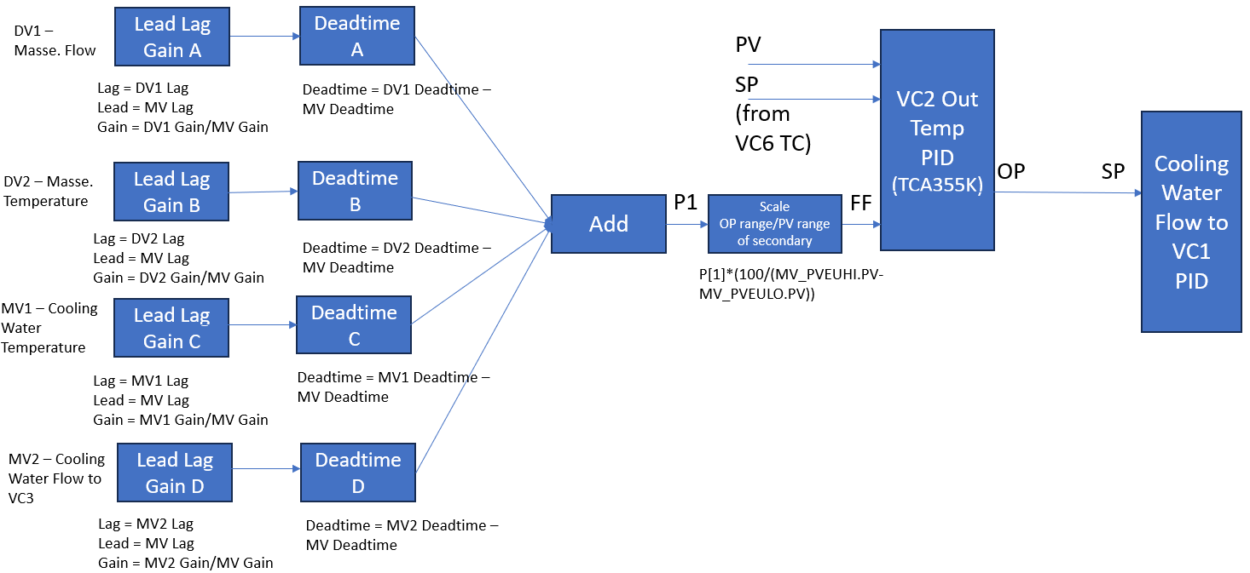
Long Dynamics – Dynamic Feedforward
CV
DV
MV
DV
DV
When there is a change in a DV, how much do I have to change the MV by, and at what time, to counteract the disturbance?
DV
Other MVs treated like DVs
Notes:
But to make this control closed loop, we have also developed a series of dynamic feedforward controllers, which mimics to some extent what a multivariable predictive control would do, but built with standard function blocks in the DCS.
Applying dynamics to feedforward variables is a well-known technique, but here we have taken it to the next level by combining the effects of multiple disturbances to generate a single feedforward variable.
Here we have the example of controlling the midpoint temperature, our CV or controlled variable, by adjusting the cooling water flow to the first vessel, our manipulated variable. We know that we have some disturbances as well as other manipulated variables that will impact our controlled variable.
I won’t dive into the maths here, but if we have the dynamic models that tell you what effect the MVs and DVs have on the CV, we can calculate the individual feedforward gains and dynamics needed for each disturbance, use lead lag and deadtime blocks to implement this, and then add the effects together to use this as the feedforward variable.
Put simply, we are working out how much we have to change the cooling water flow by and at what time in order to counteract the disturbances and keep the outlet temperature in control.
The PID controller with feedforward needs to be tuned for very slow feedback action due to the long delays, but much like a multivariable predictive control, you are relying primarily on the feedforward element to reject most of the disturbances.
This control is something we have been piloting and hope to roll out across all our factories very soon.

Slide 16

“Everything should be made as simple as possible, but not simpler.” – Albert Einstein
Thank you!
Thank you also to Gemma Sainty, Control Engineer, British Sugar
and Howard Boder, NewLand Control
James Caws
Notes:
To conclude, I hope you found those examples of advanced regulatory control interesting. An approach I like to take in British Sugar is to try to keep things as simple as possible, but applying more advanced techniques where necessary can unlock some great benefits.
Thank you very much for listening.

