Slide 1
Introducing ORTOTM
A Novel Approach Real-time Optimisation
Paul Oram

Slide 2
To introduce me…..
Process Control & Optimization Engineer, PhD in Adaptive Control
With BP until Dec. 2020. Last role held - Chief Engineer for Instrumentation, Control & Electrical
Visiting Professor at Imperial College London since July 2017:
  Taught process dynamics, control & optimization to undergraduates and postgraduates
Since leaving BP:
  Developed a novel ‘ORTO agent’ approach to Real-time Optimization (RTO)
  Started Ortomation.IO
What’s been my motivation?
  Closed loop optimisation has significant benefits, but few companies enjoy these due to the cost and expertise needed to install and maintain applications.
  There must be a better way!
paul@ortomation.io / linkedin.com/in/paul-oram-2394529

Slide 3
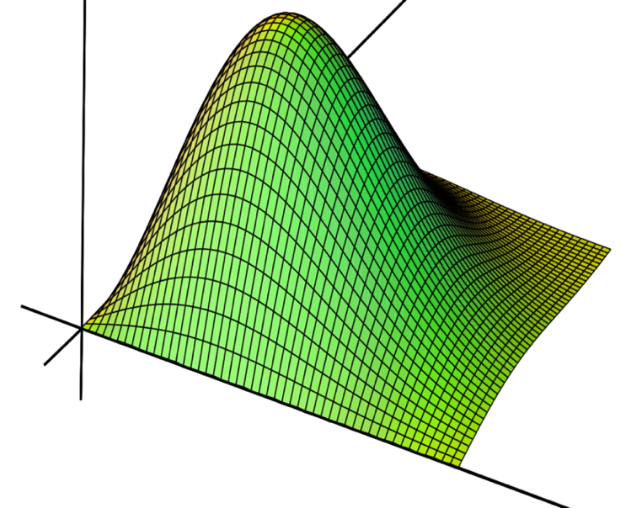
What is Real-time Optimization (RTO)?
Two MVs (no constraints):
RTO is a generic technology and has applicability across many industry sectors
Works in closed loop (no human in the loop)
Typically, the OV is a proxy for profitability e.g., an indicator / calculation of:
  Production (maximize)
  Operating costs (minimize)
  Emissions (minimize)
Delivered benefits: 2-10% in the OV
Payback measured in months, if not days.
Existing market size ~$0.5B - ~$1B / annum.
However, there are an estimated five million PID controllers in operation across all plants worldwide, but only a tiny fraction of these are being written to by RTO. Why?
Optimization
Variable (OV)
Manipulated
Variable 2
Manipulated
Variable 1
Notes:
1. Model Predictive Control (MPC)
Dependency: Strongly dependent on accurate dynamic models of the process.
Functionality: Uses these models to predict future process behavior and determine optimal control actions over a specified horizon.
Application: Widely used in industries where maintaining process variables within desired limits is critical, such as chemical processing, oil refineries, and pharmaceuticals.
2. Dynamic Optimization
Dependency: Requires dynamic models to represent the system's behavior over time.
Functionality: Solves optimization problems that incorporate the dynamic nature of the process, adjusting control actions in real-time.
Application: Energy management, advanced process control, and supply chain optimization.
3. Steady-State Optimization
Dependency: Depends on steady-state models of the process.
Functionality: Uses algebraic models to optimize the process under steady-state conditions, typically focusing on operational planning and setpoint optimization.
Application: Continuous processes in manufacturing, chemical production, and refining operations.
4. Economic Model Predictive Control (EMPC)
Dependency: Integrates economic models with dynamic process models.
Functionality: Extends MPC by incorporating economic objectives directly into the control framework.
Application: Industries where cost efficiency and economic performance are critical, such as energy production and manufacturing.
5. Hybrid Systems Optimization
Dependency: Utilizes both continuous and discrete process models.
Functionality: Optimizes systems that exhibit both continuous dynamics and discrete events.
Application: Automated warehousing, hybrid manufacturing systems, and traffic management.
6. Adaptive Control Systems
Dependency: Uses process models that can be updated or adjusted in real-time based on feedback.
Functionality: Adjusts control parameters to maintain optimal performance despite changes in process conditions.
Application: Aerospace, automotive systems, and robotics where conditions change rapidly.
7. Constraint Handling Techniques
Dependency: Often relies on process models to predict and manage constraints.
Functionality: Ensures process variables stay within specified limits while optimizing performance.
Application: Safety-critical applications like pharmaceuticals, food processing, and chemical manufacturing.
Real-Time Data Analytics and Machine Learning
Functionality: Primarily uses real-time data and statistical methods rather than detailed process models.
Application: Predictive maintenance, quality control, and adaptive systems.
Genetic Algorithms and Evolutionary Computation
Functionality: Uses evolutionary strategies that may or may not incorporate detailed process models.
Application: Design optimization, resource allocation, and other complex optimization problems.

Slide 4
The current state-of-play…..
Linear Model Predictive Control
Dominant commercial solutions all have one thing in common: a deep dependency on having a high-fidelity model of the process.
Making implementing schemes:
Difficult and laborious to build & maintain
Reliant on specialised and scarce experts
Prone to model error
Costly
Adaptive Control
Non-Linear Model Predictive Control
Existing technologies have been very successful, where:
Expertise exists
Companies have the $ resources
Applications justify the time and expense to build and sustain them
Model
(Empirical, Mechanistic, Continuous, Discrete, Dynamic, Steady-state, Linear, Non-linear, Hybrid etc.)
Genetic Algorithms / Evolutionary Computation
Steady State Optimization
Hybrid Systems Optimization
AI (RL/ML)
Current RTO market size ~$0.5B-$1B / annum
BUT, only ~10% of the possible market being served
Notes:
1. Model Predictive Control (MPC)
Dependency: Strongly dependent on accurate dynamic models of the process.
Functionality: Uses these models to predict future process behavior and determine optimal control actions over a specified horizon.
Application: Widely used in industries where maintaining process variables within desired limits is critical, such as chemical processing, oil refineries, and pharmaceuticals.
2. Dynamic Optimization
Dependency: Requires dynamic models to represent the system's behavior over time.
Functionality: Solves optimization problems that incorporate the dynamic nature of the process, adjusting control actions in real-time.
Application: Energy management, advanced process control, and supply chain optimization.
3. Steady-State Optimization
Dependency: Depends on steady-state models of the process.
Functionality: Uses algebraic models to optimize the process under steady-state conditions, typically focusing on operational planning and setpoint optimization.
Application: Continuous processes in manufacturing, chemical production, and refining operations.
4. Economic Model Predictive Control (EMPC)
Dependency: Integrates economic models with dynamic process models.
Functionality: Extends MPC by incorporating economic objectives directly into the control framework.
Application: Industries where cost efficiency and economic performance are critical, such as energy production and manufacturing.
5. Hybrid Systems Optimization
Dependency: Utilizes both continuous and discrete process models.
Functionality: Optimizes systems that exhibit both continuous dynamics and discrete events.
Application: Automated warehousing, hybrid manufacturing systems, and traffic management.
6. Adaptive Control Systems
Dependency: Uses process models that can be updated or adjusted in real-time based on feedback.
Functionality: Adjusts control parameters to maintain optimal performance despite changes in process conditions.
Application: Aerospace, automotive systems, and robotics where conditions change rapidly.
7. Constraint Handling Techniques
Dependency: Often relies on process models to predict and manage constraints.
Functionality: Ensures process variables stay within specified limits while optimizing performance.
Application: Safety-critical applications like pharmaceuticals, food processing, and chemical manufacturing.
Real-Time Data Analytics and Machine Learning
Functionality: Primarily uses real-time data and statistical methods rather than detailed process models.
Application: Predictive maintenance, quality control, and adaptive systems.
Genetic Algorithms and Evolutionary Computation
Functionality: Uses evolutionary strategies that may or may not incorporate detailed process models.
Application: Design optimization, resource allocation, and other complex optimization problems.

Slide 5
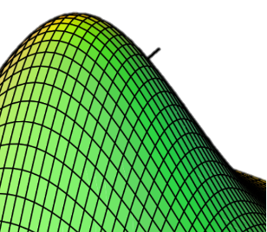

So, what is ORTOTM?
A completely novel model-free approach to process and system RTO
ORTOTM optimization schemes comprise of one or more ‘ORTO Agents’
  Reside in dedicated ORTOTM software
  Or, in OEM DCS / SCADA control libraries (future)
Agents are:
  Simple to configure and deploy
  Self-learning and autonomous.
  Work together, in closed loop, to find and then track the optimum over time
Agents are not:
  AI based
Two MVs (no constraints):
Optimum automatically
tracked over time
Optimization
Variable
Manipulated
Variable 2
(Driven by
ORTO Agent 2)
Manipulated Variable 1
(Driven by ORTO Agent 1)
Presently, the ORTO algorithm is being kept as a trade secret. Patents are being prepared.

Slide 6
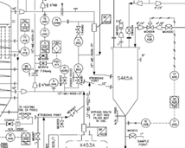
A new disruptive approach to process optimization….
Existing RTO solutions – model dependency makes them:
Difficult / dependant on scarce expertise
Deteriorate
Resource intensive
Bespoke
Require lots of maintenance
‘ORTO Autonomous Agent’ (model-free) approach:
  Simple
  Robust
  Intuitive
  Standardised / Scalable
  Minimal maintenance
Traditional Real-time Optimization Software Solutions
Optimization
Objective
Function
OA1
OA2
OA3
OA4
Regulatory PID:
Simple
Robust
Intuitive
Standardised / Scalable
Minimal maintenance
AC
PC
FC
TC
AC
PC
FC
TC
Process /
System
Process /
System

Slide 7








Traditional Model-based Optimizer versus ORTOTM Timeline
Traditional RTO Timeline
~1 Week
~1 Week
~4-12 Weeks
~2 Weeks
Robust regulatory control foundation
Assess
Prep
Model build and validation
Build
Commission & Monitor
Sustain ………>
< Resource Intensive / disruptive to operations >
< Resource Intensive >
ORTOTM Timeline
~1 Week
~2
days
~1 Week
Assess
Prep
Build
Commission & Monitor
No Model = Minimal Maintenance
< Evergreen & Process Tolerant >
Swift
Implementation
>70% reduction in project timeline
>90% reduction in maintenance

Slide 8
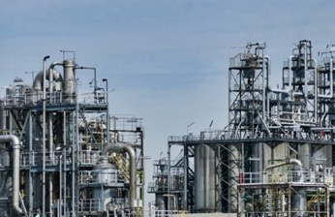
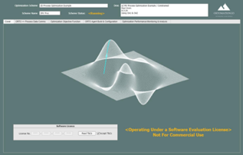
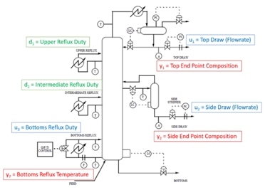

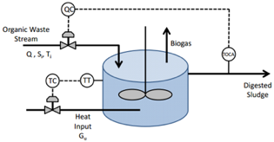
Key Milestones Achieved
Proof of Concept
  Conducted with a major O&G company
  ORTO used to maximize catalyst life on a ULSD refinery unit
  ORTO succeeded where conventional RTO / AdCon techniques had failed
Commercial ORTOTM software developed
Internally tested to optimize systems / processes, for example:
  Numerous academic benchmark problems
  Distillation column optimisation
  Variable speed wind turbine power output maximisation
  Total power maximization from a wind farm
  Wider optimization problems, including
    PID control adaptive tuning
    Non-linear Model parameter estimation
ORTO independently tested and validated by a specialist third party
  Applied to ‘benchmark’ optimization problems:
    Anaerobic Digestion Reactor
    Shell Heavy Oil Fractionator
  All success criteria achieved:
    Minimal training needed
    Schemes quickly implemented
    Constraints adhered to
    True optimum found and then tracked
    Software intuitive, easy to use

Slide 9
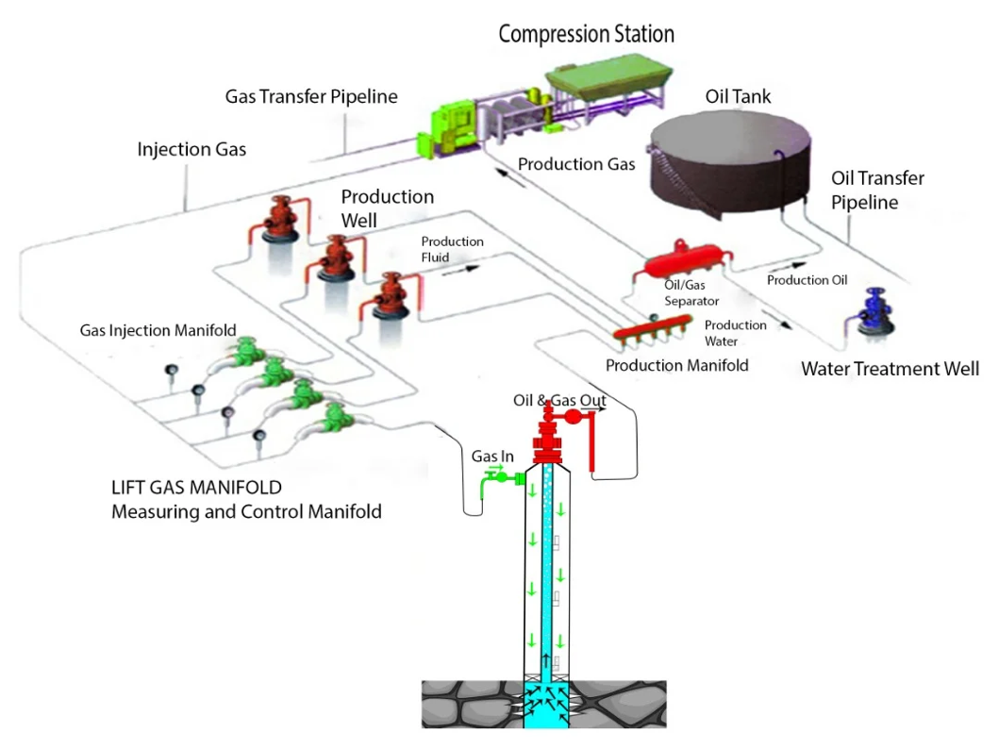
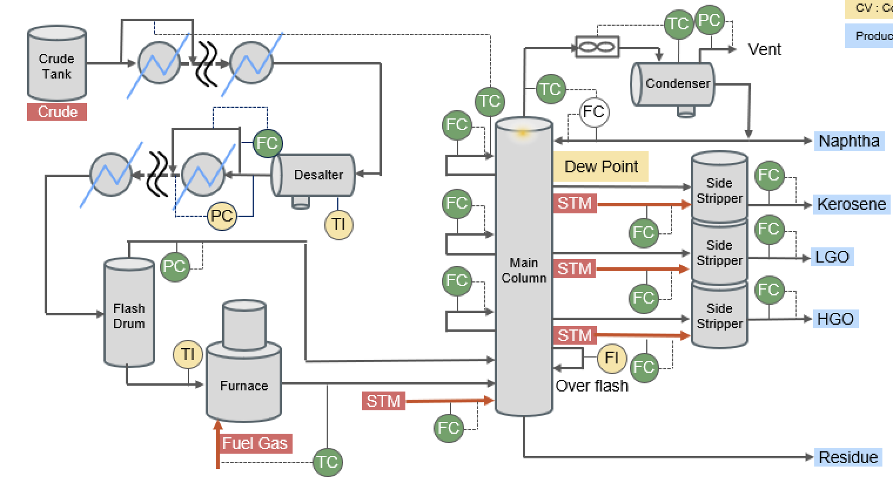
Recent Applications
CDU Optimisation
Gas Lift Optimisation

Slide 10
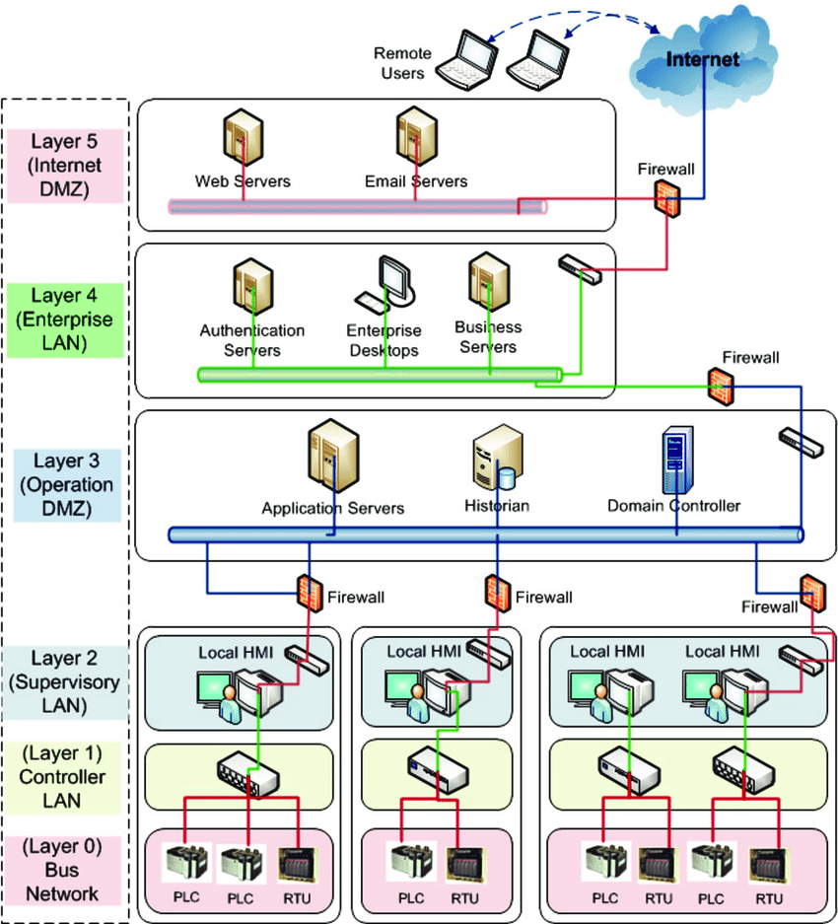


Implementation Pathways….
ORTOTM Software Installation
Enterprise
Historian
Enterprise
Historian
OPC Server
ORTOTM Agent Algorithm
(future)
ORTO
Controller
Controller

Slide 11

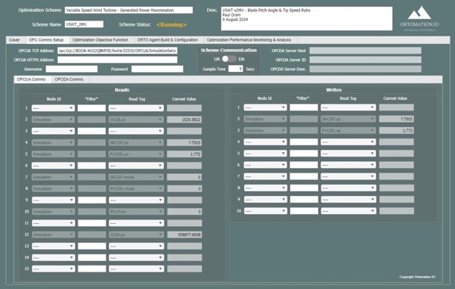
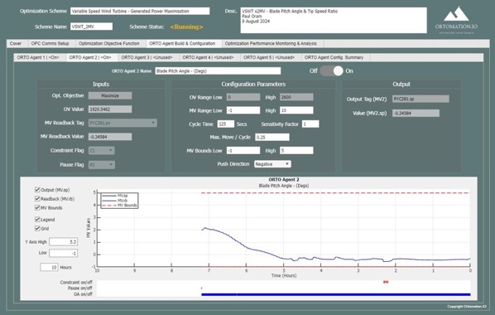
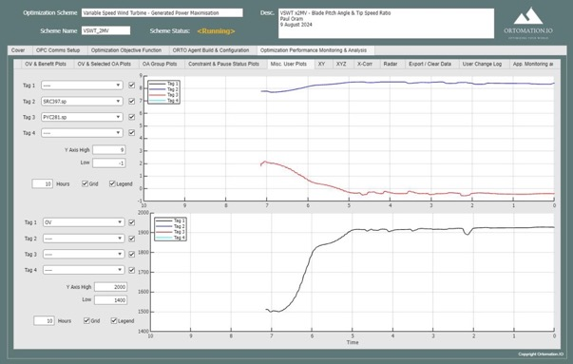
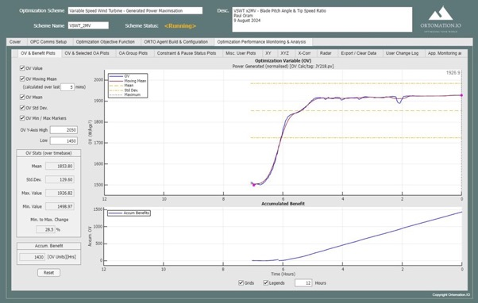
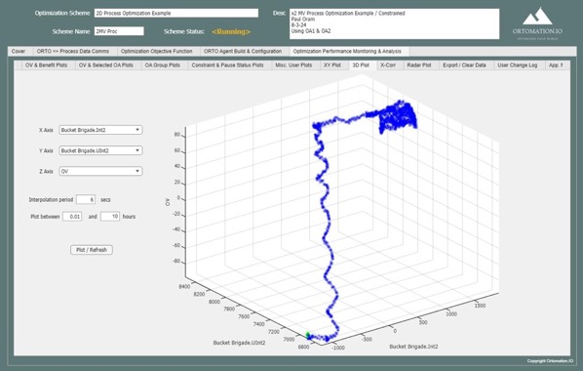
ORTO software…

Slide 12
Summary
ORTO is:
  A completely new approach to real-time optimisation
  Model-free
  Dramatically reduces engineering effort
  Highly scalable
  ‘As simple as PID’

Slide 13
Need more info?
        Visit: www.ortomation.io
        Contact: paul@ortomation.io
        andrew@ortomation.io

