Slide 1

Cloud-based Open-source Digital Twin for BioChemical Pilot Plant
Trung Trinh, PhD
Research Scientist , SINTEF Industry, Norway
Roman Tschentscher, PhD
Senior Research Scientist , SINTEF Industry, Norway
Contact: trung.trinh@sintef.no
Advances in the digitalisation of the process industries conference
Manchester, Oct 2025

Slide 2
Contents
Introduction to SINTEF
Digital Twin Concept for BioChemical Pilot Plant
Cloud Architecture
Machine Learning Models
Big Data Analytics & Visualization
Conclusion

Slide 3
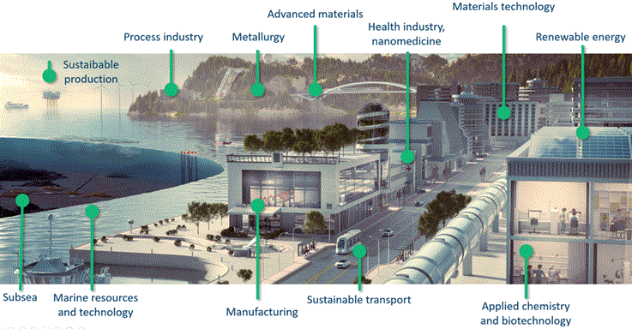
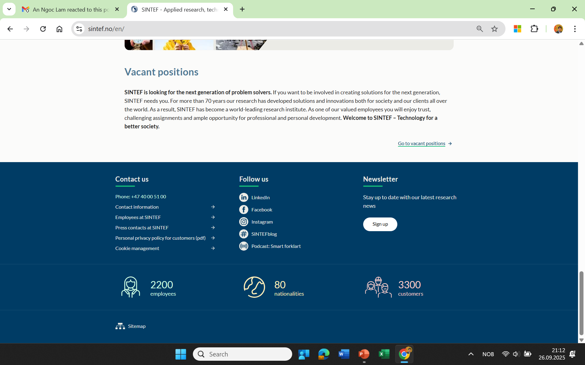
SINTEF
Norwegian Research Organization founded in 1950
INSTITUTTER
SINTEF
Community
SINTEF Industry
SINTEF
Digital
SINTEF
Ocean
SINTEF Energy
SINTEF
AI
in
Domain
Notes:
SINTEF Manufacturing er ett av 6 institutter i forskningskonsernet SINTEF.
Vi er eid av:
SINTEF Holding AS 50,07%
Nammo Raufoss AS 14,43%
SIVA – Selskapet for industrivekst Sf 10,03%
Hydro Aluminium AS 6,07%
Benteler Aluminium Systems Norway AS 6,07%
Kongsberg Automotive AS 5,57%
Raufoss Technology AS 5,53%
Hexagon Composites ASA 2,23%
Eierstrukturen vår gjenspeiler våre røtter og bakgrunn.
Figur: SINTEF

Slide 4

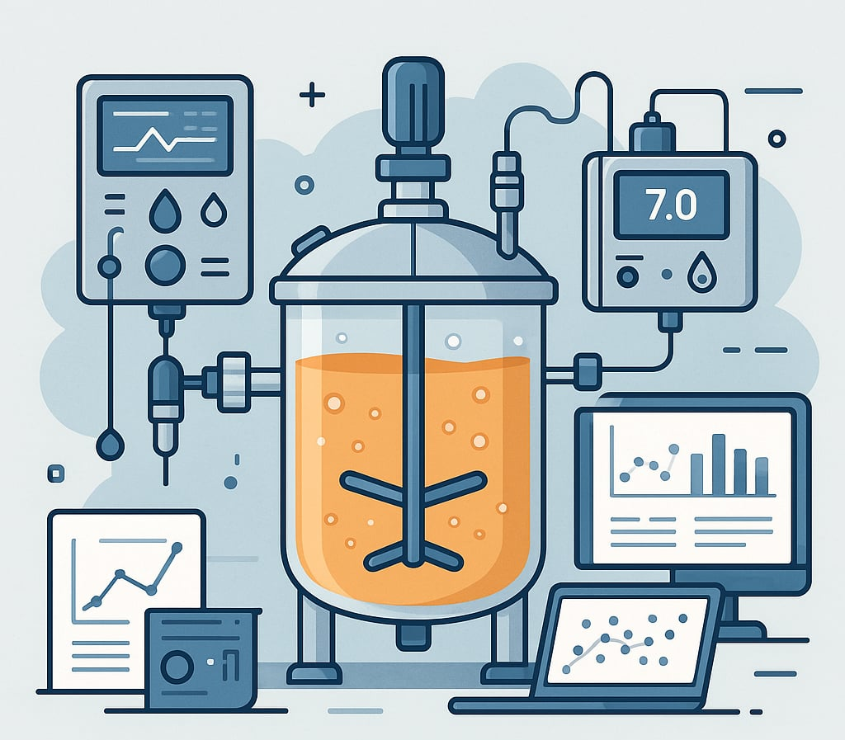
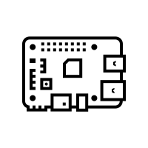
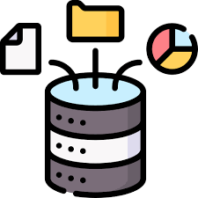


Digital Twin For Process Pilot
The Digital Twin:
AI, big data, autonomous systems, machine learning, and cloud solutions
Data Platform on Azure VM
Function 1
Function 2
Function 3
Function 4
Function 5
Cloud-based Automatic Control System
Monitoring of Targets in Real-Time
Bigdata analytics for RD
Optimalization
Pilot Managemet
The Digital Twin components:
Pilot
Data Platform
ML Models
Sytem Control
Data Storage
Process Unit
ML Models
Pilot /Process

Slide 5

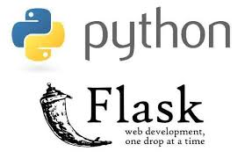



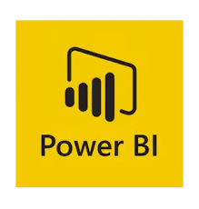



Tools for Digital Twins
Kafka app: realtime stream data from Raman analysis equipment to data platform
Flask app: web app for visullization
MQTT app: real-time communication between Cloud and control system of pilot
Grafana app: Real time monitoring
PostgreSQL: TimescaleDB to collect realtime data from Raman and operation
Power BI app (Microsoft- license app): big data analytics
Python: Data processing linked to ML models
Docker app: an environment for installing, running, and packaging all applications within a data platform.
Machine learning models (PLSr, XGBoost, Baysiean Optimalization)

Slide 6

Cloud Architecture for The Digital Twins
Dashboard Big data Analytic and Offline Monitoring
Azure VM
Database Modelling
(Star schema)
ML Models
ML PLSr
ML XGBoost
Baysiean Optimalization
Realtime Monitoring
Database
Reactor
Web app for visullization
Realtime stream Raman spectra
Realtime stream Operation Conditions
The end-to-end latency from sensors to the cloud dashboard,
including data processing and ML model execution,
is below 2 seconds.
System Control
Database

Slide 7

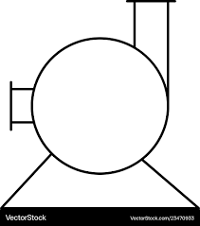
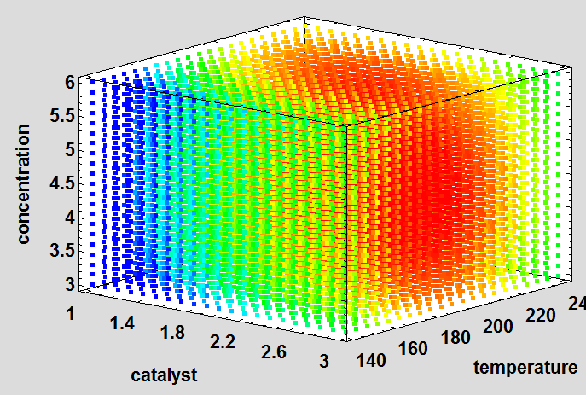
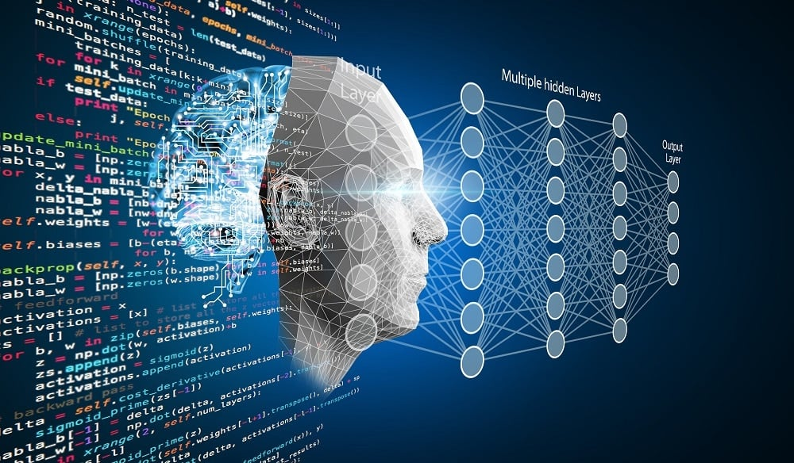
Cloud based Pilot System Control
Manual control
Auto-DOE control
Autonomous control
Sensor system
Raspberry Pi 4
Camera
Dashboard
Flow meter 1
Database
Flow meter 2
Arduino
Pump 1
Pump 2
Reactor System
Design of Experiment (DOE)
Model

Slide 8
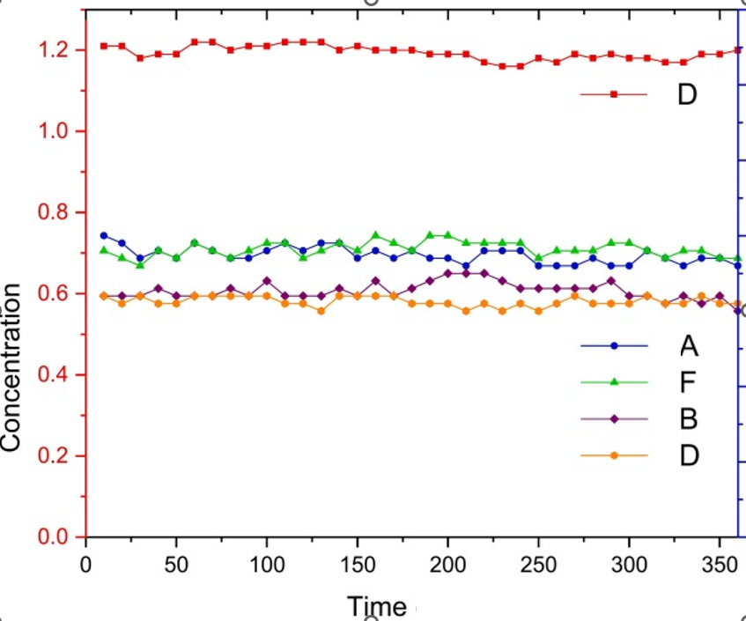
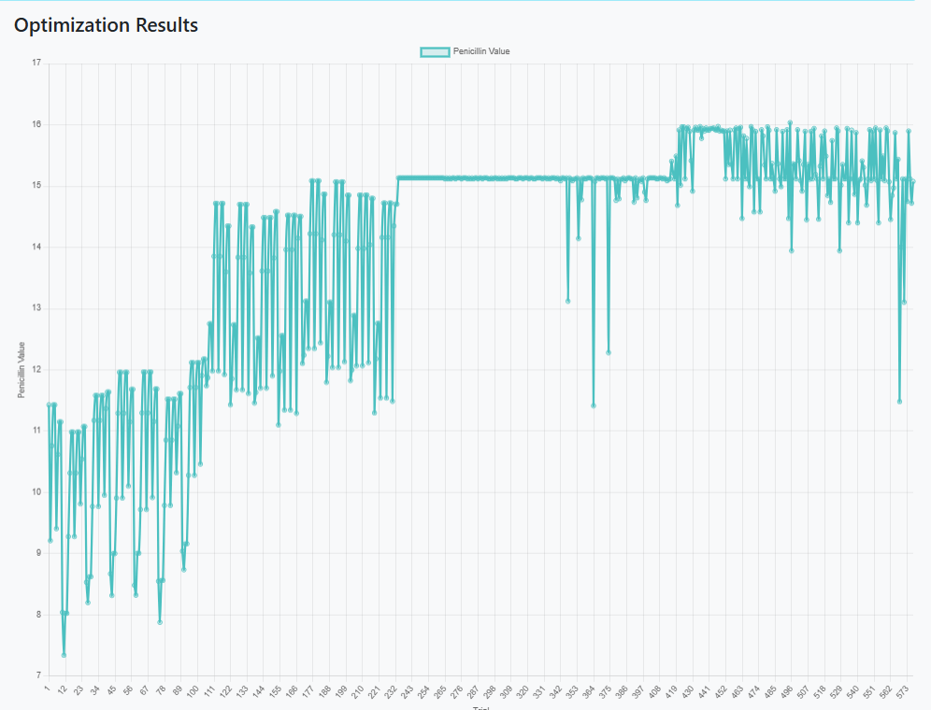
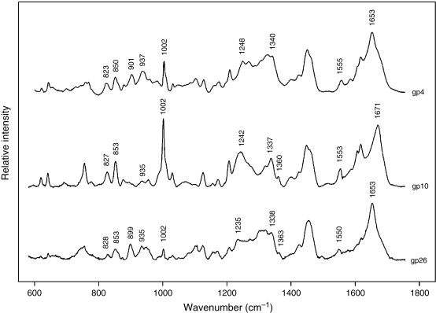
Machine Learning Models for The Digital Twin
Realtime Monitoring on cloud
Web app for Enduser
Investigated conditions
ML Models
A highly valuable data resource containing 100 batches with 113935 dataset for all available process and Raman spectroscopy measurements from the University of Manchester and University College London
is used for model training and Big Data analytics in the digital twin platform.
Data Platform
ML Models
Data Platform
Raman analysis
¹Modern day monitoring and control challenges outlined on an industrial-scale benchmark fermentation process, Computers and Chemical Engineering 130 (2019) 106471
Reactor
Optimal Targets and Conditions

Slide 9
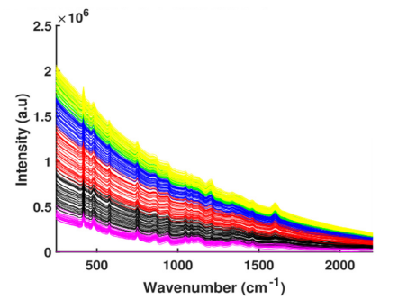
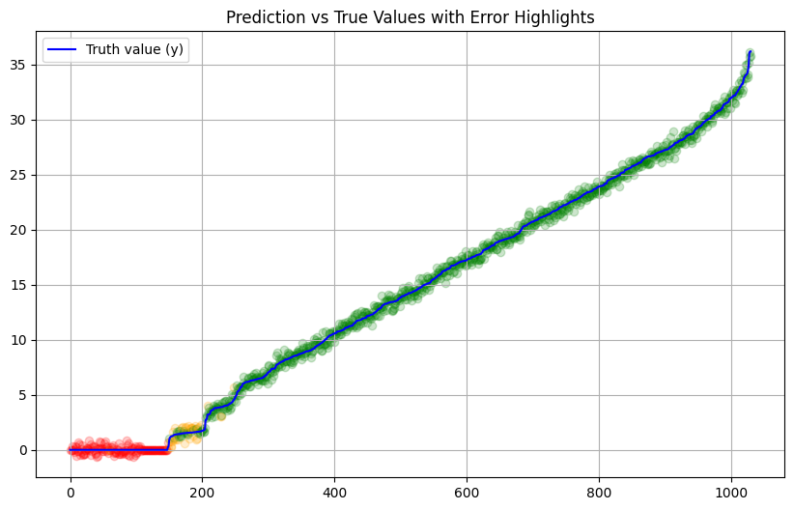
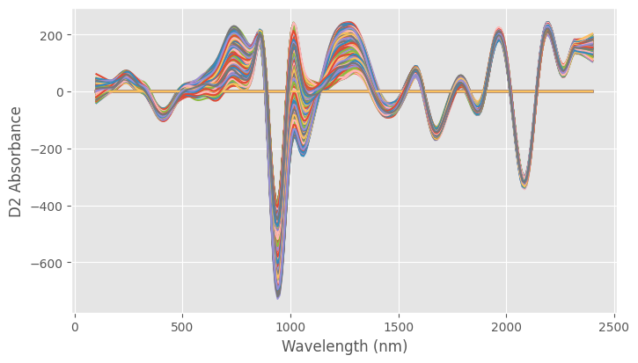
Machine Learning Models for The Digital Twin
Raman spectra (1)
PLSr Model
Used to convert Raman spectra into chemical concentrations
The savgol_filter function in Python is used for smoothing data and eliminating background noise for model development
2062 datasets applied (50% train - 50% test)
Achieved R2: 0.997 - MSE calib: 0.228
Raman spectra treated by savfol-filter
¹Modern day monitoring and control challenges outlined on an industrial-scale benchmark fermentation process, Computers and Chemical Engineering 130 (2019) 106471

Slide 10
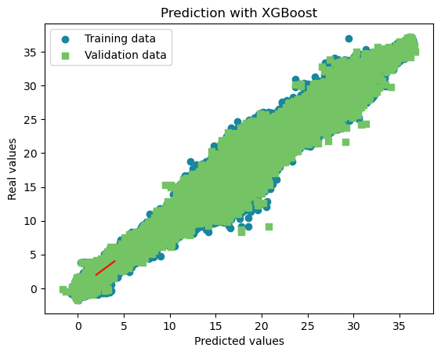
Machine Learning Models for The Digital Twin
XGBoost Model
Predicts target concentrations based on operating conditions
Trained on >100,000 datasets (1)
80% train / 20% test - Cross validation
Mean Squared Error Accuracy: 1.854
¹Modern day monitoring and control challenges outlined on an industrial-scale benchmark fermentation process, Computers and Chemical Engineering 130 (2019) 106471

Slide 11
Machine Learning Models for The Digital Twin
Optimal results
The Bayesian Optimization (BO) framework was initialized with 200 random points and further executed with 500 iterations to optimize the target.
👉 BO performed effectively after the initial 200 random points and showed significant improvement in the optimal values after ~400 iterations.
👉 Supports pilot optimization, reduces experimental costs, and enhances process efficiency
Bayesian Optimalization Model
Predicted Results
New Features
XGBoost Model

Slide 12
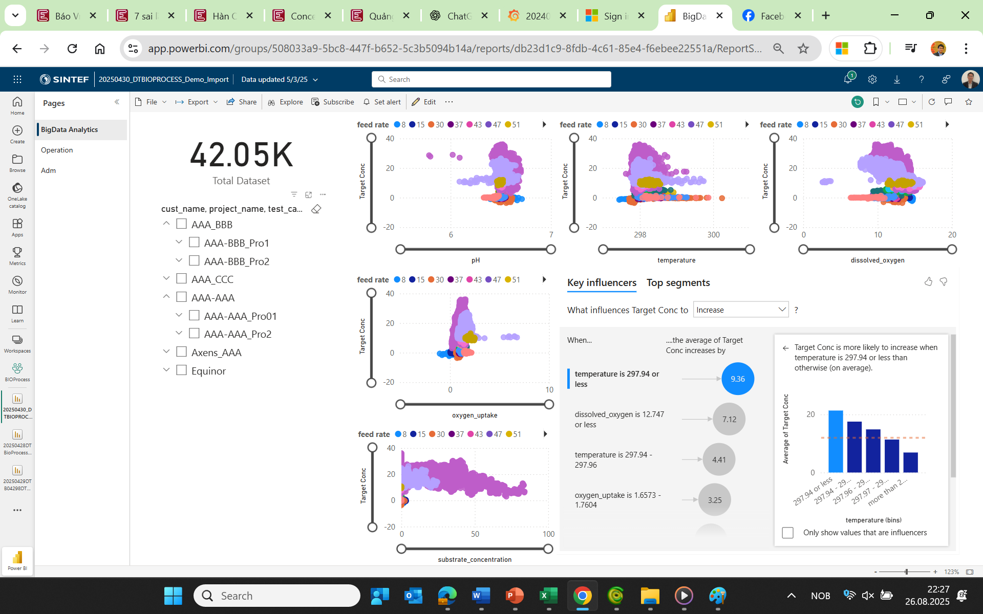
Big Data Analytics for RD
113 935 datasets¹ were processed and structured into a project–campaign–test hierarchy. The Power BI dashboard enables fast multi-level queries and real-time updates, supporting trend analysis and factor identification
The Power BI dashboard enables fast access to Big Data with multi-level relationships and is automatically updated from the database.
👉 It supports the identification of target evolution trends and the factors influencing target performance
¹Modern day monitoring and control challenges outlined on an industrial-scale benchmark fermentation process, Computers and Chemical Engineering 130 (2019) 106471

Slide 13
Conclusion
SINTEF has successfully developed a digital twin platform
based on open-source technologies and deployed on Azure Cloud VM.
The system integrates ML models, data processing pipelines, and a time-series database, operating effectively for both real-time and batch processing.
The integrated Big Data analytics and optimization models provide strong support for
accelerating research
enabling faster and more accurate decision-making.

Slide 14


