Slide 1


Replacing Missing Instrumentation with Data Science
Calculating Virtual Flow Rates for Chemical Injection
Murray Callander
Process Engineer
October 20205

Slide 2
The problem
Operator could not see if chemical injection was within spec
No online measurement of chemical injection rates
Could only be checked weekly in hindsight (manual spreadsheet based process)
1st Stage
Test
Oil rate
M
M
Oil rate
Water rate
M
M
Water rate
Flowline
Flowline
Flowline
Chemical Injection Point
A and C wells
B wells
Subsea manifold
Subsea manifold

Slide 3
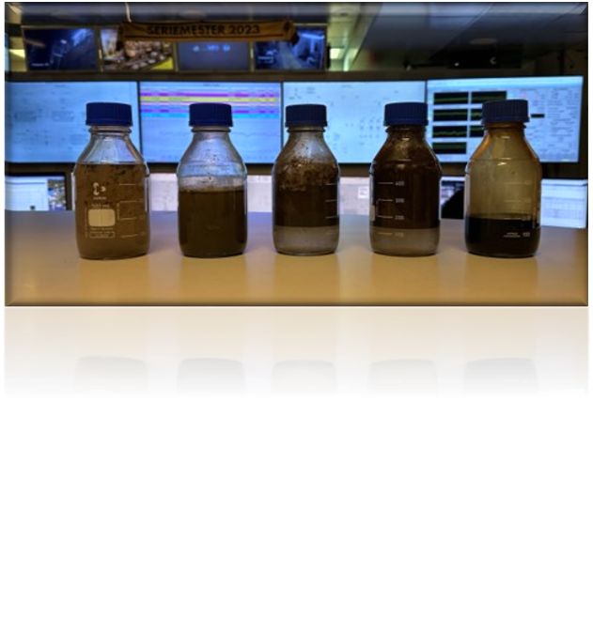
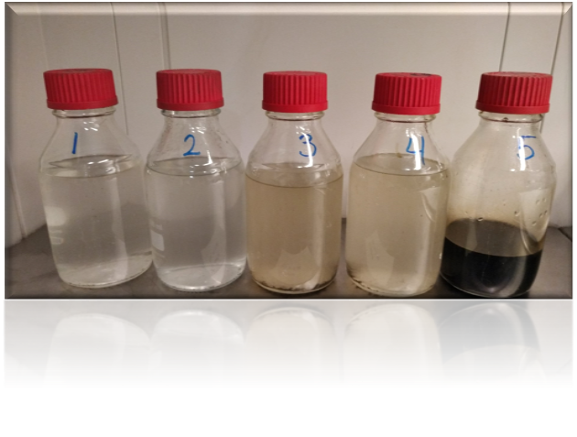
Why Accurate Dosing Matters
Both under and overdosing demulsifier causes Poor separation
Overdosing wastes money and causes operational issues
Under-dosing means you do not get the performance
Depends on the chemical but can be poor separation, corrosion, increased discharge to sea, fouling etc.)
Ideal separation
Notes:
Ideal: Clear oil-water separation (bottom: water, top: oil).
Overdosing: Sludge throughout, poor separation, higher oil discharge to sea.
Cause: Wrong dosage, broken pumps, valve faults—too many potential failure points.
Manual calibration only: Using graduated cylinders—a time-consuming, offline process.

Slide 4
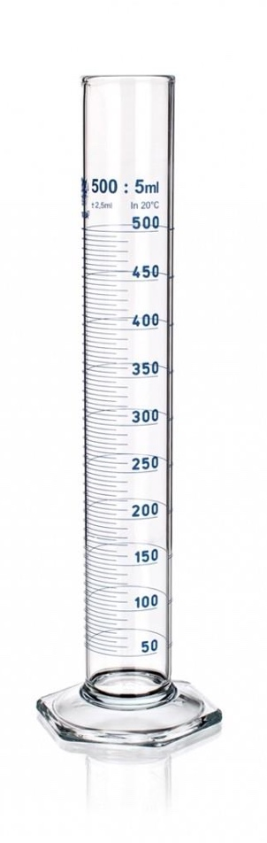
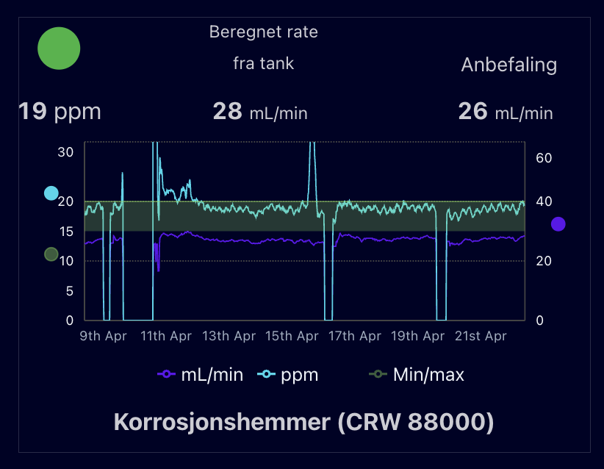
Missing information is chemical flowrate
As-is
To be
Periodic manual calibration cylinder for checking rates
These rates were written down on a board next to the injection system.
Could not react to changes in process flow to maintain the dosage.
Notes:
Periodic volumetric measurement
Onshore chemist cannot see what is being dosed offshore
Can only calculate in hindsight

Slide 5
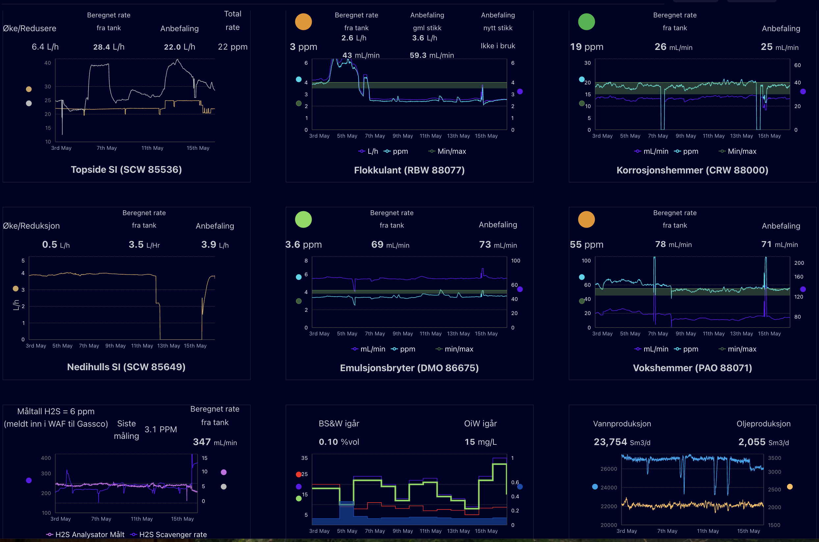
A clear actionable view
Real-time dashboard shows:
Chemical concentrations
Recommended dosage ranges
Suggested rate adjustments
Traffic light system:
Green = OK
Orange = Action required
Engineers can upload Excel sheets to update dosage limits.

Slide 6





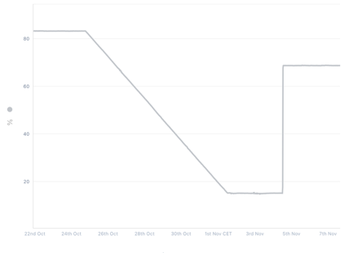


The plan
+
+
Replace manual measurements emailed to shore + weekly spreadsheet with realtime dosage based on change in tank levels plus process flows for 12 tanks/8 chemicals

Slide 7
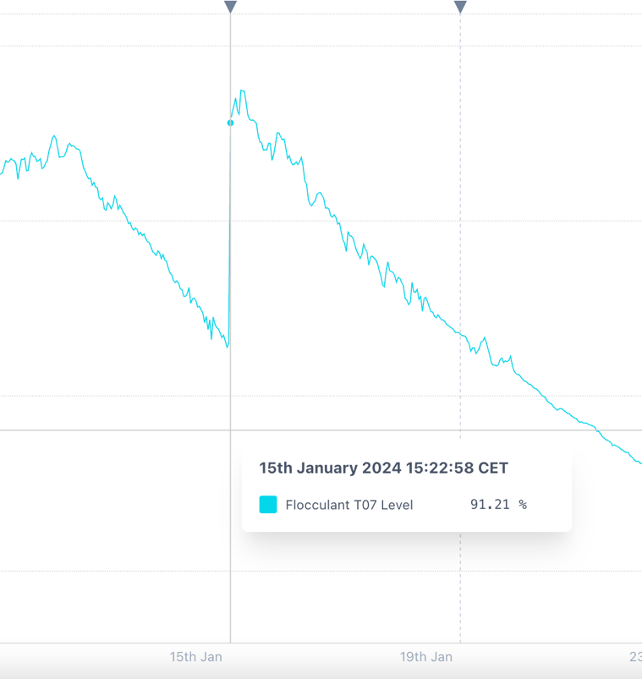
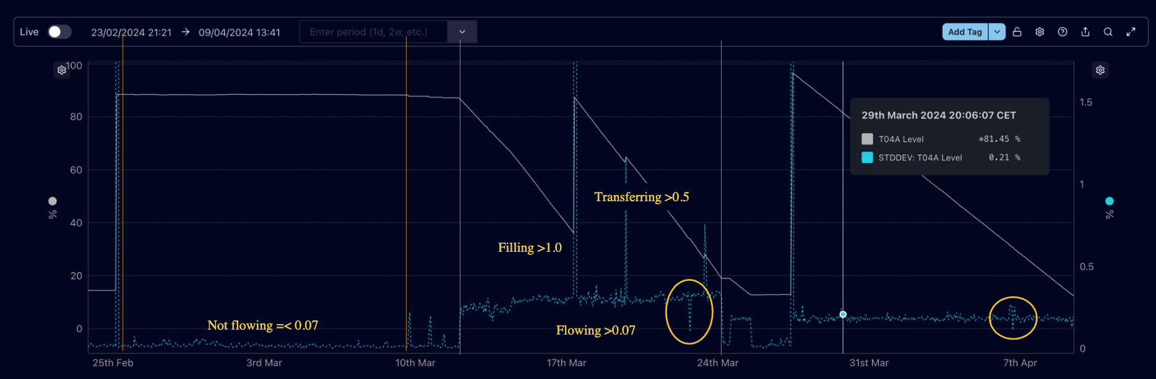
Detecting states of flow
Some tanks had a very unstable level signal
Standard Deviation can be used to identify flowing states

Slide 8
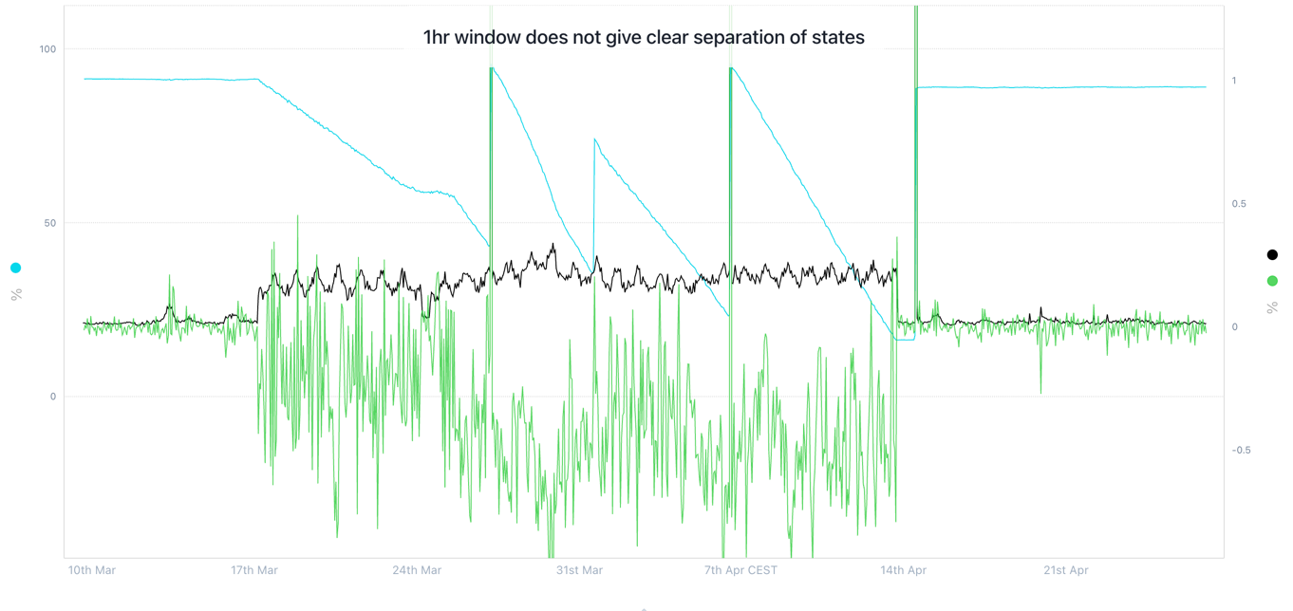
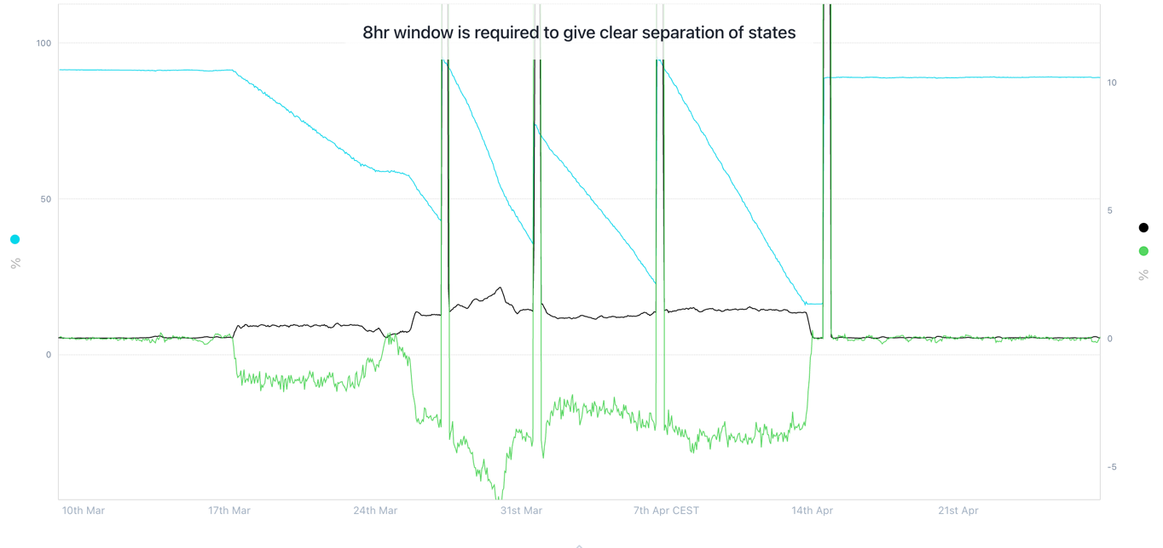
Tuning the data analytics
Define a period for each tank over which instability is “cancelled” – i.e. we can clearly differentiate between states
Use combination of STDDEV & DIFFERENTIAL to identify features

Slide 9

Identifying tank flowing state
Use combination of STDDEV & DIFFERENTIAL to identify features
Need to derive clear separation of states to avoid “chattering”
Flowing when STDDEV above this level
And DIFF below this level

Slide 10
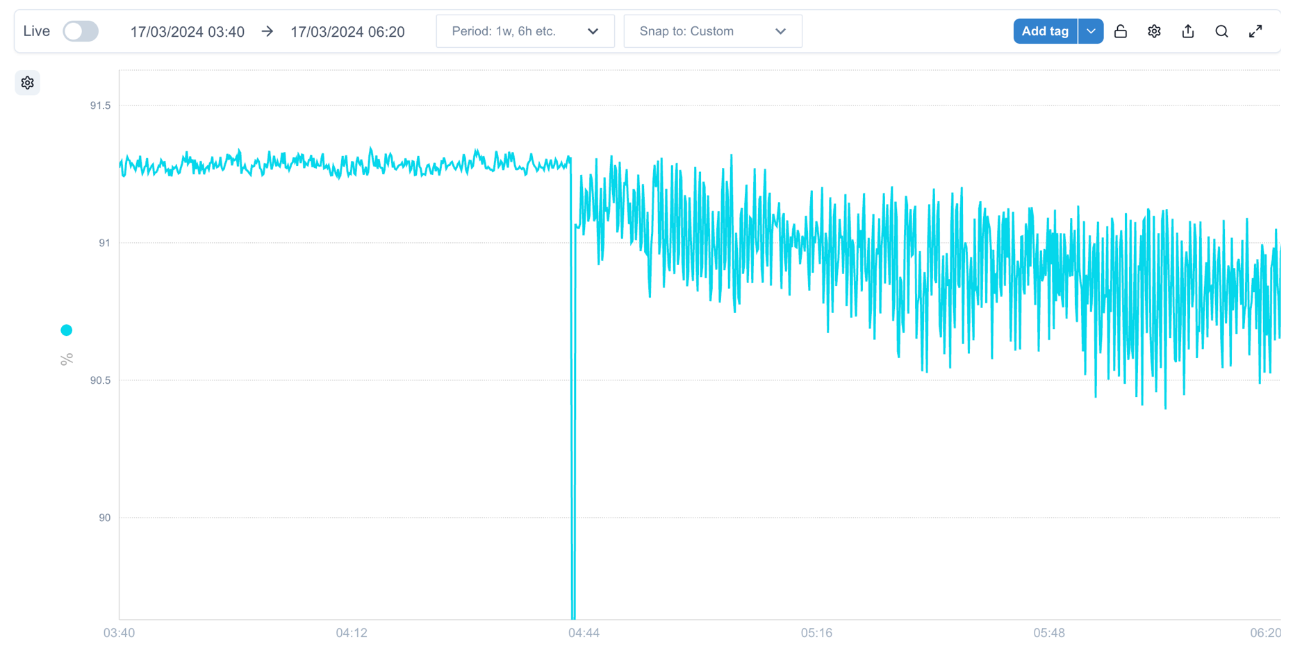
Dealing with real data
The real data was extremely noisy

Slide 11
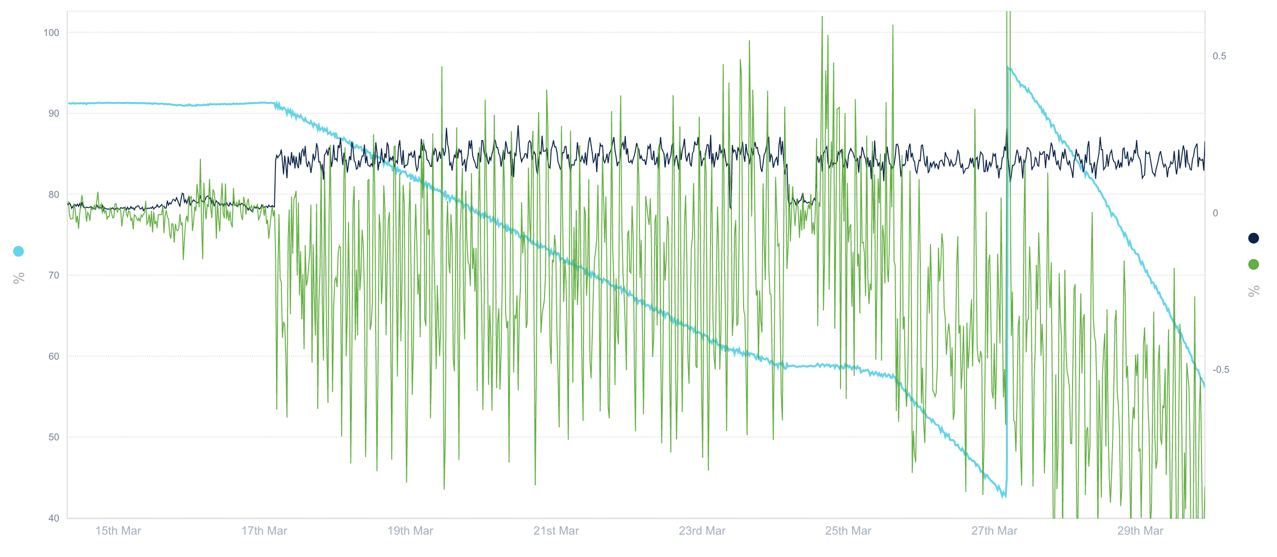
1hr STDDEV and DIFF is too unstable

Slide 12
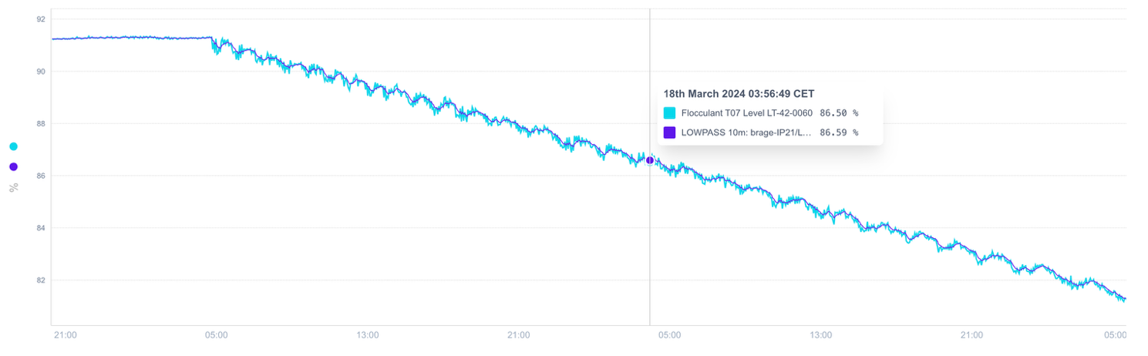
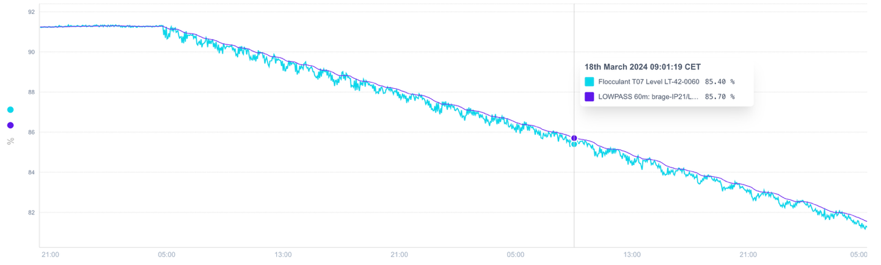
Lowpass filter improves signal
10 min window
60 min window

Slide 13
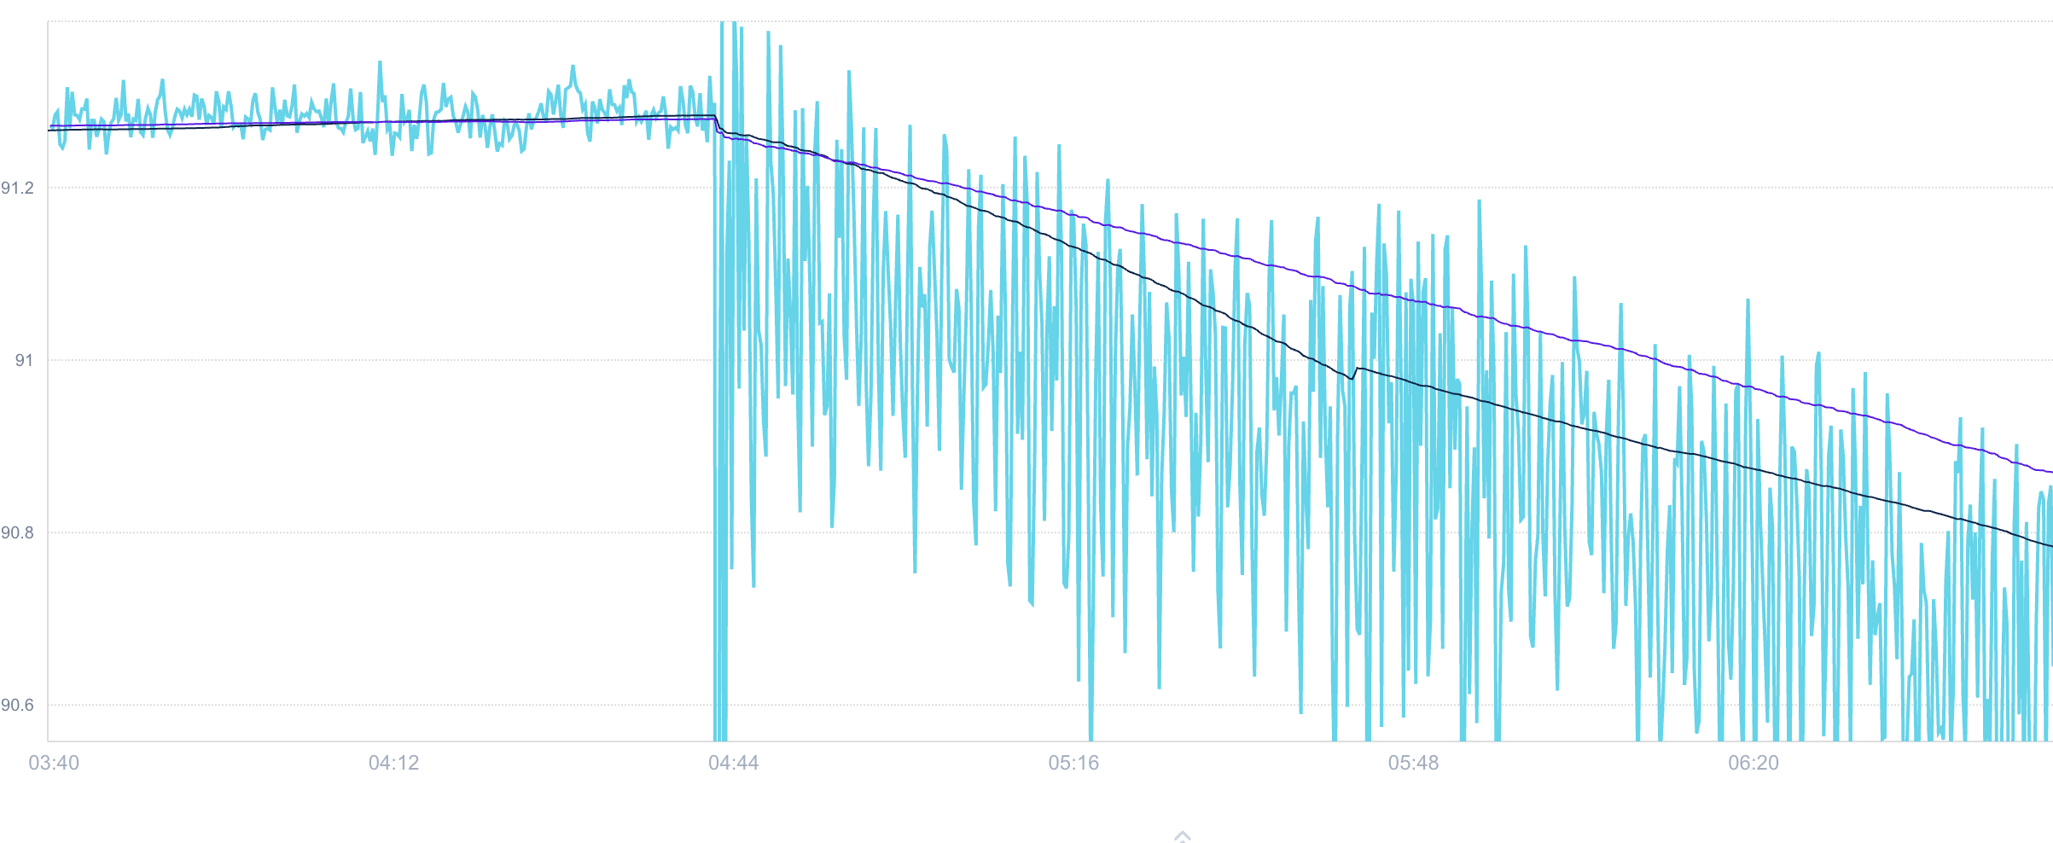
Lowpass vs Average
60 min Lowpass filter gives better smoothing for our case. This ”feature” remains in the average but it is not real* and causes us problems
* This would imply a top-up of approx. 2 litres which is not possible

Slide 14
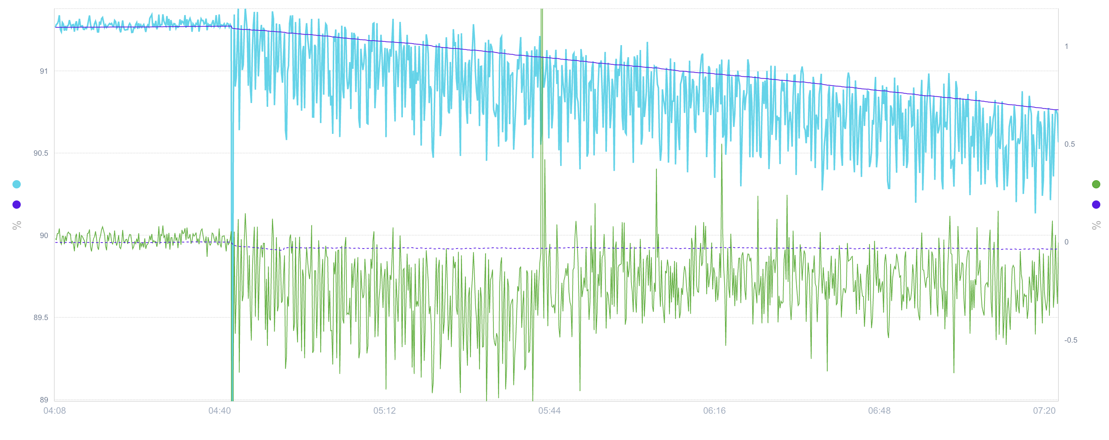
Combining LOWPASS with DIFF gives clear separation

Slide 15
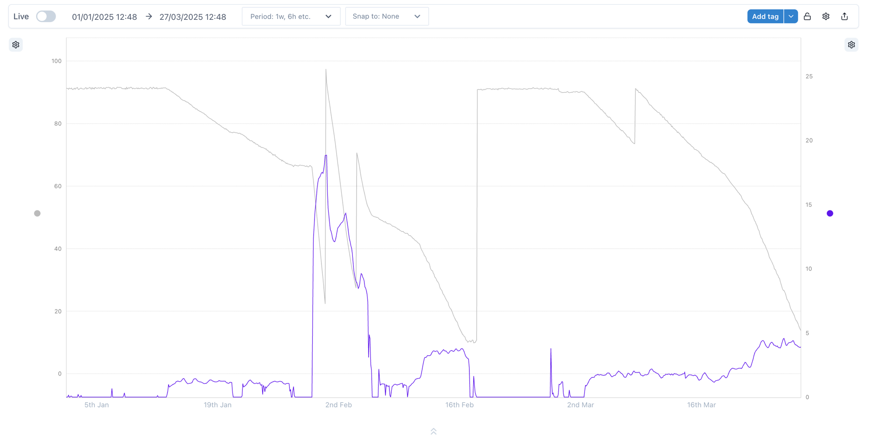
Live version
Runs every 5 minutes
Calculates the flowrates based on sliding window
Window size is chosen to smooth out instability
Good for responding quickly to changes offshore
Susceptible to variability – not so useful for historic analysis

Slide 16
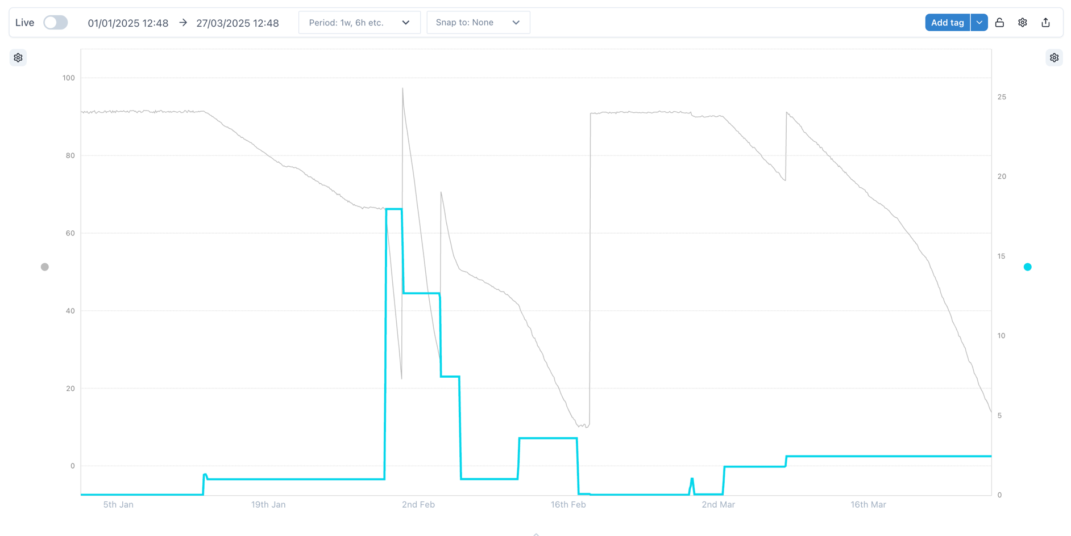
Hindsight version
Event based
Very accurate
Calculates the flowrates for complete episodes
Only calculates the flowrate at the end of an episode
Excellent for retrospective analysis
Cannot be used to detect changes in realtime

Slide 17
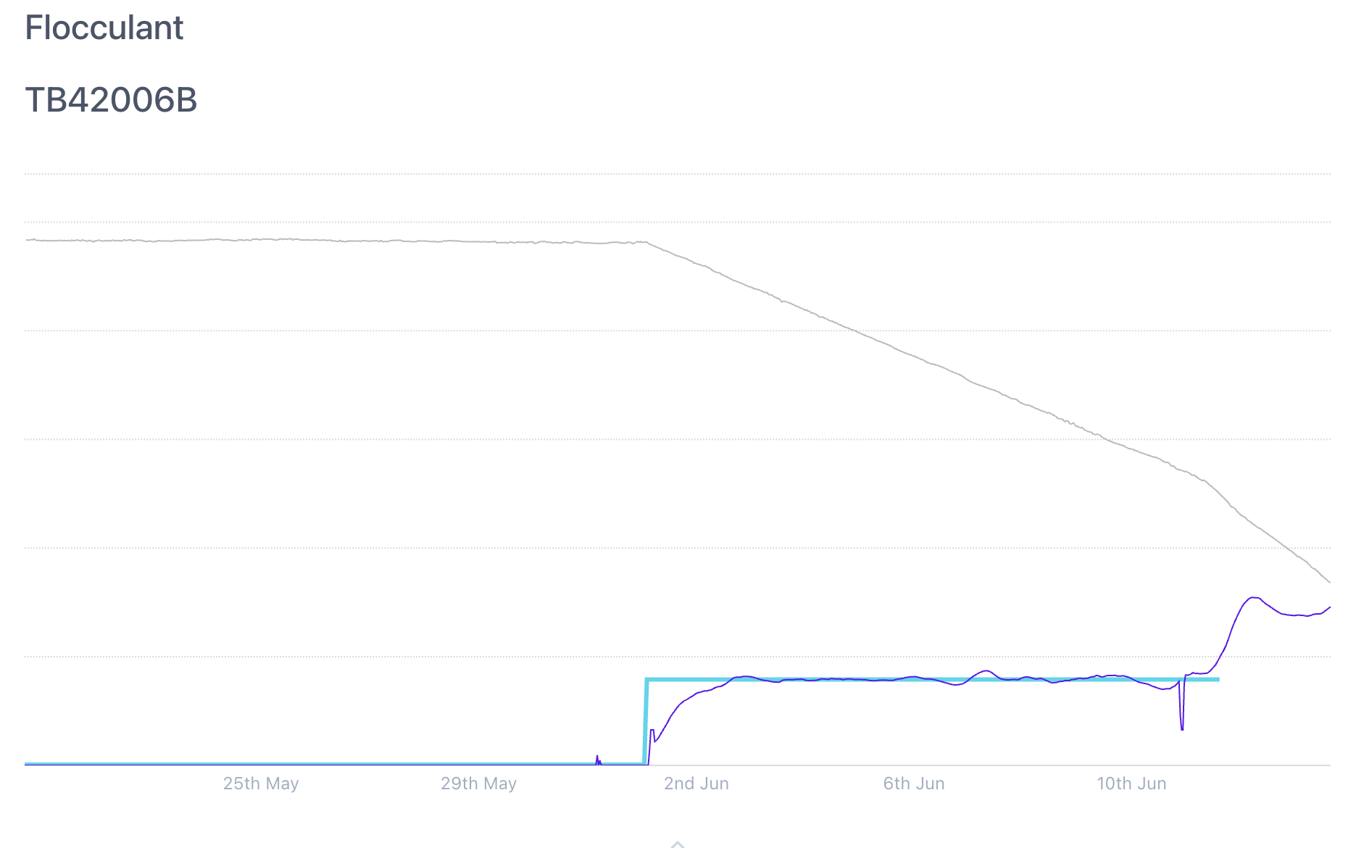
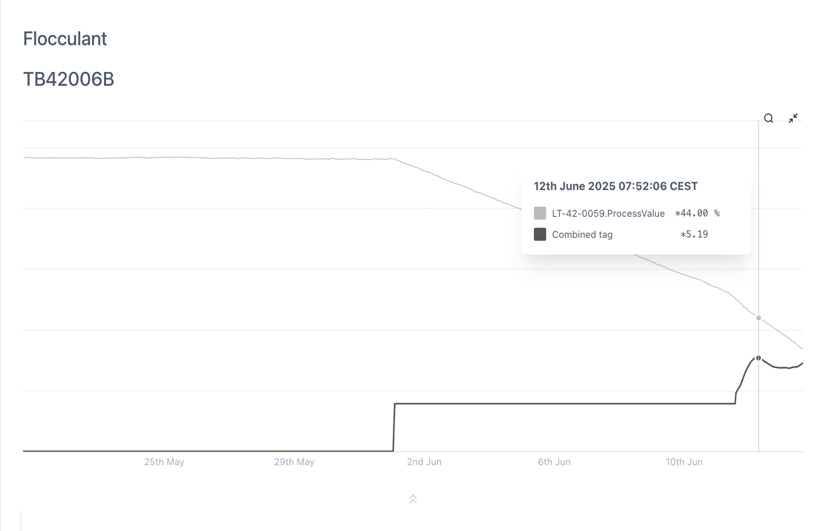
Combining the two

Slide 18
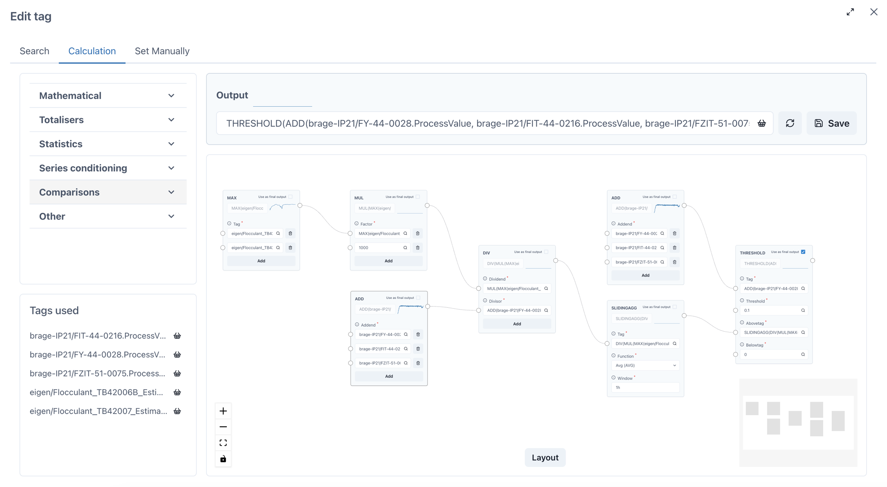

Calculating the dosage in ppm
Simple in principle:
In practice there are several steps
All of it is done in an online calculation to create a soft tag (virtual timeseries)
$$\frac{Chemical rate (l/h)× 1000}{Process fluid rate (m^{3}/h)}$$
Which tank is flowing
Convert to m3
Clamp it to zero because FI’s show small flow when there is none
Calculate dosage
Add 3 process flows (water)
Smooth it with an average

Slide 19
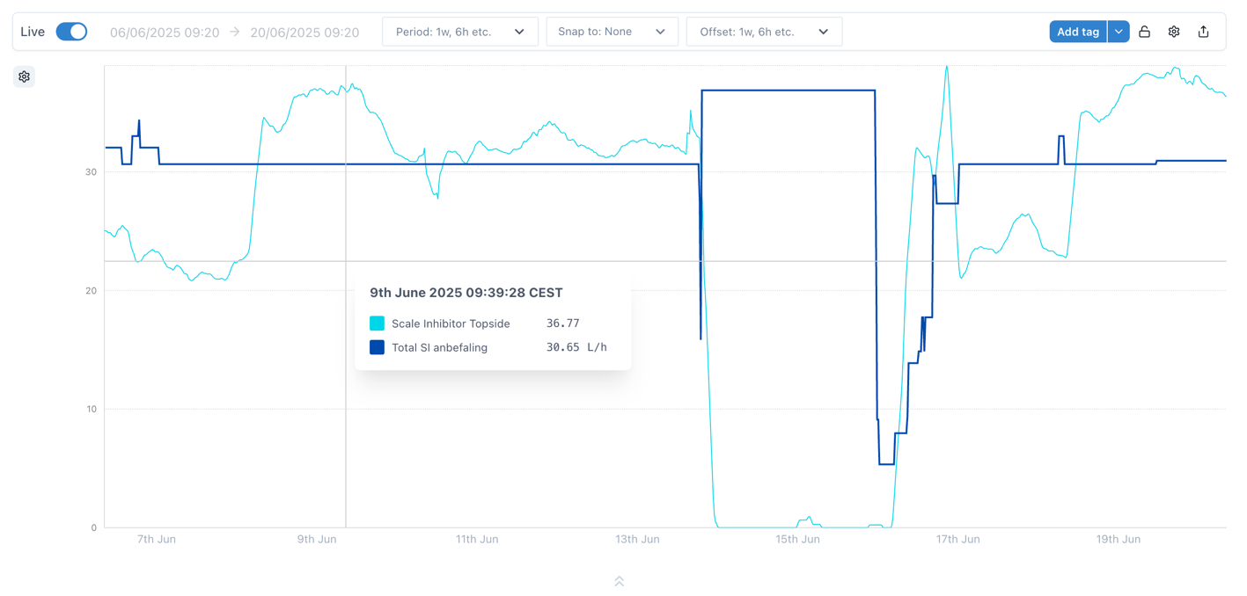
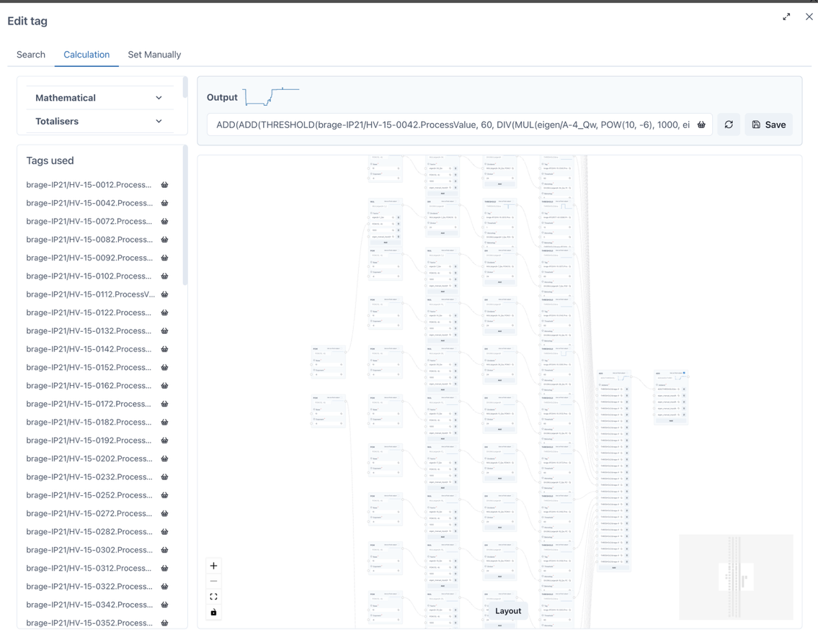

Calculating recommended dosage in l/h
Simple in principle:
Again, it is done in an online calculation to create a soft tag (virtual timeseries)
Downhole Scale Inhibitor was a big calculation!
Sum(the water rate from the last well test if the well is online)
$$\frac{Target ppm × Process fluid rate (m^{3}/h)}{1000}$$

Slide 20
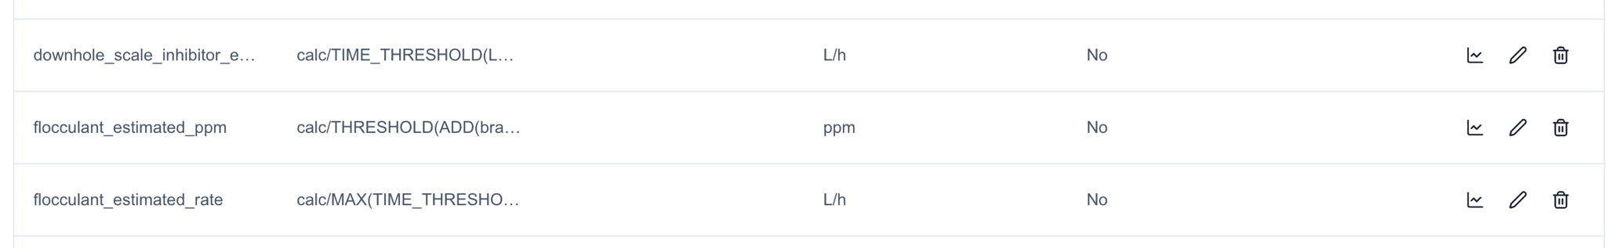
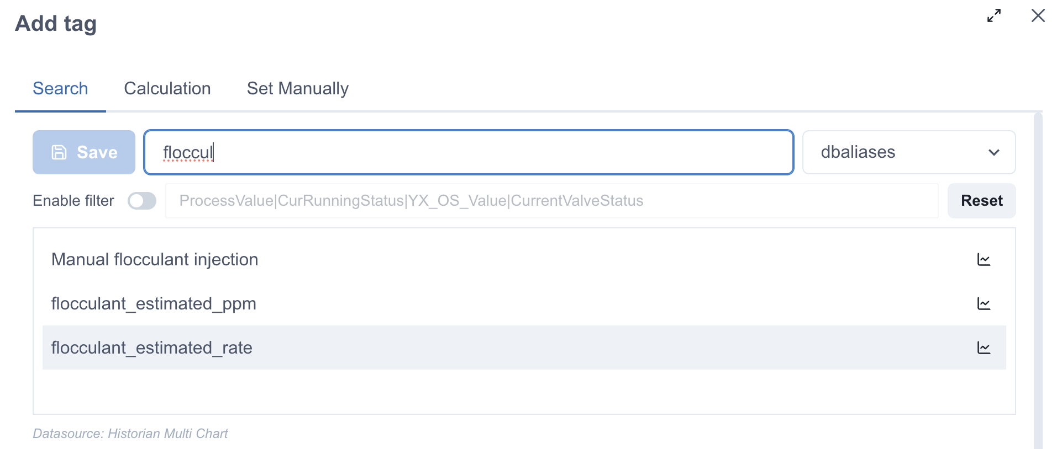
Calcs are saved with an alias for easy access by anyone – same as a “real” sensor

Slide 21




Operational Benefits
Save time:
Shortens the time of response when the dosing is getting out of the desired range from 1 week to 2-4 hours.
Instant actions:
No longer dependent on a single person or onshore-only access. Offshore operators can act immediately: Take a photo or print the recommendation.
One source of truth:
The data can be found in one place and seen in a single view instead of several tabs in a spreadsheet.
Troubleshooting aid:
Early detection of equipment issues (pumps, valves). Identify when flowmeters require calibration.

Slide 22
Thank you!
For any further queries, email us at info@eigen.co

