Slide 1

Digital Twins and Process Control with Software Defined Automation Accelerating autonomous production
Raghav Tripathi
Product Manager, Process Control Systems
Siemens, UK & Ireland

Slide 2
What
are the challenges our customers face?

Slide 3





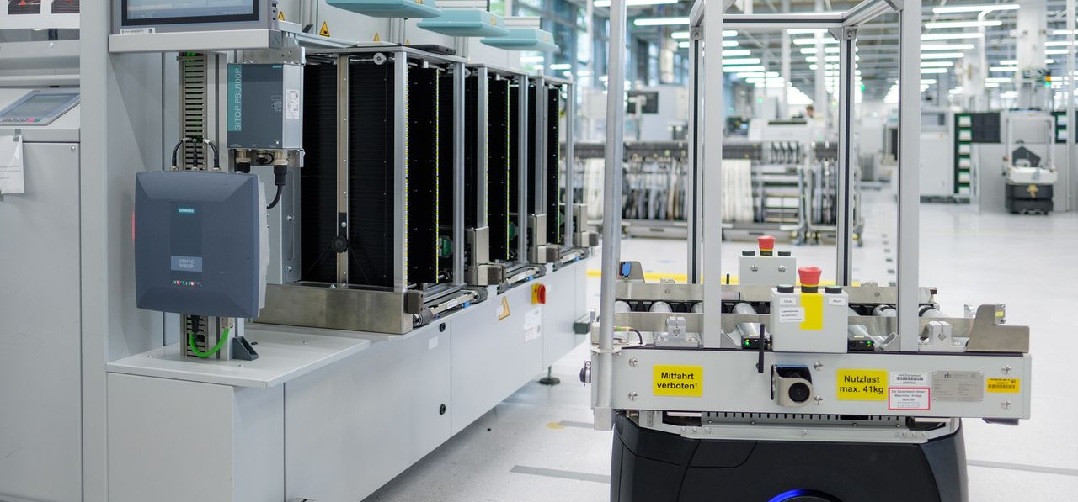
Our customers’ challenges are increasing …
Handling of labor shortages
Need for energy & resource efficiency
Cybersecurity threats and regulatory requirements
Need for alter- native feedstocks
Inflexible operations
Challenging integration of advanced technologies

Slide 4
What
is the answer?

Slide 5

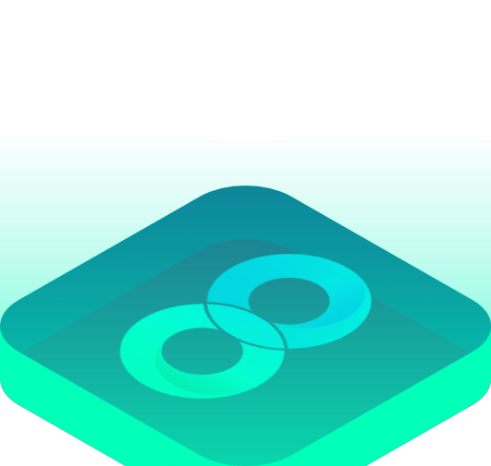
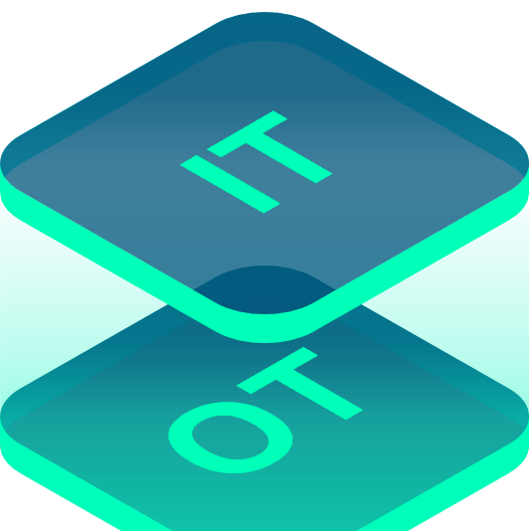


Turning key technologies into building blocks on the path to autonomous production
Digital Enterprise
Combining the real and the digital worlds – from product to production
IT/OT convergence
…with data-driven decision making and full data transparency
Autonomous production
Building Blocks
Software-Defined Automation
Data & Artificial Intelligence
Digital business platform
… faster with
Siemens Xcelerator
Cybersecurity
…protecting data with a multi-layered “Defense in Depth” concept
Industrial Metaverse & Digital Twins

Slide 6
Driving the shift from HW-Based to SW-Defined Automation
Hardware-Based Automation …
… and Software-Defined Automation
OT-like graphical engineering/
programming of devices
IT-like workflows, high-level programming languages for engineering/programming of apps
Hardware/software coupled devices as “one box”
Hardware/software decoupling leads to independence & various (OT/IT) deployments
Limited interoperability & dominance of domain-specific comm. protocols
Designed for easier integration with digital technologies (e.g., Digital Twins, AI co-pilots, …)
One time configuration with simple installation & replacement
Continuous software updates, application lifecycle management

Slide 7


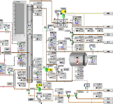



Integrated Design and Configuration
Digital Lifecycle Excellence
Operational Excellence
DESIGN
FID
Final Investment Decision
Research & Development
Requirements
FEED
Front End Engineering Design
Detailed Eng
Procure
Construct
Realize
Optimize
Commission
Start-up
Operate & Maintain

Slide 8

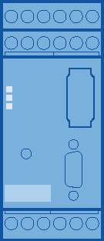

Software-defined Automation is the way the industry will evolve from classic automation pyramid to a user-defined workflow architecture
Yesterday
Today
Tomorrow
exemplary
Management level
ERP
IT
…
Cloud
MES
Field and control level
OT
Asset Mgmt.
…
Control
Edge
Field (sensor/actor)
Field (sensor/actor)
Intelligent Field
IT – OT convergence

Slide 9
Software-Defined Automation comprises four key elements
IT-like
Engineering
Cloud & Virtualization
Intelligent Operations
Dynamic Lifecycle Management
Explanation
SW development principles, applied to industrial automation
Decoupling fixed hardware from automation software
Smart solutions that build upon Software-Defined Automation
Management & Deployment infrastructure
PCS neo engineering in the cloud
DCS Co-Pilot
Siemens Portfolio
SIMATIC PCS neo
Virtual Process Controller
eaSie
SIMATIC PCS myExpert
Cybersecurity offering as strong protection layer for the software-based production

Slide 10
Software-Defined Automation comprises four key elements
IT-like
Engineering
Cloud & Virtualization
Intelligent Operations
Dynamic Lifecycle Management
Explanation
SW development principles, applied to industrial automation
Decoupling fixed hardware from automation software
Smart solutions that build upon Software-Defined Automation
Management & Deployment infrastructure
PCS neo engineering in the cloud
DCS Co-Pilot
Siemens Portfolio
SIMATIC PCS neo
Virtual Process Controller
eaSie
SIMATIC PCS myExpert
Cybersecurity offering as strong protection layer for the software-based production

Slide 11
Software-Defined Automation comprises four key elements
IT-like
Engineering
Cloud & Virtualization
Intelligent Operations
Dynamic Lifecycle Management
Explanation
SW development principles, applied to industrial automation
Decoupling fixed hardware from automation software
Smart solutions that build upon Software-Defined Automation
Management & Deployment infrastructure
PCS neo engineering in the cloud
DCS Co-Pilot
Siemens Portfolio
SIMATIC PCS neo
Virtual Process Controller
eaSie
SIMATIC PCS myExpert
Cybersecurity offering as strong protection layer for the software-based production

Slide 12
Software-Defined Automation comprises four key elements
IT-like
Engineering
Cloud & Virtualization
Intelligent Operations
Dynamic Lifecycle Management
Explanation
SW development principles, applied to industrial automation
Decoupling fixed hardware from automation software
Smart solutions that build upon Software-Defined Automation
Management & Deployment infrastructure
PCS neo engineering in the cloud
DCS Co-Pilot
Siemens Portfolio
SIMATIC PCS neo
Virtual Process Controller
eaSie
SIMATIC PCS myExpert
Cybersecurity offering as strong protection layer for the software-based production

Slide 13
Software-Defined Automation comprises four key elements
IT-like
Engineering
Cloud & Virtualization
Intelligent Operations
Dynamic Lifecycle Management
Explanation
SW development principles, applied to industrial automation
Decoupling fixed hardware from automation software
Smart solutions that build upon Software-Defined Automation
Management & Deployment infrastructure
PCS neo engineering in the cloud
DCS Co-Pilot
Siemens Portfolio
SIMATIC PCS neo
Virtual Process Controller
eaSie
SIMATIC PCS myExpert
Cybersecurity offering as strong protection layer for the software-based production

Slide 14

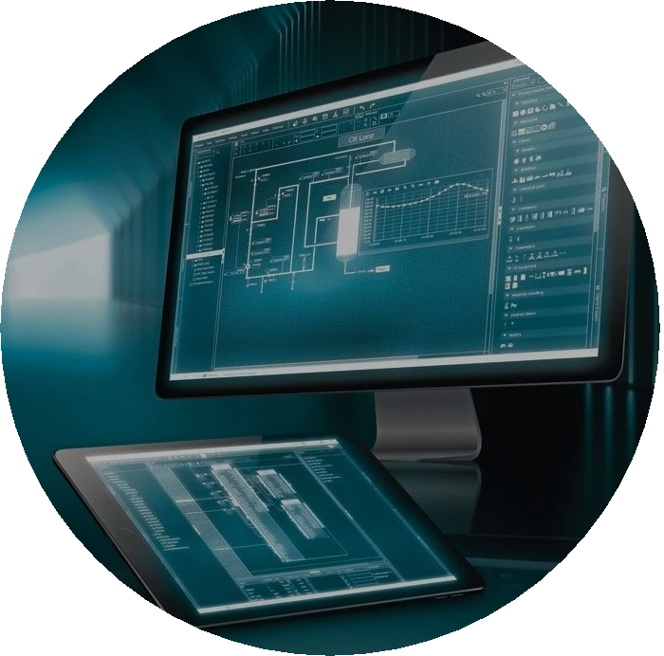
SIMATIC PCS neo – New Version 6.0 now available!
Process Safety according to
IEC 61508 & IEC 61511
Telecontrol
Enhanced alarming, e.g. alarm suppression
V6
Object type editor including UI simulation
Enhanced field device diagnostics & system transparency
PROFIBUS Configuration in Run

Slide 15
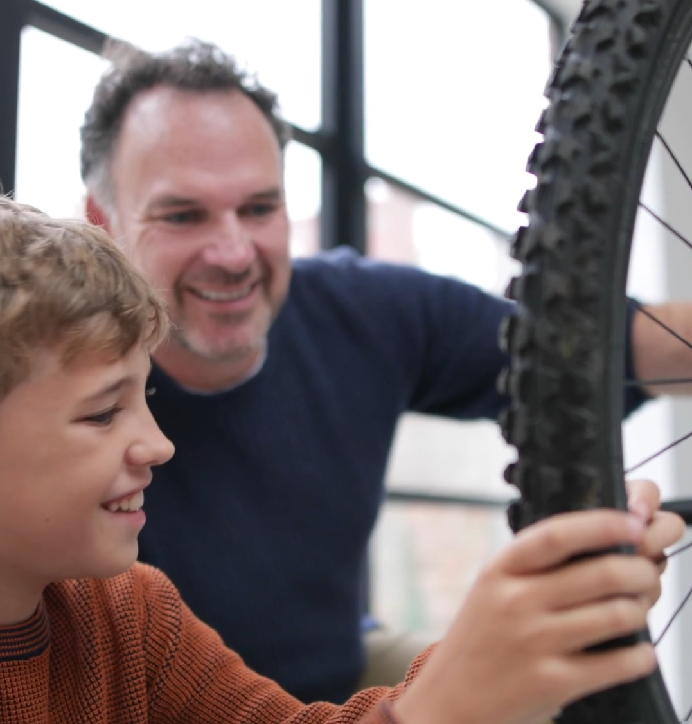
Pyrum Innovations AG
Intelligent automation to support a revolutionary recycling process and reduce waste
SIMATIC PCS neo enables modular automation with easy integration of new plant modules and web-based operation — ideal for remote access and flexible control
Intuitive interface and web platform reduce training time and staffing needs for operation and support
Scalability supports sustainable pyrolysis processes converting used tires into high-value secondary raw materials
2 days
of training to fully trained and independent
operators
1 operator
needed per pyrolysis reactor = staff efficiency, 1 position saved
100%​
inhouse engineering without external support
When we learned that SIMATIC PCS neo is web-based and that the system supports modularization of our plant, it was clear: this is the one, and nothing else.

Slide 16
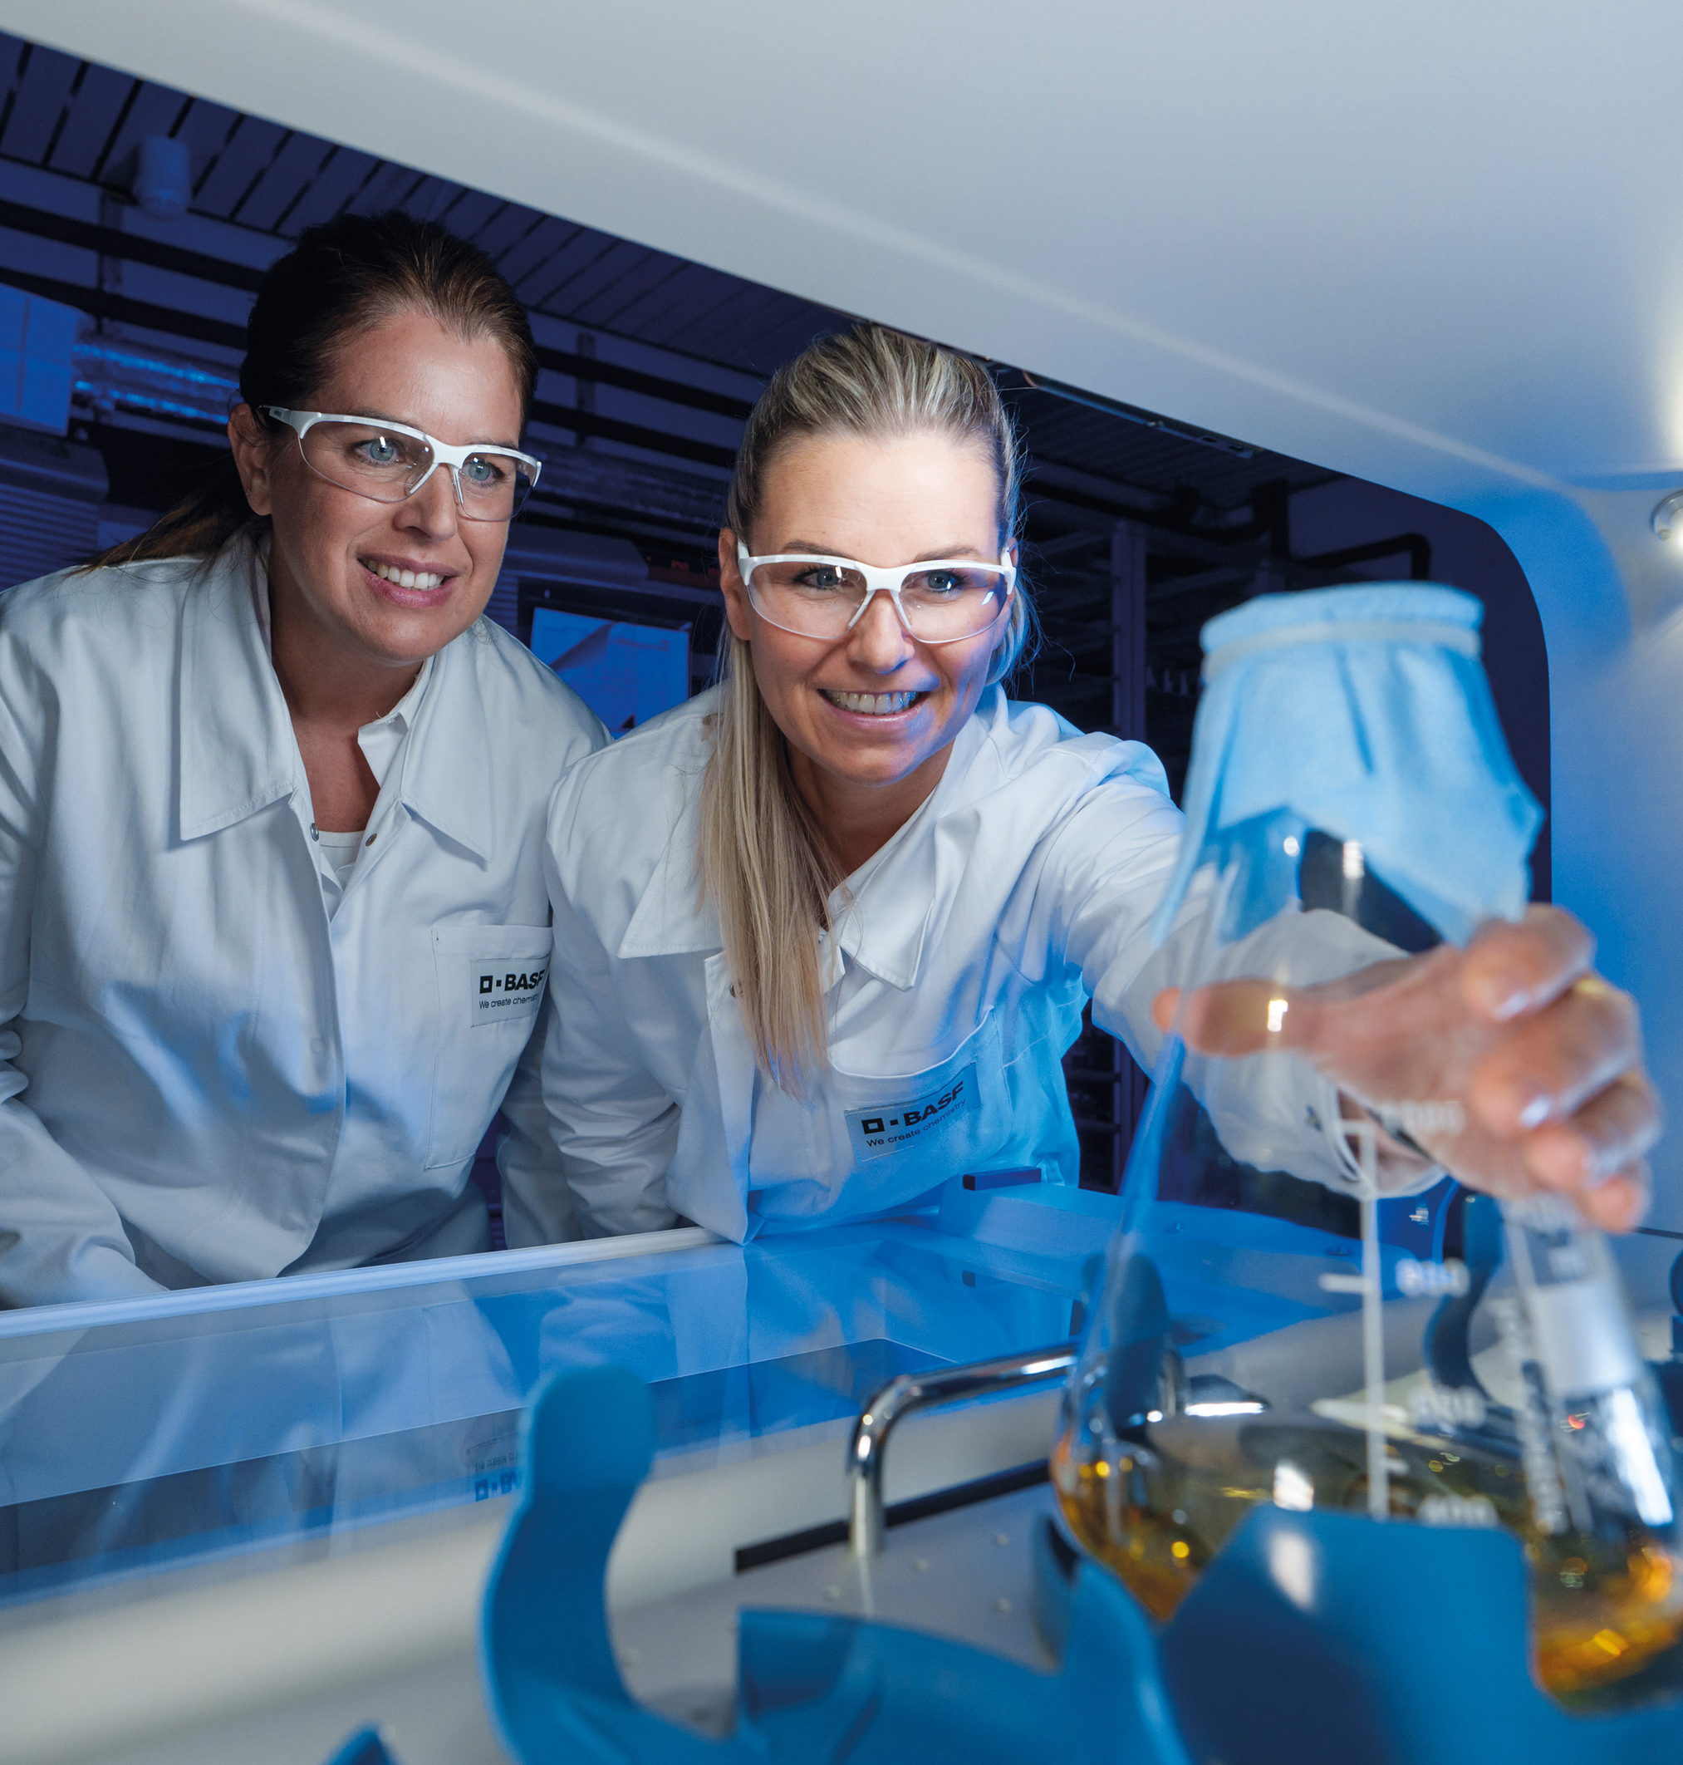
BASF
Driving Innovation in White Biotechnology
SIMATIC PCS neo deployed in biotech lab to control innovative Vitamin B2 process – validated in real pilot conditions
Modular automation via MTP and Software-Defined Automation enables fast module integration, flexible adaptation and faster time-to-market
Future-ready with web-based multi-user engineering, seamless IIoT/Edge integration, and investment protection through SIMATIC PCS 7 hardware compatibility
The successful pilot is the first step toward the global rollout of SIMATIC PCS neo at BASF. Testing under real conditions is essential for this. Now we know we can rely on a technology that will support us on the path to autonomous production.
Source: BASF

Slide 17
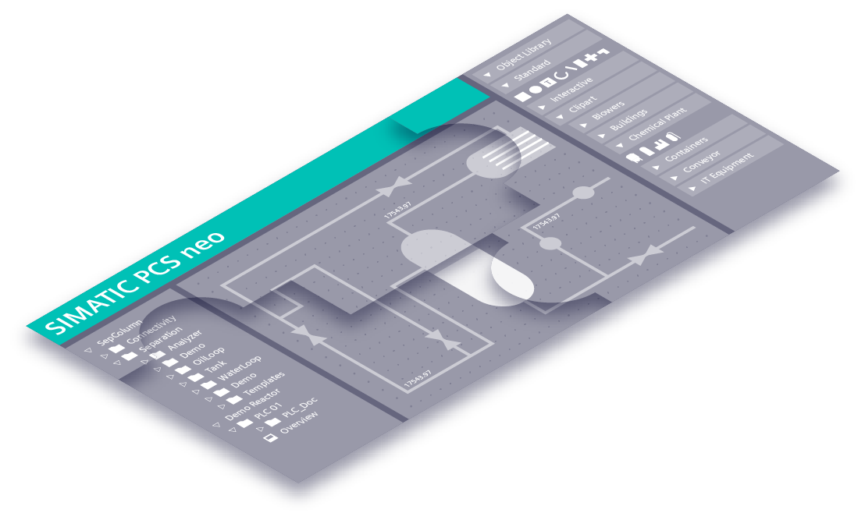

Engineering on a global scale and as a Service with SIMATIC PCS neo engineering in the cloud
Customer value
Co-creation via multi-user for optimal engineering workflows
Zero maintenance efforts
Easy and secure access for all involved parties
Integration of local workplace
SaaS Business Model You pay what you use
Customers, e.g.

Slide 18




DCS Connect & DCS Agents will Enable AI and data-driven applications
DCS Co-Pilot
SIMATIC eaSie
DCS Co-Pilot with agents in the background for data-driven applications
DCS Agent
for Process Optimization
DCS Agent
for Operator Guidance
DCS Connect
DCS Agent
for Maintenace Advice
DCS Agent
for …
PCS 7/PCS neo
3rd-Party-DCS

Slide 19
Siemens’ pledge towards the process industries Driving the Software-Defined Automation journey together with our customers & partners
America
Asia Pacific
~3.000
EMEA
~13.000
~17.000
More than 33.000 installations
in all process industries with SIMATIC DCS systems

Slide 20
How
do customers benefit today?

Slide 21
With PCS neo, we help our customers drive efficiency
15%
Lower Total Cost of Ownership (TCO)
25%
Savings in project administration
… and jointly pave the path towards Software-Defined Automation
70%
Engineering savings through easy integration of MTPs
50%
Increase in productivity
20%
Reduced testing

Slide 22
How Software-Defined Automation helps overcoming the industry's challenges
Energy & resource efficiency
Dynamically optimize processes in real-time
Labor shortage
Centralized operations & IT-like engineering
Cybersecurity & Regulations
Software-Driven updates & Data traceability
Integration advanced technologies
Open standards and APIs
Alternative feedstocks
Adaptable control systems
Inflexible operations
No changing of physical hardware

Slide 23

Thank you very much for your attention!

Slide 24
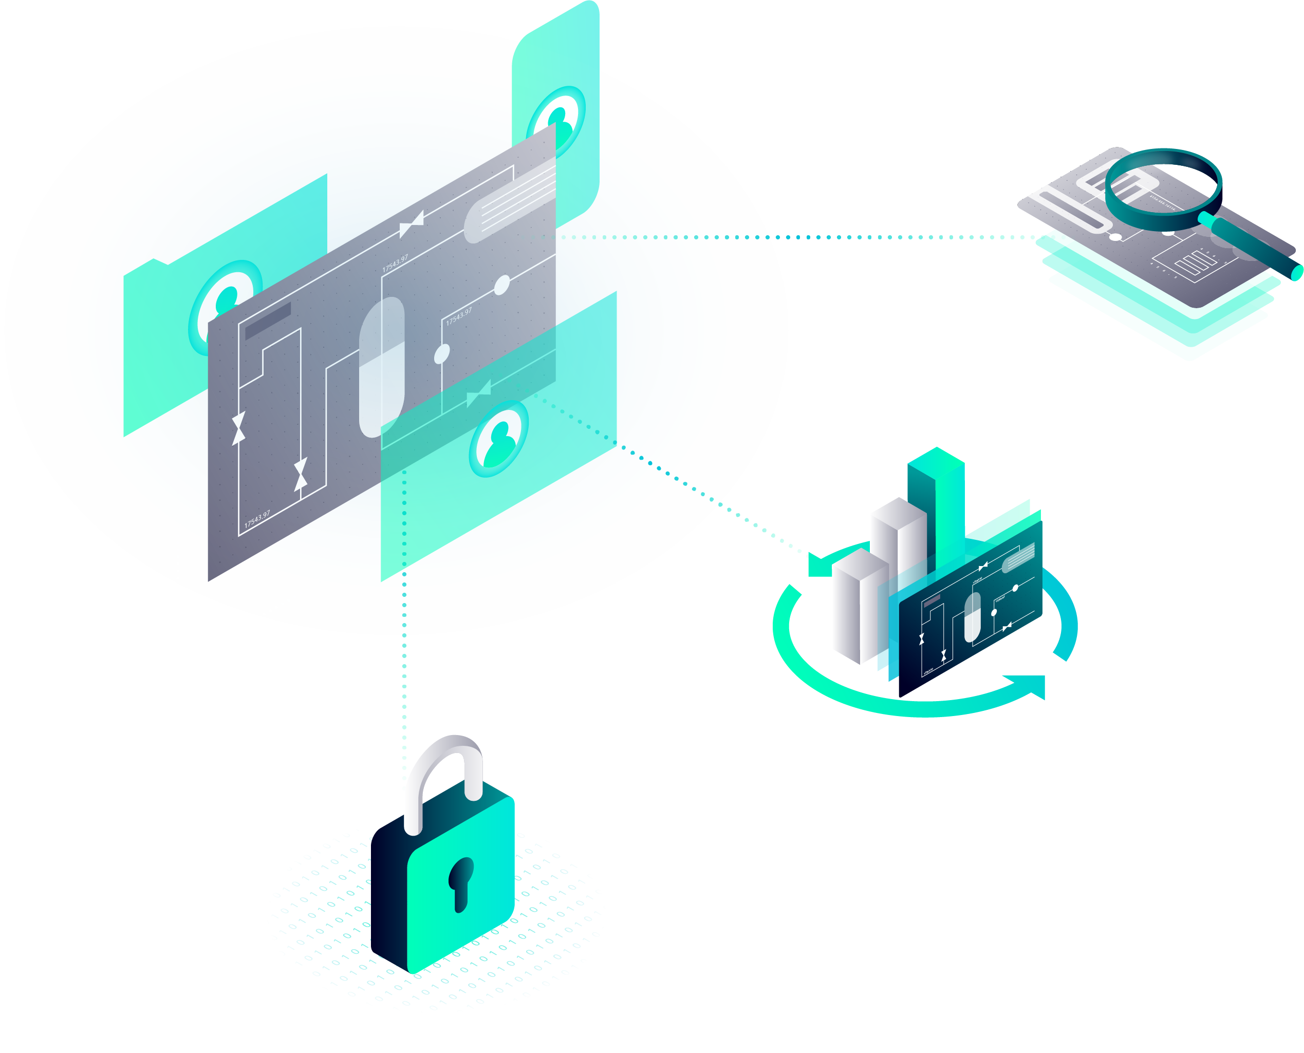
SIMATIC PCS myExpert – web based digital assistant Offering a health & lifecycle dashboard for SIMATIC PCS 7 & SIMATIC PCS neo plants
With SIMATIC PCS myExpert, you maintain an overview of your process control system.
Prove the integrity of your process control system during security audits.
Relevant life cycle product information
Display
Obsolete hardware
Firmware and software updates
Security warnings/vulnerabilities
Systematic evaluation & planning Necessary measures in PCS myExpert
Latest firmware
and software updates
Direct access to Siemens support
For quick and easy creation of support requests in relation to your equipment
Access for all authorized users to current and processed support requests
Creation of a knowledge base about your support requests for your staff
The latest security alerts

