Slide 1


From Quality by Design to Living Digital Twins
IChemE: Advances in the Digitalisation of the Process Industries (2025)
16 October 2025
Khadija Mu’azzam ^{a,b}, Francisco Vitor Santos da Silva ª, Jason Murtagh ^{b},
Maria Jose Sousa Gallagher ª,
a Process & Chemical Engineering, School of Engineering & Architecture, University College Cork, Ireland
b DPS Group Cork, Arcadis, Netherlands
© Arcadis 2023

Slide 2


Agenda
01 | Health and safety moment
02 | Why QbD still matters
03 | The modelling toolbox
04 | Data infrastructure: PAT, soft sensors & instrumentation
05 | Digital twin readiness: model (static) → shadow (live) → twin (interactive)
06 | A staged roadmap

Slide 3





Safety Moment Keeping a Safe Distance
2 SECONDS
4 SECONDS
Two second rule: to keep a safe distance from the vehicle in front, the two second rule can be followed. For dry conditions 2 seconds should be measured from a fixed point or 4 seconds in wet road conditions (icy conditions require larger gap).
2 seconds can be measured Saying “only a fool breaks the 2-second rule” which takes 2 seconds to say at a normal rate.

Slide 4
Agenda
01 | Health and safety moment
02 | Why QbD still matters
03 | The modelling toolbox
04 | Data infrastructure: PAT, soft sensors & instrumentation
05 | Digital twin readiness: model (static) → shadow (live) → twin (interactive)
06 | A staged roadmap

Slide 5

Why QbD Still Matters
Quality is embedded in the design and control rather than end-of-line testing.
Core elements include QTPP, CQAs, design space, control strategy, and continual improvement.
Models link CPPs to CQAs, to explore and operate within the design space, and prioritise experiments and control actuation.

Slide 6
Design Space & Uncertainty
Account for nonlinear regions via shape reconstruction and feasibility analysis.
Use black-box approximations to keep computation practical for expensive simulations.
Combine frequentist & Bayesian approaches to estimate prediction intervals and the probability of meeting constraints.
DoE & empirical, mechanistic, or hybrid models

Slide 7
Agenda
01 | Health and safety moment
02 | Why QbD still matters
03 | The modelling toolbox
04 | Data infrastructure: PAT, soft sensors & instrumentation
05 | Digital twin readiness: model (static) → shadow (live) → twin (interactive)
06 | A staged roadmap

Slide 8



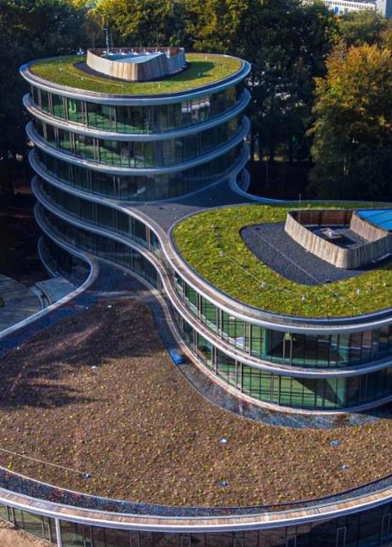
The Modelling Toolbox
Model selection should be determined by the intended application and by the level and quality of data and process understanding that can be sustained
Optimaler Zugang zu unseren weltweiten Know-how, Fähigkeiten und Erfahrung
Places
Schaffung und Erhaltung nachhaltiger Orte, an denen Menschen leben und arbeiten
Resilience
Schutz der Umwelt & Wasserressourcen, Energie für zukünftige Generationen
Mobility
Gestaltung florierender und vernetzter
Städte und Gemeinden
Empirical
fast pattern capture; limited extrapolation
Mechanistic
physics-based; better generalization & explainability
Hybrid
mechanistic spine + data-driven

Slide 9
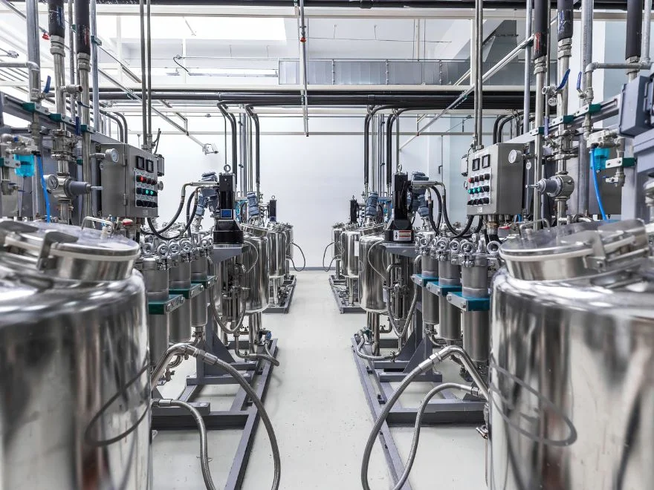
Design & Control Across Bioprocess
Upstream: Kinetic, population-balance models; heterogeneity → CQAs.
Downstream: Transport limits, thermodynamic consistency; purity–yield trade-offs set separation guardrails.
Model Predictive Control: Robust/Stochastic MPC, constraint tightening; explicit uncertainty handling → effective control.
Estimation: State estimators (e.g., Kalman filters); noisy/missing data → soft sensing.

Slide 10
Agenda
01 | Health and safety moment
02 | Why QbD still matters
03 | The modelling toolbox
04 | Data infrastructure: PAT, soft sensors & instrumentation
05 | Digital twin readiness: model (static) → shadow (live) → twin (interactive)
06 | A staged roadmap

Slide 11
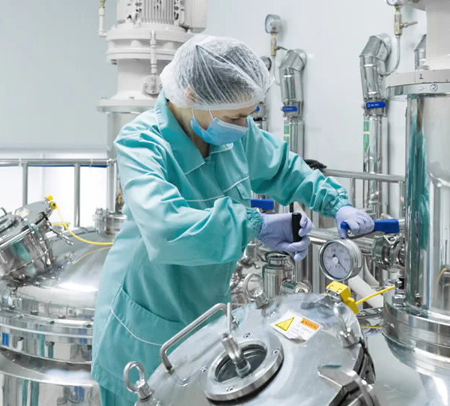




Data infrastructure: PAT, soft sensors & instrumentation
Soft sensors: mechanistic, empirical (ML), and hybrid approaches used to infer unmeasured states and CQAs.
Spectroscopy: UV–Vis, mid-IR, Raman, and fluorescence paired with chemometrics for rapid estimation of key analytes.
Data engineering: rigorous cleaning, time alignment, dimensionality reduction and drift detection to sustain model performance.
Process probes: free-floating sensors deployed to reveal mixing non-uniformities and shear gradients.

Slide 12
Agenda
01 | Health and safety moment
02 | Why QbD still matters
03 | The modelling toolbox
04 | Data infrastructure: PAT, soft sensors & instrumentation
05 | Digital twin readiness: model (static) → shadow (live) → twin (interactive)
06 | A staged roadmap

Slide 13
Digital Twin Maturity
Model maturity is selected according to purpose and data readiness, and deployed where benefits outweigh cost.
Optimaler Zugang zu unseren weltweiten Know-how, Fähigkeiten und Erfahrung
Places
Schaffung und Erhaltung nachhaltiger Orte, an denen Menschen leben und arbeiten
Resilience
Schutz der Umwelt & Wasserressourcen, Energie für zukünftige Generationen
Mobility
Gestaltung florierender und vernetzter
Städte und Gemeinden
Model
Validated representation (offline design & scenarios)
Shadow
real-time data into the model (read-only predictions)
Twin
bi-directional data & governed control actions

Slide 14
Digital Twin Requirements
Bake governance into the digital twin by using secure, standards-based communication (e.g., OPC-UA/MQTT with encryption/SSL) and strong data management to protect IP while enforcing rigorous model validation that assesses uncertainty and consistency between model and data.
Physical
Digital
Virtual
Validated & under change control
Historians, interfaces (e.g., OPC UA/MQTT), cloud/edge options
Reliable sensors/ actuators for CQAs & CPPs

Slide 15
Agenda
01 | Health and safety moment
02 | Why QbD still matters
03 | The modelling toolbox
04 | Data infrastructure: PAT, soft sensors & instrumentation
05 | Digital twin readiness: model (static) → shadow (live) → twin (interactive)
06 | A staged roadmap

Slide 16
A staged roadmap
Stage 1 | Stage 2 | Stage 3 | Stage 4 | Stage 5
1 & 2
QTPP → draft CQAs & Build first model
Integrate with plant systems (SCADA/ DCS, PI historians) and live data streams, standardize secure comms (OPC-UA/ MQTT with encryption.
Live operation is connected as a digital shadow to enable forecasts.
3
The QTPP is used to draft CQAs, and a first mechanistic and empirical model is built and validated with explicit uncertainty.
Instrument for Information
4
Soft sensors fused via Kalman, targeted spectroscopy, and free-floating probes may be added, supported by a lean data pipeline and model registry.
Shadow → Selective Twin
5
Industrialise & Scale

Slide 17

Spotlight: Cell Therapy
Heterogeneous starting material; limited sampling; single-use systems
Non-destructive sensing is key (e.g. Raman)
Hybrid soft sensors often the only viable real-time path
Discipline in data/drift management is non-negotiable

Slide 18

What “Good” Looks Like
Traceable line: QTPP → CQAs → CPPs → Design Space
Living model registry with versions, data, and uncertainty bounds
Operational twins where it counts; shadow-assisted decisions elsewhere
First-class data engineering: alignment, drift, simple visuals
Human-in-the-loop excellence (Industry 5.0 mindset)

Slide 19
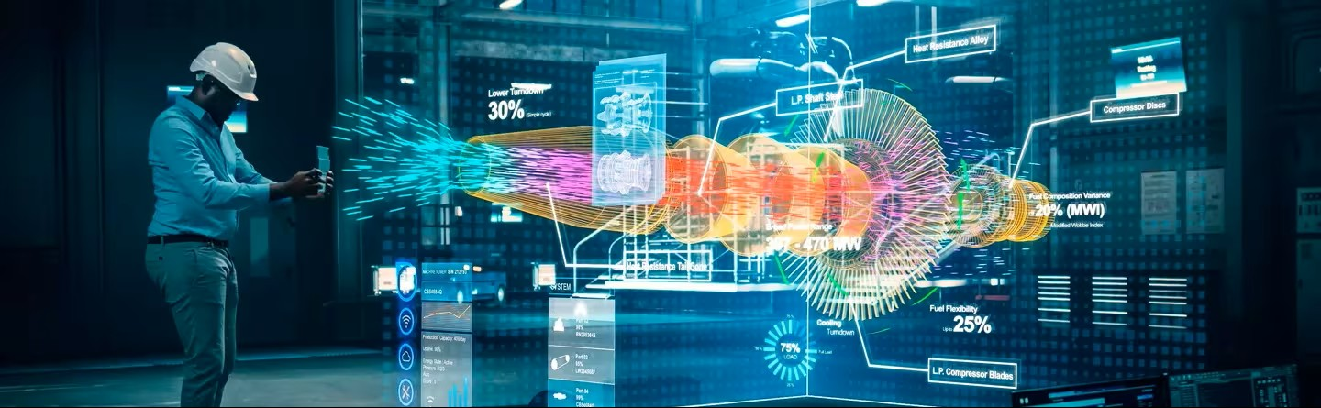
Risks & Mitigations
Model error → bad decisions
Security / IP exposure
Integration fatigue (heterogeneous / legacy systems)
Validation burden

Slide 20
Speed
Robustness
Trust
Resulting Advantages
Fewer experiments; more learning per run.
Earlier detection; tighter variability.
Auditable link from design to manufacturing

Slide 21

Key Takeaways
QbD provides the roadmap
Data reality demands discipline
Soft sensing & fusion are central
Uncertainty & drift must be explicit
DT maturity levels matter
Notes:
Gary/Dara

Slide 22


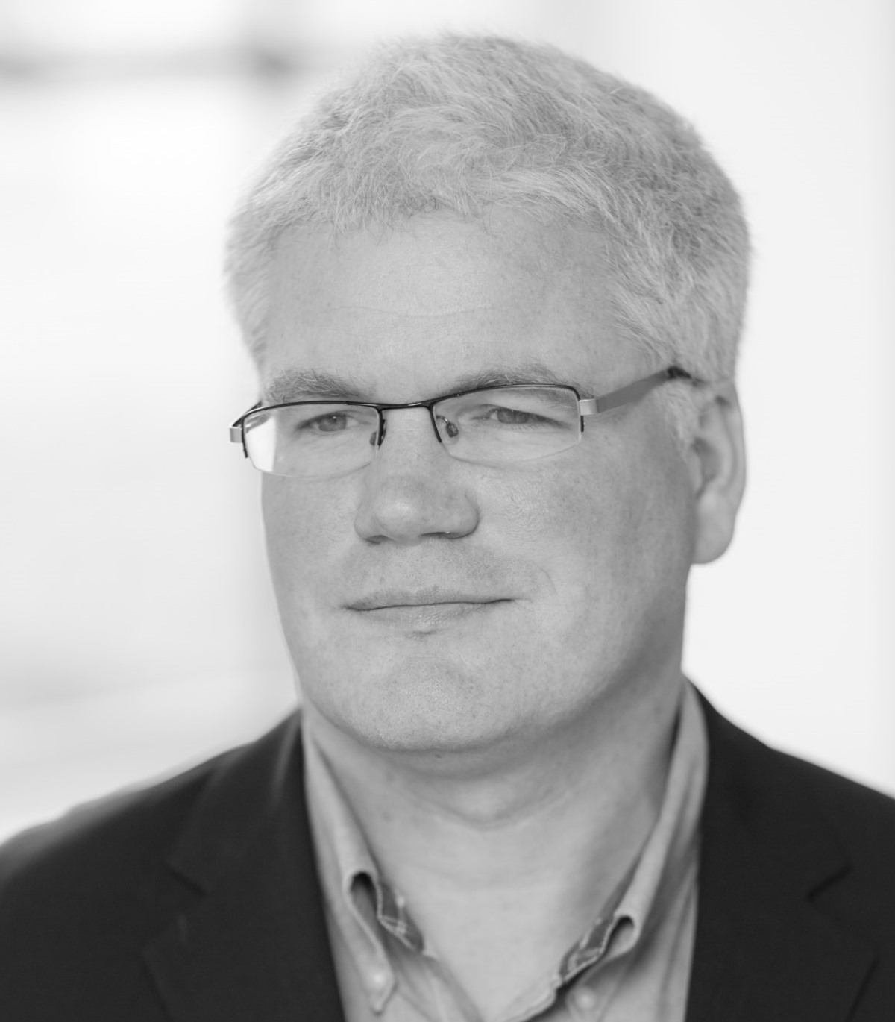

Thank you
Khadija Mu’azzam
Francisco Vitor Santos Da Silva
Jason Murtagh
Maria Jose Sousa Gallagher
Senior Process Engineer at Arcadis | PhD research at University College Cork
Senior Lecturer at University College Cork
Lead Process Engineer & SME at Arcadis
Professor in Process & Chemical Engineering, School of Engineering at University College Cork

