Slide 1

Machine Learning and Hybrid Modelling of Particle Breakage in a Jet Mill
Carl Jackson

Slide 2


About Us
Carl Jackson
Senior Digital Chemical Engineer
Core Capabilities
Group Technology
Johnson Matthey
Mingzhe Yu PhD
Senior Solids Engineer
Core Capabilities
Group Technology
Johnson Matthey

Slide 3
Johnson Matthey
A global leader in advanced materials and sustainable technologies, established in 1817 and listed on the London Stock Exchange as a constituent of the FTSE 250 Index.
Notes:
The world is facing some of its biggest challenges yet.
The impacts of global warming and climate change are being felt across the globe.
We need to change to transition to net zero and ensure a more sustainable future.
That’s where JM comes in
Through our inspiring science and continued innovation
we're catalysing the net zero transition for millions of people every day.

Slide 4
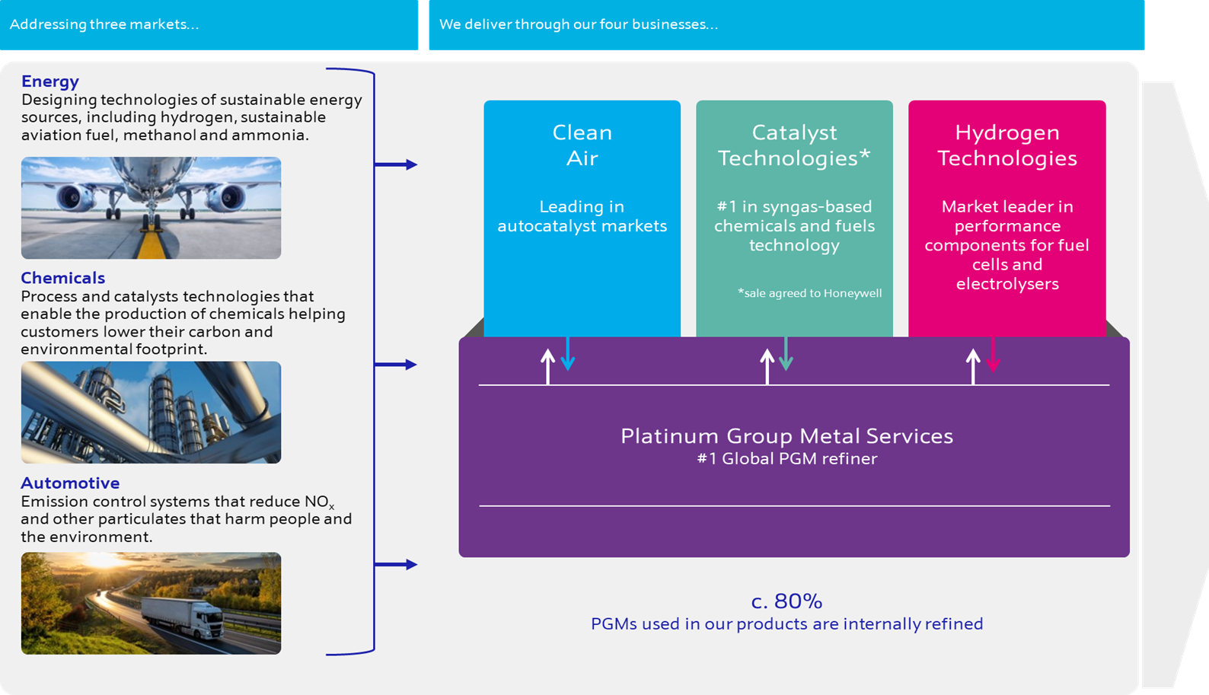
Notes:
Clean Air: is a global leader in autocatalysts that remove harmful pollutants from gasoline and diesel vehicles
CT: making syn-gas based chemicals, producing h2 and subsequent products. supplies catalyst and process technologies to enable the decarbonisation of the chemical and energy industries
Also have our licensing business, flow sheeting and plant design
Just recently agreed to sell this to Honeywell which is all happening at the moment and is exciting
HT: provide critical components for fuel cells and green hydrogen electrolysers to enable the hydrogen economy
At JM, we’ve been designing and manufacturing the key components at the heart of a fuel cell for over 20 years
PGMS: is a leading recycler and refiner of precious metals
We are the largest refiner of secondary PGMs and account for ~20% of all global refined PGMs (primary and secondary).
Our expertise in PGM catalysis and performance underpins much of the innovation across Johnson Matthey
Driving that circular economy drives synergies across our business
Other enabling functions, corporate R&D: houses our scientific expertise, and digital expertise

Slide 5
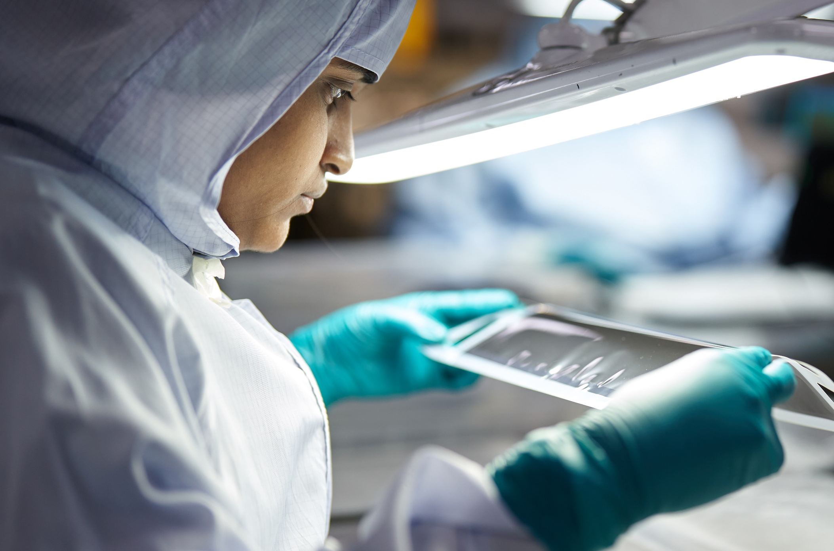
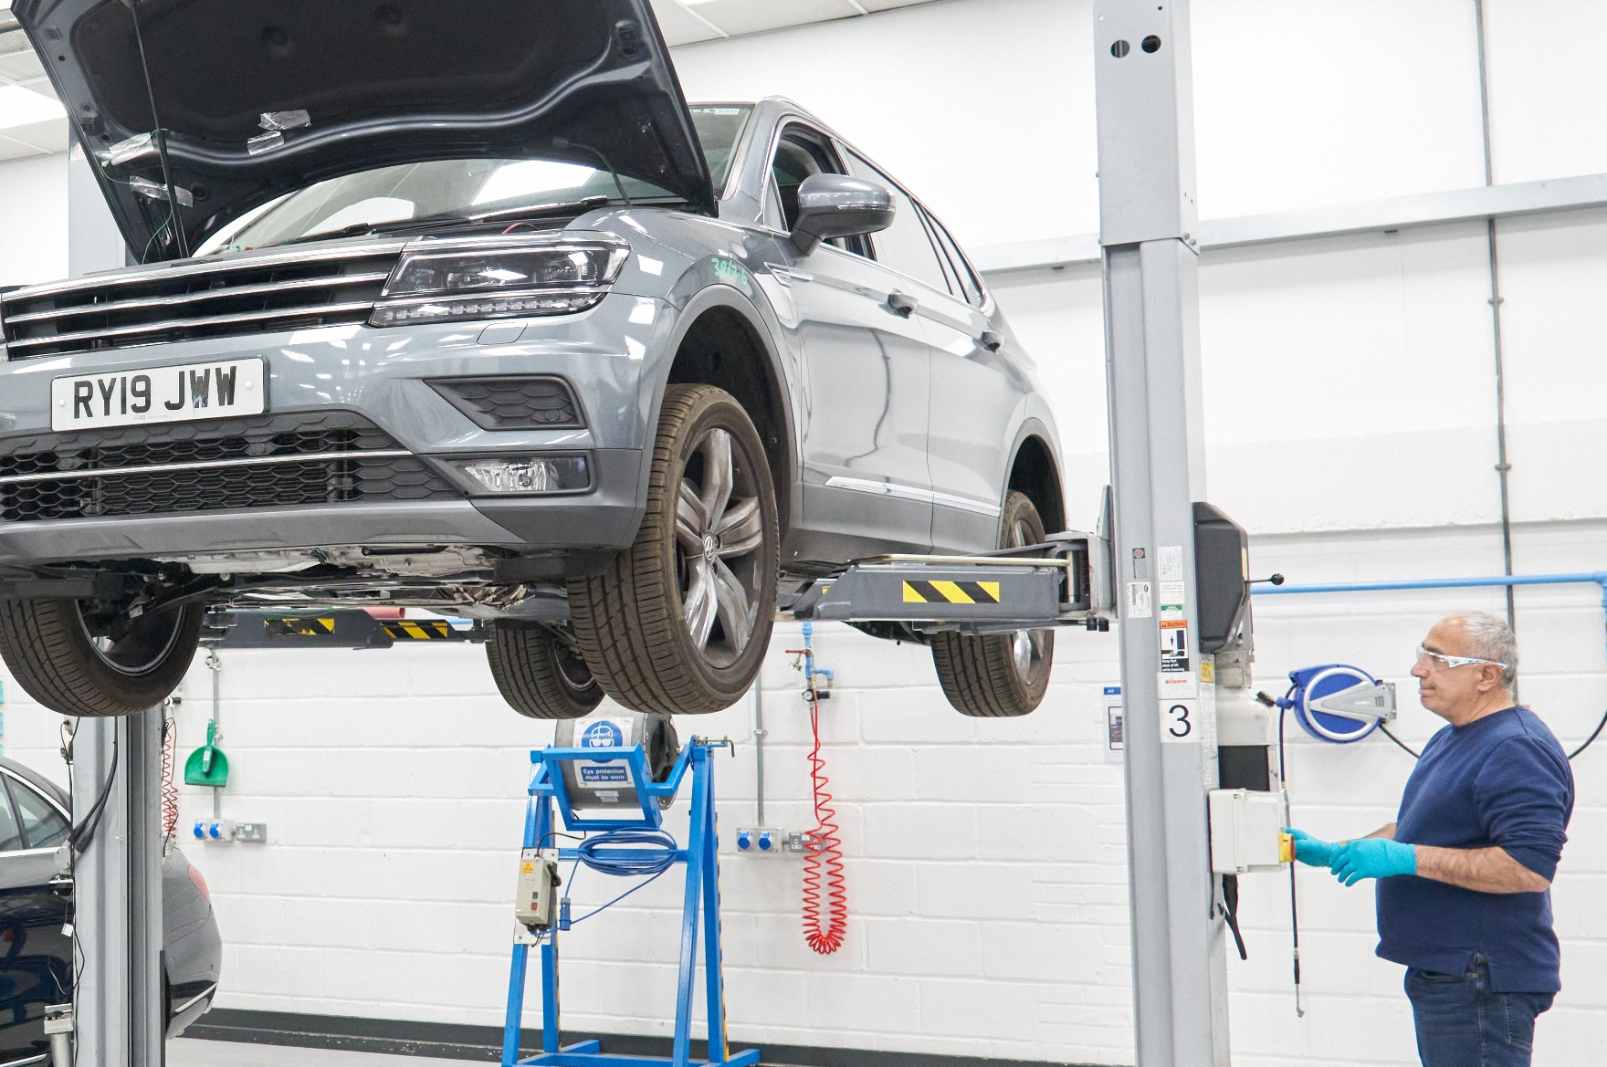
Driving down automotive emissions
Global leader in autocatalysts for diesel and gasoline vehicles
Market leader in high-performance components for hydrogen fuel cells
Notes:
Clean Air
Our catalysts and filters prevent millions of tonnes of harmful pollutants, (NOx, particulates) produced by gasoline and diesel engines, from entering the air.
Despite incoming deadlines to phase out petrol and diesel vehicles, we’re not going to see the traditional combustion engine disappear overnight.
We continue to invest and innovate to ensure that our technologies help our customers meet the higher standards demanded by new legislation.
20 million tonnes of pollutants stopped by our catalysts each year
1 in 3 cars on the road use a Johnson Matthey catalyst
Hydrogen technologies
Electric vehicles will be a major part of the future of transport.
While batteries are more suited to light duty cars and vans, hydrogen fuel cell vehicles are critical to decarbonising heavy duty trucks and buses, offering longer driving ranges and faster refuelling times.
Inside a fuel cell vehicle, hydrogen is used as a fuel to generate electricity to power, producing water as the only by-product.
We supply the catalyst coated membranes and membrane electrode assemblies which are key to making the clever chemistry in a fuel cell happen.
Our fuel cell experience goes back even further to 1842 when William Grove was first developing the concept of the fuel cell. He used platinum supplied by Johnson Matthey - so, we really have been in the fuel cells business forever!

Slide 6
Agenda
Questions
Background
Model Performances and Predictions
Key Learnings
Population Balance Models and Hybrid Modelling
Method

Slide 7
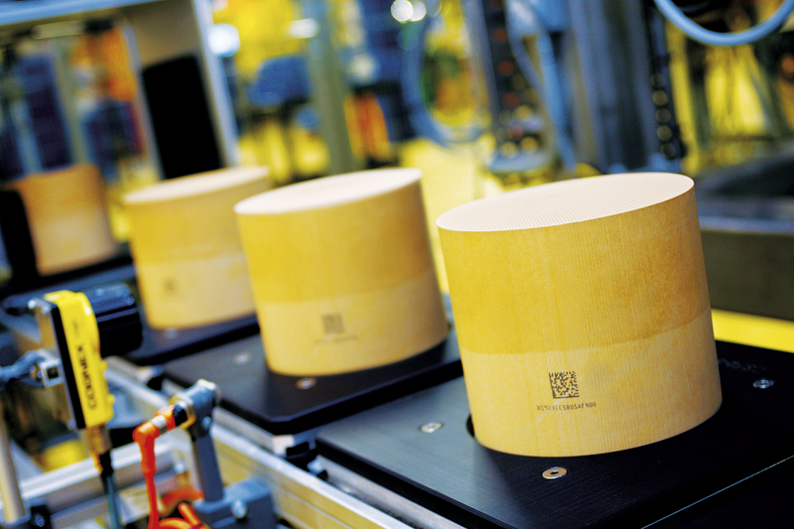
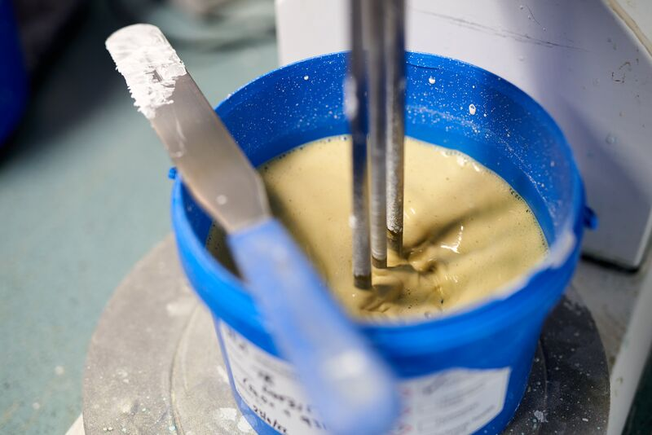
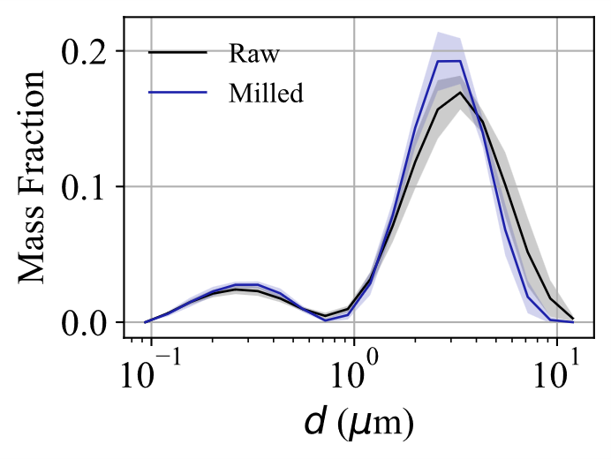
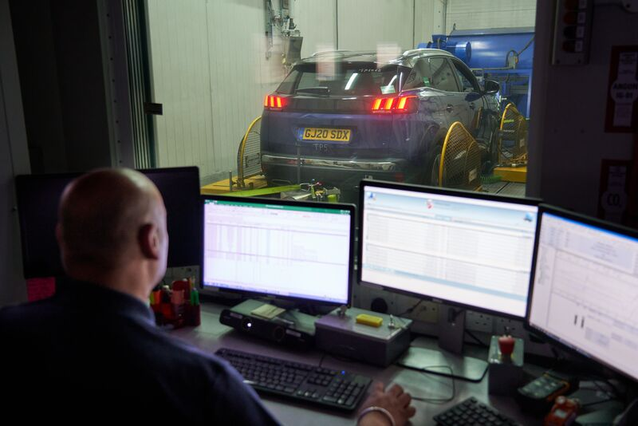
Importance of Particle Size Distributions
Both product performance and manufacturing capability are sensitive to PSD
Motivations for modelling
Reduce trial and error of mill settings
  At scale->material wastage and time
Model to inform toll manufacturers
Troubleshooting
Notes:
Add more background to clean air
What the autocatalysts do

Slide 8
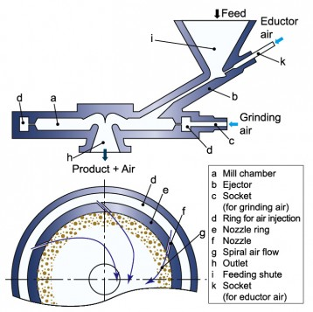
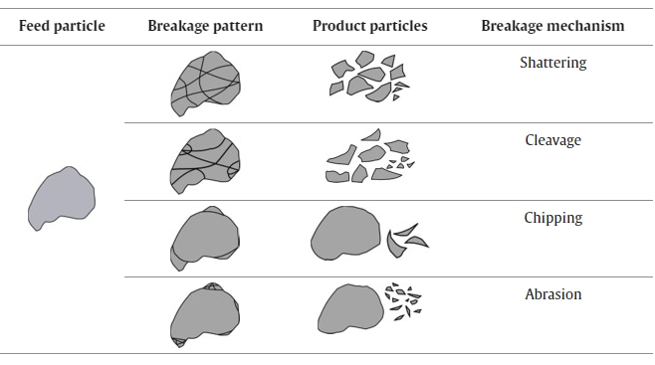
Jet Mills
Hosokawa jet mill [1]
Wet Mill
Dry Mill

Slide 9
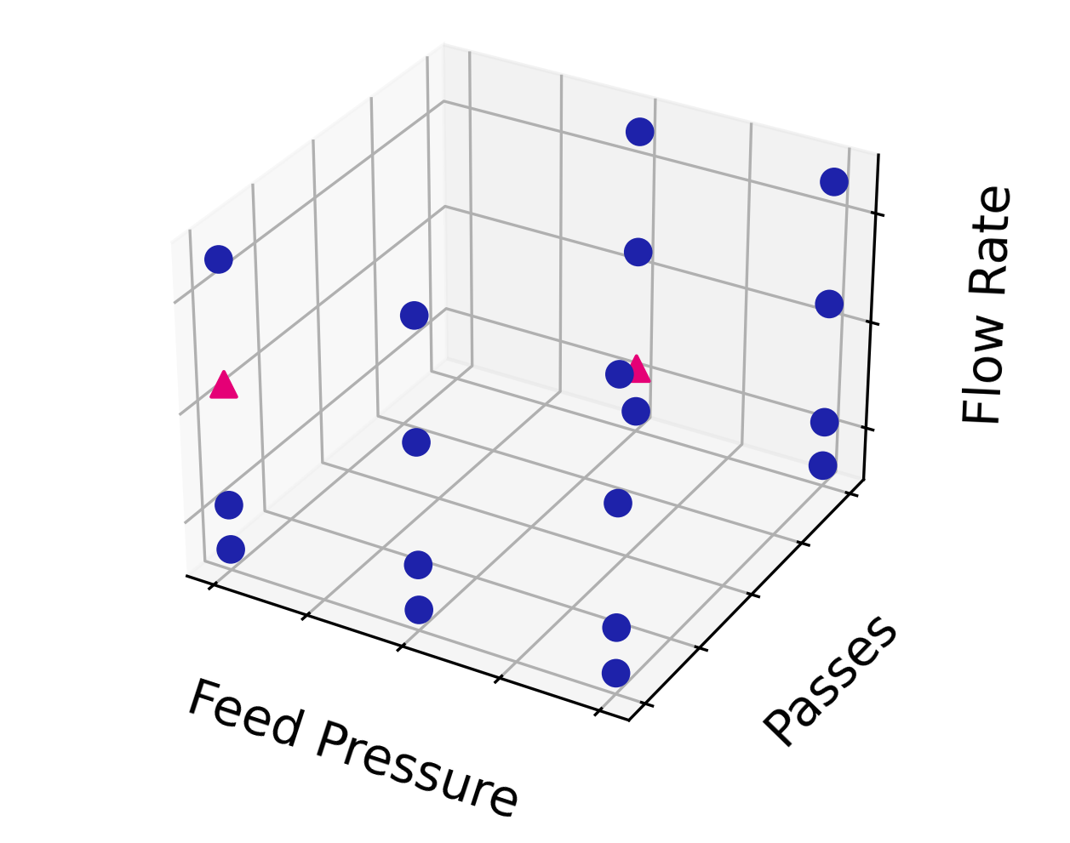

Dataset
Features
Initial PSD | Average of 3 measurements 30 bins
Feed pressure | Pressure going into the mill. Grind pressure is always 80% of feed pressure
Feed rate | Mass feed rate into the mill
Run duration | Duration of the batch
Number of passes | Passes through the mill previously. 1-3
Targets
Product PSD | Average of 3 measurements 30 bins
Yield | Mass of product relative to feed. Typically 75-90%

Slide 10
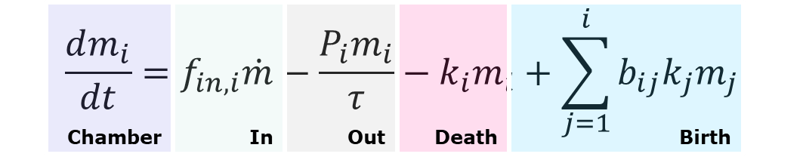
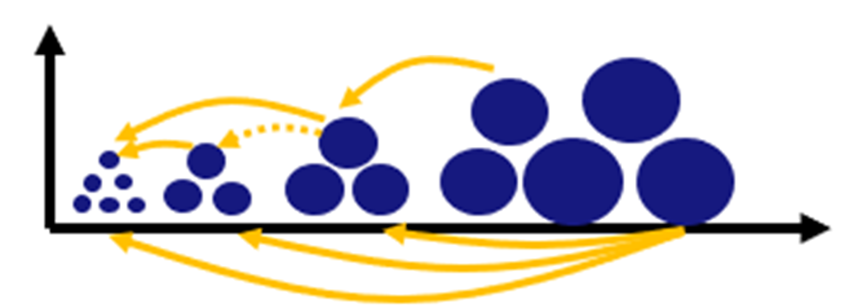
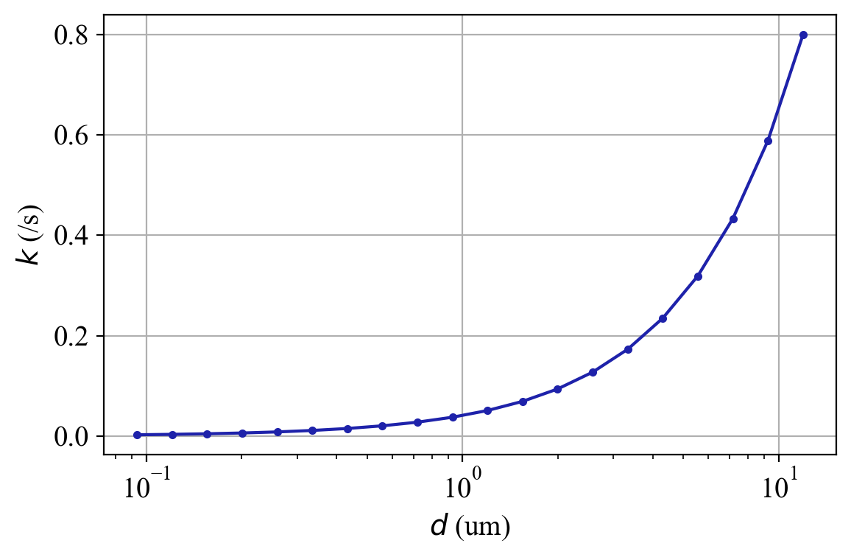
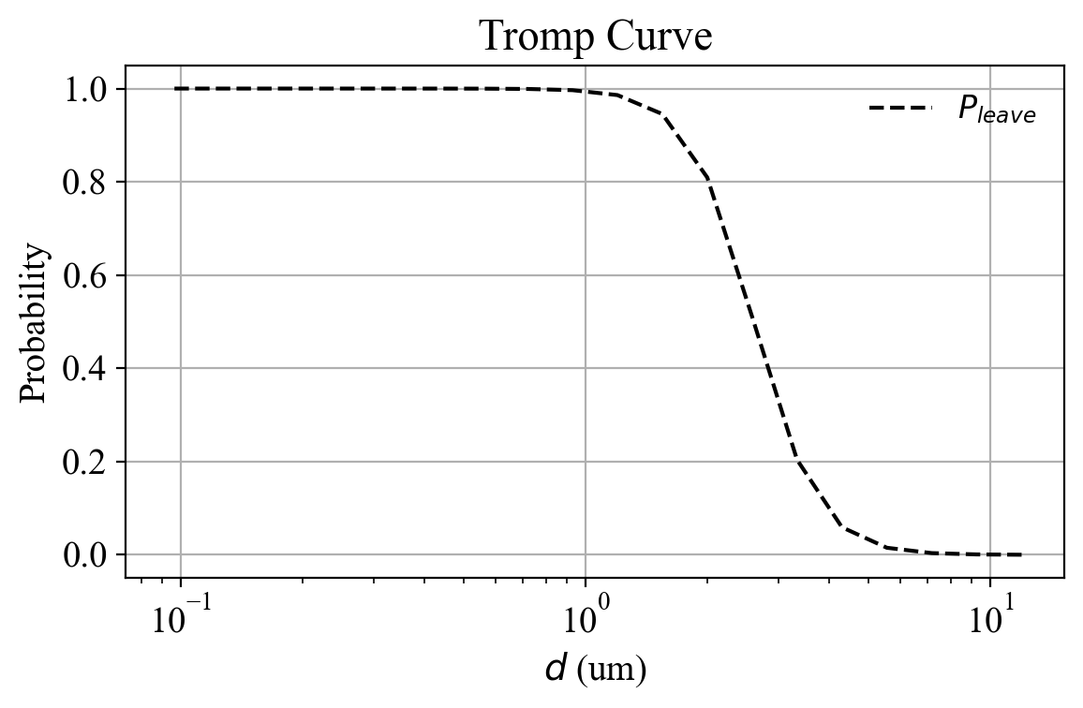


Population Balance Model (PBM)
Breakage rate
Classification function
$${ k}_{i}=α{\left(\frac{x_{i}}{x_{1}}\right)}^{γ}$$
$$P_{i}=\frac{1}{1+{\left(\frac{x_{i}}{x_{50}}\right)}^{K}}$$
Notes:
Bin size
Share alpha/gamma paper
Describe parameters better

Slide 11
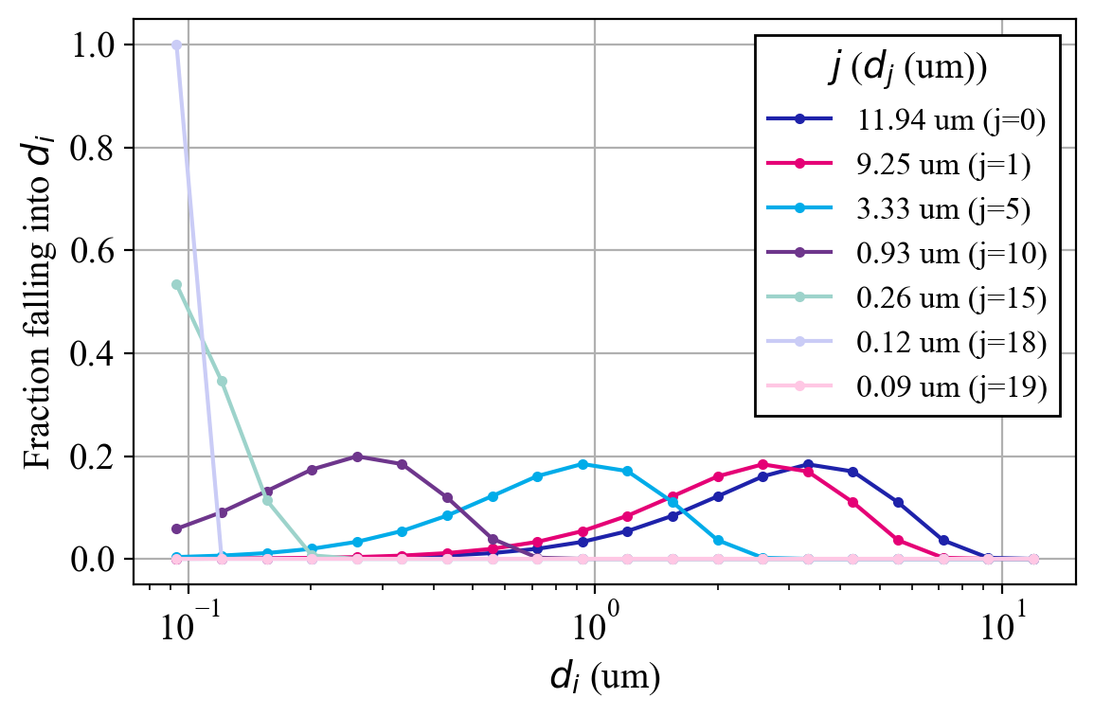
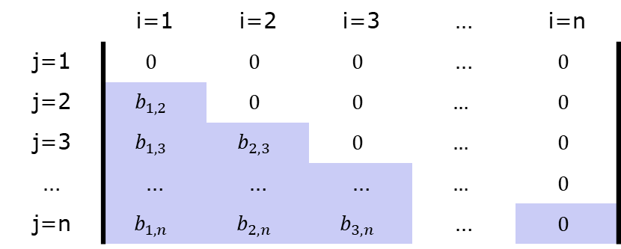
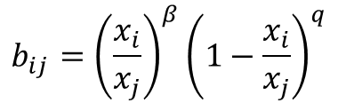
Population Balance Model (PBM)
Breakage distribution function
$$b_{ij}={\left(\frac{x_{i}}{x_{j}}\right)}^{β}{\left(1−\frac{x_{i}}{x_{j}}\right)}^{q}$$
Notes:
Bin size
Share alpha/gamma paper
Describe parameters better

Slide 12
Hybrid models
Different structures
Consists of 2 parts…
First principles model (mechanistic, white-box model)
ML model (data-driven, black-box model)
Parallel arrangement
FPM
FPM
ML
ML
Hybrid
Series arrangement
ML
FPM
Data
Extrapolation
General performance
Time/expertise to develop
FPM
ML

Slide 13
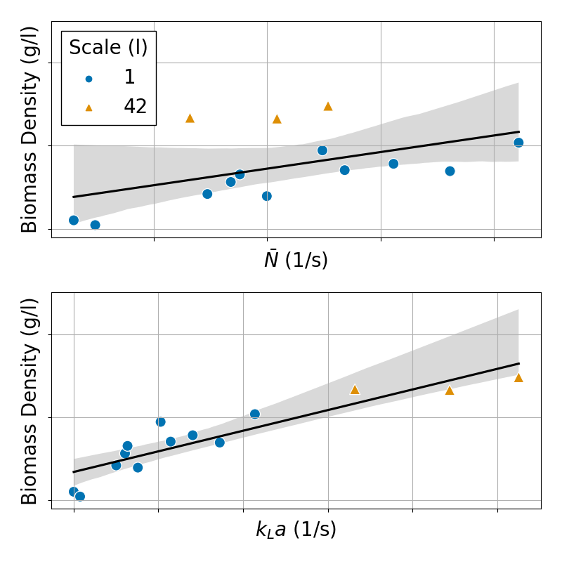
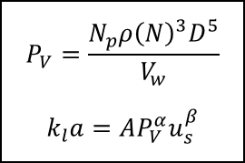
Hybrid models
Small fermentation dataset across different scales
“Which phenomena are important for biomass density (yield)?”
Oxygen mass transfer
More bugs → More oxygen uptake → More agitation to maintain DO₂
Derive a soft-sensor for final fermentation batch yield across multiple scales
$$P_{V}=\frac{N_{p}ρ{\left(N\right)}^{3}D^{5}}{V_{w}}$$
$$k_{l}a=AP_{V}^{α}u_{s}^{β}$$
FPM
ML

Slide 14
Hybrid models
Different structures
Consists of 2 parts…
First principles model (mechanistic, white-box model)
ML model (data-driven, black-box model)
Parallel arrangement
FPM
FPM
ML
ML
Hybrid
Series arrangement
ML
FPM
Data
Extrapolation
General performance
Time/expertise to develop
FPM
ML

Slide 15
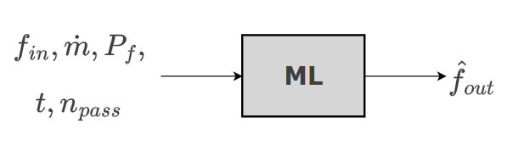
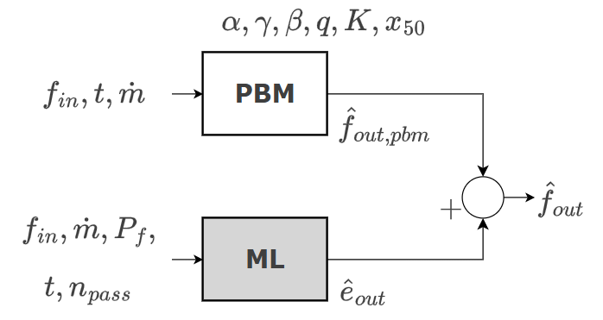
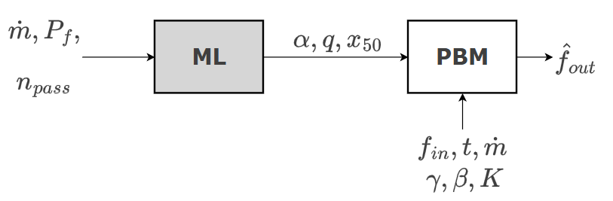
Model Architectures
Data-driven model
Corrective hybrid model
ML model predicts error of PBM
Series hybrid model
ML model predicts parameters of the PBM
α (overall breakage intensity / selection severity)
x₅₀ (classification cut size)
q (fine tail)
Notes:
higher pressure → more energy → faster attrition/fragmentation
Higher pressure/air velocity typically lowers the effective cut (finer product leaves sooner)
Pressure can broaden fragment spectrum (more fines)

Slide 16
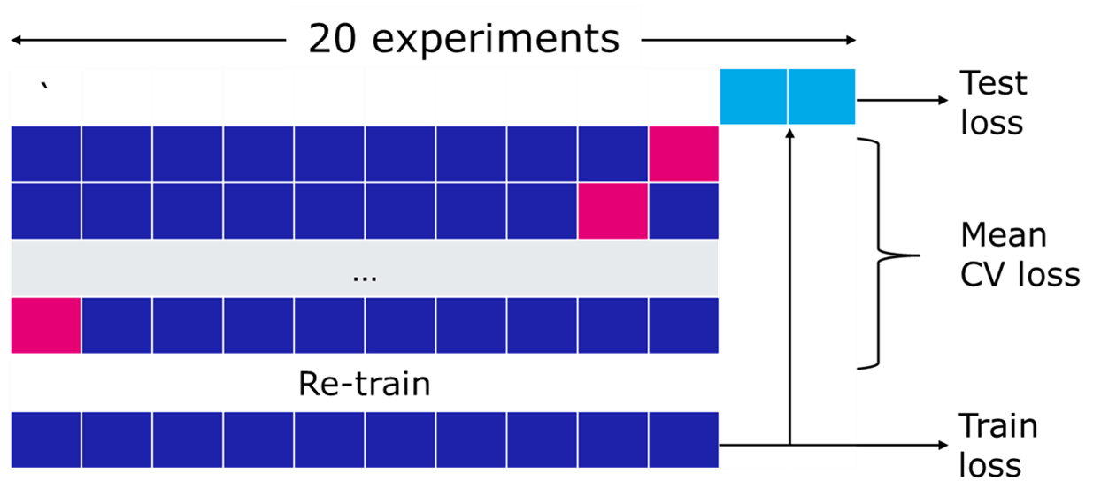
Model Evaluation and Optimisation
Hyperparameters of each model optimised using OptunaTM [2]
Loss metric is mean absolute error (MAE) between true and predicted PSD

Slide 17
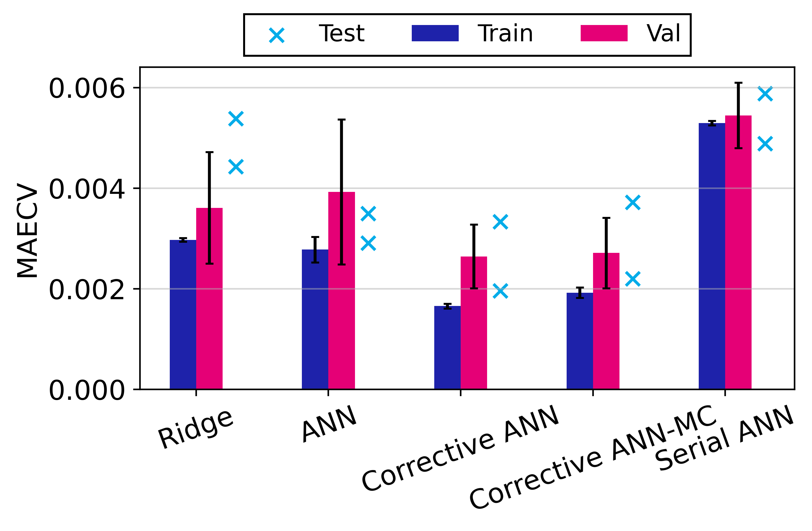

Results
$$\sum_{i=1}^{n}{{(y_{i}−{\hat{y}}_{i})}^{2}+λ\sum_{j=1}^{P}{w^{2}}}$$

Slide 18
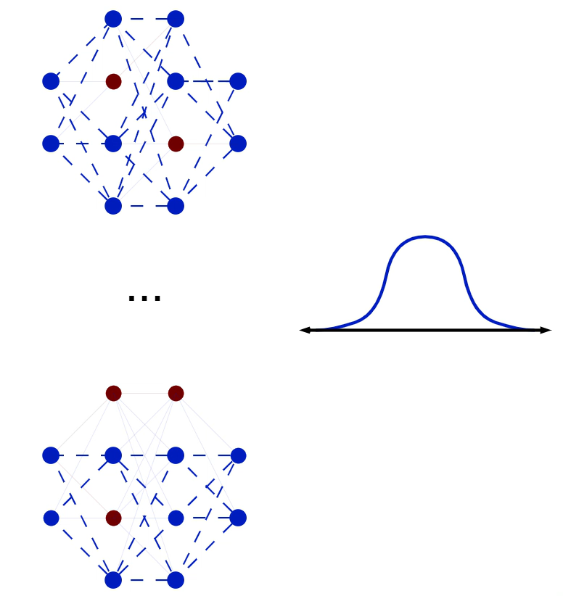
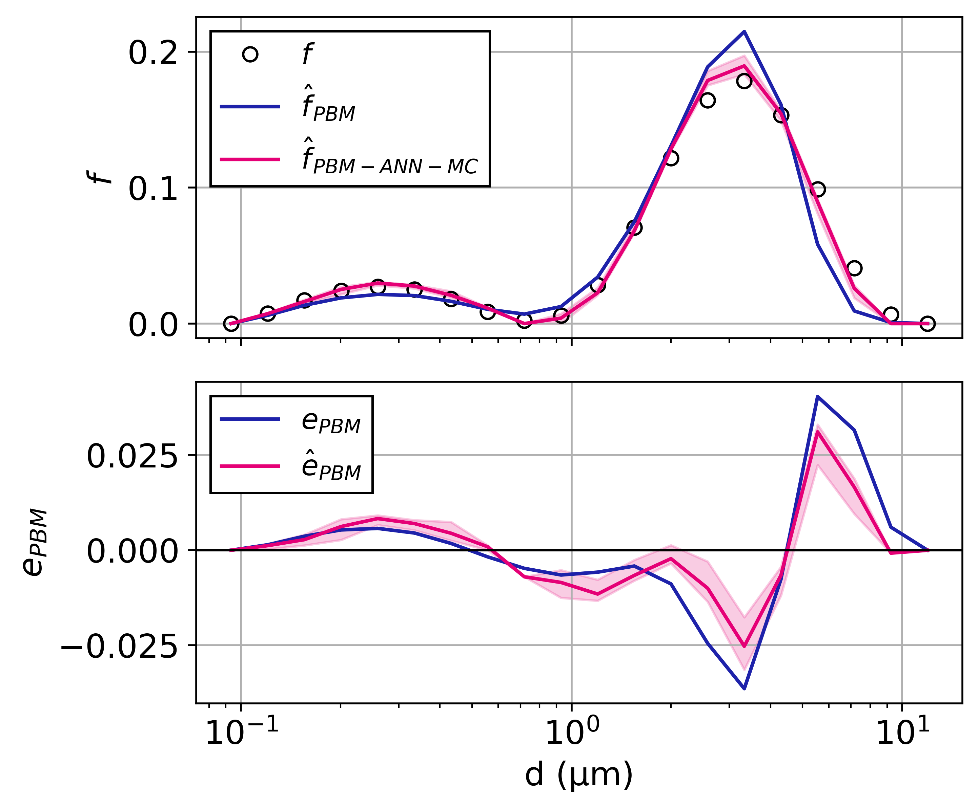



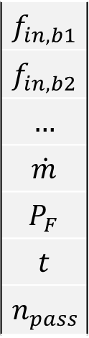



Results
Monte Carlo Dropout Neural Network
Corrective ANN-MC performance on test experiment
$$f_{in,b1}$$
$$f_{in,b2}$$
$$…$$
$$\dot{m}$$
$$P_{F}$$
$$t$$
$$n_{pass}$$
$X$ …
… ${\hat{f}}_{out}$
$$X=$$
$${\hat{f}}_{out,b1}$$
Approximation of posterior distribution of each PSD bin
$X$ …
… ${\hat{f}}_{out}$

Slide 19

Results
$$\sum_{i=1}^{n}{{(y_{i}−{\hat{y}}_{i})}^{2}+λ\sum_{j=1}^{P}{w^{2}}}$$

Slide 20

Key Learnings
A bad analogy of inductive bias in hybrid modelling
Imagine you’re cooking from a recipe…
Which will produce the best dish:
Strictly follow a recipe
Minor deviations from the recipe
Major deviations from the recipe
Depends on:
Quality of the recipe
  Quality of the first-principles model
Your past experiences and skill as a chef
  Quantity and quality of the data
Notes:
Constraining the model's search space
Helping it learn from limited or complex data
Could be beneficial, or a hindrance
I believe that starting from the recipe (mechanistic laws) is better than guessing from scratch
but I’ll still let my intuition (data-driven learning) fill in the gaps

Slide 21
Key Learnings
Pros
Production-ability
Negative inductive bias
Cons
Extrapolation capability
Model interpretability
Less data
Development/training time
Model performance

Slide 22
Conclusions
Corrective hybrid modelling has been beneficial in predicting milled product PSD
Series hybrid modelling…not so much
Negative inductive bias owing to the challenges of PBMs
Corrective hybrid models with Monte Carlo neural nets show equal performance and provide CI
But longer inference times make it impractical for series hybrid modelling
Considerations for future hybrid modelling work
Revisit PBM
Hybrid model structure
  How confident are you in the first-principles model?
  Are all of the likely phenomena captured?
  Optimise the hybrid architecture
What are the requirements for implementing into production

Slide 23

Acknowledgments
Hugh Stitt
Robert Gallen
Li Liu
Carl Jackson
Senior Digital Chemical Engineer
Core Capabilities
Group Technology
carl.jackson@matthey.com
Mingzhe Yu PhD
Senior Solids Engineer
Core Capabilities
Group Technology
mingzhe.yu@matthey.com

