Slide 1
INTRODUCTION
Universal Automation Organization

Slide 2


What is
Universal Automation?
S
E
R
Is a non-profit organization
U
S
Common Automation Layer
Is an Eco-System of Automation Users, Vendors & Academics
A
S
C
R
A Common Automation kernel based on IEC 61499
A
O
Modernising Automation
D
D
E
Shared source model → best portability and interoperability
N
M
E
I
V
S
C
Foster innovation and collaboration in automation industry
Ecosystem
Notes:
In order to make this world possible, UniversalAutomation.org (UAO) was created as the missing link to Software Defined Automation
UAO is basically 2 things:
- One common automation layer based on an innovative standard called the IEC 61499. This standard defines the decoupling of the software from the hardware on which it executes. This enable a new world of possibilities
- An ecosystem of Users, Vendors and academics taking care about this common automation layer. They are responsible to push it on the market, spread the good word and maintain and increment the technology
An analogy would be the Android system that you have on smartphone with the ability to create apps even though the UAO technology is not an operating system

Slide 3
HOW
Universal Automation Organization & IEC 61499

Slide 4

IEC 61499
The technology enabler of UAO
Scan-based cyclic control
IEC 61499 Event-driven control
Control
Control
In-Scan
Out-Scan
Change Notification – Event+Data
BACNet
PROFINET
Command Notifications
OPC UA
MQTT
Ethernet IP
Read Measurements
Command Actuators

Slide 5
IEC 61499
The technology enabler of UAO
CONTROL
IEC 61499 Event-driven control
Change Notification Event+Data
Command Notifications
Event+Data
Foundation Fieldbus
Modbus
Profibus
CANOpen
EtherCAT
HART
Scan-based IO commands
DeviceNet
Read Measurements
Command Actuators

Slide 6





IEC 61499
The technology enabler of UAO
Event-Driven Function Block
Software-Hardware Decoupling
Distribution
Application Model
Event IN
Event OUT
IEC 61499
…
System Model
Data IN
Data OUT
Device Model
Self-contained SW component
Decoupling of Application Software from Hardware
Distribution of SW components to devices
“Plug & Produce programming using hardware-independent, proven-in-use libraries of software components“
Notes:
What is the IEC 61499 standard?
It is the technology enabler of the UAO technology.
It starts with an event-driven function bloc which makes it easy to interface with IT applications which are working using transactions. This function block could be a simple function or encapsulate a complete application like interfacing your system with a digital twin. The only way to access to this block is through its interfaces (event in/event out, data in, Data out)
Then there is the decoupling as defined by the standard where the application model defines who to make an application. The device model is where you defines your devices on which the application will run
The system model is the assignment of the application to the devices. It could run on one device or on multiple. It does not matter and does not impact the program.
This is what we call plug and produce automation with the ability to use programs done by other to gain in programming efficiency.

Slide 7
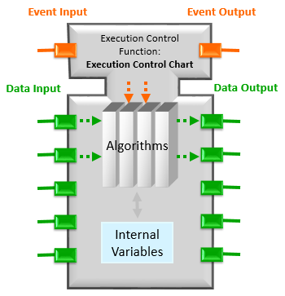
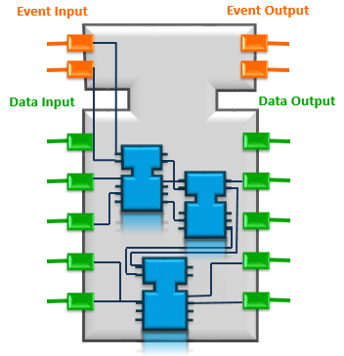
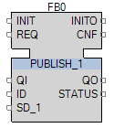
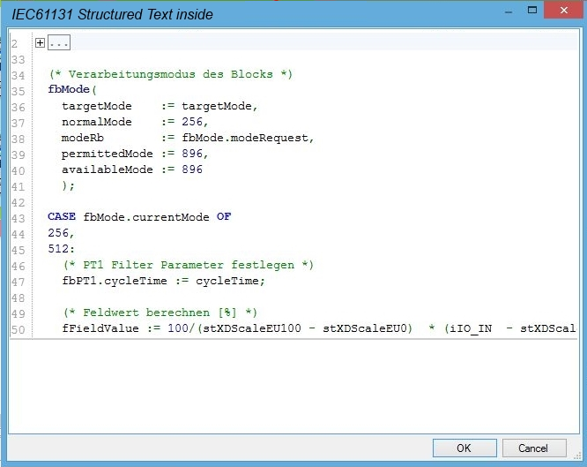
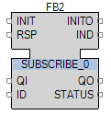
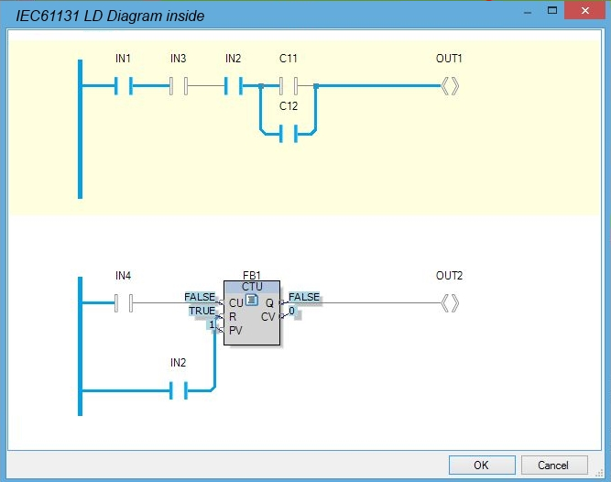
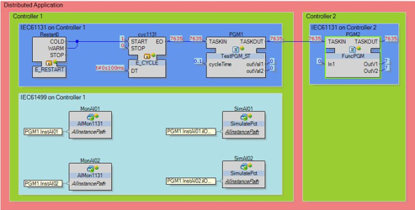
IEC 61499 –
Event Driven Function Block
Self-contained SW component providing functions thru defined interface
Programmed in any language
Real-time + Right-time
SFB: FB interface to functionality beyond IEC 61499, like comms networks, device hardware, etc.
Basic FB
e.g. Motor
+ Execution Control Chart
+ Algorithms (ST)
Composite FB
e.g. Conveyor line
Composed out of Basic FB,
Composite FB, Service FB
Service FB
e.g. I/O access (Data, HMI, Communication …)
Provided by the System
Application

Slide 8
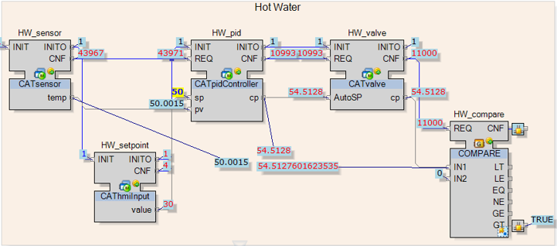



IEC 61499 –
Application and Device/Resource models
Decoupling of Application software from hardware
Application Model defines how to create application using FB networks
Device/Resource models define the compute resources on which the application will execute
Tomorrow
Hardware & Application
is completely independent due to Abstraction
Today
Hardware & Application
is tigthly linked
Application
Model
Application
Symlink
Hardware
[Device]
Device/Resource
Model
Reusability is difficult
Late modifications are challenging and costly
Create applications without considering the HW where it will be deployed
Link application and hardware at the latest possible time in the project schedule
Move applications across an automation platform

Slide 9
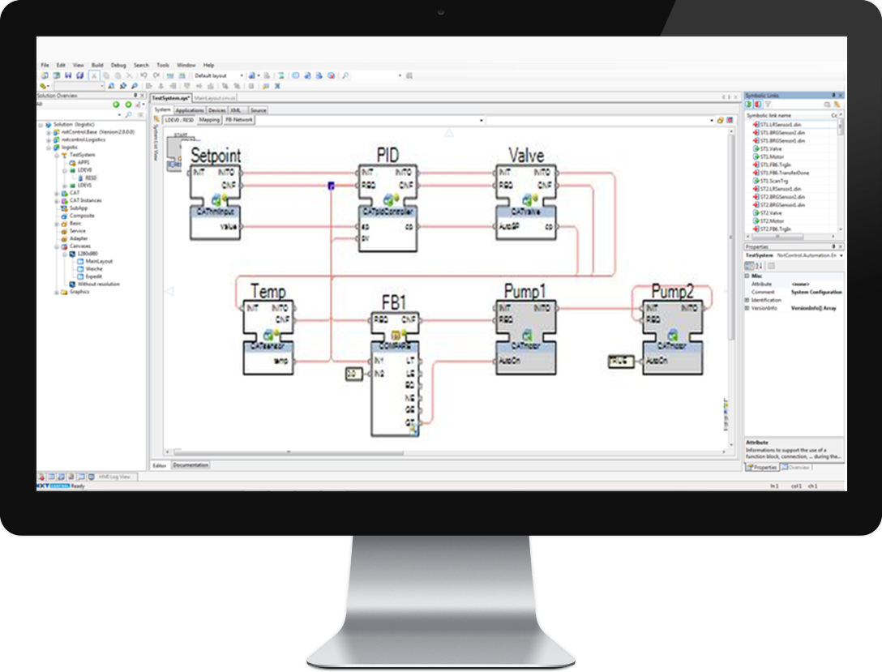
IEC 61499 Libraries - Plug & Produce SW Components
A
Instantiate from library
Market places
B
Program whole application
Proven-in-use software components (automation apps)
Segment- specific
IIoT Services
Digital Twin
Mecha-
tronics
Legacy wrap
& re-use
C
Select hardware topology
A
D
Deploy application to controllers
Integrated Development Environment for IEC61499 application
“BuildTime”
E
Inter controller communications generated automatically
B
“Write once, distribute across universal automation devices”
Today
Tomorrow
Low value proprietary applications
High value portable apps
D
Costs
Costs
Distributed control HW with embedded “RunTime”
E
Time to Market
Time to market
Flexibility
Flexibility
Quality
Quality
C
Notes:
Members are maintaining and further developing a runtime execution engine based on the IEC 61499 standard.
This standard rules the decoupling of automation software from the hardware on which it executes.
This enables the possibility to have marketplaces of software components specialized in different areas (software specific, IIoT, Mechatronics, Legacy…) which can be reused in any automation application and deployed to universal automation offers, meaning offers which have the UAO runtime execution engine running on them. This is called “plug & produce” automation.

Slide 10

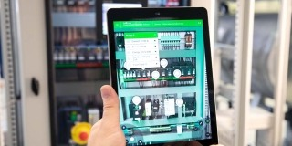

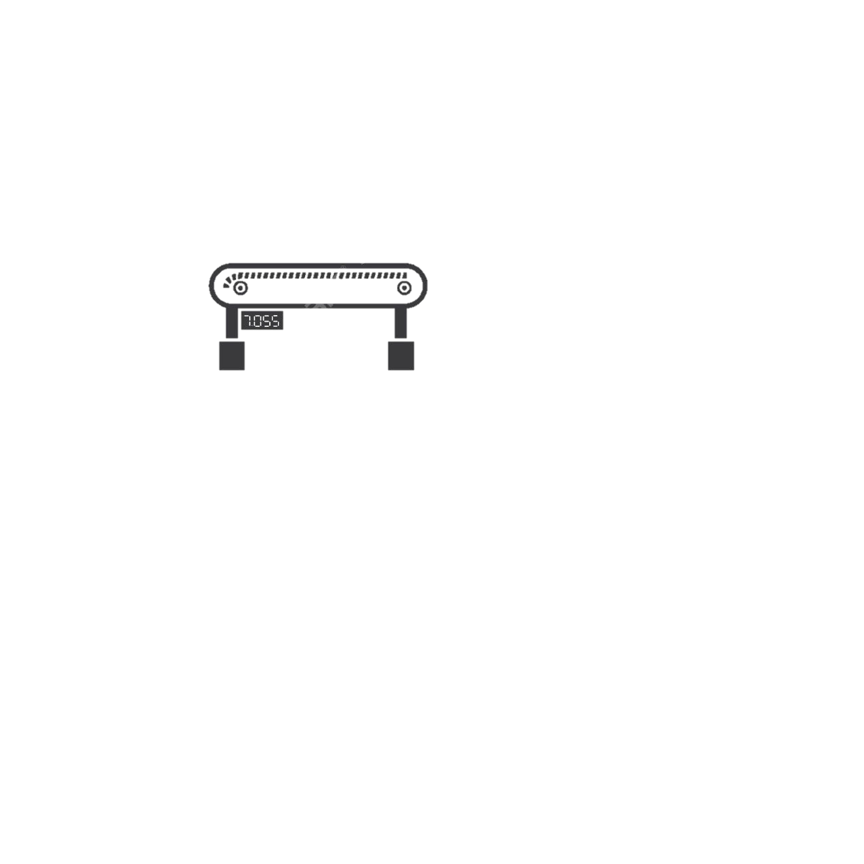

UAO RT & OPC UA
Enterprise & IT Applications
Operations
Asset Management
Operator HMI
Unified Automation High Performance Stack
Both OPC UA Server and Client available
Server Namespace – Modeled, Prepared and compiled in BT & deployed to RT.
OPC UA Client modeled as a set of SIFBs for use in application.
Archive
Analytics
MES
OPC UA
Other Runtime
Other Runtime
Other Runtime
OPC UA

Slide 11
How UAO helps you improve your KPI’s
 |  | Traditional objectives
 |  | Productivity | Lower TCO | Reliability
Rewriting the rules of automation | Plug & Produce SW Components | Low code/ no code |  | Proven-in-use application SW components
 | Software/Hardware Decoupling |  | BIC hardware- SW re-usability
 | Asset Centric Design (Object-Oriented) | Lower downtime/ MTTR
 | Event/Data-Driven | Automation + IT (Digital Twin, analytics, …)
Emerging objectives
Employee Experience | Resiliency | Flexibility | Sustainab-ility
 | SW re-usabiility |  | Accelerate open standards (OPAF, MTP,..)
Only one automation tool to learn | Easier supply chain & obsc- olescence mgt
Attractive to new gen of SW engineers |  | Modular process/ machines
 |  |  | Automation + IT (Digital Twin, analytics, …)
Degree of impact:
Low
High

Slide 12








UAO on the Web
FAQ
FLYERS
WEB
eLEARNING
Community of Practice
Frequently Asked Questions
FOLLOW US
for End-Users
for EPC/System Integrators
for Vendors
for Academics
CONTACTS
Raquel Torres – President
Greg Boucaud – Chief Marketing Officer
Sarat Molakaseema - Chief Architect Officer
Magnum Garzillo – Key Account Manager Users
Inna Arkhipova - Academics Program Manager
Sejla Trakic - UAO Member Success Manager
VIDEOS
UniversalAutomation.org (12)
IEC 61499 (5)
Testimonials (10)
UAO Goes Live (5+)

