Slide 1
Codifying Decision-Making: British Sugar’s AI-Driven Operational Framework
Daniel Simkiss: Smart Supply Chain lead

Slide 2
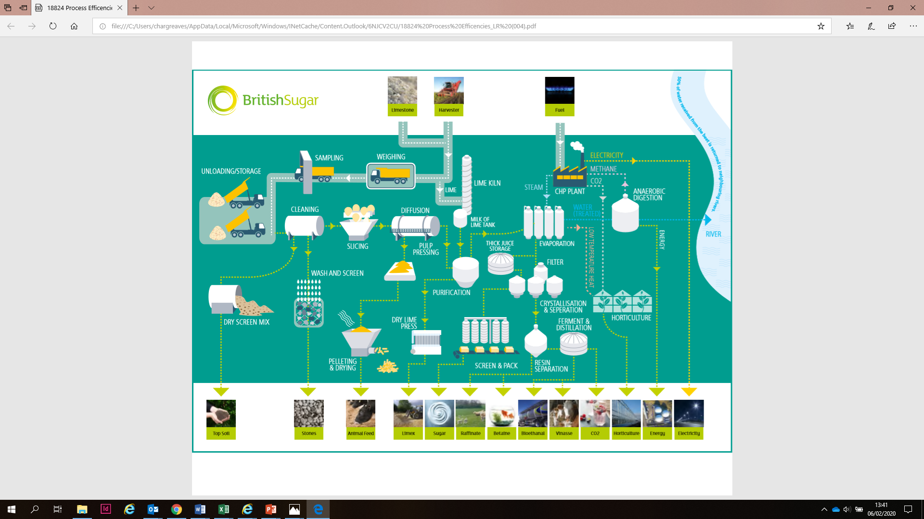
Notes:
"Today I’m going to talk about automation and digitisation in sugar manufacturing – but not the kind of sugar manufacturing you might be picturing."
Because while people often think of it as a simple commodity process… the reality is anything but.
It’s big. It’s fast. It’s highly variable. And… it’s continuous.
British Sugar is part of Associated British Foods, and across our UK sites we process all of the country’s sugar beet – that’s around 8 million tonnes a year.
What that means in practice… is a complex chain of highly integrated operations – chemical reactions… heat exchange… separation… precision controls – all running at serious scale.
Our biggest site, for example, handles up to 20,000 tonnes of raw material a day. For a sense of scale – that’s an artic arriving every 45 seconds during daytime deliveries.
And these aren’t batch processes. They run 24/7, with constantly changing inputs. Which means… we have to be able to respond to variability and make thousands of process decisions… every single day. The success of these decisions determines our costs, throughputs and yields.
We supply about 60% of the UK’s sugar market – but it’s not just sugar we produce.
Out of the same process, we also generate: Ethanol Animal feed Betaine – a high-value nutrient CO₂ And even surplus electricity that goes back into the grid.
So yes – we make sugar. But behind the scenes… this is a fast-paced, highly engineered, multi-discipline operation.
And that’s where automation and digitisation come in.

Slide 3
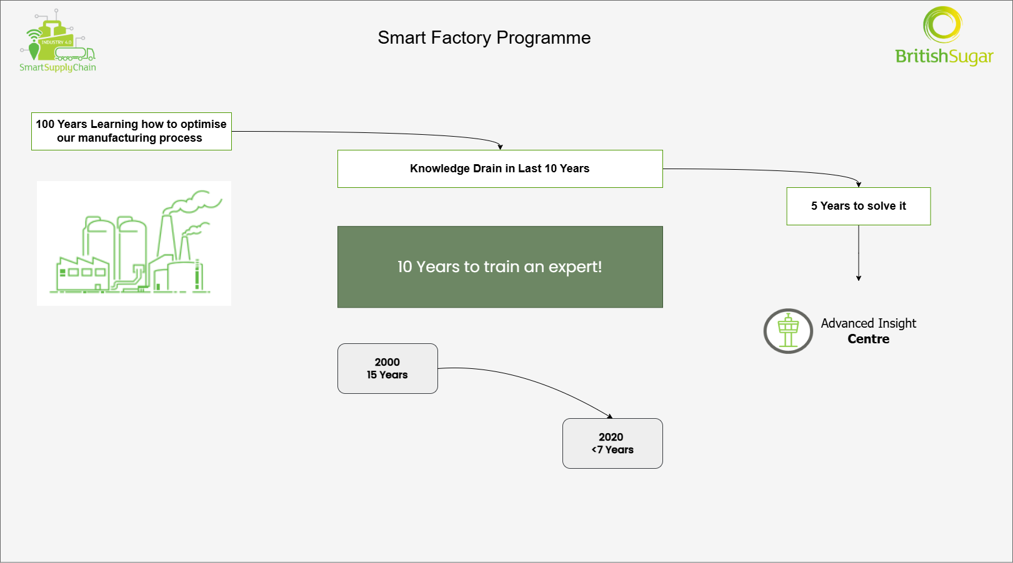
Notes:
As with many of these types of projects cost reduction is a key driver however we also have a burning platform which I’m sure many of you will share
British Sugar has a century-long legacy of efficiency
at one stage we could rightfully claim to be the best sugar beet processor in the world
We face the risk of losing this legacy within five years – probably even less, why?
Our workforce is changing, the trend towards frequent job changes and focus on work-life balance – fewer people want to be experts
Data from the year 2000 shows that the average tenure of our process experts was around 15 years. By 2020 it had dropped to less than 7.
And as I touched on
Sugar processing is a complex, interconnected operation.
It takes a decade to create an expert. Clearly the math isn’t adding up.
We believe data and digitisation are the answer to this burning platform
“So where do we go from here? That brings me to the most exciting part of this journey — how we’ve started tackling this challenge head-on.”
Well first lets acknowledge that we’re living in one of the most exiting periods of technological change

Slide 4



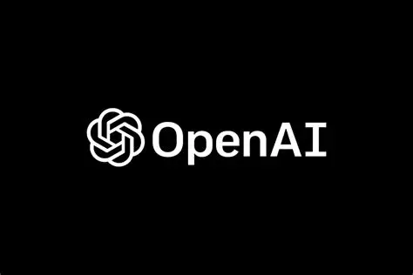
AI News
Google announces plans to have an AI Agent on “everybody’s desk”
Alpha schools in the US run 2 hours of AI lessons a day
OpenAI is now the most valuable startup ever at ~$500Billion
Notes:
Clearly I need to work on my prompt engineering as I have nowhere near that much grey hair!
But seriously…we’re living in one of the most exciting times of technological change there has ever been
On the train here yesterday I heard about Google are planning to put an AI Agent on everybodys desk, how Alpha schools in the US are upending our views of education and that OpenAI is now the most valuable startup ever with a valuation of over 500 billion dollars
But….and it’s a big but

Slide 5

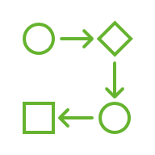

The Project
People
Process
Technology
Shorter career spans reducing institutional knowledge creating and urgent need for effective knowledge capture
People centric approach to decision making with local accountability and central expertise. Data drives events that drives action.
Leveraging recent advances in software systems and AI
Notes:
I’m not going to talk about a technology project – this is a people, process and technology project – in that order.
The most important thing I’ve learned in the last 16 years is not to force the technology on people, but rather to identify the most valuable opportunities and bring the people and technology together to solve them.
So this project is about driving improved decision success – making decisions faster, smarter, and more consistent.
Not just about technology – it’s about people, process, and technology working together to improve decision-making. (Pause to let it land.)
People
We’ve worked with our teams and established the opportunities
Process
We’ve recognised that decision making has several constituent parts—we’re creating a process that facilitates action through environment design, people structures and data insights
Technology
To enable this we’re leveraging the latest in technological advances including AI.
However the AI and software support people, not replace them.

Slide 6
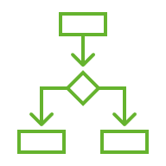


The Outcome
Codified
Predictive
Prioritised
Decisions and knowledge incorporated into the system based on 100 years of learning
Events detected based on codified knowledge used to predict outcomes and allow preventative action
Events detected based on codified knowledge are prioritised to ensure the most pressing issues are dealt with 1st
Notes:
So what have we done? We’ve focussed on driving what we’ve called decision success. Nice and simple – we make lots of decisions every hour, every day every week – lets make them more successful
1. We’ve realised that we already know how to make good decisions somewhere in our business and Based on 100 years of experience we’ve taken that knowledge and embedded it into the systems
2. We’ve used that codified knowledge to Make It Predictive
Events are detected early—before they become problems.
This moves us from reacting to issues to stopping them before they happen. (Pause.)
3. We’ve Prioritized It
Codified knowledge helps us rank what matters most, so we focus time and resources where they have the biggest impact.
Hopefully that gives you a flavour of what we’ve done – now let’s see what it looks like in action.

Slide 7

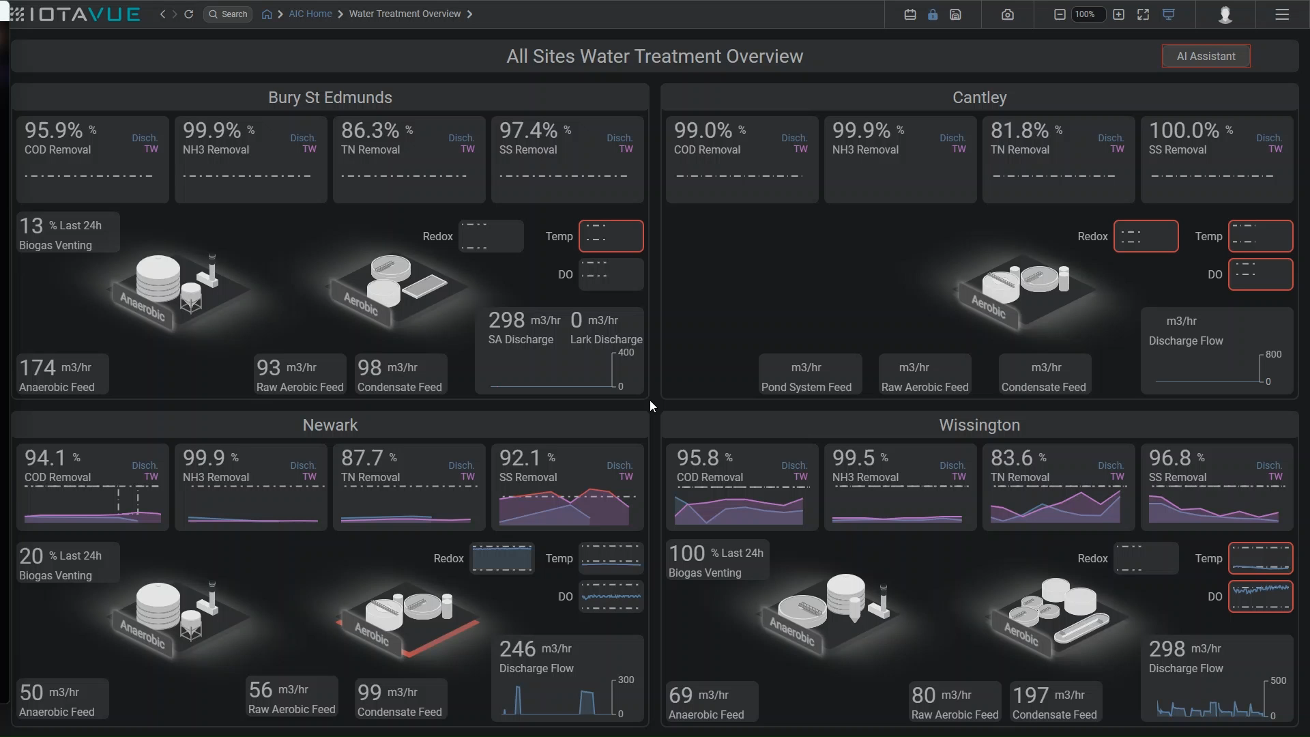

Slide 8

Traditional Decision Making
07:00
08:00
Event
Context
History
Documents
Tacit Knowledge
Stock issue
Breakdown
Resourcing
Raw Material
Price Change
Demand Shift
Stored Raw Material degraded by 35% across 50% of the stock
Run @ 120% throughput and 5% loss increase
Similar incident in 2016
Previous incident report
Run @ 110% throughput and 7% loss increase
Run @ 117% throughput and 2% loss increase
Read daily memo
Talk to Sarah
Find old emails
Search network drive
Use 10 Years experience to augment decision
Notes:
Fantastic – so you can see we’ve made some great progress but I’m not finished yet – we want to take it even further.
This is my view of what I call a decision support system.
Its visual representation of the decision making process in practice and helps to illustrate how you can take Gen AI from being a mildly useful chat interface to being a genuine part of your organisational structure.
First, we have an event - something happens that demands a response. It might be an opportunity, a problem, or a shift in the environment.
Then we have Current Context—this includes real-time data, what’s happening on the ground right now, and the immediate operational realities.
Alongside that is Historical Context—what we’ve done before, what worked, what didn’t, and what patterns we've seen over time. That memory—both institutional and human—is invaluable.
Next, we pull from Documented Knowledge—our SOPs, playbooks, standards, and systems. These provide a consistent base of truth, especially in complex environments.
But what we find is most important and a key barrier with traditional machine learning is Tacit Knowledge—this lives in people's heads. It’s the hard-won wisdom that comes from experience, often unspoken. It’s the difference between knowing what the manual says and knowing how it actually plays out.
So what? Well previously many of these crucial elements of the decision making process sat in peoples heads, random spreadsheets, shift logs and old emails. Now with agentic AI we can shift that to structured AI knowledge that can then be provided to the right person at the right time 24/7.

Slide 9
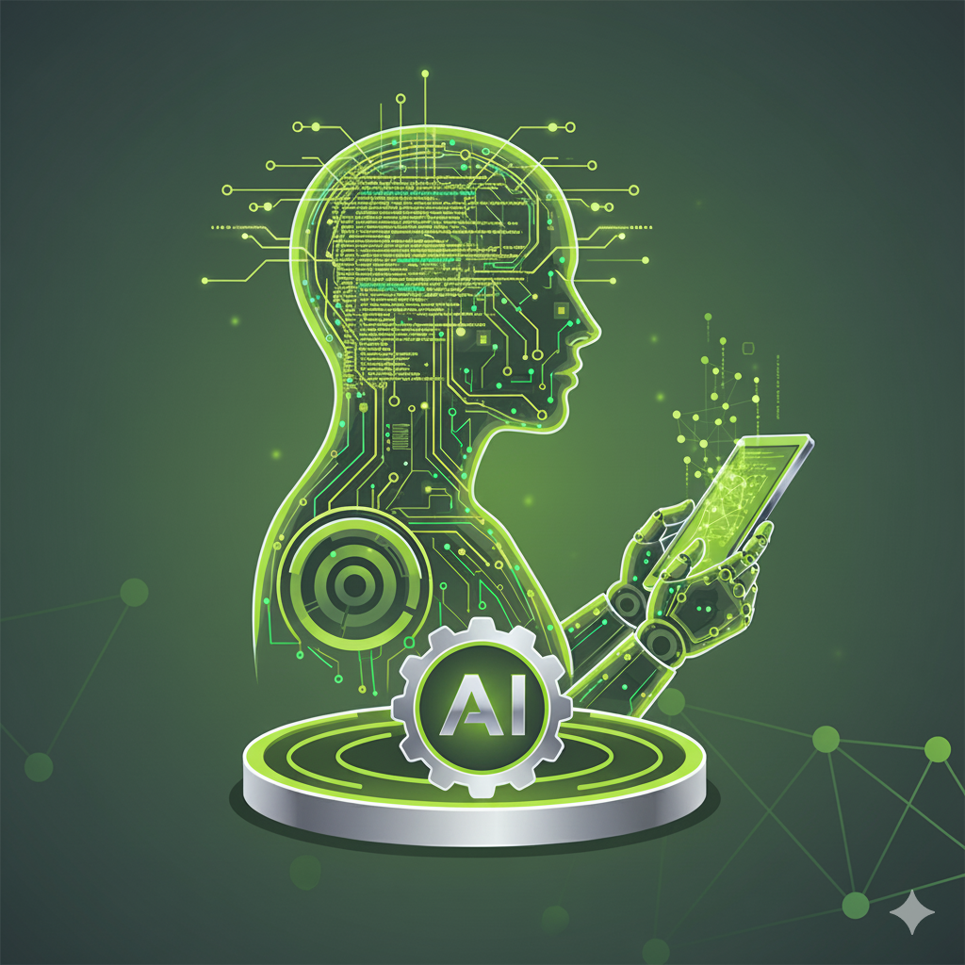
Augmented Decision Making – Stage 1
07:00
07:10
Event
Context
History
Documents
Tacit Knowledge
Stock issue
Breakdown
Resourcing
Raw Material
Price Change
Demand Shift
Stored Raw Material degraded by 35% across 50% of the stock
Similar incident in 2016
Previous incident report
Run @ 117% throughput and 2% loss increase
AI Summary every hour
One stop shop AIC
AI event detection
AI corporate knowledge included
AI Tacit knowledge included
Notes:
So what? Well previously many of these crucial elements of the decision making process sat in peoples heads, random spreadsheets, shift logs and old emails. Now with agentic AI we can shift that to structured AI knowledge that can then be provided to the right person at the right time 24/7.
The events are summarised and prioritised at a frequency of your choosing
The context is available in the advanced insight dashboards
The AI detects similar events and automatically searches the corporate knowledge for relevant information
And finally the tacit knowledge is captured and surfaced so the hard won experience of running factories for over 100 years is shared

Slide 10


Augmented Decision Making – Stage 1
07:10
10:00
Decision
Action
Result
Learn
3% Loss incurred
Run @ 117% throughput and 2% loss increase
Future advice updated to %116%
2% Loss incurred
Notes:
This helps us to move from experience led decision making to data led decision making
In doing so we reduce the time it takes to take good decisions, significantly drop the time to train good decision makers and simultaneously improve the quality of the decisions.
Not only that but we’re also trying for the first time embed an AI learning loop into our decisions. When the recommended decision proves to be correct we want that to reinforce it for the next time and when it proves to be incorrect we want to dampened for the next time.

Slide 11
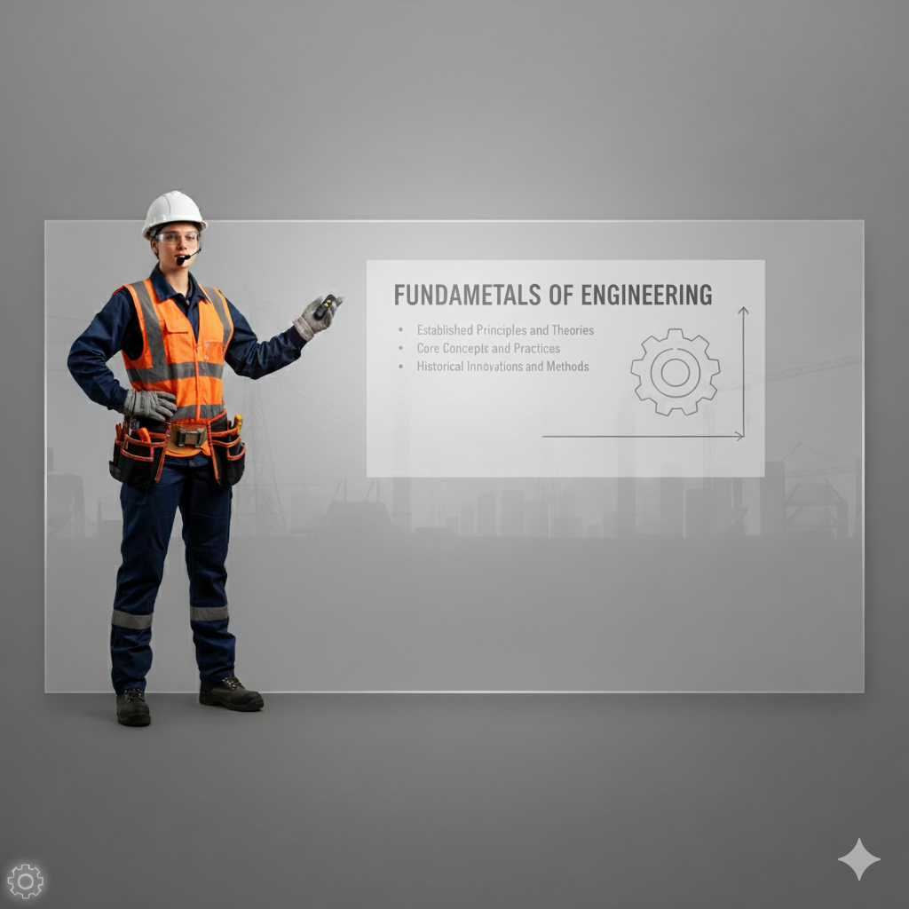

Final Thoughts
1 to Many = Generic
1 to 1 = Tailored
Harvest Knowledge
Share Knowledge
Notes:
(Start slow and reflective – connect to the audience)
So finally, I want to leave you with this…
Historically, the way we’ve passed on knowledge in our organisation has been through people — through stories, conversations, mentoring, masterclasses, questions, and shadowing.
That human connection — that lived experience — has been invaluable.
But as I said at the beginning… this approach is starting to fail us. Not because the knowledge isn’t there — but because it’s not being captured or shared at the speed and scale we need today.
(Shift tone – opportunity and excitement) Now — turning language into data gives us a huge opportunity. Not just to digitise documents, but to actually capture the tacit knowledge that lives in people’s heads.
And once we’ve captured it — we can do something even more powerful: We can make it available, on demand, in ways that are actually useful and relevant.
(Refer to the slide — walk the audience through the visual) If you look at the left side of the slide — this is how we’ve traditionally shared expertise: 1 to many, often quite generic. A subject matter expert speaks, others listen. Valuable, but limited.
With AI, we can shift to the model on the right. We harvest that knowledge, and then deliver it back in a 1-to-1, tailored way — at the exact moment it’s needed.
It’s not about replacing people — it’s about making everyone better by using what our best people already know.
(Finish strong – forward-looking and human)
“So yes, we’re digitising manufacturing — but more than that, we’re digitising how we think, how we learn, and how we grow together. And that, I believe, is how we honour the legacy of 100 years… and build something even stronger for the next.”

Slide 12
Final Thoughts
Thanks to
Seeq
IOTA
IBM
British Sugar Team
Contact
Daniel.Simkiss@BritishSugar.com

